Slide 1
DRACUNCULUS MEDINENSIS (Guinea worm)
KIMAIGA H.O
MBChB (University of Nairobi)

Slide 2
Dracunculus medinensis
Phylum: NEMATODA
CLASS: SECERNENTEA
ORDER: SPIRURIDA
FAMILY: DRACUNCULIDAE
Dracunculus medinensis
Common name: Guinea worm, medina worm, serpent worm

Slide 3
DRACUNCULIASIS (Dracunculosis, dracontiasis/ guinea worm disease)
Parasitic disease caused by Dracunculus medinensis (in human beings) which is a long thread like nematode/flat worm.
Human parasite in subcutaneous tissues Dracunculiasis () is caused by the nematode (roundworm) Dracunculus medinensis.
Nodular dermatosis produced by the Dracunculus parasite in the sub Cutaneous tissues of mammals mainly attacking the lower limbs.
Also known as guinea worm disease commonly abbreviated as GWD
Dracunculias insignis is more prevalent in mammals such as dogs and reptiles
Avioserpens causes the disease in birds
Reported in humans, dogs, cats, horses, cattle and other animals in Africa and Asia.

Slide 4
Geographical distribution
Affects people in rural deprived and isolated communities who depend on open surface water sources such as ponds for drinking water
In 13 sub-Saharan African countries
Mauritania, Cote d’Voire, Togo, Benin, Burkina, Central African Republic, Ethiopia, Uganda
In 2007 – 9,173 cases in Sudan (5,815), Ghana (3,348) and Mali (313), Nigeria (73), Niger (14 cases)
In isolated rural areas
There are also very small foci in Cameroon and Ethiopia and possibly still in Chad, Kenya and Senegal. Infection has been officially eliminated from the formerly endemic areas in
India (1999) and Pakistan (1994) in the last few years and the disease has probably now vanished from Saudi Arabia andYemen.

Slide 5
WORLDWIDE PREVALENCE 2002

Slide 6
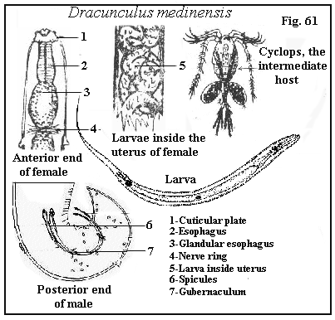
What do they LOOK like?

Slide 7
Location in host
Adult females emerge from the subcutaneous tissues, usually of the foot or lower limbs but sometimes from any part of the body.

Slide 8
Morphology
Nematode 70-120 cm
The mature female measures 500–800 mm 1.0–2.0 mm.
The mouth has a triangular oval opening surrounded by a quadrangular cuticularized plate, with an internal circle of four double papillae.
The vulva opens halfway down the body but is non-functional in the mature worm.
The uterus has an anterior and a posterior branch and is filled with 1–3 million embryos; it fills the entire body cavity (pseudocoel), the gut being entirely flattened.
Males recovered from experimental infections in animals measure 15–40 mm 0.4 mm (Fig. 114). The tail has 4 (3–6)

Slide 9
Morphology 2
Adult female and smaller male of D.medinensis.

Slide 10
THE DREADED DRACUNCULUS

Slide 11
Morphology 3
pairs of preanal and 4–6 pairs of postanal papillae; the subequal spicules are 490–750 μm long, with a gubernaculum measuring about 117 μm.
males about 3 cm, females longer up to 100 cm.
Larvae measure upto 10 mm, usually found in lesions of disease

Slide 12
AGENTS RESERVOIR
Ponds or open wells
Superficial stagnant water
No known animal reservoirs known
Water copepods (water fleas) ingested with guinea warm larvae
Water infested with Cyclops (micro-crustaceans that have ingested the female worm). Cyclops therefore act as the intermediate host

Slide 13
Route of exit from the reservoir
Through drinking water infested with
Copepods (micro-crustaceans) that have also ingested the larvae . The larvae are ingested in L1 stage and within this intermediate host they mature to L3 (the infective stage)

Slide 14
Life Cycle
Adult females in subcutaneous tissues of the legs and arms; follow lymphatic tissues
also found in intermuscular tissues of hosts
females secrete toxins forming blister forms over nematode and help breaks the skin of the hosts when exposed to water.
female and males mate; males die after mating. Pathology due to female
females migrate towards the skin,uterus ruptures and release the larvae in first stage juveniles at the site of the skin it has broken and made a wound (ovoviviparous).
When man comes in contact with water, the larvae are released into the water. The larvae can stay up to 3 -4 days.
.

Slide 15
Larvae eaten by Cyclops, intermediate host; they further develop in the cyclops, penetrates the gut of the cyclops and migrate to the rest of the cyclops ( 2 weeks)
when man eats up cyclops in water, the larvae is released into the man's GIT, the larvae is resistance to the GIT enzymes.
They penetrate the human hosts GIT walls. Matures during penetration and migration of the host subcutaneous tissues. 9 months for females to mature and produce larvae (long incubation period)
The larvae moves freely in the tissues in which it matures; adults arise, male fertilize female, fertilized females move towards the skin, release toxin and lay eggs again

Slide 16
Humans become infected by drinking unfiltered water containing copepods (small crustaceans) which are infected with larvae of D. medinensis .
Following ingestion, the copepods die and release the larvae, which penetrate the host stomach and intestinal wall and enter the abdominal cavity and retroperitoneal space
After maturation into adults and copulation, the male worms die and the females (length: 70 to 120 cm) migrate in the subcutaneous tissues towards the skin surface . Approximately one year after infection, the female worm induces a blister on the skin, generally on the distal lower extremity, which ruptures. When this lesion comes into contact with water, a contact that the patient seeks to relieve the local discomfort, the female worm emerges and releases larvae . The larvae are ingested by a copepod and after two weeks (and two molts) have developed into infective larvae . Ingestion of the copepods closes the cycle .

Slide 17
Dracunculus medinensis life cycle discussion
Step 1 on shows that copepods have been infected with larvae and for further development of the larva, the host copepod needs to be ingested in drinking water obtained from ponds or open wells.
The people become infected when they drink the water-containing microcrustaceans (water fleas) that harbor the infective larvae.
Once in the human body, the ingested copepod is destroyed by stomach acids and the larvae are free to penetrate the gut lining and migrate through the intestinal wall, across the peritoneal cavity, to subcutaneous tissues via the lymphatics.

Slide 18
The larvae are not destroyed because they can quickly adapt to the change in pH of stomach acid.
Researchers are still uncertain to the specifics of how this is done, but some believe that it is triggered by the copepod’s response to the changing conditions.
Step 2 gives a visual of the larvae being released and it shows that they begin to grow and mature.
Step 3 takes the most time. A mature female D. medinensis is one of the longest nematodes, measuring up to 100 cm (2-3 feet), but is only 1 to 2 mm thick.
A mature male is quite smaller and lives for only a few months. The sexually mature males and females meet and mate in about 100 days, while they are both of comparable size.

Slide 19
The males stay in the tissues, and within a few months become encapsulated, and die.
As the female matures, she slowly moves down the muscle planes of the infected host and by approximately 10 months, has grown to maturity, with the uterus being filled with larvae.
After a year from initial infection the female worm travels from the subcutaneous connective tissues, moves to the surface of the skin, dies by the body erupting, the uterus is extrude through the mouth, and releases millions of juveniles in a milky white liquid

Slide 20
Step 4 is where the the disease is diagnosed. Up until this point, there are no symptoms that the human host has been carrying a parasite.
The hosts immune system recognizes these juveniles and causes an intense allergic reaction and extreme discomfort (hence the name, the fiery serpent).
This reaction provokes the formation of a painful blister, which bursts into an ulcer, causing the anterior end of the worm to be exposed. If the affected portion of the body (usually the foot or leg) is cooled by immersion in water, the milky white liquid that contains the first-stage larvae is expelled and contaminates the water.
These larvae measure 643 (490-737) by 23 (18-24) µm with a pointed tail and a fully formed gut, although they do not feed.
They move actively in the water, resembling a free-living nematode, and can live for a few days in water, until a copepod recognizes the movement as food.

Slide 21
Step 5 shows how the larvae are expelled from the foot and the copepods consume them.
Step 6 completes the cycle. For the larvae to continue to develop further they need to be ingested by suitable predatory species of copepods (Cyclops sp.), measuring 1 to 2 mm. Besides these copepods, there is no known animal reservoir of infection (even though this has not been conclusively disproved), which makes eradication much more probable if safe drinking water can be ensured.
“Larvae develop to the infective third stage in the body cavity of the crustaceans in about 14 days at 26°C, which completes the life cycle” (Cairncross, S., et al. (2002).

Slide 22
Larva expulsion (extra)
Ovoviparity is a characteristic D. medinensis. The thousands of embryos in the uteri of a gravid female produce high internal pressure. At this phase of the life cycle, it has migrated to the host’s skin. The lower limbs of the host's body are the most likely to be infected, but any body portion is susceptible for infection (Okoye et al. 1995). When the worm’s uterus and body wall burst because of the high internal pressure, the juveniles are freed into the host (human). The release of the juveniles initiates violent allergic reactions that cause the formation of skin blisters in the host. These skin blisters eventually rupture, creating an exit for young worms which trickle out onto the host’s skin. In some instances, instead of the body wall rupturing, the uterus forces itself out of the parasite’s mouth. The contracting body wall muscles of the host force juveniles out in periodic spurt, with more than 500,000 expelled at a single time. Cool water instigates the contraction of the muscles, which causes the worm and its uterus to protrude through the wound. When portions of the protruding uterus are emptied of their juvenile contents, they disintegrate, and adjacent portions move into the ulcer or rupture. Healing of the wound happens only when the entire worm is “used up”. (John et al. 2006; Cox 1993)

Slide 23
The freed juveniles (J1s) must directly enter water in order to survive. They can live 4 to 7 days but are able to infect an intermediate host (crustacean) for only 3 days. For the juveniles to develop further, they must be ingested specifically by a cyclopoid crustacean (e.g. Cyclops vernalis). Upon reaching the intestine of the crustacean, the juveniles penetrate into the hemocoel, especially below the gut, where they develop into infective J3s within 12 to 14 days at 25 degrees Celsius.

Slide 24
Definitive hosts (humans) are infected by ingesting infected copepods with drinking water. Freed juveniles break through the duodenum, cross abdominal mesenteries, perforate the abdominal muscles, and enter subcutaneous connective tissues, where they move to inguinal and axillary regions. The 3rd molting of the parasite occurs about 20 days after infection, and the last one at about 43 days. Males fertilize the females by the 3rd month of infection; and between the 3rd and 7th months, become encysted and eventually degenerate. The gravid females travel to the host’s skin between the 8th and 10th months, by which time the embryos are fully developed. Ten to 14 months after the initial infection, the female worm causes skin blister. A person with the blister usually experiences intense burning pain, but immersing the wound into the water somewhat alleviate the pain. (John et al. 2006)

Slide 25
The human host of this ‘guinea worm’ usually remains asymptomatic for about 1 year after they were infected, at which time the mature female worm approaches the skin and forms a small round protuberance on the skin by secreting an irritating chemical. The immune system of the host finally recognizes the parasite as foreign and causes an allergic reaction. This is seen as the cardinal signs of infection (heat, redness, swelling, and pain) and is at the site of the worm’s location on the skin. The pain that is associated with this inflammatory reaction is often intense, so much so, that the worm received the alias of ‘fiery serpent’. The nodule forms a blister, which is accompanied by redness, a minor fever, and a rash with severe itching. The systemic symptoms include nausea, vomiting, diarrhea and dizziness. These symptoms can last for several days while the blister enlarges and ruptures to expose the adult worm. The pain and systemic symptoms begin to diminish with the rupture of the blister, and the worm usually is manually forced out by slowly winding it onto a stick over several weeks to months

Slide 26
First-stage larvae of Dracunculus medinensis in water (phase contrast) after being expelled by adult female (actual size 0.66 mm).

Slide 28
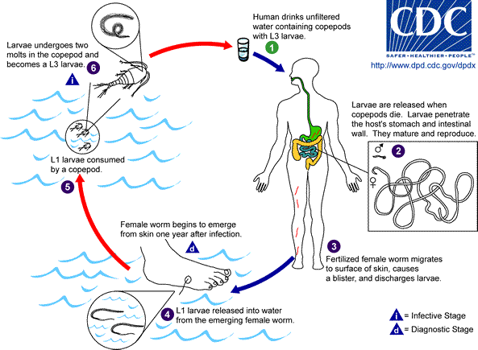

Slide 29
Clinical Manifestations/Symptoms
There are usually none while the female worms are moving freely through the connective tissues,until blister forms and toxic fluids result in:-
because of irritation by female worms
allergy, pain confined to lesions
a rash accompanied by severe itching
nausea
vomiting
diarrhea
dizziness.
open wounds may have secondary bacterial infections
Anaphylaxis – shock, itchiness near the wound
worms do not go above the knee, thus no manifestations above the knee

Slide 30
Clinical Manifestations cont..
In many patients (30–80%), urticaria, sometimes accompanied by fever, giddiness, gastrointestinal symptoms, dyspnoea and infraorbital oedema, appears the day before the blister forms but vanishes in a few hours.
The clinical manifestations are localized but incapacitatingThe worm emerges as a whitish filament (duration of emergence: 1 to 3 weeks) in the center of a painful ulcer, accompanied by inflammation and frequently by secondary bacterial infection.
Painful blister (ulcer)
Inflammation
Worm emerges as a whitish filament

Slide 31
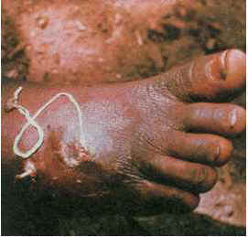
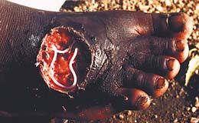
Clinical Manifestations cont..
Secondary bacterial infections of opening are possible.
There may be later symptoms--fibrosis of the skin, muscles, tendons and joints ( may interfere with locomotion or use of limbs).
Dracunculiasis can migrate to the foot

Slide 32
Dracunculiasis dx [Dracunculus medinensis]
The clinical presentation of dracunculiasis is so typical, and well known to the local population, that it does not need laboratory confirmation.
In addition, the disease occurs in areas where such confirmation is unlikely to be available.
Examination of the fluid discharged by the worm can show rhabditiform larvae.
No serologic test is available.

Slide 33
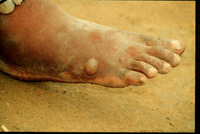
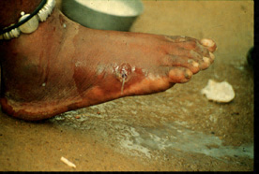
D. medinensis: (emerging worm)
The female guinea worm induces a painful blister (A); after rupture of the blister, the worm emerges as a whitish filament (B) in the center of a painful ulcer which is often secondarily infected

Slide 34
Clinical Complications
Redness and swelling (Cellulitis)
Boils (Abscesses)
Generalized Infection (Sepsis)
Joint Infections (Septic Arthritis)
Lock Jaw (Tetanus)

Slide 35
Pathogenesis
The blister fluid consists of a bacteriologically sterile fluid containing lymphocytes, neutrophils, eosinophils and larvae.
The female worm bursts in the tissues before emergence, releasing many thousands of larvae upon contact with water (temperature sensitive)
This results in an intense tissue reaction, with myositis and formation of an abscess containing up to 0.5 l of pus, which can lead to chronic ulcerations, bubo or epididymo-orchitis in males.

Slide 36
Pathogenesis cont..
Adult females sometimes enter joints and liberate larvae into the synovial fluid, causing oedema, congestion and plasma-cell infiltration of the synovial membrane.
Once larvae have been released from the emerging female worm, there is a strong adhesive reaction at the cuticle along the whole length of the worm.

Slide 37
Pathogenesis cont..
In the early stages, the tissue reaction consists of inflammatory cells and is followed by a foreign- body giant-cell reaction.
This makes extraction of the worm difficult and increases the chances of secondary bacterial infection along the track of the worm, with cellulitis.

Slide 38
Laboratory Diagnosis
based on xtic wounds below the knee
The clinical presentation of dracunculiasis is so typical, and well known to the local population, that it does not need laboratory confirmation. In addition, the disease occurs in areas where such confirmation is unlikely to be available. Examination of the fluid discharged by the worm can show rhabditiform larvae. No serologic test is available.
Extraction of worm from wounds
expose the wounds in water to excrete more larvae in water; larvae identification of larvae from water.
PBF – Eosinophilia (non specific
Clinical and parasitological
Local itching, urticaria and a burning pain at the site of a small blister are usually the first signs of infection,sometimes a palpable and sometimes moving worm.
The blister bursts in about 4 days and active larvae, can be recognized under a low-powered microscope.
Discharged fluid & larvae discharged by female worm
Immunological.
ELISA, dot ELISA and SDS-PAGE/Western blotting
The fluorescent antibody test using deep-frozen first-stage larvae

Slide 39
Treatment
Local cleansing of the lesion and local application of antibiotics, if indicated because of bacterial superinfection. Mechanical, progressive extraction of the
Surgery
Surgical removal of mature female worms before emergence is sometimes possible using a small incision
Ivermectin
DEC
effects less when females have migrated towards the skin to lay larvae.
Avoid wading waters that are for drinking
Chemotherapy
Thiabendazole,niridazole, metronidazole, mebendazole and albendazole have been reported as hastening the expulsion of worms and may act as anti-inflammatory agents.

Slide 40
Prevention and Control
Mode of transmission
Filter or boil water, or treat with chlorine to kill intermediate host/copepods
Treating pond water with Abate (temephos) to kill Cyclops sp.
Reservoir
Avoid bathing or wading or drinking contaminated water - reservoir
Susceptible Host
Early detection and mechanical removal of adult worms by extraction or with surgery
Drug Therapy
Health education and social mobilisation

Slide 41
Prevention and Control
Mode of Transmission/Reservoir/Point of Entry/Point of Exit/Susceptible Host
Health education interventions by local health workers

Slide 42
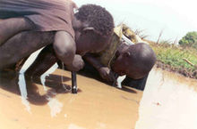
Sudanese boys using pipe filters to prevent guinea worm disease

