Slide 1
TAENIA SAGINATA AND TAENIA SOLIUM, CYSTICERCOSIS
KIMAIGA H.O
MBChB (University of Nairobi)

Slide 2
Causal Agents:
The cyclophyllidean cestodes (tapeworms)
  Taenia saginata (beef tapeworm)
  T. solium (pork tapeworm).
Cause taeniasis
Taenia solium can also cause cysticercosis

Slide 3
Geographic Distribution
Both species are worldwide in distribution.
Highest prevalence –Latin America, Africa, South East Asia.
Moderate prevalence's- eastern Europe, Spain and PortugalTaenia solium is more prevalent in poorer communities where humans live in close contact with pigs and eat undercooked pork and is very rare in Muslim countries
.

Slide 4
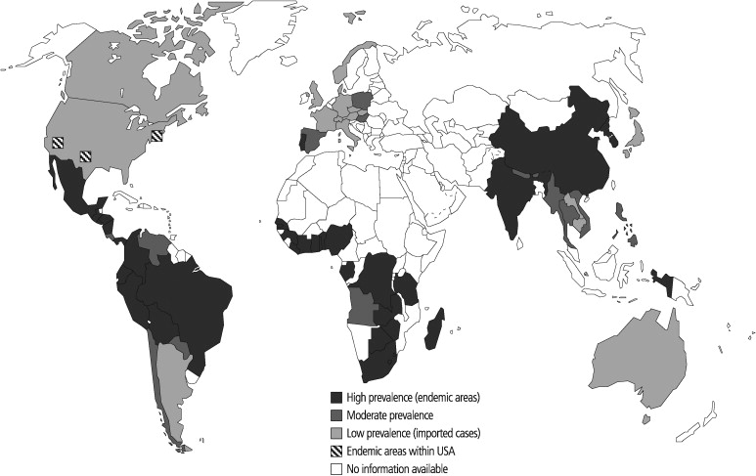

Slide 5
DISRIBUTION IN KENYA
Prevalence surveys
  2009 publication-2.5% of persons living in cattle grazing areas in north turkana district
  2000-2009- 3.2% of patients with African trypanosomiasis
  T.saginata 2012 publication- 5.3% of HIV positive patients in Baringo county
  Cysticercosis 1996 publication- app 20% cattle in export slaughterhouses
  Homabay district- 5.6% of pigs , Cysticercosis 2010 publication
  10-14% of pigs in the south west( Cysticercosis 2003 publication)

Slide 6
Life Cycle of Taenia saginata and Taenia solium
Definitive hosts for T. saginata and T. solium are humans
Intermediate hosts are cattle (t.saginata) and pigs (t. solium)
Eggs or gravid proglottids detach from SI and are passed out with faeces (apolytic)
Can also wriggle out actively.
Upon dying, rupture occurs along the mid-ventral wall releasing the infective eggs (fully embryonated.) → Cysticercus bovis = cysts of T. saginata. T. solium = Cysticercus cellulosae.

Slide 7
Remain viable for a very long esp under moist conditions..
  Eggs of T. saginata are non-infective in man, but eggs of T. solium are infectious in man and when ingested through contaminated food/water releasing an embryo which penetrates the GIT and larvae enters the blood stream to active muscles of man including CNS causing cysticercosis etc.
  Indigestion may lead to eggs in GIT
Cattle (T. saginata) and pigs (T. solium) become infected by ingesting vegetation contaminated with eggs or gravid proglottids.
In the animal's intestine, the hexacanthic oncospheres hatch , penetrates the mucosa, aided by larval hooks and migrate to the striated muscles, where they develop into cysticerci.

Slide 8
A cysticercus can survive for several years in the animal.
Humans become infected by ingesting raw or undercooked infected meat .
In the human intestine, the cysticercus develops over 2 months into an adult tapeworm, which can survive for years.
The adult tapeworms attach to the small intestine by their scolex and reside in the small intestine .
Length of adult worms is usually 5 m or less for T. saginata (however it may reach up to 25 m) and 2 to 7 m for T. solium. The adults produce proglottids which mature, become gravid, detach from the tapeworm, and migrate to the anus or are passed in the stool (approximately 6 per day).

Slide 9
T. saginata adults usually have 1,000 to 2,000 proglottids, while T. solium adults have an average of 1,000 proglottids. The eggs contained in the gravid proglottids are released after the proglottids are passed with the feces. T. saginata may produce up to 100,000 and T. solium may produce 50,000 eggs per proglottid respectively.

Slide 10
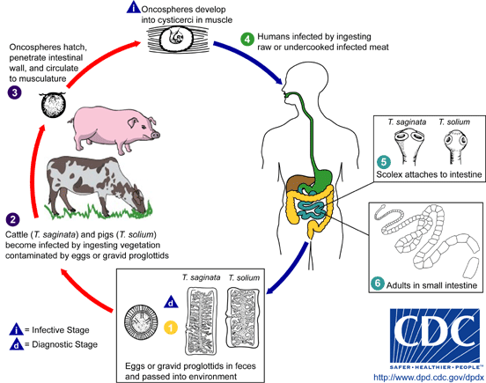

Slide 11
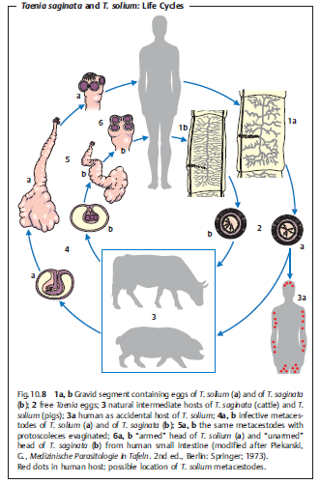

Slide 12
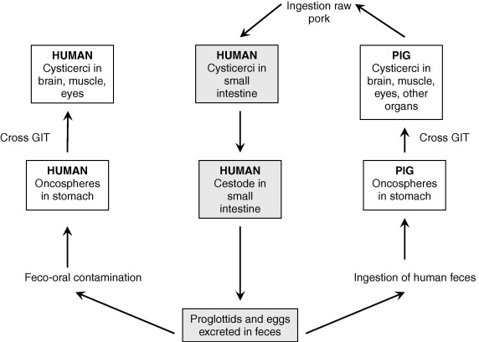

Slide 13
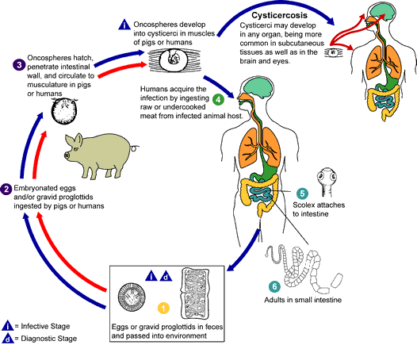
http://www.dpd.cdc.gov/dpdx/

Slide 14
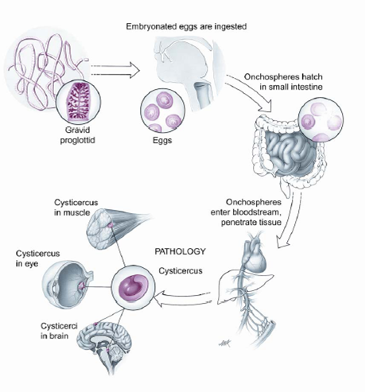

Slide 15
Taenia saginata (beef tape worm)
Adults
Most common tape worm in all countries where beef is eaten.
Man gets infection by eating uncooked beef.
It is a segmented tapeworm and is also flat
Segments are known as strobila/proglottids
The head of the worm is called scolex
Scolex lacks scolex armatures or a rostellum (hooks)
Scolex is cuboidal in shape and has 4suckers ***
May be as long as 75 ft but they are usually 10 – 15 ft long.

Slide 16
Long, slender neck followed by proglottids that are longer than broad.
Usually have up to 2,000 proglottids.
Each proglottid matures in a proximal-distal manner from the scolex being the proximal end hence the distal ends are more mature (gravid/pregnant)
Each proglottid is capable of detaching/dislodging so if the mature ones detach from the mother worm, then it moves away to other parts of the body due to its muscular ability
Uterus usually has a median stem with 15-20 lateral branches.
Usually the eggs cannot be distinguished from those of T. solium
Specific diagnosis is by identification of gravid proglottid

Slide 17
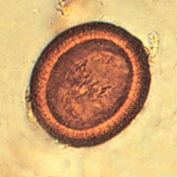
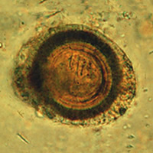
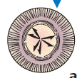
Eggs
Eggs are usually spherical with a thin hyaline membrane (capsule which enables them to survive in the external environment).
Very thick embryo pore which is usually riddled with many tiny pores.
Egg has a striated appearance with a hollow space called oncosphere
Developing hexacanth (oncosphere).

Slide 18
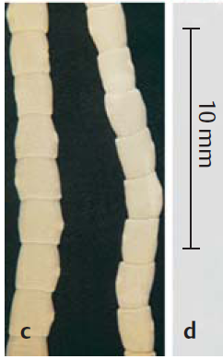
Proglottid

Slide 19

The larvae is called cysticercoids and is as shown below

Slide 20
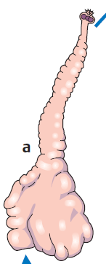
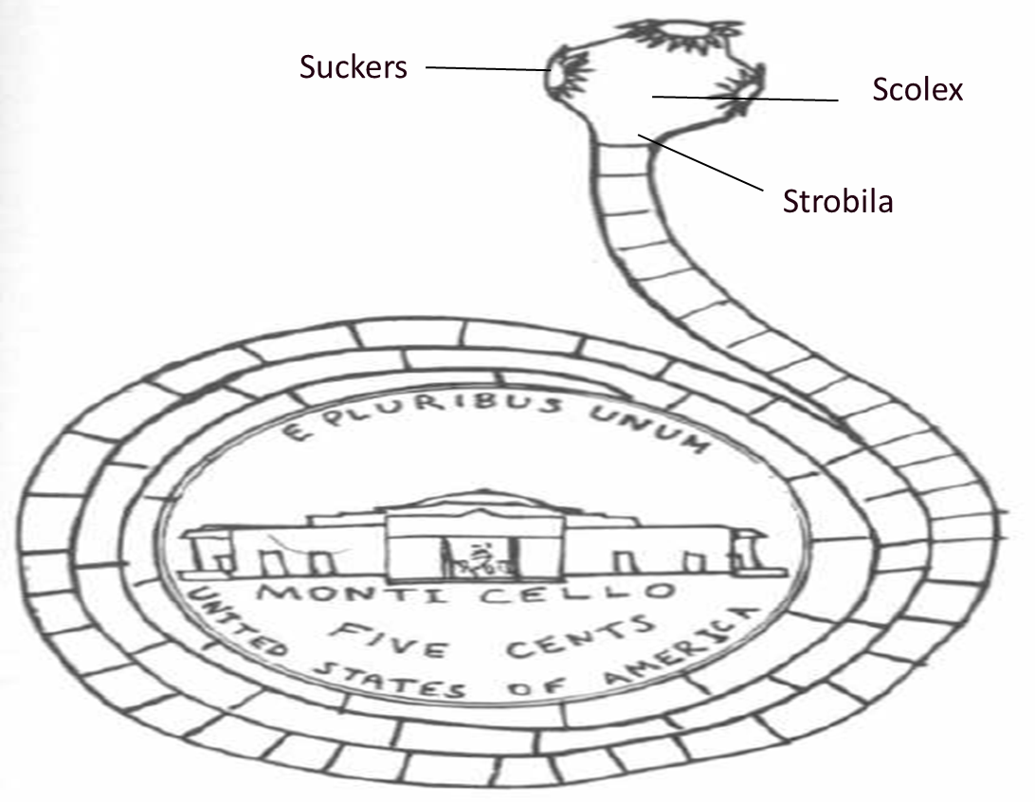
Larvae
  Invaginated but once released it becomes evaginated as shown below to take the shape of the worm
  This then enter humans and mature into adult worms and can measure up to 10-15ft long in length

Slide 21
T. solium
Common where pork is eaten
More dangerous due to self-infection with Cysticercus.
Scolex is spherical and bears a rostellum armed with 2 circles of 22-32 hooks.
Scolex smaller in size compared to that of T. saginata
Strobilla is also similar (can be up to 30’ in length but is usually 6-15’)
Mature proglottids are broader than long. Uterine branches are fewer
Eggs have 3 pairs of hooklets

Slide 22
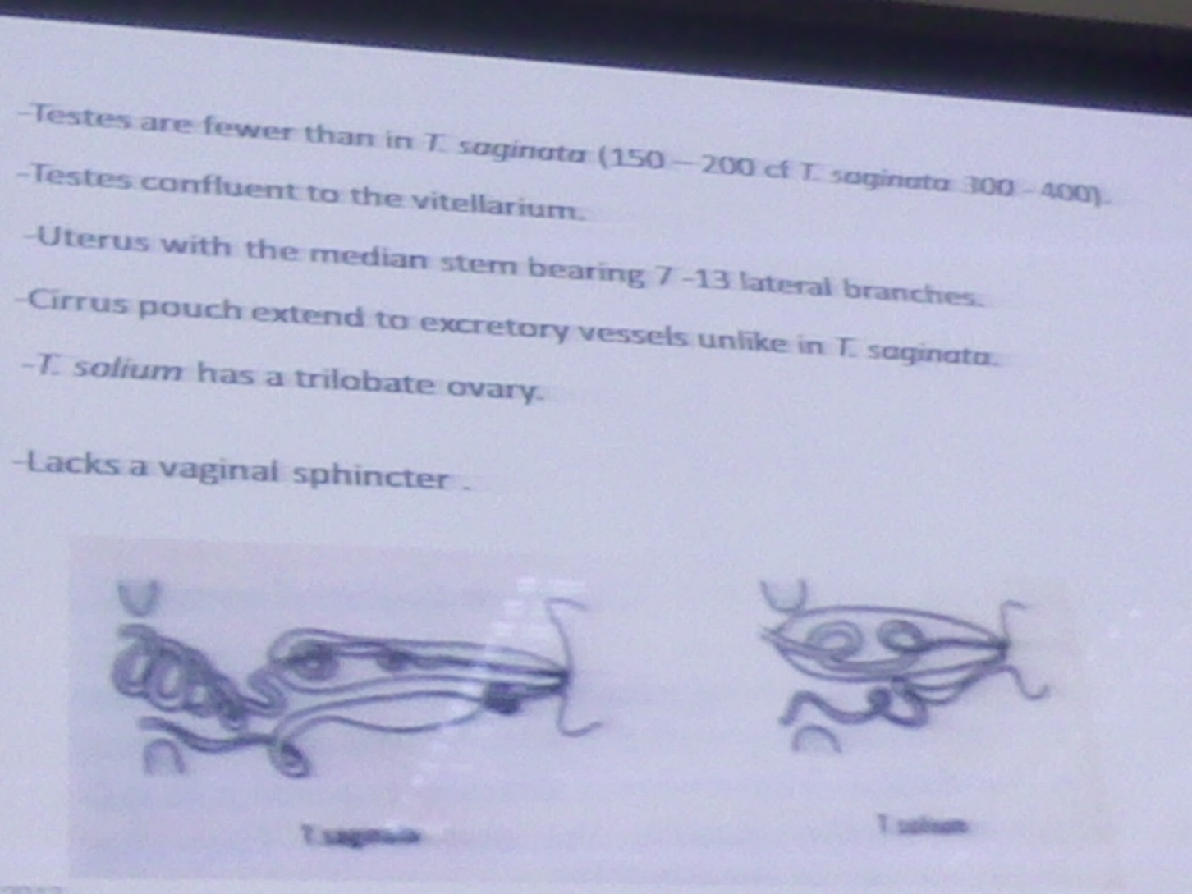

Slide 23
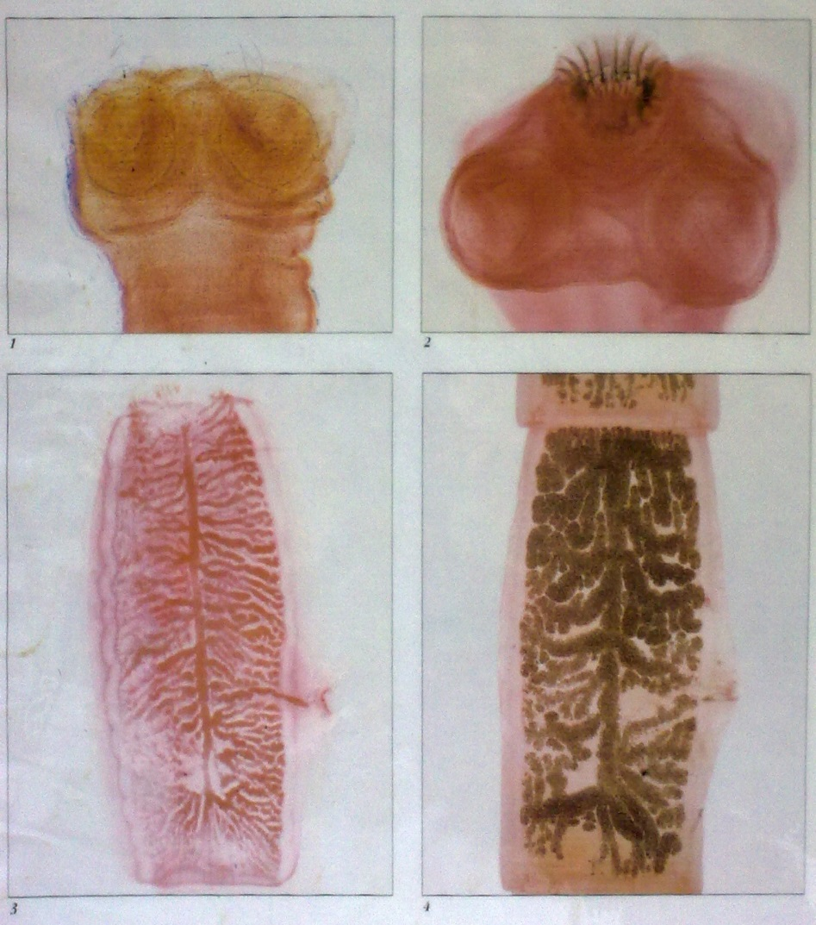
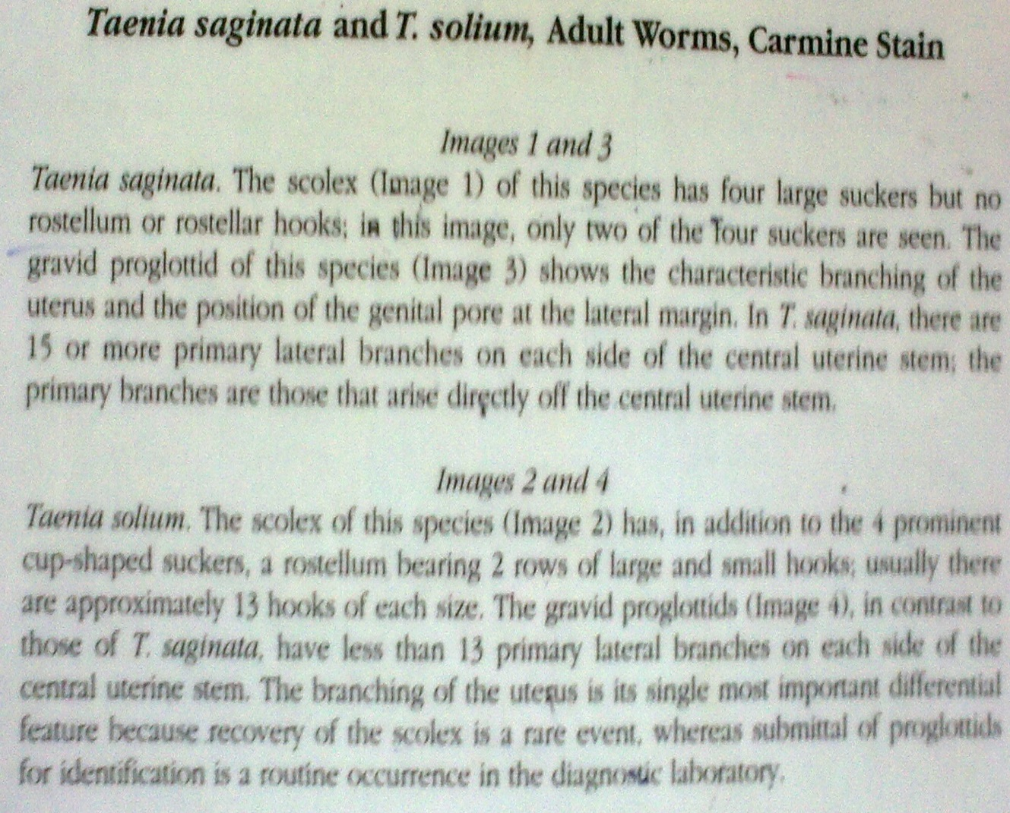

Slide 24
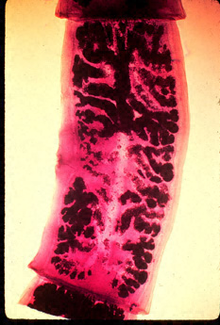
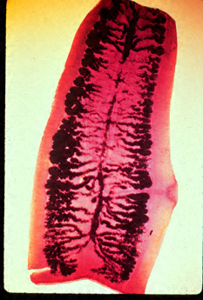
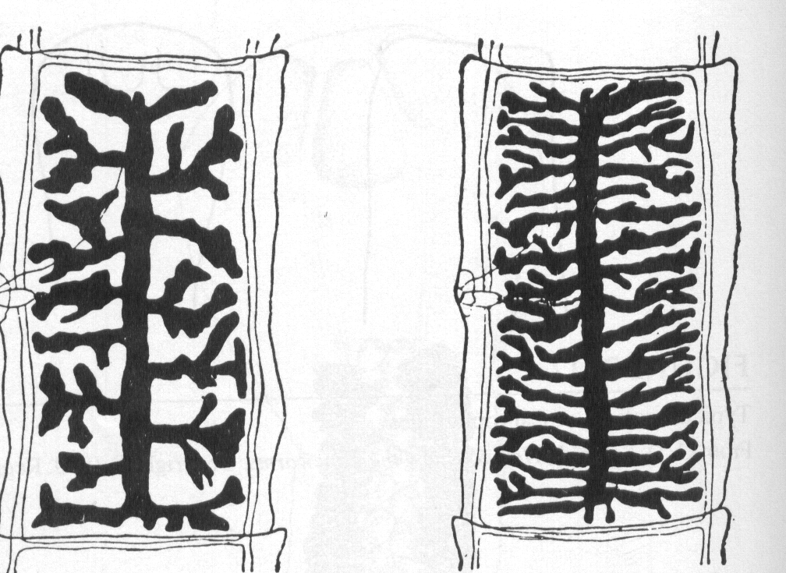
Taenia solium and saginata
Gravid proglottids of Taenia solium has 7 - 13 primary lateral branches.
T. saginatus has 15 - 20 branches on each side.

Slide 25
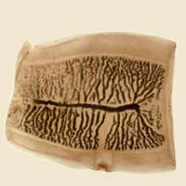
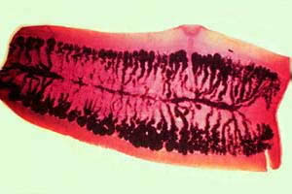
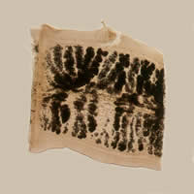
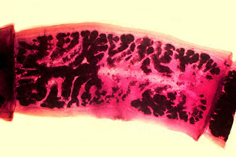
T. solium;T. saginata
(gravid proglottids)
T saginata lateral branches of uterus 15-20
T. saginata
T solium lateral branches of uterus 7-13
T. solium

Slide 26
Clinical Features
Taenia saginata taeniasis produces only mild abdominal symptoms.
  The most striking feature consists of the passage (active and passive) of proglottids.
  Occasionally, appendicitis or cholangitis can result from migrating proglottids.
Taenia solium taeniasis is less frequently symptomatic than Taenia saginata taeniasis.
  The main symptom is often the passage (passive) of proglottids. The most important feature of Taenia solium taeniasis is the risk of development of cysticercosis.

Slide 27
Laboratory Diagnosis:
Microscopic identification of eggs and proglottids in feces is diagnostic for taeniasis, but is not possible during the first 3 months following infection, prior to development of adult tapeworms. Repeated examination and concentration techniques will increase the likelihood of detecting light infections. Nevertheless, speciation of Taenia is impossible if solely based on microscopic examination of eggs, because all Taenia species produce eggs that are morphologically identical. Eggs of Taenia sp. are also indistinguishable from those produced by cestodes of the genus Echinococcus (tapeworms of dogs and other canid hosts). Microscopic identification of gravid proglottids (or, more rarely, examination of the scolex) allows species determination.
TAKE EXTREME CARE IN PROCESSING THE SAMPLES! INGESTION OF EGGS CAN RESULT IN CYSTICERCOSIS!
Cystercercus bovis in beef.
Antibody detection may prove useful especially in the early invasive stages, when the eggs and proglottids are not yet apparent in the stools

Slide 28
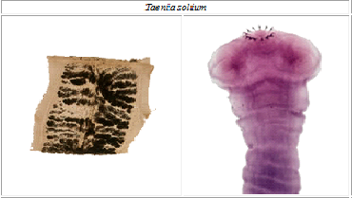
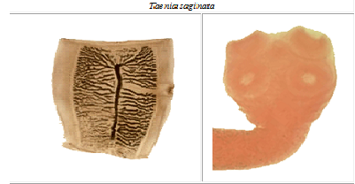
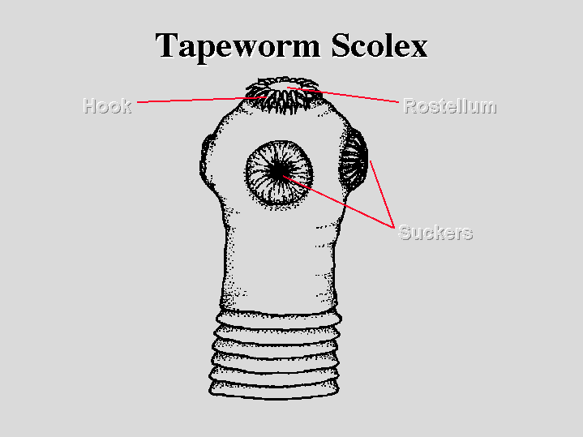

Slide 29
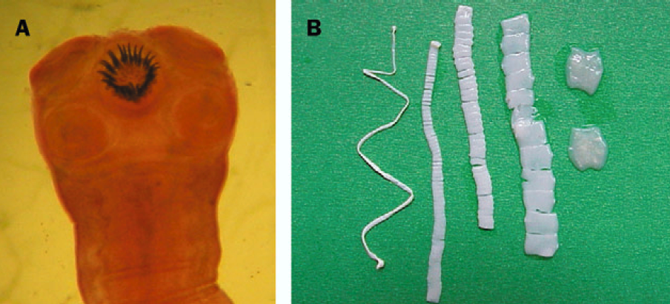
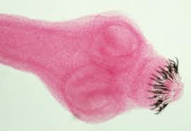

Slide 30
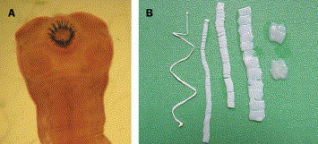
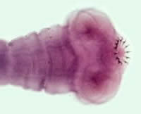
TAENIA SOLIUM
The armed scolex of T. solium (note hooks on top of scolex). CDC
T. solium has a scolex (A) with four suckers and a double crown of hooks, a narrow neck, and a large strobila (2-4 m) (B) consisting of several hundred proglottids.
About 2 months after ingestion, proglottids begin to detach from the distal end and are excreted in the feces.
Each segment contains 50-60,000 fertile eggs.
The Lancet (2003) 361: 547

Slide 32
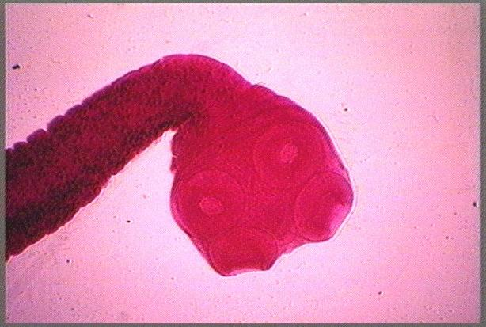

Slide 33
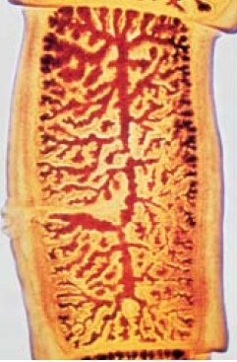

Slide 36
Treatment
Niclosamide
Praziquentel
Albendazole

Slide 37
Human infection - taeniasis
The scolex attaches to the mucosa and begins forming segments (proglotids)
After two months of infection, gravid proglotids begin to detach from the distal end - excreted in the feces
Each segment contains 60,000 eggs
Light infection causes no serious health problems
GIT symptoms: dizziness, abdominal pain, distension, diarrhea, intestinal obstruction, hunger pains, poor apetite etc.

Slide 38
They are spoliative, they spoil what one has eaten; they consume the nutrients one has ingested hence become useless to the individual
They lead to protein energy malnutrition especially in children (e.g. Kwashiokor, edema due to hypoalbuminemia, low body weight, hair changes; fragile and light, and swollen abdomen)
They are huge tapes hence cause blockage of intestinal lumen
The human body responds via allergic responses due to the strangeness of the worms in the body hence causing allergies

Slide 39
Human infection - cysticercosis
Faecal-oral contamination with T. solium eggs from tapeworm carriers
Internal autoinfection is also possible
The invasive oncosphere (embryos) in the eggs are liberated by the action of gastric acid and cross the bowel wall (remember - cysticerci are too big to cross the bowel wall)
They establish at small terminal vessels (muscles, brain, eye) where they grow to about the size of 1 cm in 2-3 months
CNS and space occupying lesions (SOL) due to larvae(Cysticercus cellulosae)

Slide 40
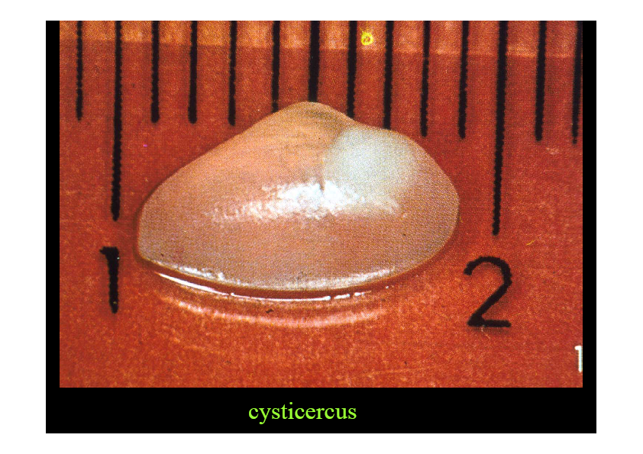
Therefore it can present as
  Muscle - small, palpable, movable nodules - chests and arms - mild or no symptoms.
  Ophthalmic cysticercosis - intraocular cysts floating freely in the vitreous humor - decreased visual acuity
  Neurocysticercosis - most symptoms are because of the inflammatory reaction associated with cyst degeneration (that may take years to happen) - epilepsy, hydrocephalus, encephalitis, meningitis

Slide 41
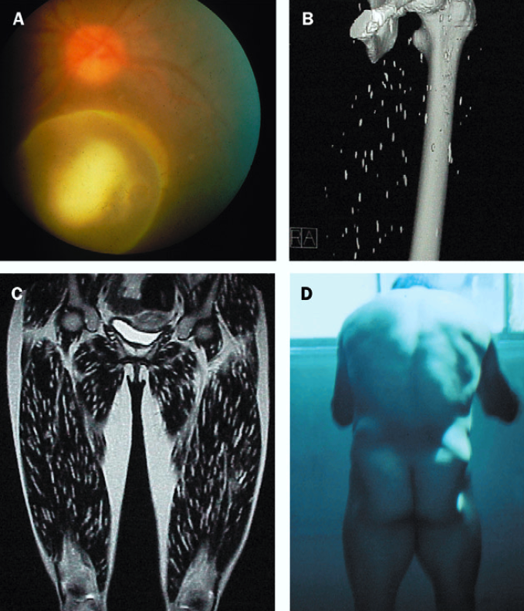

Slide 42
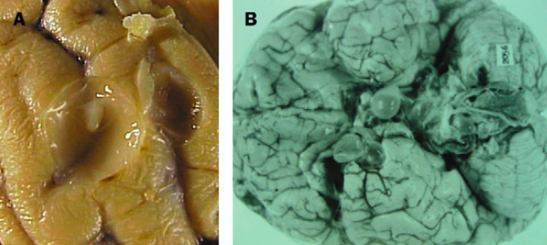
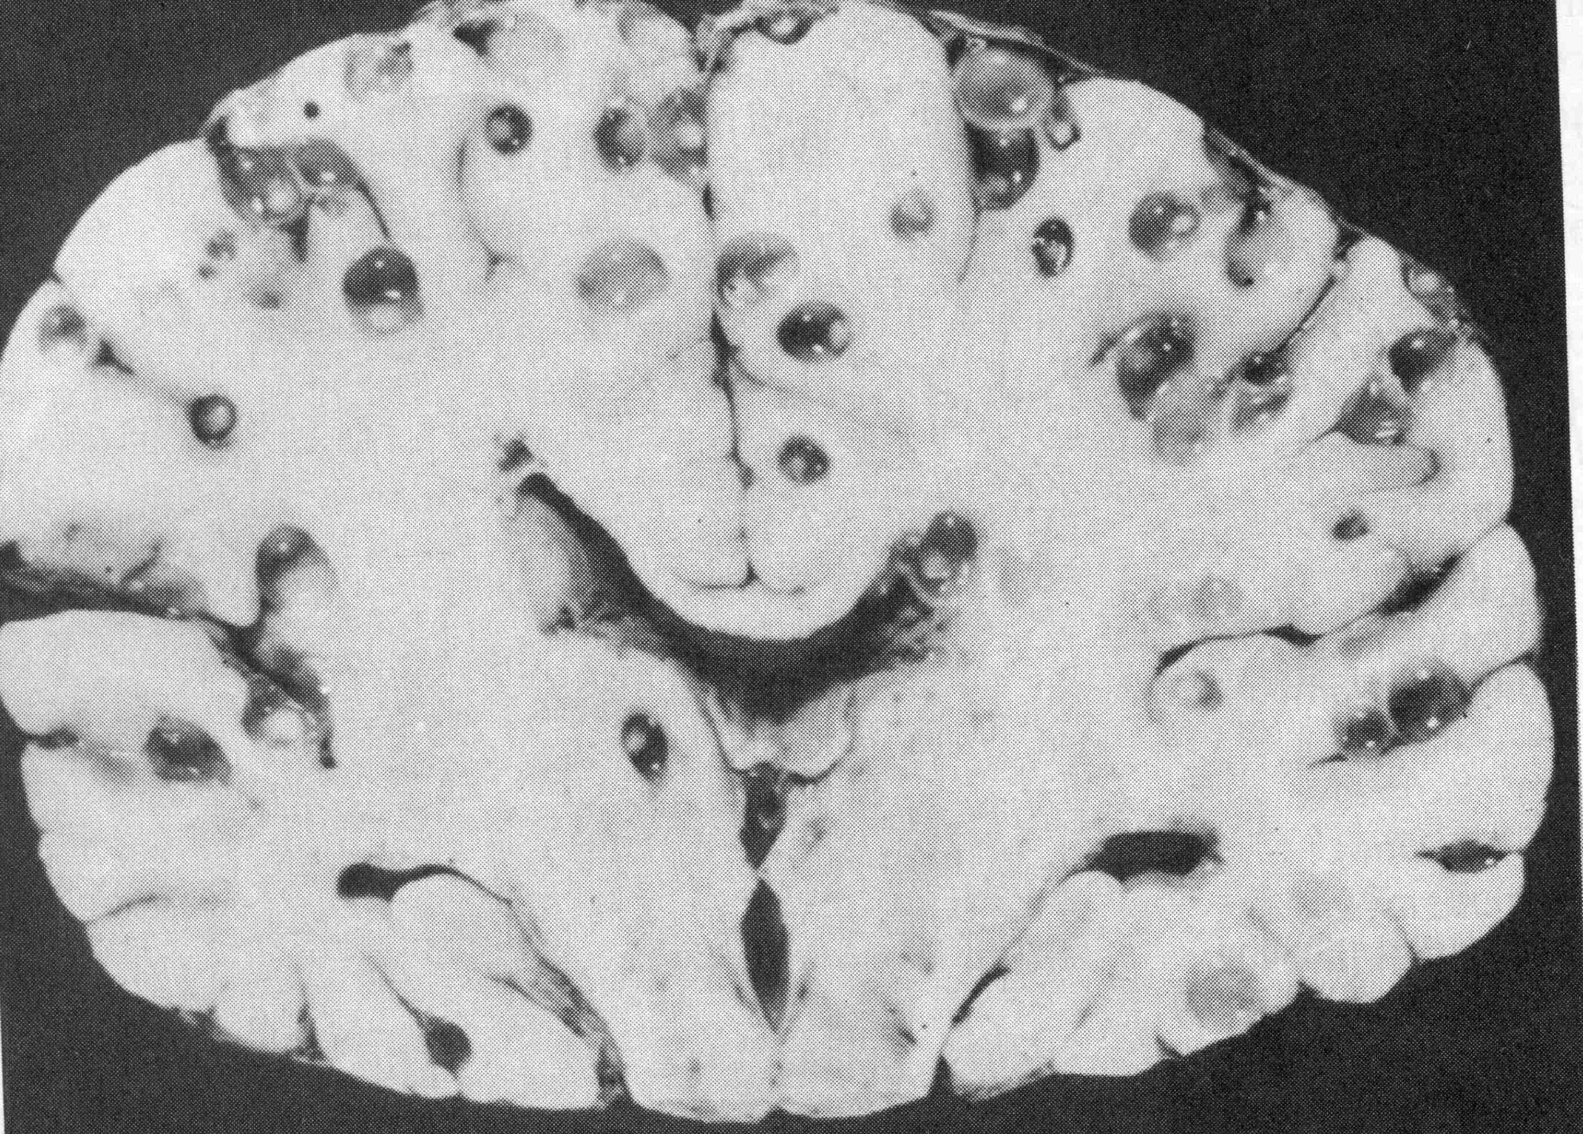
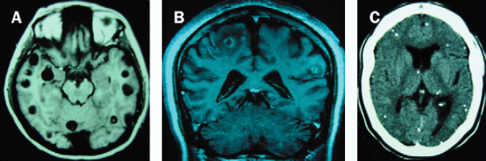

Slide 43
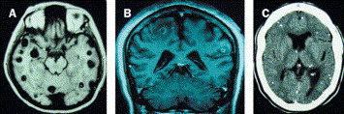
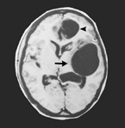
Neurocysticercosis
Neuroimaging: MRI of viable (A) and degenerating (B) cysts and CT of calcified cysticerci. The Lancet (2003) 361: 547
The parasite infects the CNS
Epileptic seizures (58-80% when parenchymal brain cysts).
Intracranial hypertension, hydrocephalus, or both. This syndrome is related to the location of parasites in the cerebral ventricles or vasal cisterns.
Occasionally a cyst may grow larger (giant cyst)
Geographical variation in clinical manifestations
From: NEJM (2001) 345:879

Slide 44
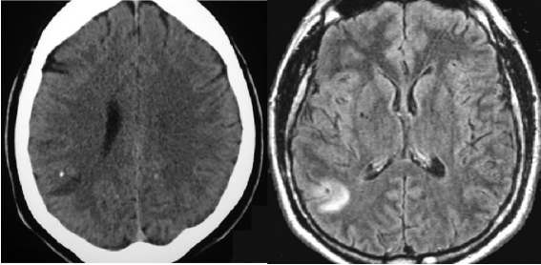

Slide 45
How to diagnose and treat this condition?
Differences taeniasis vs. cysticercosis

Slide 46
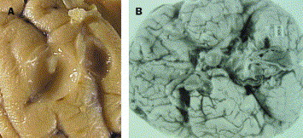
Cysticercosis pathology
Cysts are rounded or oval vesicles from a few mm to 1-2 cm
Most common location is in the cerebral hemispheres, mainly at the junction of grey and white matter.
Cysts can be found in the cerebellum, ventricles, brainstem, basal cisterns, and spine.
Viable cysts have a translucent membrane through which the scolex is visible.
Cysts degenerate: the fluid becomes opaque and dense and edges irregular and shrink.
Calcification starts in the cephalic portion and leaves a whitish calcified nodule

Slide 47
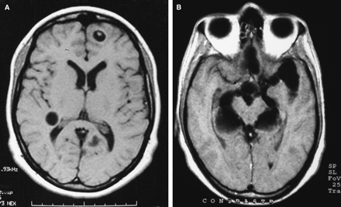
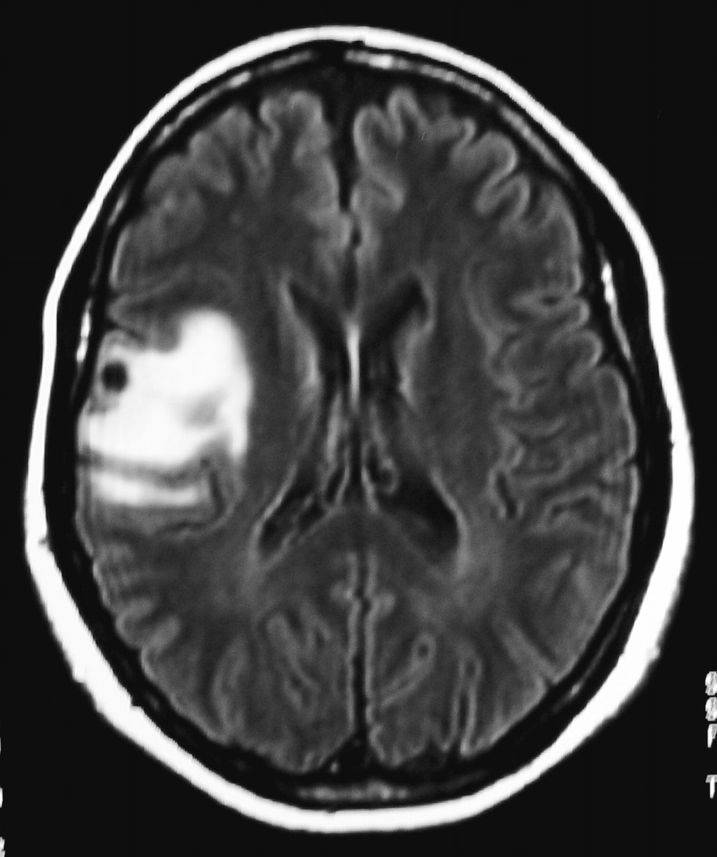
Cysticercosis diagnosis
Serologic diagnosis:
    Antibody assays for cysticercosis:
    Antigen-detection assays: circulating antigens means live parasites. Ongoing viable infection. Monoclonal antibodies seem to detect AGs in CSF.
    Antibody assays for taeniasis: TSE33 and TSE38 were recognized by a panel of taeniasis but not cysticercocis, patient serum samples.
Neuroimaging diagnosis: CT and MRI provide objective evidence on number and location of cysticerci. Also their viability and the severity of the host inflammatory reaction.
MRI showing parenchymal (A) and extraparenchymal (basal ccs) (B) viable NCC.
MRI showing calcified cyst with surrounding edema

Slide 48
Diagnosis - taeniasis
Stool examination; look for eggs (striated egg wall, oncosphere with hooklets), proglottids (with folding/uterine branches more than 13 as shown below)
Usually, the eggs cannot be distinguished from those of T. salium hence specific diagnosis is by identification of gravid proglottid
Recovery of head in stool (unarmed)
Cystercercus bovis in beef
Best diagnosis - coproantigen detection ELISA (detect taenia specific molecules in the feces - 95% sensitivity and 99% specificity)
Options:
  not efficient and cheap test vs. efficient and expensive test

Slide 49
Diagnosis - cysticercosis
Stool examination; eggs look similar to T.saginata
Depends on the targeted organ:
  CNS - CSF immunology, neuroimaging (the scolex can be seen)
  Muscle - imaging, biopsy
  Eye - imaging (ultrasound)
  Xray CT Scan, MRI
  Serological exam - ELISA)

Slide 50
Treatment - taeniasis
Taeniasis - relatively easy for intestinal disease - PO drugs - niclosamide and praziquantel.
Niclosamide is the choice as it is not absorbed; however, it is an expensive drug

Slide 51
Treatment - cysticercosis
Neurocysticercosis is the main problem
The problem of the cyst is the inflammatory reaction
Use of parasiticide (praziquantel or albendazole) - debatable - aim is to reduce inflammation and scar tissue
Use of praziquantel
Niclosamide is not used because it causes disintegration of the proglottids and this releases the eggs inside the host body and this may lead to autoinfection due to cystocersosis
For cysticercosis, in tissues, corticosteroids used
palliative treatment to control inflammation - corticosteroids, antihistamines
Surgery for SOL

Slide 52
Treatment should be individualized based on cyst location, level of inflammation and clinical presentation
Therapy should include analgesics, antiepileptic drugs, cysticidal drugs, surgical resection of lesions and placement of ventricular shunts
Parenchymal cysticercosis with viable cysts: Albendazole 15 (mg/kg/day) with dexamethasone (0.1 mg/kg/day). Praziquantel.
Subarachnoid ccs: antiparasitic therapy
No reason to use antiparasitic drugs to treat dead calcified cysts. Symptomatic therapy.
Surgical therapy: ventricular shunting to resolve hydrocephalus. Also excision of giant cysts or intraventricular cysts

Slide 53
Prevention and control
AT LEVEL OF RESERVOIR
  Pig vaccination
  Pig treatment
  Human carriers mass treatment
EXIT FROM THE RESERVOIR
  Proper disposal of human excreta into pit latrines
  Sewage treatment and proper toilet use

Slide 54
IN THE MECHANISM OF TRANSMISSION AND ENTRY TO HOST
  Properly cooking beef and pork
  Wash hands after using the toilets
  Inspection of meat at slaughter houses
INSIDE THE HOST
  Taeniasis
    Rx with niclosamide and praziquantel.-niclosamide is preferre
  Cysticercosis
    Mainly neurocysticercosis.- The cyst causes inflammation.To reduce inflammation and scar tissue:
      Parasiticides (praziquantel or albendazole) are used. This is however debatable.
      Corticosteroids and antihistamines are also used to control inflammation.

Slide 55
Bovine Cysticercosis
Bovine cysticercosis is caused by Cysticercus bovis, which is the cystic form of the human tapeworm Taenia saginata.
Life cycle : Cysticercus bovis is the larval stage of Taenia saginata. Taenia saginata may grow from 3 – 7 m in length and lives in the intestine of man. It consists of a suckered head called scolex which is attached to the intestine. It also consist of a neck and hundreds of proglotid segments. Mature proglotids are filled with eggs. The proglotids break off and are excreted in the faeces where they fragment and release the ova. Cattle become infected by grazing on ground and by the digestion of foodstuff contaminated with human faeces. The oncosphere liberated in the intestine from the egg penetrates the intestinal wall and through the lymphatics and blood stream reaches the skeletal muscles and heart. In the muscles the oncosphere develops into the intermediate or cysticercus stage containing a scolex. The sites of predilection are the masseter muscles, tongue, heart and diaphragm. In some countries in Africa the cysticerci appear to show uniform distribution in the musculature. If ingested by man, the final or definite host, the scolex attaches itself to the intestinal wall and tapeworms then develop and mature

Slide 56
