Slide 1
ECHINOCOCCUS GRANULOSUS
AND
ECHINOCOCCUS MULTILOCULARIS
(dog tapeworm)
KIMAIGA H.O
MBChB (University of Nairobi)

Slide 2
INTRODUCTION
Human echinococcosis (hydatidosis, or hydatid disease) is caused by the larval stages of cestodes (tapeworms) of the genus Echinococcus.
Echinococcus granulosus causes cystic echinococcosis, the form most frequently encountered;
E. multilocularis causes alveolar echinococcosis;
E. vogeli causes polycystic echinococcosis;
E. oligarthrus is an extremely rare cause of human echinococcosis.

Slide 3
Geographic Distribution:
E. granulosus
  Worldwide
  Close association with dogs
  E.g. in Lebanon, some traditional tanners use a tanning solution
  More frequent in rural, sheep raising areas e.g. S. America
E. multilocularis
  Occurs in northern hemisphere
  This includes central and northern Europe (Britain, Siberia), Asia, parts of Japan, Alaska Turkey, S. America and North America
  Main definitive hosts are foxes
  In the domestic cycle, the intermediate hosts, herbivores and rodents, and dogs, the definitive hosts.

Slide 4
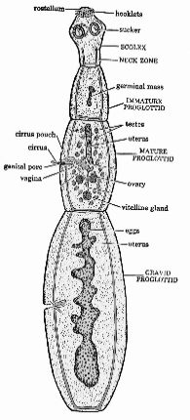

Slide 5
MORPHOLOGY
Both have 3 proglottids, hooks and suckers
E. granulosus
  Causes cystic Echinococcosis
  This form is most frequently encountered
  3 mm-6 mm long
  Rostellum contains 28-50 hooks
E. multilocularis
  Causes alveolar Echinococcosis
  Looks like little alveoli
  Can travel to any part of the body
  1.2 mm-3.7 mm long
  Also called alveolar or multilocular hydatid cyst.
  Cyst lacks the multilaminated capsule
  Has a thin wall – allows it to form exogenous budding in all tissues.
  Looks like cancerous tissues – some alveolar may lack protoscolices.
  Difficult to ***
  Testes are , posterior to ***

Slide 6
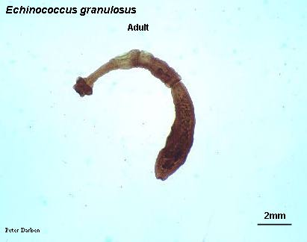
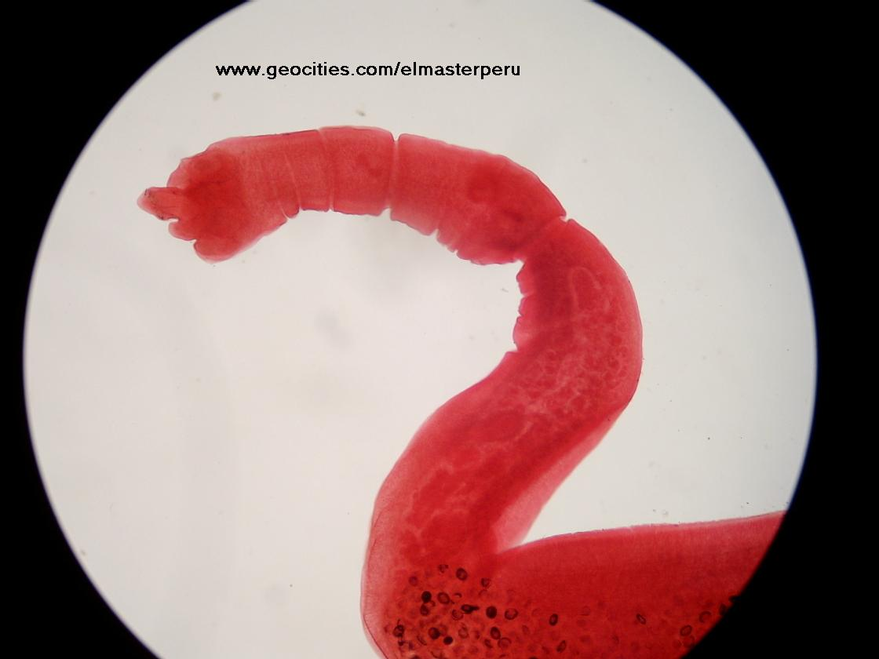
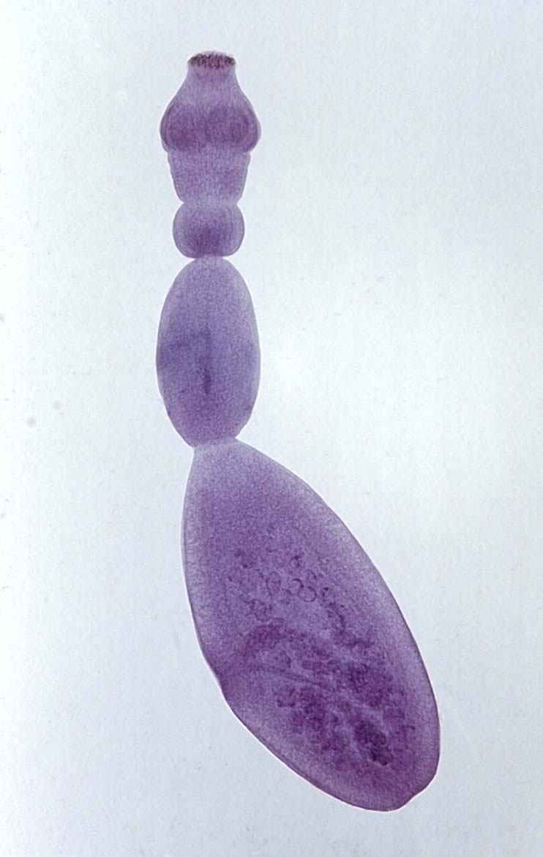

Slide 7
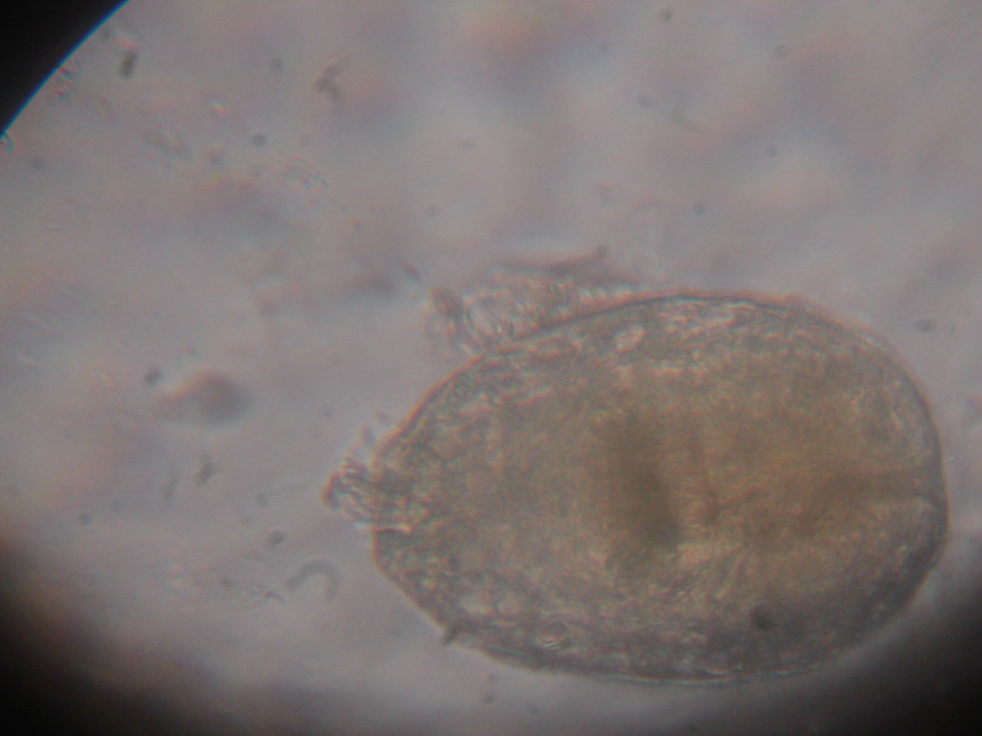
E. GranulosusProtoscolex

Slide 8
Differences
 | E. granulosus | E. multilocularis
Size | 3 mm – 6 mm long | 1.2mm- 3.7mm long
Genital pores | Equatorial | Pre-equatorial
Testes | 45-67 (few anterior to cirrus pouch) | 15-30 (all located posterior to cirrus pouch)
Metacestodes | Develops a thick laminated layer and grows into a large single cyst | Thin outer wall that grows and infiltrates processes into surrounding host tissues like a cancer

Slide 9
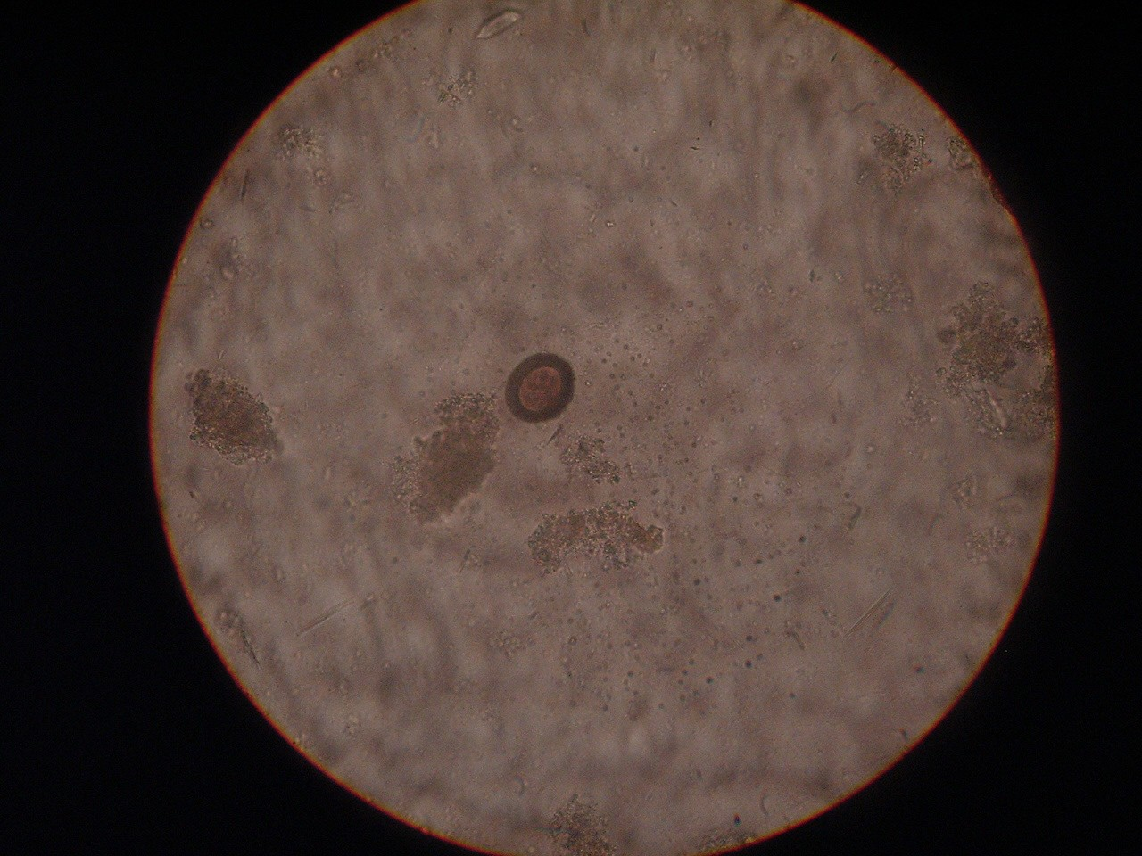
Echinoccocus granulosus - egg

Slide 10
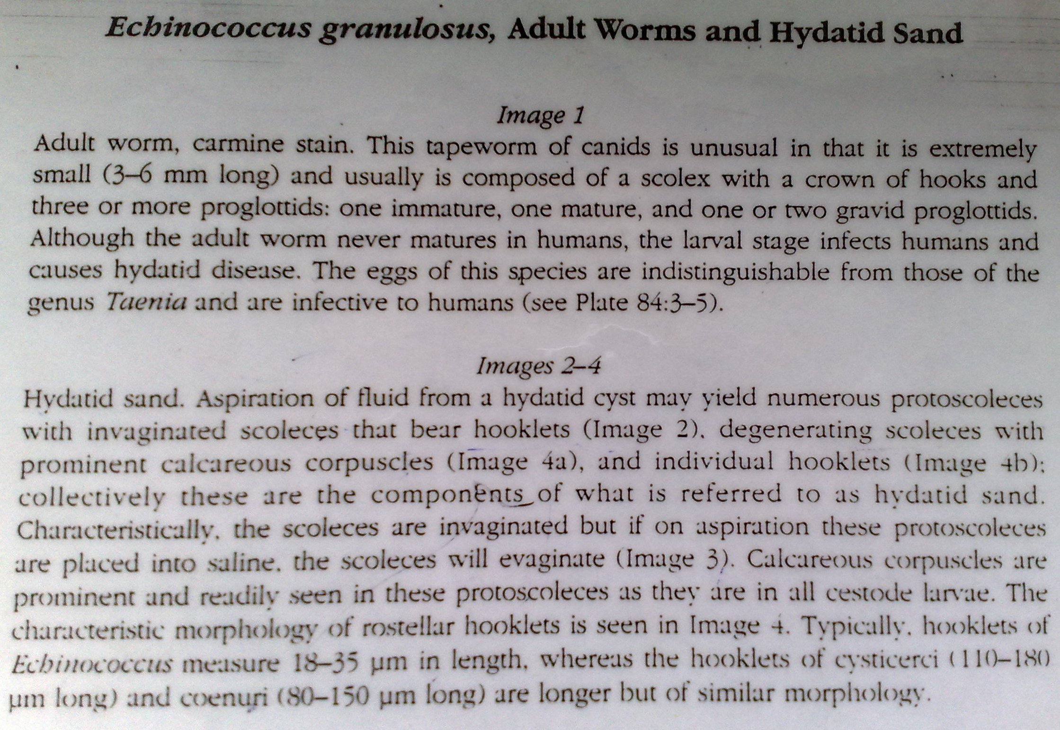

Slide 11
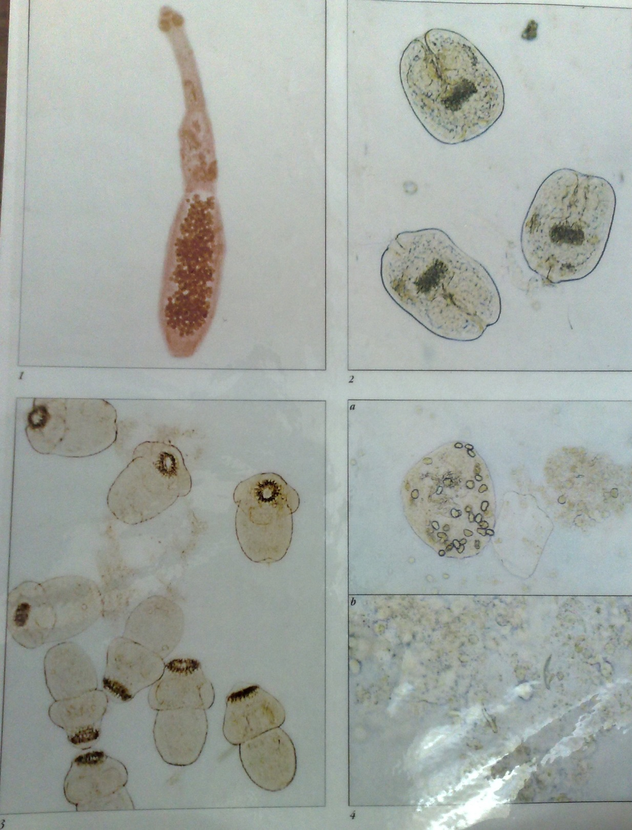

Slide 12
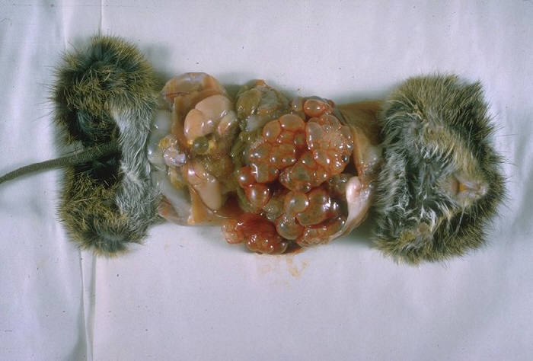

Definitive Host/Intermediate Host:
Echinococcus granulosus:
  Definitive Host: dogs and other carnivores
  Intermediate Host: mammals, including humans or herbivorous species
Echinococcus multilocularis:
  Definitive Host: mainly foxes but dogs, cats, coyotes and wolves also
  Intermediate Host: small rodents, rarely humans

Slide 13
LIFE CYCLE
The adult Echinococcus granulosus resides in the small bowel of the definitive hosts, dogs or other canids.
Man is an accidental host by eating contaminated food/water by dogs, not by eating sheep/cows etc.
Gravid proglottids release eggs that are passed in the feces.
The eggs are ingested by an intermediate host (under natural conditions: sheep, goat, swine, cattle, horses, camel)
The egg hatches in the small bowel
The egg releases an oncosphere that penetrates the intestinal wall
The oncosphere migrates through the circulatory system into various organs, especially the liver and lungs.

Slide 14
In the liver or lungs, the oncosphere develops into an infective hydatid cyst in the tissue of the tissue of what definitive host eats.
The hydatid cyst enlarges gradually
Inner germinal layer of the hydatid cyst produces protoscolices and daughter cysts that fill the cyst interior.
Once the (hydatid) cyst is ingested by definitive host, the wall is digested.
Protoscolices are released, evaginate and attach to the intestinal mucosa villi
The protoscolices then develop into adult stages in in 2 months and may live to 5-20 months in the canids.

Slide 15
Sylvatic transmission cycle:
  Wild herbivore and carnivores like foxes, coyotes & jackals.
  Eggs may be taken by moose, reindeer and rodents (moles, mice, lemmings, etc)
  Intermediate host may then be eatn by the canids
Domestic cycle
  Domestic dogs eat meat from infected wild carnivores (e.g. hunter communities)
  ***
  Humans are nomarly regarded as the ‘dead end’ host Coz man does not transmit the cysts to dog.
  Dx may take very long to develop (e.g. 20yrs)
  Depends on the location of the hydatid cyst in the host’s tissue.
  Adjacent tissues are clouded.
  If in a bone tissue – chronic internal pressure
  Subsequently necrosis of the bone tissue
  Bone becomes weak, ***
  In unrestricted site, hydatid cyst may grow very large (e.g. 1-2’ in diameter and hold up to 18 litres of hydatid fluid).
  Occludes the adjacent organs hence necrosis
  Hydatid cyst may rapture and may anaphylactic shock.

Slide 16
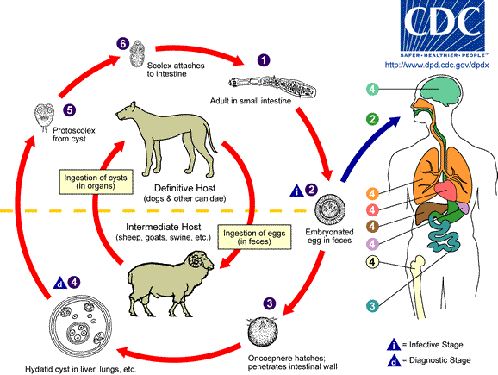

Slide 17
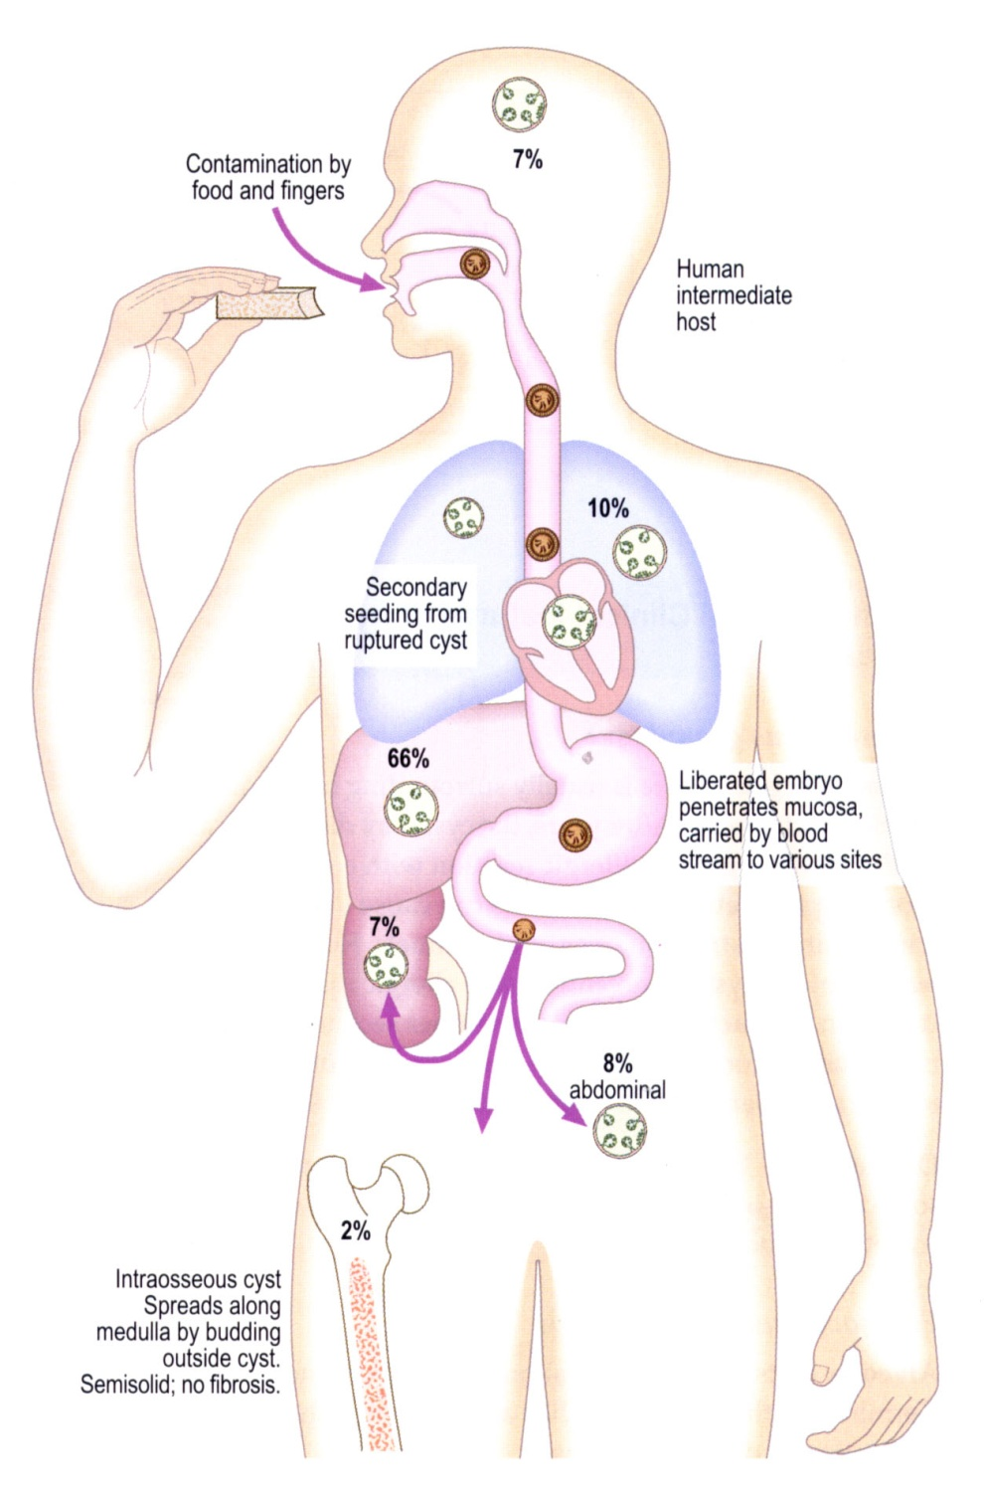

Slide 18
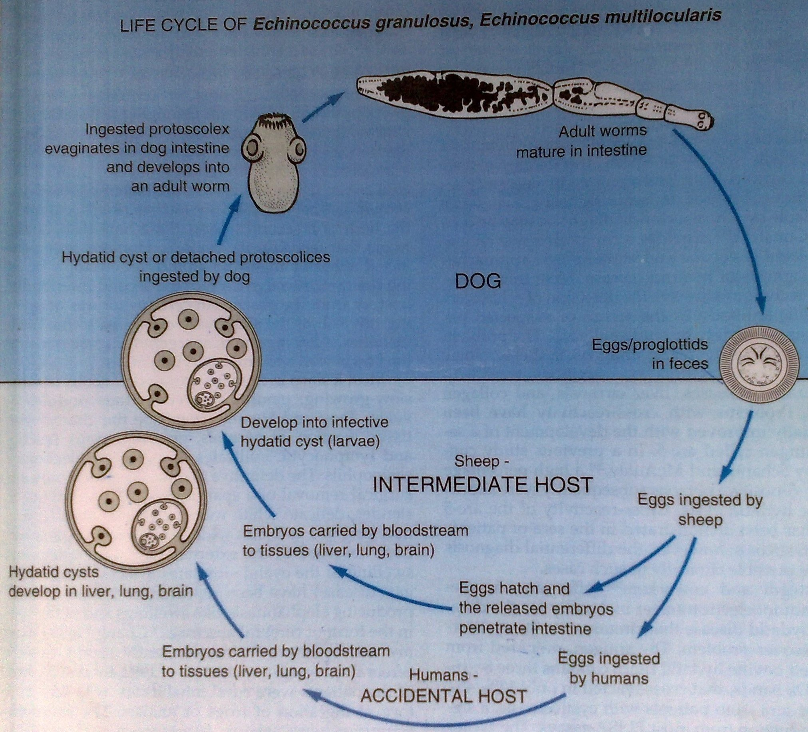

Slide 19
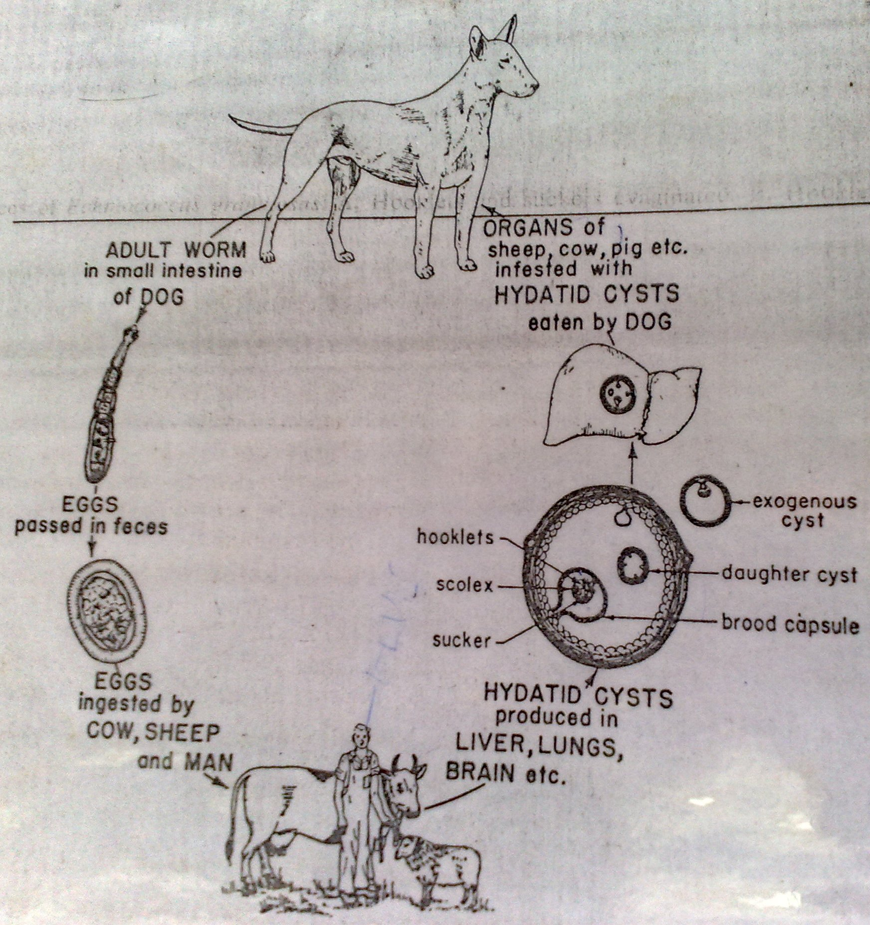

Slide 20
The same life cycle occurs with E. multilocularis with the following differences: the definitive hosts are foxes, and to a lesser extent dogs, cats, coyotes and wolves; the intermediate host are small rodents; and larval growth (in the liver) remains indefinitely in the proliferative stage, resulting in invasion of the surrounding tissues.
With E. vogeli (up to 5.6 mm long), the definitive hosts are bush dogs and dogs; the intermediate hosts are rodents; and the larval stage (in the liver, lungs and other organs) develops both externally and internally, resulting in multiple vesicles.
E. oligarthrus (up to 2.9 mm long) has a life cycle that involves wild felids as definitive hosts and rodents as intermediate hosts. Humans become infected by ingesting eggs , with resulting release of oncospheres in the intestine and the development of cysts in various organs.

Slide 21
Pathology
Human is an accidental host, it is more of a veterinary problem
The hydatid cyst has an external fibrous layer to avoid being digested by the host
On the inner side of the outer layer is a hyalinated layer
On the most inner is a germinal layer then hydatid fluid and fragments of the larvae referred to as hydatid sand
There is then a live larvae referred to as protoscolices
It will produce space occupying lesions consequences
Hydatid fluid is highly antigenic thus evoking allergic reactions in the body and anaphylactic reactions (type 1) and this can cause death in severe conditions
In cases of bursting of the hydatid cyst, the protoscolices attach on the human host and form other numerous hydatid cysts which cause an even more severe reaction resulting to organ bursting, hemorrhage and death especially once in the brain

Slide 22
Clinical Presentation
E. granulosus
  Can remain silent for years
  It is the enlarging cysts that cause symptoms in organs
    Hepatic involvement (abdominal pain, mass in the hepatic area, biliary duct obstruction)
    Pulmonary involvement (chest pain, Cough, hemoptysis)
    Brain, bone, and heart can get involved
  Rupture of cyst (fever, hives, pus, urticaria, eosinophilia, anaphylactic shock, and the cyst spreads throughout body cavity)

Slide 23
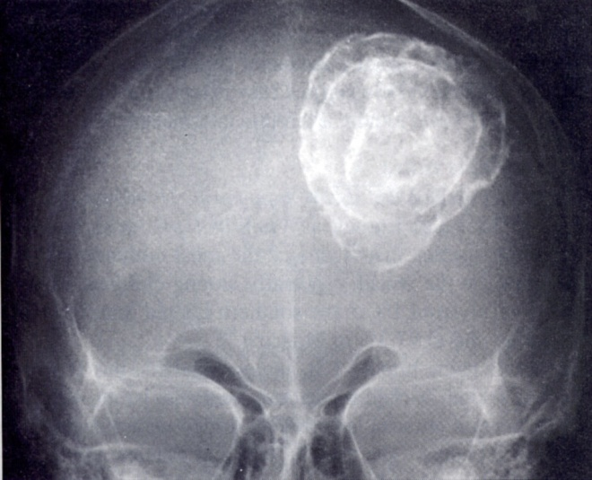
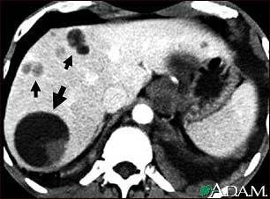
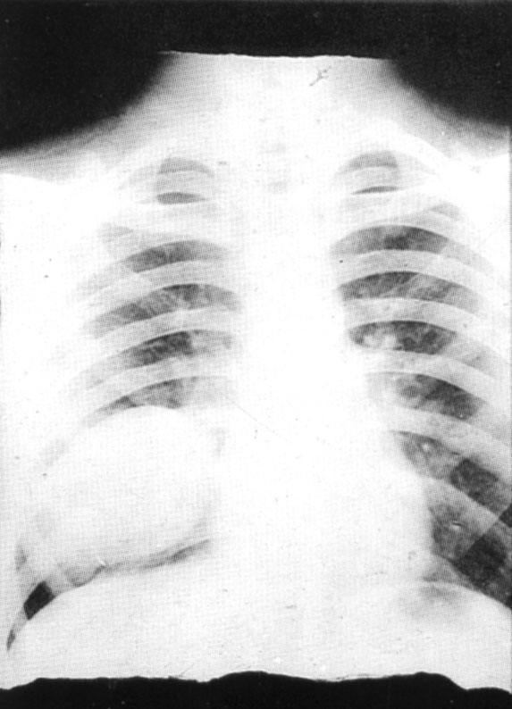

Slide 24
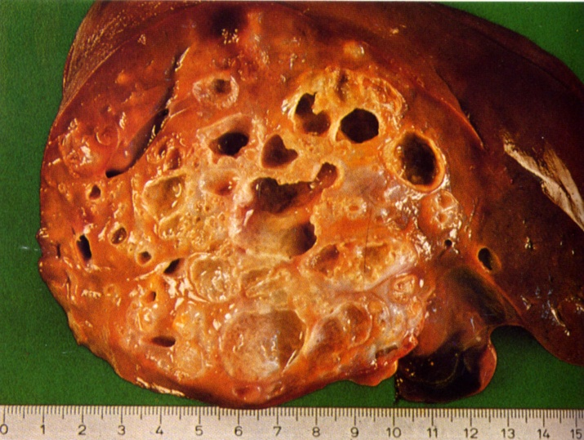
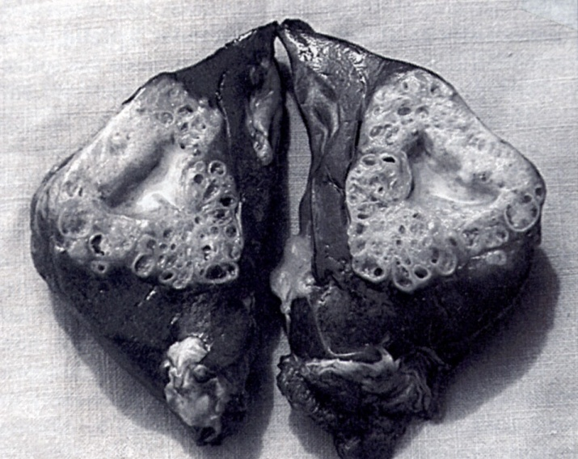
E. multilocularis
  Affects the liver as a slow growing destructive tumor
  Abdominal pain, biliary obstruction, and sometimes metastatic lesions in lungs and brain are common symptoms
  Causes alveolar echinococcosis
Echinococcus vogeli affects mainly the liver, where it acts as a slow growing tumor; secondary cystic development is common.

Slide 25
Laboratory Diagnosis
Imagery
  Hydatids are found during X-radiography, ultrasonography, CAT scans
Immunodiagnostic techniques
  Generally less sensitive then imagery
Microscopy
  Fluid aspirated from hydatid cyst will show many protoscolices
Molecular diagnosis
  PCR detects parasite nucleic acids in needle biopsies or in stool samples of foxes or dogs (final hosts) with excellent sensitivity and specificity
Antigen detection
  Several home-made tests detect copro-antigens in the faeces of definitive hosts by ELISA and specific monoclonal antibodies. One test kit is commercially available.
Antibody detection
  Serology is an important diagnostic element for detecting alveolar echinococcosis. Various test formats (IFA, ELISAs, Western blots) have been developed to detect specific antibodies with a high sensitivity.
  These tests use antigen preparation from hydatid fluid, which detect antibodies

Slide 26
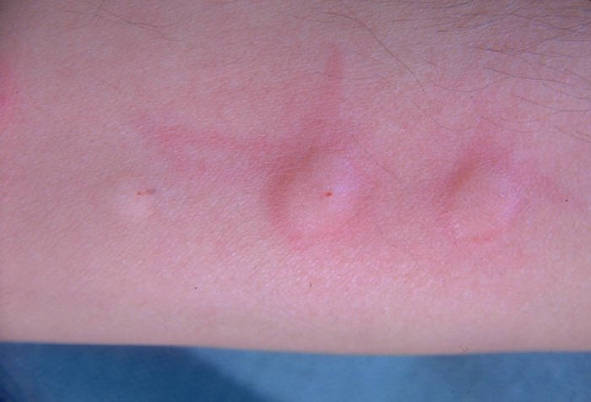
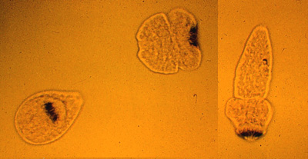
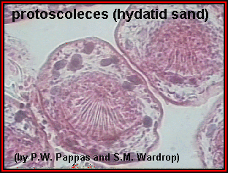
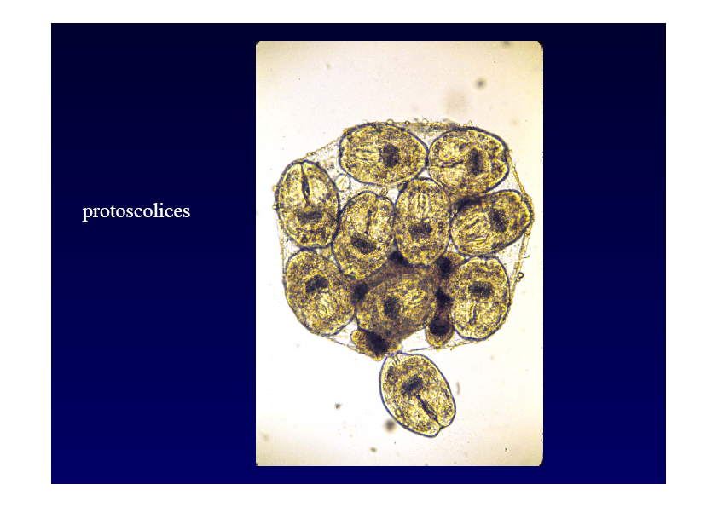

Slide 27
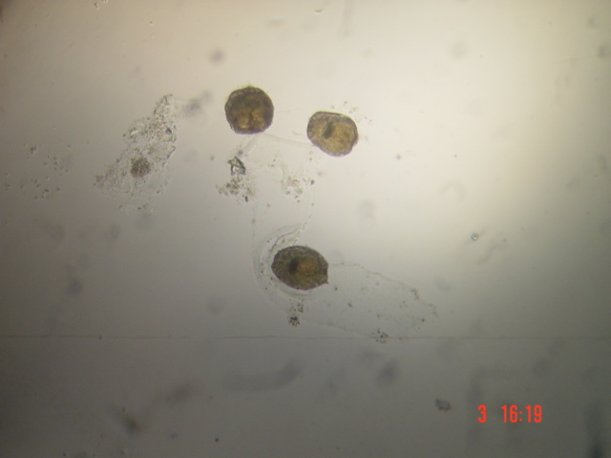
Echinococcus granulosus - protoscolex 2

Slide 28
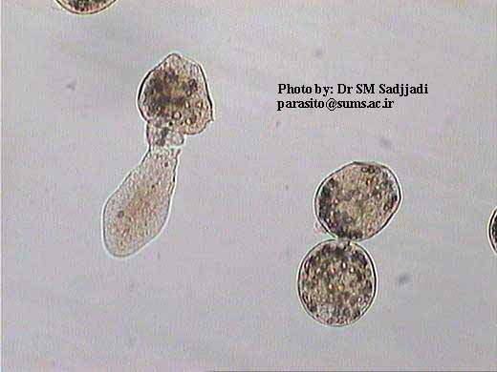
Echinnococcus invaginated head

Slide 29
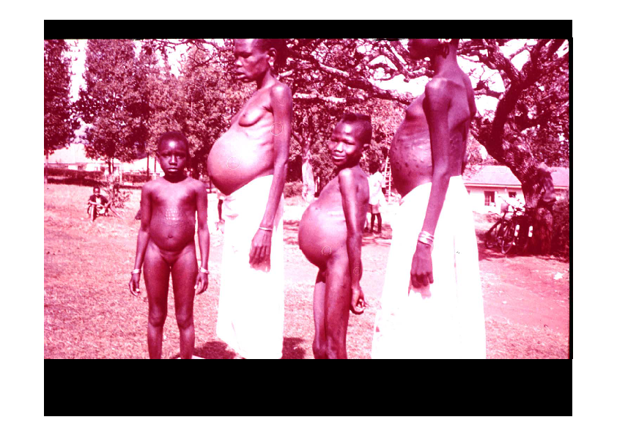
Echinococcus granulosus

Slide 30
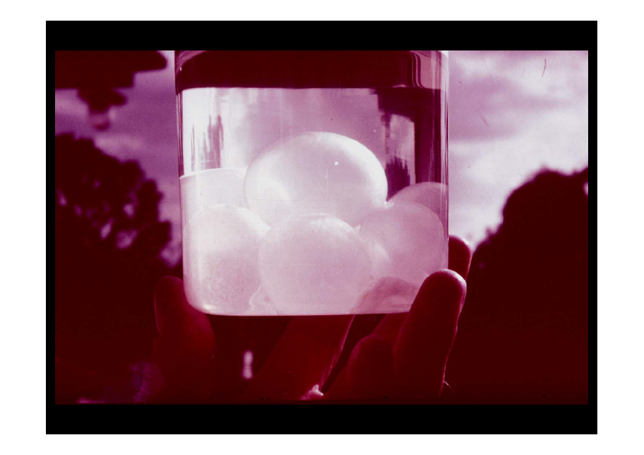
Echinococcus cyst

Slide 31
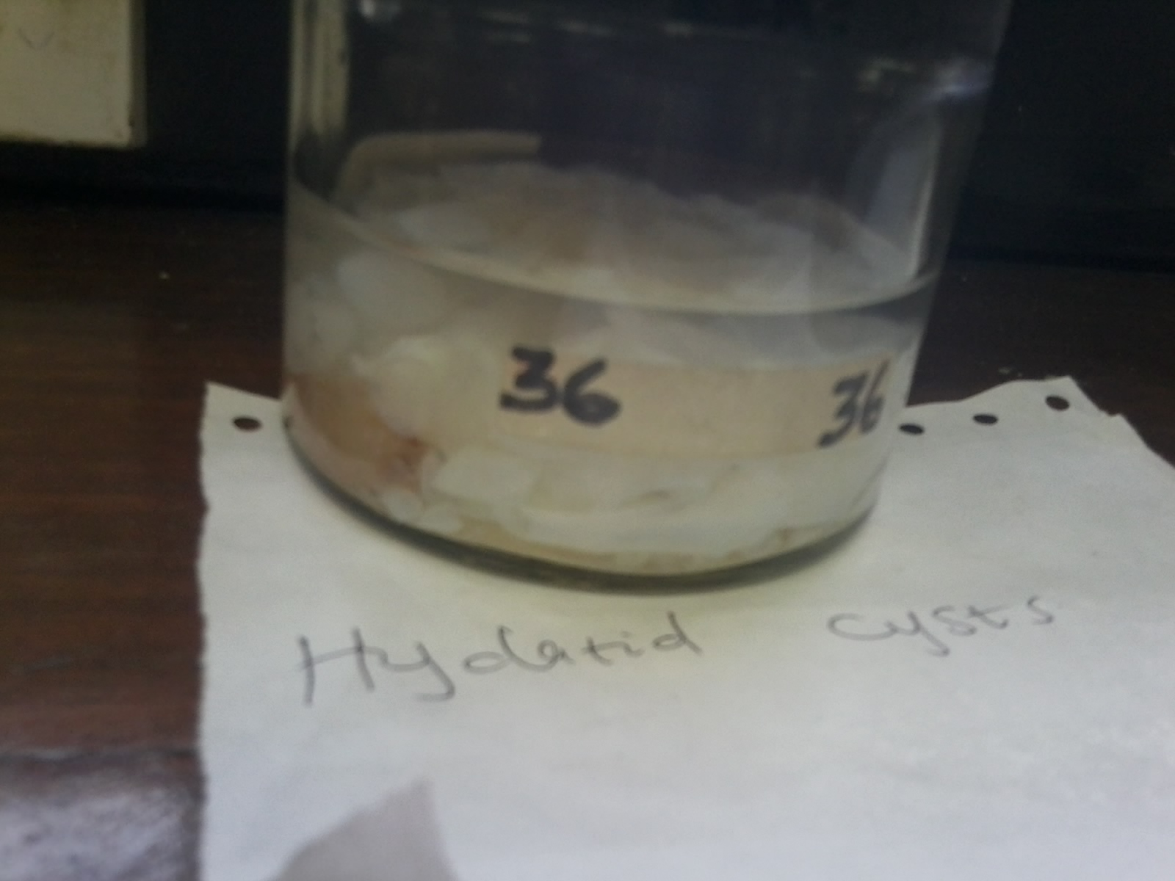

Slide 32
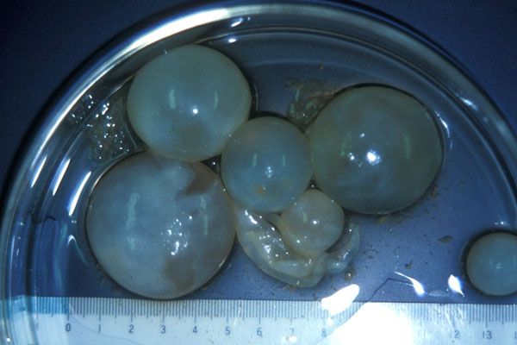
Hydatid Cysts

Slide 33
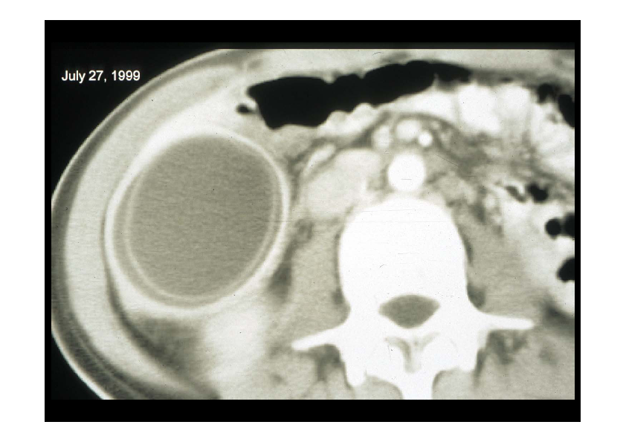
Echinococcus cyst in brain

Slide 34
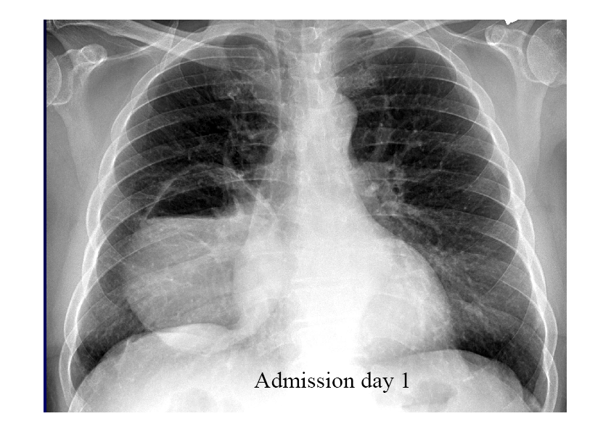
Echinococcus sp cyst in abdominal cavity

Slide 35
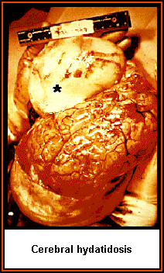
Metacestode (cyst)
Unilocular
Sub spherical in shape
Fluid-filled
Pulmonary cyst are commonly found in the lower lobe on the right side
http://www.biosci.ohio-state.edu/~parasite/echinococcus.html

Slide 36
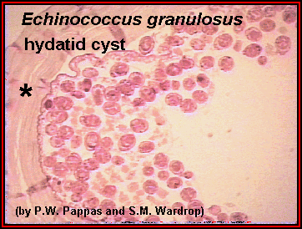
Cyst stage in Humans
The cyst consists of a thick outer layer (*), several thinner internal layers, and many protoscolices. The protoscolices are often called "hydatid sand."
A single protoscolex.
“Hooks” can be seen that will form the hooks associated with the adult worm's rostellum
http://www.biosci.ohio-state.edu/~parasite/echinococcus.html

Slide 37
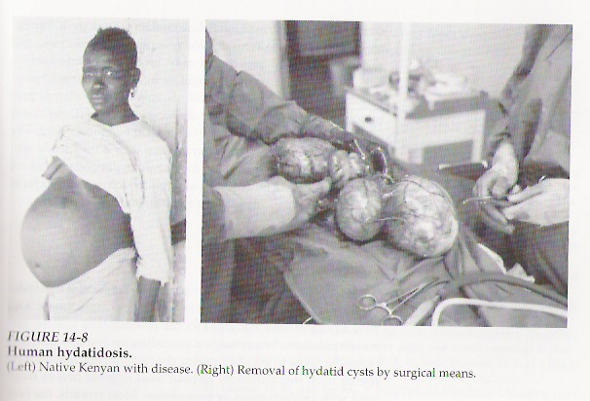
Hydatid Cysts

Slide 38
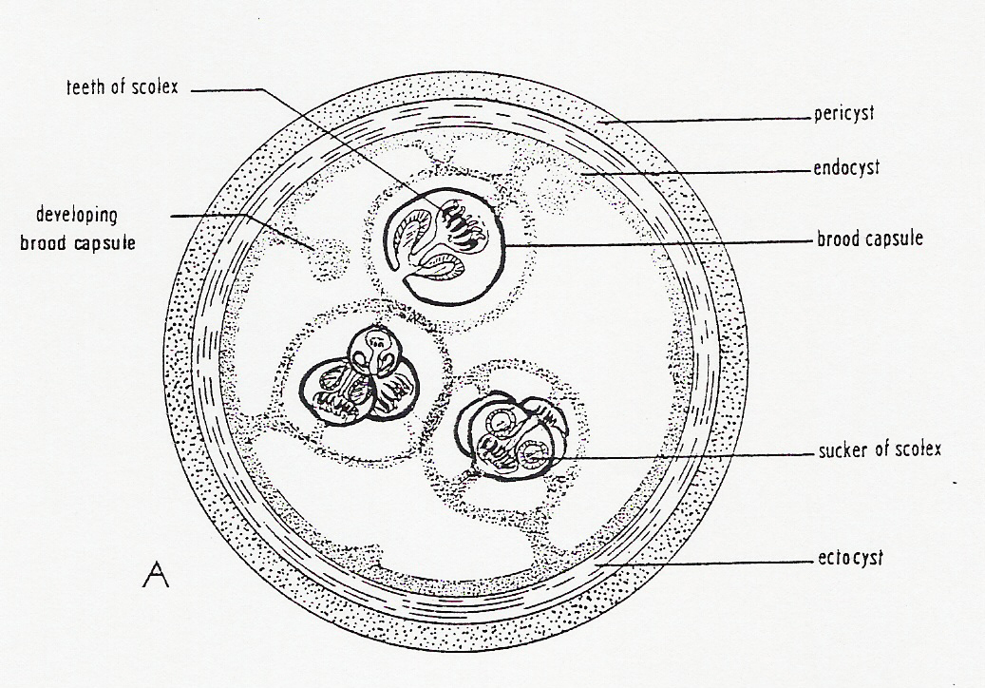
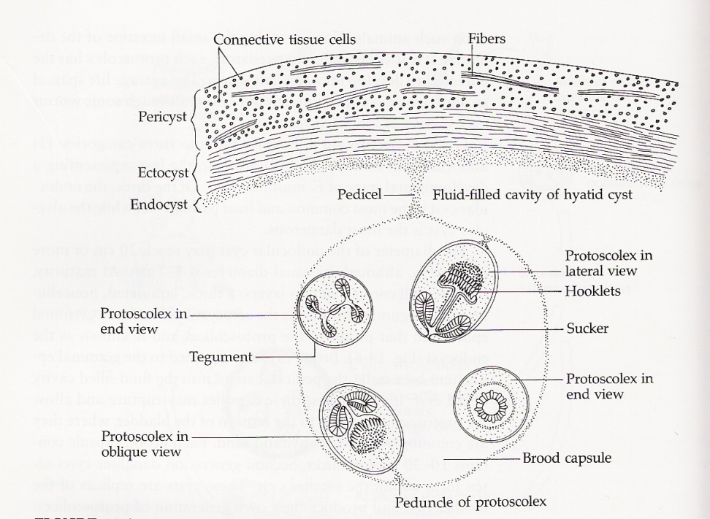

Slide 39
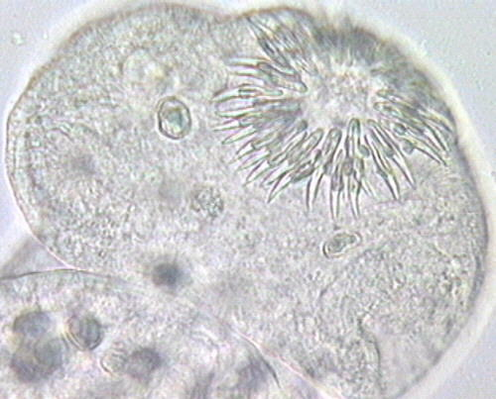
Mature protoscolex

Slide 45
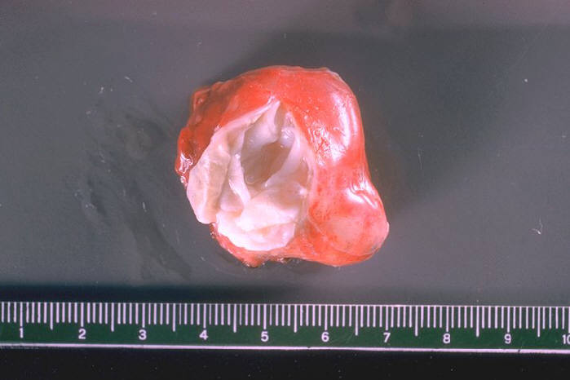
Treatment
Surgery to remove the parasite mass is the most common form of treatment for echinococcosis
After surgery, medication may be necessary to keep the cyst from recurring.
Use of albendazole for Echinococcus granulosus.
Use of albendazole or mebendazole for Echinococcus multilocularis.
  http://youtube.com/watch?v=E9Hx9oKkEVg
Medication after surgery may be necessary to keep the cyst from recurring
  Drug of choice is albendazole for E. granulosus
  Drug of choice is albendazole and mebendazole for E. multilocularis

Slide 46
Control and prevention methods
Threefold approach:
Dog control:
  Killing stray dogs
  Sterilization of female dogs
  Deworming of domesticated dogs
Treatment
  Surgery
  PAIR (puncture, aspiration, injection, reaspiration)
Participatory community health education
  Sheep herders should not live closely with their dogs

Slide 47
Interesting fact
The drug that is so effective for most flatworm parasites, Praziquantel, may actually enhance growth of alveolar hydatids.

Slide 48
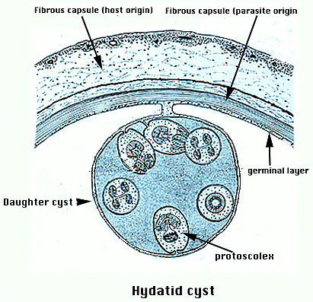
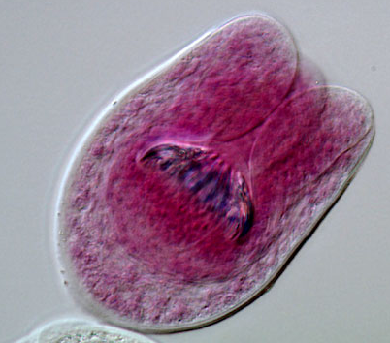
The Hydatid Cyst
The cyst is lined by a multilayer parasite tissue with the innermost layer being the germinal layer
This layer is a undifferentiated “stem cell” layer that can spawn the formation of “brood capsules” which are themselves lined by GL
The daughter cysts (the encircled body) "bud" into the center of the fluid-filled cyst.
This is a very small portion of the cyst which may become quite large.
Each of the smaller bodies will develop into diminutive tapeworms should this be eaten by a definitive or final host such as a canine.

Slide 49
Diagnosis & Management
Disease
Hydatid cyst or disease
Clinical presentation
Nonspecific or asymptomatic
60% right hypochondriac pain
15% jaundice
Others like skin rashes, pruritus, allergic reaction
Cyst can rupture leading to broncho biliary fistula
Diagnosis
Aspiration is contraindicated
X ray / US / CT / MRI
Casoni’s intradermal test
IHA / ELISA

Slide 50
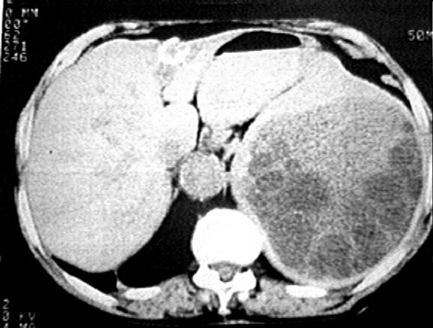
Hydatid cysts

Slide 51
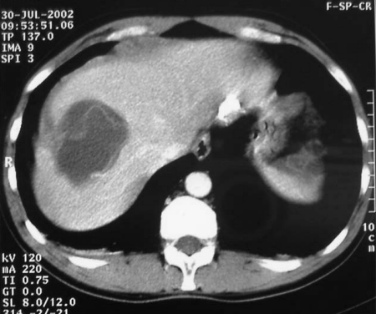
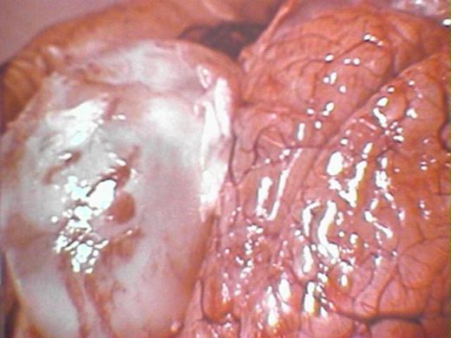
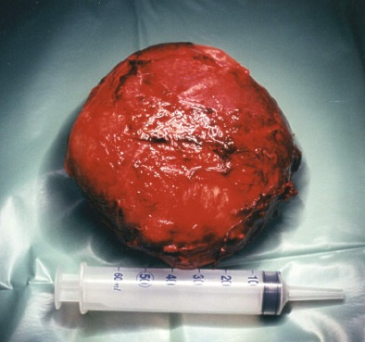
Management
Drugs are not curative
Act as adjunct to kill spilled scolices
Praziquantel, albendazole, mebendazole
Surgical removal of the cyst

