Slide 1
SPARGANOSIS
KIMAIGA H.O
MBChB (University of Nairobi)

Slide 2
Sparganosis
Sparganosis is common in Asia
A phenomenon where larvae of D. latum can infect man and does not develop fully into an adult.
It thus remains as a spargana (Ribbon-like and ivory-white larvae) in the host tissues i.e. man
Basically, a larval stage is fixated in the host
Inflammation, swelling and fibrosis
Genus spirometra (S. mansoni, S. ranarum, S. mansonoides and S. erinacei, as well as the aberrant Sparganum proliferum.)
Others are Diphyllobothrium ursi, D. dendriticum

Slide 3
Life cycle
Adult members of the genus Spirometra live in the intestines of dogs and cats . Eggs are shed in feces and embryonate in the environment . Eggs hatch in water and release coracidia , which are ingested by copepods. The coracidia develop into procercoid larvae in the copepod intermediate host . Second intermediate hosts, including fish, reptiles and amphibians, ingest infected copepods and acquire procercoid larvae. The procercoid larvae develop into plerocercoid larvae in the second intermediate host . The cycle is completed when a predator (dog or cat) eats an infected second intermediate host . Humans cannot serve as definitive hosts for Spirometra spp., but serve as paratenic or second intermediate hosts and develop sparganosis. Humans acquire sparganosis by either drinking water contaminated with infected copepods or consuming the flesh of an under-cooked second intermediate or paratenic host. Spargana can live up to 20 years in the human host.

Slide 4
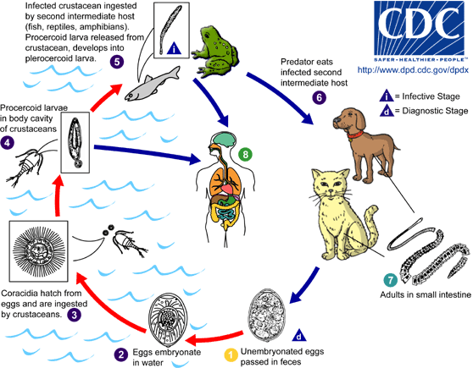

Slide 5
Normally infection takes place in 3 ways:
  Direct ingestion of infected copepods
  Ingestion of amphibian, reptilian, avian or mammalian intermediate host (instead of fish)
  Local application of infected flesh as poultices to wounds or sore eyes (e, g, split frogs). Migrate in tissues causing swelling, inflammation and fibrosis, e.g beneath the skin, between the muscles, and occasionally in viscera and brain.

Slide 6
Develops when man eats Cyclops, diatons or any other water related animals (procercoid) but it has not reached the plericercoid stage hence develops into a spargana instead
Other forms of infections by spargana is by eating frogs and other reptiles which eat sea food where the procercoids are found
Sparganosis can also be found by using the frogs and reptiles as oriental medicine i.e. scrubbing the skin with the skin of frogs or reptiles on ulcer wounds etc
Spirometra also cause sparganosis

Slide 7
Clinical Features
Migrating spargana cause various symptoms depending on the final location in the host. Spargana may locate anywhere, including subcutaneous tissue, breast, orbit, urinary tract, pleural cavity, lungs, abdominal viscera and the central nervous system. The migration in subcutaneous tissues is usually painless, but when spargana settle in the brain or spine a variety of neurological symptoms may occur, including weakness, headache, seizure, and abnormal skin sensations, such as numbness or tingling. If the inner ear is involved, the patient may experience vertigo or deafness. Occasionally, Sparganum proliferum can cause proliferative lesions in the infected tissue, with multiple plerocercoids present in a single site.

Slide 8
Laboratory Diagnosis:
Diagnosis is usually made by the recovery of a sparganum from infected tissue. The presence of a sparganum is diagnostic and identification to the species level is usually not warranted. However, the best way to identify the species is to infect an appropriate definitive host with a living sparganum and identify the adult after maturation.

Slide 9
Microscopy
Sparganosis is infection by the third-stage plerocercoid larva (sparganum) of pseudophyllidean cestodes of the genera Spirometra and Sparganum, the latter of which may be an aberrant Spirometra sp. The definitive hosts for Spirometra spp. are canids and felids, and humans serve as only paratenic or second intermediate hosts for the parasites. Spargana can be found in many organs in the human host, including the pleural cavity, eyes, pericardium, abdominal cavity and viscera, and the central nervous system.

Slide 13
Treatment of Sparganosis
There is no medicinal treatment
Surgical removal of the larvae and fibrous tissue
Give cortisol when the larval stage causes an allergic reaction

Slide 14
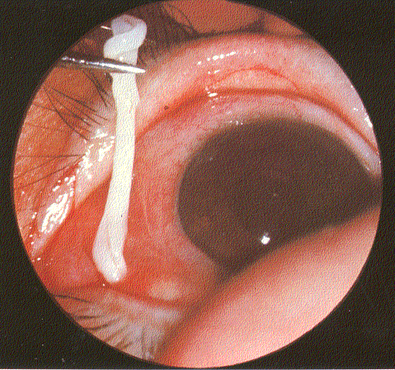
Human Infections of Spirometra (Diphyllobothrium) mansonoides
A few cases in the US have involved finding plerocercoids in the eyes.

Slide 15
Digeneans
Most common and abundant flat worms
Found in all vertebrates but more common in fish
Vary in size from 0.16 mm (e.g. Levinseniella minuta) to 100 mm (e.g. Fasciola magna)

Slide 16
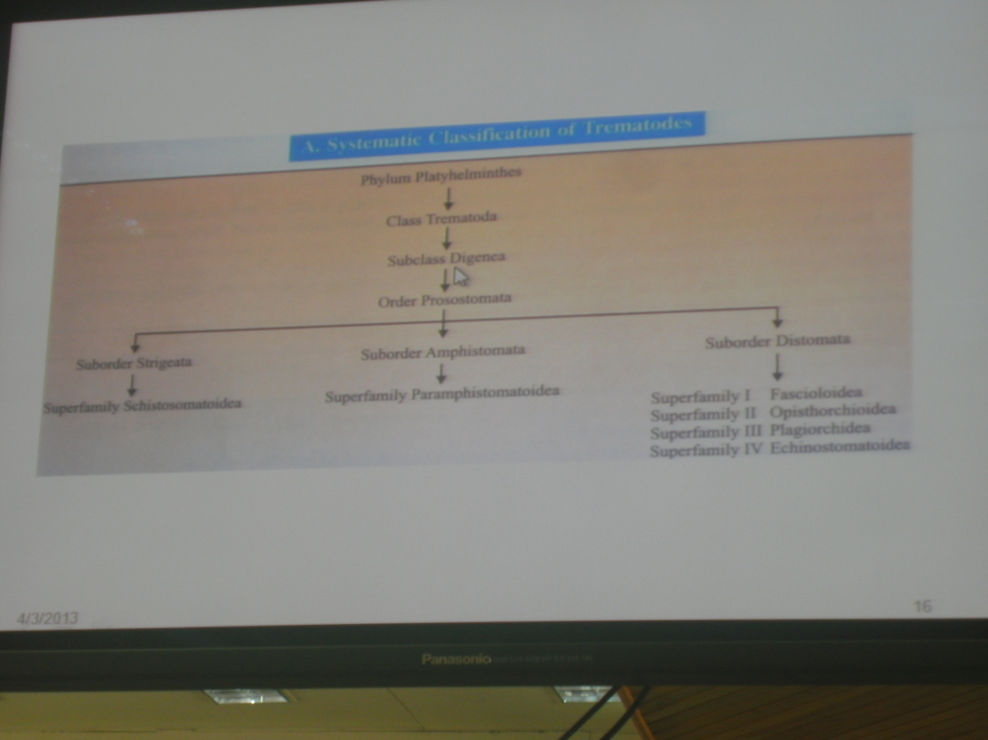

Slide 17
Life cycle
Life cycles involve a minimum of two hosts
Egg hatches into a free wimming ciliated miracidium
Miracidium gets into the first host
Sheds its ciliated epithelium and transforms into sporocyst
Has germinal tissues that asexually produce 3rd larval stage called redia (pl Rediae)
More developed than sporocyst – e.g have a pharynx and a gut
Rediae, within tissues of intermediate host, produce cercariae within its germinal tissues.

Slide 18
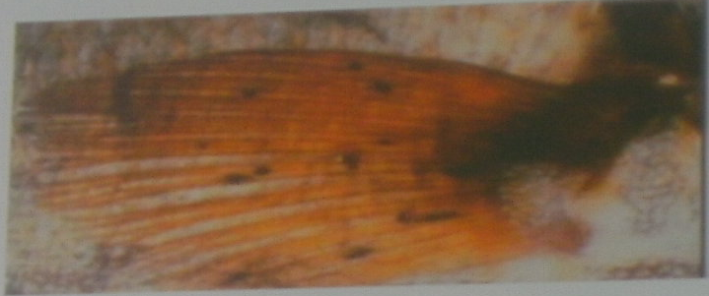
More developed than the rediae:
  A tail for swimming
  Suckers
  Genital primordial
  Some form of metacercariae
  On substrates, or in the intermediate host ingested by next host (passively)

Slide 19
Morphology
Bodies are dorso-ventrally flattened
May be oval, round or filiform
Nave two suckers, although some have just one
  Powerful (muscular) oral sucker and,
  Ventral sucker (acetabulum) – located at various positions along the ventral surface

Slide 20
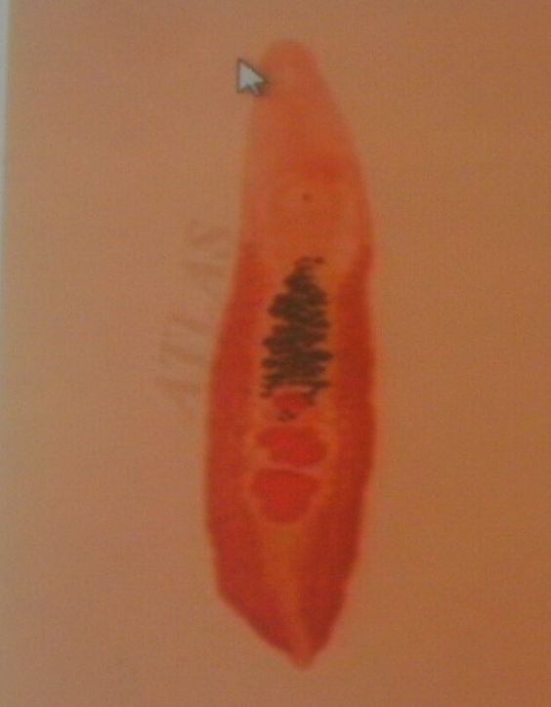
If acetabulum opccurs anywhere along the ventral surface but not an anterior tip – diastome fluke
If at posterior end – amphistome
If only one sucker (oral sucker) – monostome
Oral sucker may be ornamented with: muscular flaps (lappets)
Tentacles
Spiny retractably proboscis

Slide 21
Tegument
A living complex tissue
Numerous surface invaginations on the plasma membrane
Cytoplasm has vesicles and other cytoplasmic inclusions
Help in replacement of the plasma membrane
Tegument may also be bear spines (dense around the sucker and dorsal surface)
Spines have their bases on basal membrane
Are covered by external plasma membrane and a glycocalyx crust

Slide 22
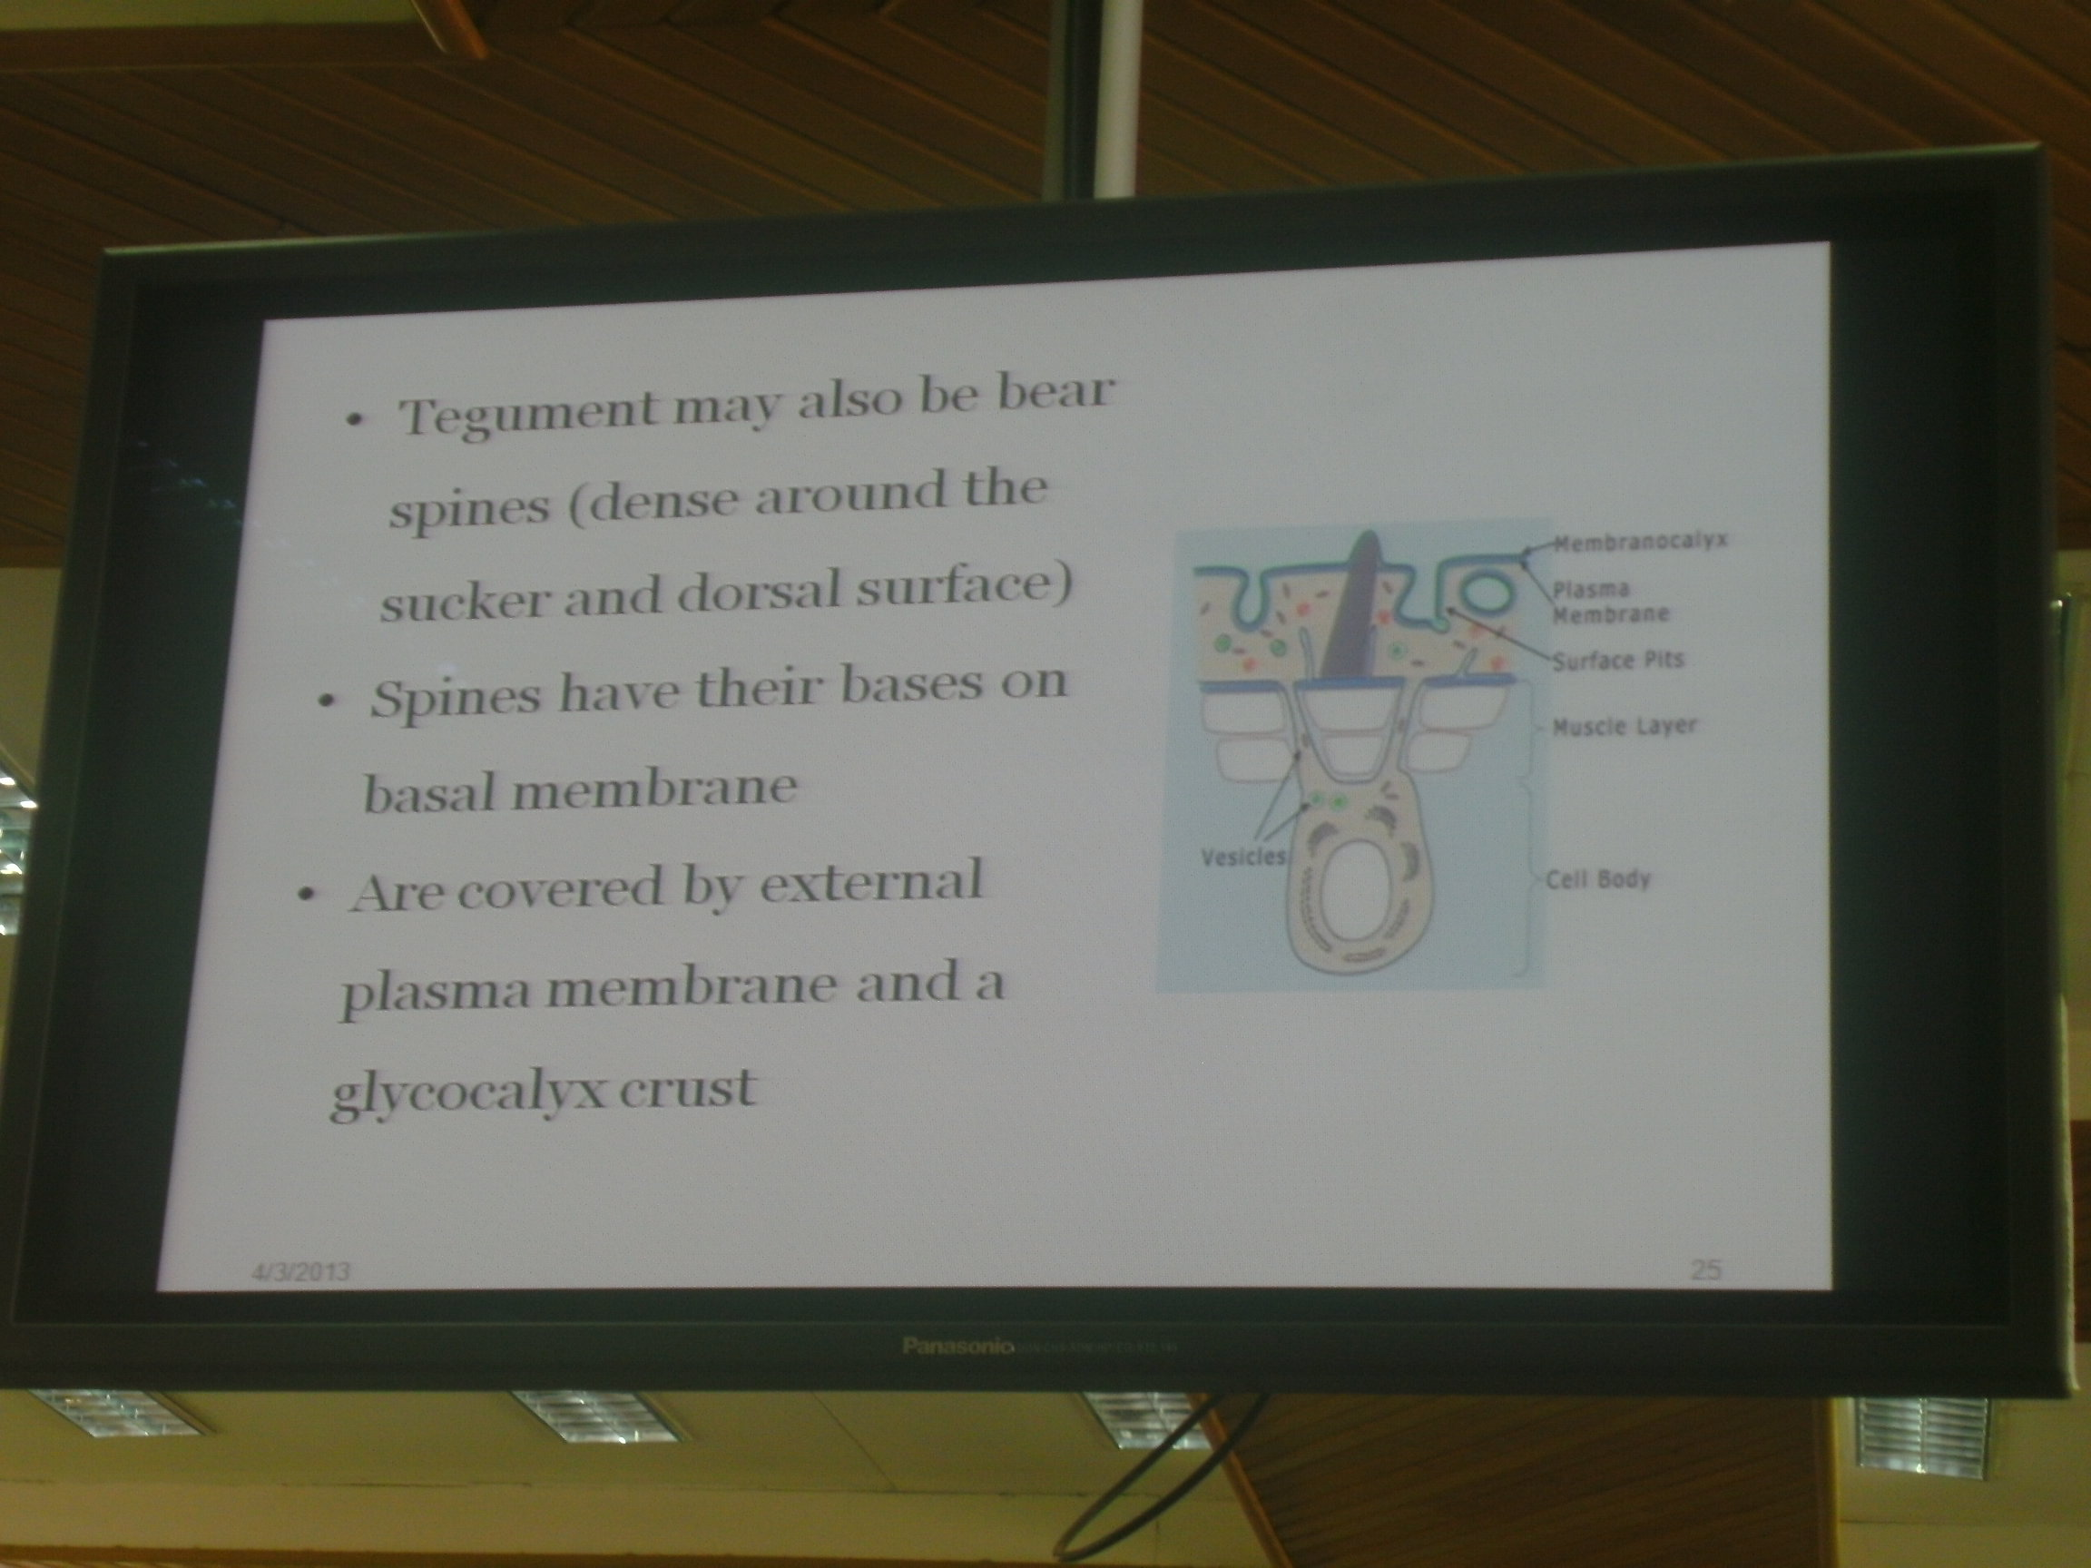

Slide 23
Musculature
Made up of superficial/subcutaneous muscles (smooth)
More prominent on the anterior part of the body
Muscles are syncytial and found in clusters called myoblasts

Slide 24
Nervous system
Ladder type of nervous system
Anteriorly – two cerebral ganglia
Three pairs of longitudinal cords arise from these ganglia
Longitudinal cords connected to each other by transverse commissures.
There are various sensory elements in the nervous system, e.g:
Tango receptors (bulbous nerve endings with a modified cilium at the end ) for touch
Eye spot- usually prominent in free-living larval stages,
Chemoreceptors

Slide 25
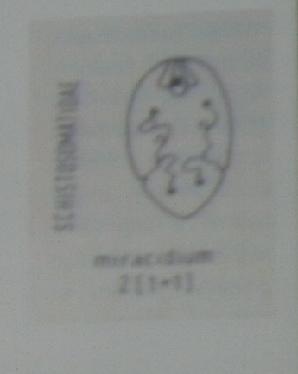
Osmoregulation
Basic unit of osmoregulation is flame cell protonephridia
Two collecting tubes joining posteriorly to form an excretory bladder.
Bladder leads to the excretory pore.

Slide 26
Feeding
Food is captured though mouth (surrounded by oral sucker)
May be digested extracellularly or intracellularly (within gastrodermal cells)
Absorption (e.g simple molecules such as glucose, amino acids, thymine and adenosine) of may occur though the tegument
Intestines could be branched or join to end blindly at the posterior end

Slide 27
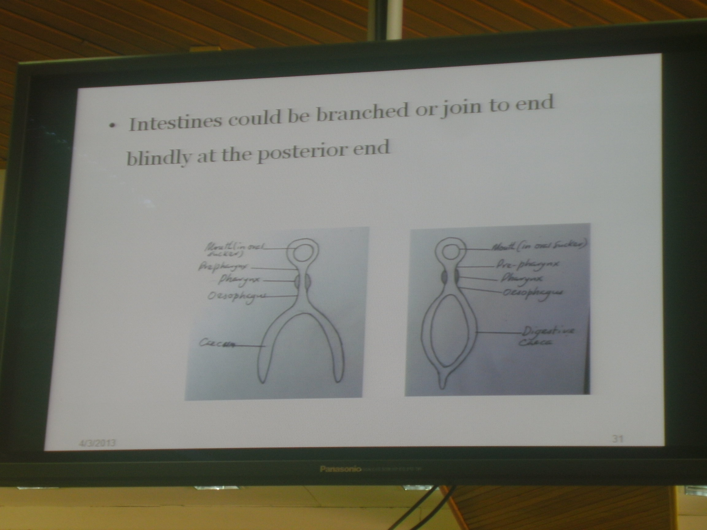

Slide 28
Reproductive System
Digeneans are hermaphroditic (except schistosomes)
Some have a self-fertilization and others cross fertilization
The male has 1 to 2 testes drained by a vas efferens
Vas efferens join to form vas deferens, then seminal vesicle.
Finally open in an ejaculatory duct whose terminal end opens to cirrus that open in common genital atrium
Cirrus may be absent and the ejaculatory duct is muscular at its distal end

Slide 29
Female has one ovary (oval, round, lobate or dendritic)
Oviduct is short and provided with a sphincter muscle that regulates release of ova
May be ciliated to aid propulsion of ova
A duct from seminal receptacle forms oviduct
Stores sperms during ejaculation

Slide 30
May be replaced by expansion of oviduct
Oviduct is joined by Laurer’s canal (a slender tube that may end blindly in the parenchyma or open to it)
May serve to store sperms
Follicular vitelline glands arranged in two lateral fields and connected by ducts
Produced vitelline cells stored in a vitelline reservoir
Ootype (expanded as a part of the uterus where the egg formation occurs) is present.

Slide 31
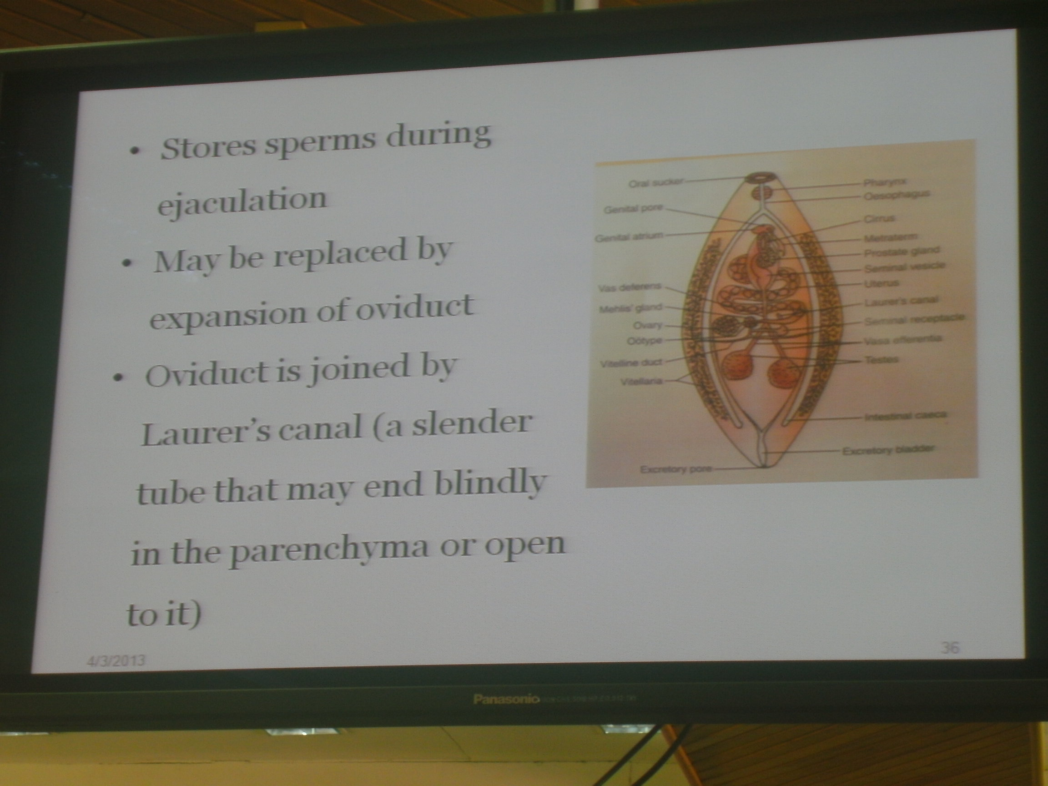

Slide 32
