Slide 1
HYMENOLEPIS NANA
AND
HYMENOLEPIS DIMINUTA
KIMAIGA H.O
MBChB (University of Nairobi)

Slide 2
INTRODUCTION
Causal Agents
Hymenolepiasis is caused by two cestodes (tapeworm) species,
  Hymenolepis nana (the dwarf tapeworm, adults measuring 15 to 40 mm in length)
  Hymenolepis dimnuta (rat tapeworm, adults measuring 20 to 60 cm in length). Infrequently seen in humans and frequently found in rodents.
Are transmitted by the fecal oral route
There are no intermediate hosts except the flea

Slide 3
Geographic Distribution:
Hymenolepis nana is the most common cause of all cestode infections, and is encountered worldwide. In temperate areas its incidence is higher in children and institutionalized groups. Hymenolepis diminuta, while less frequent, has been reported from various areas of the world.

Slide 4
H.nana and H.diminuta
Adult is found in human intestines and is very short
The eggs which are recoverable from stool
  Pea shaped (round or slightly oval)
  H. diminuta, Size 70 - 85 µm X 60 - 80 µm
  Eggs of Hymenolepis nana are oval and smaller than those of H. diminuta, with a size range of 30 to 50 µm.
  Striated outer membrane and a thin inner membrane.
  The space between the membranes is smooth or faintly granular.
  The oncosphere has six hooks.
  H. diminuta, There are no polar filaments extending into the space between the oncosphere and the outer shell.
  Eggs of Hymenolepis nana. On the inner membrane are two poles, from which 4-8 polar filaments spread out between the two membranes.

Slide 7
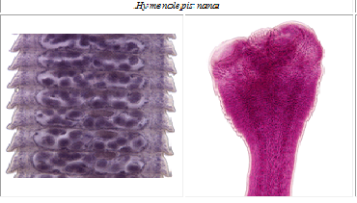

Slide 8
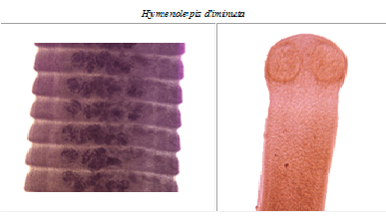

Slide 10
Life cycle of Hymenolepis nana
Eggs of Hymenolepis nana are immediately infective when passed with the stool and cannot survive more than 10 days in the external environment .
When eggs are ingested by an arthropod intermediate host (various species of beetles and fleas may serve as intermediate hosts), they develop into cysticercoids, which can infect humans or rodents upon ingestion and develop into adults in the small intestine.
A morphologically identical variant, H. nana var. fraterna, infects rodents and uses arthropods as intermediate hosts. When eggs are ingested (in contaminated food or water or from hands contaminated with feces), Egg wall is removed by host enzymes the oncospheres contained in the eggs are released. The oncospheres (hexacanth larvae) penetrate the intestinal villus and develop into cysticercoid larvae . Upon rupture of the villus, the cysticercoids return to the intestinal lumen, evaginate their scoleces , attach to the intestinal mucosa and develop into adults that reside in the ileal portion of the small intestine producing gravid proglottids . Eggs are passed in the stool when released from proglottids through its genital atrium or when proglottids disintegrate in the small intestine . An alternate mode of infection consists of internal autoinfection, where the eggs release their hexacanth embryo, which penetrates the villus continuing the infective cycle without passage through the external environment . The life span of adult worms is 4 to 6 weeks, but internal autoinfection allows the infection to persist for years.

Slide 11
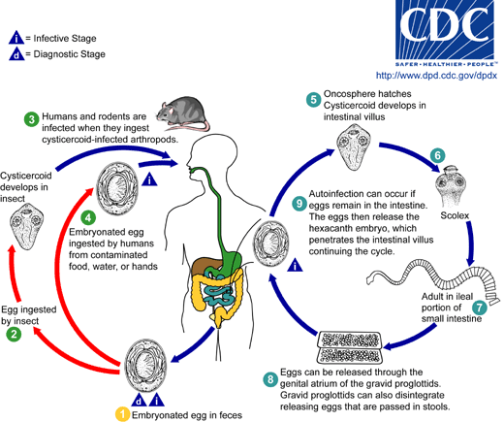

Slide 12
Life cycle of Hymenolepis nana
Eggs of Hymenolepis diminuta are passed out in the feces of the infected definitive host (rodents, man) . The mature eggs are ingested by an intermediate host (various arthropod adults or larvae) , and oncospheres are released from the eggs and penetrate the intestinal wall of the host , which develop into cysticercoid larvae. Species from the genus Tribolium are common intermediate hosts for H. diminuta. The cysticercoid larvae persist through the arthropod's morphogenesis to adulthood. H. diminuta infection is acquired by the mammalian host after ingestion of an intermediate host carrying the cysticercoid larvae . Humans can be accidentally infected through the ingestion of insects e.g fleas in precooked cereals, or other food items, and directly from the environment (e.g., oral exploration of the environment by children). After ingestion, the tissue of the infected arthropod is digested releasing the cysticercoid larvae in the stomach and small intestine. Eversion of the scoleces occurs shortly after the cysticercoid larvae are released. Using the four suckers on the scolex, the parasite attaches to the small intestine wall. Maturation of the parasites occurs within 20 days and the adult worms can reach an average of 30 cm in length . Eggs are released in the small intestine from gravid proglottids that disintegrate after breaking off from the adult worms. The eggs are expelled to the environment in the mammalian host's feces

Slide 13
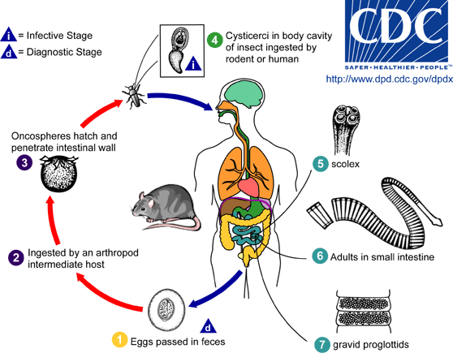

Slide 14
Clinical Features
Hymenolepis nana and H. diminuta infections are most often asymptomatic. Heavy infections with H. nana can cause weakness, headaches, anorexia, abdominal pain, and diarrhea.

Slide 15
Laboratory Diagnosis:
The diagnosis depends on the demonstration of eggs in stool specimens. Concentration techniques and repeated examinations will increase the likelihood of detecting light infections

Slide 16
Treatment
Praziquantel* is the drug of choice.

Slide 17
Control
Pest control of fleas
Kill rats
Clean the dogs and pest control on the dogs
Regular deworming by using praziquantel

