Slide 1
DIPYLIDUM CANINUM
KIMAIGA H.O
MBChB (University of Nairobi)

Slide 2
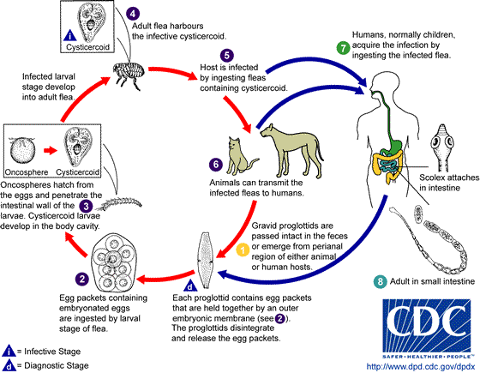
Dipylidium canium

Slide 3
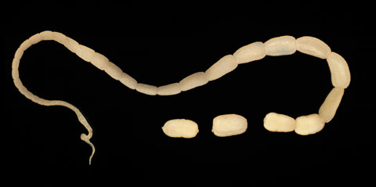
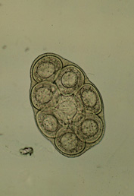
D. canium (egg/proglottid/adult)

Slide 4
