Slide 1
FASCIOLA HEPATICA
AND BUSCI
KIMAIGA H.O
MBChB (University of Nairobi)

Slide 2
Fasciola hepatica
Causal Agents:
  The trematodes Fasciola hepatica (the sheep liver fluke) and Fasciola gigantica, parasites of herbivores that can infect humans accidentally.

Slide 3
Geographic Distribution
Fascioliasis occurs worldwide. Human infections with F. hepatica are found in areas where sheep and cattle are raised, and where humans consume raw watercress, including Europe, the Middle East, and Asia. Infections with F. gigantica have been reported, more rarely, in Asia, Africa, and Hawaii.

Slide 4
Fasciola hepatica Epidemiology
Liver blockage and watercress consumption
Prevention - Eschewing (shunning or avoiding) watercress.
Rabbits are probably important in spreading
In some parts of southeastern United States, it is important parasite of domestic animals

Slide 5
Morphology
Large leaf shaped fluke
Measures 30mm * 13mm
Anterior end there is a distinct conical projection
The intestinal cerca, testis and vitelline follicles of the parasite are extensively branched.

Slide 6
Life Cycle:
Immature eggs are discharged in the biliary ducts and in the stool .
Eggs become embryonated in water
Release miracidia , which invade a suitable snail intermediate host , including the genera Galba, Fossaria and Pseudosuccinea.
In the snail the parasites undergo several developmental stages (sporocysts , rediae , and cercariae ).

Slide 7
The cercariae are released from the snail and encyst as metacercariae on aquatic vegetation or other surfaces.
Mammals acquire the infection by eating vegetation containing metacercariae. Humans can become infected by ingesting metacercariae-containing freshwater plants, especially watercress .
After ingestion, the metacercariae excyst in the duodenum and migrate through the intestinal wall, the peritoneal cavity, and the liver parenchyma into the biliary ducts, where they develop into adults .
In humans, maturation from metacercariae into adult flukes takes approximately 3 to 4 months.
The adult flukes (Fasciola hepatica: up to 30 mm by 13 mm; F. gigantica: up to 75 mm) reside in the large biliary ducts of the mammalian host.
Fasciola hepatica infect various animal species, mostly herbivores.(definitive host)

Slide 8
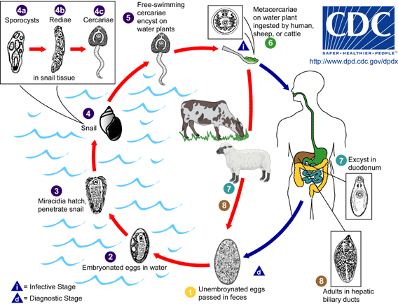

Slide 9
Fasciola hepatica Pathology
Necrosis of the liver by wandering fluke
Anemia common, inflammation and damage of the bile ducts, abscesses formed
May damage other organs (eye, brain, lung)
Halzoun - Ingestion of raw liver - adult worms migrate to the lungs and cause a respiratory blockage.

Slide 10
Clinical Features:
During the acute phase (caused by the migration of the immature fluke through the hepatic parenchyma), manifestations include abdominal pain, hepatomegaly, fever, vomiting, diarrhea, urticaria and eosinophilia, and can last for months.
In the chronic phase (caused by the adult fluke within the bile ducts), the symptoms are more discrete and reflect intermittent biliary obstruction and inflammation.
Occasionally, ectopic locations of infection (such as intestinal wall, lungs, subcutaneous tissue, and pharyngeal mucosa) can occur.

Slide 11
Laboratory Diagnosis:
History of eating water cress.
Specimen:Stool, Duodenal aspirates, Billiary drainage, Serum
Microscopic identification of eggs is useful in the chronic (adult) stage. Eggs can be recovered in the stools or in material obtained by duodenal or biliary drainage. They are morphologically indistinguishable from those of Fasciolopsis buski. False fascioliasis (pseudofascioliasis) refers to the presence of eggs in the stool resulting not from an actual infection but from recent ingestion of infected livers containing eggs. This situation (with its potential for misdiagnosis) can be avoided by having the patient follow a liver-free diet several days before a repeat stool examination.
Antibody detection tests are useful especially in the early invasive stages, when the eggs are not yet apparent in the stools, or in ectopic fascioliasis.

Slide 12
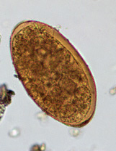
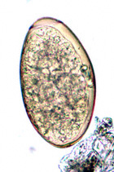
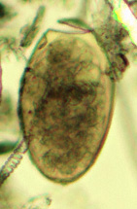
The eggs of F. hepatica can be difficult to distinguish from Fasciolopsis spp., although the abopercular end of the former often has a roughened or irregular area.

Slide 13
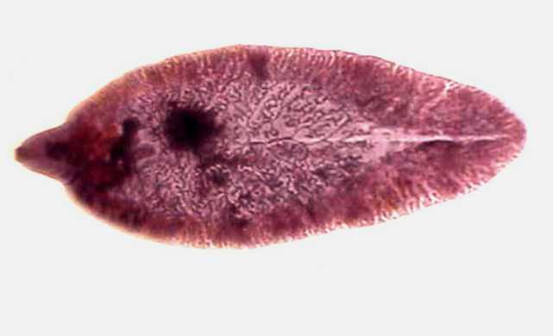
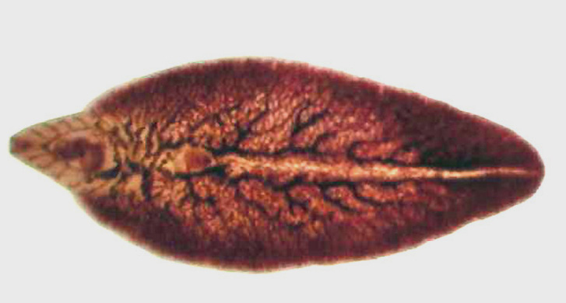
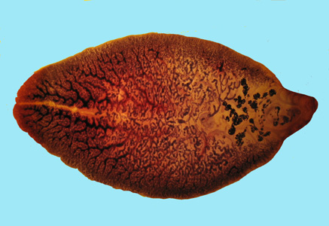
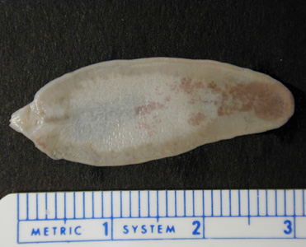
1 cm
Adults of Fasciola hepatica are large and broadly-flattened, measuring up to 30 mm long and 15 mm wide. The anterior end is cone-shaped, unlike the rounded anterior end of Fasciolopsis buski. Adults reside in the bile ducts of the liver in the definitive host.

Slide 15
Treatment:
Unlike infections with other flukes, Fasciola hepatica infections may not respond to praziquantel.
The drug of choice is triclabendazole with bithionol as an alternative.
Also rafoxanide

Slide 16
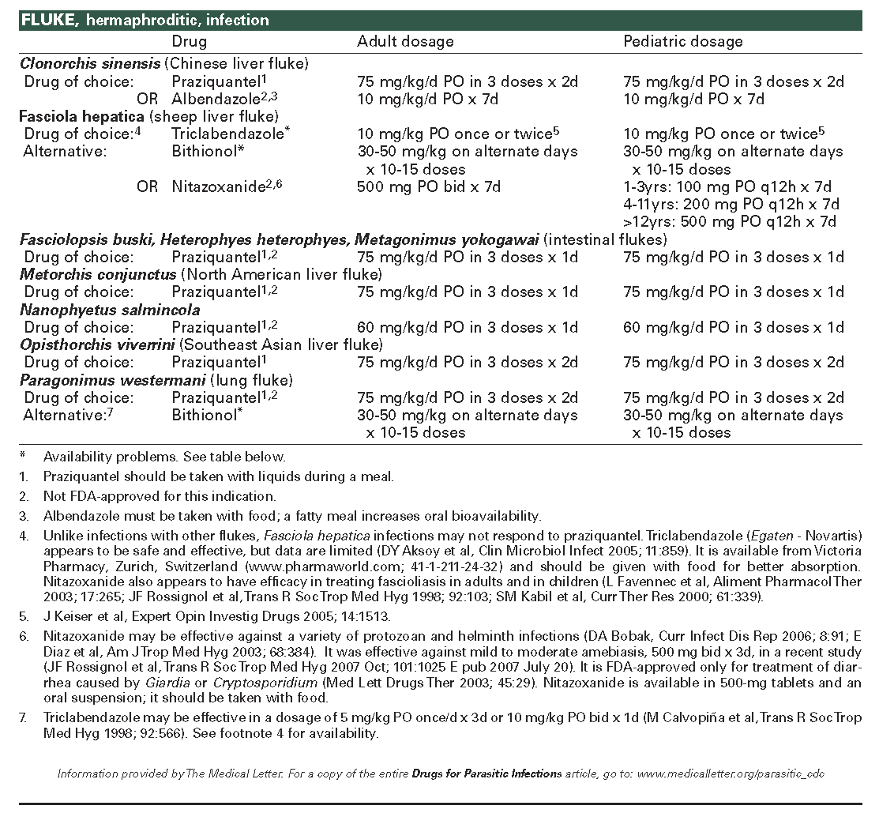

Slide 17
Fasciola busci
Causal Agent:
  The trematode Fasciolopsis buski, the largest intestinal fluke of humans.
  Cause fasciolepsis
  Definitive host: humans and pigs
  First intermediate hosts: aquatic snails.
  Second intermediate host: aquatic vegetation, including water chestnuts, water caltrope, lotus, and bamboo

Slide 18
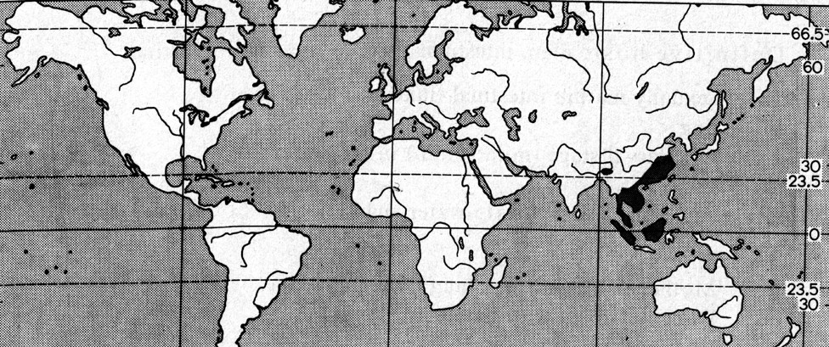
Geographic Distribution:
Asia and the Indian subcontinent, especially in areas where humans raise pigs and consume freshwater plants.

Slide 19
Morphology
The largest trematode in man
Anterior end is narrower than posterior end
Measures 20-75 mm * 8-20mm
No conical projection
The 2 intestinal cerca are not branched

Slide 20
Life Cycle
Immature eggs are discharged into the intestine and stool .
Eggs become embryonated in water , eggs release miracidia , which invade a suitable snail intermediate host .
In the snail the parasites undergo several developmental stages (sporocysts , rediae , and cercariae ).
The cercariae are released from the snail and encyst as metacercariae on aquatic plants .

Slide 21
The mammalian hosts become infected by ingesting metacercariae on the aquatic plants.
After ingestion, the metacercariae excyst in the duodenum and attach to the intestinal wall. There they develop into adult flukes (20 to 75 mm by 8 to 20 mm) in approximately 3 months, attached to the intestinal wall of the mammalian hosts (humans and pigs) .
The adults have a life span of about one year.

Slide 22
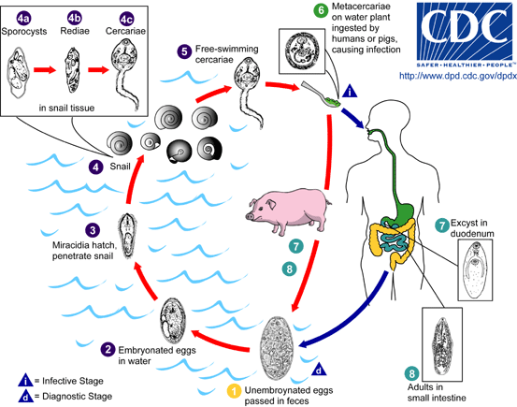

Slide 23
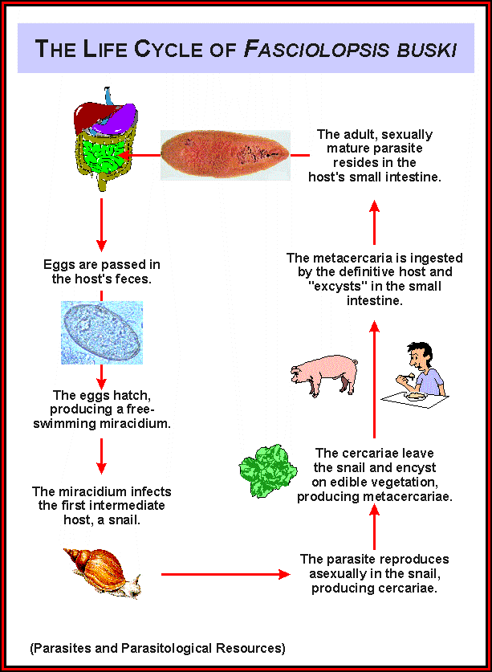

Slide 24
Fasciolopsis buski -Pathology
Blockage of food passage or interference with normal digestive processes
Destruction of intestinal tissue resulting in ulcers, hemorrhages, and abscesses formation
Chronic diarrhea
Verminous intoxication - result of absorption of parasite metabolites (waste products), can lead to death.

Slide 25
Clinical Features:
Most infections are light and asymptomatic.
In heavier infections, symptoms include diarrhea, abdominal pain, fever, ascites, anasarca and intestinal obstruction.

Slide 26
Laboratory Diagnosis:
Microscopic identification of eggs, or more rarely of the adult flukes, in the stool or vomitus is the basis of specific diagnosis. The eggs are indistinguishable from those of Fasciola hepatica.

Slide 27
The eggs of F. buski can be difficult to distinguish from Fasciola hepatica, although the abopercular end of the latter often has a roughened or irregular area.

Slide 28
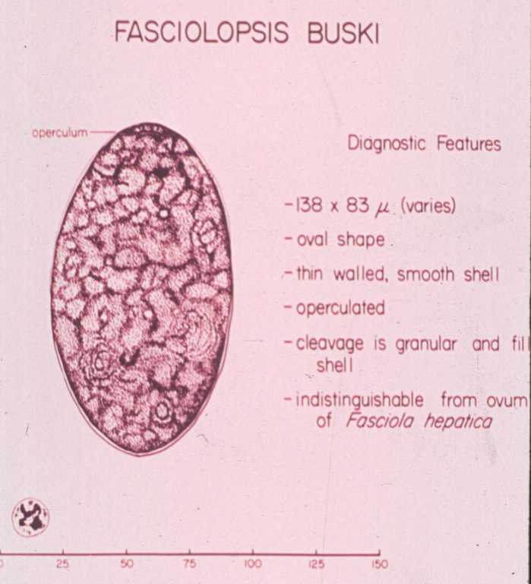

Slide 29
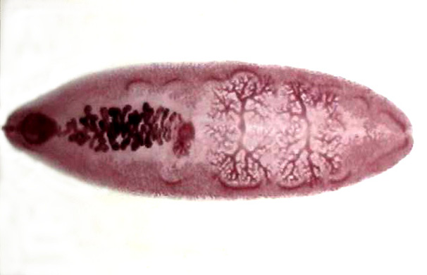

Slide 30
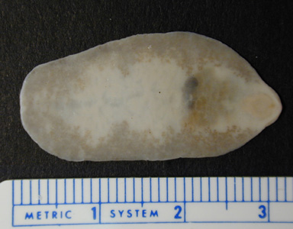
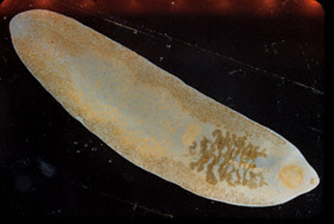
Adults of F. buski measure 20-75 mm long and have poorly-developed oral and ventral suckers. Adults reside in the intestine of the mammalian host.

Slide 31
Treatment
The treatment of patients, carriers and pigs
Praziquantel
Othereffective drugs include hexachloroparaxylol, bithionol(bitin).

Slide 32
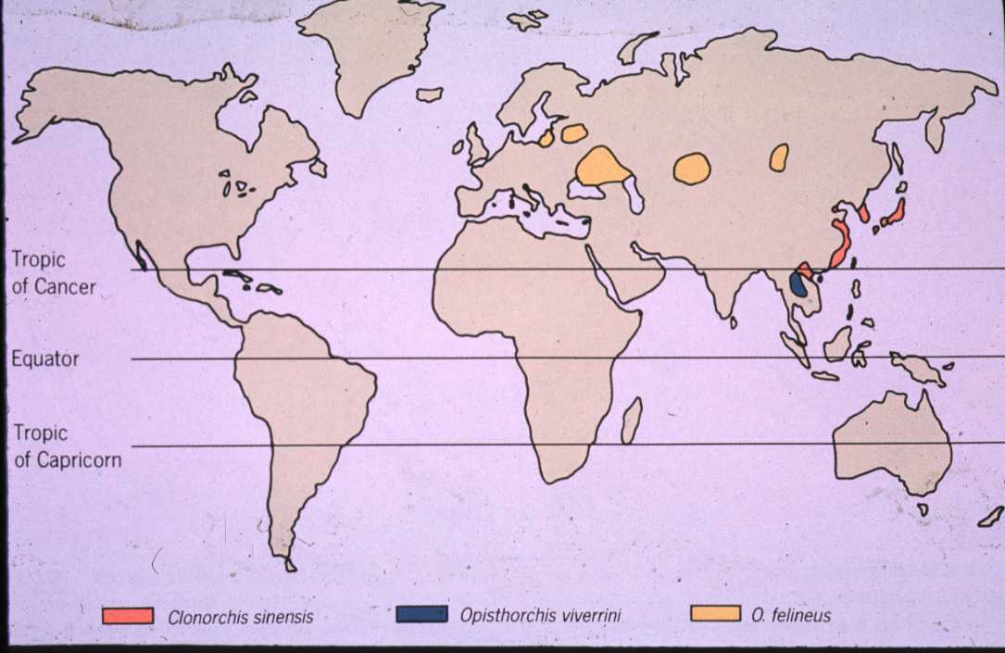
Opisthorchis sinensis:
Geographic Distribution

Slide 33
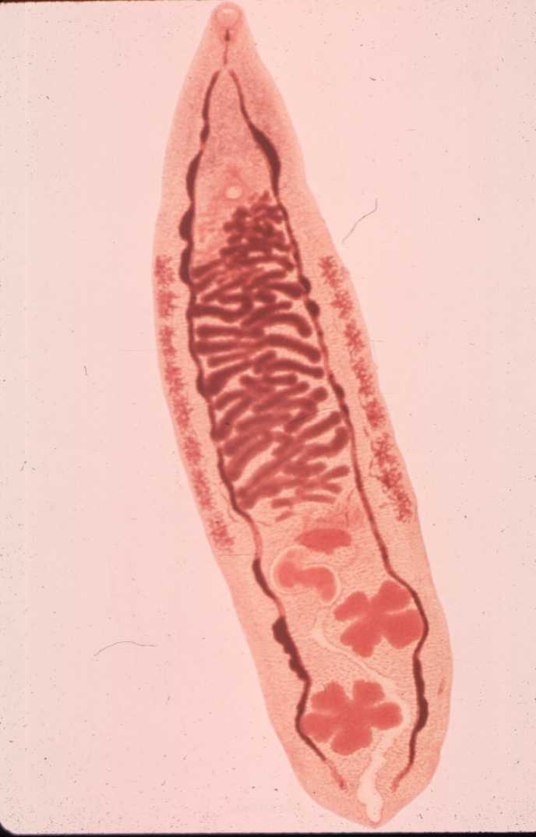
Opisthorchis sinensis:
Morphology
1 cm

Slide 34
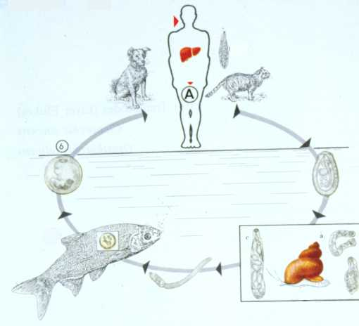
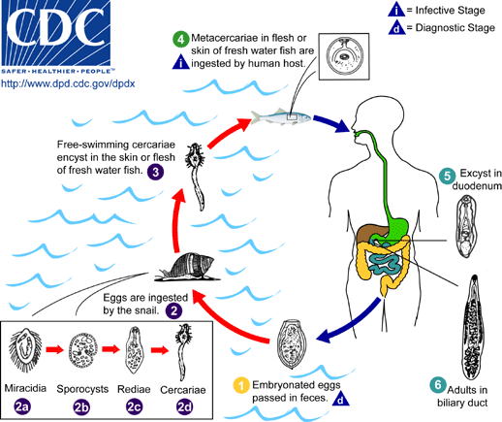
Opisthorchis sinensis:
Life Cycle

Slide 35
Opisthorchis sinensis: Symptoms
Epigastric pain
Indigestion
Liver necrosis and tenderness
Liver dysfunctions related to fluke burden
Diarrhea, hepatomegaly, jaundice and ascites in heavier infections

Slide 36
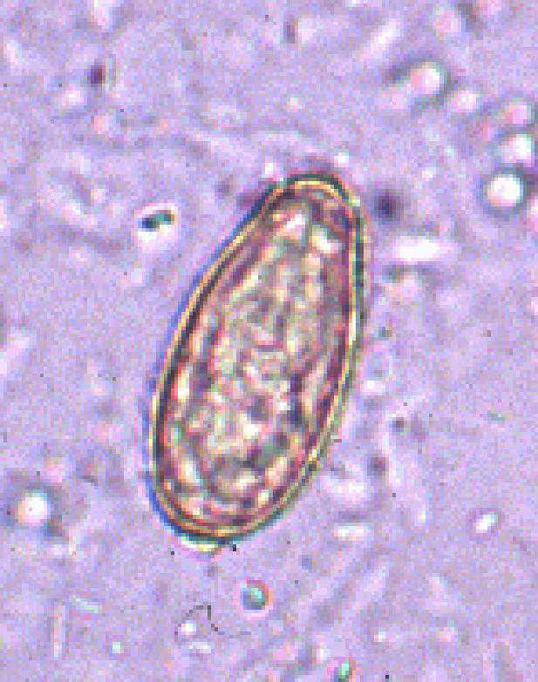
Opisthorchis sinensis: Diagnosis
Symptoms
History of eating improperly cooked fish in endemic areas
Eggs in the stool
30 μm

Slide 37
Opisthorchis sinensis:
Treatment and Control
Praziquantel is effective
Avoid eating improperly cooked fish in endemic areas
Sanitary disposal of sewage
Elimination of snails

