Slide 1
HETEROPHYES HETEROPHYES
KIMAIGA H.O
MBChB (University of Nairobi)

Slide 2
INTRODUCTION
The trematode Heterophyes heterophyes, a minute intestinal fluke.
Adults reside in the small intestine of the definitive host.

Slide 3
Geographic Distribution:
Egypt, the Middle East, and Far East.

Slide 4
Morphology
Adult
Elongated, small fluke measuring 1-2 mm in length by 0.3-0.4mm in breadth
Oral sucker is smaller than ventral sucker
A genital sucker, surrounding the genital pore is situated on the left posterior border
The tests are large and paired, and are situated near a small ovary.
The surface of the worm is covered with minute spines

Slide 5
Life cycle
Adults release embryonated eggs each with a fully-developed miracidium, and eggs are passed in the host's feces . After ingestion by a suitable snail (first intermediate host), the eggs hatch and release miracidia which penetrate the snail’s intestine . Genera Cerithidia and Pironella are important snail hosts in Asia and the Middle East respectively. The miracidia undergo several developmental stages in the snail, i.e. sporocysts , rediae , and cercariae . Many cercariae are produced from each redia. The cercariae are released from the snail and encyst as metacercariae in the tissues of a suitable fresh/brackish water fish (second intermediate host) . The definitive host becomes infected by ingesting undercooked or salted fish containing metacercariae . After ingestion, the metacercariae excyst, attach to the mucosa of the small intestine and mature into adults (measuring 1.0 to 1.7 mm by 0.3 to 0.4 mm) . In addition to humans, various fish-eating mammals (e.g., cats and dogs) and birds can be infected by Heterophyes heterophyes .

Slide 6
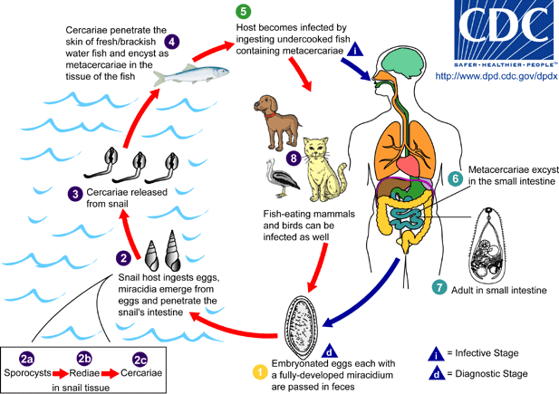

Slide 8
Clinical Features:
The main symptoms are diarrhea and colicky abdominal pain. Migration of the eggs to the heart, resulting in potentially fatal myocardial and valvular damage, has been reported from the Philippines. Migration to other organs (e.g., brain) has also been reported.

Slide 9
Laboratory Diagnosis:
The diagnosis is based on the microscopic identification of eggs in the stool. However, the eggs are indistinguishable from those of Metagonimus yokogawai and resemble those of Clonorchis and Opisthorchis.

Slide 10
Treatment
Praziquantel is the drug of choice.

