Slide 1
METAGONIMUS YOKOGAWAI
KIMAIGA H.O
MBChB (University of Nairobi)

Slide 2
INTRODUCITION
Metagonimus yokogawai, a minute intestinal fluke (and the smallest human fluke).
Adults reside in the small intestine of the definitive host.
Geographic Distribution:
  Mostly the Far East, as well as Siberia, Manchuria, the Balkan states, Israel, and Spain.

Slide 3
Morphology
Adult flukes
  Minute intestinal flukes (1-2.5 mm in length) that resemble Heterophyes heterophyes.
  However in M. yokogawai the ventral sucker (genitoacetabulum), is situated to the right of the mid-line and closely associated with the genital pore.
  No genital sucker

Slide 5
Life Cycle:
Adults release fully embryonated eggs each with a fully-developed miracidium, and eggs are passed in the host’s feces . After ingestion by a suitable snail (first intermediate host), the eggs hatch and release miracidia which penetrate the snail’s intestine . Snails of the genus Semisulcospira are the most frequent intermediate host for Metagonimus yokogawai. The miracidia undergo several developmental stages in the snail, i.e. sporocysts , rediae , and cercariae .

Slide 6
Many cercariae are produced from each redia. The cercariae are released from the snail and encyst as metacercariae in the tissues of a suitable fresh/brackish water fish (second intermediate host) . The definitive host becomes infected by ingesting undercooked or salted fish containing metacercariae . After ingestion, the metacercariae excyst, attach to the mucosa of the small intestine and mature into adults (measuring 1.0 mm to 2.5 mm by 0.4 mm to 0.75 mm) . In addition to humans, fish-eating mammals (e.g., cats and dogs) and birds can also be infected by M. yokogawai .

Slide 7
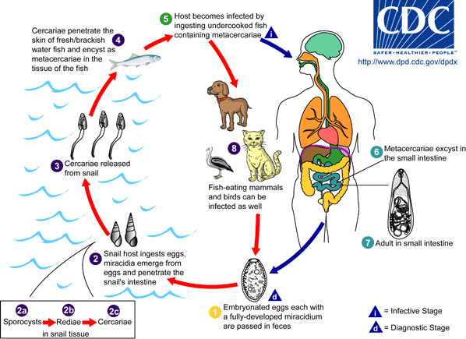

Slide 8
Clinical Features:
The main symptoms are diarrhea and colicky abdominal pain. Migration of the eggs to extraintestinal sites (heart, brain) can occur, with resulting symptoms.

Slide 9
Laboratory Diagnosis:
The diagnosis is based on the microscopic identification of eggs in the stool. However, the eggs are indistinguishable from those of Heterophyes heterophyes and resemble those of Clonorchis and Opisthorchis. Specific diagnosis is based on identification of the adult fluke evacuated after antihelminthic therapy, or found at autopsy.

Slide 10
Treatment:
Praziquantel* is the drug of choice.

