Slide 1
PARAGONIMUS WESTERMANI
KIMAIGA H.O
MBChB (University of Nairobi)

Slide 2
INTRODUCTION
Causal Agent:
More than 30 species of trematodes (flukes) of the genus Paragonimus have been reported which infect animals and humans. Among the more than 10 species reported to infect humans, the most common is P. westermani, the oriental lung fluke.

Slide 3
Geographic Distribution
Paragonimus spp. are distributed throughout the Americas, Africa and southeast Asia. Paragonimus westermani is distributed in southeast Asia and Japan. Paragonimus kellicotti is endemic to North America.

Slide 4
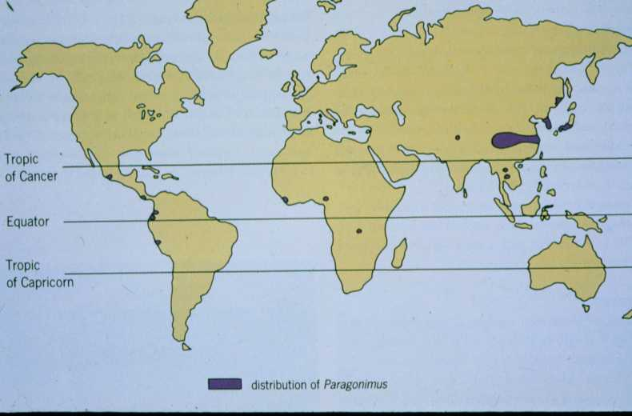

Slide 5
Morphology
Adults
Large, robust, ovoid flukes.
It is thick, fleshy, oval & reddish-brown in color with integument covered with spines
They are hermaphroditic, with a lobed ovary located anterior to two branching testes.
Like all members of the Trematoda, they possess oral and ventral suckers.
Its anterior end is slightly broader than the posterior end. It measures up to 16mm in length by 8 mm in thickness
The 2 intestinal area are unbranched and extend to caudal region.

Slide 6
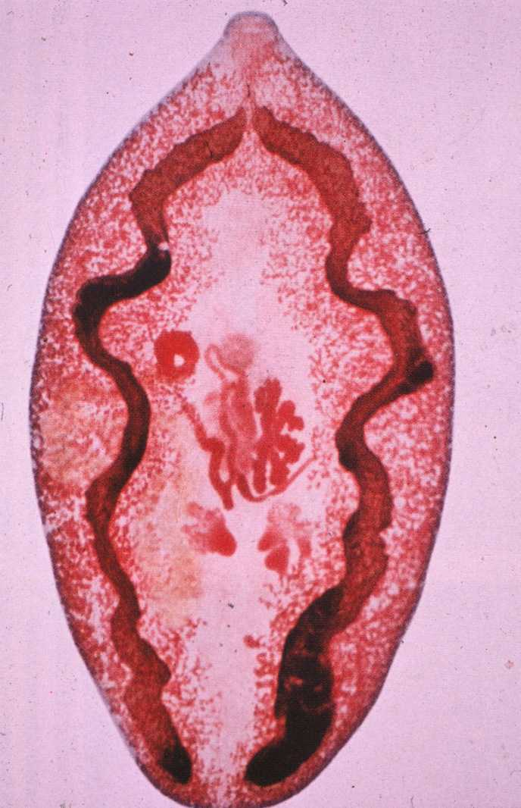
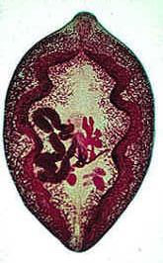

Slide 8
Paragonimus westermani eggs range from 80 to 120 µm long by 45 to 70 µm wide.
They are yellow-brown, ovoid or elongate, with a thick shell, and often asymmetrical with one end slightly flattened. At the large end, the operculum is clearly visible. The opposite (abopercular) end is thickened. The eggs are unembryonated when passed in sputum or feces.

Slide 9
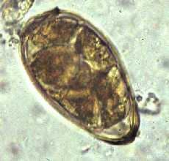
50 μm

Slide 10
Life Cycle:
The eggs are excreted unembryonated in the sputum, or alternately they are swallowed and passed with stool . In the external environment, the eggs become embryonated , and miracidia hatch and seek the first intermediate host, a snail, and penetrate its soft tissues . Miracidia go through several developmental stages inside the snail : sporocysts , rediae , with the latter giving rise to many cercariae , which emerge from the snail. The cercariae invade the second intermediate host, a crustacean such as a crab or crayfish, where they encyst and become metacercariae. This is the infective stage for the mammalian host . Human infection with P. westermani occurs by eating inadequately cooked or pickled crab or crayfish that harbor metacercariae of the parasite .

Slide 11
The metacercariae excyst in the duodenum , penetrate through the intestinal wall into the peritoneal cavity, then through the abdominal wall and diaphragm into the lungs, where they become encapsulated and develop into adults (7.5 to 12 mm by 4 to 6 mm). The worms can also reach other organs and tissues, such as the brain and striated muscles, respectively. However, when this takes place completion of the life cycles is not achieved, because the eggs laid cannot exit these sites. Time from infection to oviposition is 65 to 90 days.
Infections may persist for 20 years in humans. Animals such as pigs, dogs, and a variety of feline species can also harbor P. westermani.

Slide 12
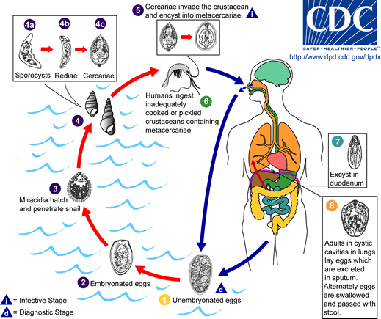

Slide 13
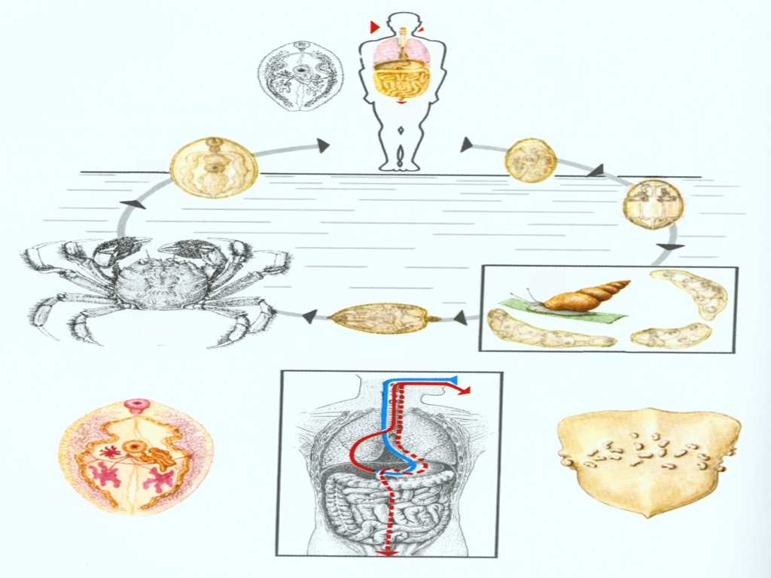

Slide 14
Clinical Features:
The acute phase (invasion and migration) may be marked by diarrhea, abdominal pain, fever, cough, urticaria, hepatosplenomegaly, pulmonary abnormalities, and eosinophilia.
During the chronic phase, pulmonary manifestations include dry cough, pleurisy, expectoration of discolored sputum, blood-stained rusty brown sputum, hemoptysis, and chest radiographic abnormalities.
Extrapulmonary locations of the adult worms result in more severe manifestations, especially when the brain is involved. Fluke may migrate to brain, produce eggs and cause epilepsy-like symptoms

Slide 15
Laboratory Diagnosis
History of eating improperly cooked crab-meat in endemic areas
Diagnosis is based on microscopic demonstration of eggs in stool or sputum, but these are not present until 2 to 3 months after infection. (Eggs are also occasionally encountered in effusion fluid or biopsy material.) Concentration techniques may be necessary in patients with light infections. Biopsy may allow diagnostic confirmation and species identification when an adult or developing fluke is recovered
Antibody detection is useful in light infections and in the diagnosis of extrapulmonary paragonimiasis.

Slide 16
Treatment:
Praziquantelis the drug of choice to treat paragonimiasis.
Bithionol is an alternative drug for treatment of this disease.

