Slide 1
PROTOZOA
KIMAIGA H.O
MBChB (University of Nairobi)

Slide 2
Introduction
Main human parasites
pathogenic and non pathogenic

Slide 3
Classification of protozoas (zoological classification)
Sarcomastigophora phylum - unicellular (nucleus, cytoplasm and memb)
amoeboid shape e.g sarcodina sub-phylla – amoeba
some are flagellated e.g mastigophora sub-phylla – trypanosomes (blood), Giardia (GIT)
Cidophora phylum – has cilia, cause infections in the GIT but found to be infected immunosuppressed people.
Balatidium coli

Slide 4
Sporozoa – no flagella, no cilia = no movement capacity
malaria parasites – P. falciparum, P. vivax, P. ovale, P. malariae
Apicomplexia – all animals; species known to infect man have a structure called apico-complex that enable then to attach to RBCs ; also infections in the immunocompromised e.g toxoplasma gondi, isospori (one of the leading causes of infections in the immunocompressed

Slide 29
Introduction to Parasitic Protozoa
Not classified under Kingdom Animalia but under Kingdom Protista
Main feature is they are unicellular eukaryotes
First described some 300 + years ago by Leeuwenhoek when he described Giardia from his own intestine.

Slide 30
Classification
See Classification beginning on page 49
Subject to much variation
Four major types of organisms I will discuss
Flagellated protozoa - Mastigophora
Amoeba - Sarcodina
Ciliated protozoa - Ciliophora
Apicomplexa (sporozoans)

Slide 31
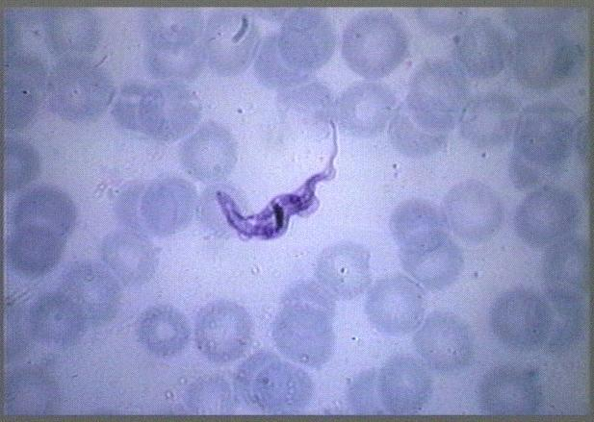
Organelles of Locomotion of Mastigophorans
Flagella

Slide 32
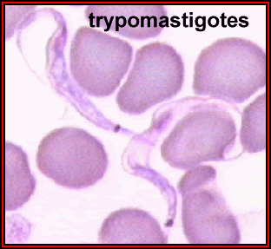
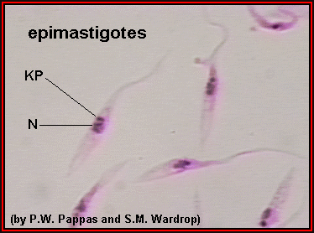
Organelles of Locomotion of Mastigophorans
Flagella

Slide 33
Types of Nutrition
Autotrophic = Holophytic or photosynthetic
Zooxanthellae which are found in many Cnidaria and other invertebrates are the best examples of these symbiots.
Heterotrophic
Holozoic nutrition
Saprozoic nutrition

Slide 34
Reproduction in the Protozoa
Asexual reproduction
Binary fission
Multiple fission, merogony or schizogony (also sporogony)
Budding

Slide 35
Reproduction in the Protozoa
Sexual reproduction
Gametogony
Syngamy
Isogametes
Anisogametes Macrogametes - Microgametes -
Conjugation

Slide 36
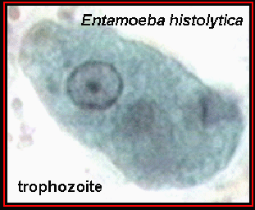
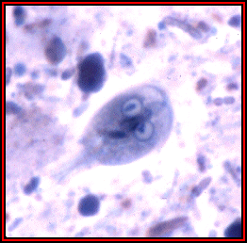
Trophozoite or Vegetative Stage
Entamoeba Giardia lamblia

Slide 37
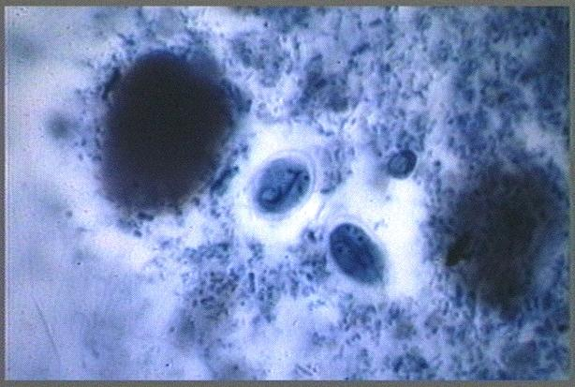
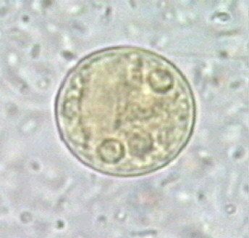
Encystment
Entamoeba Giardia lamblia

Slide 38
Protozoa Overview
Belong to Kingdom Protista
Unicellular
Eukaryotic
Some very important parasites

