Slide 1
AMOEBAE
KIMAIGA H.O
MBChB (University of Nairobi)

Slide 2
Amoeba is a unicellular anaerobic intestinal parasite belonging to kingdom Protozoa and genus Entamoeba
Several Entamoeba colonize humans, but not all of them are associated with disease.
Entamoeba histolytica is well recognized as a pathogenic ameba, associated with intestinal and extraintestinal infections.
The other species are important because they may be confused with E. histolytica in diagnostic investigations.

Slide 3
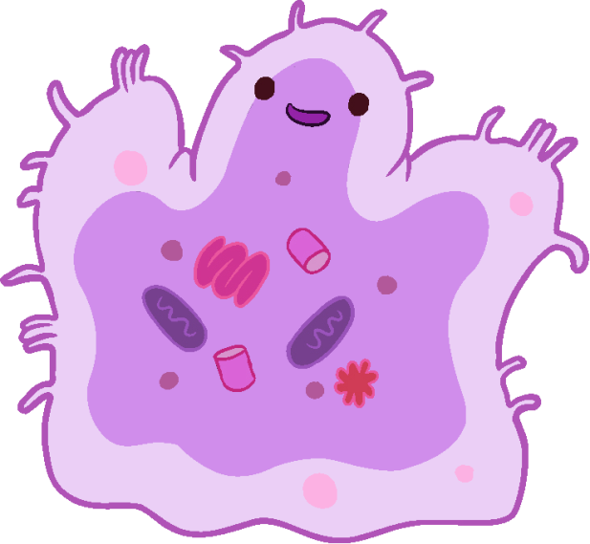
Entamoeba coli
Entamoeba histolytica
Entamoeba hartmanni
Entamoeba polecki
Entamoeba dispar
Other species Include
Endolimax nana
Iodamoeba butschii

Slide 4
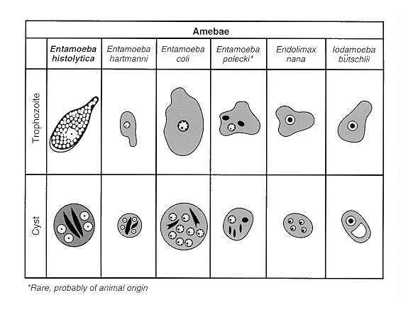

Slide 5
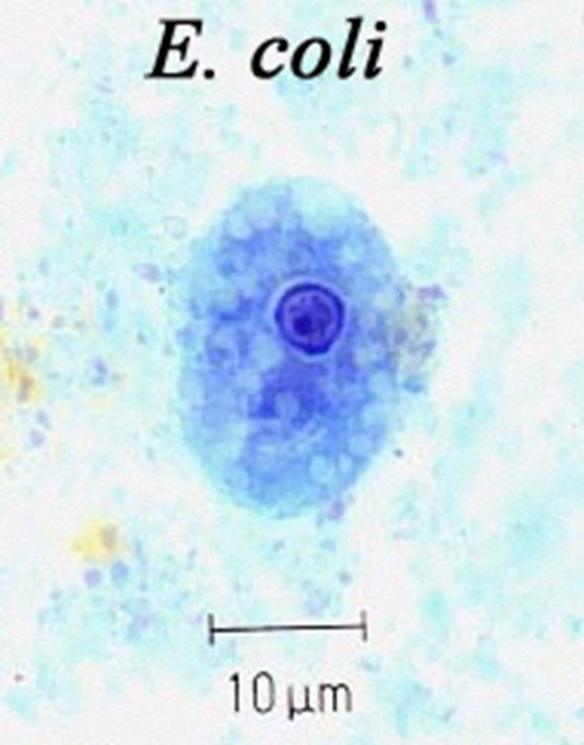
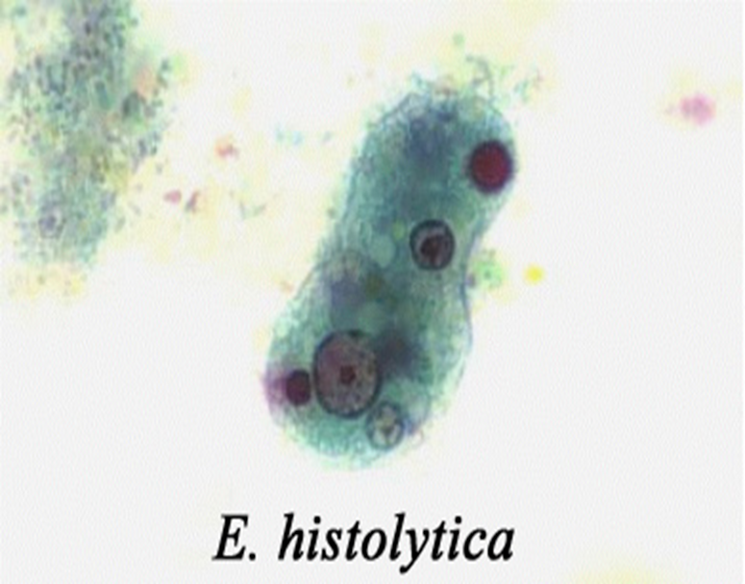

Slide 6
ENTAMOEBA HISTOLITICA- Introduction
A protozoa using pseudopodia for motility
Lives in Large intestine
Worldwide distribution
Poor sanitation
Causes amoebiasis

Slide 7
Geographic Distribution
Worldwide distribution
Higher incidence of amebiasis in developing countries.
In industrialized countries, risk groups include male homosexuals, travelers and recent immigrants, and institutionalized populations.

Slide 8
Epidemiology
Found in poorly sanitized areas-Neglected Tropical Disease. erg Mexico, Central, West and South America, South Asia, Western and Southern Africa.
About 50,000,000 new cases are reported yearly
Causes nearly 40-100,000 deaths yearly worldwide.
90% of infected individuals are asymptomatic. Symptoms 2-4wks to manifest

Slide 9
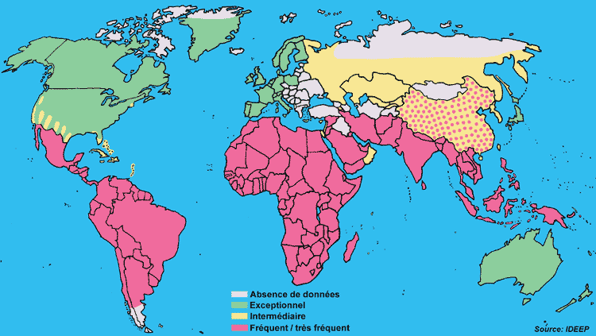

Slide 10
Morphology
Trophozites - Measure 10-40 µm and elongated in diarrheal stool, Single nucleus with central karyosome, which have a uniformly distributed peripheral chromatin. cytoplasm has 2 zones(endoplasm-granular with food vacuoles)
Cysts- 10-15 µm, 4 nuclei that have centrally located karyosomes (mature cyst) and 1-2 chromatin bodies (thick and blunt and peripheral)
If they are more than 4 nuclei it’s a different entamoeba.
Erythrophagocytosis (ingestion of red blood cells by the parasite) is the only morphologic characteristic that can be used to differentiate E. histolytica from the nonpathogenic E. dispar.

Slide 11
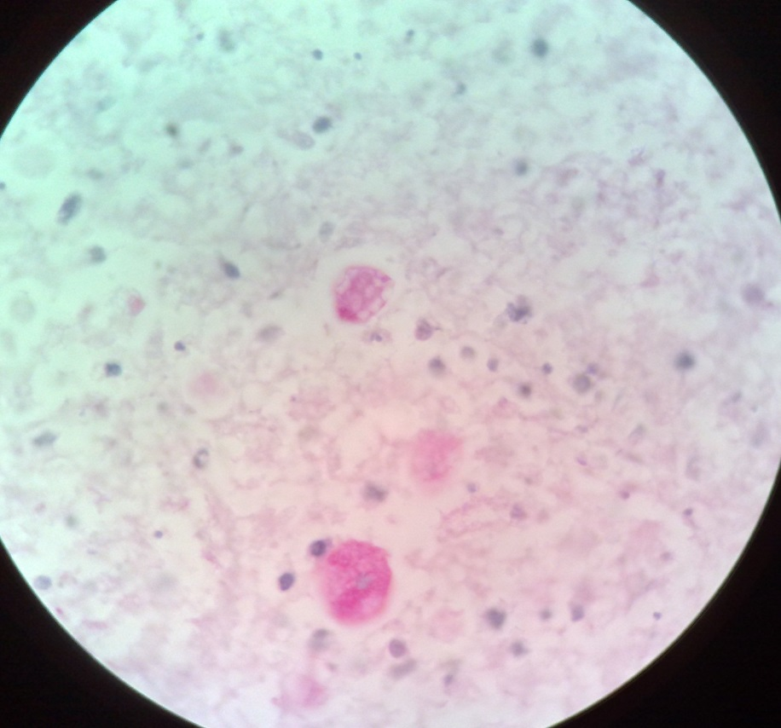
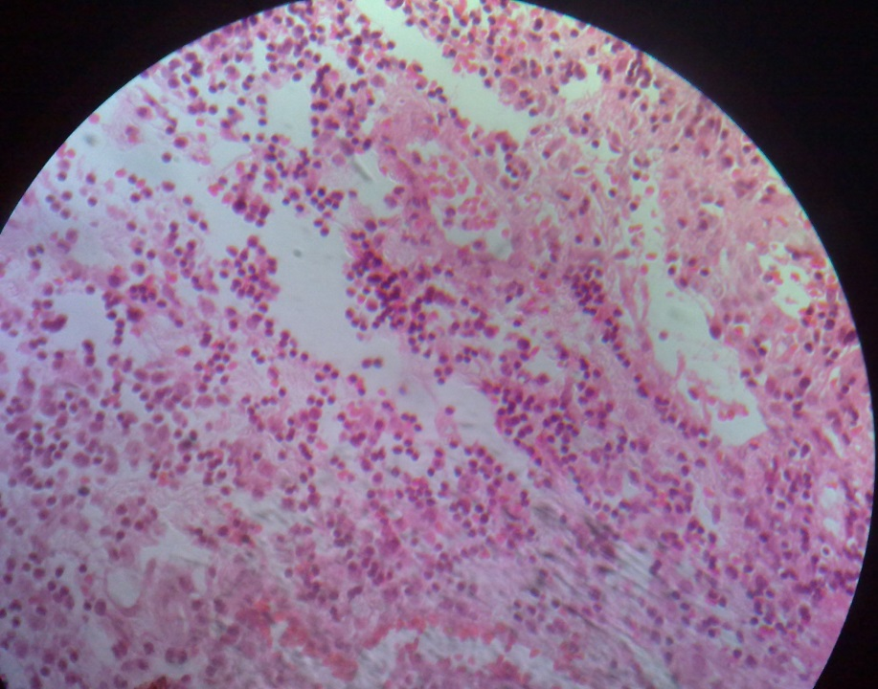
Tzoite E. Histolytica in tissue

Slide 12
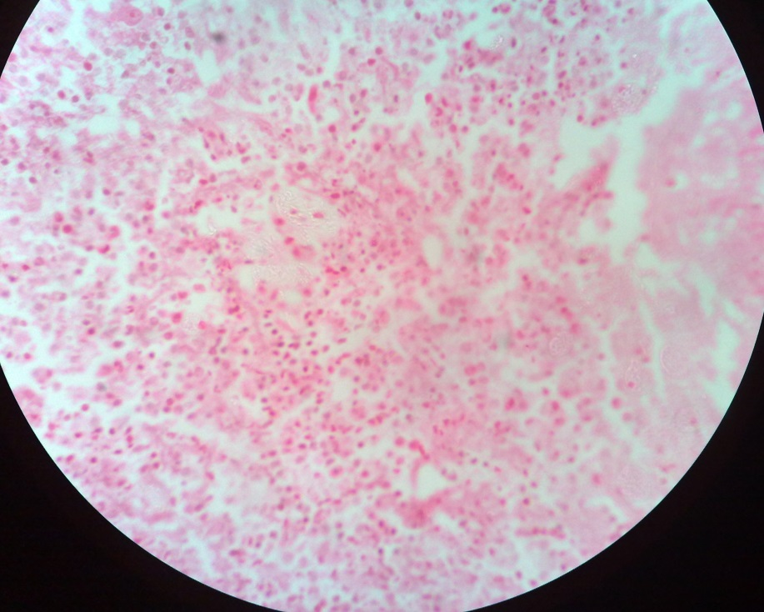
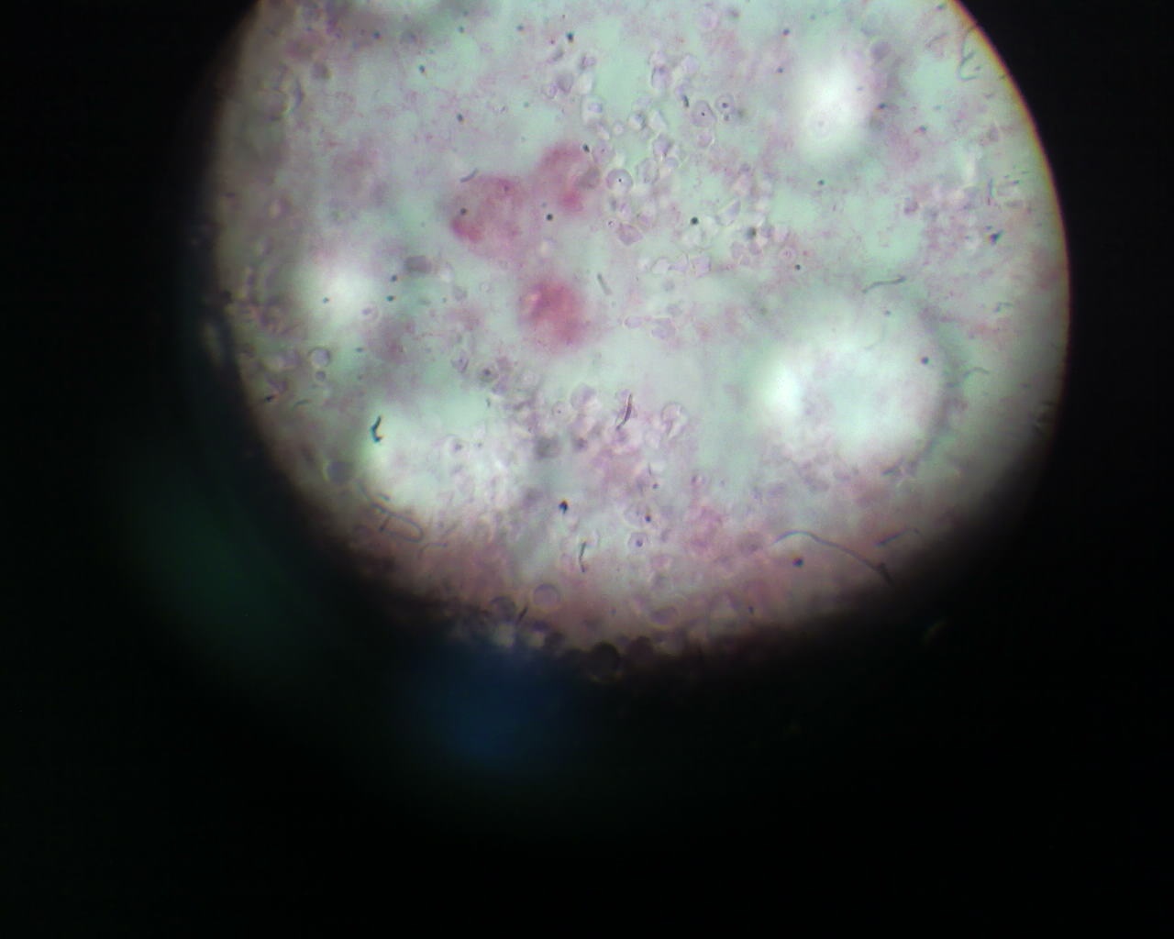
Trophozoites E.histolytica

Slide 14
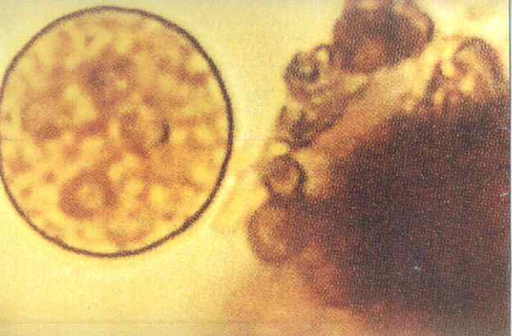
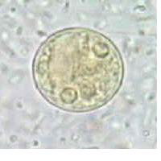

Slide 18
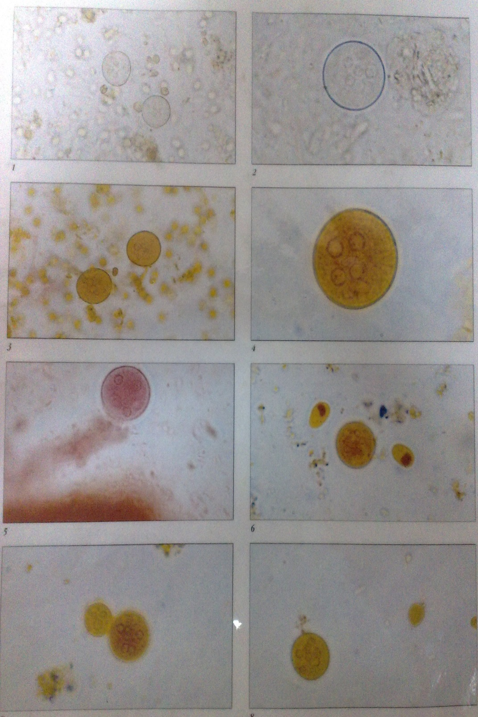
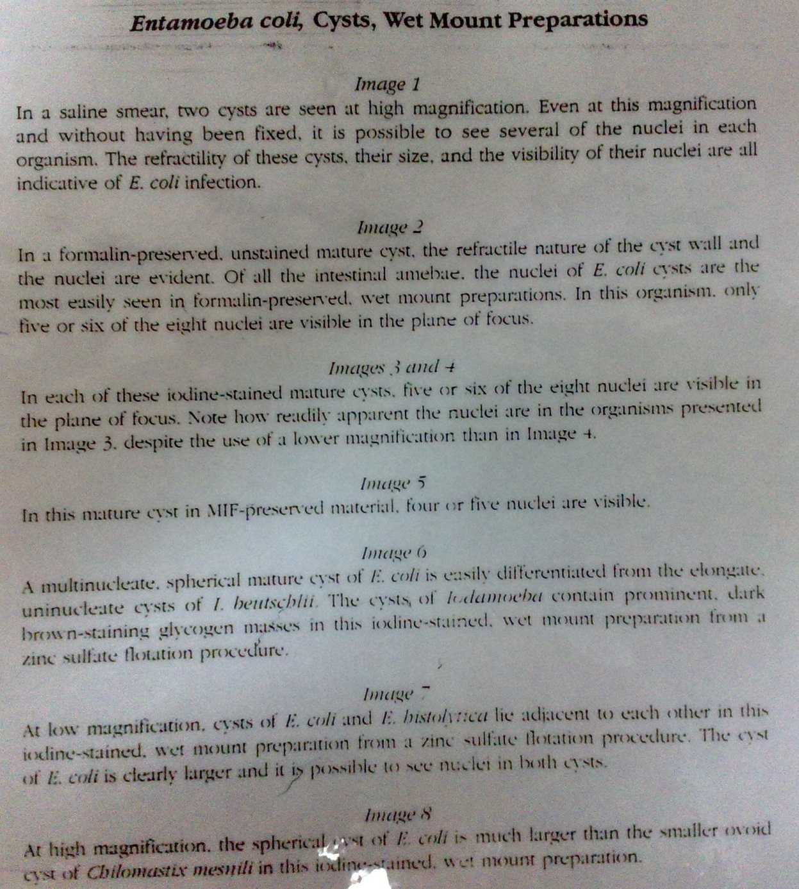

Slide 19
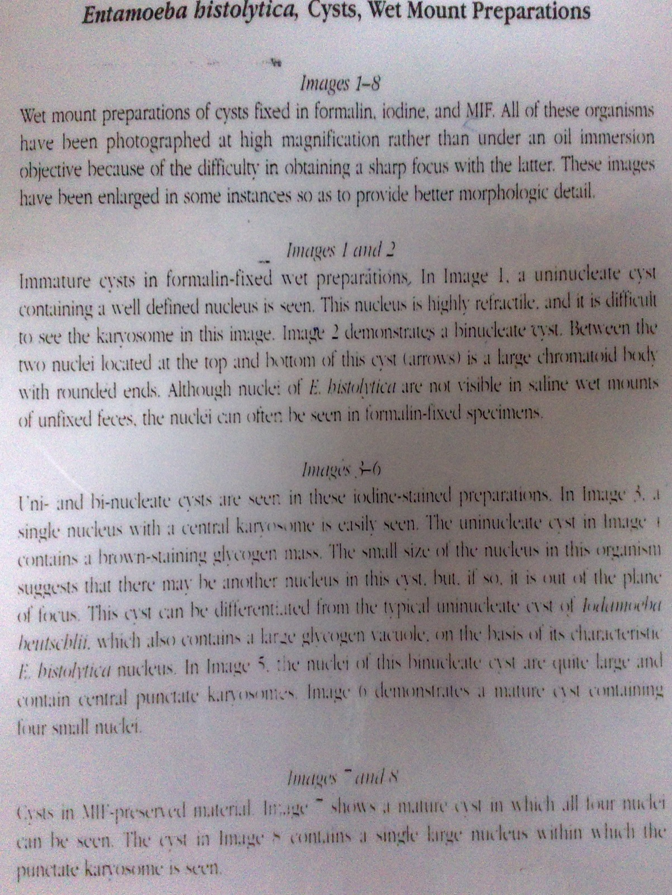
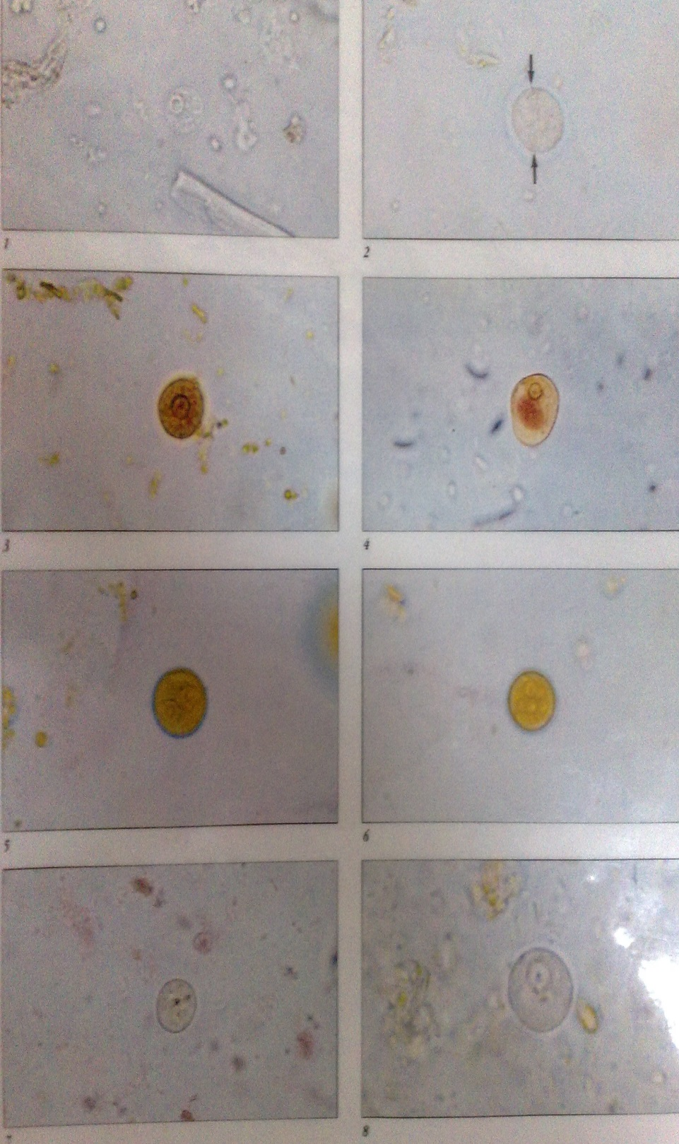

Slide 20
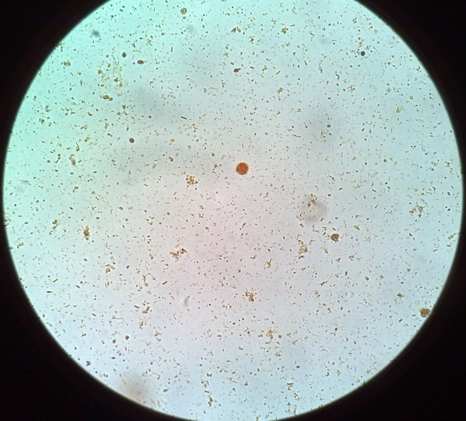
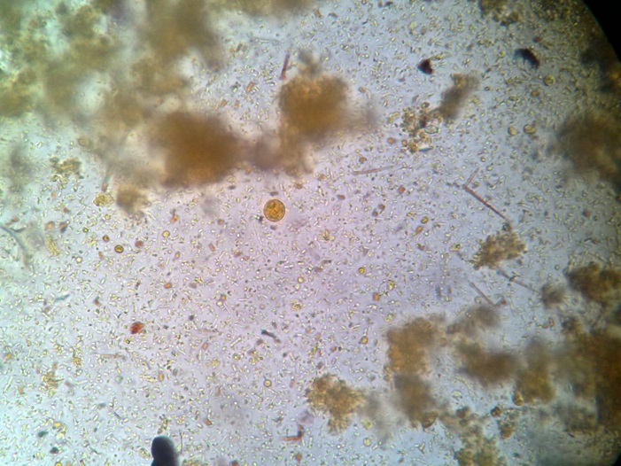
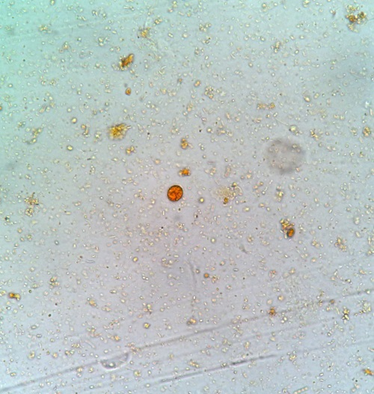
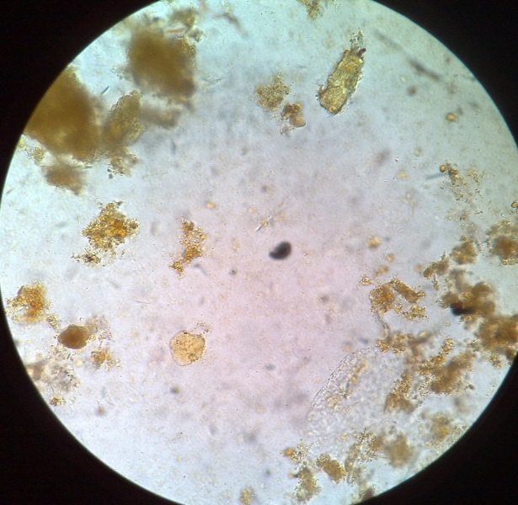
Cyst E. Histolytica
E.histolytica & G.lamblia

Slide 21
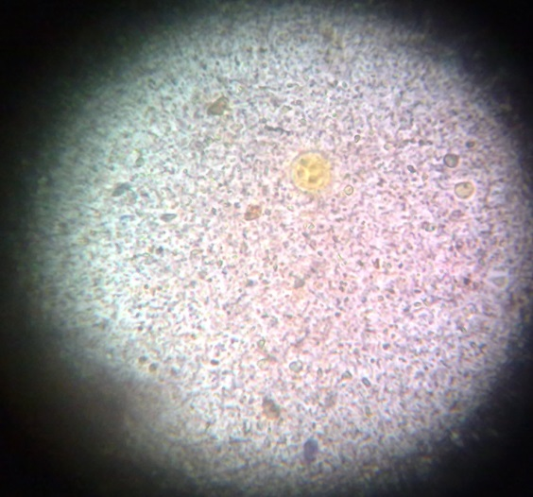
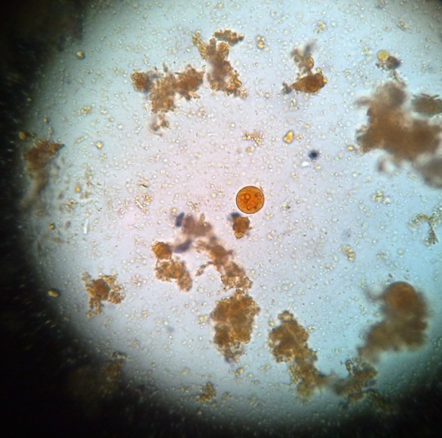
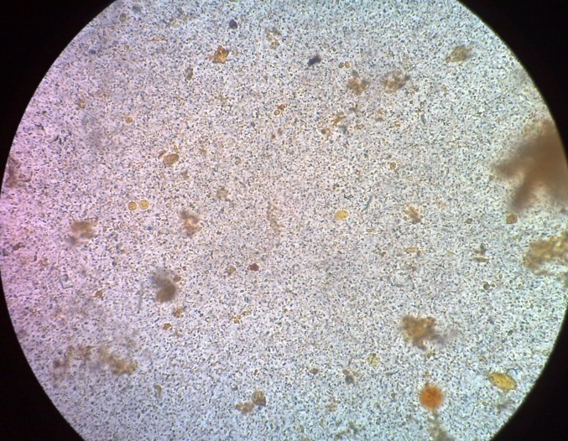
Cyst of E. Coli
Cysts E.Coli & E.Nana

Slide 22
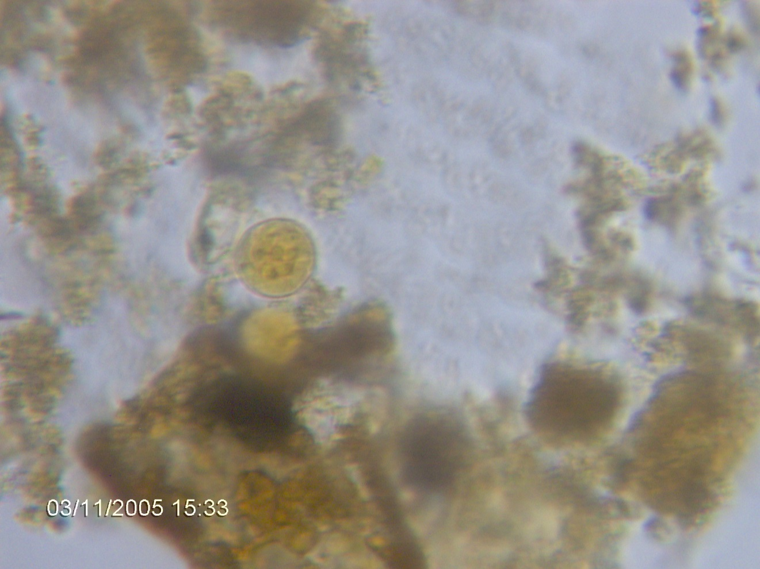
E histolytica cyst-nucleolus visible with chromatin edge

Slide 25
LIFE CYCLE
Cysts and trophozoites are passed in feces. - Cysts are typically found in formed stool and further down colon due to less favourable conditions as faecal materials gets drier. Trophozoites are in crypts of LI (caecum and 1st part of colon) hence typically found in diarrheal stool.
Infection by Entamoeba histolytica occurs by ingestion of mature cysts in fecally contaminated food, water, hands and oral-anal sex
Healthy cyst carriers can transmit infxn in the food industry.
Excystation occurs in the small intestine
Trophozoites are released, and migrate to excyst in caecum and lower part of colon
The trophozoites multiply by binary fission and produce cysts , and both stages are passed in the feces .

Slide 26
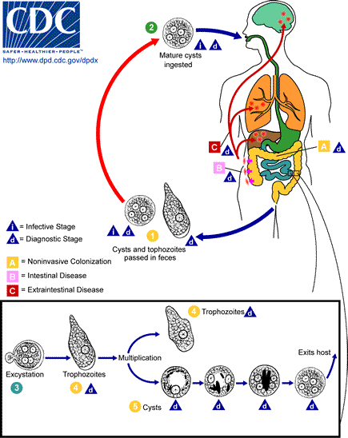

Slide 27
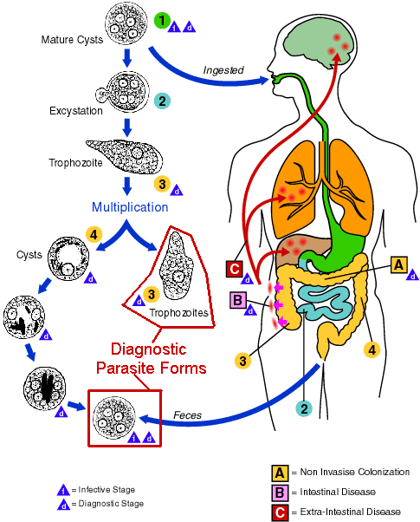

Slide 28
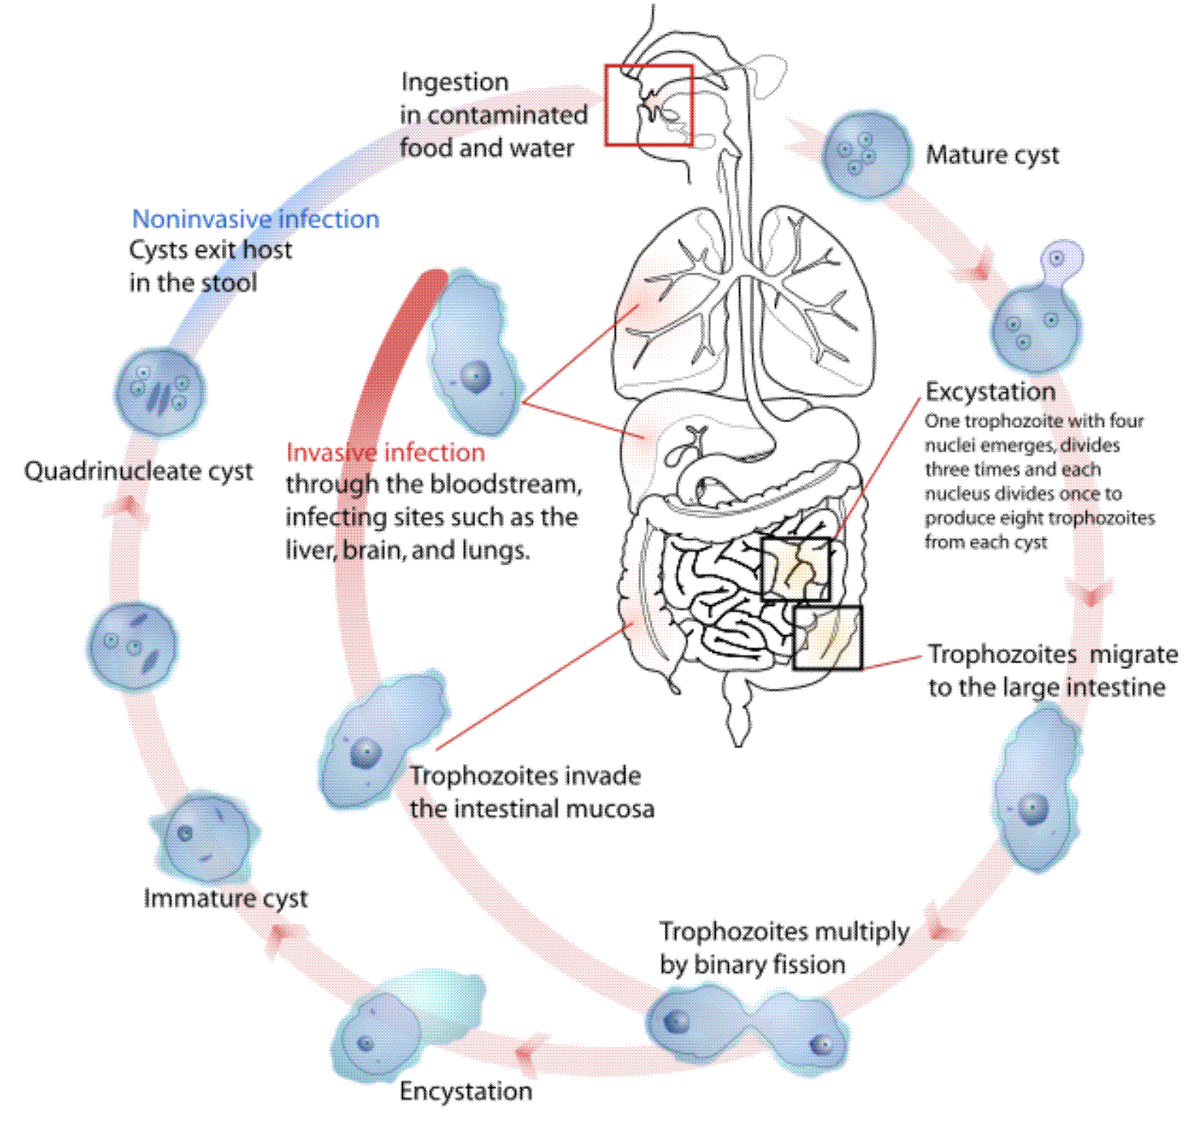
t

Slide 29
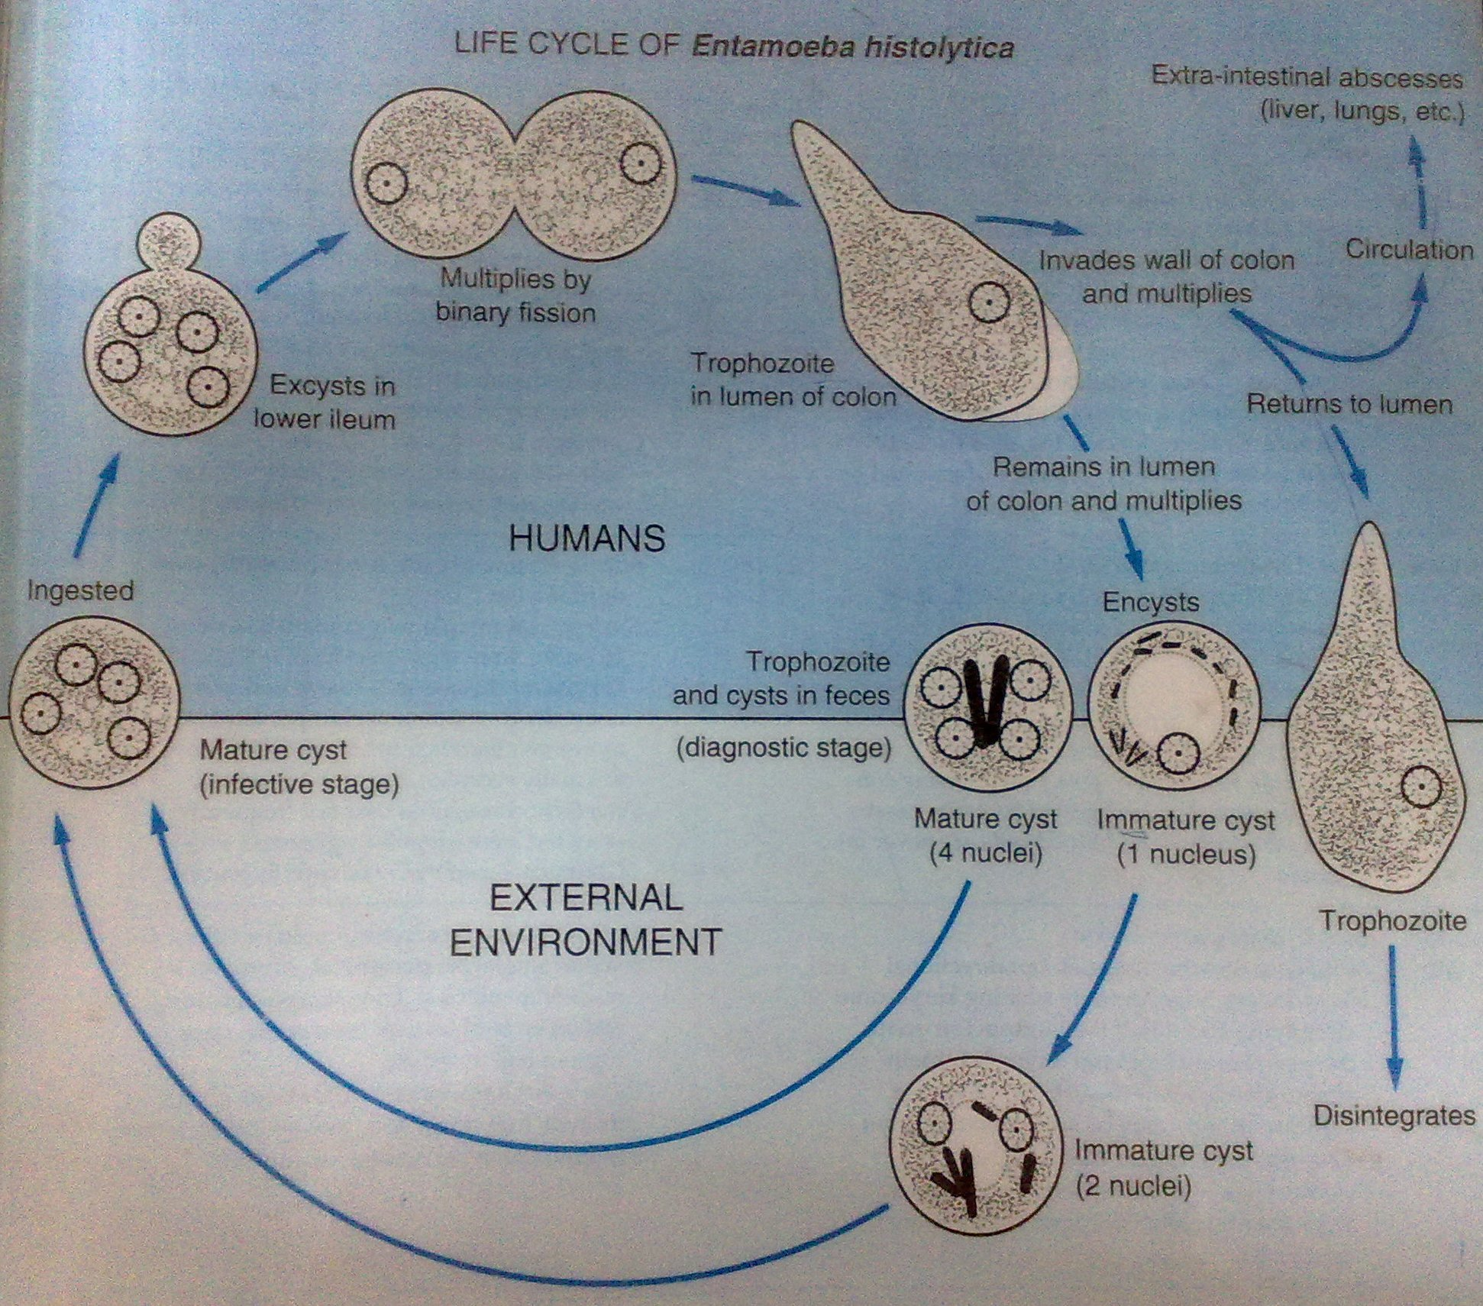

Slide 30
Only cysts can survive in the external environment because of the protection conferred by their walls and are responsible for transmission.
Trophozoites passed in the stool are rapidly destroyed once outside the body, and if ingested are destroyed by gastric acids.
Trophozoites usually remain confined to the intestinal lumen ( : noninvasive infection) of individuals who are asymptomatic carriers, passing cysts in their stool.- E. dispar.
They may also invade the intestinal mucosa (intestinal disease), or, through the bloodstream, extraintestinal sites such as the liver, brain, and lungs (extraintestinal disease), with resultant pathologic manifestations.- E. histolytica
Transmission can also occur through exposure to fecal matter during sexual contact (both cysts and trophozoites are infective in this case).

Slide 31
Clinical presentation
Varied from asymptomatic infection ("luminal amebiasis"), cyst passers
Symptoms can start 2 or more weeks after infection.
At onset abdominal discomfort, diarrhoea, abdominal pain over caecum simulating appendicitis or transverse colon simulating peptic ulcer, tenesmus
Later dysentery- but patient not toxic, febrile (dd. Bacterial dysentery)

Slide 32
Complications
Due to invasive intestinal amebiasis (dysentery, colitis, appendicitis, toxic megacolon, amebomas) may have intestinal perforation of ulcer, haemorrhage (eruption of blood vessel by ulcer in colon) fulminating necrotinizing amoebic colitis- whole colon full of ulcers, patients ill, toxic, fever, dehydrated muscle cramps due to electrolyte imbalance, death: intestinal obstruction, intussusception by amoeboma, colon stricture, extensive ulceration of skin around anus or stoma of colostomy
Due to to invasive extraintestinal amebiasis - Travel in the bloodstream and get to the liver and cause Amoebic liver abscess (anchovy sauce appearance of aspirate), single or multiple, usually right lobe,-rupture pleural space(pleura effusion) pericardium (amoebic pericarditis) lung (lung abscess), peritoneum (amoebic peritonitis), pleuropulmonary abscess, cutaneous and genital amebic lesions,
Systemic spread- brain, spleen, muscle.
Entameoba histolytica: disease caused, action EntAmoeba causes Amoebic dysEntery.
Action: histo (cell) lytic (burst), so it bursts cells

Slide 33
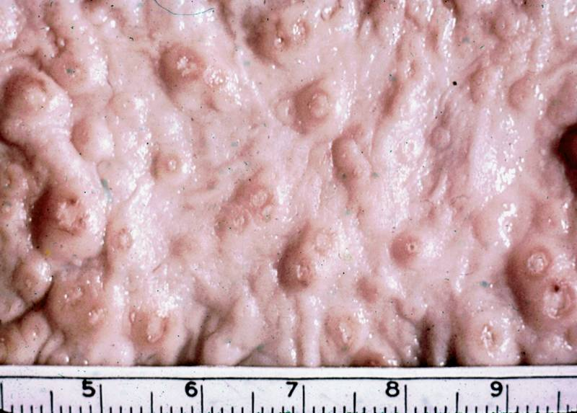
ulcers with raised borders
little inflammation between lesions

Slide 34
Signs and Symptoms
Intestinal Amebiasis:-
Dysentery
Bloody diarrhoea
Weight loss
Fatigue
Abdominal cramps
Abdominal pain
Intestinal lesions
Extra intestinal Amebiasis:-
Liver abscess, Fever, Tenderness at the upper right quadrant of the abdomen.- In Liver Amebiasis
Cerebral lesions in Cerebral Amebiasis. Fatal
Pulmonary abscesses
Haemaptysis and purulent sputum
Cough
Dyspnea
Pulmonary Amebiasis

Slide 35
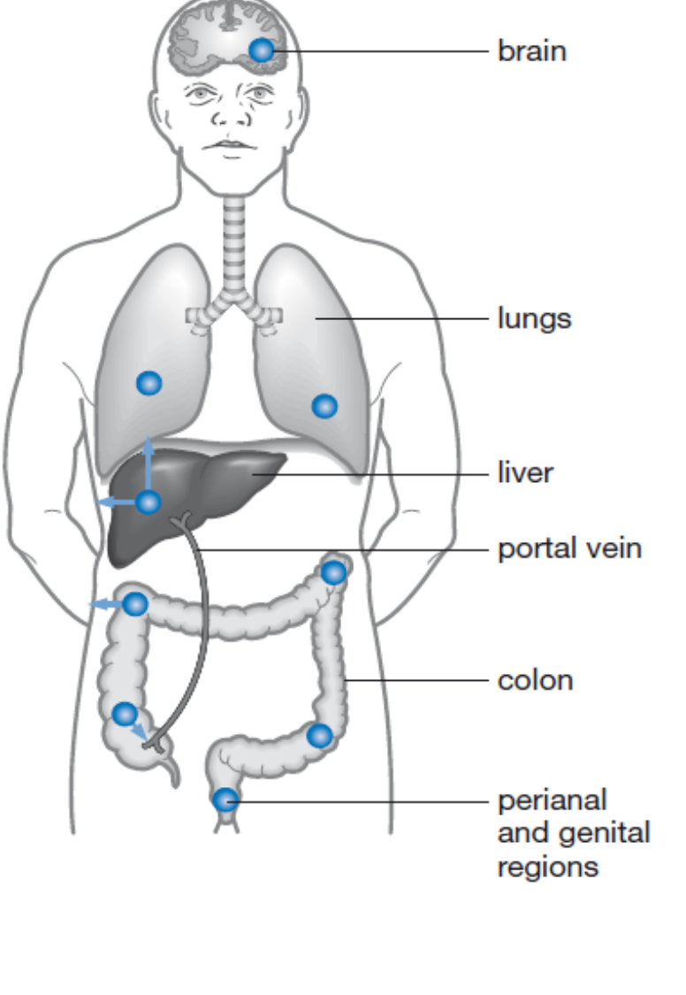
Extraintestinal Infection

Slide 36
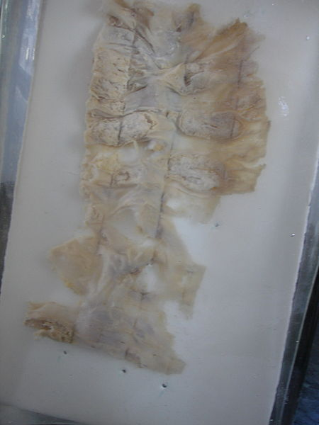
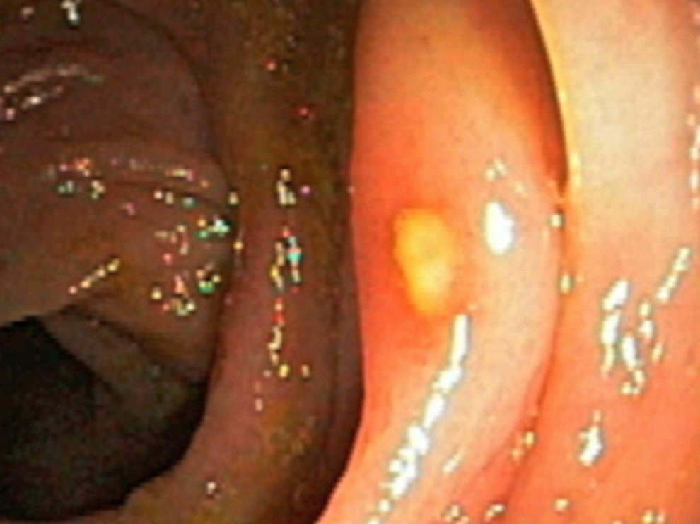

Slide 37
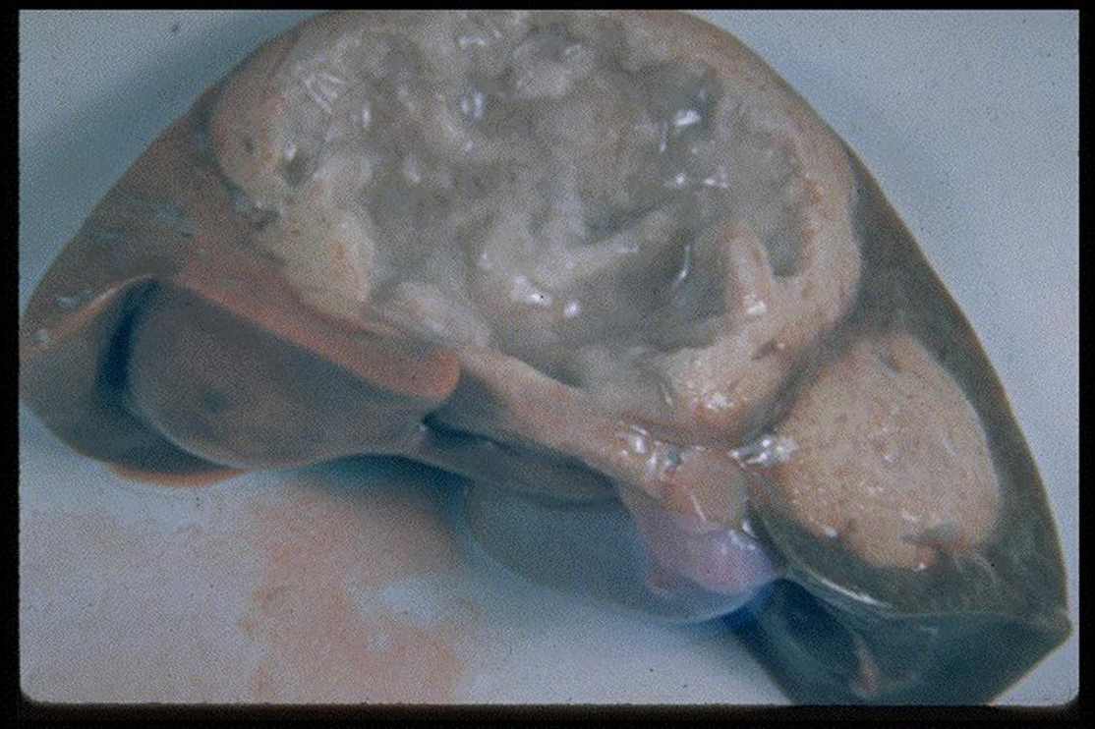
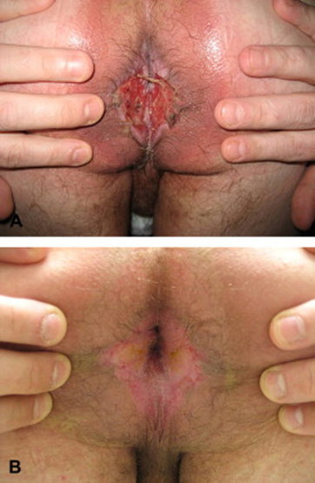

Slide 38
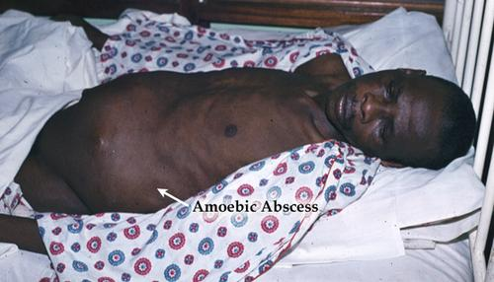

Slide 39
Factors that determine the intensity of symptoms
Strain of amoeba (non-pathogenic, pathogenic, resistance)
Immune response of the host.
Associated bacteria and viruses.

Slide 40
Laboratory Diagnosis
Stool examination - Solid(cyst) diarrhoea(trophozites with RBC in food vacuoles).
  Fresh stool: Wet mounts with or without iodine stain and permanently stained preparations (e.g., trichrome). Concentration procedures, however, are not useful for demonstrating trophozoites.
Culture-dyphasic media
Endoscopy (protoscopy, sigmoidoscopy) - Small intestinal ulcers covered with yellowish exudates. Ulcers material for examination
Radiology-amoebic liver abscess, barium enema strictures, amoeboma, intussusception
Ultrasound-amoebic liver abscess
CT scan- amoebic abscess in liver, Liver, brain
Serological tests:-
  Elisa test for antigen and DNA detection. Also serum antibodies against E. histolytica
  ESR- elevated
  LFTs- elevated alkaline phosphatase.
  Urinalysis- proteinuria

Slide 41
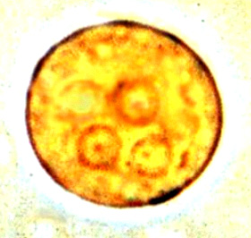
Laboratory diagnosis. An iodine-stained cyst of the pathogen Entamoeba hystolytica with 4 nuclei is illustrated.

Slide 42
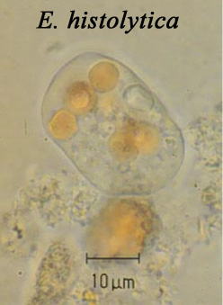


Slide 43

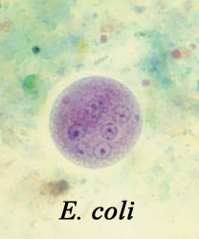
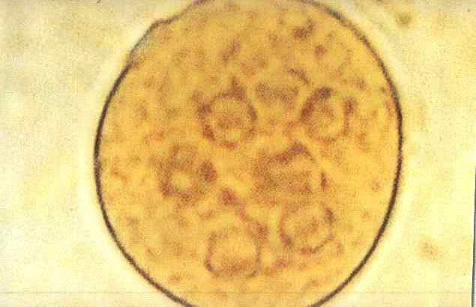

Slide 44
Treatment
For asymptomatic infections are treated with luminal amebicides such as iodoquinol, paromomycin, or diloxanide furoate.
For symptomatic intestinal disease, or extraintestinal, infections (e.g., hepatic abscess), the drugs of choice are metronidazole, tinidazole, omidazole or secridazole immediately followed by treatment with iodoquinol, paromomycin, or diloxanide furoate.
Cysts- Diloxanide fuorate
Amoebic liver abscess- drugs and aspiration or surgical drainage to prevent impending rupture. If rupture has occurred etc. perform Laparotomy.
Surgery for closing perforations and removal of necrotic tissue

Slide 45
1/ Metronidazole (Flagyl, Protostat). Kills trophozoites of E. histolytica in intestine and tissue. Does not eradicate cysts from intestines. Adult oral dose: 500-750 mg 3 times per day for 10 day. Elimination is accelerated by simultaneous use of phenytoin and phenobarbital; clearance is decreased by cimetidine.

Slide 46
2/Tinidazole (Fasigyn). 5-nitroimidazole derivative with selective antimicrobial activity against anaerobic bacteria and protozoa. Not available in United States. Adult oral dose: 600 mg bid or 800 mg 2 times a day for 5 days. Pediatric dose 50-60 mg/kg for 5 days, not to exceed 2 g/day.

Slide 47
3/Paromomycin (Humatin). Amebicidal aminoglycoside antibiotic that is poorly absorbed. Active only against intestinal form of amebiasis. Used to eradicate cysts of E. histolytica following treatment with metronidazole or tinidazole for an invasive disease. Adult oral dose: 25-35 mg/kg/day divided 3 times for 7 days. Pediatric dose: Administer as in adults.

Slide 48
4/Diloxanide furoate (Furamid, Entamizole, Furamide). Luminal amebicide; acts primarily in bowel lumen since it is poorly absorbed. Used to eradicate cysts of E. histolytica after treatment of invasive disease. Available through US CDC Drug Service (404-639-3670). Adult oral dose 500 mg 2 times a day for 10 days. Pediatric dose 20 mg/kg/ divided twice a day for 10 days, not to exceed 1500 mg/day.

Slide 49
5/Iodoquinol (Yodoxin). Halogenated hydroxyquinoline. Luminal amebicide; acts primarily in bowel lumen since it is poorly absorbed. Best tolerated when given with meals. Since active only against intraluminal form of amebiasis, used to eradicate cysts of E. histolytica after treatment of invasive disease. Adult oral dose 650 mg 2 times a day for 20 days. Pediatric dose: 30-40 mg/kg/day divided 2 times for 20 days; not to exceed 2 g/day.
Notes:
Have these and other drugs including the antimitotic type been adequately tested in in vitro, i. e., in trophozoite and cyst cultures? They have not. Is simple mitosis understood? It is not.

Slide 50
Prevention and control
Level of host. Human is the only host therefore it is important to observe the following:-Proper sanitation i.e.
Proper disposal of waste
Provision of safe water supply –filtration, boiling e.t.c
Proper hygiene- washing of hands with soap before meal, after visiting toilet, before preparing food, covering food, using clean utensils
Avoid eating raw salads or ensure proper washing of vegetables if eaten raw
Health education on improving personal hygiene and sanitary disposal of feces
Infectious agent: Use of amebicides.
Iodizing water with tetraglycine hydroperiodide..
Chlorination doesn’t kill E. histolytica cysts. Therefore sedimentation and filtration of water supplies are necessary to reduce incidence of infection

Slide 51
Risk factors
Poor sanitary conditions
Low socio-economic conditions
Oral-anal sexual relation
Immunosuppresed individuals

Slide 52
ENTAMOEBA COLLI

Slide 53
Introduction
Non-pathogenic motile using pseudopodia
Large intestine
Wordwide distribution

Slide 54
Morph
Trophozoites- large, 20-30um in diameter, 1 nucleus, eccetric karysome, vacuole have bacteria, no RBC,no distinction endo and ecto cytoplasm
Cysts- 15-30 um, 8 or more nuclei(mature), chromatid bodies (fine and pointed), rare in mature cysts

Slide 55
Life cycle
Ingestion of cysts in water or food or fingers
Cysts pass the stomach acidic ph
Get into the SI where they exyst to form *** - similar to E. hystolitica
THEY DO NOT INVADE THE WALL OF LI.

Slide 57
Entamoeba coli, E. hartmanni, E. polecki, Endolimax nana, and Iodamoeba buetschlii are generally considered nonpathogenic and reside in the large intestine of the human host . Both cysts and trophozoites of these species are passed in stool and considered diagnostic . Cysts are typically found in formed stool, whereas trophozoites are typically found in diarrheal stool. Colonization of the nonpathogenic amebae occurs after ingestion of mature cysts in fecally-contaminated food, water, or fomites . Excystation occurs in the small intestine and trophozoites are released, which migrate to the large intestine. The trophozoites multiply by binary fission and produce cysts, and both stages are passed in the feces . Because of the protection conferred by their cell walls, the cysts can survive days to weeks in the external environment and are responsible for transmission. Trophozoites passed in the stool are rapidly destroyed once outside the body, and if ingested would not survive exposure to the gastric environment.

Slide 58
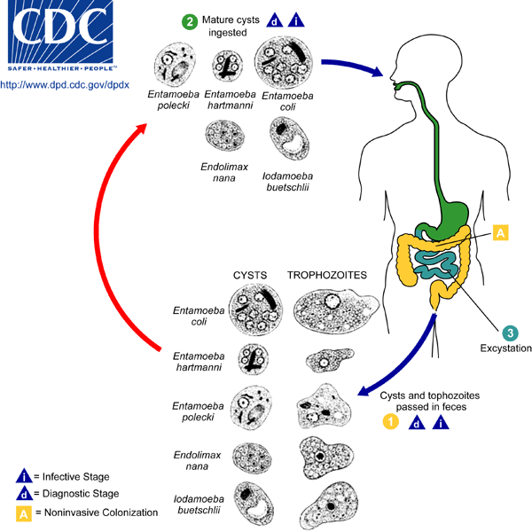

Slide 59
Clinical presentation
Non-pathogenic thus asymptomatic

Slide 60
Laboratory Diagnosis
Stool examination (wet smears, stain-iodine, eosin)
  Cysts
  Trophozoites
ELISA, etc. not done coz there’s no ulceration

Slide 61
Treatment
Not necessary

Slide 62
DIFFERENCES BETWEEN THE TROPHOZOITES E. COLI AND E. HISTOLYTICA
Entamoeba coli Entamoeba histolytica
15 μm - 40 μm in size 10 μm - 35 μm size
Nondirectional motility Unidirectional motility
Multiple pseudopodia Single pseudopodia
No ingested erythrocytes Ingested erythrocytes
Cytoplasm rough looking Finely granular cytoplasm
Large, eccentric karyosome Small, central karyosome
Clumped nuclear chromatin Finely beaded chromatin

Slide 63
Cysts
Entamoeba coli Entamoeba histolytica
10 μm - 35 μm in size 10 μm - 20 μm in size
May have 8 nuclei Never more than 4 nuclei
Karyosomes eccentric Karyosomes small, central
Nuclear chromatin clumped Chromatin finely beaded
Splintered chromatoidal bars Rounded chromatoidal bars

Slide 64
DIENTAMOEBA FRAGILIS
Amoebae
Worwid dis
Inhabits large inte
Trophozoites are small, 3-9 um
Not seen in unstained specimen
No cystic stage

Slide 65
Endolimax nana
Amoebae
Wordeide
Live in large intestines
Have 1 nucleus, food vacuoles with bacteria not RBCs
Cysts oval, no chromatids bodies, 5-10 um, mature 4 nuclei

Slide 66
IODAMOEBA BUTSCHLII
Amoebae lives in large intestin
Trophozoites measure 8- 20 um
Have 1 nucleus with lager central karysome, and have food vacuolse
Cysts measure 5-15 um
1 nucleus, large eccentric karysome
Large glycogen mass which staind with iodine

Slide 67
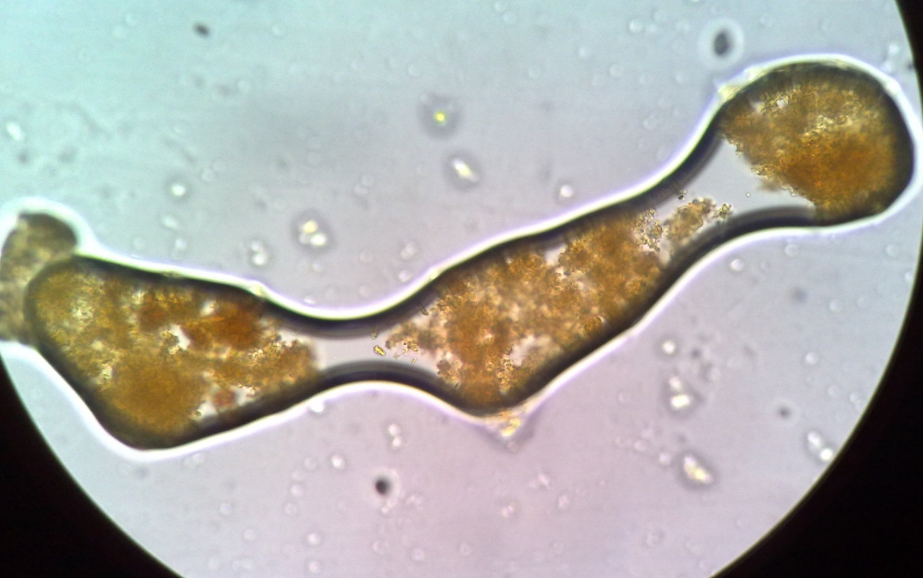
Cysts of Iodamoeba butschlii

