Slide 1
ATYPICAL AMOEBAE
KIMAIGA H.O
MBChB (University of Nairobi)

Slide 2
OPPORTUNISTIC AMOEBA/FREE LIVING AMOEBA/ ATYPICAL AMOEBA
Naegleria fowleri
Acanthamoeba spp (4 spp – A castellani, A. culbersoni, A. polyphage & A, rhysonde) – pple suffering from either chronic dx, cancer or immunosuppressed px
Leptomyxid
World-wide distribution
N. fowleri affects normal pple
Acanthamoeba infects immunosuppressed subjects mainly
Leptomyxid – unknown

Slide 3
Morphology
It’s found in environment and water as cysts or trophozoites in the hosts
Exists in 2 forms
Trophozoites
2 cysts
Trophozoites feed mainly on bacteria

Slide 4
Mode of transmission
Air contaminated with cysts
Salts with cysts in environment
Water in swimming pools (swimmers)- Poorly maintained and minimally-chlorinated or unchlorinated swimming pools
Humidifiers air in gyms and spas
Bodies of warm freshwater, such as lakes, rivers

Slide 5
Geothermal (naturally hot) water such as hot springs
Geothermal (naturally hot) drinking water sources
Warm water discharge from industrial plants
Naegleria sp. is not found in salt water locations like the ocean
Enters the nose through the cribriform plate then olfactory nerve to the CNS

Slide 6
Pathology/Immunology
N. fowleri injures the nerve cells by trogocytosis
‘Inflammatory process’ like meningitis if gets to the CNS
Lymphokine production
Cell mediated immunity
Trophozoites inflict cytopathic changes on the cell membranes
Immunologically the trophozoites are killed by complement system
Production of IgA & IgM

Slide 7
Clinical presentation
Acute meningitis called Primary amoebic menignoencephalitis (PAM)
Symptoms of h/ache, fever, vomiting, body pains, rhinitis, neck stiffness, positice Kernigs sign, body rigidity, coma
PAM is usually observed in N & healthy pple
It’s also called asceptic meningitis

Slide 8
Granulomatous amoebic encephalitis (GAE)
GAE similar to PAM & chronic in type
Chronic amoebic keratitis (CAK) common in acanthamoeba
Affects the conjuctiva and keratinized tissues of the body
GAE & CAK are common in immunosuppressed & chronically ill patients

Slide 9
Lab diagnosis of N. fowleri
CSF obtained through a LP
Examination include: pressure of CSF, color of CSF, wet prep, culture & sensitivity of CSF, isoenzymes
Biochemistry of CSF: glucose, proteins & antibodies IgG, M
WBCs esp neutrophils, RBCs
PCR
ELISA
Stain & examine CSF
Monoclonal antibodies
Seroimmunological analysis
Xenodiagnosis

Slide 10
Treatment
Amphoteric B
Sulphadimidine
Surgery for cysts/keratinization

Slide 11
Prevention & control
For Naegleria fowleri:
Water chemical treatment with Chlorine
Water filtration in swimming pools & ultra-heating
Using sodium hypochlorite concentration
Early screening, detection & treatment of cases.
Health education
Avoid water-related activities in bodies of warm freshwater, hot springs, and thermally-polluted water such as water around power plants.

Slide 12
Acanthamoeba sp.
This ameba has been isolated from water (including natural and treated water in pools or hot tubs), soil, air (in association with cooling towers, heating, ventilation and air conditioner systems), sewage systems, and drinking water systems (shower heads, taps).

Slide 13
Acanthamoeba sp.:Modes of infection
Improper storage and handling of lenses
Improper disinfection of lenses (such as using tap water or homemade solutions to clean the lenses)
Swimming, using a hot tub, or showering while wearing lenses
Coming into contact with contaminated water
Having a history of trauma to the cornea

Slide 14
Acanthamoeba sp. Life cycle
Lower respiratory tract
GAE
Cysts
Excystation
Encystation
Man
Environment
Trophozoites
Mitosis

Slide 15
Clinical presentation
Cause eye pathology mainly
Acanthamoeba keratitis or keratouveitis
Common in contact lens users
Inflammation of the cornea and erosion of the cornea
Accumulation of pus in the anterior chamber of the eye
Chemosis
Glaucoma
Blindness

Slide 16
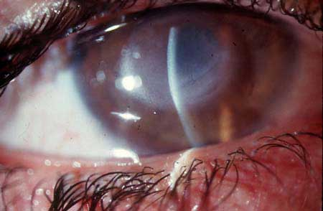
Acanthamoebakeratitis

Slide 17
Lab diagnosis
Culture of cornea scrapings on wet mountings, trophozoites and cysts can be seen
Biopsy of cutaneous lesions
Histology of sectional biopsies
Microscopic examination of stained (giemsa) smears of biopsy specimens (brain tissue, skin, cornea) for trophozoites
Serology. identification by direct immunofluorescent antibody (IFAT), ELISA, PCR,

Slide 18
X RAYS in calcification
The infection is usually diagnosed by an eye specialist based on symptoms, growth of the ameba from a scraping of the eye, and/or seeing the ameba by a process called confocal microscopy.
Granulomatous Amebic Encephalitis (GAE) and disseminated infection are more difficult to diagnose and are often at advanced stages when they are diagnosed. Tests useful in the diagnosis of GAE include brain scans, biopsies, or spinal taps. In disseminated disease, biopsy of the involved sites (e.g., skin, sinuses) can be useful in diagnosis.

Slide 19
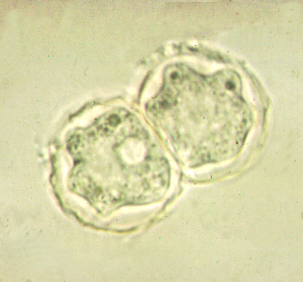
Acanthamoebaysts

Slide 20
Treatment
Diamidines e.g. propamdine & dibromopropamide
Corticosteroids
Neomycin (antibacterial)
Polymixin (antibacterial)
Ketoconazole

Slide 21
Prevention & control
Contact lens treatment, cleaning & disinfection
Using of sodium tidecyl ether sulphate
Use sorbic acid on contact lenses
Chlorhexidine
Health education

