Slide 1
MOTILE PROTOZOA
KIMAIGA H.O
MBChB (University of Nairobi)

Slide 2
FLAGELLATES & CILIATES
Giardia lamblia – flagellate
Trichomonas vaginalis – flagellate
Balantidium coli – ciliate

Slide 3
GIARDIA LAMBLIA
Causal Agent:
Giardia intestinalis is a protozoan flagellate (Diplomonadida).
This protozoan was initially named Cercomonas intestinalis by Lambl in 1859 and renamed Giardia lamblia by Stiles in 1915, in honor of Professor A. Giard of Paris and Dr. F. Lambl of Prague.
Geographic Distribution:
Worldwide, more prevalent in warm climates, and in children.

Slide 4
Vulnerable people to Giardiasis
Children in child care settings, including diaper-aged children.
Close contacts (such as those in the same family or in the same household or child care setting) or caregivers of infected people.
People who drink water or use ice made from contaminated sources (e.g., lakes, streams, shallow or poorly monitored or maintained wells). Contaminated water may include water that has not been boiled, filtered, or disinfected with chemicals.
Backpackers, hikers, and campers who drink untreated or insufficiently treated water or who do not practice good hygiene (e.g., proper hand washing).
People who swallow contaminated water while swimming, especially in lakes, rivers, springs, ponds, and streams. Several community-wide outbreaks of giardiasis have been linked to recreational water or drinking water contaminated with Giardia.
International travelers.
People exposed to human feces through sexual contact.

Slide 5
Morphology
Exists as cysts and trophozoites
Cysts in colon and environment
  Oval to ellipsoid and measure 8-19 µm (average 10-14 µm).
  Mature cysts have 4 nuclei, while immature cysts have 2.
  Nuclei and fibrils are visible in both iodine-stained wet mounts and trichrome-stained smears.
Trophozoites in tissues
  Pear-shaped and measure 10-20 micrometers in length.
  2 large nuclei, sucking disks (used for attaching to the host’s mucosal epithelium), median bodies, and flagella (8) may be seen.

Slide 6
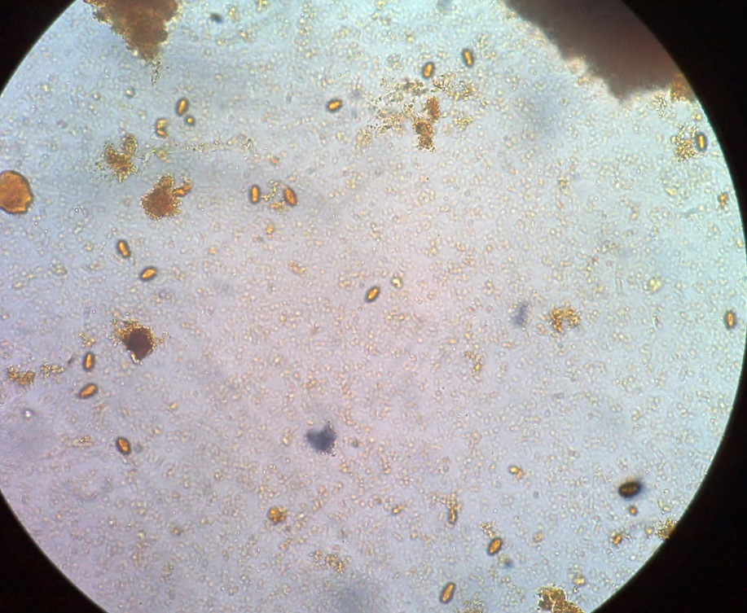
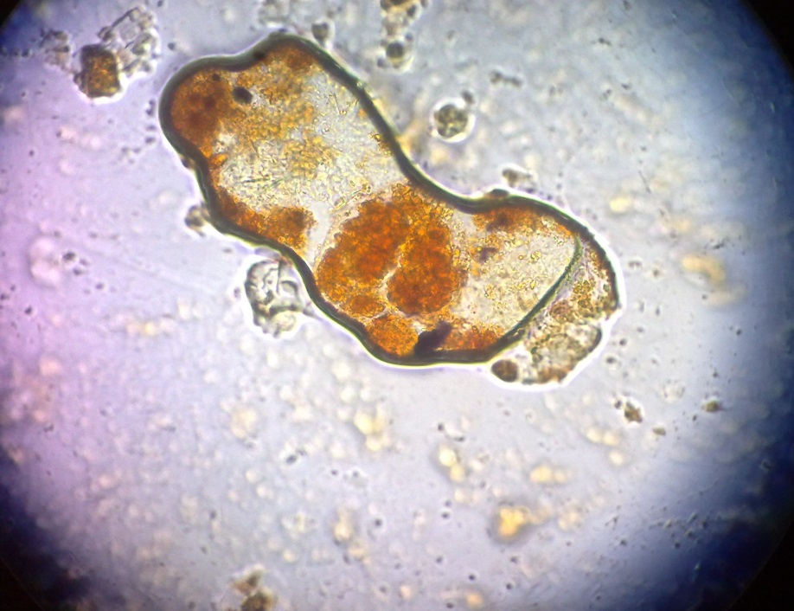
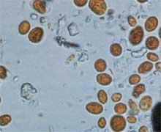
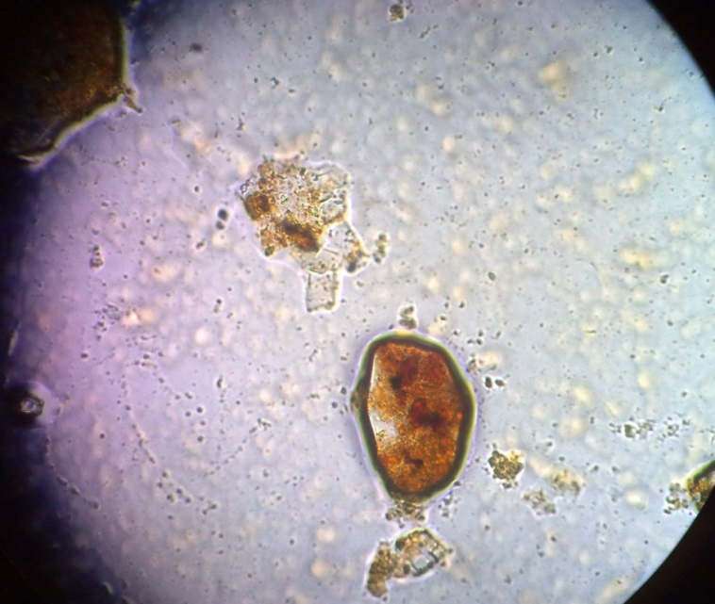

Slide 8
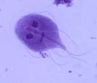
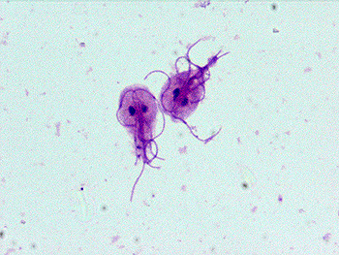
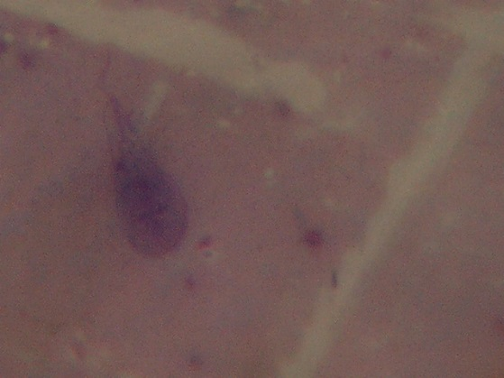
G. lamblia trophozoite (tennis racket)

Slide 10
Life cycle
Beaver, dogs, cats, serve as reservoir hosts.
Cysts are resistant forms and are responsible for transmission of giardiasis. Both cysts and trophozoites can be found in the feces (diagnostic stages) .
The cysts are hardy and can survive several months in cold water. Infection occurs by the ingestion of cysts in contaminated water, food, or by the fecal-oral route (hands or fomites) .
IIngested cysts excyst in the small intestine, releasing the trophozoite (each cyst produces two trophozoites) .
Trophozoites multiply by longitudinal binary fission,
The bile salinity and alkaline pH environment induce the change from trophozoite to cyst form.
They remaini in the lumen of the proximal small bowel where they can be free or attached to the mucosa by a ventral sucking disk .
Encystation occurs as the parasites transit toward the colon. The cyst is the stage found most commonly in nondiarrheal feces .
Because the cysts are infectious when passed in the stool or shortly afterward, person-to-person transmission is possible.
While animals are infected too with Giardia

Slide 11
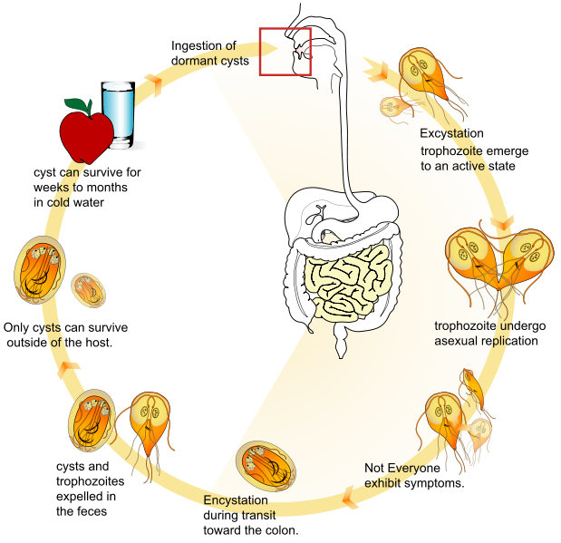

Slide 12
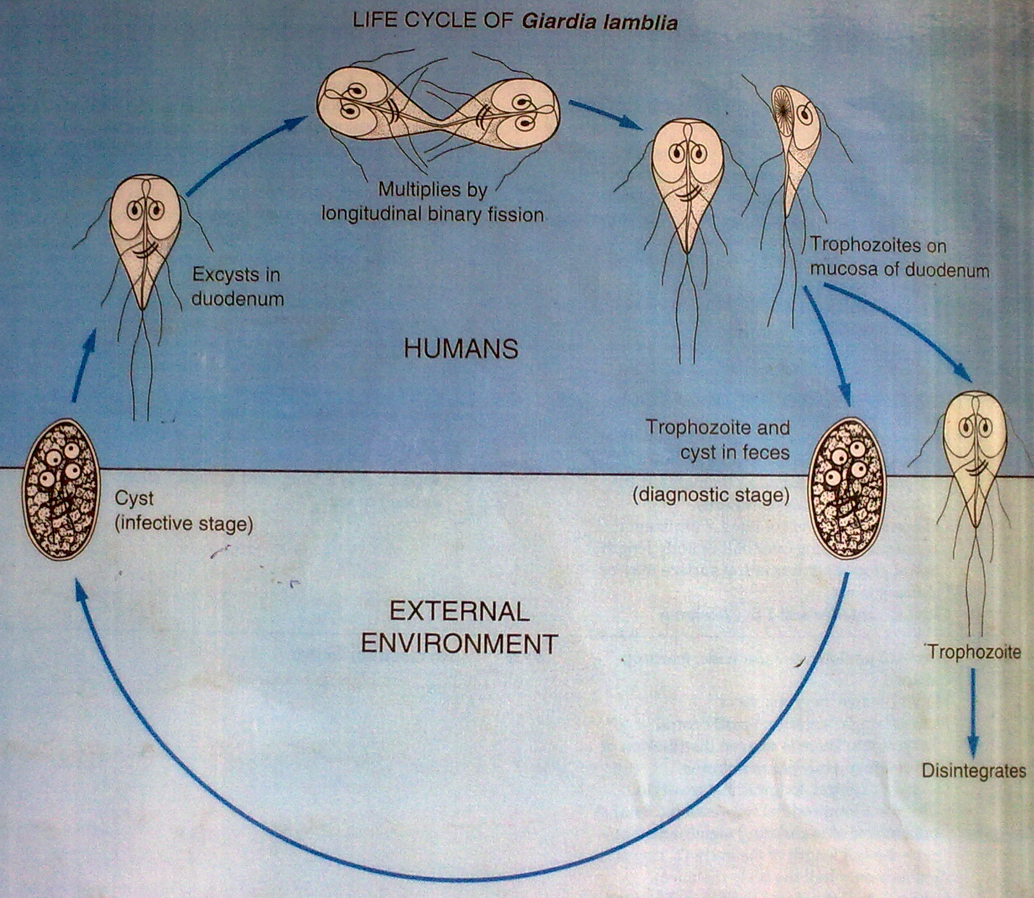

Slide 13
Pathogenesis
Usually in glandular crypts of duodenal-jejunal mucosa
Do not invade tissues they feed on mucosal secretions
It attaches itself to the epithelial surface of the duodenum and jejunum and may lead to duodenitis or jejunitis

Slide 14
Clinical manifestations:
Acute giardiasis develops after an incubation period of 1 to 14 days (average of 7 days) and usually lasts 1 to 3 weeks.
In chronic giardiasis the symptoms are recurrent and malabsorption and debilitation may occur.
Dull Epigastric pain, abdominal pain, flatulence, bloating, nausea, and vomiting.
Chronic diarrhoea – steatorrhoea type which is voluminous and fowl smelling with loads of mucus and fat and no blood.
In the biliary tract – chronic cholecystitis & jaundice
In HIV +ve px there’s associated hypergammaglobulinaemia, protein/caloric malnutrition, gastric acchlorhydria, decreased release of secretory IgA levels.

Slide 15
Immune response
Majority produce detectable levels of Giardia spp. Antibodies however the role is unclear
igM anti-Giardia antibodies – short-lived, may be important in both defense and parasite clearance
IgG-anti-Giardia antibodies remain in high titers for many months after Rx
There’s a certain degree of protection in breast milk IgA anti-Giardia antibodies

Slide 16
Lab diagnosis
Cysts in formed stools
Trophozoites in diarrhoeal stools by N saline and iodine prep
Parasites are passed in the stool cyclically. Also in vomitus.
Trophozoites seen in bile aspirated from duodenum by intubation and by duodenal capsule technique
Monoclonal Abs using fluorescent method
Duodenal & jejunal biopsies
Touch preps are air dried and fixed in methanol & stained with Giemsa & trophozoites appears purple
ELISA & IFA

Slide 17
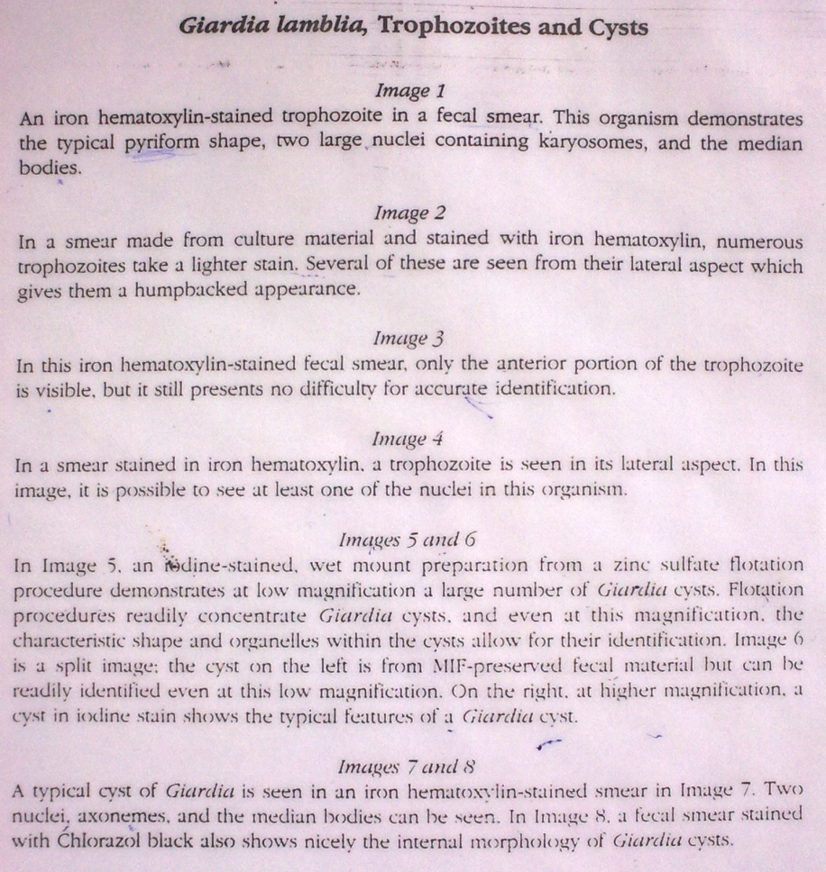
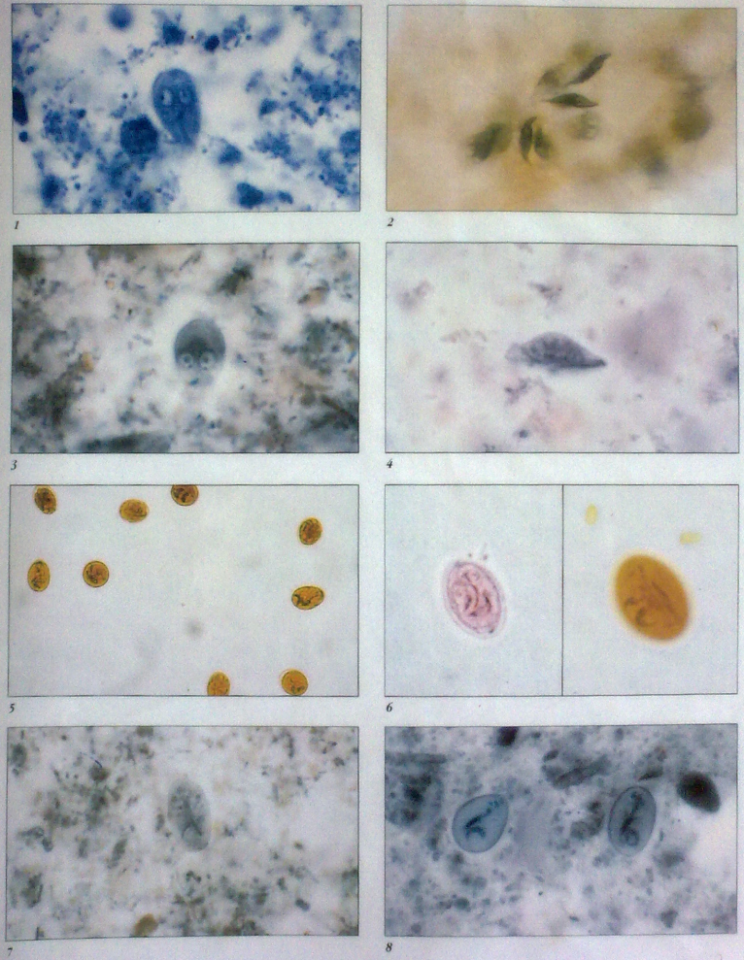

Slide 18
Rx
Metronidazole
Tinidazole
Furazolidine

Slide 19
Prevention
Improved water supply
Proper fecal disposal
Improve personal hygiene
Proper food storage
Routine hand washing
Proper pest control
Rx of symptomatic & asymptomatic px.

Slide 20
TRICHOMONAS VAGINALIS
Causal Agent:
  Trichomonas vaginalis, a flagellate, that exists only in trophozoite stage
  Normal habitat – human vagina, prostrate & urinary tract
  Lives on mucosa feeding on bacteria & leucocytes
  It’s an obligate parasite
  Tritrichomonas foetus, Causes a disease in cattle and other herbivores. Third leading cause of spontaneous abortions in cattle

Slide 21
Morphology
Trophozoites of Trichomonas vaginalis are pyriform and 7-30 µm long.
They have five flagella: four anteriorly directed flagella and one posteriorly along the outer membrane of the undulating membrane.
The large nucleus is usually located at the wider, anterior end and contains many chromatin granules and a small karyosome.
The cytoplasm also contains many granules, but these are often not seen in Giemsa-stained specimens.

Slide 22
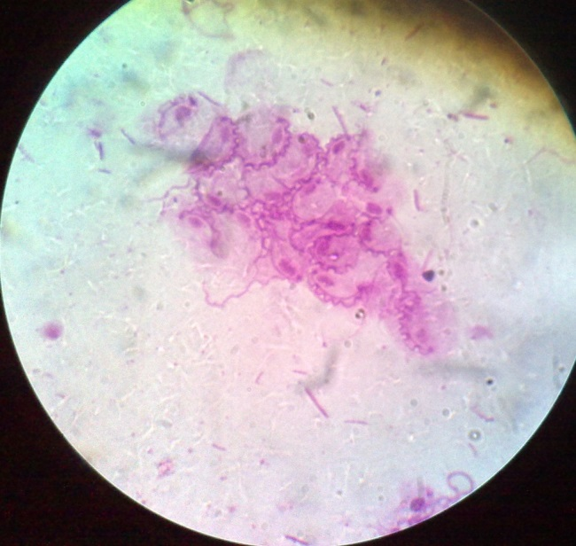
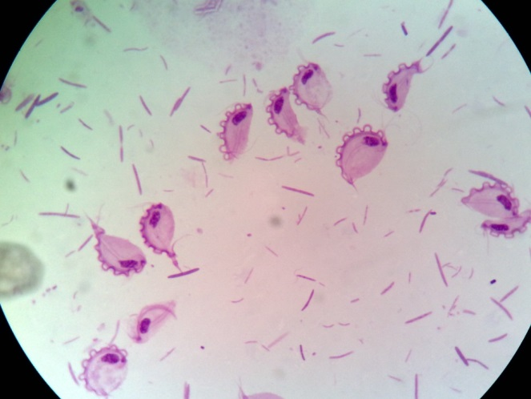

Slide 23
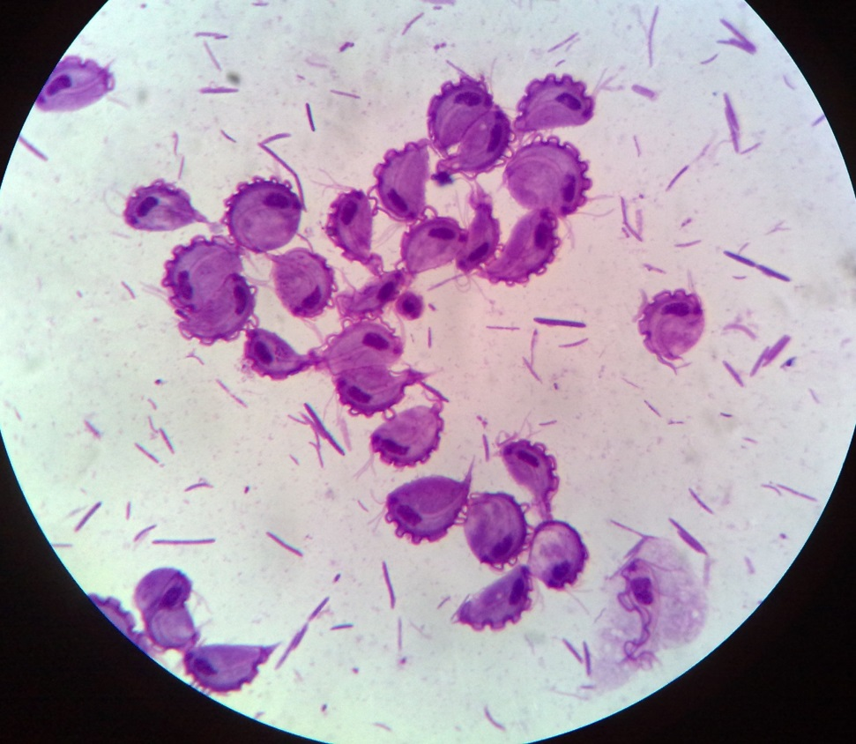
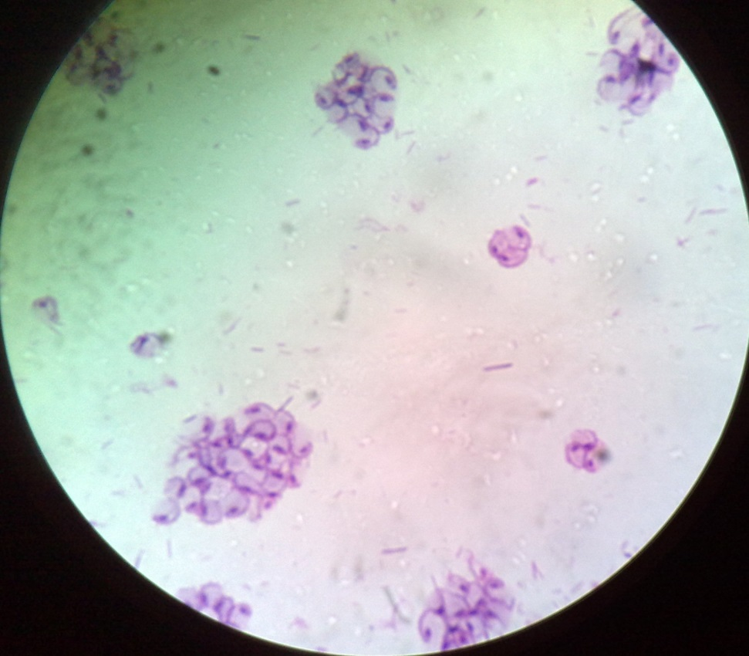
Trophozoites T.vaginalis

Slide 24
Geographic Distribution:
Worldwide.
Higher prevalence among persons with multiple sexual partners or other venereal diseases.
Incidence: 10% in the N popn & 50% is asymptomatic in females.
Is the most common pathogenic protozoan of humans in industrialized countries.

Slide 25
Life Cycle
Trichomonas vaginalis resides in the female lower genital tract and the male urethra and prostate , where it replicates by binary fission
The parasite does not appear to have a cyst form, and does not survive well in the external environment. Trichomonas vaginalis is transmitted among humans, its only known host, primarily by sexual intercourse .

Slide 26
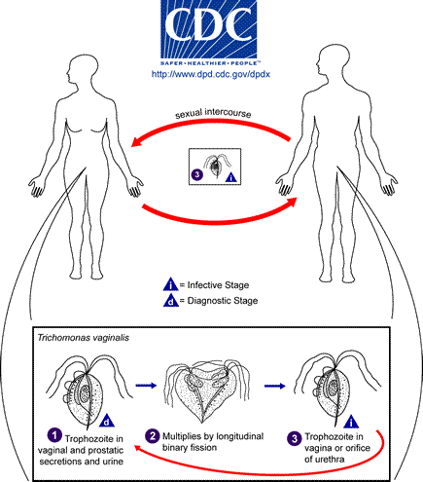

Slide 27
Modes of infection
Sexual intercourse
Men usually get the infection in the urethra (urine canal).
Women can get the disease from infected men or women. Men usually get it only from infected women
Infants: If an infant is infected, it is possible that the mother spread infection during childbirth. The mother should be checked for infection.
Young children: Because trichomoniasis is an STD, infection in a young child may indicate sexual abuse. If sexual abuse is suspected, an evaluation for other STDs is recommended.
Teenagers: Because trichomoniasis is an STD, infection in a teenager may indicate sexual activity or sexual abuse. An evaluation for other STDs is recommended.

Slide 28
Clinical manifestations
The incubation period is 5 to 28 days.
Mild vaginitis and vaginal discharge with large number of leucocytes and is liquid greenish-yellow in females
In males it causes mild/asymptomatic dx and causes itching and discomfort inside penile urethra esp during urination
Exact mechanism of pathogenesis is unclear, appears to be multifactorial

Slide 29
Lab diagnosis
Trophozoites on a wet mount of sedimented urine, vaginal & prostatic secretions & scrapings by microscopy
Fluorescent microscopy
Fixed smears can be stained with Papanicolau, Giemsa, Leishman & PAS
Culture on Trussel & Johnsons’ medium/simplified trypticase serum medium used to maintain bacteria free cultures of the flagellate
Nucleic acid hybridization & PCR

Slide 30
Rx
Metronidazole – drug of choice
Tinidazole
Secnidazole
Prevention – 4 cs
  Counselling, contact, compliance, condoms

Slide 31
BALANTIDIUM COLI
Geographic Distribution:
  Worldwide. Because pigs are an animal reservoir, human infections occur more frequently in areas where pigs are raised. Other potential animal reservoirs include rodents and nonhuman primates.

Slide 32
Morphology
Large ciliated protozoan parasite.
Exists only in 2 forms both found in stool
  Cyst (not dx causing) & trophozoite (dx causing)
Trophozoites are characterized by: their large size (40 µm to 200 µm), the presence of cilia on the cell surface, a cytostome, and a bean shaped macronucleus which is often visible and a smaller, less conspicuous micronucleus.
Cysts are seen less frequently and range in size from 50 µm to 70 µm. B. coli can also invade tissue.

Slide 35
Life cycle
Cysts are the parasite stage responsible for transmission of balantidiasis . The host most often acquires the cyst through ingestion of contaminated food or water
Following ingestion, excystation occurs in the small intestine, and the trophozoites colonize the large intestine
The trophozoites reside in the lumen of the large intestine of humans and animals, where they replicate by binary fission, during which conjugation may occur
Trophozoites undergo encystation to produce infective cysts . Some trophozoites invade the wall of the colon and multiply. Some return to the lumen and disintegrate. Mature cysts are passed with feces .

Slide 36
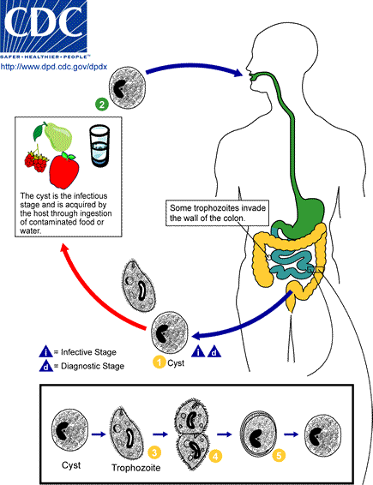

Slide 37
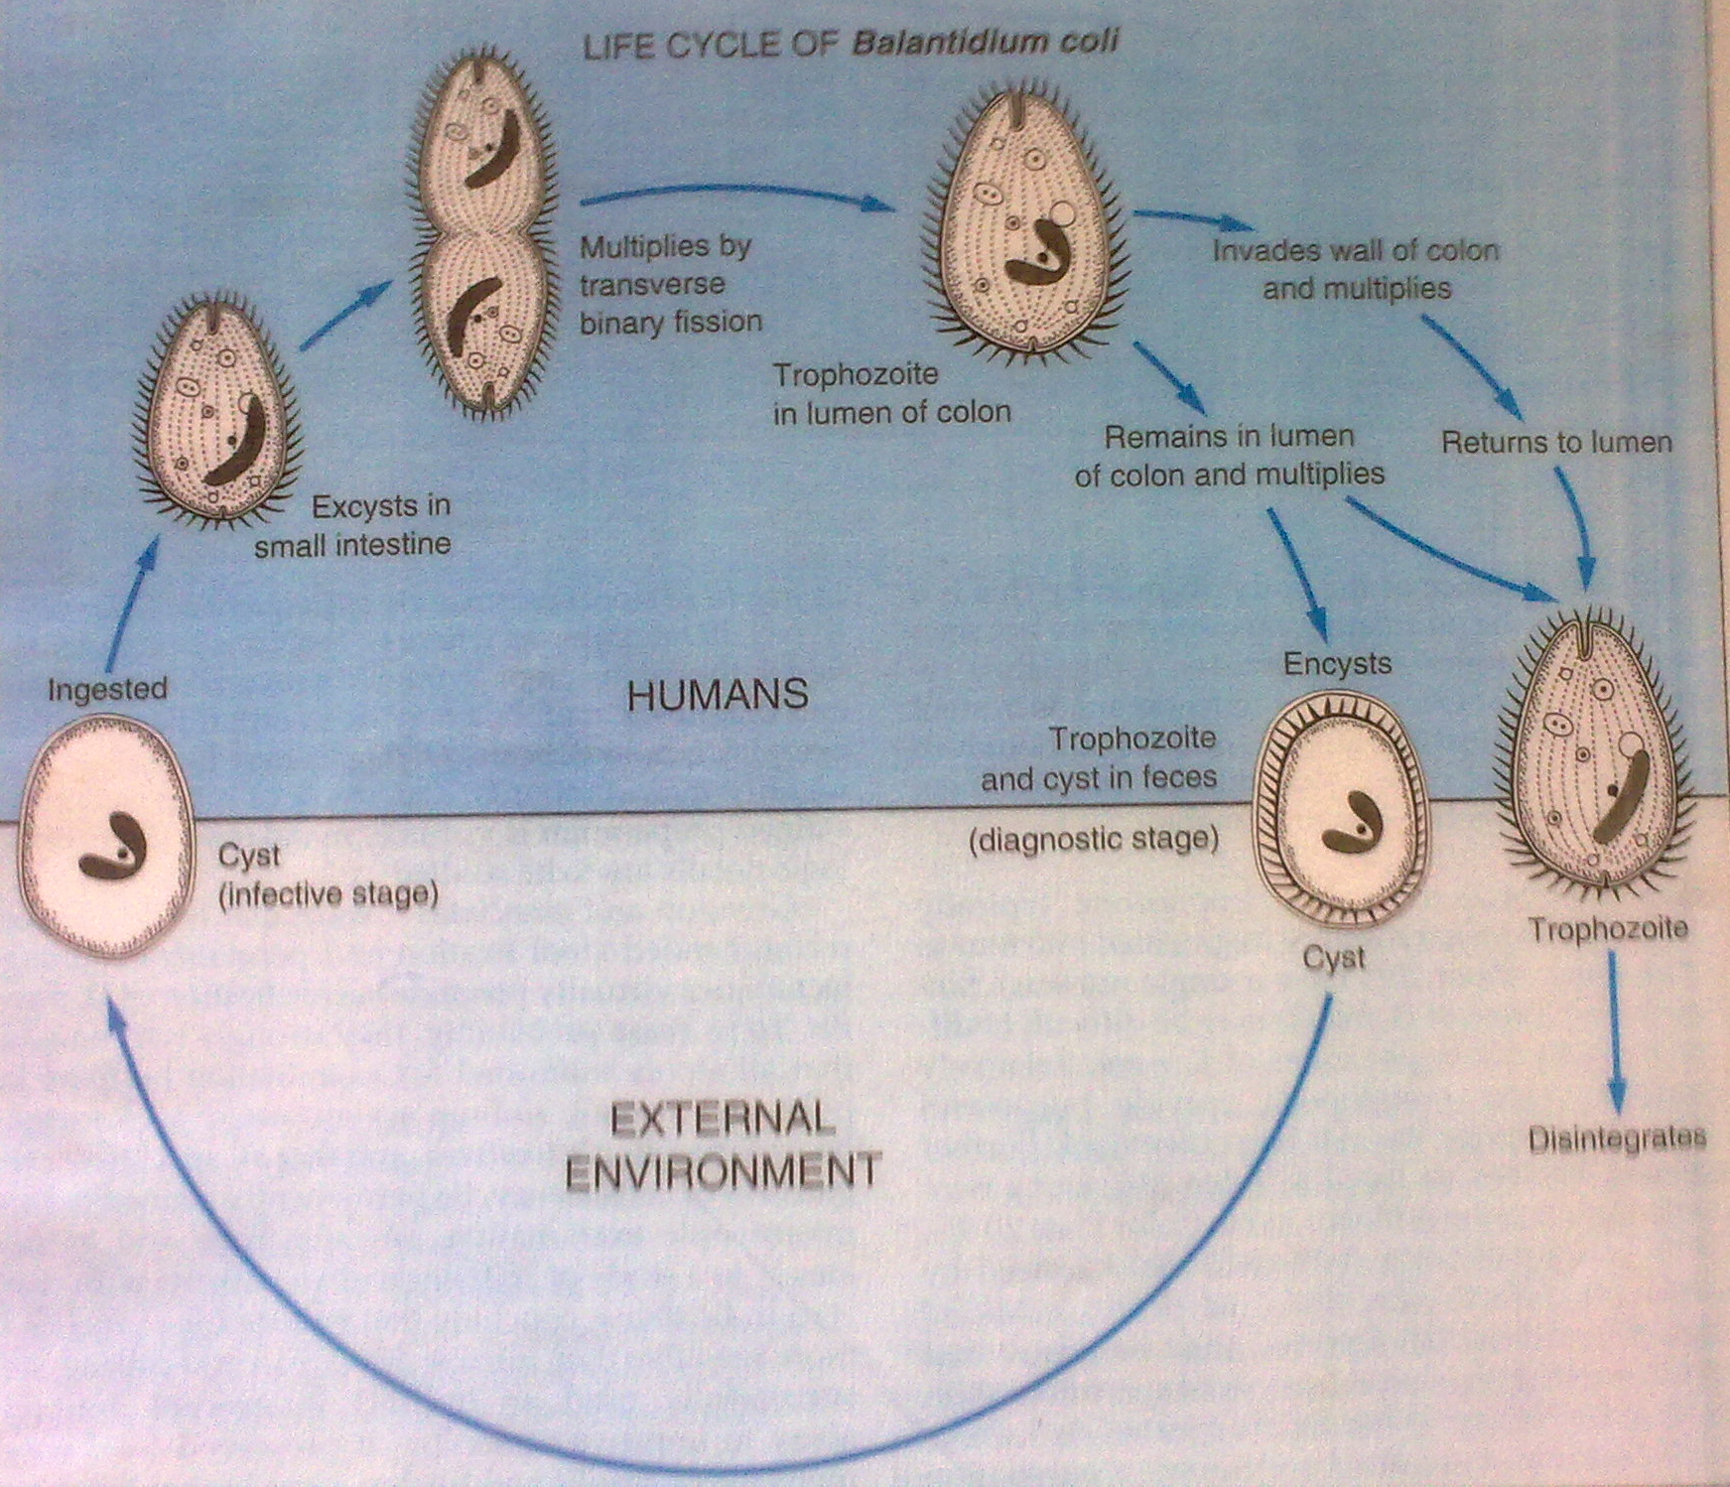

Slide 38
Pathogenesis
Most infections are harmless
May invade mucosa & sub-mucosa of L.I and terminal ileum & produce ulcers/sub mucous coats that sometimes extend to the muscular layer
Abscess is usually small filled with mucoid material with numerous B. coli

Slide 39
Immune response
Cellular
Lymphocytic with some plasma cells with few neutrophils
May invade regional lymph nodes and detected inside lymphatic tissues
B. coli produce hyaluronidase that aids in the invasion of host tissue

Slide 40
Clinical manifestations
Chronic recurrent and persistent diarhoea
Bloody mucoid stools
Tenesmus
Anorexia, nausea
Vomiting & intestinal colic
Recovery is usually 3-4 days even without Rx
In px with acute infxn, there may be extra intestinal involvement e.g. liver abscess formation, peritonitis, pleuritis & pneumonia

Slide 41
Lab diagonosis
Repeated stool examination– trophozoites on wet mounts – shows active infxn. Cysts don’t mean there is an active infxn.
Iodine mounts – stain yellow-brown – macronucleus easily visible
Biopsy for sigmodoscopy/scrapings of an ulcer
Culture

Slide 42
Rx & Prophylaxis
Tetracycline & metronidazole – Rx
Hygienic rearing of pigs
Prevention of food & water contamination – prophylaxis
Rx of persons shedding cysts

