Slide 1
NON-MOTILE PROTOZOA
KIMAIGA H.O
MBChB (University of Nairobi)

Slide 2
NON-MOTILE PROTOZOA
Cryptosporidium parvum
Isospora beli
Blastocystis homonis
Sarcocystis spp

Slide 3
CRYPTOSPORIDIUM PARVUM
It infects warm-blooded vertebrates, the developmental stages do not occur deep within host cells but are confined to an intracellular; extracytoplasmic location
Each stage is within a parasitophorous vacuole in the microvillous region of epithelial cells of the S.I
Less frequently found in the stomach and L.I & lungs.

Slide 4
Life cycle
Sporulated oocysts, containing 4 sporozoites, are excreted by the infected host through feces and possibly other routes such as respiratory secretions .
Transmission of Cryptosporidium parvum and C. hominis occurs mainly through contact with contaminated water (e.g., drinking or recreational water).
Occasionally food sources, such as chicken salad, may serve as vehicles for transmission. Many outbreaks have occurred in waterparks, community swimming pools, and day care centers.
Zoonotic and anthroponotic transmission of C. parvum and anthroponotic transmission of C. hominis occur through exposure to infected animals or exposure to water contaminated by feces of infected animals .

Slide 5
Following ingestion (and possibly inhalation) by a suitable host , excystation occurs. The sporozoites are released and parasitize epithelial cells of the gastrointestinal tract or other tissues such as the respiratory tract.
In these cells, the parasites undergo asexual multiplication (schizogony or merogony) and then sexual multiplication (gametogony) producing microgamonts (male) and macrogamonts (female).
Upon fertilization of the macrogamonts by the microgametes oocysts develop that sporulate in the infected host.
Two different types of oocysts are produced, the thick-walled, which is commonly excreted from the host , and the thin-walled oocyst , which is primarily involved in autoinfection.
Oocysts are infective upon excretion, thus permitting direct and immediate fecal-oral transmission.

Slide 6
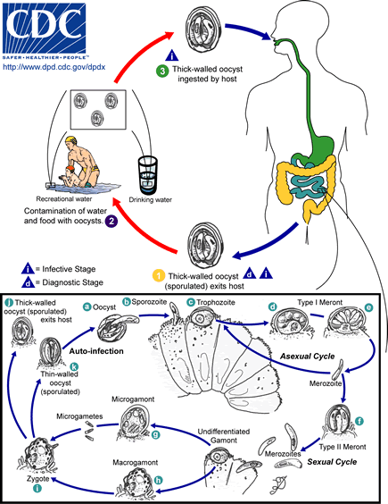

Slide 7
Pathogenesis
Humans are infected either from direct contact with infected animals or from ingestion of fecally contaminated food or water
Human to human transmission can occur
In immunocompetent: 1-2 weeks mild and self-limiting diarrhea
In immunocompromised: prolonged life-threatening, cholera-like illness 3-6 lts of watery stool per day
May also have abd pain, vomiting, nausea, low grade fever & h/ache
Additional symptoms in ISS (immunosuppressed): respiratory cryptosporidiosis, cholecystitis, hepatitis, & pancreatitis.
NB: C. parvum is a multisystem dx esp in ISS

Slide 8
Lab diagnosis
Stool examination
  Wet mount shows oocysts using stool concentration techniques. Modified acid-fast staining is the method of choice for staining. However, auramine-rhodamine and acridinne orange can be used.
  IFA for antibodies
Sputum examination
  Oocyst examined as for stool
Serodiagnosis: IgG & IgM
Molecular methods (e.g., polymerase chain reaction – PCR) to identify Cryptosporidium sp. at the species level.

Slide 9
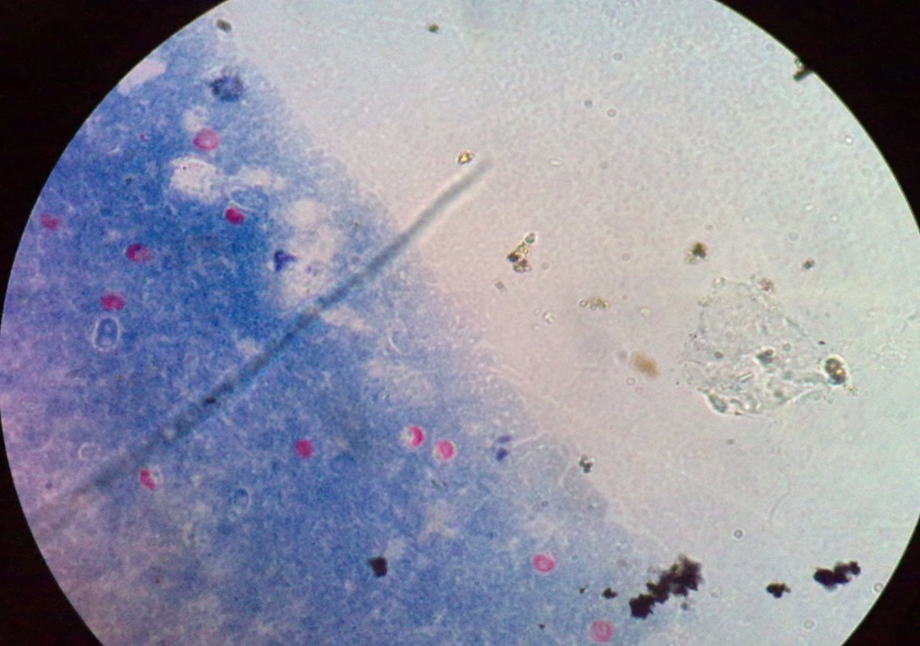
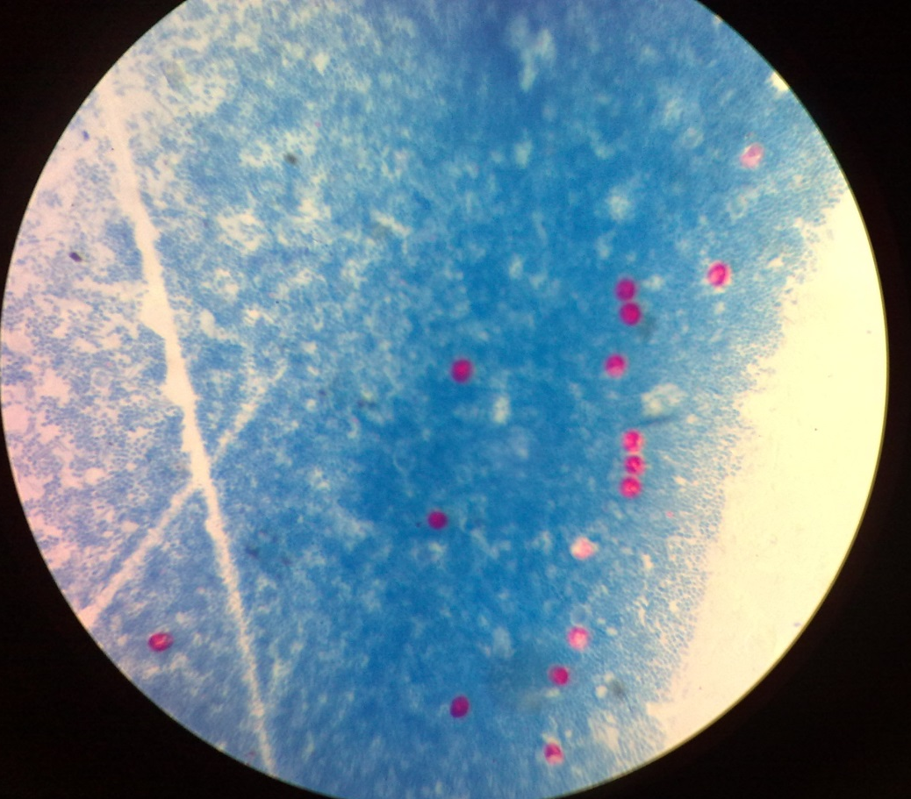

Slide 10
Rx
Spiramycin
Azithromycin
Paromomycin
Nitazoxanide

Slide 11
Preventive measures
Practice good hygiene (hand washing).
Avoid water that might be contaminated.
If you are unable to avoid using or drinking water that might be contaminated, then you can make the water safe to drink by boiling it or filtering it.
Avoid food that might be contaminated (unpeeled fruits, salads, uncooked food).
Avoid sexual practices that might result in oral exposure to stool (e.g., oral-anal contact).

Slide 12
ISOSPORA BELLI
Causal Agent:
The coccidian parasite, Cystoisospora belli, infects the epithelial cells of the small intestine, and is the least common of the three intestinal coccidia that infect humans.
It’s a sporozoan of the human intestine

Slide 13
Geographic Distribution
Worldwide, especially in tropical and subtropical areas.
Infection occurs in immunodepressed individuals, and outbreaks have been reported in institutionalized groups in the United States.
It’s endemic in Africa, Asia & S. America
15% in Haitian HIV px

Slide 14
Morphology
The unsporulated oocysts of I. belli are elongated-ovoidal with 2 sporoblasts which later on convert into sporocysts each have 4 crescent–shaped sporozoites.
The oocysts of C. belli are large (25 to 30 µm) and have a typical ellipsoidal shape. When excreted, they are immature and contain one sporoblast. The oocyst matures after excretion: the single sporoblast divides in two sporoblasts, which develop cyst walls, becoming sporocysts, which eventually contain four sporozoites each. Cystoisospora will autofluoresce under ultraviolet (UV) microscopy.

Slide 15
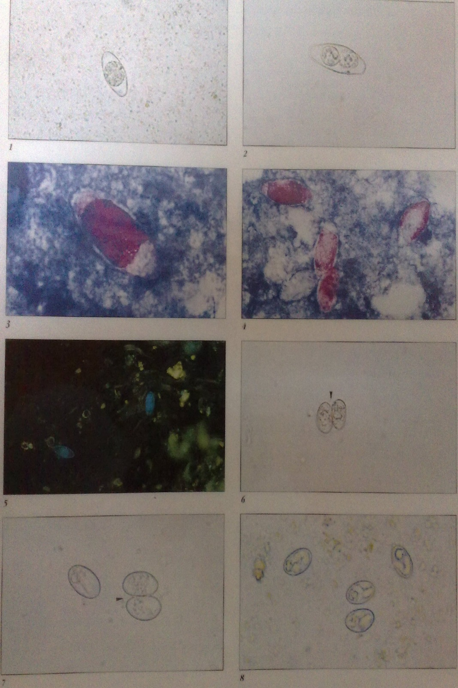
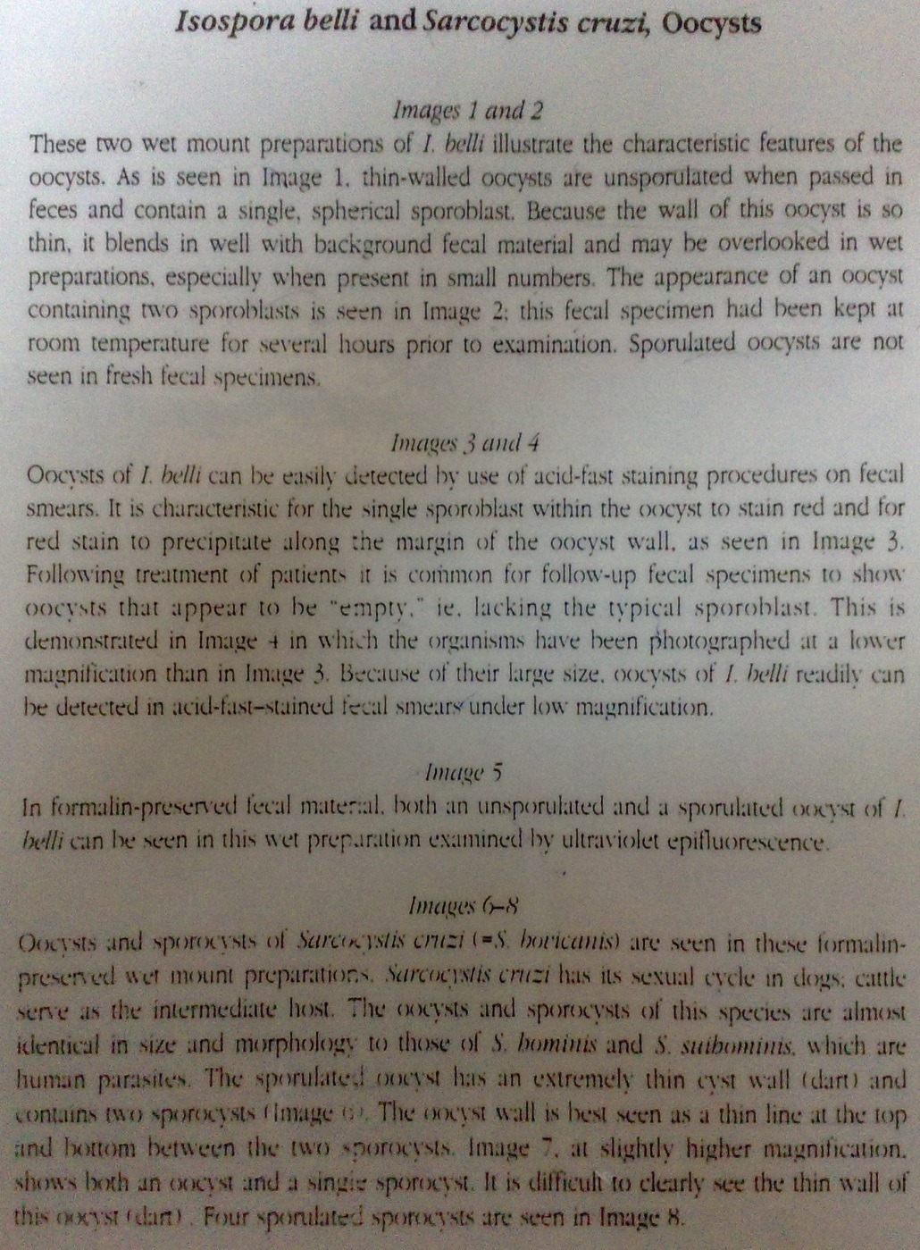

Slide 16
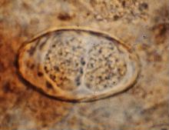
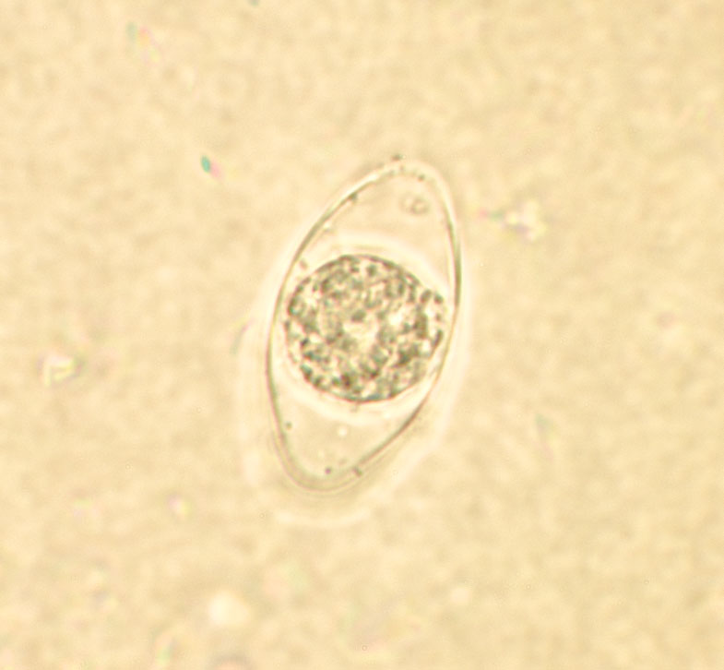
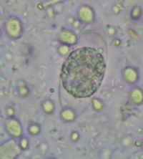
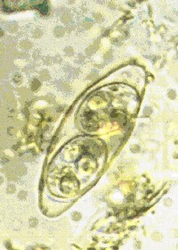
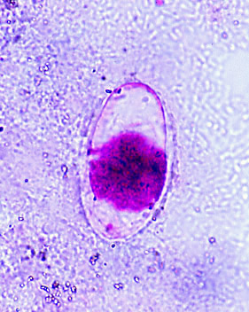

Slide 21
Life Cycle
At time of excretion, the immature oocyst contains usually one sporoblast (more rarely two) . In further maturation after excretion, the sporoblast divides in two (the oocyst now contains two sporoblasts); the sporoblasts secrete a cyst wall, thus becoming sporocysts; and the sporocysts divide twice to produce four sporozoites each . Infection occurs by ingestion of sporocysts-containing oocysts: the sporocysts excyst in the small intestine and release their sporozoites, which invade the epithelial cells and initiate schizogony . Upon rupture of the schizonts, the merozoites are released, invade new epithelial cells, and continue the cycle of asexual multiplication . Trophozoites develop into schizonts which contain multiple merozoites. After a minimum of one week, the sexual stage begins with the development of male and female gametocytes . Fertilization results in the development of oocysts that are excreted in the stool . Cystoisospora belli infects both humans and animals.

Slide 22
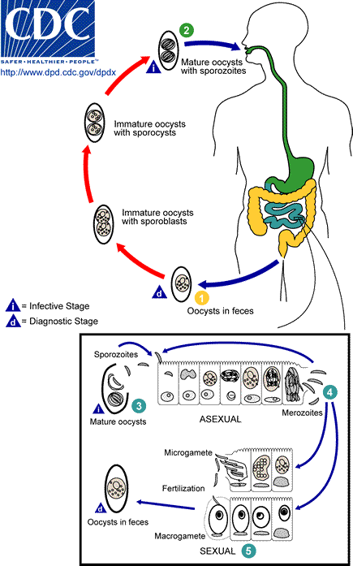

Slide 23
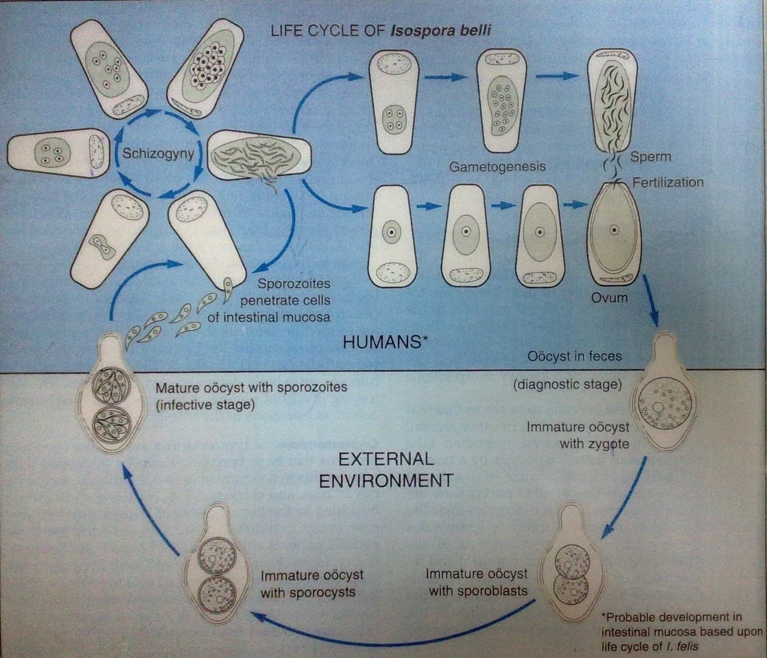

Slide 24
Pathogenesis
It causes a mild, self-limiting diarrhea but associated with more severe infxn in AIDS px
Clinical manifestations
  Acute, nonbloody diarrhea with crampy abdominal pain, which can last for weeks and result in malabsorption and weight loss, Dehydration and death
  In immunodepressed patients, and in infants and children, the diarrhea can be severe.
  Fever, H/ache, Malaise
  Cholecystitis
  Steatorrhoea
  Infection causes
  Eosinophilia may be present (differently from other protozoan infections).

Slide 25
Lab diagnosis
Oocysts in the feces by unstained or iodine-stained direct smear preps
Oocysts in intestinal biopsy specimens
If stool examinations are negative, examination of duodenal specimens by biopsy or string test (Enterotest®) may be needed.
These organisms are stained by modified acid-fast stain and can be demonstrated using auramine-rhodamine stains. Just like for M. tb diagnosis
Trophozoites have been reported in tracheobronchial, mediastinal & mesenteric lymph nodes, gall bladder liver & spleen of AIDS px

Slide 26
Rx
Co-trimoxazole
Septrin
Trimethoprim-sulfamethoxazole is the drug of choice.

Slide 27
Prevention & control
Health education
Environmental Mx of sewage waste
Water Rx – chlorination
Food prep
Early diagnosis & Rx of cases
Prophylaxis – Co-trimoxazole

Slide 28
BLASTOCYSTIS HOMINIS
Causal Agent:
The taxonomic classification of Blastocystis hominis is mired in controversy. It has been previously considered as yeasts, fungi, or ameboid, flagellated, or sporozoan protozoa. Recently, however, based on molecular studies, especially dealing with the sequence information on the complete SSUrRNA gene, B. hominis has been placed within an informal group, the stramenopiles (Silberman et al. 1996). Stramenopiles are defined, based on molecular phylogenies, as a heterogeneous evolutionary assemblage of unicellular and multicellular protists including brown algae, diatoms, chrysophytes, water molds, slime nets, etc. (Patterson, 1994). Cavalier-Smith (1998) considers stramenopiles to be identical to his infrakingdom Heterokonta under the kingdom Chromista. Therefore, according to Cavalier-Smith, B. hominis is a heterokontid chromista.
Worldwide distribution

Slide 29
Morphology
Blastocystis hominis appear as spherical to oval cyst-like structures. They vary widely in size (5 to 30 µm; usual range 8 to 10 µm), and typically consist of a central body, or "vacuole," surrounded by a thin rim of cytoplasm containing up to six nuclei. The vacuoles stain variably from red to blue in trichrome stain, which is preferred to wet mounts as the organisms can be overlooked as debris.

Slide 33
Life Cycle:
Knowledge of the life cycle and transmission is still under investigation, therefore this is a proposed life cycle for B. hominis. The classic form found in human stools is the cyst, which varies tremendously in size from 6 to 40 μm . The thick-walled cyst present in the stools is believed to be responsible for external transmission, possibly by the fecal-oral route through ingestion of contaminated water or food
The cysts infect epithelial cells of the digestive tract and multiply asexually ( , ). Vacuolar forms of the parasite give origin to multi vacuolar and ameboid forms. The multi-vacuolar develops into a pre-cyst that gives origin to a thin-walled cyst , thought to be responsible for autoinfection. The ameboid form gives origin to a pre-cyst , which develops into thick-walled cyst by schizogony . The thick-walled cyst is excreted in feces .

Slide 34
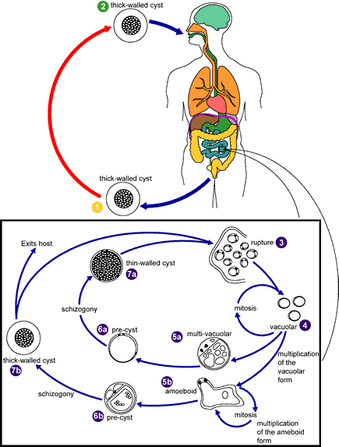

Slide 35
Clinical Features
Whether Blastocystis hominis can cause symptomatic infection in humans is a point of active debate. This is because of the common occurrence of the organism in both asymptomatic and symptomatic persons. Those who believe symptoms could be related to infection with this parasite have described a spectrum of illness including watery diarrhea, abdominal pain, perianal pruritus, and excessive flatulence.

Slide 36
Laboratory Diagnosis:
Diagnosis is based on finding the cyst-like stage in feces. Permanently stained smears are preferred over wet mount preparations because fecal debris may be mistaken for the organisms in the latter. Do not wash specimens in water (e.g., during concentration procedures) as this will lyse the organisms, resulting in false negatives.

Slide 37
Treatment
Despite the controversial clinical significance of this organism, metronidazole or iodoquinol has been reported to be effective

Slide 38
SARCOCYSTIS HOMINIS
Causal Agent:
  Sarcocystis hominis and S. suihominis use humans as definitive hosts and are responsible for intestinal sarcocystosis in the human host.
  Humans may also become dead-end hosts for non-human Sarcocystis spp. after the accidental ingestion of oocysts.
Geographic Distribution
  Worldwide, but more common in areas where livestock is raised.

Slide 39
Morphology
Oocysts of Sarcocystis in human feces measure 15-20 µm long by 15-20 µm wide. Oocysts sporulate in the intestinal epithelium and contain two sporocysts, each of which contains four sporozoites and a refractile residual body. Due to the fragile nature of mature oocysts, both sporulated oocysts and individual sporocysts may be shed in feces. Sporocysts will autofluoresce under ultraviolet (UV) microscopy.

Slide 44
Life Cycle
Both sporulated oocysts (containing two sporocysts) and individual sporocysts can be passed in stool . Sporocysts contain four sporozoites and a refractile residual body. Sporocysts ingested by the intermediate host (cattle for S. hominis and pigs for S. suihominis) rupture, releasing sporozoites. Sporozoites enter endothelial cells of blood vessels and undergo schizogony, resulting in first-generation schizonts. Merozoites derived from the first-generation invade small capillaries and blood vessels, becoming second-generation schizonts.

Slide 45
The second generation merozoites invade muscle cells and develop into sarcocysts containing bradyzoites, which are the infective stage for the definitive host . Humans become infected when they eat undercooked meat containing these sarcocysts. Bradyzoites are released from ruptured cysts in the small intestine and invade the lamina propria of the intestinal epithelium . There, they differentiate into macro- and microgametocytes. Fusion of male and female gametes results in the formation of oocysts . Oocysts sporulate in the intestinal epithelium and are shed from the host in feces . Due to the fragile nature of the oocyst wall, individual sporocysts may also be detected in feces.

Slide 46
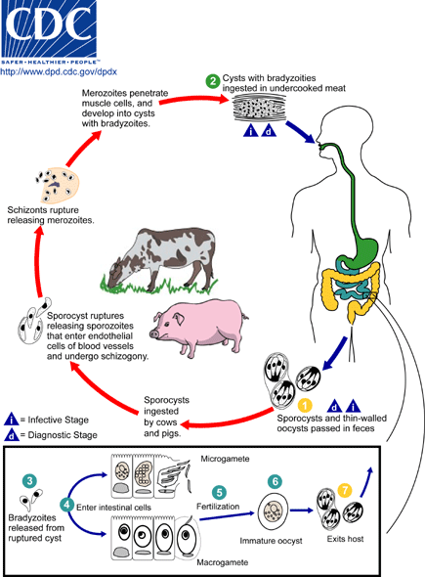

Slide 47
Clinical Features:
In cases of intestinal sarcocystosis, when humans serve as the definitive hosts, infections are often asymptomatic and clear spontaneously. Occasionally, mild fever, diarrhea, chills, vomiting and respiratory problems may occur. When humans become infected with sarcocysts of non-human species, the infections are not intestinal but rather result in muscle cysts; symptoms such as myalgia, muscle weakness and transitory edema may occur. In these cases, humans are dead-end intermediate hosts.

Slide 48
Laboratory diagnosis:
For intestinal sarcocystosis caused by S. hominis and S. suihominis, diagnosis is made by the observation of oocysts or sporocysts in stool. They are easily overlooked as they are often shed in small numbers. Also, the two species cannot be separated by oocyst or sporocyst morphology. When humans serve as dead-end hosts for non-human Sarcocystis spp., diagnosis is made by the finding of sarcocysts in tissue specimens.

Slide 49
Treatment:
Currently, there is no prophylaxis or therapeutic treatment for either intestinal or tissue sarcocystosis.

