Slide 1
MALARIA
KIMAIGA H.O
MBChB (University of Nairobi)

Slide 2
INTRODUCTION
Malaria is a disease caused by the protozoan parasites of the genus plasmodium species,
Member of Apicomplexa
The 4 species that commonly infect man are:
Species | Major features
P. falciparum | The most important species as it is responsible for 50% of all malaria cases worldwide and nearly all morbidity and mortality from severe malaria Found in the tropics & sub-tropics
P. vivax | The malaria parasite with the widest geographical distribution Seen in tropical and sub-tropical areas but rare in Africa Estimated to cause 43% of all malaria cases in the world
P. ovale | This species is relatively rarely encountered Primarily seen in tropical Africa, especially, the west coast, but has been reported in South America and Asia
P. malariae | Responsible for only 7% of malaria cases Occurs mainly in sub-tropical climates

Slide 3
Four species of importance to man
Caused by a protozoan parasite- plasmodium parasites
Non motile protozoa
Malaria parasites belong to the genus Plasmodium (phylum Apicomplexa)
  Plasmodium falciparum - malignant tertian, subtertian
  Plasmodium vivax - benign tertian malaria
  Plasmodium malaria -Quartan malaria - paroxysms every 72 hours (4 days by Roman time).
  Plasmodium ovale - mild tertian malaria

Slide 4
Epidemiology
40% of the world’s population lives in endemic areas
3-500 million clinical cases per year
1.5-2.7 million deaths (90% Africa)
Malaria is transmitted by the female anopheles mosquito.
  Factors which affect mosquito ecology, such as temperature and rainfall, are key determinants of malaria transmission.
  Mosquitoes breed in hot, humid areas and below altitudes of 2000 meters.
  Development of the malaria parasite occurs optimally between 25-30ºC and stops below 16ºC. Indigenous malaria has been recorded as far as 64ºN and 32ºS.
  Malaria largely in tropics, previously in the temperate regions - has been eradicated in Europe & parts of Asia
Increasing problem in sub-Saharan Africa (re-emerging disease)
  Resurgence in some areas
  Drug resistance (mortality)
  Other important factors include the persistence of poverty, HIV/AIDS, mosquito resistance to insecticides, weak health services, conflict and population migration.

Slide 5
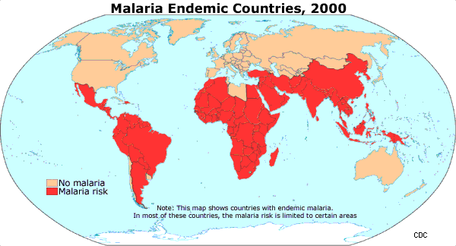

Slide 6
MALARIA TRANSMISSION
Other methods of transmission include:
  Transfusion malaria: Transfusion of infected blood
  Congenital malaria: Verticle transmission (from mother to foetus) transplacental
  Using contaminated syringes e.g. by drug addicts
  Accidental inoculation in malaria research labs.

Slide 7
Malaria Transmission
Malaria parasites are transmitted from one person to another by the bite of a female anopheles mosquito.
The female mosquito bites during dusk and dawn and needs a blood meal to feed her eggs.
Male mosquitoes do not transmit malaria as they feed on plant juices and not blood.
There are about 380 species of anopheles mosquito but only about 60 are able to transmit malaria.
Like all mosquitoes, anopheles breed in water - hence accumulation of water favours the spread of the disease.
NB: anopheline mosquitoes breed in natural, and clean water thus malaria is rare in Nairobi ∵ of lack of clean natural water! Only female mosquitoes take blood!

Slide 8
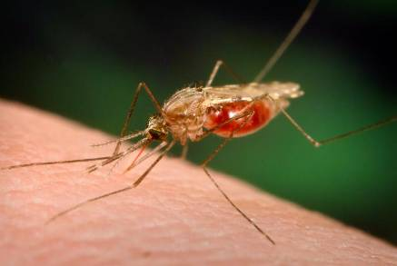
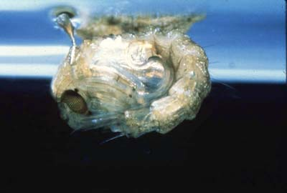
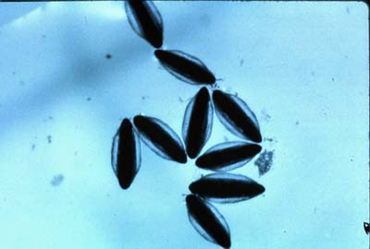
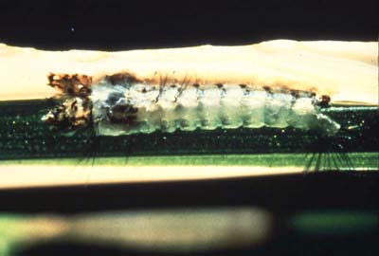
Malaria - Vectors
Anopheles freeborni

Slide 9
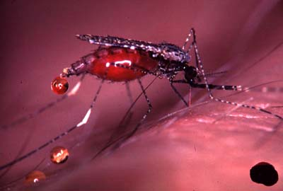
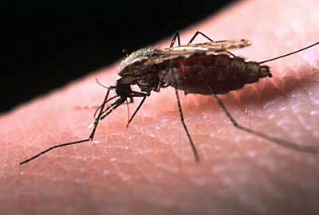
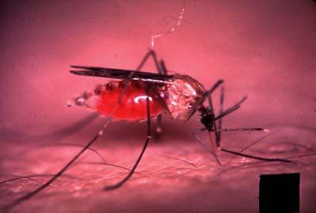
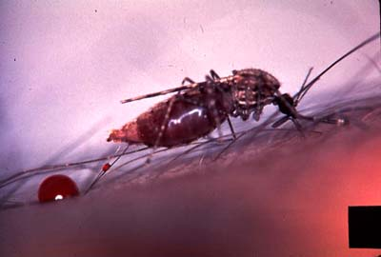
Malaria – Vectors (cont.)
Anopheles balabacensis
A. gambiae
A. freeborni
A. stephensi

Slide 10
Morphology
Sporozoites – infective stages of malaria
Schizonts
  Merozoites - within schizonts
Gametocytes
  picked by mosquitoes
Trophozoites
  used by Dx (found in RBCs)

Slide 11
Life cycle
Human (Intermediate host)
Female Anopheles mosquito (definitive host)
Infective stage is the sporozoites
Mosquitoes deposit them from their salivary glands during the bites
Sporozoites get picked up by macrophages & circulate in the blood for about 30 minutes after which they go to the liver and get trapped by liver (receptor-ligand).

Slide 12
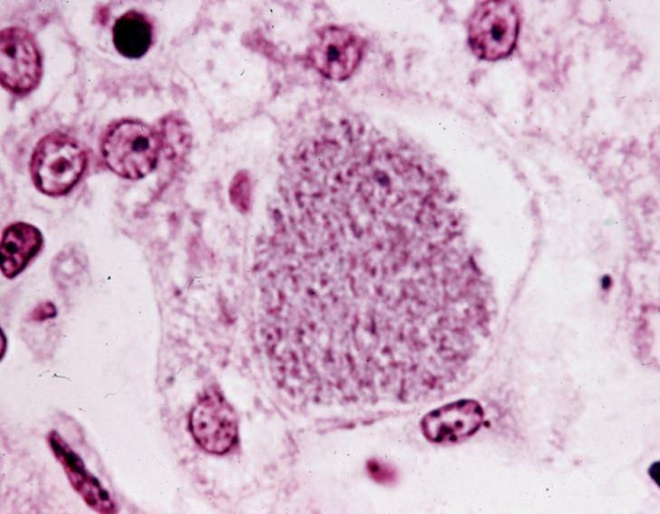
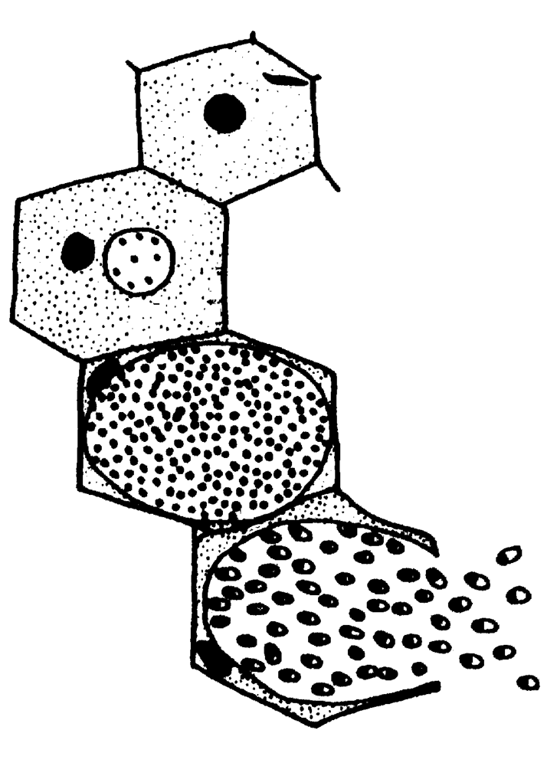
In the liver they evade and infect the hepatocytes. This is the pre-erythrocytic phase/ Exoerythrocytic Schizogony
This phase has no fever
They develop by asexual replication to schizonts (circular structures with 1000-10,000 merozoites inside) 6-15 days.
These are known as the liver schizonts formed from the sprozoites.

Slide 13
Schizonts rupture to release merozoites that get to the circulation
Merozoites invade (using receptors) RBC -Erythrocytic Stage
Within RBCs they develop into trophozoites
The young trophozoite called ‘ring form’ mature into erythrocytic schizonts
Merozoites inside the erythrocytic schizonts keep on multiplying

Slide 14
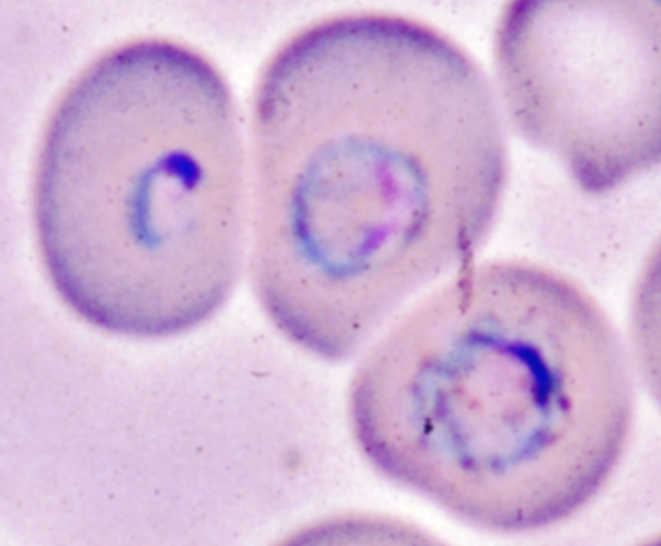
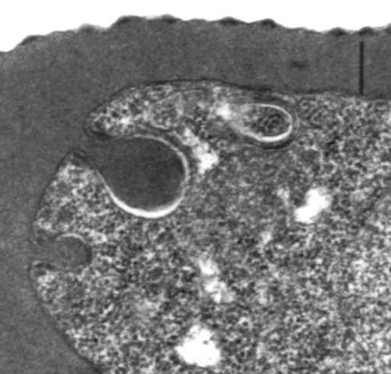
The schizonts ingests host hemoglobin- Cytostome, food vacuole, hemozoin (malarial pigment)
Requires haemoglobin from the RBCs of human for metabolism transforming it into malaria pigment which can be used by the parasite.
Causes RBC to rupture releasing millions of merozoites that infect other RBCs.
It is a cascade of events. In this erythrocytic phase, there is fever that can continue, if not treated, till death

Slide 15
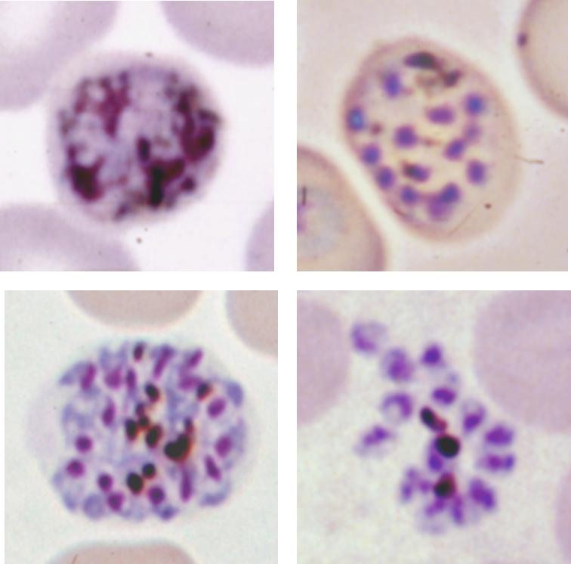

Slide 16
Some of the schizonts undergo sexual differentiation with formation of microgametocytes (male gametocytes) & macrogametocytes (female gametocytes) which are then ingested by a mosquito (female Anopheles mosquito)
When in the mid-gut of the mosquito, fusion of the 2 gametocytes occurs (sexual reproduction). Gametoctye activating factor in mosquito is xanthurenic acid
Fertilization occurs forming a zygote which penetrates from the gut into the thoracic cavity of the mosquito forming a ookinite. (~24 hr)

Slide 17
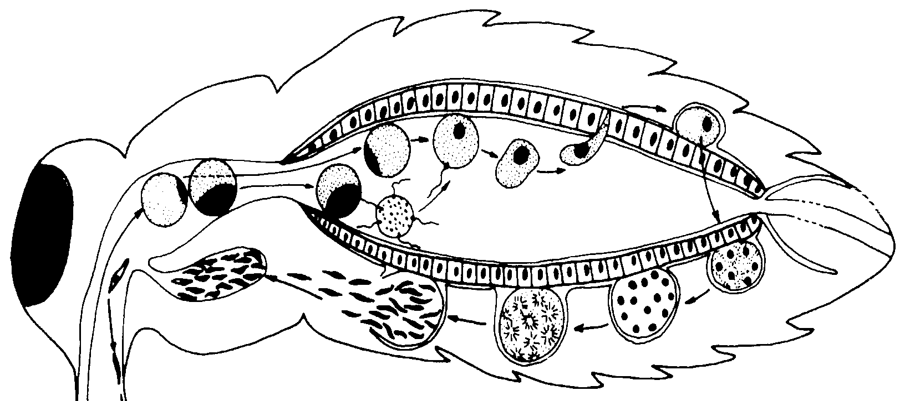
It develops into an oocyte then to sporozoites which then migrate through hemocoel to the thorax of the mosquito.
The sporozoites enter the mouth parts of the mosquito (salivary glands)
Mosquito bites deposits sporozoites into another host human beings during a blood meal.

Slide 18
Hypnozoite Forms
In two spp, P. vivax and P. ovale, the sporozoites deposited do not all develop into liver schizonts; they develop into hypnozoites (dormant stages in the liver) and thus do not progress into the other stages
At some stage in life, they get reactivated and continue the cycle causing disease.
They are responsible for relapse in malaria.

Slide 19
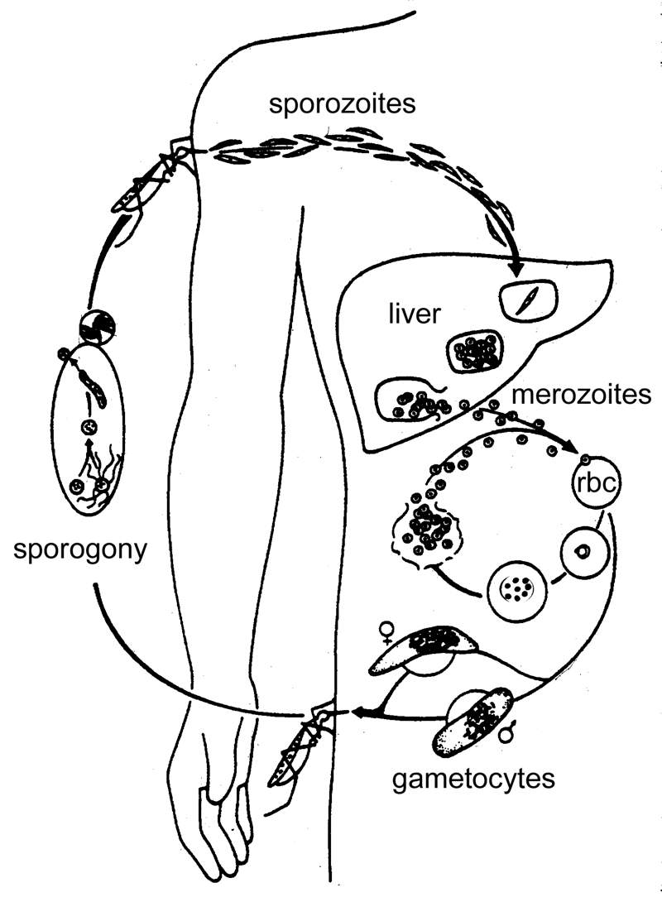

Slide 20
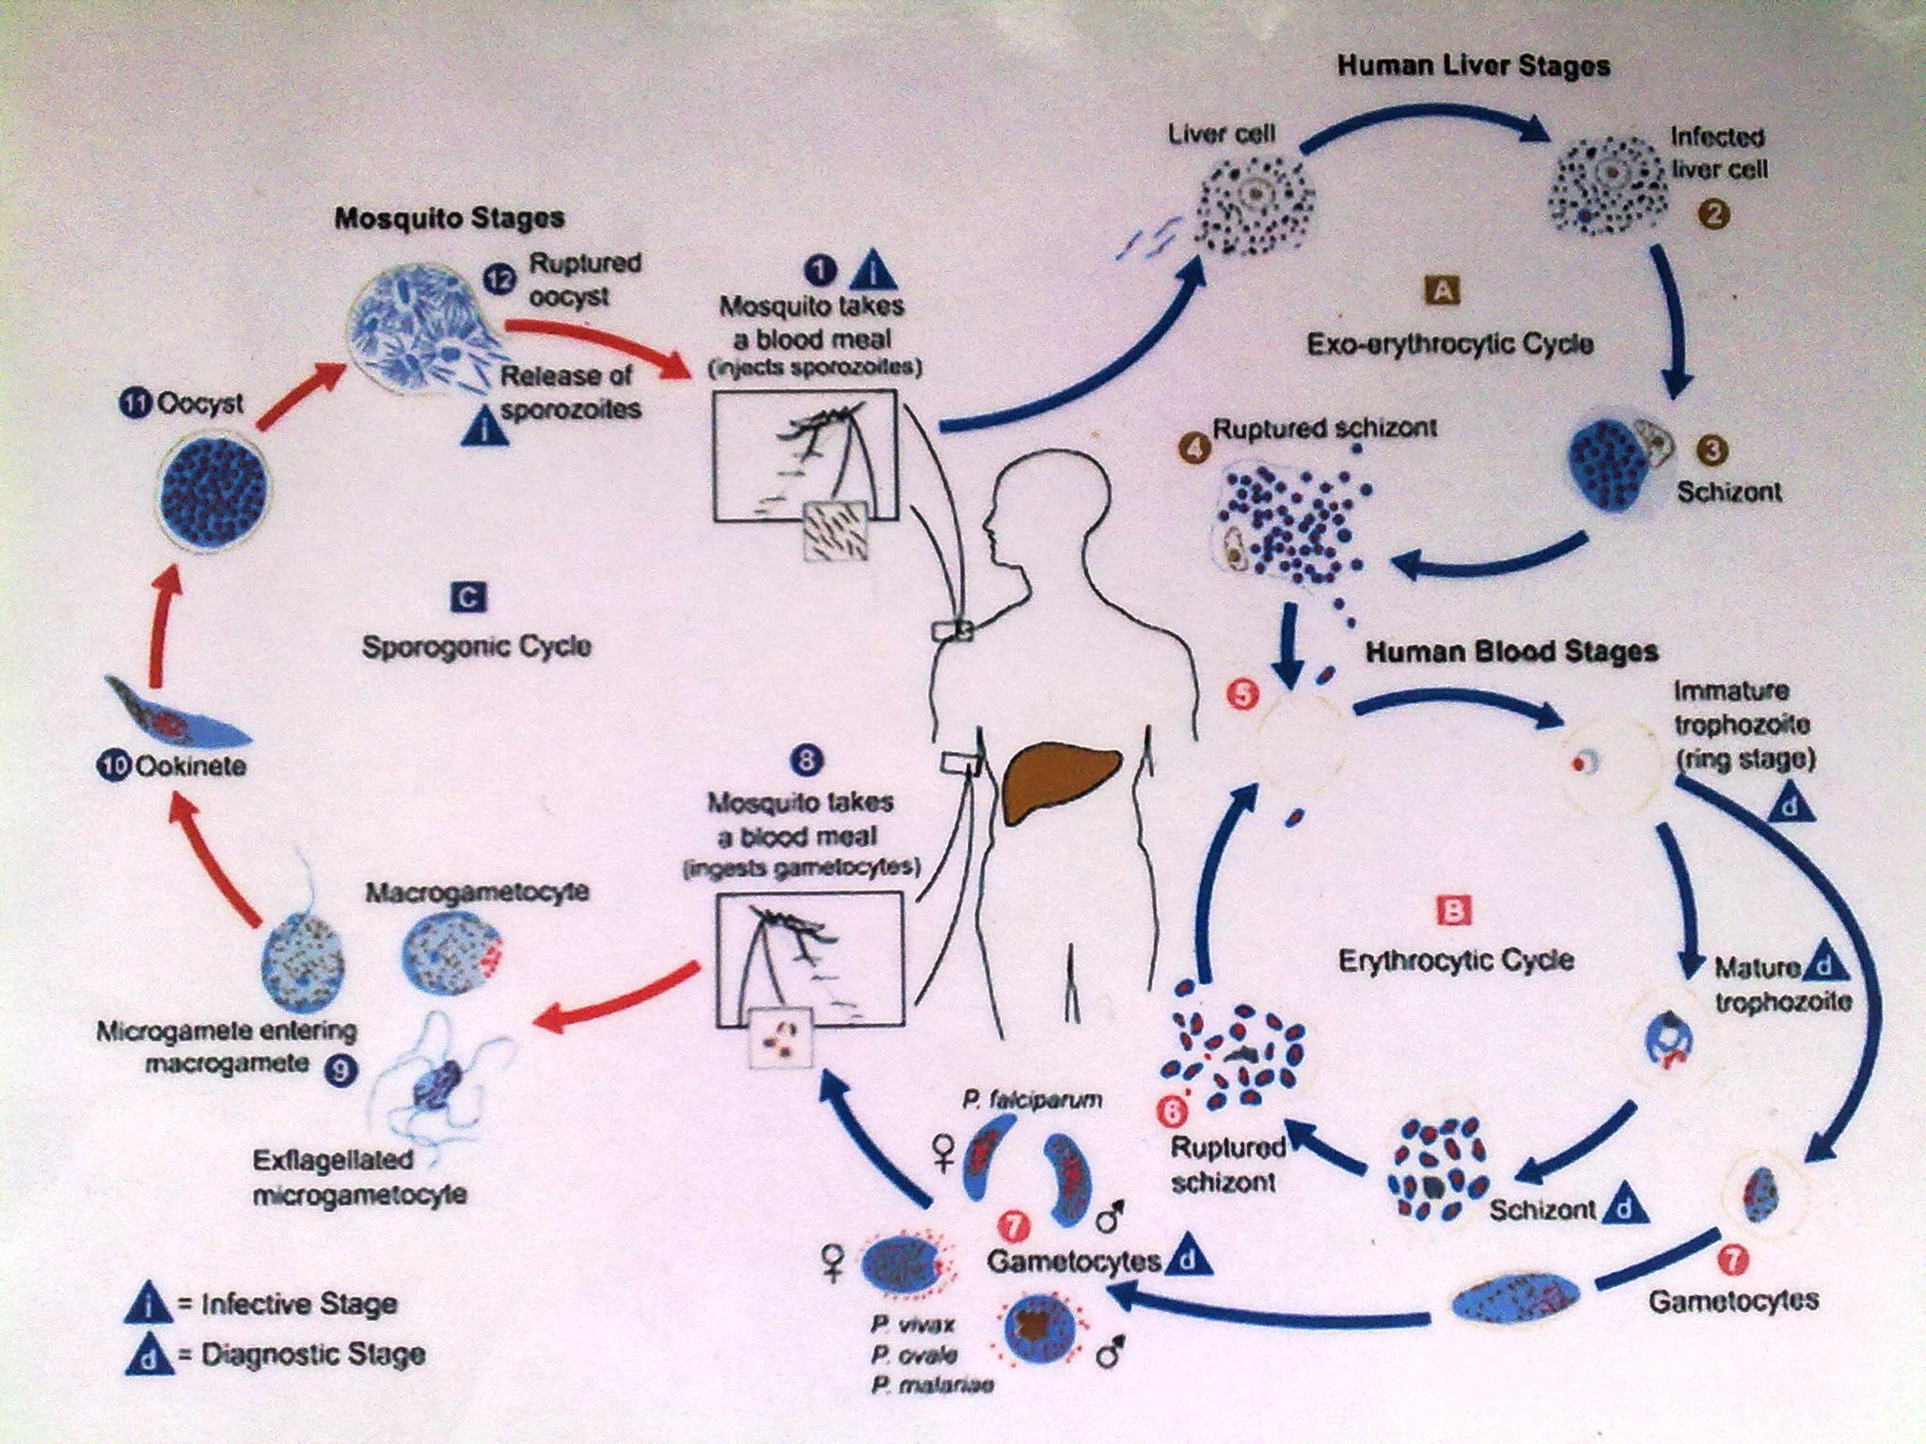

Slide 21
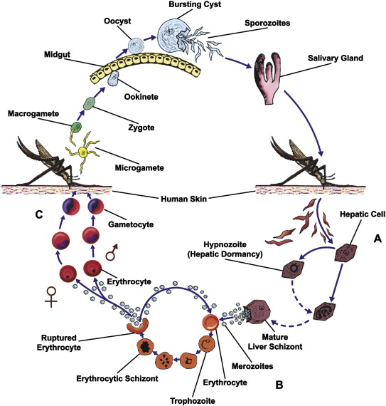

Slide 22
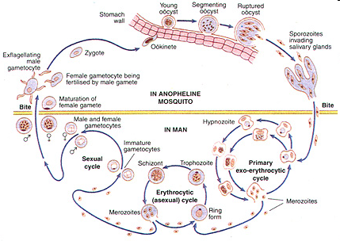

Slide 23
Clinical presentation
Manifestations and severity depend on species and host status, immunity, general health, nutritional state, genetics
Simple malaria
  Fever – usually irregular; alternates with shivering ( paroxysmal fever)
  Generalized weakness (malaise), joint weakness
  Hepatomegaly, splenomegaly, jaundice, Headache

Slide 24
  Diarrhoea – more commonly seen in young children and, when vomiting also occurs, may be misdiagnosed as viral gastroenteritis
  Nausea, Vomiting, loss of appetite
  Febrile convulsions in young children.
  Pallor of conjunctiva or beds of nails – resulting mainly from the lysis of red blood cells. Malaria also reduces the synthesis of red blood cells in the bone marrow.
  Jaundice – mainly due to haemolysis.

Slide 25
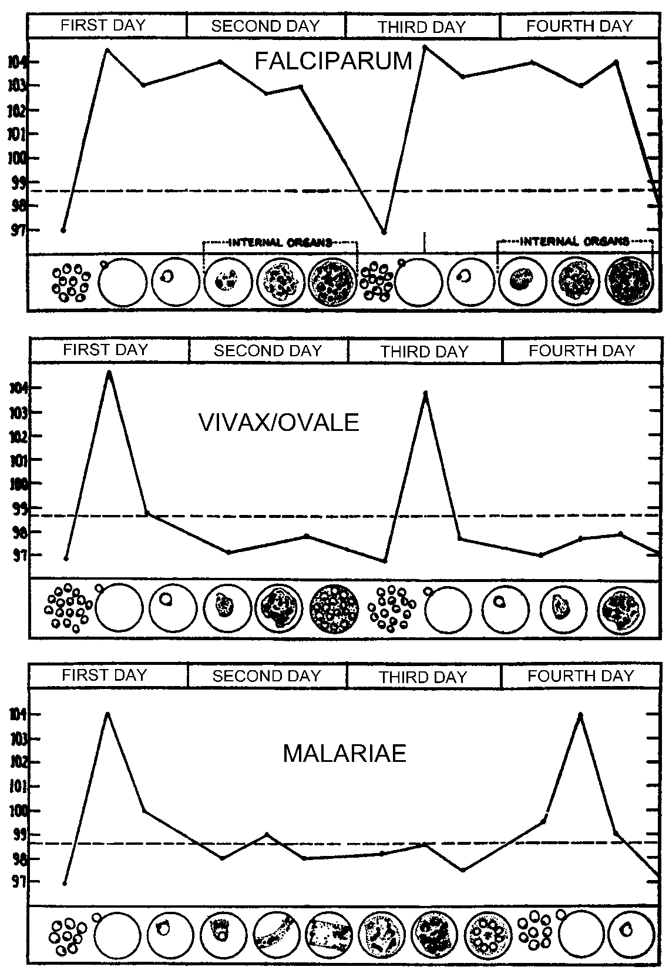
Malaria Paroxysm
Characterized by acute febrile attacks
  Periodic episodes of fever alternating with symptom-free periods
Paroxysms associated with synchrony of merozoite release
Between paroxysms temperature is normal and patient feels well
P. falciparum may not exhibit classic paroxysms (continuous fever)

Slide 26
Severe complicated malaria
  The following are 8 important severe manifestations of malaria:
    Cerebral malaria
    Severe malaria anaemia
    Hypoglycemia
    Metabolic acidosis
    Acute Renal Failure
    Acute Pulmonary oedema
    Circulatory collapse, hypovolemic shock or “algid malaria”
    Haemoglobinuria or “Blackwater Fever”
  Note: It is common for an individual patient to have more than one severe manifestation of malaria!
Notes:
Sequestration of parasitised red cells in different tissues probably underlies most severe manifestations of malaria

Slide 27
1. Cerebral malaria
The most well-known severe manifestation of malaria
Defined as:
  The illness may start with drowsiness and confusion and then progress to unarousable coma persisting for more than one hour
  The loss of consciousness is often preceded by repeated convulsions. Mental confusion, violent patients, aggressive, coma and even death.
  Retinal haemorrhages may be seen on fundoscopy.
  Only caused by asexual forms of P. falciparum in the peripheral blood
  Result from sequestration of parasitised red cells in the small blood vessels in the brain causing making RBCs sticky; they stick to each other and to the endothelium thus
    Blocking the blood vessels of the brain and reducing cerebral blood flow
    Cerebral hypoxia
    Release of cytokines which in turn induce the release of nitrous oxide, a known depressor of consciousness
  Other common causes of encephalopathy excluded

Slide 28
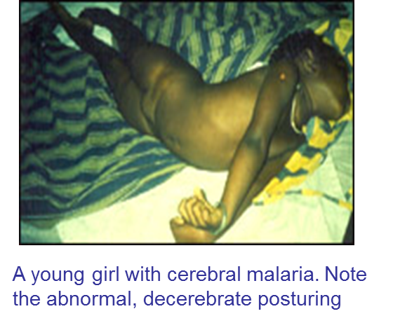
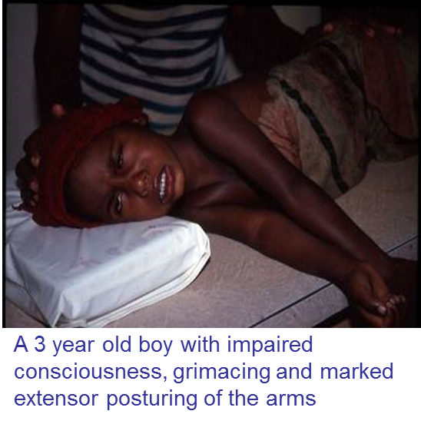
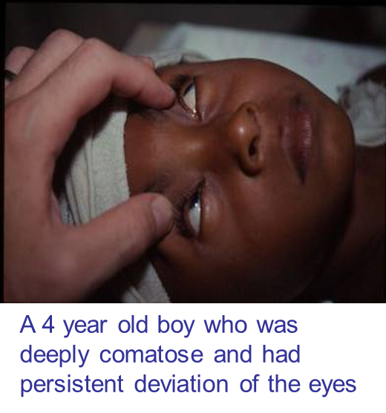
Occurs most commonly in young children although non-immune adults are also at risk
Cerebral malaria can rapidly progress to death, even with appropriate treatment. Case fatality is between 20-30%.
In survivors, resolution of coma usually occurs within 1-2 days in children and within 2-4 days in adults but may be complicated by neurological sequelae in ~5% adults and >10% of children.

Slide 29
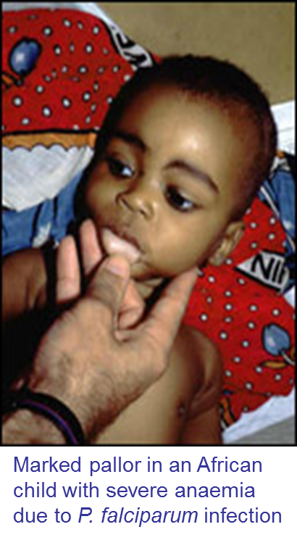
2. Severe malaria anaemia
Defined as a haematocrit of <15% or haemoglobin concentration <5 g/dl.
Occurs commonly in young children and pregnant women.
  Main cause of neonatal death
Anaemia in malaria results from a combination of factors:
Destruction of parasitised red blood cells
Destruction of unparasitised red cells by complement-mediated lysis
Bone marrow suppression by cytokines produced by malaria parasites
Haemolysis induced by medications in individuals with glucose-6-phosphate dehydrogenase deficiency
Many patients require urgent transfusion. The condition may be rapidly fatal when blood transfusion is delayed.

Slide 30
3. Hypoglycaemia
Blood sugar <2.5 mmol/L
Increases the risk of mortality and sequelae in children with cerebral malaria; may present with convulsions or a deterioration in level of consciousness.
Results from a combination of factors:
  reduced glycogen stores because of reduced food intake
  increased metabolism due to fever and repeated convulsions
  glucose consumption by malaria parasites
  cytokine or quinine-stimulated hyperinsulinaemia

Slide 31
4. Metabolic acidosis
Lactic acidosis is a major contributor and probably results from tissue anoxia and anaerobic glycolysis
Presents with deep, rapid respirations (as in diabetic ketoacidosis)

Slide 32
5. Acute renal failure
Due to stromal necrosis. The capillaries supplying the kidneys are occluded
Occurs almost exclusively in adults and older children in areas of unstable malaria
Affected patients are usually oliguric (urinary output <400 ml/day) or anuric (<50 ml/day)
serum creatinine levels are elevated

Slide 33
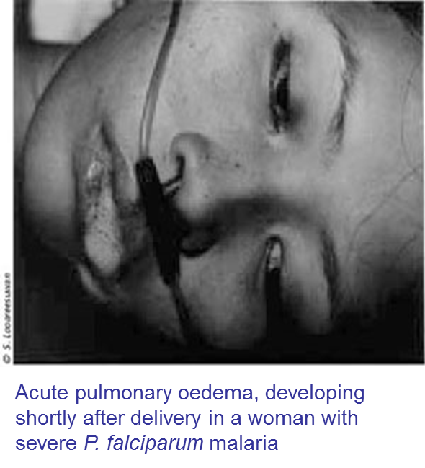
6. Acute pulmonary oedema
This is a grave and usually fatal manifestation of severe falciparum malaria and occurs mainly in adults. Hyperparasitaemia, renal failure and pregnancy are recognised predisposing factors and the condition is commonly associated with hypoglycaemia and metabolic acidosis.

Slide 34
7. Circulatory collapse, shock, “algid malaria”
Features of circulatory collapse (cold/clammy skin, hypotension, peripheral cyanosis, weak/thready pulses) may be seen in patients with severe P. falciparum malaria.
“Algid malaria” is characterised by hypotension, vomiting, diarrhoea, rapid respiration and oliguria. This condition is associated with a poor prognosis.

Slide 35
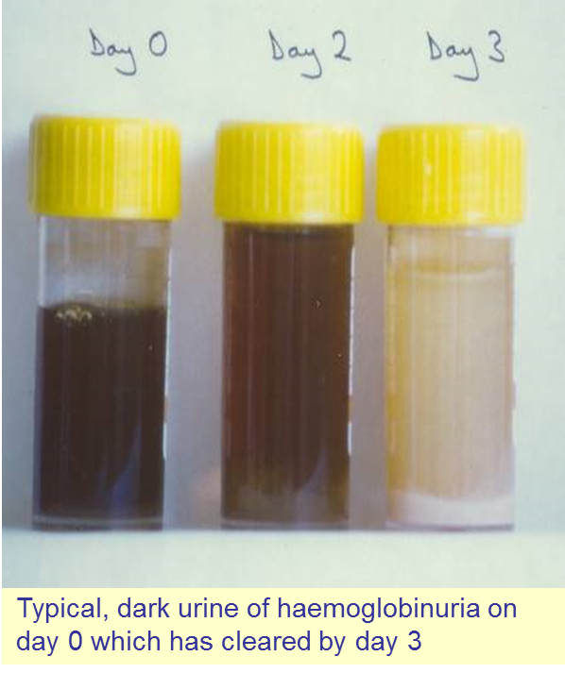
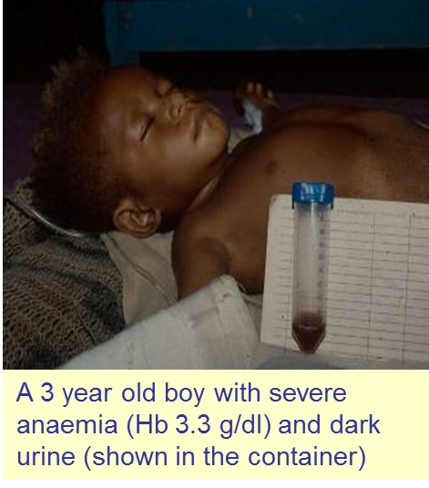
8. Haemoglobinuria or “Blackwater Fever”
Due to massive intravascular haemolysis/ excessive destruction of RBCs and hemoglobin goes into urine
The condition presents with severe pallor, jaundice, passage of dark urine/ haemoglobinuria. It may be associated with acute renal failure.

Slide 36
Summary of differences in the clinical features of severe malaria in adults and children
Frequency of occurrence
Clinical Manifestation | Children | Adults
Similar in adults and children Prostration Circulatory collapse | +++ + | +++ +
More common in children Cerebral malaria Severe anaemia Multiple convulsions Metabolic acidosis Hypoglycaemia | +++ +++ +++ +++ ++ | ++ + + + + / -
More common in adults Jaundice Pulmonary oedema Haemoglobinuria Abnormal bleeding Renal failure | + + / - + / - + / - + / - | +++ ++ + + +

Slide 37
In pregnancy
  Spontaneous abortions
  Premature delivery and intrauterine growth retardation result in the delivery of low birth weight infants
  Intra-uterine death
  Stillbirths
  Maternal anaemia
Chronic complication
  Tropical splenomegaly syndrome a.k.a hyperimmune malaria splenomegaly
  Recurrent anaemias
  Spleen can easily rupture

Slide 38
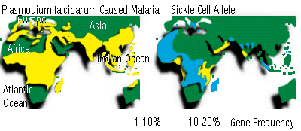
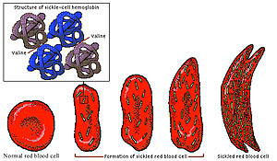
Malaria and Sickle cell anemia
Notes:
Univ. Michigan, Global Change Program and VCU Dept. Pediatrics

Slide 39
  Thick smears- dx because it detects light infections (larger blood volume); don’t show spp
  Thin smear- shows features of the parasites for species identification

Slide 40
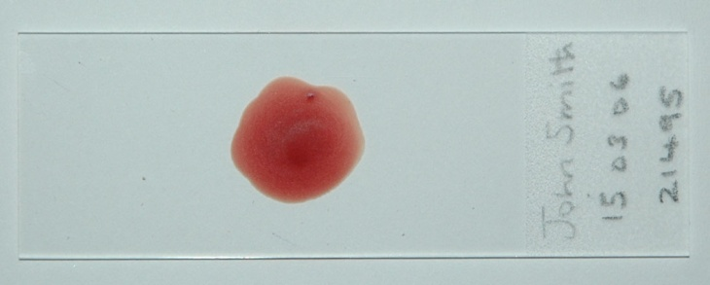
Laboratory diagnosis
Blood Film (or “smears”) Examination
Blood smears; thin & thick smears have remained the gold standard for the diagnosis of malaria. The films are stained and examined by microscopy.
Thick blood film - Used for detecting malaria: A drop of blood is spread over a small area. When dry, the slide is stained with Field’s or Giemsa stains. The red cells lyse leaving behind the parasites. A larger volume of blood is examined allowing detection of even light infections. Also used for determining parasite density and monitoring the response to treatment. Don’t show spp.

Slide 41
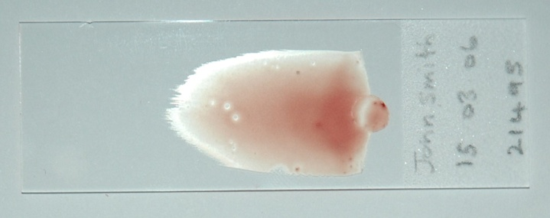
Thin blood film –A small drop of blood is spread across a microscope slide, fixed in methanol and stained with Giemsa stain.
The microscopist finds the area of the film where red cells are lying next to each other. The fine details of the parasites can be examined to determine the species.
Gives more information about the parasite morphology and, therefore, is used to identify the particular infecting species of Plasmodium.
Does not detect low parasitaemia

Slide 42
Antigen detection tests
  Uses a dipstick and a finger prick blood sample.
  Antibody strips for detection of malarial antigens in blood (do not distinguish species)
  Rapid diagnosis - results are available in 10-15 minutes. Expensive and sensitivity drops with decreasing parasitaemia.
Quantitive Buffy coat exam (QBC)
  Use fluorescent microscopy
  Acridine dye used as stain
PCR based techniques for research purposes
  Detects DNA or mRNA sequences specific to Plasmodium. Sensitivity and specificity high but test is expensive, takes several hours and requires technical expertise

Slide 43
Fluorescent techniques. Relatively low specificity and sensitivity. Cannot identify the parasite species. Expensive and requires skilled personnel.
Serologic tests. Based on immunofluorescence detection of antibodies against Plasmodium species. Useful for epidemiologic and not diagnostic purposes.

Slide 44
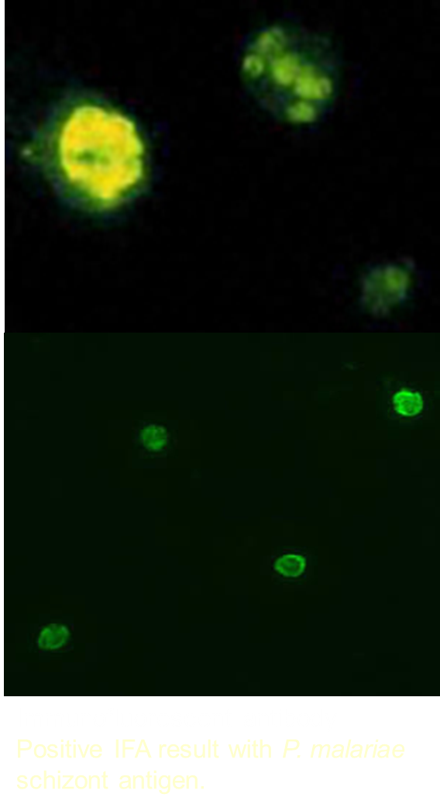
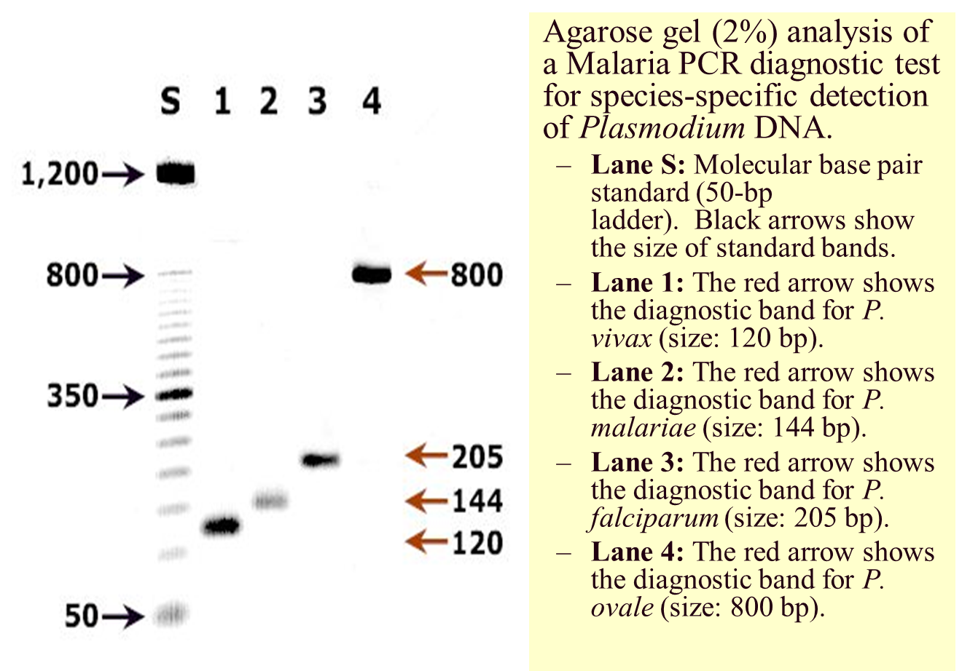

Slide 45
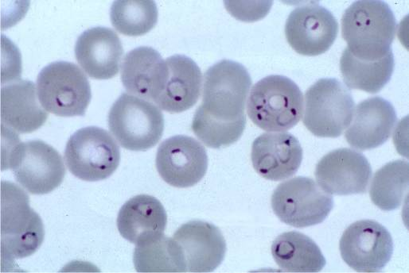
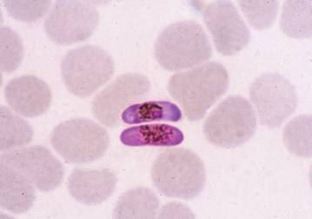
Appearance of P. falciparum in thin blood films
Ring forms or trophozoites; many red cells infected – some with more than one parasite
Gametocytes (sexual stages); After a blood meal, these forms will develop in the mosquito gut

Slide 46
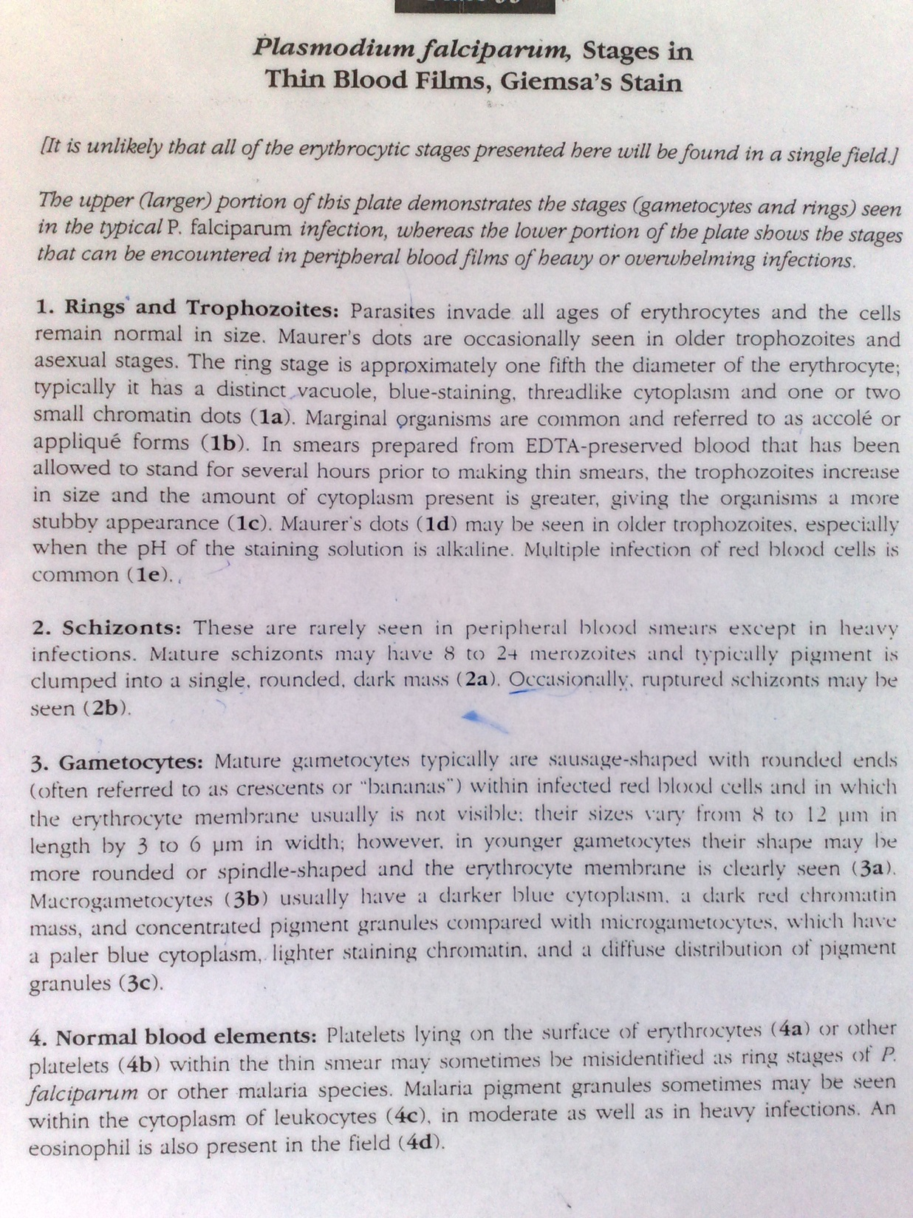
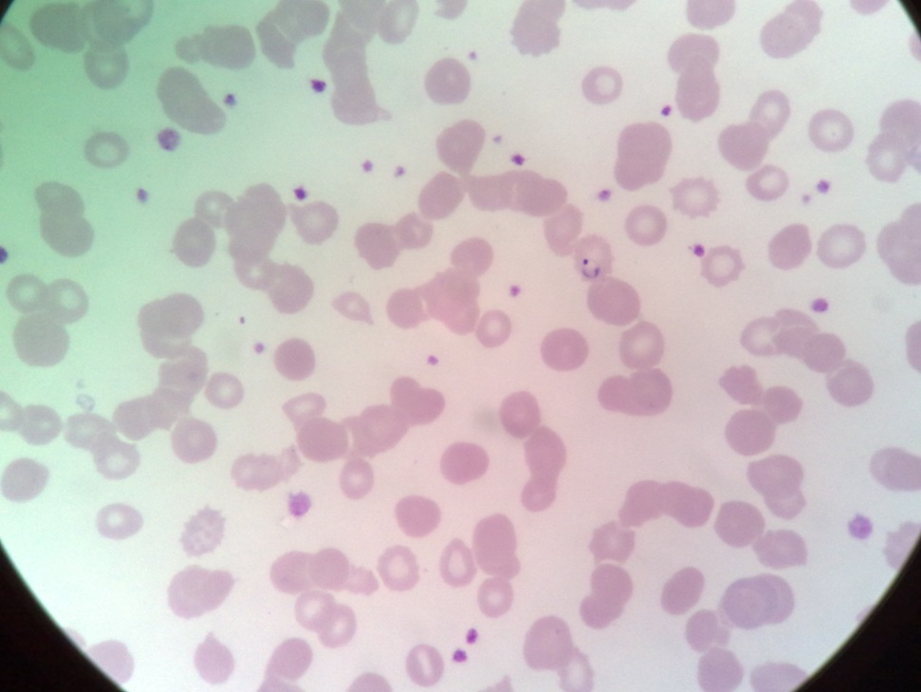
P.falciparum thin Bld film

Slide 47
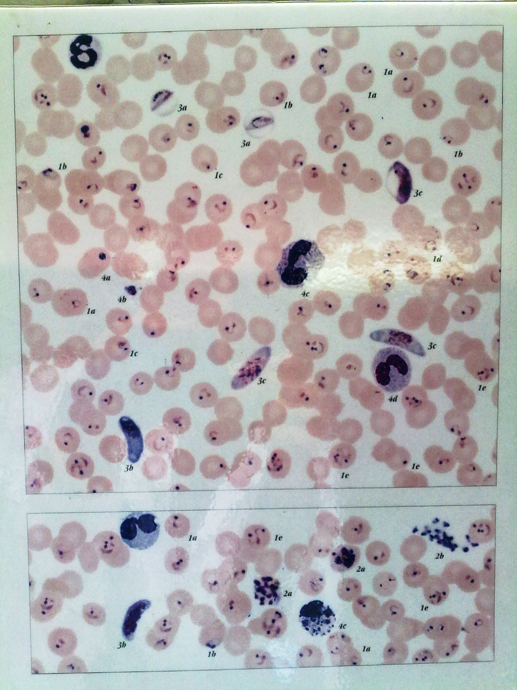

Slide 48
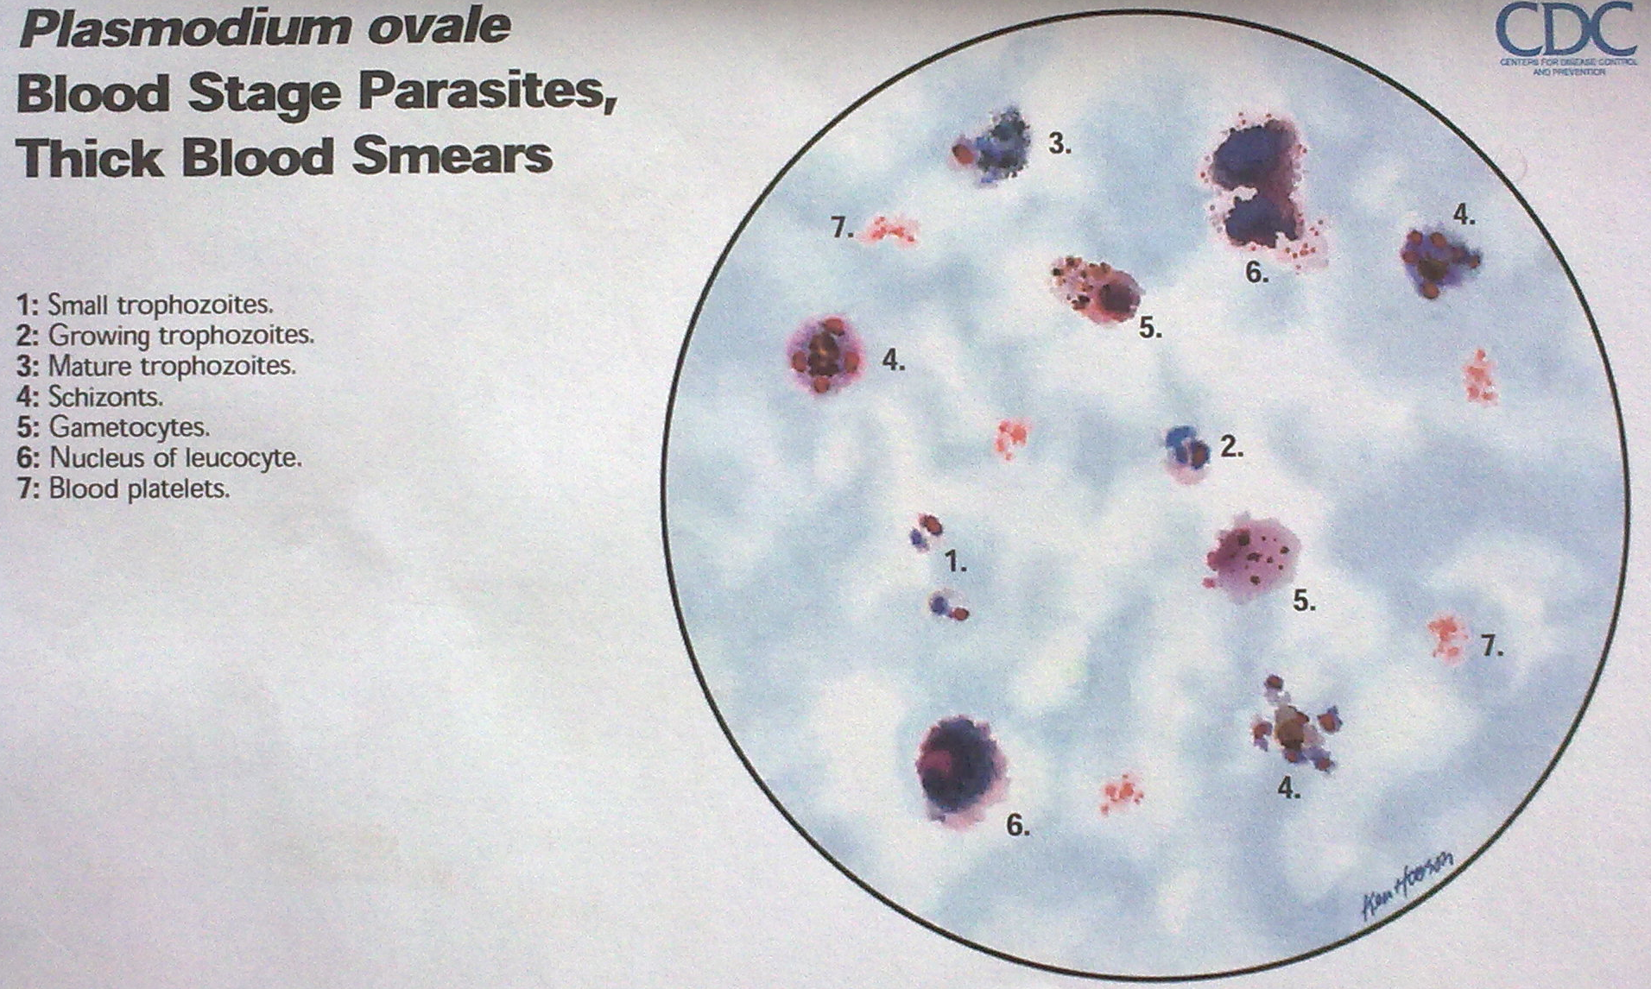

Slide 49
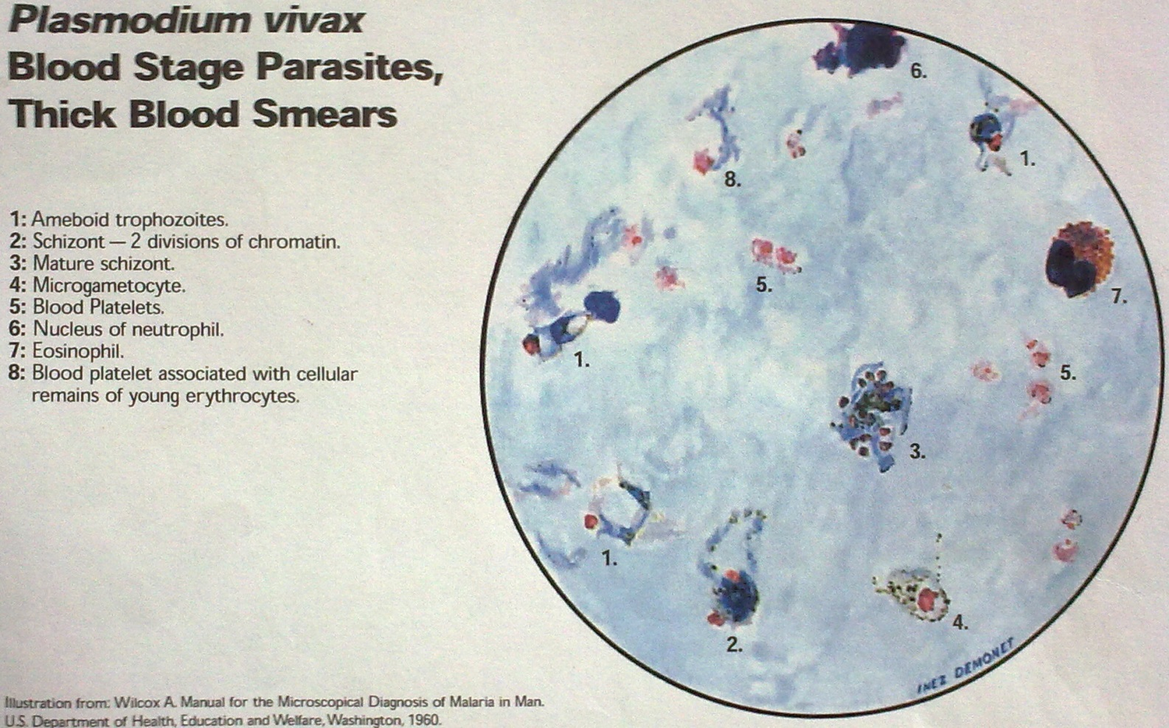

Slide 50
Comparison of Plasmodium Species Which Cause Malaria in Humans
Plasmodium species | Stages found in blood | Appearance of Erythrocyte (RBC) | Appearance of Parasite
P. falciparum Images | Ring Images | normal; multiple infection of RBC more common than in other species; Maurer's clefts (under certain staining conditions) | delicate cytoplasm; 1 to 2 small chromatin dots; occasional appliqué (accolé) forms
 | Trophozoite Images | normal; rarely, Maurer's clefts (under certain staining conditions) | seldom seen in peripheral blood; compact cytoplasm; dark pigment
 | Schizont Images | normal; rarely, Maurer's clefts (under certain staining conditions) | seldom seen in peripheral blood; mature = 8 to 24 small merozoites; dark pigment, clumped in one mass
 | Gametocyte Images | distorted by parasite | crescent or sausage shape; chromatin in a single mass (macrogametocyte) or diffuse (microgametocyte); dark pigment mass

Slide 51
Plasmodium species | Stages found in blood | Appearance of Erythrocyte (RBC) | Appearance of Parasite
P. vivax Images | Ring Images | normal to 1.25×, round; occasionally fine Schüffner's dots; multiple infection of RBC not uncommon | large cytoplasm with occasional pseudopods; large chromatin dot
 | Trophozoite Images | enlarged 1.5 to 2×; may be distorted; fine Schüffner's dots | large amoeboid cytoplasm; large chromatin; fine, yellowish-brown pigment
 | Schizont Images | enlarged 1.5 to 2×; may be distorted; fine Schüffner's dots | large, may almost fill RBC; mature = 12 to 24 merozoites; yellowish-brown, coalesced pigment
 | Gametocyte Images | enlarged 1.5 to 2×; may be distorted; fine Schüffner's dots | round to oval; compact; may almost fill RBC; chromatin compact, eccentric (macrogametocyte) or diffuse (microgametocyte); scattered brown pigment

Slide 52
Plasmodium species | Stages found in blood | Appearance of Erythrocyte (RBC) | Appearance of Parasite
P. ovale Images | Ring Images | normal to 1.25×, round to oval; occasionally Schüffner's dots; occasionally fimbriated; multiple infection of RBC not uncommon | sturdy cytoplasm; large chromatin
 | Trophozoite Images | normal to 1.25×; round to oval; some fimbriated; Schüffner's dots | compact with large chromatin; dark-brown pigment
 | Schizont Images | normal to 1.25×, round to oval, some fimbriated, Schüffner's dots | mature = 6 to 14 merozoites with large nuclei, clustered around mass of dark-brown pigment
 | Gametocyte Images | normal to 1.25×; round to oval, some fimbriated; Schüffner's dots | round to oval; compact; may almost fill RBC; chromatin compact, eccentric (macrogametocyte) or more diffuse (microgametocyte); scattered brown pigment

Slide 53
Plasmodium species | Stages found in blood | Appearance of Erythrocyte (RBC) | Appearance of Parasite
P. malariae Images | Ring Images | normal to 0.75× | sturdy cytoplasm; large chromatin
 | Trophozoite Images | normal to 0.75×; rarely, Ziemann's stippling (under certain staining conditions) | compact cytoplasm; large chromatin; occasional band forms; coarse, dark-brown pigment
 | Schizont Images | normal to 0.75×; rarely, Ziemann's stippling (under certain staining conditions) | mature = 6 to 12 merozoites with large nuclei, clustered around mass of coarse, dark-brown pigment; occasional rosettes
 | Gametocyte Images | normal to 0.75×; rarely, Ziemann's stippling (under certain staining conditions) | round to oval; compact; may almost fill RBC; chromatin compact, eccentric (macrogametocyte) or more diffuse (microgametocyte); scattered brown pigment

Slide 54
Plasmodium species | Stages found in blood | Appearance of Erythrocyte (RBC) | Appearance of Parasite
P. knowlesi Images | Ring Images | normal to 0.75×; multiple infection not uncommon. | delicate cytoplasm; 1 to 2 prominent chromatin dots; occasional appliqué (accolé) forms
 | Trophozoite Images | normal to 0.75×; rarely, Sinton and Mulligan's stippling (under certain staining conditions) | compact cytoplasm; large chromatin; occasional band forms; coarse, dark-brown pigment
 | Schizont Images | normal to 0.75×; rarely, Sinton and Mulligan's stippling (under certain staining conditions) | mature = up to 16 merozoites with large nuclei, clustered around mass of coarse, dark-brown pigment; occasional rosettes; mature merozoites appear segmented
 | Gametocyte Images | normal to 0.75×; rarely, Sinton and Mulligan's stippling (under certain staining conditions) | round to oval; compact; may almost fill RBC; chromatin compact, eccentric (macrogametocyte) or more diffuse (microgametocyte); scattered brown pigment

Slide 55
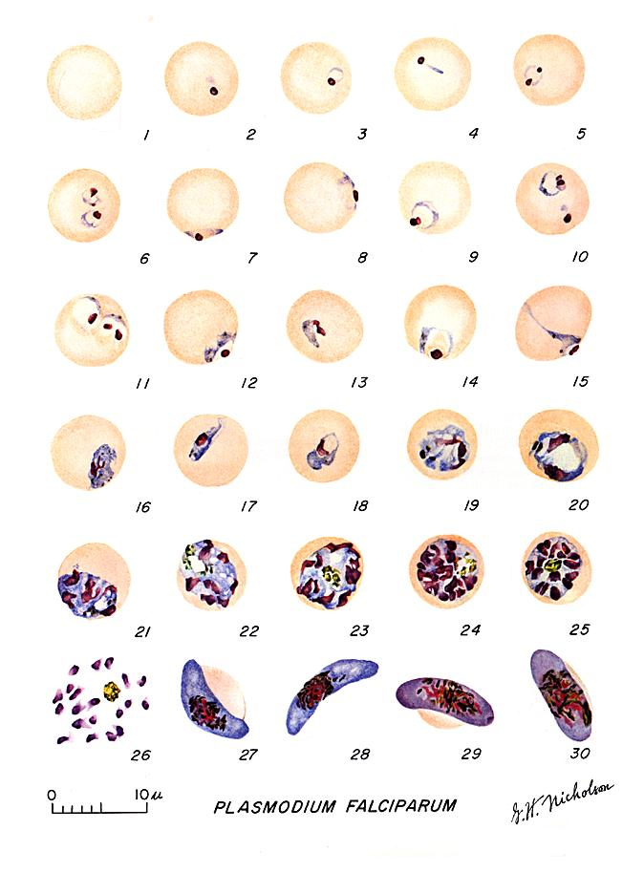
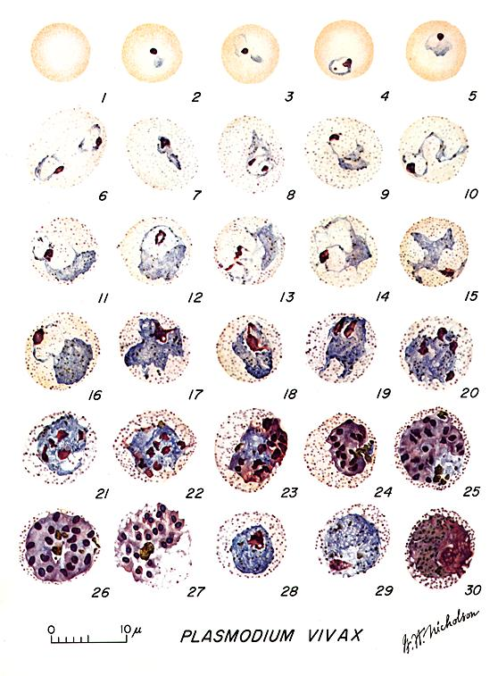
Malaria - Diagnosis

Slide 56
P. falciparum
Ring-form trophozoites (rings) of Plasmodium falciparum are often thin and delicate, measuring on average 1/5 the diameter of the red blood cell. Rings may possess one or two chromatin dots. They may be found on the periphery of the RBC (accolé, appliqué) and multiply-infected RBCs are not uncommon. Ring forms may become compact or pleomorphic depending on the quality of the blood or if there is a delay in making smears. There is usually no enlargement of infected RBCs.

Slide 60
Developing trophozoites of P. falciparum tend to remain in ring form, but may become thicker and more compact. The amount of pigment and chromatin may also increase. Compact or amoeboid forms may be seen in smears where there was a delay in processing the blood.

Slide 63
Schizonts are rarely seen in peripheral blood of Plasmodium falciparum infections, except in severe cases. When seen, schizonts contain anywhere from 8-24 merozoites. A mature schizont usually fills about 2/3 of the infected RBC.

Slide 65
Gametocytes of Plasmodium falciparum are crescent- or sausage-shaped, and are usually about 1.5 times the diameter of an RBC in length. The cytoplasm of the macrogametocytes (female) are usually a darker, deeper blue; the cytoplasm of the microgametocytes (male) is usually more pale. The red chromatin and pigment is more coarse and concentrated in the macrogametocytes than the microgametocytes. Sometimes in thin blood smears, the remnants of the host RBC can be seen; this is often referred to as Laveran's bib

Slide 69
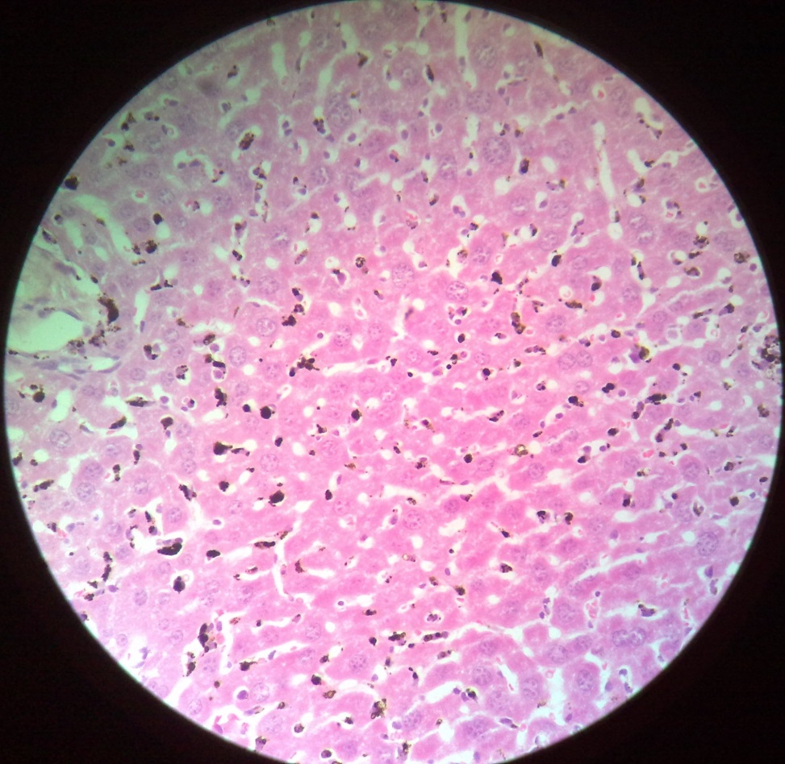
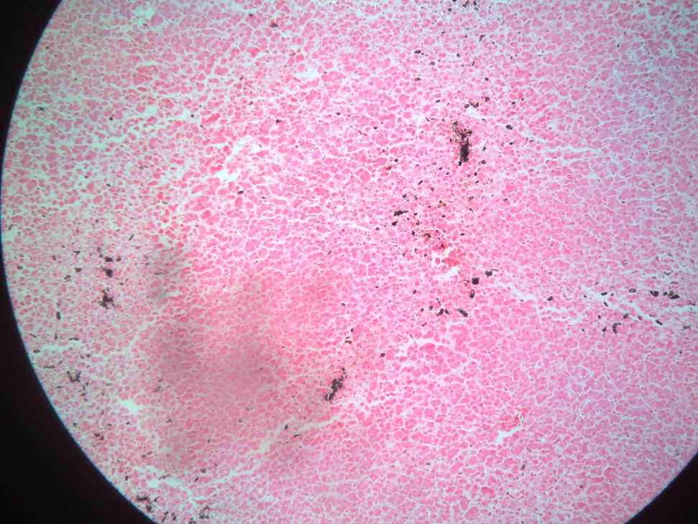
Malaria pigmentation
Malaria pigmentation

Slide 70
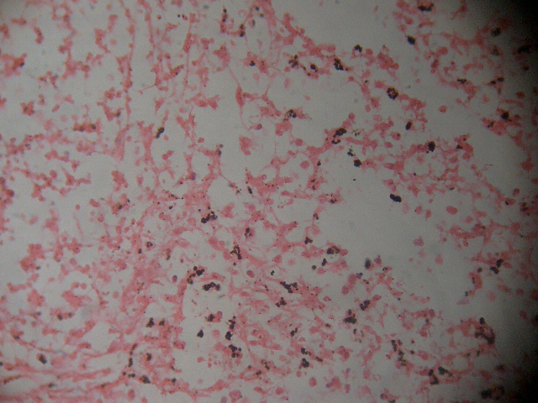
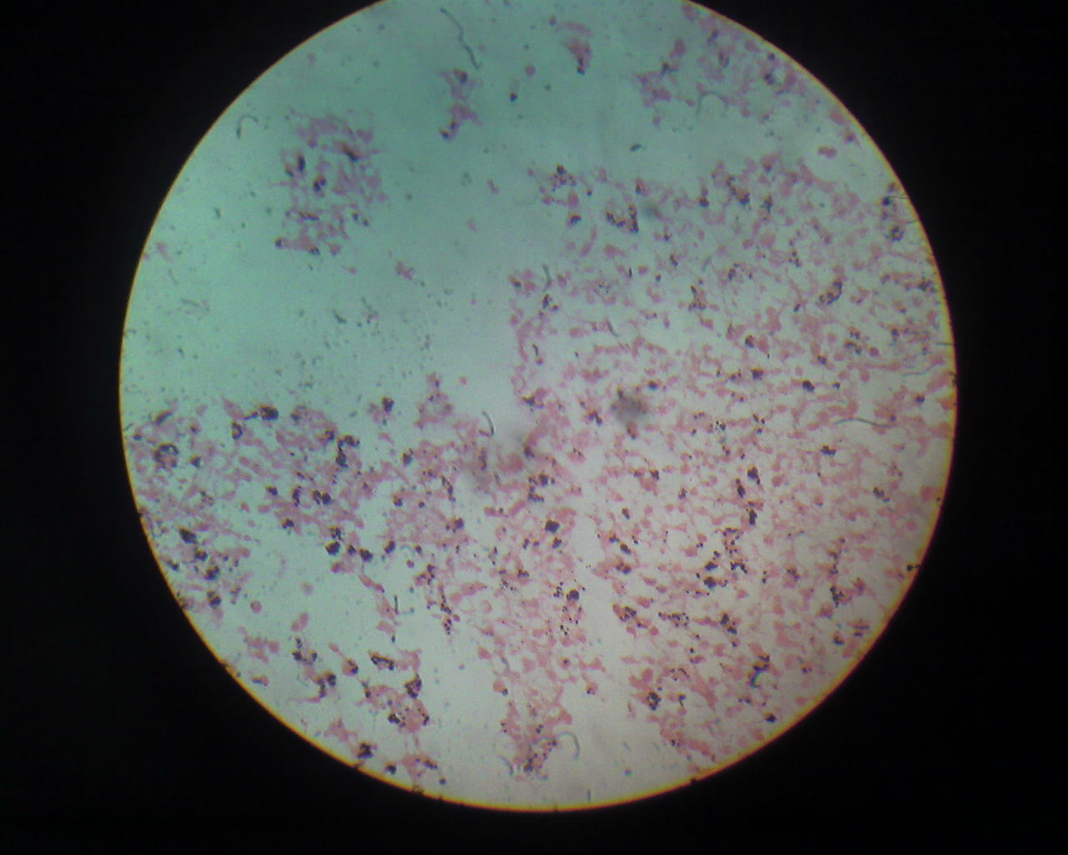
Malaria pigmentation
Malaria pigmentation

Slide 71
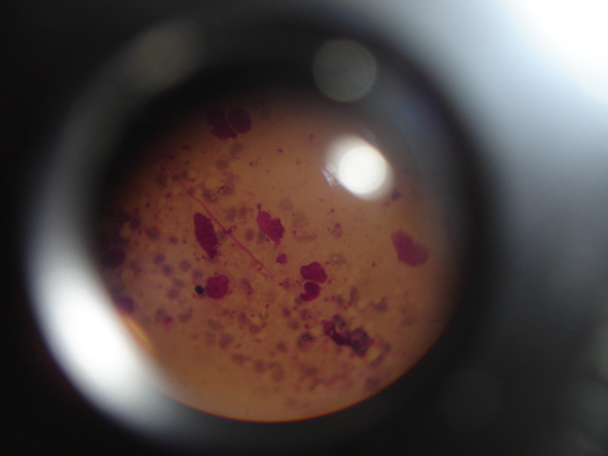
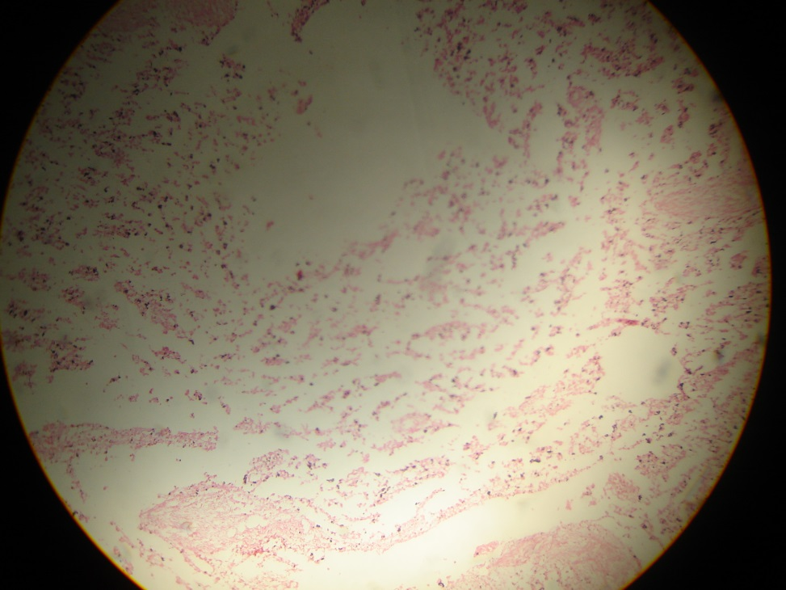
Malaria pigmentation
Malaria pigmentation

Slide 72
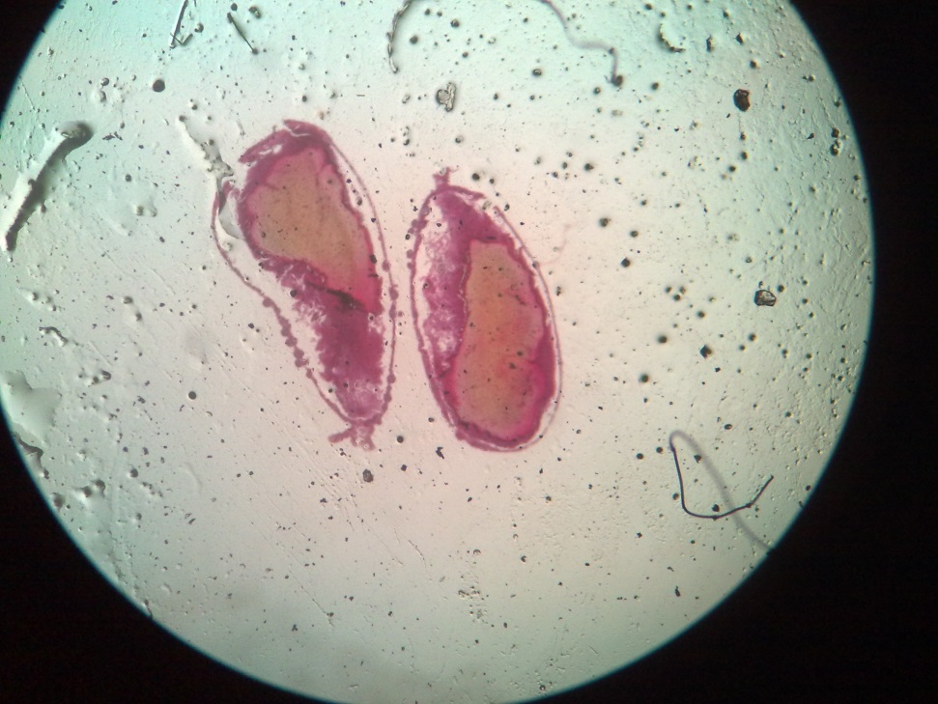
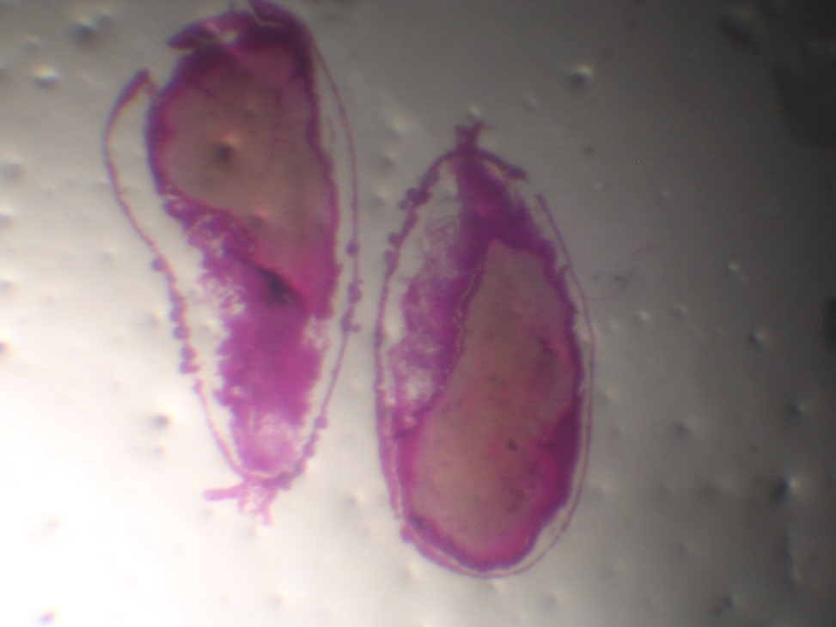
Pl. Oocysts in mosquito gut
Protozoa-Malaria Oocyst

Slide 73


Ooocytes

Slide 74


P. Falciparum gametocyte
P. Falciparum gametocyte

Slide 75

P. Falciparum trophozoites

Slide 76


Tphozoites P.falciparum blood
Tphozoite of P.ovale

Slide 77


P_malariae_trophozoite_bandform2
P_malariae_trophozoite_basket1

Slide 78


Schizont P. Malariae

Slide 79


Sporozoites Pl spp
Tzoites Ps in thick bld flm

Slide 80


Band form P.malariae

Slide 81


Band form P.malariae

Slide 82


Cerebral Malaria

Slide 83





Slide 84



Slide 85


Troph of pla in thick bld fi
Troph of p. In thin bld flm

Slide 86

P. Falciparum thick smear

Slide 87


P.malariae thin Bld film

Slide 88


Slide 89


P.vivax thin Bld film

Slide 90


P.ovale thin Bld film

Slide 91


Malaria in thick bld film
Pl. Thick smear

Slide 92
Treatment
ACT – Artemisinin combination therapy - reduces the ability of the parasite to develop resistance to any single drug component. Combined with Sulfur drugs
  Coartem (artemesinin + lunefentren)
  Artemesinin + pyrimethamine sulfur combination drugs
  Artemesinin + amodiaquine
Severe complicated malaria and cerebral malaria
  Quinine (IV) 5% Dextrose drip
  Used as the last result drug.
  Artesunate used in the absence of Quinine (IM or IV)
In pregnancy, quinine tablets are used (even if simple)

Slide 93
WHO now recommends intermittent preventive treatment (IPT): the administration of anti-malarial drugs (e.g. sulphadoxine-pyrimethamine) during antenatal care whether or not women show symptoms.
  IPT has been shown to substantially reduce the risk of maternal anaemia in the mother and low birth weight in the newborn.
  Previously, chemoprophylaxis (e.g. with chloroquine) was recommended for all women living in malaria endemic areas.

Slide 94
Recrudescence
  If not all parasites are killed, infection may reoccur over months or years (one sporozoite is enough)
Radical treatment
  Hypnozoites are cleared in radical treatment of malaria; primaquine is used to clear hypnozoites.

Slide 95



Malaria - Treatment
Artemisinin

Slide 96
Control
Vector control methods (female anopheles mosquito)
  The female anopheles mosquito requires iron found in haem for the maturation of it's ovary thus feeds on blood. Male feeds on nectar
  Drainage of stagnant water (where larva mosquitoes breed)
  Use of oil to cover stagnant waters (though not recommended) to get rid of larvae
  Use of polystyrene in pit latrines that may be breeding ground for mosquitoes (long lasting, biodegradable)
  Biological methods of controlling the larval stage:
    Tilapia fish, Gambusia (feeds on the larvae)
    Bacteria that infect the larvae – Bacillus thiuringensis infects the larvae

Slide 97
Control of adult mosquitoes
  Insecticide use e.g carbamates, organophosphates
  Sterilization of the mosquitoes by radiation
  Environmental methods
    Modifying housing (no gaps for mosquitoes entry) → mesh and nets
    Use of residual insecticides (spray on the wall)

Slide 98
Human host control methods
  Prompt diagnosis and rx of infected individuals
  Chemoprophylaxis – regular admin of antimalarials to susceptible individuals
  Health education – wear protective clothes e.t.c
  Encourage use of mosquitoes bed nets (impregnated with insecticides-pyrethrin)
  Use of mosquito repellants to exposed individuals e.g Diethyl etuolamide (DEET)
Precautions in transfusions
  Admin antimalarials to the recipients of blood transfusions
  Screen blood donors
Encourage diagnosis and treatment of pregnant women – prevents transmission from mother to child

Slide 99

Malaria - Vaccination

Slide 100




