Slide 1
PNEUMOCYSTIS
KIMAIGA H.O
MBChB (University of Nairobi)

Slide 2
Introduction
Pneumocystis is commonly found in the lungs of healthy people, but being a source of opportunistic infection, it can cause a lung infection in people with a weak immune system.
Pneumocystis pneumonia is especially seen in people with cancer, HIV/AIDS and the use of medications that affect the immune system.

Slide 3
It is mostly found in the lungs; may also occur in extra-pulmonary organs and tissues, including lymph nodes, spleen, liver, bone marrow, skin, intestinal tract and possibly other sites in their host.

Slide 4
Geographic Distribution
Worldwide, in humans and animals. Serologic evidence indicates that most healthy children have been exposed by age 3 to 4. Pneumocystis pneumonia (PCP) occurs in immunosuppressed individuals and in premature, malnourished infants.

Slide 5
Classification
Phylogenetic analysis of Pneumocystis through comparison of macromolecular sequences indicates that this organism is more closely related to fungi than protozoa.
Currently only 5 species have been formally named: P. jirovecii from humans, P. carinii, as originally named, from rats, P. murina from mice, P. wakefieldiae also from rats, and P. oryctolagi from rabbits.
Pneumocystis jirovecii (previously classified as Pneumocystis carinii) was previously classified as a protozoa. Currently, it is considered a fungus based on nucleic acid and biochemical analysis.

Slide 6
Morphology
Trophic Forms
Found in very great numbers in infected lungs
Range in size from 1.5 to 10.0 μm
These have been sub-grouped into “small” (1–2 μm) and “large” trophozoites.
Elliptical to pleomorphic irregularly shaped
The pellicle (cortex) of the trophozoites is thin (20–30 nm) compared to the cyst wall

Slide 7
The cell's exterior is coated with a distinct thick glycocalyx which is of uniform thickness (15 nm) in all life cycle stages found in the lung.
Tubular extensions, which are thin, long, tubular evaginations of the cell surface, are distinct features of the organism, especially of large trophozoites.
Tubular extensions may function in anchoring the organisms in the alveolus, or enhance nutrient uptake by increasing cell surface area.

Slide 8
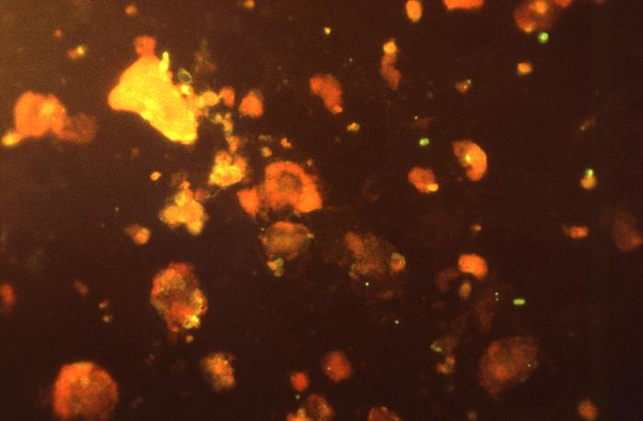
Trophic Form of Pneumocystis jiroveci from the Lungs of a Person with PCP

Slide 9
Cystic Forms
Precyst
Larger (approx. 4–5 μm) and has a rigid pellicle (40–120 nm) which is thicker than that of trophozoites and thinner than that of mature cysts.
Thick-walled cysts containing round intracystic bodies (ICB)
The single nucleus in the pre-cyst stage divides to give rise to a cyst containing two ICB, which then gives rise to a four-ICB stage.

Slide 10
After division of these four ICB, the mature spores, containing eight ICB, are formed.
At this stage, most cysts are spherical and the middle layer of the cyst wall becomes very thick, giving a total pellicle thickness of 100–160 nm.
The ICB is formed by delineation of its nucleus and cytoplasm by membranes derived from the cyst inner surface membrane.
These forms resemble the small trophozoites with a thin pellicle containing two membranes

Slide 11
Thick-walled cysts containing banana-shaped ICB
Banana-shaped ICB in some cysts clearly exhibit cell motility (wiggling, flexing)
The ICB appear to be attached to the inner membrane of the cyst wall by a stalk-like structure

Slide 12
Thin-walled cysts containing pleomorphic ICB
Thin-walled cyst that have ICB which are irregularly shaped and resemble trophozoites
Irregularly shaped ICB are closely packed and appear attached to each other by their glycocalyxes, resembling adhesions between organisms

Slide 13
Dormant form
There appears to be a life cycle stage which remains dormant and infective outside the mammalian host.
Morphological features may differ from most other forms described in the lung

Slide 14
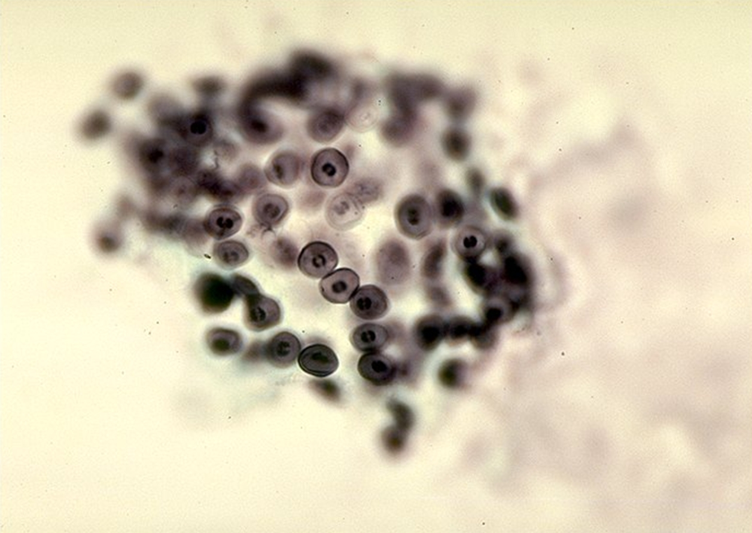
Cysts of Pneumocystis jiroveci

Slide 17
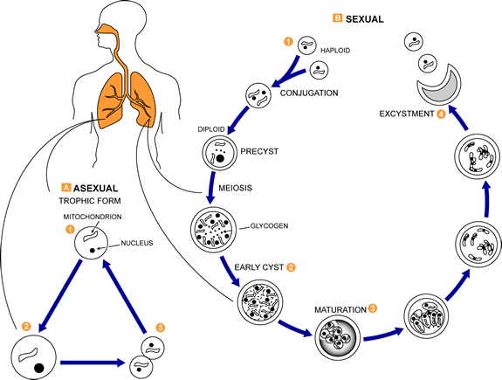

Slide 18
Life Cycle
These fungi are found in the lungs of mammals where they reside without causing overt infection until the host's immune system becomes debilitated. Then, an oftentimes lethal pneumonia can result. Asexual phase: trophic forms replicate by mitosis to . Sexual phase: haploid trophic forms conjugate and produce a zygote or sporocyte (early cyst) . The zygote undergoes meiosis and subsequent mitosis to produce eight haploid nuclei (late phase cyst) . Spores exhibit different shapes (such as, spherical and elongated forms). It is postulated that elongation of the spores precedes release from the spore case. It is believed that the release occurs through a rent in the cell wall. After release, the empty spore case usually collapses, but retains some residual cytoplasm . A trophic stage, where the organisms probably multiply by binary fission is also recognized to exist. The organism causes disease in immunosuppressed individuals.

Slide 19
Pathogenesis
In immunosuppressed individuals the manifestations of the infection are highly variable.
The disease attacks the interstitial, fibrous tissue of the lungs, with marked thickening of the alveolar septa and alveoli and leading to significant hypoxia which can be fatal if not treated aggressively

Slide 20
Clinical Features
Common symptoms of pneumocystis pneumonia (PCP) include the subtle onset of progressive dyspnea, nonproductive cough, and low-grade fever.
Acute dyspnea with pleuritic chest pain may indicate the development of a pneumothorax.
Extrapulmonary lesions occur in a minority (<3%) of patients, involving most frequently the lymph nodes, spleen, liver, and bone marrow. Typically, in untreated PCP increasing pulmonary involvement leads to death.

Slide 21
Diagnosis
Chest X-ray shows widespread pulmonary infiltrates
Microscopic identification of P. jiroveci in bronchopulmonary secretions obtained as induced sputum or bronchoalveolar lavage (BAL samples. Trophic forms can be detected with modified Papanicolaou, right–Giemsa, or Gram–Weigert stains. Cysts can be stained with Gomori methenamine silver, cresyl echt violet, toluidine blue O, or calcofluor white
Transbronchial biopsy or open lung biopsy may prove necessary.
Immunofluorescence microscopy using monoclonal antibodies can identify the organisms with higher sensitivity than conventional
PCR

Slide 22
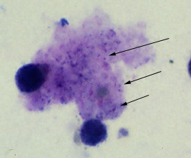
Trophozoites in a bronchoalveolar lavage (BAL) specimen stained with Giemsa

Slide 23
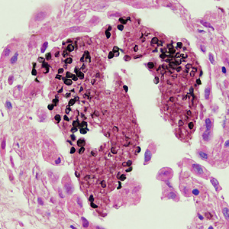
Cysts of P. jirovecii in lung tissue, stained with methenamine silver

Slide 24
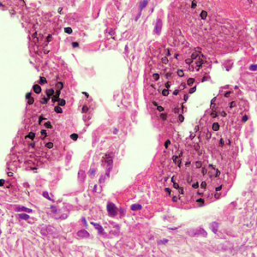
Cysts of P. jirovecii in lung tissue, stained with hematoxylin and eosin (H&E)

Slide 26
Treatment
Primary prophylaxis against pneumocystis pneumonia in HIV-infected adult should begin when the CD4+ count is less than 200 cells / mm or if there is a history of oropharyngeal candidiasis.
Drugs used include:
Trimethoprim-sulfamethoxazole
Trimethoprim + Dapsone*; atovaquone; and primaquine* plus clindamycin*.
Pentamidine

Slide 27
Prevention and Control
Prophylaxis with cotrimoxazole or regular pentamidine inhalations may help prevent PCP in immunocompromised hosts.

