Slide 1
TOXOPLASMA GONDII
KIMAIGA H.O
MBChB (University of Nairobi)

Slide 2
Introduction
Toxoplasma gondii is a protozoan parasite that infects most species of warm blooded animals, including humans, and can cause the disease toxoplasmosis.
T. Gondii was first discovered in 1908 in desert rodent ,the gondii, in a colony maintained at the Pasteur institute in Tunis.
An intracellular parasite in many tissues, such as intestinal epithelum and muscle.
The organisms can be found also free in the blood and peritoneal exudate.
In the fetal life, the parasite infection can lead to death (Human & sheep)

Slide 3
Classification
Kingdom: Protista
Phylum: Apicomplexa
Class: Conoidasida
Subclass: Coccidiasina
Order: Eucoccidiorida
Family: Sarcocystidae
Genus: Toxoplasma
Species: T.gondii

Slide 4
Geographic distribution
Worldwide
Infection is more common in warm climates and lower altitudes than cold climates and mountainous regions.
A high prevalence of infection in France has been related to a preference for eating raw or undercooked meat, while a high prevalence in Central America has been related to the frequency of stray cats in a climate favoring survival of oocysts and soil exposure.

Slide 5
Modes of transmission
Ingestion of cyst-containing meat (carnivores)
Ingestion of oocysts (environmental contamination)
Congenital infection
Transfusion (rare)
Raw goat’s milk, transplantation

Slide 6
Definitive host
Family Felidae - Mainly domestic and wild cats.
Cats can become infected by ingesting sporulated oocyst or infected rodent or a bird.

Slide 7
Intermediate host
Human, cattle, birds, rodents, pigs, and sheep.
Humans get the disease through ingestion of a cyst, infected raw meat, transplacental, organ transplatantion or blood transfusion.

Slide 8
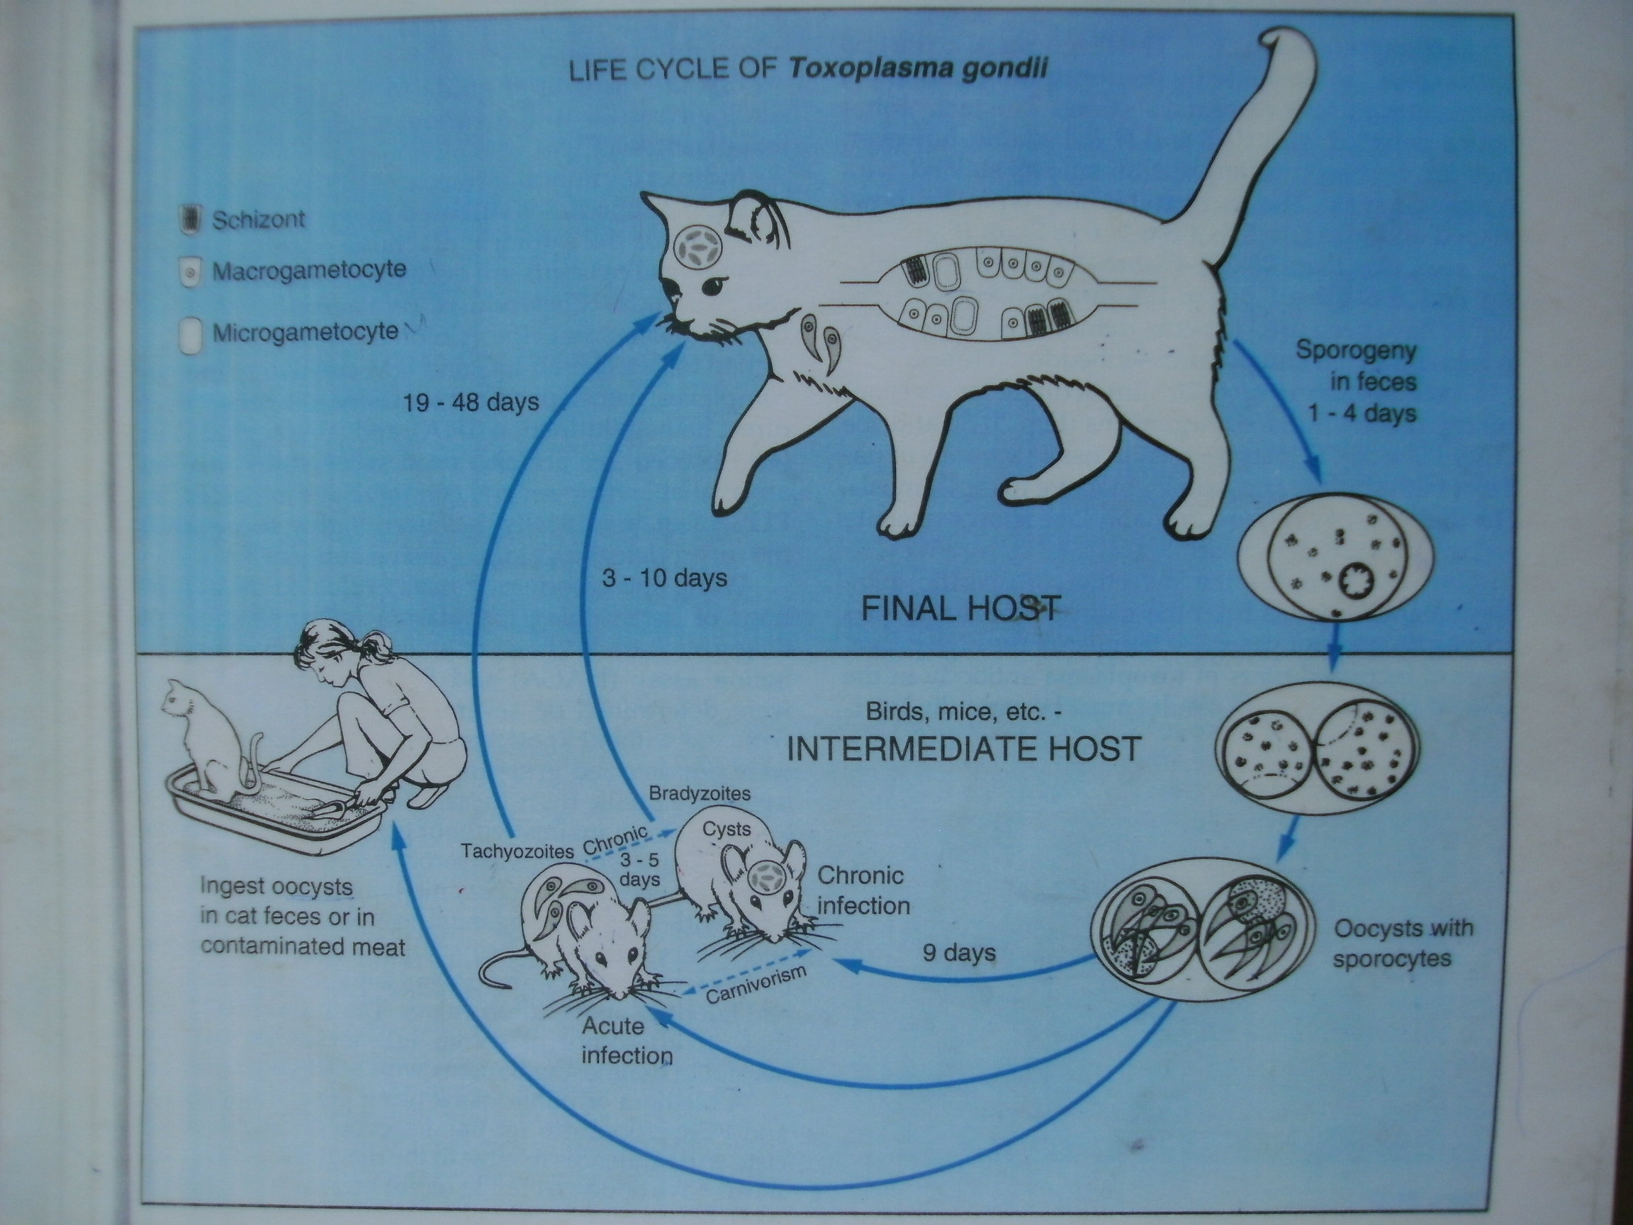

Slide 9
Life cycle
The protozoa multiplies sexually in the cat’s intestinal and asexually in a many mammals and even birds.
Cats are infected by eating infected rodent.
The zoitocyst which contains bradyzoites travel to the intestine via digestive tract.
Bradyzoites are released in the intestine.
Bradysoites infect cells and become trophozoites.

Slide 10
Fertilization occurred in the intestine and immature/ unsporulated oocyst are passed in the cat’s feces.
Although oocysts are usually only shed for 1-2 weeks, large numbers may be shed. Oocysts take 1-5 days to sporulate in the environment and become infective.
The Oocyst are contaminated with water, food and soil are ingested by intermediate host (including birds and rodents).
The protozoa reproduces asexually in the intermediate host.
Ingested oocyst goes to the digestive tract.
It is here that they are engulfed by macrophages.
In the macrophage oocysts develop into tachyzoites shortly after ingestion.

Slide 11
These tachyzoites travel via blood stream (Heart, spleen, liver and brain) and localize in neural and muscle tissue and develop into tissue cyst bradyzoites
Once immune response is trigered, tachyzoites encyst into zoitocysts and pseudocysts which contain bradyzoites(inactive).
Bradyzoite are inactive and they stay in the intermediate host and waits until the intermediate is consumed.
Cats become infected after consuming intermediate hosts harboring tissue cysts
Cats may also become infected directly by ingestion of sporulated oocysts. Animals bred for human consumption and wild game may also become infected with tissue cysts after ingestion of sporulated oocysts in the environment .

Slide 12
Humans can become infected by any of several routes:
  Eating undercooked meat of animals harboring tissue cysts .
  Consuming food or water contaminated with cat feces or by contaminated environmental samples (such as fecal-contaminated soil or changing the litter box of a pet cat) .
  Blood transfusion or organ transplantation .
  Transplacentally from mother to fetus .
  Ingestion of tachyzoites in unpasteurised goat's milk

Slide 13
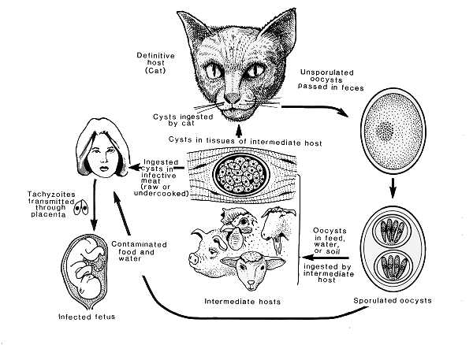

Slide 14
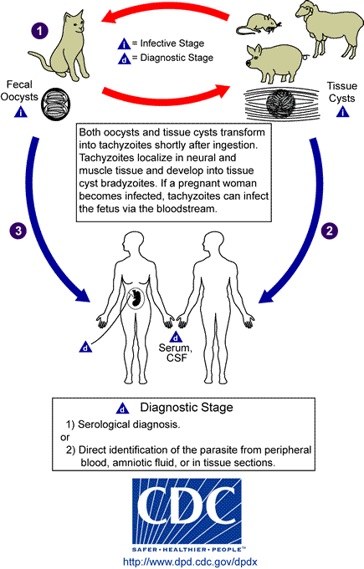

Slide 15
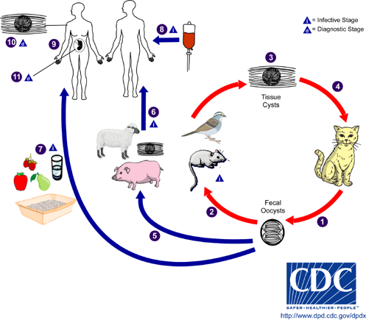

Slide 16
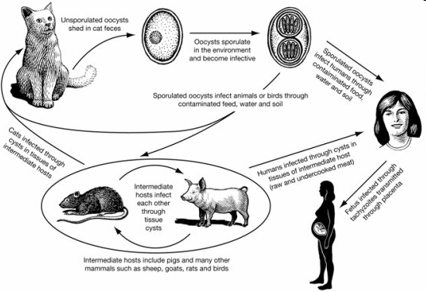

Slide 17
In the human host, the parasites form tissue cysts, most commonly in skeletal muscle, myocardium, brain, and eyes; these cysts may remain throughout the life of the host. Diagnosis is usually achieved by serology, although tissue cysts may be observed in stained biopsy specimens
Diagnosis of congenital infections can be achieved by detecting T. gondii DNA in amniotic fluid using molecular methods such as PCR .

Slide 18
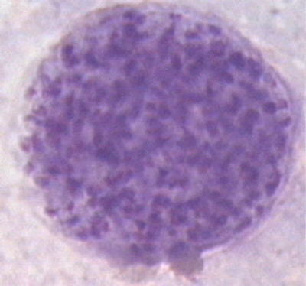
Notes:
T. gondii: tissue cysts, 100-300 µm, may contain up to 3.000 bradyzoites.
The wall of mature pseudocysts is believed to represent
a combination of host and parasitic components.

Slide 19
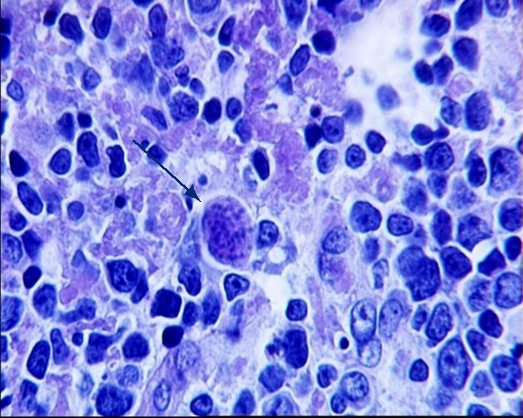
Notes:
pseudocysts found subcutaneous tissue

Slide 20
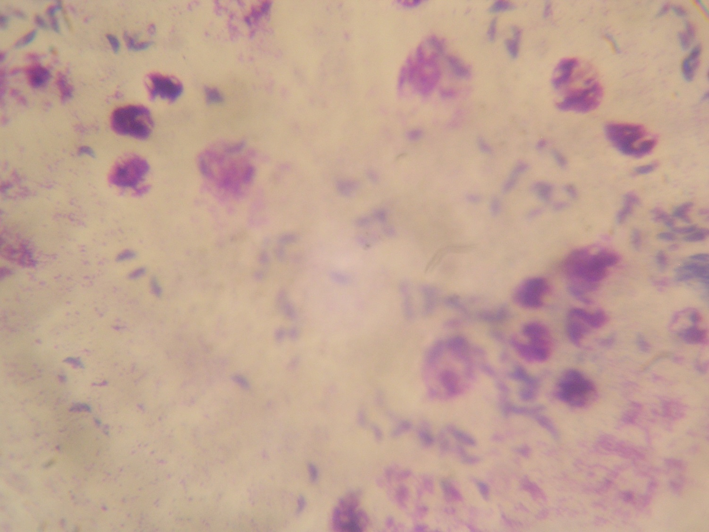

Slide 21
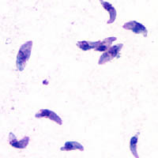
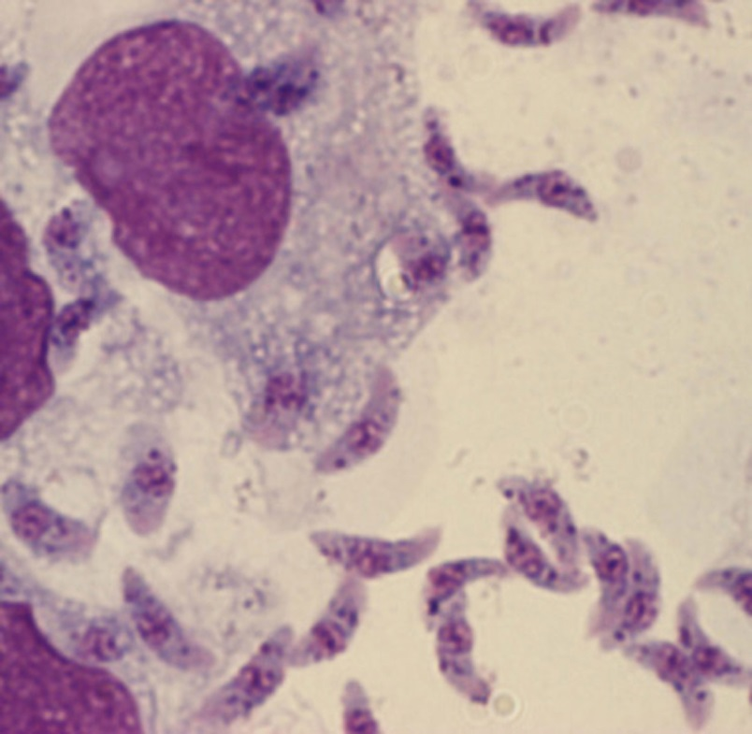
Tachyzoite stage
Tachyzoites are typically crescent shaped with a prominent, centrally placed nucleus."
Notes:
Tachyzoites move fast

Slide 22
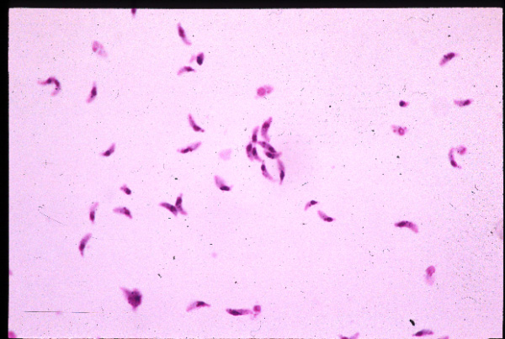

Slide 23
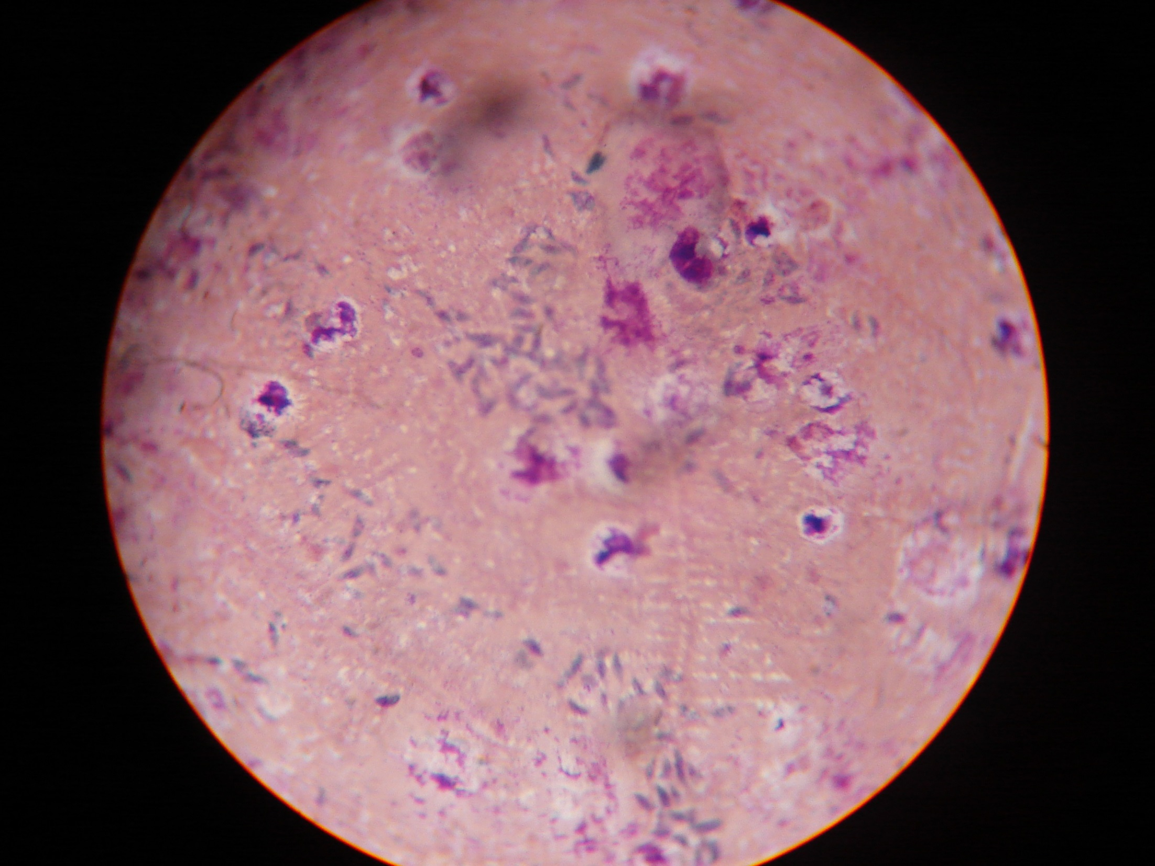

Slide 24
Pathogenesis
Infection with Toxoplasma in immunocompetent persons is generally an asymptomatic infection.
The clinical course is benign and self-limited; symptoms usually resolve within a few months to a year.
Immunodeficient patients often have central nervous system (CNS) disease but may have retinochoroiditis, or pneumonitis.
In patients with AIDS, toxoplasmic encephalitis is the most common cause of intracerebral mass lesions and is thought to be caused by reactivation of chronic infection.
Notes:
The most common symptom of acute toxoplasmosis is painful swollen lymph glands in the cervical, supraclavicular and inguinal regions. These symptoms may associated with headache, muscle pain, anemia and sometime lung complications.

Slide 25
Pathogenesis
Causes Encephalitis for immunosuppressed patients and people infected with (AIDS).
Lymphadenitis is the most common in humans.
Children exhibit Hydrocephalatus, retinochoroiditis, convulsion and intracerebral calsifications.
Congenital neurological defects in infants.

Slide 26
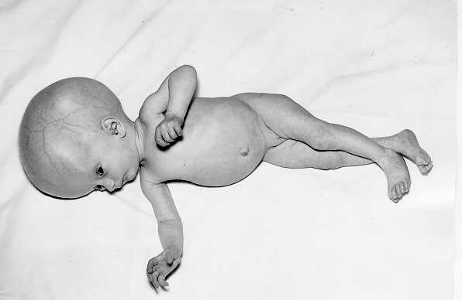
Hydrocephalatus

Slide 27
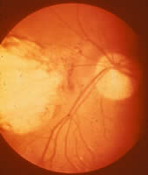
Severe, active retinochoroiditis

Slide 28
Laboratory Diagnosis
Observation of parasites in patient specimens, such as bronchoalveolar lavage material from immunocompromised patients, or lymph node biopsy.
Isolation of parasites from blood or other body fluids, by intraperitoneal inoculation into mice or tissue culture. The mice should be tested for the presence of Toxoplasma organisms in the peritoneal fluid 6 to 10 days post inoculation; if no organisms are found, serology can be performed on the animals 4 to 6 weeks post inoculation.

Slide 29
Diagnostic tests for Toxoplasma
Sabin-Feldman dye test (DT)
Enzyme immunoassay for T. gondii specific IgM (EIA)
Immunsorbent agglutination assay (ISAGA)
Enzyme immunoassay for IgG avidity
Isolation and culture of parasite
Detection of parasite genetic material by PCR, especially in detecting congenital infections in utero.
    The Ring Phenomenon*
Serologic testing is the routine method of diagnosis.

Slide 30
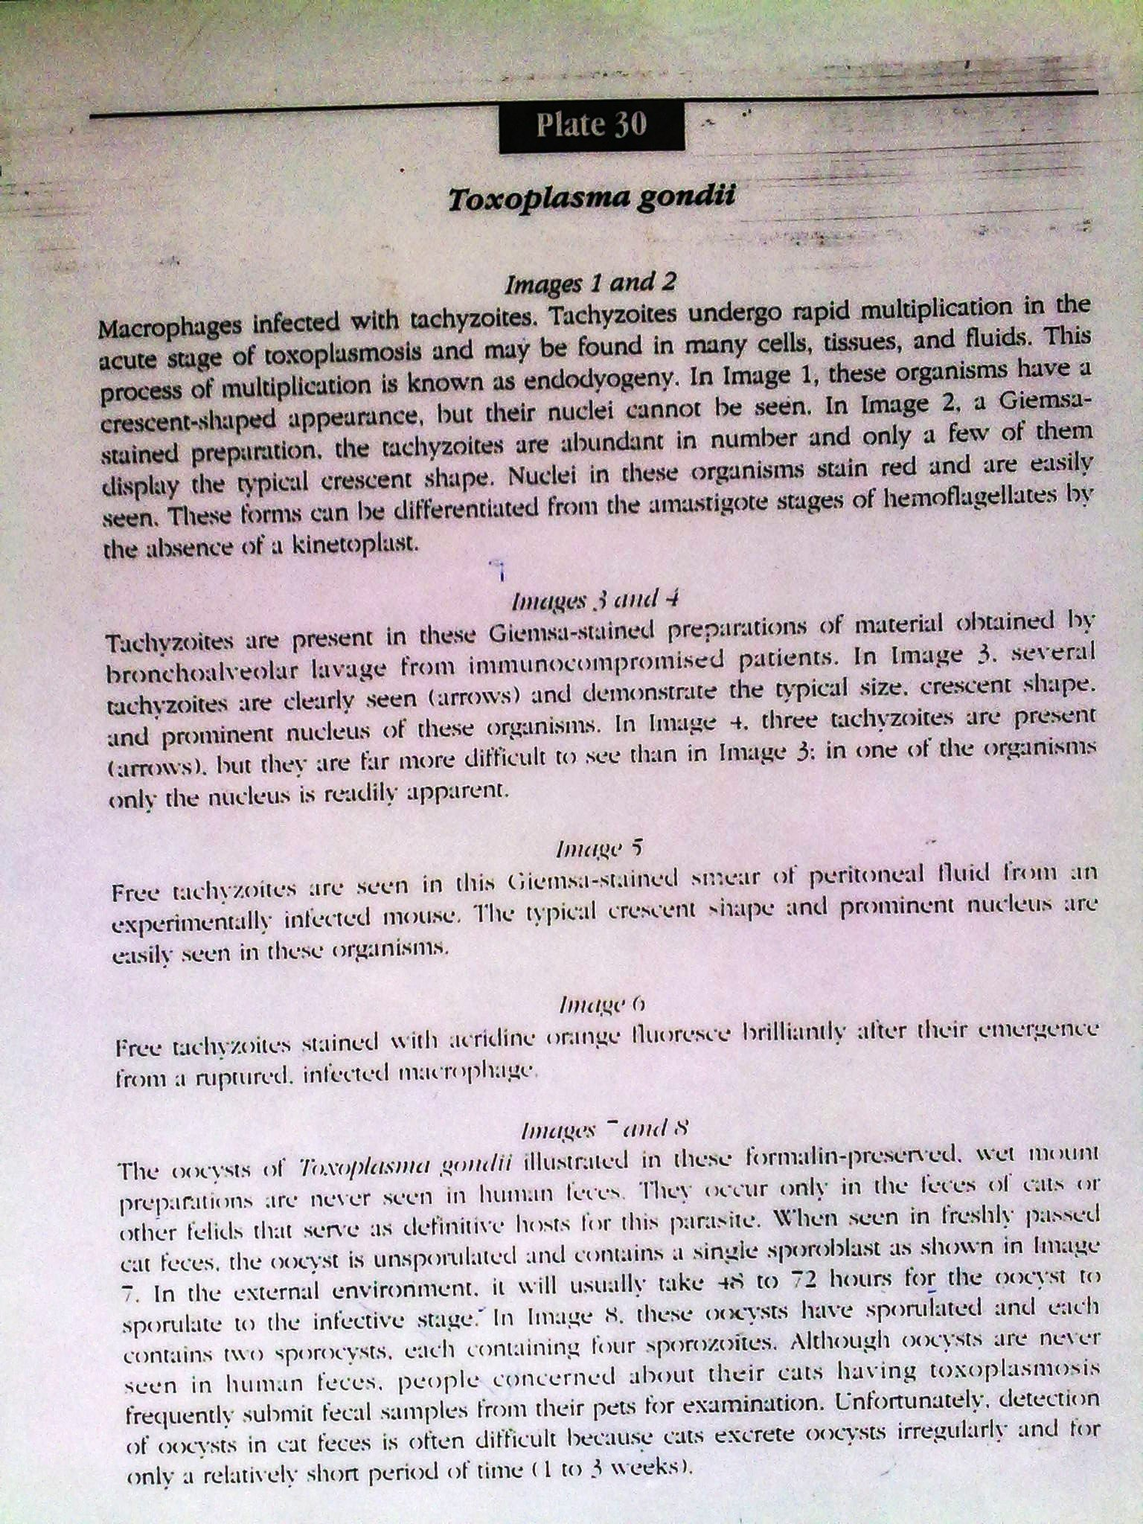
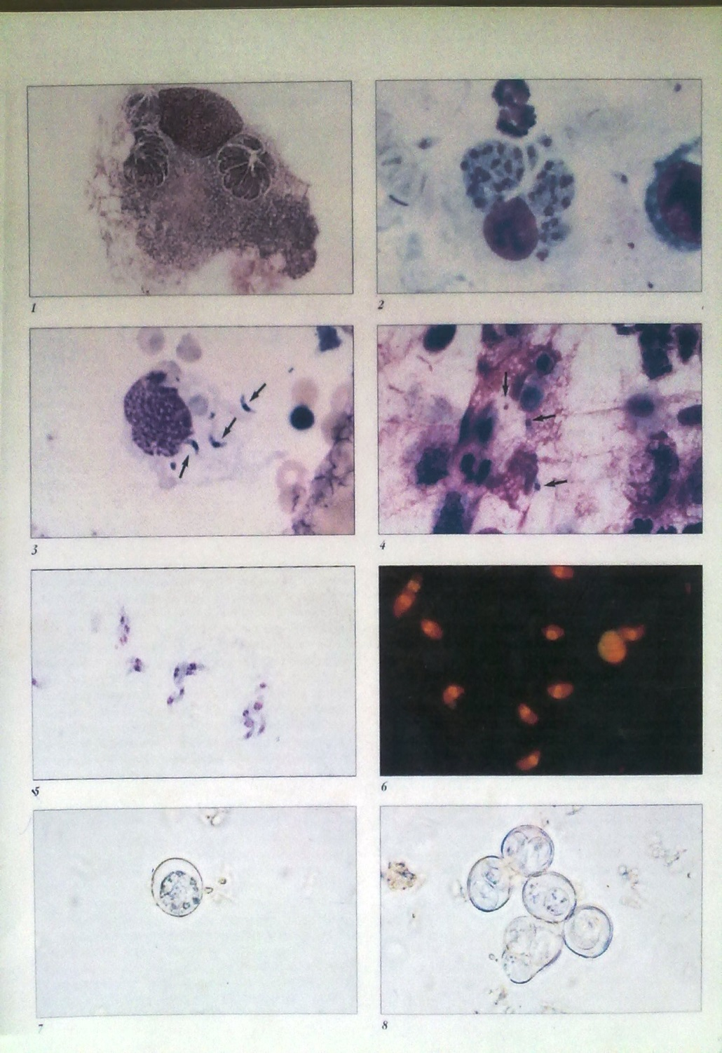

Slide 31
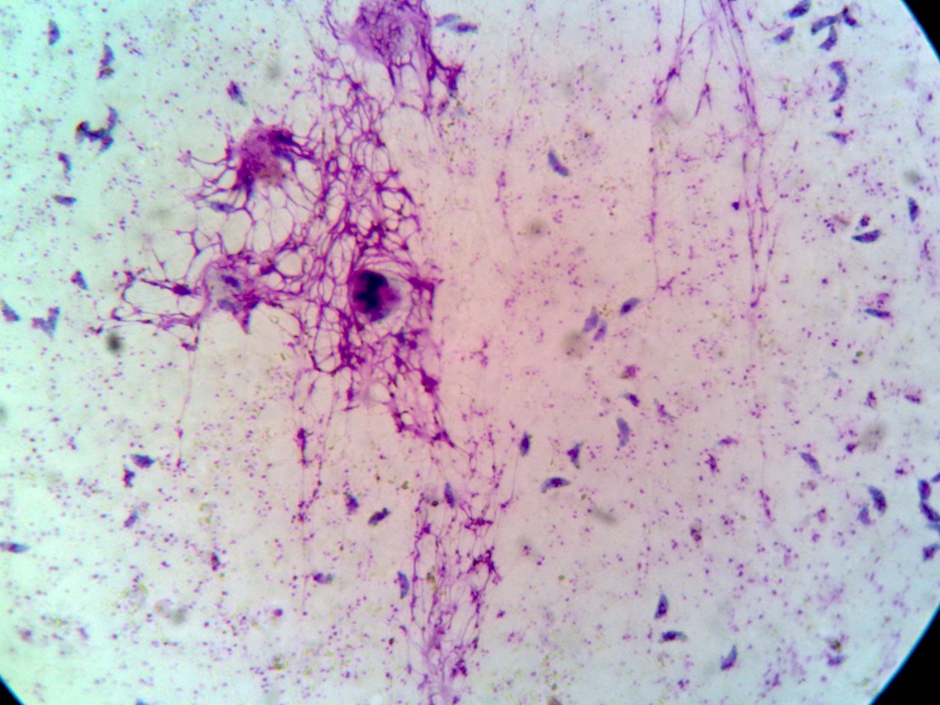
T.gondii tachyzoites stained with Giemsa, from a smear of peritoneal fluid obtained from a laboratory-inoculated mouse.

Slide 32
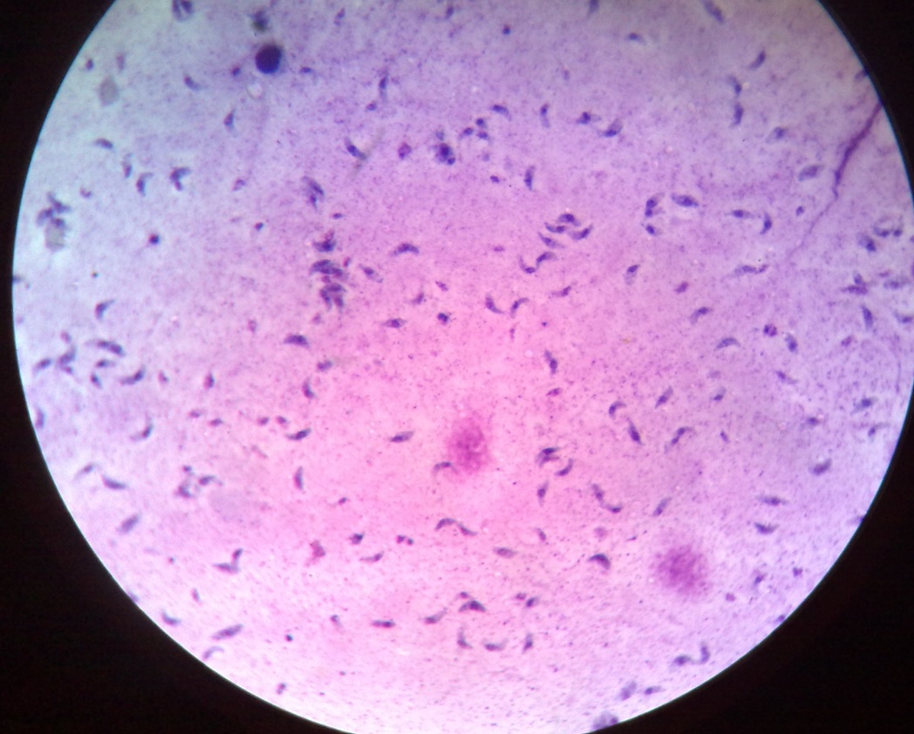
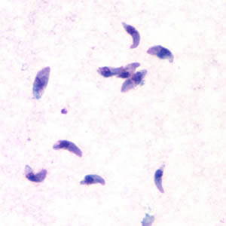
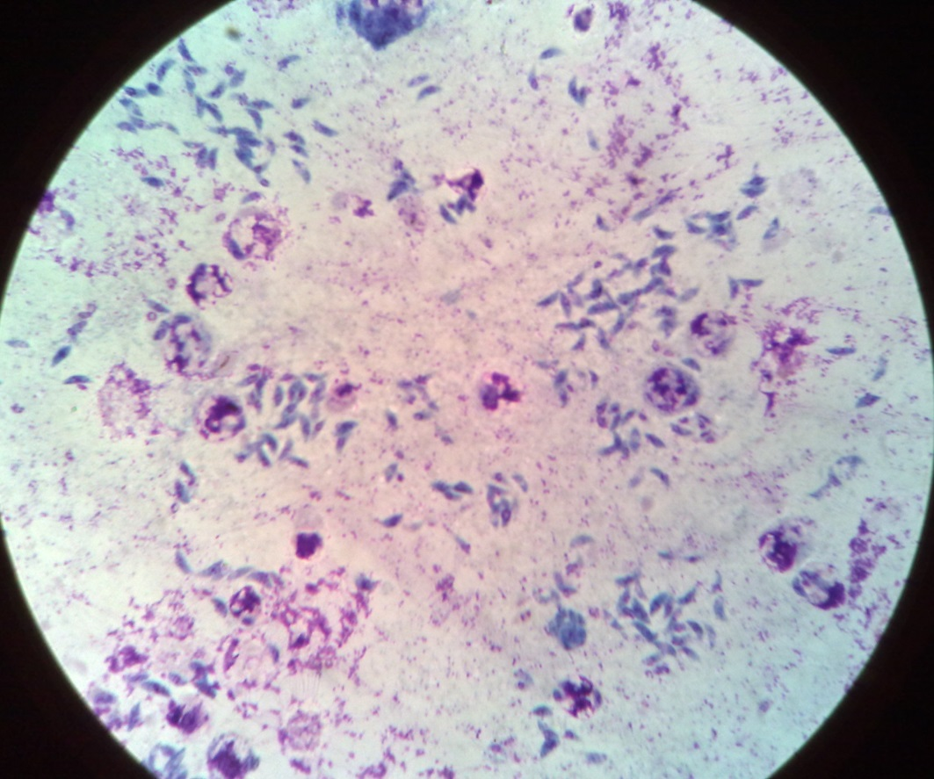
Tachyzoites of T.gondii

Slide 34
Differential Diagnosis
Immunocompetent adults (DT, IgM EIA)
Pregnant women (maternal serum DT, IgM EIA, IgG avidity; Amniotic fluid culture or PCR)
Neonates (DT, EIA, ISAGA for IgM, IgA)
Organ transplantation (DT, IgM EIA)
Immunodeficiency (serum and CSF : DT, EIA, ISAGA for IgM and IgA; PCR, culture, microscopy)

Slide 35
Treatment
Sulfonamides
Pyrimethamine(daraprim)
Are given together and widely used. They act synergistically by blocking a pathway involving p-amino benzoic acid and folic-folinic acid cycle respectively

Slide 36
Control
Pets should be checked and cured.
Wash hands thoroughly with soup
Cats should be kept indoors and litter boxes changed daily.
Better cook your meat well.
Cat feces should be flashed down the toilet or burned.
Pregnant women should avoid contact with cats
Issue of prenatal screening

Slide 37
Sarcocystis
bovihominis, S. suihominis; protozoa belong to the class of sporozoa in the phyrum of apicomplexa
Transmission: ingestion of raw/undercooked beef or pork ( other), containing sarcocysts in muscle fibers
Pathogenic potential low in human DH
Clinical signs: absent except in rare cases
Reservoir limited to human DH (+ possibly other anthropoids), and bovine/porcine IHs

Slide 38
Cont’
Prevalence: world-wide, determined by cultural food prep and consumption factors
Diagnosis: microscopic ID of oocysts and/or sporocysts in feces
No treatment identified: trimethoprim + sulfamethoxazol probably suppressive

Slide 39
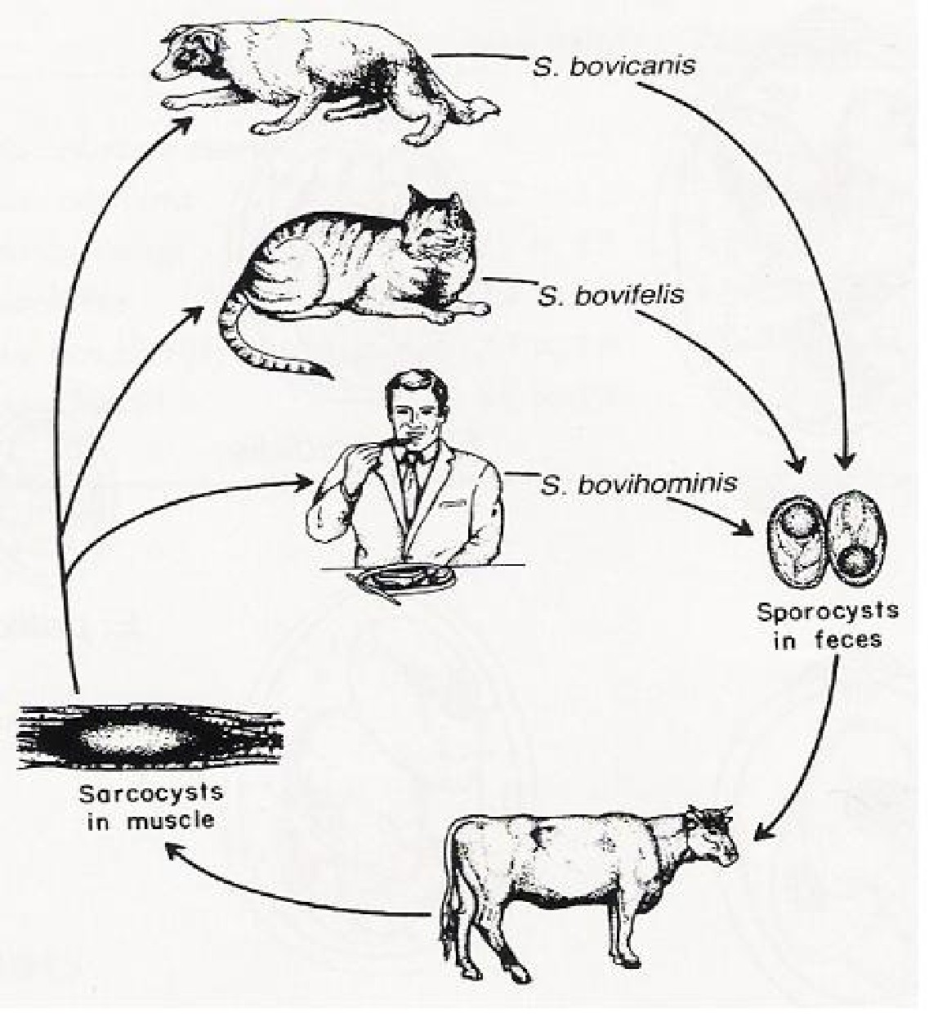
Sarcocystis species Life Cycle

Slide 40
Toxoplasmic Encephalitis
common complication associated with AIDS during the 1980's
recrudescence of latent infection
multifocal disease associated with immunosuppression
lesions detectable with CT or MRI
little spread to other organs
symptoms include: lethargy, apathy, incoordination, dementia
progressive disease → convulsions
usually fatal if untreated

Slide 41
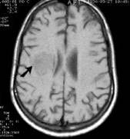
Diagnosis
various serological tests
active (acute) vs chronic infection
  compare samples at 2 week intervals
  IgM > IgG; ↑ Ab titers
seldom by direct parasite demonstration
  biopsy
  inoculation into mice or cell culture (only acute stage)
CT scans or MRI for toxoplasmic encephalitis

