Slide 1
TRYPANOSOMIASIS
KIMAIGA H.O
MBChB (University of Nairobi)

Slide 2
TRYPANOSOMIASIS
Causal Agents:
African trypanosomiasis (African sleeping sickness)
  Trypanosoma brucei gambiense causes West African sleeping sickness
  T. brucei rhodesiense causes East African sleeping sickness. .
Nagana or animal sleeping sickness - T. brucie brucei
American trypanosomiasis (Chaga’s disease)
  Trypanosoma cruzi, that can be transmitted to humans by blood-sucking triatomine bugs.

Slide 3
Geographical distribution
African trypanosomiasis
Confined to the continent of Africa. Between latitude 12deg north & 25 deg south. Tsetse vector is limited to this also
West Africa, central, east & South Africa countries. Botswana, Lesotho
Uganda & Tanzania
Kenya western, Busia, Teso, Siaya, south Nyanza, Lambwe valley
T. brucei brucei is widespread in the livestock on the continent

Slide 4
ILRI (International Livestock Research Institute) in Kenya & Tryps institute in Nigeria research ad study on Nagana
In Kenya ministry of livestock handles the disease
PATEC is the organization and OAU that is involved in regional efforts to fight tryps
American trypanomiasis
T. cruzi is found mostly in poor, rural areas of Mexico, Central America, and South America, Brazil, Argentina, Columbia
Causes Chagas disease in those countries

Slide 5
Trypanomiasis morphology
Exists in following stages:-
  Amastigotes – rounded body without free flagella definitive stage in only leishmania & T. cruzi.
  Promastigotes – elongated forms with free flagella extending from anterior to posterior. In vectors, in cultures
  Epimastigotes – short forms with flagella. Found in vector’s salivary glands
  Trypomastigotes – elongated forms flagellum runs on the whole body. In blood, tissues in the host/patient

Slide 6
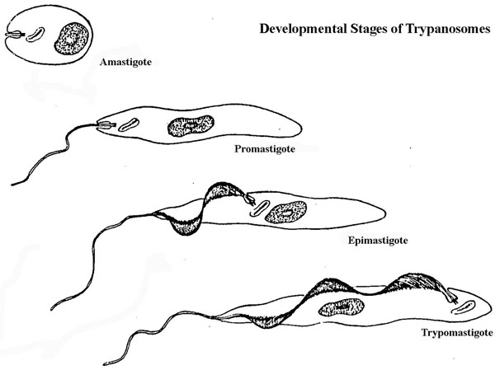
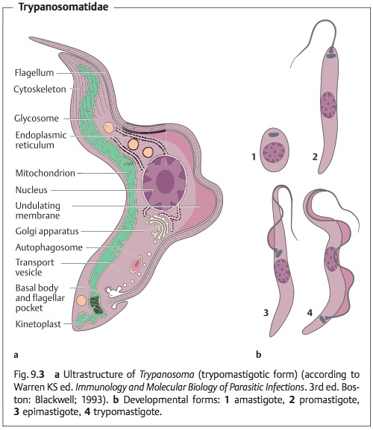

Slide 7
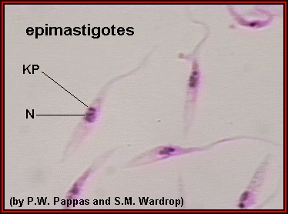
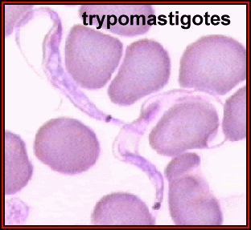

Slide 8
Morphology
Trypomastigote are the only stage found in the blood and CSF of an infected person (Either T. brucei or T. cruzi)
  Body elongated and torpedo-shaped (18-29 microns)
  Have centrally located, large nucleolus
  Subterminal or terminal kinetoplast and kinetosome – behind the nucleus
  Undulating membane
  Free moving flagella arising from kinetosome (haemoflagellates)
Amastigote stage of T.cruzi may be seen in histopathology specimens from affected organs.

Slide 9
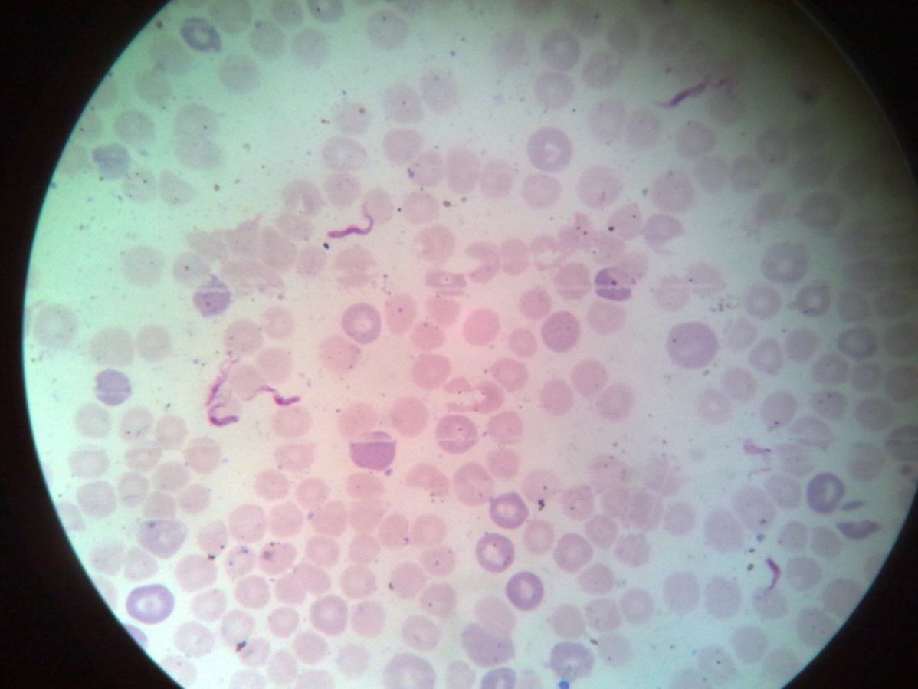
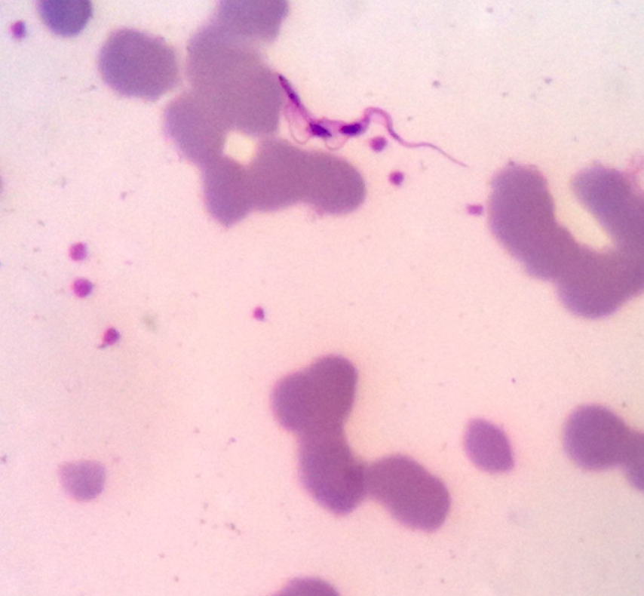
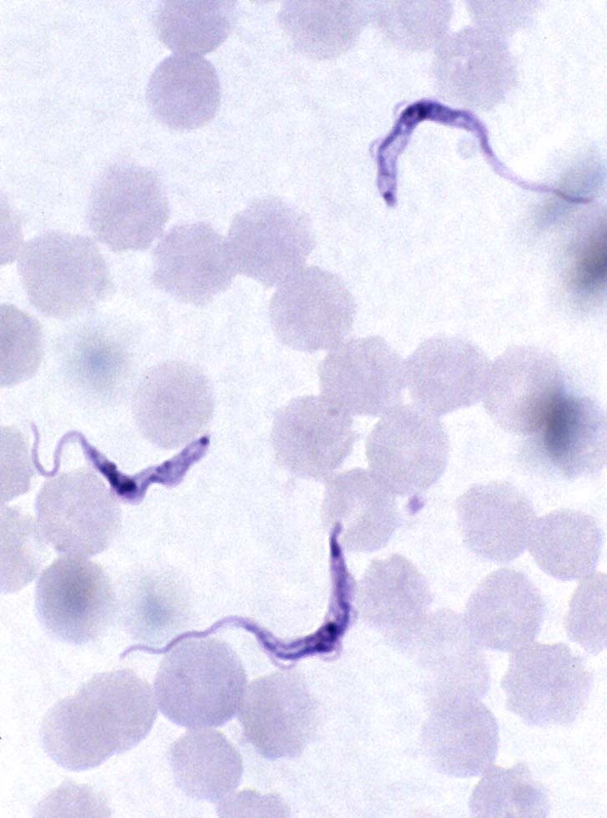
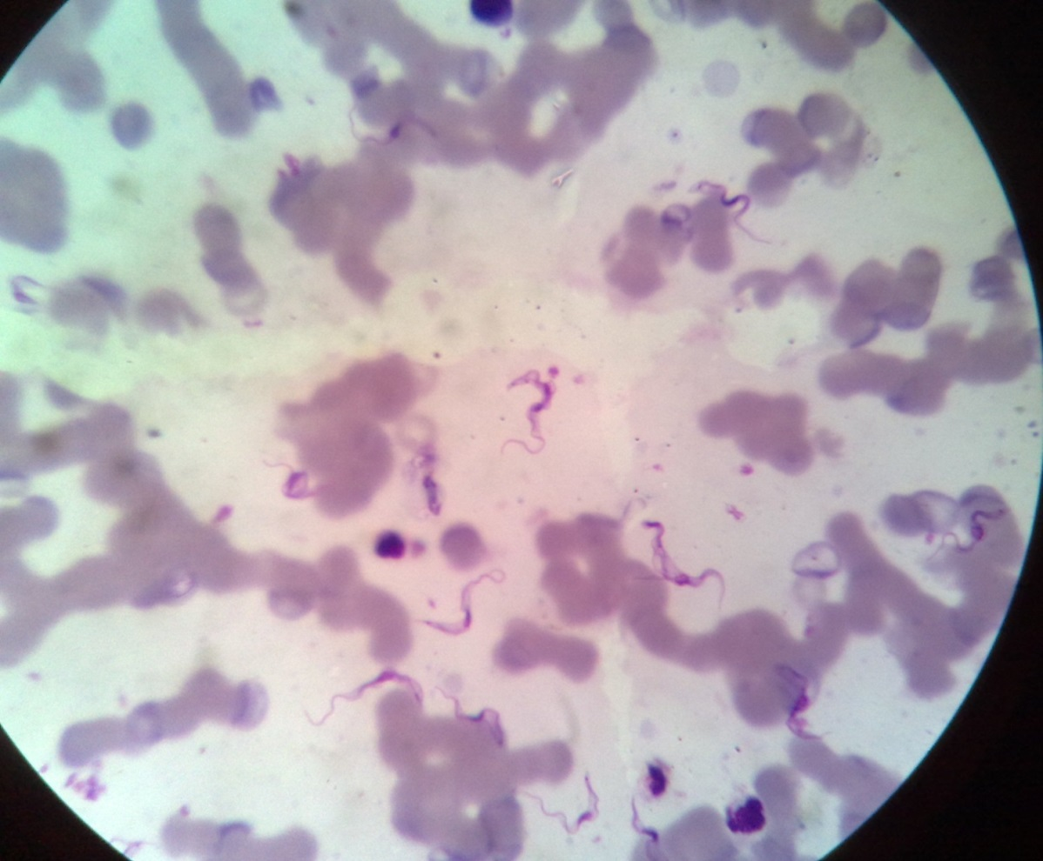
Trypamastigotes

Slide 10
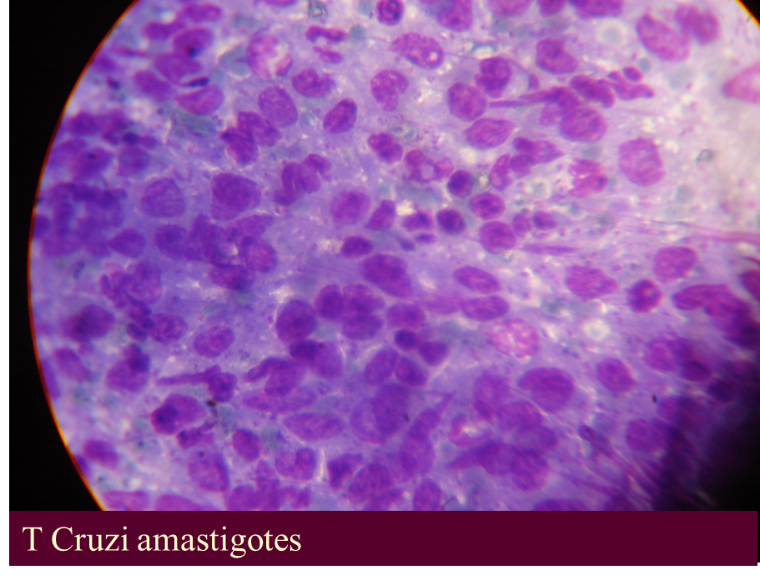

Slide 13
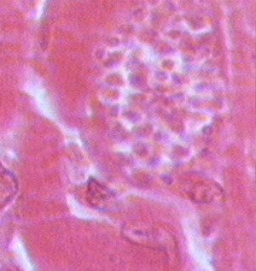

Slide 14
Transmission of tryps (modes)
Vectors
  Tryps undergo salivarian development in the anterior gut in tsetse flies (glassina spp)
  T. cruzi undergoes stercorian development in hindgut of the Reduviid bugs. Found in America, esp south
  Biological transformation takes place in these vectors
Congenital – mother to baby in utero (protozoa)
Blood transfusion
Zoonosis – through animals, and to humans

Slide 15
Tsetse vectors (Glossina)
Only found Africa
Riverine (reside in rivers) group or palpalis tsetse flies
Glossina palpalis, G. tachnoides
Savanna group or morsitans
G. morsitans, G. pallipedes, G. longipalpis, G. swynnertonii
Forest or Fusca group
G. fusca, G. modicorum
All found only on the African continent
Male & female bite to get blood

Slide 16
Glossina
Hemoglobin is important in females laying eggs
Have a proboscis for biting the hosts (very painful)
Attracted by dung of cattle and buffaloes – easily trapped for studying. Animals keep wagging their tail to rid of the flies
Have a hatchel cell in the wings
Breed in the forests, along rivers or open savannah
Fly long distances (50kms!) and bite human when they miss cattle

Slide 17
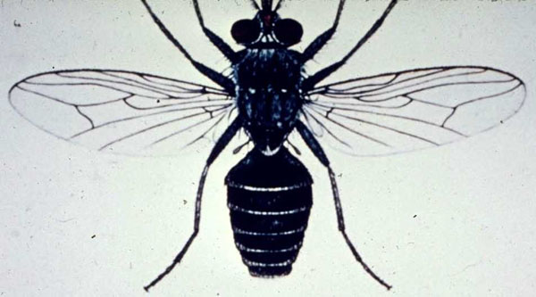

Slide 18
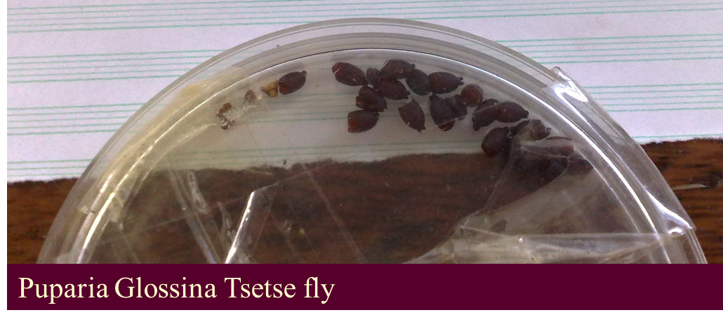

Slide 19
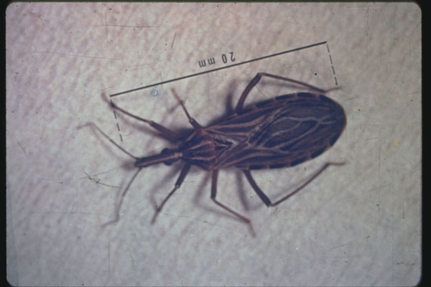

Slide 20
AFRICAN TRPANOMIASIS

Slide 21
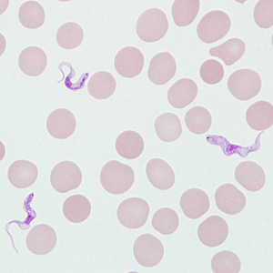
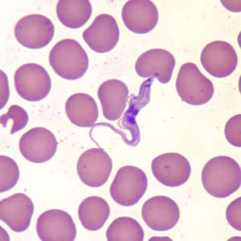

Slide 22
Life cycle of African Trypanomiasis
During a blood meal on the mammalian host, an infected tsetse fly (genus Glossina) injects metacyclic trypomastigotes into skin tissue.
  They infect the new host at site of bite – parasite is dropped at site, they are not injected when the vector bites. So do the filarial worms that cause filariasis (e.g. wuchereria). Only mosquito injects the plasmodium parasites into host! The parasites enter the site of bite,
The parasites divide at site of bite and enter the lymphatic system and pass into the bloodstream
  A chancre (ulcer) develops

Slide 23
Inside the host, they transform into bloodstream trypomastigotes
They are carried to other sites throughout the body, reach other blood fluids (e.g., lymph, spinal fluid and even pass through the BBB to the CCNS), and continue the replication by binary fission
  Parasitaemia (multiplication of parasites in b/stream) rate will depend on other host factors – immunity, etc.
The entire life cycle of African Trypanosomes is represented by extracellular stages.

Slide 24
The tsetse fly picks bloodstream trypomastigotes with salivary fluid when taking a blood meal on an infected mammalian host
Gets to mid-gut of vector and with fast multiplication by binary fission change to procyclic promastigotes
Leave the midgut, and transform into epimastigotes
The epimastigotes reach the fly’s salivary glands and continue multiplication by binary fission to metacyclics trypomastigotes.
The cycle in the fly takes approximately 3 weeks.
Humans are the main reservoir for Trypanosoma brucei gambiense, but this species can also be found in animals. Wild game animals are the main reservoir of T. b. rhodesiense.

Slide 25
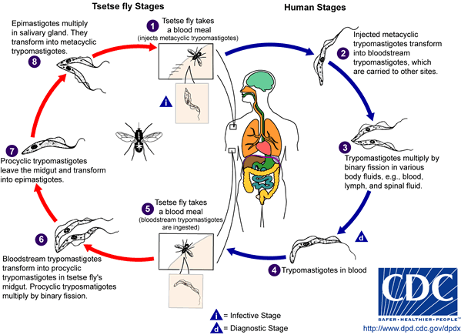

Slide 26
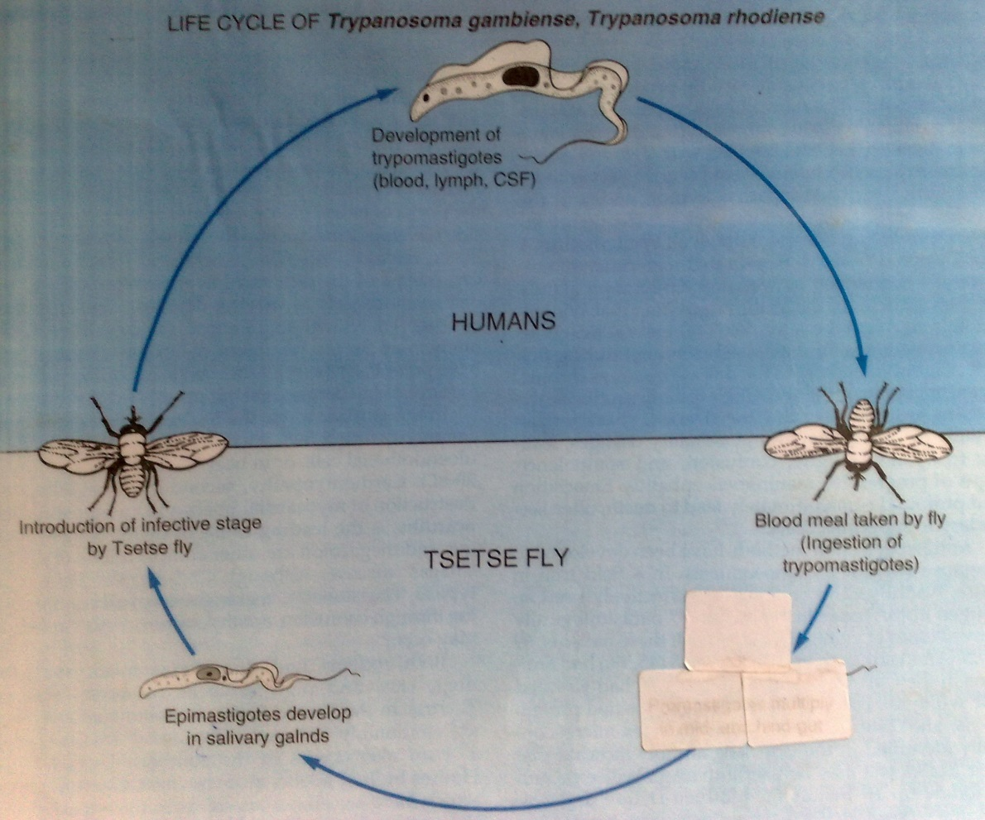

Slide 27
Clinical manifestations (early signs)
Usually 10 days following the bite of vector. Due to rising Parasitaemia and chancre related: erythema, tenderness
Fever 39-41 deg, pain at site, erythema swelling, ulcer at site (chancre), h/ache, general malaise
Lymphadenitis, myalgia, lymphadenopathy, and neck pains
Winter bottoms sign (posterior neck triangle lymph nodes swelling)

Slide 28
Parasitemia related signs
  Fever, generalized body pain, h/ache, joint pains, myalgia, weight loss
  Lymphadenopathy, pruritus, anemia, generalized weakness
  Edema, peripheral ascites, bleeding

Slide 29
Organ related signs
  Lung edema
  Cardiac arrhythmias, CCF (congestive cardiac failure), pericardial effusions
  Hepatomegaly
  Splenomegaly
  Endocrine manifestations – abortions, amenorrhea, anorexia, impotence
  GIT diarrhea

Slide 30
CNS related (late)
  When parasites reach CNS
  Early for T. rhodesciense 3-6 months of an infection
  Severe h/aches: sleeping all time
  Epileptic like fits, insomnia, dyskinesia
  Convulsions, slurred speech, paralysis
  Kerandels sign (delayed sensation to pain indicative of African trypanosomiasis. Altered/ delayed reflexes)
  Athetosis, drowsiness, lethargy
  Psychosis
  Semicoma & coma

Slide 31
Pathology/immunopathology
Due to the surface coat of the parasite
Continuously changing the surface to escape host immune response
Parasite surface elicits antigens (variant antigen surface types). VSAT (variant surface antigen types) & VSG (variant surface glycoprotein)
Infection characterized by waves of parasitemia caused by antigenic variation in successive trypanosome populations
Immune responses mounted → immune complexes cause pathology
Immunocomplex deposition
Perivascular cuffing (lining around the brain), choroid plexus attack in CNS (CSF production interrupted), meningoencephalitis (direct attack to meninges)
Cytokines & PGs and monoamines
Parasites able to absorb nutrients e.g glucose → low glucose in CSF. Glucose increased uptake

Slide 32
Lab diagnosis
Parasitic detection is the conclusive proof of tryps infection
Parasite can be recovered in blood or tissue fluid
Wet prep and stained smears can be used
Sample specimens may include:-
  Blood, CSF, chancre biopsy, lymph node aspirate
  Immunological tests on fluids

Slide 33
Microscopy – wet prep of blood, fluid. The trypomastigotes are larger than the RBC
Stained with Giemsa
In low Parasitaemia – use concentration techniques (capillary, QBC –quantitative buffy coat) and do microscopy. Culture in RPMI, NNN media
Anion exchange cellulose column (separates/filters) parasites from blood & fluids
Xenodiagnosis
  Mice, rates, hamsters- – crushing the body organs and then re-infecting them*

Slide 34
Immunological tests
  Can be done on all fluids and blood
  CSF can also be examined by culture and immunologically
  Indirect fluorescent antibody test (IFAT)
  CAT
  ELISA
  PCR
    All these tests are confirmatory!

Slide 35
CSF diagnosis
  Lumbar puncture to obtain CSF is a must in all patient with tryps
  Usually CSF is under pressure in trypanosomiasis, tryps may be found
  Pleocytosis – lymphocytes (>5*10^6)/L
  Morular cell of MOH (abnormal plasma cell)
  Raised proteins
  High IgM

Slide 36
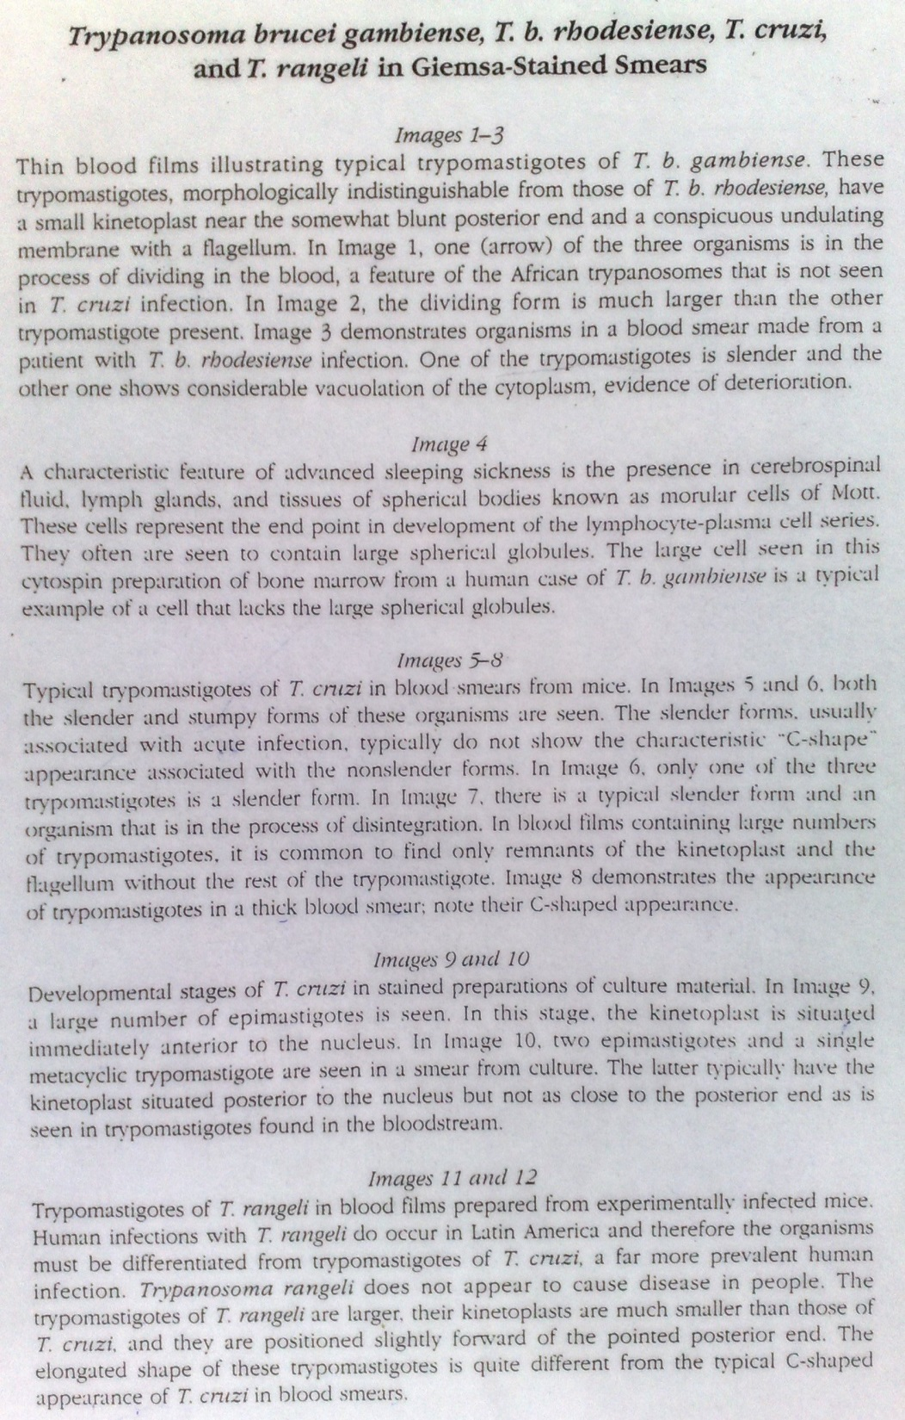
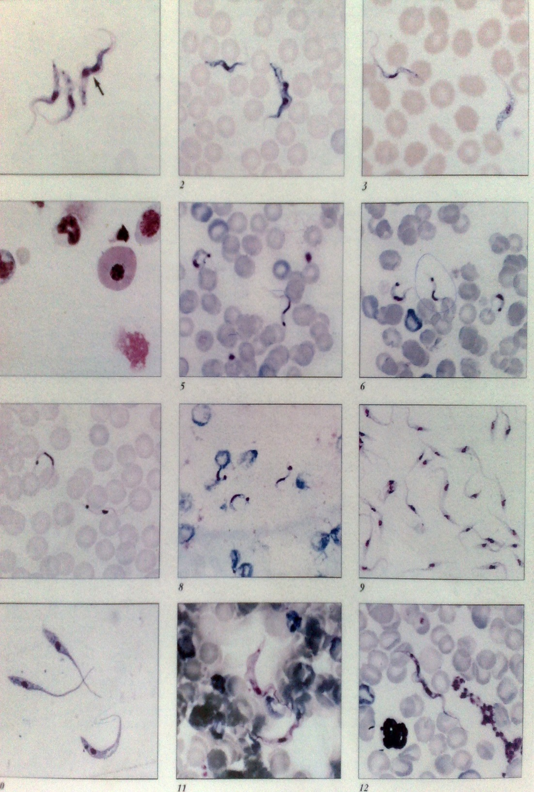

Slide 37
Rx of African trypanamiasis
Before CNS after CNS involvement
Before CNS- Early phase
  Suramin sodium (very toxic drug) 1.0 gm. IV/IM weekly for 4 weeks
  S/e
    N, V, shock, jaundice & renal toxicity
  Pentamidine 4 mg/kg/bwt. IM daily * 7 days
    S/e
      Hypotension
      Hypoglycemia
      Renal & renal hepatoxocity
  Benznidazole 2-3mg/kg/bwt. It kills the trypomastigotes

Slide 38
After CNS involvement- Late phase
  Melarsoprol (arsobal) IV 2.6mg/kg 5 wks
    S/e
      Local toxicity at skin site
      Thrombophlebitis
      Cellulitis
      CNS & hepatoxocity
  DFMO (difluoromethylornithine) 400mg/kg for 2 wks. IV oral tabs available
  Nitrofurazone: 500mg; PO qdv, 7 days

Slide 39
Prevention & control
Vector control
Ground to aerial spraying with insecticides
Odor baited traps for tsetse flies
Sterile insect techniques (SIT)
Pour on animals (to repel vector) dips

Slide 40
Host: prevention
  Early diagnosis through surveillance/screening examine possible cases by lymph node aspiration, b/examination
  Health education
  Immunological tests: CAT
  Prophylaxis with pentamidine
Environment
  Clearing breeding sites for vectors
  Wildlife control/Rx: lions, gazelles, antelopes

Slide 41
Life cycle of American Trypanomiasis (T. cruzi)
An infected triatomine insect vector (or “kissing” bug) takes a blood meal and releases trypomastigotes in its feces near the site of the bite wound.
  Common triatomine vector species for trypanosomiasis belong to the genera Triatoma, Rhodinius, and Panstrongylus
Trypomastigotes enter the host through the bite/abrasion/wound or through intact mucosal membranes, such as the conjunctiva
  Ulcer or chagoma develops at site – Chagas disease
They invade cells near the site of inoculation, where they differentiate into intracellular amastigotes

Slide 42
The amastigotes multiply by binary fission and differentiate into trypomastigotes, and then are released into the circulation as bloodstream trypomastigotes.
Trypomastigotes infect cells from a variety of tissues and transform into intracellular amastigotes in new infection sites.
Clinical manifestations can result from this infective cycle. The bloodstream trypomastigotes do not replicate (different from the African trypanosomes).
Replication resumes only when the parasites enter another cell or are ingested by another vector.

Slide 43
The “kissing” bug becomes infected by feeding on human or animal blood that contains circulating parasites
The ingested trypomastigotes transform into amastigotes, epimastigotes in the vector’s midgut and differentiate into infective metacyclic trypomastigotes in the hindgut then passed out with feces(stercorian transmission)
Trypanosoma cruzi can also be transmitted through blood transfusions, organ transplantation, transplacentally, and in laboratory accidents.

Slide 44
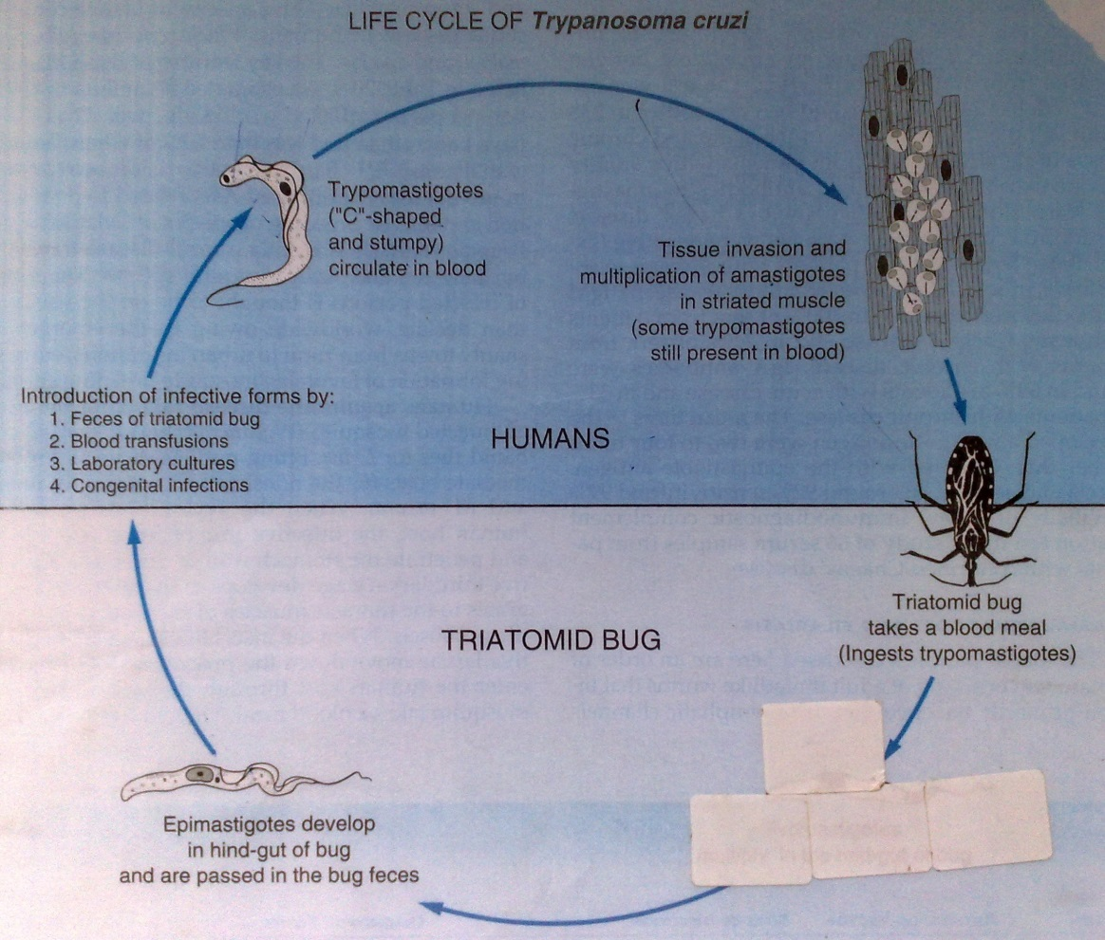

Slide 45
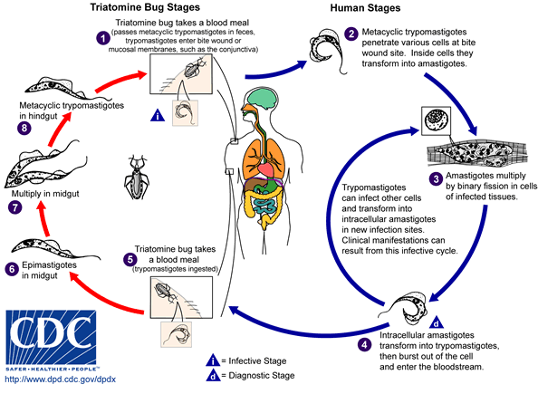

Slide 46
T. cruzi vectors
Triatoma bugs hide in cracks of old buildings and usualy bite at night
Attacked by wasps & cobwebs
Bugs bite the host in the conjuctiva, face and areas of solf skin
Found in central & south America
Triatoma infestans, T. brasiliensis, T. pseudomaculata are the 3 spp of triatoma
Panstrongylus megistus – other spp
Rhodnius prolixus ­– other spp

Slide 47
T. cruzi vectors (Reduviid bugs)
Bite & suck blood from hosts
Excrete on the host and contaminate the bitten wounds with excreta
Excreta contains T. cruzi
Found only in S & C America

Slide 48
Chagas disease: modes of infection
Vector Natural biological transmission by triatomine bugs via infected feces.
Transfusion Especially prevalent in urban areas. Gentian violet treatment eliminates parasites in blood.
Congenital Occurs during any stage of the infection. Can result in premature labour, abortion, or neonatal death.
Accidental Ingestion of food contaminated with metacyclic trypomastigotes. Laboratory accidents.

Slide 49
Clinical manifestation of T. cruzi
The acute phase
  Usually asymptomatic, but can present with manifestations that include fever, anorexia, lymphadenopathy, mild hepatosplenomegaly, and myocarditis.
  Children may present with D & V.
  Ulcer at site of bite (chagoma) pains, swelling & fever, edema & itchiness
  Romana’s sign (unilateral palpebral and periocular swelling) may appear as a result of conjunctival contamination with the vector's feces.
  Optic nerve may be affected – vision
  Most acute cases resolve over a period of a few weeks or months into an asymptomatic chronic form of the disease.

Slide 50
Chronic phase
  Often seen 10-20 yrs after acute phase
  Tissue dissemination phase – where spreads to all possible tissues but mainly heart & GIT
  Organ localization phase – heart & GIT
    Its manifestations include cardiomyopathy (the most serious manifestation)
    Pathogenic processes → immunological damage of autonomic ganglia (causes dysfunction and organomegaly) and inflammatory processes
    Pathologies of the digestive tract such as megaesophagus and megacolon, GIT obstruction ascites and weight loss.
  Chronic Chagas disease and its complications can be fatal.

Slide 51
Immunopathology
Amastigotes of T. cruzi are antigenic
Feed on autonomic ganglia of the GIT & heart muscle
T. cruzi has common antigens to the myocardium hence self-destruction and leading to enlargement of heart
Filling of smooth muscle by amastigotes leads to destruction

Slide 52
Lab diagnosis
Microscopic ID of trypomastigotes or amastigotes in tissues: stain with Giemsa
Chagoma fluids, blood, lymph fluid
Culture of blood, fluid in NNN, RPMI mediums
Serology
  Biopsy, x-rays, MRI
  Xenodiagnosis –Uninfected/starved triatomine bugs are fed on the patient's blood, and their faeces examined for parasites 4 weeks later.
  Immunological tests: IFAT, ELISA, PCR

Slide 53
Rx
Chemotherapy
  Nifurtimox 10mg/kg/bwt - DOC, eliminates amastigotes and trypomastigotes
  Benznidazole
Surgery correct cardiomegaly and GIT obs due to mega syndrome.

Slide 54
Prevention & control
Vector
  Spray with insecticides to remove bugs
  Sterilize and irradiation of vectors
Host:
  Health education
  Early detection
  Rx
  Avoid old settlements where hoses are infested with bugs
Environment
  Remove breeding places for bugs
  Houses to be constructed avoiding cracks

