Slide 1
Influenza Viruses
Masika M.M.

Slide 2
Outline
Taxonomy
Epidemiology
Structure
Replication
Antigenic variation
6. Pathogenesis
7. Clinical Features
8. Diagnosis
9. Treatment
10. Prevention

Slide 3
Respiratory Viruses
Orthomyxoviridae | Influenza viruses A, B & C
2. Picornaviridae | Rhinoviruses, enteroviruses, coxsackie
3. Paramyxoviridae | PIV, RSV, Measles Virus, etc.
4. Adenoviridae | Adenoviruses
5. Coronaviridae | Coronoviruses - HCoVs, MERSCo
6. Bunyaviruses | Hantavirus
7. Parvoviridae- | Human Bocavirus
8. Herpesviridae | (in immunocompromised persons)

Slide 4
Introduction
Influenza is caused by Influenza viruses
Seasonal – cold season/winter
Transmission higher in low temp & low humidity
‘Flu’ - loosely used to describe a myriad of infections that cause respiratory and systemic symptoms

Slide 5
Taxonomy
1. ICTV
Family | Genus | Species
Orthomyxoviridae | Influenzavirus A | Influenza A virus
 | Influenzavirus B | Influenza B virus
 | Influenzavirus C | Influenza C virus
2. Baltimore classification:
(-)ssRNA virus (Group V)

Slide 6
Influenza types…
Type A: Causes pandemics, most severe form
Also infects birds, pigs, horses, dogs & seals
Type B: Causes epidemics
Infects humans & seals
Sporadic outbreaks especially in institutionalized communities
Type C: causes mild disease
Infect humans and other animals, least common
Notes:
Type C – common but rarely causes disease

Slide 7
Global Burden of Influenza
3 - 5 Million p.a.
0.25 - 0.5 Million p.a.
Severe Cases
Deaths
Notes:
Severe disease – 10,000 cases daily
Deaths – 1000 daily

Slide 8
Classification
Influenza Type
Place of isolate
Number of isolate
Year isolated
For Type A, the H and N subtypes are included
Examples:
A/Michigan/45/2015 (H1N1) virus
A/Singapore/INFIMH-16-0019/2016 (H3N2) virus
B/Colorado/06/2017 virus
Notes:
E.g. 2014-2015 Northern Hemisphere flu vaccine has:
A/California/7/2009 (H1N1)-like virus
A/Switzerland/9715293/2013 (H3N2)-like virus
B/Phuket/3073/2013-like virus
B/Brisbane/60/2008-like virus

Slide 9
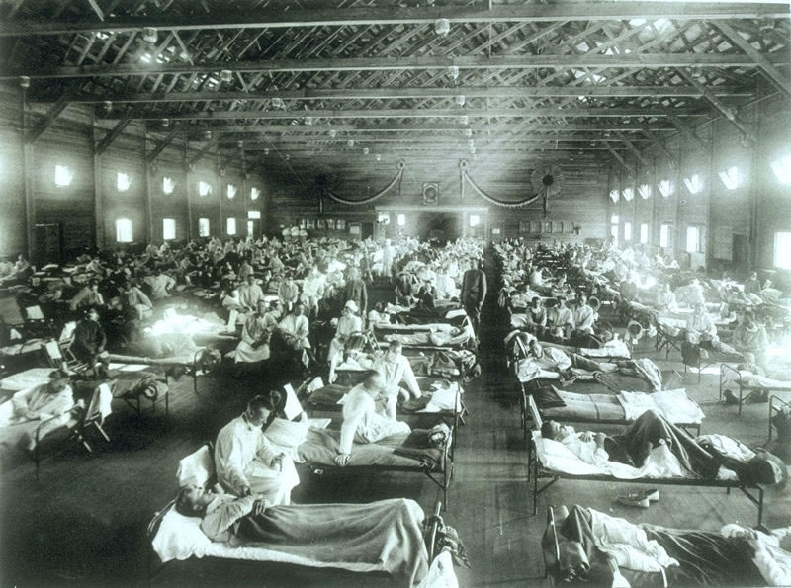
Notes:
1918 - Soldiers at an Influenza Hospital – Camp Funston, Kansas, USA.
Spanish flu caused over 25 million deaths
WW I caused 17 million deaths

Slide 10
Epidemiology
Influenza has caused several epidemics and pandemics, e.g.
Year | Name | Strain | Deaths
1918 | Spanish Flu | H1N1 | 30 million
1957 | Asian Flu | H2N2 | 1 million
1968 | Hong Kong Flu | H3N2 | 1 million
1997 | Avian Flu | H5N1 | 6
2009 | Swine flu | H1N1 | 477
Year | Strain | Subtype | Proportion
1918 | - | H1N1 | Pandemic (Spanish flu)
1957 | A/Singapore/57 | H2N2 | Pandemic (Asian flu)
1964 | A/Taiwan/64 | H2N2 | Epidemic
1968 | A/Aichi/68 | H3N2 | Pandemic (Hong Kong flu)
1977 | A/USSR/77 | H1N1 | Epidemic (Russian flu)
2009 | A/California/09 | H1N1 | Pandemic (Swine flu)
Notes:
1918 – 25M deaths worldwide
2009-2010 – 16,000 deaths worldwide

Slide 11
Influenza virus: Structure
(8 coated RNA segments)
Notes:
The 8 RNA molecules (the number in brackets is the designated segment number):
The HA gene [4] encodes the hemagglutinin. 3 distinct hemagglutinins (H1, H2, and H3) are found in human infections; 15 others have been found in animal flu viruses.
The NA gene [6] encodes the neuraminidase. 2 different neuraminidases (N1 and N2) have been found in human viruses; 9 others in other animals.
The NP gene [5] encodes the nucleoprotein. Influenza A, B, and C viruses have different nucleoproteins.
The M gene [7] encodes two proteins (using different reading frames of the RNA): a matrix protein (M1 — shown in blue) and an ion channel (M2) spanning the lipid bilayer (not shown).
The NS gene [8] encodes two different non-structural proteins (also by using different reading frames). These are found in the cytosol of the infected cell but not within the virion itself.
One RNA molecule (PA [3], PB1 [2], PB2 [1]) encoding each of the 3 subunits of the RNA polymerase. Occasional frameshifts during translation of PA produce a protein that reduces host gene expression.

Slide 12
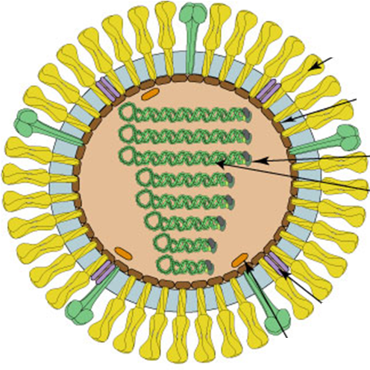
Structure
Envelope (Lipid bilayer) – host-derived
Studded with two proteins:
Haemaglutinin (HA) - attachment
Neuraminidase (NA) – viral release
Matrix protein
M1
M2 ion channel
RNA – 8 RNA segments
Code for different proteins

Slide 13
Structure:
Hemagglutinin (HA) protein:
For attachment
Binds sialic acid on surface of epithelial cells in the RT
Causes RBC agglutination in vitro
basis for hemadsorption test
16 subtypes: H1 – H16
(H1, H2, H3, H5, H7 & H9 have been recorded in man)

Slide 14
Structure…
Neuraminidase (NA) protein:
Facilitates virus release
Breaks down sialic acid around infected cells
Sialic acid is on cell surface and in mucus secretions
9 sub-types: N1 – N9.
N1, N2, N9 have been recorded in man

Slide 15
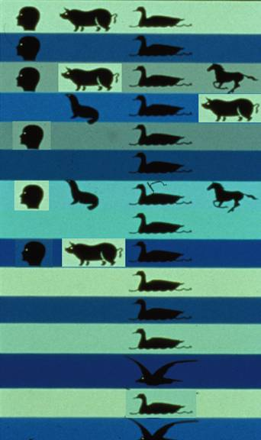
Influenza A: HA & NA Subtypes
H1
N1
H2
N2
H3
N3
H4
N4
H5
N5
H6
N6
H7
N7
H8
N8
H9
N9
H10
H11
H12
H13
H14
H15, H16, H17
Notes:
B has two serotypes: Yamagata and Victoria

Slide 16
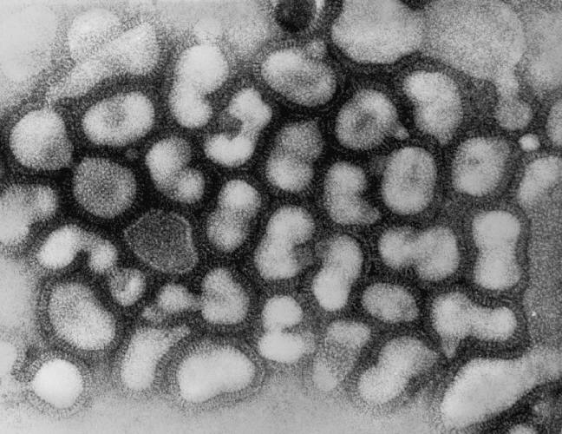
Influenza virus
© Dr. K. G. Murti

Slide 17
Replication
Attachment
Endocytosis
Uncoating
Replication
Transcription
Translation
Assembly
Budding

Slide 18
Antigenic variation
Virus changes its antigens thus evading the immune system
1. Antigenic drift:
Occurs in all Influenza viruses
Gradual accumulation of mutations
May generate a new strain
Acquired immunity is no longer effective
Causes seasonal outbreaks and limited epidemics
Notes:
Shift is worse if both proteins or HA changes

Slide 19
Antigenic Drift

Slide 20
Antigenic variation…
2. Antigenic Shift
Mainly occurs in Influenza A
Due to re-assortment of RNA segments
Occurs in a cell infected with different sub-types (mixing vessel)
May lead to a new virus subtype
No previous immunity to the new sub-type
Causes sporadic epidemics/pandemics

Slide 21
Antigenic Shift

Slide 22
Pathogenesis
Transmission: small particle aerosol (10μm) and fomites
Incubation period: 18-72 hrs
Replicates in epithelial cells in the respiratory tract
Viremia is rare
Cell death is from direct viral effect
Later from T-cytotoxic cells
Epithelial cell death reduces clearance of pathogens

Slide 23
Pathogenesis…
Viral clearance is by interferon and cell-mediated immunity
Interferon is also responsible for most symptoms
Significant antibody response develops after the virus is cleared, protects against future infection with same virus
Notes:
A humoral antibody response is the main source of protection. IgG and IgA are important in protection against reinfection.
Antibody to the HA protein is most important since this can neutralize the virus and prevent the virus initiating the infection.
Neutralization frequently involves blocking of the binding of the virus to host cells and may work at other steps involved in the entry and uncoating of the virus. Antibody to the NA protein has some protective effect since it seems to slow the spread of the virus. IgG persists longer than IgA and so plays a more important role in long term immunity.

Slide 24
The following are key in pathogenesis of influenza virus EXCEPT:
Viral cytopathic effect
Interferons
Cytotoxic T-cells
Viremia
p2.gg/zs8
Notes:
p2.gg/zs8

Slide 25
Flu face

Slide 26
Clinical Features:
High risk groups: the young, the elderly and the sickly
90% of deaths in elderly,
Main causes of death: bacterial pneumonia, heart failure
Uncomplicated influenza:
Non specific symptoms: Headache, Myalgia, Fever
Cough
Rhinorrhea
Rarely, GIT symptoms (vomiting, diarrhea)
Notes:
vomiting, diarrhea associated with 2009 H1N1 ‘Swine’ Flu
Young: no previous exposure, no immunity and narrow airways
Elderly: senescent immune system, COPD, Cardiac disease

Slide 27
Clinical Features…
Pulmonary Complications:
Croup – Laryngotracheobronchitis
Viral pneumonia
Secondary bacterial infection; usually due to:
Hemophilus influenzae
Streptococcus pneumoniae
Staphylococcus aureus
Notes:
Croup: (LTB) – barking cough, stridor & dyspnoea

Slide 28
Clinical features…
Non-Pulmonary Complications:
Myositis
Cardiac complications
Encephalopathy
Guillan-Barre syndrome
Reye’s syndrome
Notes:
Reye’s syndrome= Fatty liver, edema in brain

Slide 29
Diagnosis
Specimen: throat/nasal swabs, nasal washes
Rapid tests –
Antigen detection - Low sensitivity (60%), high specificity (90%)
RNA detection
Serologic Tests – e.g. Direct Immunofluorescent tests
Polymerase Chain Reaction Tests (PCR)
Usually part of a panel for several resp. viruses
Viral culture
Notes:
Provisional diagnosis often clinical, based on seasonal trends
Culture on cell lines; confirmed by cytopathic effect, hemadsorption or fluorescent antibody testing
e.g. Quickvue, ZStatFlu

Slide 30
Treatment
Supportive:
Airway management, Antipyretics/analgesics
Chemotherapy:
Polymerase inhibitors: Ribavirin, Favipravir
Uncoating inhibitors: Amantadine/Rimantadine
Viral release Inhibitors: Zanamivir/Oseltamivir/Peramivir
Endonuclease inhibitor: Baloxavir
Antibiotics
Useful if there’s secondary bacterial infection

Slide 31
Uncoating Inhibitors
Amantadine/Rimantadine
Prevent uncoating of the virus
Block M2 ion channels – a viral protein
Prevent acidification of the endosome
Active on Influenza A only, not B or C

Slide 32
Viral release inhibitors
Zanamivir, Oseltamivir, Peramivir
Effective for Influenza A & B, ?C
Block viral neuraminidase (NA)
Prevents virus spread from infected to uninfected cells
Notes:
NA clears sialic acid from the infected cell surface and respiratory mucus secretions

Slide 33
RNA polymerase inhibitors
Ribavirin, Favipravir
Effective for Influenza A & B,C
Inhibit RNA polymerase
Prevents replication of the virus in infected cells

Slide 34
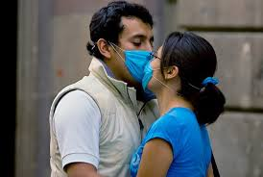
Prevention
Vaccines:
Inactivated
Trivalent Inactivated Vaccine
A quadrivalent inactivated vaccine
Monovalent vaccine
Live attenuated Influenza Virus
Quadrivalent - given as intranasal spray to children
Chemoprophylaxis
Zanamivir/Oseltamivir/ Peramivir/ Baloxavir
Notes:
Trivalent Inactivated Vaccine (TIV) – two A and 1 B types
A quadrivalent inactivated vaccine - two type A and two B viruses
Monovalent vaccine – e.g. H5N1

Slide 35
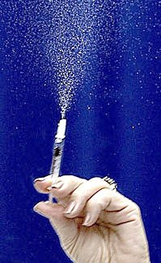
Flu vaccines

Slide 36
Control of pandemic Influenza
Surveillance
Screening
Information sharing
Health education
Health worker capacity
6. Drugs (Prophylaxis)
7. Vaccination (annual)
8. Culling animals (chicken/swine)
9. Limiting travel
10. Isolation of infected persons

Slide 37
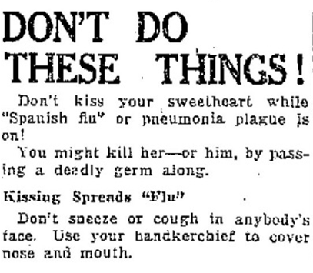
1918

Slide 38
Thermal scanner

Slide 39
WHO - GISRS

Slide 40
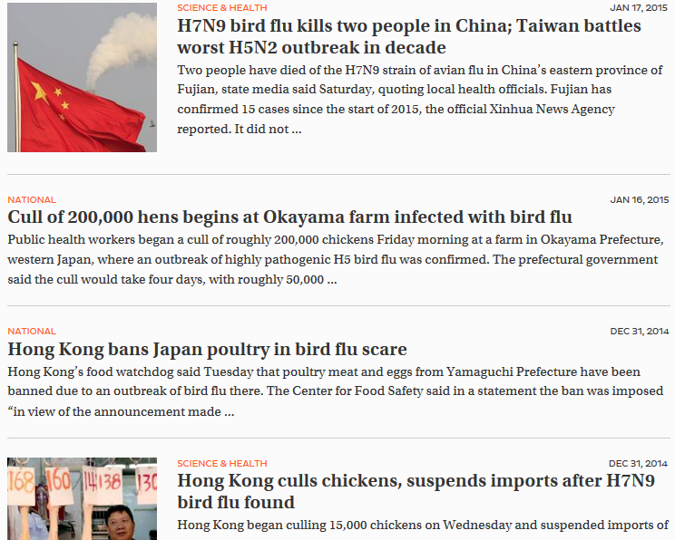
Japan Times – Avian Flu

Slide 41
Seasonal vs Pandemic influenza
 | Seasonal | Pandemic
Pattern | Predictable, cold season | Rare, a few in a century
Immunity | Some immunity from previous exposure | No previous exposure, little or no immunity
Affected persons | Health adults usually spared | Everyone is at risk
Health systems | Able to meet demand | Overwhelmed
Vaccines & drugs | Usually adequate | Vaccine unavailable Drugs inadequate
Impact | Manageable | May severely affect economy
Notes:
Young, elderly & sickly

Slide 42
Comparison: Influenza types A/B/C
 | Type A | Type B | Type C
Disease Severity | +++ | ++ | +
Animal hosts | Yes (swine, horse, birds) | No | Yes
Outbreaks | Pandemic, Epidemic | Epidemic | Rare
Chemotherapy | Amantadine Rimantadine Oseltamivir Zanamivir | Oseltamivir Zanamivir | ??

Slide 43
Recap
Classification
Characteristics
Antigenic Variation
Pathogenesis
Clinical features
Diagnosis
Treatment
Deterrence

Slide 44
One of the following drugs is used to treat Influenza B virus:
Acyclovir
Amantadine
Oseltamivir
Lamivudine

Slide 45
Antigenic Shift
p2.gg/zsq

Slide 46
Questions
?
@mosmasika
mosmasika@gmail.com
Masika Moses
@MicrobiologyUoN
Medical Microbiology UoN
Notes:
REFERENCE: www.Microbiologybook.org

