Slide 1
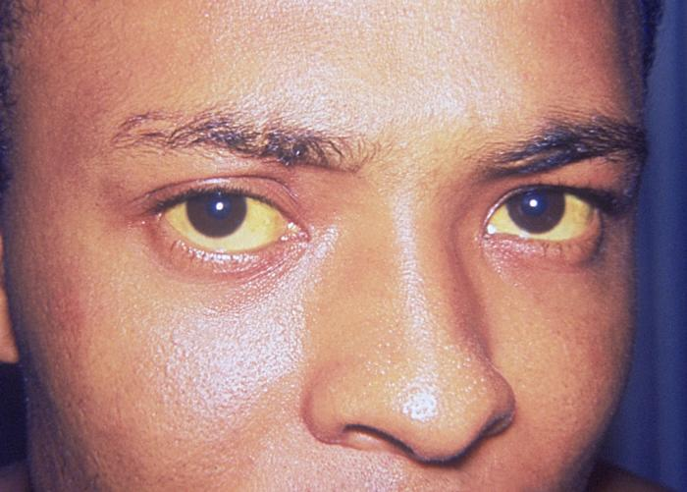
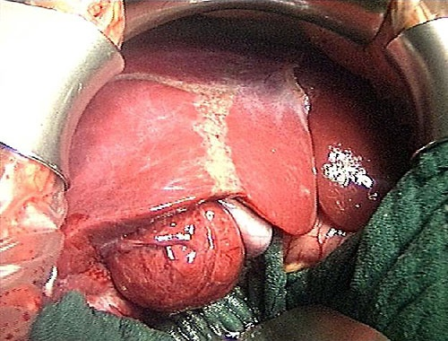
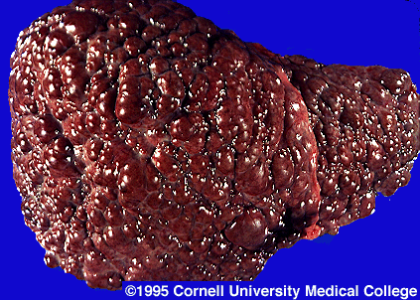
Viral Hepatitis
Masika M.M.

Slide 2
Session Outline
Etiology
Acute Hepatitis
Chronic Hepatitis
HBV: Virology, epidemiology, presentation, diagnosis, treatment, prevention
HAV: Virology, epidemiology, presentation, diagnosis, treatment, prevention
HCV: Virology, epidemiology, presentation, diagnosis, treatment, prevention

Slide 3
References
http://www.microbiologybook.org/
WHO
AASLD - http://www.aasld.org/
http://www.hcvguidelines.org/
www.easl.eu
Medscape
PUBMED/HINARI

Slide 4
Hepatitis
Hepatitis is inflammation of the liver.
Causes:
Infectious – Viral, Fungal, Bacterial, Parasitic
Drugs – e.g. anti-TBs, ARVs, NSAIDS, etc.
Alcohol
Poisoning – e.g. aflatoxin
Metabolic disorders
Autoimmune diseases

Slide 5
Viral Hepatitis ETIOLOGY
Hepatitis A virus (HAV)
Hepatitis B virus (HBV)
Hepatitis C virus (HCV)
Hepatitis D virus (Co-infection with HBV only)
Hepatitis E virus (HEV)
Infrequent: Adenovirus, EBV, CMV, HSV,
Notes:
NANB – Non-A, Non-B Viruses

Slide 6
 | HAV | HBV | HCV | HDV | HEV
Family | Picornaviridae | Hepadnaviridae | Flaviviridae | Unassigned | Hepeviridae
Transmission | Feco-oral | Blood/body fluids | Blood/body fluids | Blood/body fluids | Feco-oral
Chronic Infection | No | Yes 5-90% of infections | Yes 70% of infections | Yes | No
Vaccine | Yes | Yes | No | No HBV vaccine | Yes
Antivirals | No | Yes | Yes | No HBV drugs | None
Notes:
Pegylation – conjugation with Polyethylene Glycol (PEG) slows metabolism
Sofosbuvir – uridine analogue (nucleotide) prodrug – Inhibits HCV RNA-dependent Polymerase – FDA approval in 2013
Boceprevir – HCV Protease inhibitor – FDA approval in 2011 (no longer recommended coz Sofusbuvir is more efficacious)
Telaprevir – HCV protease inhibitor – Vertex TM to discontinue sale in October 2014
Simeprevir – HCV protease inhibitor –FDA approval in 2014

Slide 7
Hepatitis B virus
HBV

Slide 8
HBV Virology
Family: Hepadnaviridae
Species: Hepatitis B virus
10 genotypes: A - J
Circular DNA, partially double-stranded
Enveloped
Hardy
Notes:
Double-shelled
15 yrs at -20C
2 yrs at -80C
6 months at rtp
7 days at 44C
400-yr old mummified remains in Korean

Slide 9
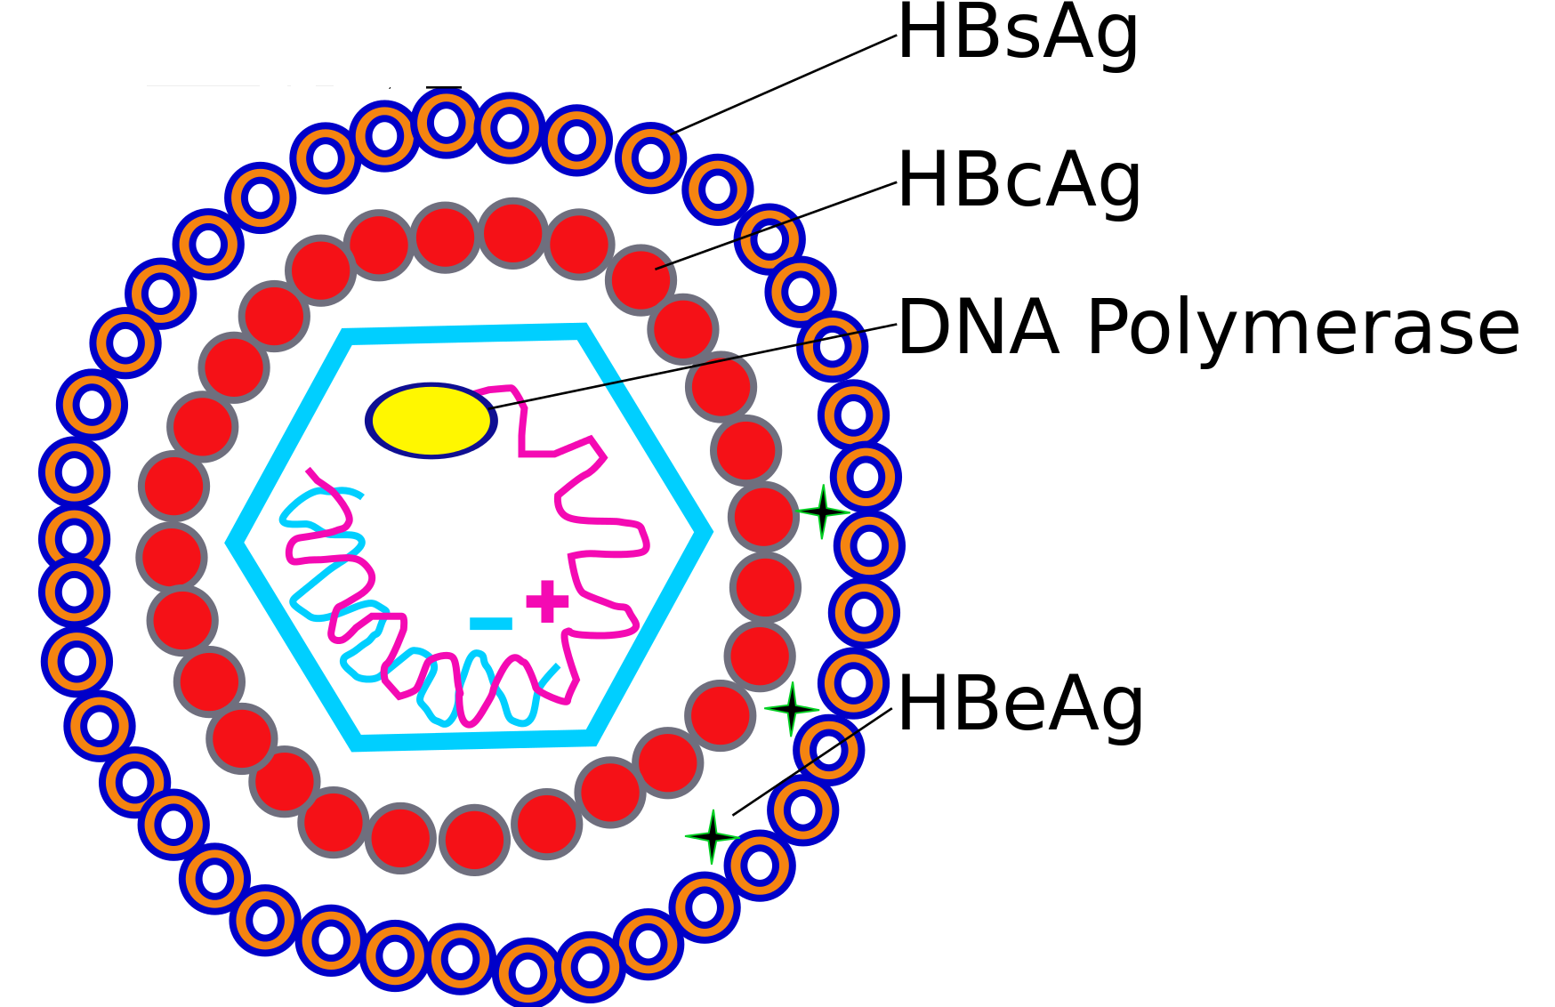
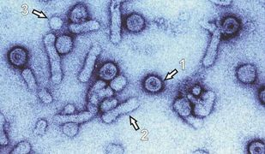
HBV structure

Slide 10
HBV Epidemiology
A third of global population has been infected
5% (400 million) have chronic HBV infection
Chronic infection may cause chronic liver disease: cirrhosis, Hepatoma
1 million deaths p.a. related to HBV
HBV causes 50% of all cases of HCC

Slide 11
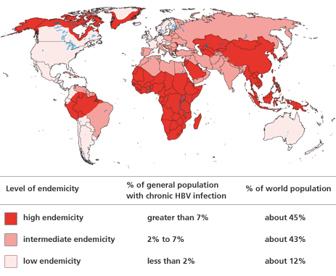
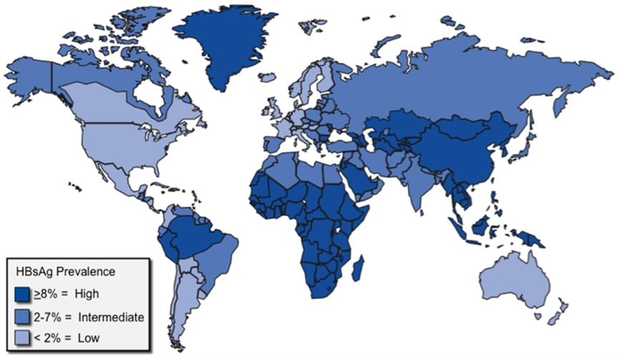
HBV Prevalence
©WHO 2011
Notes:
Source: Hwang E & Ramsey Cheung R, Global Epidemiology of Hepatitis B Virus (HBV) Infection. North American Journal of Medicine and Science. January 25, 2011

Slide 12
HBV Transmission
Sexual contact
Predominant mode among adults
Close contact
In children & families
Vertical transmission
During delivery, rarely transplacental
No evidence of transmission through breastfeeding
Blood
Unscreened blood transfusions, serum products
Sharing of needles, razors
Tattooing, acupuncture
Renal dialysis
Organ transplant
Notes:
Vertical transmission:
Usually during delivery
Rarely transplacental
No evidence of transmission during breastfeeding

Slide 13
HBV Risk Factors
Multiple sexual partners
Intravenous Drug Use (PWIDs)
MSM
Household members of an infected person
Crowding/Institutionalization
Occupational risk – Health workers

Slide 14
HBV Pathogenesis
Parenterally transmitted
Replicates in Hepatocytes
Virus particles & surface protein released into blood
Viremia is prolonged and blood is highly infectious
Host immune response to the virus causes hepatocellular damage

Slide 15
HBV Clinical outcomes
Acute Hepatitis B
90%
1%
9%
Resolution
Fulminant Hepatitis
HBsAg + for > 6 months
50%
Resolution
Asymptomatic carrier state
Chronic Persistent Hepatitis
Chronic Active Hepatitis
Extra-hepatic manifestations:
Glomerulonephritis
Arteritis
Myocarditis
Cirrhosis
Hepatocellular Carcinoma
Notes:
Chronic persistent hepatitis (Immunotolerant, usually after early infection or vertical transmission)

Slide 16
HBV Infection Disease Phases
Immune tolerance phase
Immune active /immune clearance phase
Inactive chronic infection
Chronic disease
Recovery

Slide 17
HBV Clinical Features
Long incubation period -120 days (1-6 months)
Insidious onset of symptoms
Often asymptomatic, esp. in the very young
90% of infected infants develop chronic infection
Approx. 5% of adults develop chronic infection

Slide 18
HBV Acute Phase
Variable presentation
Subclinical
Icteric
Fulminant hepatitis (1% of HBV infections)
Notes:
Few have icteric acute HBV infection (10% of children and 30-50% of adults)

Slide 19
Acute Hepatitis
Symptoms
Non-specific symptoms:
Malaise, Myalgia, Fever, Fatigability, Nausea or vomiting, Anorexia
Abdominal pain – Right upper quadrant (abdomen)
Dark urine/ pale stools
Jaundice

Slide 20
HBV Fulminant Hepatitis
CNS:
Hepatic encephalopathy
Somnolence/altered sleep pattern
Confusion
Coma
GIT: bleeding, Ascites
Coagulopathy

Slide 21
HBV Chronic Phase
Possible outcomes of Chronic HBV infection:
Asymptomatic Chronic Infection (carrier)
Chronic Persistent Hepatitis
Chronic Active Hepatitis
Cirrhosis
Hepatocellular Carcinoma
Notes:
Chronic persistent infection: minimum liver damage
Chronic active infection: Aggressive liver damage >> cirrhosis, liver failure
Hepatocellular carcinoma: HBV causes 80% of all cases of HCC
Fulminant Hepatitis: 1% of all HBV infections

Slide 22
Chronic Hepatitis
Symptoms
Malaise,fatigue, weakness
Weight loss
Peripheral edema
Ascites
Extra-hepatic manifestations

Slide 23
HBV Infection Complications
Extra-hepatic manifestations:
Resp: Pleural effusions/ hepatopulmonary syndrome
CVS: arrhythmias, pericarditis, myocarditis, arteritis
CNS: encephalopathy, somnolence, confusion
MSS: arthralgia, Serum sickness
Renal: Glomerulonephritis,
Hematological: bone marrow aplasia
Notes:
PAN = Polyarteritis nodosa

Slide 24
HBV Diagnosis
Serology:
Antigens:
HBsAg, eAg ,
Antibodies:
antiHBs , eAb, core Ab
PCR:
HBV DNA/ Viral load
Notes:
HBsAg- indicates infection/replication
eAg – a secreted Ag - indicates high level of viral replication – High infectiousness

Slide 25
HBV Acute infection

Slide 26
HBV Persistent infection

Slide 27
HBV Viral antigens
Surface Antigen (sAg)
Surface (envelope) protein
Secreted in excess into the blood (spheres & tubules)
Presence in serum indicates virus replication
e antigen (eAg)
Secreted protein, shed in small amounts into blood
Presence indicates that a high level of viral replication
May be falsely negative in carriers some mutations in eAg gene
Core Antigen (cAg)
Core protein
Present in infected liver cells, not found in blood

Slide 28
HBV Antibody Response
Surface antibody (sAb, antiHBs)
Detectable late in convalescence after resolution of infection,
Remains detectable for life
Not found in chronic carriers
Indicates immunity
e antibody (eAb, antiHBe)
Becomes detectable as viral replication falls
In a carrier, it indicates low infectivity
Core IgM
Rises early in infection
Indicates recent infection
Core IgG
Rises early
Present for life in both carriers & those who clear the infection
Indicates exposure to HBV

Slide 29
HBV Viral Load
HBV viral load measures level of HBV DNA in blood
The most reliable marker of infectivity.
More reliable than eAg which can be negative in some carriers due to mutations in the eAg gene

Slide 30
Hepatitis B serology
HBsAg | Anti-HBs | Anti-HBc | Anti-HBc (IgM) | Interpretation
(-) | (-) | (-) |  | Susceptible
(-) | (+) | (+) |  | Immune after infection
(-) | (+) | (-) |  | Immune after vaccine
(+) | (+/-) | (+) | (+) | Acute Infection
(+) | (-) | (+) | (-) | Chronic Infection
(-) | (-) | (+) |  | Resolved infection, Low level chronic infection, False positive (Anti-HBc)
Notes:
Hepatitis B serology

Slide 31
HBV Other Investigations
Liver Function Tests:
Coagulation Profile
Renal Function Tests
Full blood count
Radiology: Ultrasound/CT scan/ MRI
Liver biopsy & histology

Slide 32
HBV Treatment
Interferons (6 months)
INF-α2a
Pegylated INF – α2a
DNA polymerase inhibitors (Lifelong)
Tenofovir
Lamivudine
Adefovir
Entecavir
Notes:
Interferons:
Clearance of infection (and immunity) is the best outcome, but is achieved in only around 25% cases (after a six month course of treatment).
Interferon is the best available treatment for chronic HBV, but side effects and expense limit its use.
Best outcome is infection clearance (25% of all treated cases)

Slide 33
Ongoing Trials
Encapsidation inhibitors
Entry inhibitors
TLR7 agonists
Therapeutic vaccines

Slide 34
HBV Prevention
Vaccine
Post-exposure prophylaxis
Safe sex practices
Safe injection practices
Screening blood/blood products
Health education
Notes:
Post-exposure prophylaxis (Vaccine & HBIG - given within 48hrs)

Slide 35
HBV Active immunization
Four types of vaccines are available
Serum derived - sAg purified from the serum of HBV carriers
Recombinant sAg - made by genetic engineering in yeast
3rd Generation - Genetically engineered vaccines
Combination vaccines - vaccines against HBV vaccine + other organisms e.g. Hepatitis A+B
3 doses induce immunity in 95% of recipients
Infants receive three doses: at 6, 10 and 14 weeks
Notes:
Saccharomyces cerevisiae, also known as Brewer's yeast

Slide 36
HBV Passive immunization
Passive Antibody
HBIG (Hepatitis B surface Immunoglobulin)
Both HBIG and vaccine should be administered to non immune individuals following exposure to

Slide 37
HBV Co-infection
HBV/HCV Co-infection
Increases risk for severity & complications
HBV-HDV Co-infection
Increases risk for severity & complications
HBV-HIV Co-infection
Lower incidence of icteric illness
Higher rates of chronicity
Higher risk of cirrhosis & end-stage Liver Disease

Slide 39
Hepatitis C virus
HCV

Slide 40
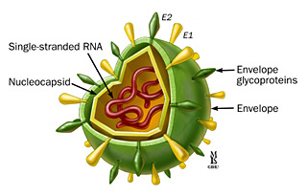
HCV Virology
Family: Flaviviridae
Genus: Hepacivirus
(+)ssRNA, enveloped
6 genotypes, numerous subtypes
Infects man and chimpanzees
Transmitted via blood or body fluids:
Transfusions, PWIDs, tattoing, needle-stick injuries

Slide 41
HCV Epidemiology
170 million cases World wide
Highest burden: SE Asia, Eastern Mediterranean, N. Africa
Africa – prevalence of 5%, highest in Egypt ~ 20%
Kenya < 2%
Prevalence higher in older population > 20 years
Notes:
Egypt- antischistosomal therapy led to high prevalence

Slide 42
HCV Pathogenesis
Parenteral transmission
Multiplies in hepatocytes
Viral clearance with long-term CM immunity (25%)
Usually causes chronic infection (75% of infections)
Persistent viremia & hepatic inflammation/fibrosis
Notes:
?HCV targets B lymphocytes
HCV polymerase generates mutants (quasispecies)
Challenges in CMI & vaccine development

Slide 43
HCV Clinical Features
60-70% of cases are asymptomatic
Incubation period is 15-150 days
Commonest symptoms are fatigue & jaundice
70 - 80% of newly infected individuals develop chronic infection
Notes:
It is the cause of 15-20 % of acute hepatitis in the developed world.

Slide 44
HCV Complications
Chronic HCV infection (75%)
Cirrhosis (10-20% of chronic infections)
Hepatocellular carcinoma (1-5%)
HCV is responsible for about 25% of HCC cases.
Immune complex disorders common in carriers

Slide 45
HCV Diagnosis
Serology: Anti-HCV IgG
PCR
HCV can not be cultured
Notes:
Other tests:
LFTs, Full hemogram, biopsy, radiology

Slide 46
HCV Treatment
Antiviral agents
Interferon-α2a & 2b
Polymerase inhibitors:
Ribavirin
Sofosbuvir
Protease inhibitors:
Boceprevir,
Simeprevir
NS5A Inhibitors:
Daclatasvir, Ledispavir, Ombitasvir
Notes:
Ns5A: Plays a role viral replication and assembly?!

Slide 47
HCV Prevention
No vaccine currently
Screening blood & blood products
Risk reduction for people who inject drugs

Slide 48
HIV/HCV Co-infection
Increases liver scarring and long term complications e.g. cirrhosis
Increases viral replication
Increased perinatal HCV transmission

Slide 50
Hepatitis D virus
RNA virus
Requires HBV to spread (infect new cells/hosts)
3 genotypes
May co-infect or superinfect with HBV
Notes:
Can replicate on its own

Slide 51
HDV Epidemiology
Transmission: Parenteral
Risk factors: IVDU, multiple blood transfusions
15 million cases globally

Slide 52
HDV Clinical Manifestations
Variable clinical presentation
Acute infection (Mild to fulminant hepatitis)
Chronic infection
5% in co-infection with HBV
80% in super-infection with HBV
Chronic Liver Disease
Cirrhosis, Hepatoma, Liver failure

Slide 53
HDV complications
Liver failure
Hepatocellular carcinoma
Autoimmune manifestations

Slide 54
HDV Diagnosis
Serology:
HDV antigen
Anti-HDV IgM and IgG
HDV RNA PCR

Slide 55
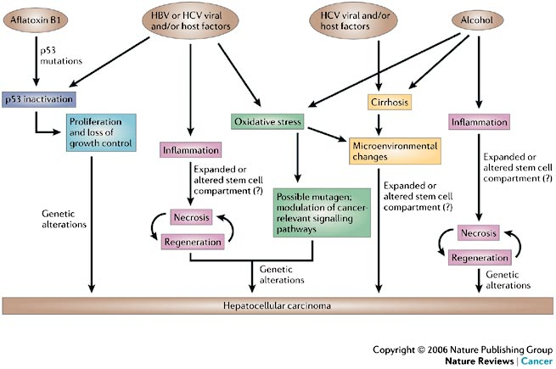
HCC
Hepatocellular Carcinoma

Slide 56
Hepatocellular Carcinoma: PATHOGENESIS
Hepatocellular Carcinoma: Mechanisms of Carcinogenesis
Etiology | Mechanism
HBV, HCV, Alcohol | Inflammation, necrosis/regeneration
HCV, Alcohol | Liver cirrhosis
HBV, HCV, Alcohol | Oxidative stress
HBV, HCV, Aflatoxin | Inactivation of _{p}53 (Tumor Suppressor)

Slide 58
Hepatitis A Virus
HAV

Slide 59
Hepatitis A virus (HAV)
Order: Picornavirales
Family: Picornavirus
Genus: Hepatovirus
7 genotypes, 1 serotype
(+)ssRNA virus, naked, icosahedral
Withstands acid, dessication, temp (-20 to 56⁰C)
Transmission is feco-oral
Notes:
Acid - (pH 3.0)
Destroyed by boiling, chlorine & iodine

Slide 60
HAV Epidemiology
Worldwide distribution
Commonest cause of acute hepatitis
Highest in developing countries
Nearly universal in Urban centres in Africa & Asia
Factors: Overcrowding & poor sanitation
Most are infected by 2 yrs of age

Slide 61
HAV Pathogenesis
Feco-oral transmission
Replicates in enterocytes
Spreads to liver & multiplies in hepatocytes
Triggers cell-mediated hepatocellular destruction
Excreted in feces
Causes transient viremia

Slide 62
HAV Clinical Features
Incubation – 28 days (2-6 weeks)
Pre-icteric prodrome – 1 week
Flulike illness: non-specific symptoms
Icteric Phase – up to 12 weeks
Dark urine, pale stool, jaundice, abdominal pain, pruritus
Notes:
Jaundice – 70-80% of all adults with acute HAV infection. Less likely in children, uncommon in infants
Abdominal pain in 40% of all patients
Rash and arthralgia may occur
Relapses may occur in the elderly

Slide 63
HAV Complications
Fulminant Hepatitis - 1% of all HAV infections
Relapsing HAV infection – (usually in the elderly)
Autoimmune Hepatitis
Extra-hepatic manifestations - rare
Renal Failure
Arrythmias
Bone marrow aplasia
SLE
Guillan Barre Syndrome

Slide 64
HAV Diagnosis
Serology: IgM/IgG
RNA PCR (stool & blood )
HAV cannot be cultured in vitro
Notes:
Other tests:
LFTs, ultrasonography, Full blood count, coagulation profile, histology

Slide 65
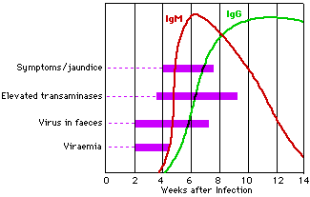
HAV Infection Time Course

Slide 66
HAV Treatment
Supportive
Analgesia/antypyretics
Antiemesis
Rehydration
Liver transplant – may be needed in fulminant HF

Slide 67
HAV Prevention
Vaccination:
Live attenuated vaccine (IM, 2 doses)
Passive immunization with immunoglobulins
Environmental sanitation, clean drinking water

Slide 68
Hepatitis E virus
Genus: Hepevirus, Family: Hepeviridae
RNA virus
Non-enveloped
4 genotypes (1 -4)
1 & 2 are human, 3&4 are zoonotic
Notes:
rodents, pigs, sheep, and cattle

Slide 69
HEV Epidemiology
Transmission: Feco-oral (food or water)
Causes epidemics in developing countries
More deadly in pregnant women
Does not cause chronic infection

Slide 70
Parameter | HAV | HBV | HCV | HDV | HEV
Family | Picornaviridae
Genus | Hepatovirus
Genome | +ssRNA
Envelope | No
Transmission | Feco-oral
Viremia | Brief
Chronic disease | No
Fulminant disease | Rare
Vaccine | Yes
Antivirals | None
Oncogenicity | No

Slide 71
Poll: Vaccines
p2.gg/zsn

Slide 72
Poll: Treatment
p2.gg/zs3

Slide 73
The End

