Slide 1
Kitum Cave, Mt. Elgon

Slide 2
Emerging & Remerging Infections
Masika MM

Slide 3
Outline
Definitions: Emerging, re-emerging
Significance
Factors fuelling ERIs
Case studies: Zika, SARS, Influenza, Ebola, HIV
Diagnosis
Management
Prevention

Slide 4
Emerging Infections
Infections whose incidence has increased in the last 20 years and could increase in the near future
Have not occurred before in humans

Slide 5
Re-emerging Infections
Infections which had initially declined but are now posing a significant threat to public health
Had been controlled initially then resurged OR
Occurring in a new geographical region OR
Occurring in a new population OR
Causing new clinical manifestations
Notes:
Urban sanitation, improved housing, personal hygiene, antisepsis & vaccination
Antibiotics further suppressed morbidity & mortality

Slide 6
Why the Concern?
Morbidity & Mortality
Economic losses
Social impact
Public anxiety/panic
Unpredictability
Mystery
i.e. Limited knowledge on source, transmission, control, etc.

Slide 7
Disease Emergence
Notes:
Karesh et al
Lancet
2012

Slide 8
Disease Emergence
Increased circulation of the virus in it reservoir,
Species-jumps to secondary /intermediate host
Individual zoonotic transmissions
to humans
VIRUS EVOLUTION
CROSS-SPECIES TRANSFER TO HUMANS
TIME
Short human-to human transmission chains
Restricted epidemics
Prolonged human-to-human transmission
Large epidemics, pandemic
Notes:
How Zoonoses Emerge

Slide 9
Factors fuelling ERIs
Economic Activities:
Logging, irrigation, animal husbandry,
Climate change
International travel & trade
Immunosuppression
Pathogen evolution
E.g. Antimicrobial resistance, increased virulence& host range
Notes:
Changing human behaviours, such as increased use of child-care facilities, sexual and drug use behaviours, and patterns of outdoor recreation
Changes in food processing and handling, including foods prepared from many different individual animals and countries, and transported great distances

Slide 10
Factors fuelling ERIs
6. Weak public health systems
7. Poverty & social inequality
8. Civil unrest/war
9. Bioterrorism
10. Illiteracy/ Lack of awareness
11. Human behaviors:
Outdoor recreation activities, drug use, sexual habits

Slide 11
Examples of ERIs
Viral ERIs
Arboviruses: Zika, Dengue, Chikungunya, West Nile, etc.
Respiratory viruses: Influenza, SARS, MERSCoV, Hantavirus
STI: HIV
Prion ERI
BSE (Bovine Spongiform Encephalopathy) – Mad cow disease
Notes:
From over 1400 known human pathogens, 177 are ERIs

Slide 12
Bacterial ERIs
Antimicrobial resistance:
TB, Gonorrhea, Enterobacteriaceae, etc.
Vaccine-preventable:
Pertussis, Diphtheria, Cholera, etc.
Zoonotic:
E.coli, Salmonellosis, Campylobacter, etc.

Slide 13
Parasitic ERIs
Food/Water-borne:
Cyclosporidiasis, blastocystosis, microsporidiosis, trematodiasis
Vector-borne
Malaria, leishmaniasis, trypanosomiasis
Zoonotic
Echinococcosis, babesiosis, trichinellosis
Transfusion-related
Babesiosis, trypanosomiasis, toxoplasmosis

Slide 14
List of Emerging Infections
SEE: https://theconversation.com/explainer-why-cholera-remains-a-public-health-threat-74444

Slide 15
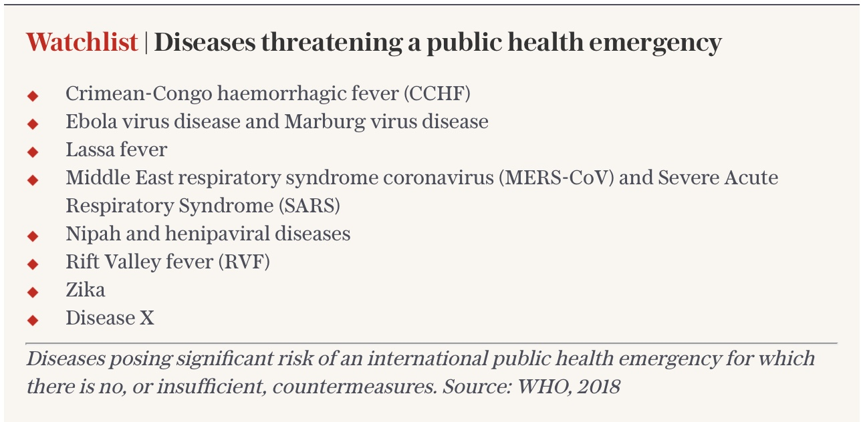
WHO Watchlist for Emerging Infections
Crimean-Congo haemorrhagic fever
Ebola
Lassa fever
MERS
SARS
Nipah
Rift Valley fever
Notes:
Nipah: http://www.who.int/csr/disease/nipah/en/
Anthrax: September 18, 2001, one week after the September 11 attacks
Letters containing anthrax spores were mailed to several news media offices and two Democratic US Senators,
Killing five people and infecting 17 others

Slide 16
ERIS: Common Virus Groups
Arenaviridae
Bunyavirales
Flaviviridae
Togaviridae
Filoviridae
Reoviridae
Orthomyxoviridae
Paramyxoviridae

Slide 17
Transmission
Arthropods
Vertebrate vectors
Direct contact
Vertical transmission
Sexual intercourse
Inhalation

Slide 18
Vectors
VECTOR | VIRUSES TRANSMITTED
Aedes mosquitoes | Flaviviridae - Dengue, Yellow fever, Zika Alphaviruses – Chikungunya, Phenuiviridae (Bunyavirus) – Rift valley fever
Anopheles mosquitoes | Alphaviruses – O’nyong-nyong
Culex mosquitoes | Flaviviridae – West Nile virus, Japanese Encephalitis Alphaviruses – Eastern Equine Encephalitis
Ticks | Flaviviridae – Tick-borne Encephalitis virus Nairoviridae (Bunyavirus) – Criméan Congo HF Reoviridae – Colorado Tick Fever
Phlebotomine sandflies | Flavivirus - Sandfly Fever Bunya viruses - Toscana virus, Sicilian Virus, Naples virus

Slide 19
Vertebrate Hosts
Bats | Ebola, Marburg, MERSCoV, Rabies
Rodents | Rabies, Nipah
Camels | MERSCoV
Birds | West Nile Virus

Slide 20
Zika Virus
Zika virus was isolated in Uganda in 1947 from rhesus monkeys
First human ZIKV infection was reported in UG & TZ 1952, then 1954 in Nigeria
Two ZIKV lineages: African and Asian
African lineage: East and West African clusters

Slide 21
Zika virus…
2007: First ZIKV outbreak occurred in Yap (Micronesia)
2013: Second outbreak occurred in French Polynesia
2015: ZIKV emerged Brazil
Transmission: initially enzootic cycle then urban cycle
Notes:
Yap - (73% of the population infected) (7,500 inhabitants)
French Polynesia - 28,000 people (11% of the population)
Brazil: North Eastern

Slide 22
Zika: Clinical Features
Asymptomatic in 80% of the cases
Incubation period < 1 week
Non-specific Clinical Features:
Fever (may be absent)
Rash
Arthralgia
Myalgia
Conjunctivitis

Slide 23
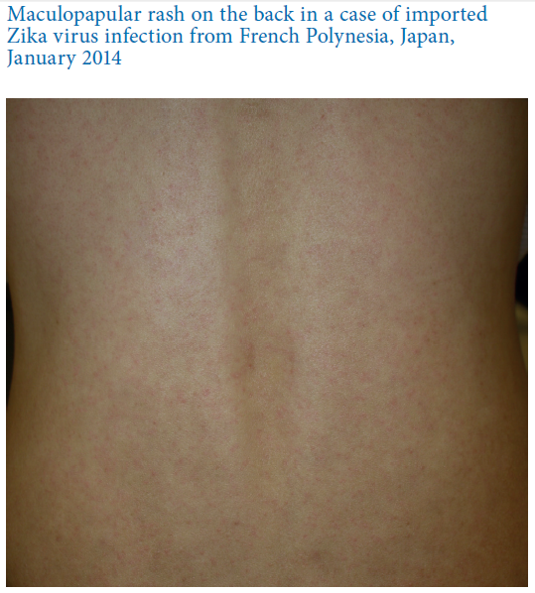
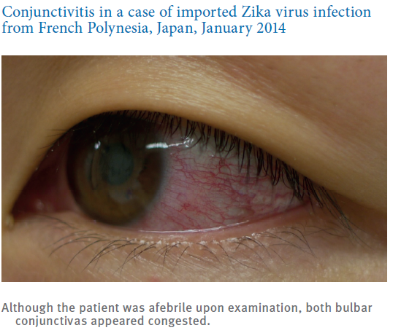
© Eurosurveillance, 2014

Slide 24
ZIKV: Other Manifestations
Headache
Malaise
Dizziness
Retro-orbital Pain
Anorexia
Photophobia
GIT disorders
Sore Throat
Cough
Aphthous Ulcers
Back Pain
Lymphadenopathies

Slide 25
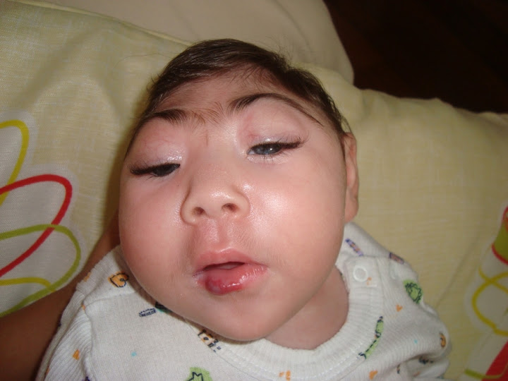
Complications
Neurological
Guillain Barré Syndrome
Microcephaly
Eye disease:
Chorioretinal atrophy
Optic nerve abnormalities
Notes:
Focal pigment mottling of the retina

Slide 26
Management
Supportive:
Paracetamol & Antihistamines
Avoid NSAIDS

Slide 27
Ebola Virus Disease
First outbreaks in DRC and Sudan – 1976
Largest outbreak to date occurred in W/Africa – 2014-15
Family: Filoviridae; Genus: Ebolavirus; 5 species:
Zaire Ebola virus
Sudan Ebola virus
Bundibugyo EBOV
Tai Forest EBOV
Reston EBOV
Notes:
Yambuku – DRC
Nzara – South Sudan

Slide 28
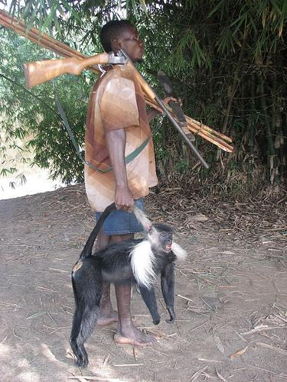
Ebola Virus
Natural hosts thought to be Fruit bats
Transmitted to humans by wild animals:
Chimpanzees, gorillas, monkey, antelopes, porcupines, bats
Human to human transmission amplifies the outbreak
Through blood and other body secretions incl. semen.

Slide 29
Ebola Outbreak: 2014-2015
WHO Situational Report
Notes:
Ministry of Health (MoH) of Guinea has reported an outbreak of Ebola hemorrhagic fever in four southeastern districts: Guekedou, Macenta, Nzerekore and Kissidougou. Reports of suspected cases in the neighboring countries of Liberia and Sierra Leone are being investigated. In Guinea, a total of 86 suspected cases, including 59 deaths (case fatality ratio: 68.5%), had been reported as of March 24, 2014.

Slide 30
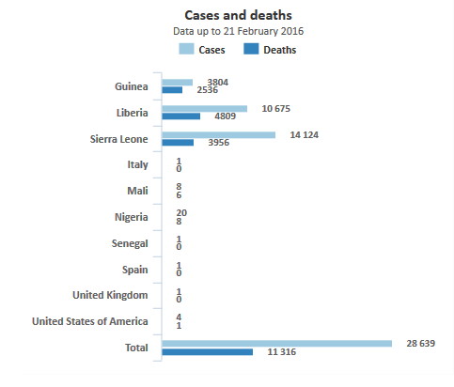
Ebola outbreak 2014-2015

Slide 31
Ebola…

Slide 32
Ebola: Clinical Manifestations
Non-specific signs:
Fever, Fatigue, Myalgia, Headache, Sore throat.
Vomiting & diarrhoea
Rash
Impaired kidney and liver function,
Internal and external bleeding
Notes:
FHG: Low WBC and Low platelet count

Slide 34
SARS
(Severe Acute Respiratory Syndrome)
NOV 2002: highly contagious, severe atypical pneumonia observed in China
FEB 2003: Spread to Hong Kong by a doctor who later died
Similar outbreaks occurred in different local communities
The virus was identified in March 2003 (A coronavirus)
Notes:
Guangdong Province

Slide 35
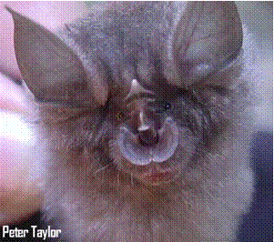
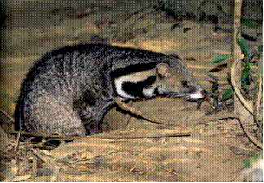
SARS: Transmission
Transmission through droplet
CIVETS: Initially thought to natural hosts (later refuted)
BATS: Reservoir hosts for SARS Coronavirus
Notes:
10,000 civets killed and other animals

Slide 36
SARS: Clinical features
Incubation period: 10 days
Non-specific: Fever, Chills, muscle aches
Respiratory: Shortness of Breath, Cough

Slide 37
SARS: Spread

Slide 38
SARS: Impact
Approx: 8,000 cases and 800 deaths
26 countries affected
Airline passenger movement dropped markedly
Tourism dropped 40%
Economic loss: US$ 60 billion
Notes:
Total: 8098 cases and 774 deaths

Slide 39
HIV
June 1981: Pneumocystis pneumonia in LA, USA
July 1981: Kaposi Sarcoma & PCP in MSM in New York & California
Today:
Over 70 Million Total infections
36 million deaths
35 million PLWHA
2.3 million infections annually
1.6 million deaths annually
Notes:
MSM = Men who have sex in men

Slide 40
Viral ERIs: Diagnosis
Serology: Antibody/antigen detection by
ELISA,
Immunofluorescence assays
Neutralization assays
Nucleic Acid Detection by PCR
Next-generation sequencing
Virus isolation by cell culture
Electron microscopy

Slide 41
Challenges in Combating ERIs
Unpredictability
Numerous pathogens
Animal reservoirs
Lack of appropriate vaccines & Antimicrobials
Diagnosis
Capacity (Lab, Human resource)

Slide 42
Mitigation
Political will
Funding
Capacity building:
Health workers, infrastructure, lab facilities
Surveillance
Vaccination
Research & development
Notes:
Vulnerable populations: Sex workers, MSM, PWIDs, adolescent girls Vs other epidemics: Travelers, geographical location
Fatality: HIV takes years to kill an infected person, this provides an opportunity to spread
Presentation: Signs are usually not obvious hence it’s not easy to identify those who are sick
Stigma: Causes challenges is disclosure, delays diagnosis, reduces adherence and promotes transmission
No animal reservoir: can be eliminated by treating all infected humans

Slide 43
Mitigation…
Antimicrobial stewardship
Vector control
Health education
Develop early warning & rapid response systems
Research
International Health Regulations (IHR)
Global pubic health surveillance networks

Slide 44
OneHealth Approach
A strategy to foster inter-disciplinary collaboration in all aspects of health for humans, animals and the environment
Notes:
A strategy to foster inter-disciplinary collaboration in all aspects of health for humans, animals and the environment

Slide 45
One Health Scope

Slide 46
Question:
Emerging Infections:
Are restricted to the tropics
Present with distinct characteristics
Can be recognized easily since they are new
Are often contracted from animals

Slide 47
Questions??
?
@mosmasika
mosmasika@gmail.com
Masika Moses
@MicrobiologyUoN
Medical Microbiology UoN
Notes:
1400 human pathogens
58% are zoonotic
177 emerging pathogens (13%)

