Slide 1
ANTIVIRAL AGENTS
Masika M. M.

Slide 2
Recap (Influenza)
The following are true about influenza EXCEPT?
Influenza B has no animal hosts
Prophylactic vaccine is recommended every year
Bacterial pneumonia is a common superinfection
PCR on serum is the gold-standard for diagnosis

Slide 3
Recap…
Amantadine
Blocks M2 ion channels
Is effective for Influenza A, B and C
Inhibits viral release
Resistance against it is rare
Has no role in prevention of influenza

Slide 4
Outline
Key terms
Viral characteristics of interest
Life cycle stages
Classification of antiviral agents
Antiviral agents by mechanism of action

Slide 5
Key terms
Antiviral agent
Antiretroviral agent
Combination therapy
Resistance & Cross-resistance
Side effect Vs. Adverse effect
Cure vs Treatment
Co-infection

Slide 6
Viral Characteristics
Intracellular life
No organelles
Require specific receptors to attach (viral tropism)
Exploit host enzymes for replication
Virus-specific targets do exist
High level of mutation

Slide 7
Target: Life Cycle Stages
Attachment
Fusion/uptake
Uncoating
Reverse transcription
Integration
Transcription
Translation to protein
Protein modification
Viral Assembly
Viral release
Notes:
Protein modification (e.g. glycosylation, phosphorylation, acylation etc.)

Slide 8
Classification of Antiviral Agents
By mechanism of action
By target condition
By mode of administration
By chemical composition

Slide 9
Classification by Target virus
1. Anti-herpesvirus agents
Acyclovir
Valacyclovir/ Ganciclovir/ Valganciclovir/ Famciclovir
Foscarnet
Fomiversen
Docosanol

Slide 10
2. Anti-influenza agents
Uncoating Inhibitors
Amantadine, Rimantadine
Viral release inhibitors
Oseltamivir, Zanamivir, Peramivir
RNA Polymerase Inhibitors
Ribavirin, Favipravir
Endonuclease Inhibitor
Baloxavir

Slide 11
3. Anti-hepatitis B virus agents
Immunomodulant
Interferon (IFN)
HBV DNA Polymerase Inhibitors
Entecavir
Tenofovir
Lamivudine
Telbivudine
Adefovir
Notes:
First line for HBV infection: PEG-IFN, Entecavir & Tenofovir
HBV/HIV co-infection: to include TDF/3TC or FTC

Slide 12
4. Anti-Hepatitis C virus agents
1. Immunomodulant
Interferon
2. RNA Polymerase Inhibitors
Ribavirin, Sofosbuvir, Dasabuvir
3. Protease Inhibitors
Simeprevir, Paritaprevir, Grazoprevir, (Ritonavir)
4. NS5A Inhibitors
Daclatasvir, Ledipasvir, Velpatasvir, Ombitasvir, Elbasvir
Notes:
1st line: Sof/IFN/Rib – 12 weeks or Sof/Rib – 24 wks
Immunomodulants
Interferon-α2a & 2b
Polymerase inhibitors:
Nucleoside Analogues: Ribavirin, Sofosbuvir
Non-nucleoside analogues: Dasabuvir
Protease inhibitors:
Boceprevir - discontinued
Simeprevir
NS5A Inhibitors: Daclatasvir, Ledispavir, Ombitasvir

Slide 13
5. Anti-retroviral agents (ARVs):
Attachment blocker - Maraviroc
Fusion Blocker - Enfuvirtide
Reverse transcriptase inhibitors
Nucleoside analogues – Zidovudine, Lamivudine
Non-Nucleoside analogues – Efavirenz, Nevirapine, Etravirine
Integration inhibitors – Raltegravir, Dolutegravir
Protease inbitors – Ritonavir, Lopinavir

Slide 14
1. Receptor binding Inhibitors
Maraviroc
Blocks CCR5 co-receptor preventing binding of HIV
HIV tropism test required before use
Notes:
Challenge in developing these agents is because proteins are rapidly broken down in circulation

Slide 15
2. Fusion inhibitors
Enfuvirtide
Binds HIV gp41 hence preventing fusion with host cell membrane
Palivizumab
Monoclonal antibody - binds F protein of RSV preventing fusion

Slide 16
3. Agents that block Uncoating
Amantadine/ Rimantadine
Block M2 ion channels – a viral protein
Prevents acidification of the endosome (required for uncoating)
Active on Influenza A only, not B or C
Resistance is widespread especially in H1N1 and H3N2 strains
Notes:
Other agents that prevent uncoating
Pleconaril – prevents nucleocapsid release from RNA
Arildone - blocks ion transport
Both have some activity against Picornaviridae – Enterovirus &Rhinovirus

Slide 17
4. Nucleic acid synthesis inhibitors
DNA Synthesis Inhibitors
DNA polymerase inhibitors
Reverse transcriptase inhibitors
DNA Integration inhibitors
RNA Synthesis inhibitors

Slide 18
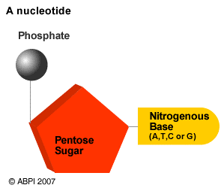
4(a) DNA Synthesis Inhibitors
(i). DNA Polymerase Inhibitors (DdDp)
Incorporated into DNA chain by DNA polymerase causing termination
i. Nucleoside analogues
Acyclovir, Idoxuridine
ii. Nucleotide analogues
Cidofovir
iii. Pyrophosphate analogues:
Foscarnet, Phosphonoacetic acid

Slide 19
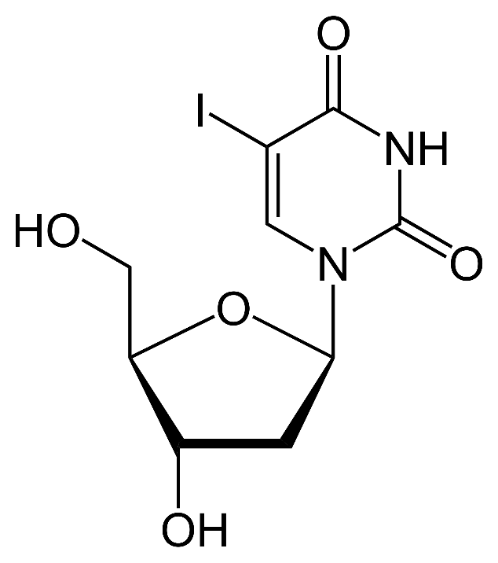
Idoxyuridine
First antiviral agent (1963)
A pyrimidine analogue
Inhibits viral DNA polymerase
Non-selective – also inhibits host DNA polymerase
Largely replaced by less toxic drugs e.g. Acyclovir
Notes:
First antibiotic = Prontosil (Sulfamidochrysoïdine hydrochloride) developed in 1930s by Bayer™

Slide 20
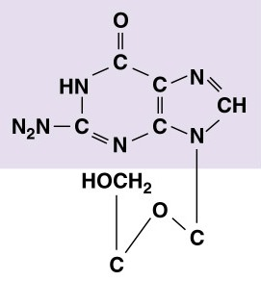
Acyclovir
Acyclic nucleoside analogue
Active against HSV-1, HSV-2 and VZV
A pro-drug, undergoes 3 phosphorylation steps to its active form
Initial phosphorylation by Viral thymidine kinase
Subsequent di & tri phosphorylation by host-cell enzymes
Notes:
Guanosine analogue
Weak in-vitro activity against EBV, CMV & HHV-6

Slide 21
Acyclovir…
MoA: Inhibition of DNA Polymerase
Acyclovir triphosphate competes with endogenous nucleotides for DNA Polymerase
Incorporated into the growing DNA chain (viral genome)
Causes chain termination once incorporated
Mechanisms of Resistance:
Reduced production of Viral Thymidine kinase (TK)
Altered TK hence reduced affinity for Acyclovir
Altered DNA polymerase
Notes:
Cross-resistance with its analogues – Valacyclovir, Gancyclovir but not Cidofovir, Foscarnet

Slide 22
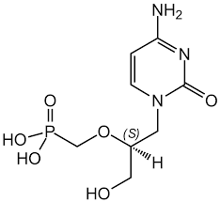
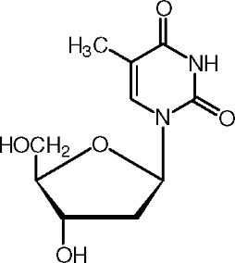
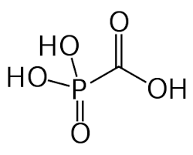
Other DNA Polymerase Inhibitors
1. Trifluridine
2. Cidofovir
Thymidine
3. Foscarnet

Slide 23
(ii) Reverse Transcriptase Inhibitors
Block DNA synthesis from RNA by Reverse transcriptase (aka RNA-dependent DNA polymerase)
Nucleoside Reverse Transcriptase Inhibitors (NRTIs) Zidovudine, Lamivudine, Abacavir
Nucleotide RT Inhibitors (NtRTIs)
Tenofovir (HIV)
Non-Nucleoside RT Inhibitors
Nevirapine, Efavirenz, Etravirine
Notes:
NtRTI - Adefovir (HBV)

Slide 24
4 (b).DNA Integration inhibitors
Prevent integration of viral DNA into host genome by binding Integrase enzyme
Raltegravir
Dolutegravir
Elvitegravir
All are ARVs

Slide 25
4(c). RNA Synthesis Inhibitors
Block action of RNA polymerase
Ribavirin
Inhibits RNA polymerase of several RNA viruses (HCV, Influenza)
Prevents capping of mRNA in Influenza viruses
Sofosbuvir
Inhibits Hepatitis C virus RNA Polymerase
Notes:
Favipiravir – currently being tried for Ebola in Guinea
In prokaryotes, the 5′ cap (cap-0), found on the 5′ end of an mRNA molecule, consists of a guanine nucleotide connected to mRNA via an unusual 5′ to 5′ triphosphate linkage. It is methylated on the 7 position directly after capping in vivo by a methyltransferase
The 5′ cap has four main functions:
Regulation of nuclear export;
Prevention of degradation by exonucleases
Promotion of translation
Promotion of 5′ proximal intron excision
Vidarabine
Interferes with mRNA capping (polyadenylation) in HSV & VZV

Slide 26
Novel RNA synthesis inhibitor
Favipiravir
Approved in Japan in 2014 for Influenza
Inhibits RNA polymerase in several viruses (e.g. Influenza virus)
In vitro activity against: Arenaviridae, Bunyaviridae, Flaviviridae, etc.

Slide 27
5. Protein Synthesis Inhibitors
5'-GCG TTT GCT CTT CTT CTT GCG-3'
Formivirsen
An anti-sense oligonucleotide
Binds the complementary CMV mRNA
Prevents translation of the mRNA into protein
Stabilized to prevent degradation by nucleases
Used to treat CMV retinitis – intravitreal injection
Notes:
Fomivirsen – blocks CMV immediate early 2 protein preventing its translation into protein
Stabilized by phosphorothioate

Slide 28
6. Protease Inhibitors
Bind Protease preventing protein cleavage hence blocking viral maturation
Hepatitis C protease inhibitors:
Simeprevir, Paritaprevir, etc.
HIV protease inhibitors:
Lopinavir, Ritonavir, etc.
Notes:
Bocepravir

Slide 29
7. Viral release inhibitors
Oseltamivir/Zanamivir
Block viral neuraminidase of Influenza A & B viruses
NA clears sialic acid from the infected cell surface and mucus secretions allowing the Influenza virus to spread to other cells
Notes:
Neuraminic acid = Sialic acid is the influenza virus receptor.

Slide 30
8. Interferons
Cytokines with antiviral, immunomodulatory and antiproliferative activity
Synthesized by the body in response to certain stimuli
IFNs induce synthesis of proteins that prevent viral entry, replication or maturation
Numerous side effects
Notes:
Type I:
IFN-α (leukocytes)
IFN-β (fibroblasts)
Type II – IFN – γ (immune cells)
?? Type III – IFN-λ

Slide 32
Interferon: Mechanism of action
Bind specific cellular receptors >
Induce gene expression through the JAK-STAT signaling pathway >
Synthesis of several proteins which have antiviral activity through inhibition of viral:
Transcription
Translation
Post-translational modification of protein
Virus maturation
Virus release
Notes:
Transcription – blocks mRNA synthesis
Translation – activates methylase> reduced RNA cap methylation. Activates protein kinase> blocks elf-2a function> inhibits initiation of mRNA translation. Activates phosphodiesterase> blocks tRNA function
Post-translational modification – inhibits glycosyltransferase> reduced glycosylation of proteins
Virus maturation – inhibits glycosyltransferase> reduced glycoprotein maturation
Virus release – causes membrane changes> blocks budding

Slide 33
Available forms
Natural IFN
Recombinant IFN
Pegylated IFN
PEG – PolyEthylGlycol – large inert molecule
slows metabolism allowing for lower, less frequent doses
Notes:
Flu-like syndrome: Fever, chills, headache, myalgia, N,V, D
Myelosuppression – thrombocytopenia, granulocytopenia
CNS – somnolence, confusion, depression, seizures
CVS – tachycardia, hypotension
Hepatotoxicity
Nephrotoxicity
Drug interactions – Zidovudine, Ribavirin

Slide 34
Therapeutic Use
Hepatitis B virus infection
Hepatitis C virus infection
Notes:
Kaposi sarcoma
Genital warts (HPV)
Others: Herpesviruses, Rhinovirus, SARS,

Slide 35
Recap
Receptor binding inhibitors
Fusion inhibitors
Uncoating inhibitors
Nucleic acid synthesis inhibitors
Protein synthesis inhibitors
Protease inhibitors
Viral release inhibitors
Interferons
Notes:
www.microbiologybook.org
Katzung, Masters & Trevor - Basic & Clinical Pharmacology- 11th edition
Brunton, Chabner & Knollman - Goodman and Gilman's The Pharmacological Basis of Therapeutics, 12th Edition
Saxena, S., Mishra, N., & Saxena, R. (2009). Advances in antiviral drug discovery and development Future virology, 4(2).
Furuta, Y., Gowen, B. B., Takahashi, K., Shiraki, K., Smee, D. F., & Barnard, D. L. (2013). Favipiravir (T-705), a novel viral RNA polymerase inhibitor. Antiviral Res, 100(2), 446-454. doi: 10.1016/j.antiviral.2013.09.015

Slide 36
Questions?
@mosmasika
mosmasika@gmail.com
Masika Moses
@MicrobiologyUoN
Medical Microbiology UoN

