Slide 1
ANAEROBIC BACTERIA
KIMAIGA H.O
MBChB (University of Nairobi)

Slide 2
INTRODUCTION
A group of bacteria in which the main determining factor for growth and viability is the state of oxidation of the environment they are in.
Expressed in terms of oxidation-reduction or redox potentials
For neutralization they require –ve ox-red potential
Require –ve oxidation-reduction potential for metabolism.
Exposure to O2 causes a series of reactions within the bacteria

Slide 3
Anaerobic bacteria vary in the ability to tolerate O2.
Strict/obligate anaerobes- Bacteria which remain viable and grow only in the absence of O2.
Aero-tolerant anaerobic bacteria – Show limited or scanty growth in air or 5-10% CO2 but produce significant growth under anaerobic conditions
Most anaerobes isolated from specimens from humans tend to be relatively more tolerant to the toxic effect of O2 than the obligate anaerobes but still susceptible to higher concentrations of O2.

Slide 4
HABITATS
Anaerobic bacteria present in soil, water, sewage, foods and GIT of animals
In humans- oral cavity, GIT, colon, lower parts of Genitourinary Tract (GUT)

Slide 5
CLASSIFICATION
Shape- Bacilli ( or rods) or cocci
Gram stain – Gram +Ve/-ve
Spore forming or non-spore forming
Examples:
Cocci
Gram +Ve
Peptostreptococci
Peptococci
Gram –ve cocci
Veillonella
Bacilli
Gram +ve spore forming – Clostridia
Gram +ve non spore forming – Actinomyces
Gram –ve non spore forming – Bacteroides & Fusobacterium

Slide 6
EXAMPLES OF HUMAN CLINICAL CONDITIONS ASSOCIATED WITH ANAEROBIC ORGANISMS
Brain abscess
Periodontal infections
Intraabdominal infections
Wound infection secondary to trauma
Absecesses in inner tissues – lung abscess
Pelvic abscess & endometritis
Post traumatic abortion infections
Bacteriaemia or septiceamia

Slide 7
Laboratory examination
SPECIMEN
Specimen examined depend on the clinical manifestations and they include :
Body fluids
Pus from deep abscesses
Aspirates
Infected tissue

Slide 8
COLLECTION & TRANSPORT OF SPECIMENS
Proper Collection – Avoid/minimize exposure to air and contamination
Transportation – Exposure to air avoided/minimized by use of proper systems which include:
Thioglycollate broth
Syringe used in aspiration with the needle bent

Slide 9
CULTURE FOR ISOLATION AND IDENTIFICATION
Media can be
Semi solid- Non selective, enrichment and selective
Selective media where required contain blood agar as a base plus antibiotics –Kanamycin & Neomycin
Liquid media – Broth medium containing reducing substances – Sodium thioglycollate

Slide 10
Sodium Thioglycollate for Anaerobes

Slide 11
SOME ANAEROBIC CULTURE SYSTEMS
Various techniques – Aim at exclusion of O2 from incubation environments involve:
Growth media as above
Evaluation of air and replacement with inert gases:
By use of suction & pumping
Use of gas generating chemical reactions
These methods in 2 (above) involve the use of anaerobic jars: Mcintosh- fildes, Gaspak, Oxoid
Any O2 left in the jar is removed by reacting it will H₂ under Pallidium catalyst to form H₂O. Catalyst is heated before incubation to activate it.

Slide 12
Other systems
Anaerobic glove-box technique
Anaerobic cabinets
Anaerobic chambers
Copper coated steel wool to react with O₂
All the culture processes require quality control:
Chemical – Use of indicators which change color when O₂ is completely removed and when O₂ is detected
Biological – Use of organisms which grows only in O₂ present or one which grows only in O₂ absence.

Slide 13
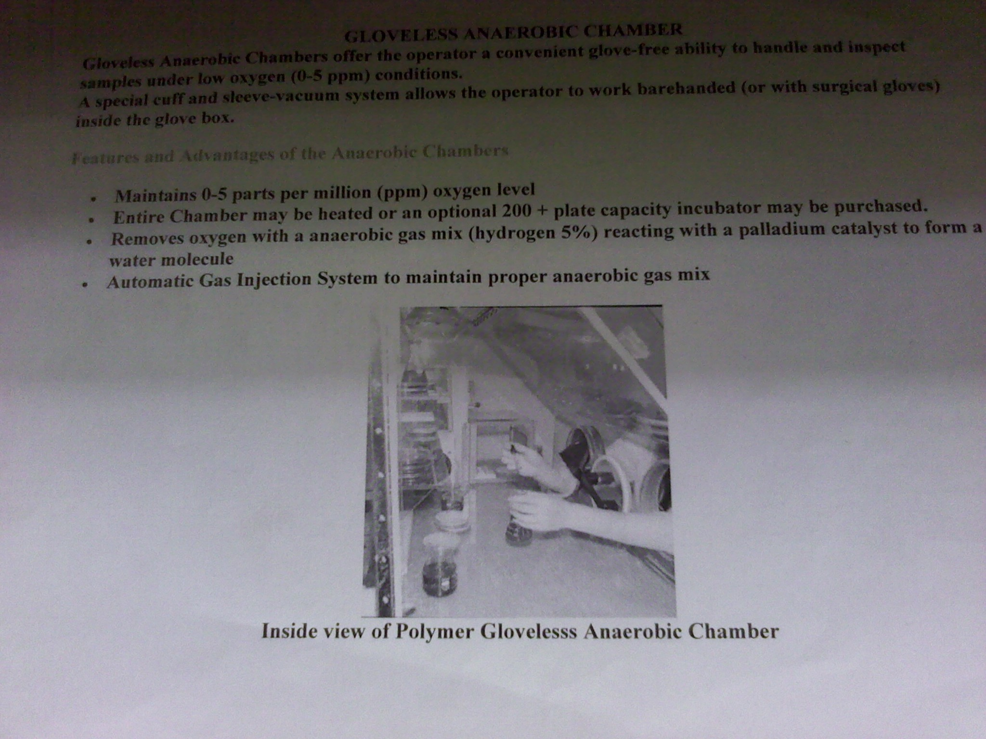

Slide 14
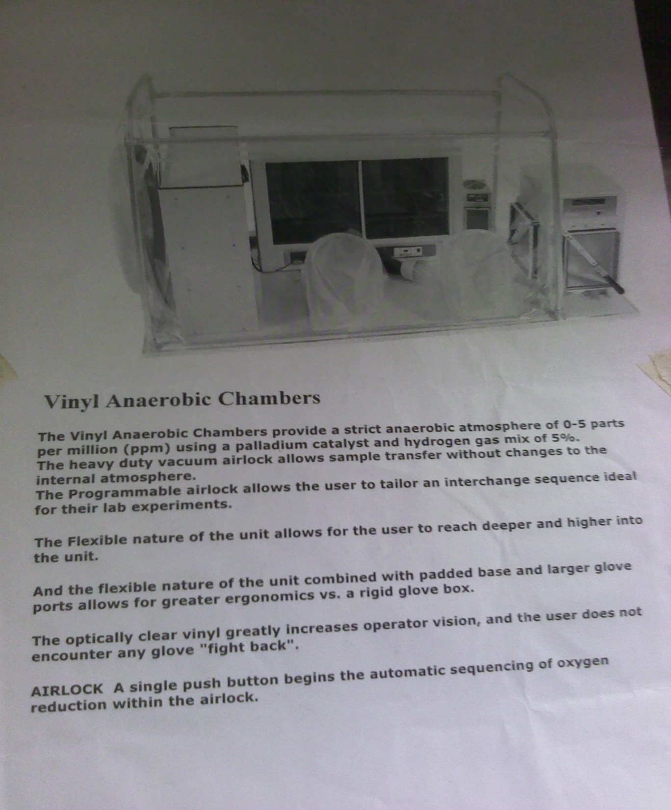
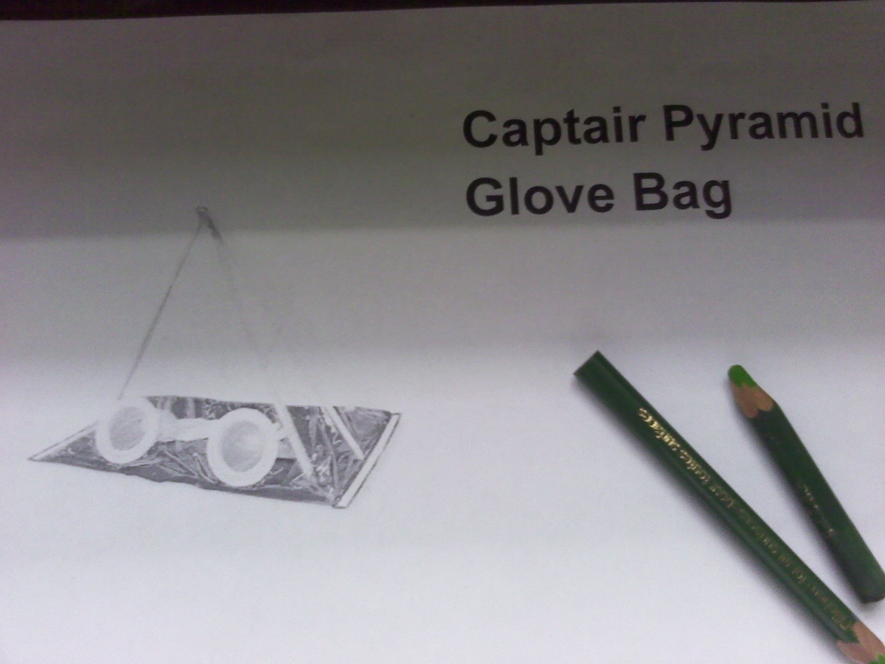

Slide 15
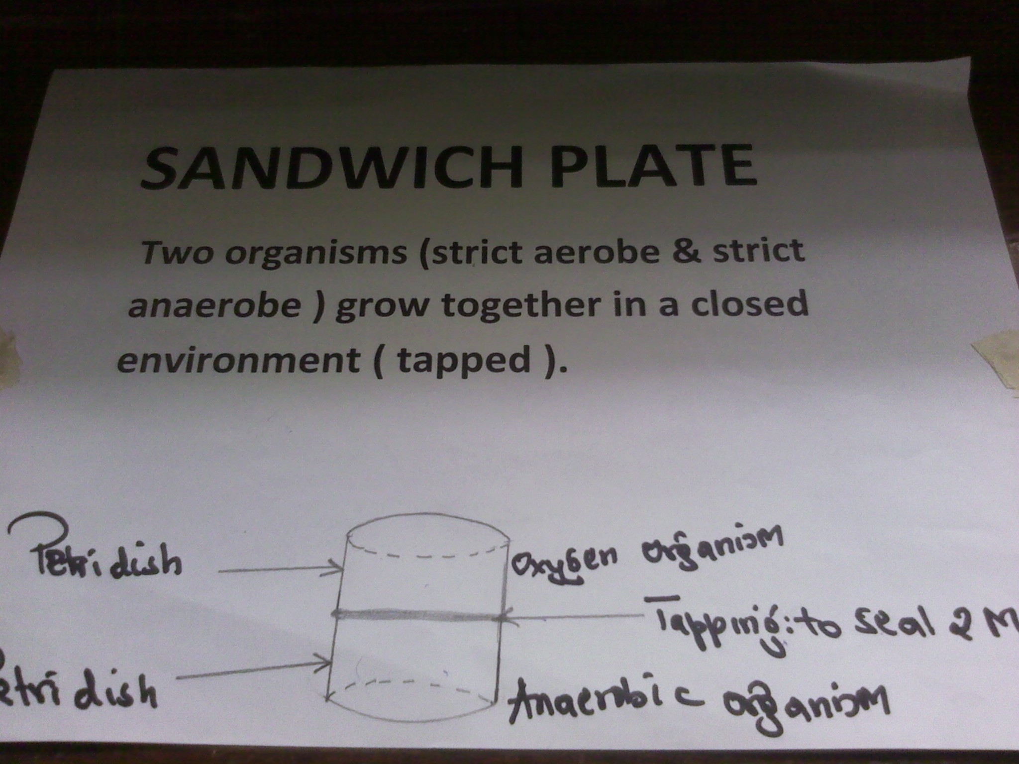

Slide 16
BACTERIODES
MICROSCOPIC
Pleomorphic, gram –ve bacilli, non- motile, non-spore forming
Capsulated strains
OCCURANCE
Normal flora of mucus membrane of animals and humans

Slide 17
Examples of species
Bacteriodes fragilis
Bacteriodes melanino genicus
Recognized mostly as a comensal
Associated with mixed infection
Form dark brown colors on BA…

Slide 18
Pathogenesis properties
Has virulence factors – capsule, pilli, enzymes, hyaluronidase
Potential pathogens – cause endogenous infections
Some diseases are associated with precipitating factors:
Trauma involving colon
Lowering of redox potential by some tissues- necrosis and impaired blood supply
Presence of facultative anaerobes

Slide 19
CLINICAL IMPLICATIONS
Bacteroides fragilis– most common
Conditions either localized or generalized
Include intra-abdominal infections developing into abscesses, appendicitis, perinitis, septicaemia, bacteremia.
Post partum infections- puerperal fever.

Slide 20
Lab diagnosis
Specimens – discharge, pus, infected tissue, blood aspirates, pleural, nasal sinuses
Gram stained smears = Gram –ve bacilli
Cultures
Media enriched with blood, yeast or vegetable products, Glc and amino acids(colony is Saccharolytic)
Non-selective media e.g Tryptose agar with glucose
Incubate anaerobically at 35-37ºC
RCM before subculturing to BA
Selective BA(e.. With vancomycin or neomycin)
Produces xtic FA’s in gas liquid chromatography
Grows in 20% bile

Slide 21
ANTIMICROBIAL SUSCEPTIBILITY
Susceptible to clindamycin, metro, chlampunicole
Produces Beta lactamase.

Slide 22
FUSOBACTERIA
MICROSCOPY
Anaerobic, non-spore forming, gram –ve bacilli
Thinner than other gram –ve bacilli, has pointed ends – pleomorphic
CLINICAL IMPLICATIONS
Part of normal flora particularly in the oral cavity
Often isolated as part of mixed infection with facultative anaerobes or strict anaerobes such as bactericides fraglis
Fusobacterium nucleotrium is one of the causative agents of ulcerative gingivitis

Slide 23
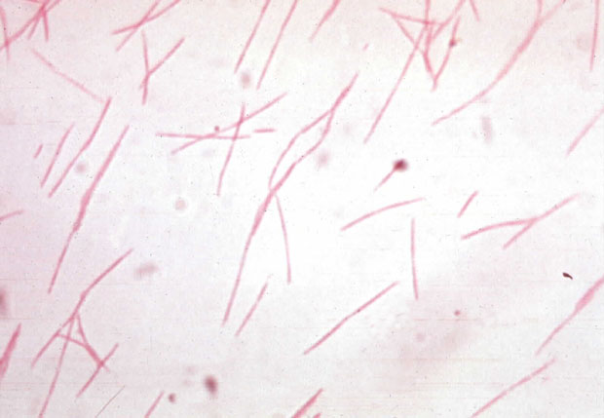
LAB DIAGNOSIS
Use selective media
Identification, growth requirements, biochemical tests
ADI- Micometod multitest system.
Identified by the ability to produce butyric acid from fermentable CHO’s.
Gas liquid chromatography
Susceptible to penicillin, metanidazole and clindamycin

Slide 24
VEILLONELLA
MICROSCOPY
Gram –ve cocci, obligate anaerobe.
Species = veilonella parvula
GROWTH IN LAB
MEDIA- BA – colonies small, convex, translucent
SIGNIFICANCE
Normal flora in oral cavity – URT, Intestines, female’s genital tract.
Isolated in mixed cultures
Role in infectious process
Susceptible to penicillin, clindamycin, Beta lactam antibiotics.

