Slide 1
INTRODUCTION TO MYCOLOGY
KIMAIGA H.O
MBChB (University of Nairobi)

Slide 2
Introduction
Mycology is the study of fungi
Fungi are a group of eukaryotic organisms with a diversity of morphological appearances depending on species.
Natural habitat- environment
Fungi are important human pathogens
Used in industries: production of cheese, bread, wine and beer
Implicated in the spoilage of fruits, grains, vegetables and jam
Fungi differ from bacteria in several aspects

Slide 3
FEATURE | FUNGI | BACTERIA
Cell type/Nucleus | Eukaryotic | Prokaryotic
Cytoplasm | Mitochondria, ER present | Both absent
Cell membrane | sterols | Not there except mycoplasma
Cell wall structure components | Chitin, cellulose, hemicellulose | Peptidoglycan
Spores | For reproduction | For survival
Thermal dimorphism | Yes(some) | No

Slide 4
Physiology
Fungi are better able to withstand certain extreme environmental conditions than most other microorganisms.
For example, yeasts and moulds can grow in substrates containing concentrations of sugars that inhibit most bacteria, e.g. jams and jellies are spoiled by moulds but not bacteria.
Yeasts and moulds can generally tolerate more acidic conditions than most other microbes.
Moulds and most yeasts are aerobic. Some yeasts are facultative.

Slide 5
Fungi grow over a wide range of temperature, with optimum for most saprophytic species ranging from 22 to 30 ºC; pathogenic species have higher temperature optimum, generally 30-37 ºC. Some fungi grow at or near 0 ºC and thus can cause spoilage of foods (meat, vegetables etc.) in cold storage.
Fungi are heterotrophic, using a wide variety of materials for nutrition. Some species can use inorganic compounds such as N₂ and ammonium salts as source of energy. All fungi can use organic N₂, hence culture media for fungi contain peptone.

Slide 6
Comparative physiology of fungi and bacteria.
Characteristic | Fungi | Bacteria
Optimum pH | 3.8 - 5.6 | 6.5 - 7.5
Optimum temperatures | 22 – 30ºC (saprohytes) 30 – 37ºC (parasites) | 20 - 37 ºC (mesophiles)
Oxygen requirement | Strictly aerobic (moulds) Facultative (some yeasts) | Aerobic to anaerobic
Light requirement | None | Some photosynthetic bacteria occur
Sugar concentration in laboratory media | 4 - 5% | 0.5- 1%
Carbon requirement/ Metabolism | Require organic Carbon | Require Inorganic and/ or organic carbon
Antibiotic susceptibility | Resistant to penicillin, tetracycline, chloromphenicol; sensitive to griseofulvin | Resistant to griseofulvin; sensitive to penicillin, tetracycline, chloramphenicol.

Slide 7
Cultivation of fungi
Most fungi grow more slowly than bacteria so that media which support both bacteria and fungi may be over grown by bacterial contaminants in mixed inoculums.
Where fungi are to be isolated, it is good practice to use a medium that favours their growth, but is not optimal for the growth of bacteria.
Acidic media (pH 5.6) that incorporate a relatively high sugar concentration are tolerated by moulds but inhibitory to many bacteria.
Antibiotics may also be used as inhibitory agents.

Slide 8
Classification of fungi
Morphological classification
Fungi are grouped into 4 morphologic classes:
1. Moulds
2. Yeasts
3. Dimorphic fungi
4. Yeast-like fungi(dimorphic)

Slide 9
Systematic classification
Based on sexual/asexual reproduction and characteristics of sexual spores:
But differences in opinion are still numerous.
Fungi classified into kingdom, divisions, subdivisions, classes, subclasses, orders, families, genera and species.

Slide 10
Nomenclature Fungi
The Nomenclature and Taxonomy of fungi is based on the recommendations of the committee on international rules of Botanical Nomenclature.
Division names end in: -mycota
Sub-division names end in: -mycotina
Class names end in: -mycetes
Sub- class names end in: -mycetidae
Order names end in: -ales
Family names end in: -aceae
Genus and species names do not follow any order.

Slide 11
MOULDS (filamentous fungi)
Multicellular and composed of branching filaments (hyphae) usually branch and intertwine to form a network called mycelia.
Have thali (singular, thallus) consisting of two parts:
Spores are resistant resting or dormant cells. A spore which on germination puts out germ tubes. The germ tubes elongate and branch to form hyphae, via pseudohyphae or pseudomycelia.
Mycelium (plural, mycelia) - Interwoven mass complex (network) of hyphae (singular, hypha)
Mycelia can be vegetative or reproductive.

Slide 12
MOLD

Slide 13
The hyphae of vegetative mycelia penetrate into the medium in order to obtain nutrients; soluble nutrients are absorbed through the walls; insoluble ones are first digested externally by secreted exoenzymes before absorption. Hyphae occur in three forms:
Non-septate- such hyphae have no septa (regular cross walls)
Septate with uninucleate cells,
Septate with multinucleate cells- each cell has more than one nucleus in each compartment.

Slide 14
Morphology - Septate hyphae
Morphology - Aseptate hyphae

Slide 15
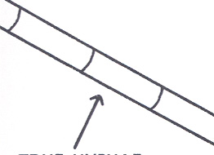
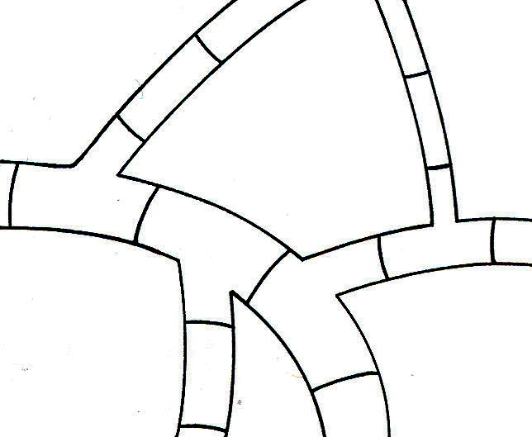

Slide 16
Reproduction
Reproduction by spores produced by asexual cell division or sexual reproduction
Asexual reproduction/somatic or vegetative reproduction
Does not involve the union of nuclei, sex cells or sex organs.
It may be accomplished by:
Fission of somatic cells yielding two similar daughter cells
Budding of somatic cells or spores, each bud growing into a new individual
Fragmentation or disjoining of hyphal cells, each fragment becoming a new organism, or
Spore formation.

Slide 17
Asexual spores, whose function is to disseminate the species, are produced in large numbers. There are many kinds of asexual spores:
Sporangiospores- single celled spores formed in sacs called sporangia.
Conidiospores (conidia) - are of two types; microconidia or macroconidia. Microconidia are small and single celled. Macroconidia are large and multicelled. Shape colour & arrangement of conidia aid in identification of fungi
Arthrospores (oidia) - are single celled spores formed by disjoining of hyphal cells.
Chlamydospores - thick-walled, single-celled spores highly resistant to unfavourable conditions; formed from cells of vegetative hyphae.
Blastospores- spores formed by budding.

Slide 18
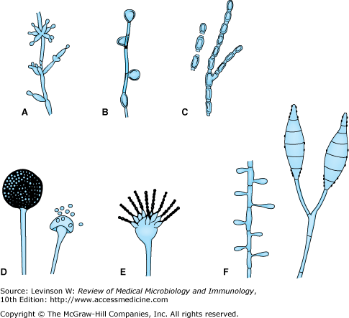
Asexual spores.
A: Blastoconidia and pseudohyphae (Candida).
B: Chlamydospores (Candida).
C: Arthrospores (Coccidioides).
D: Sporangia and sporangiospores (Mucor).
E: Microconidia (Aspergillus).
F: Microconidia and macroconidia (Microsporum).

Slide 19
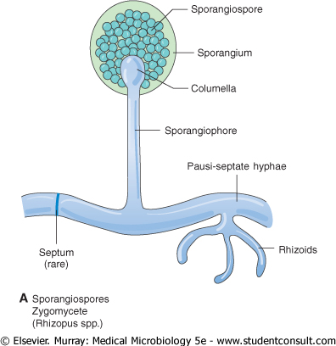
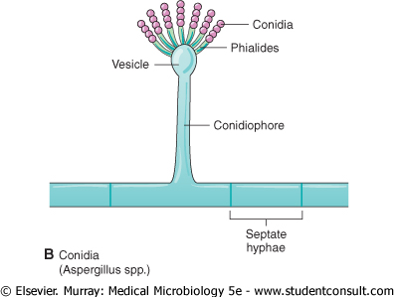
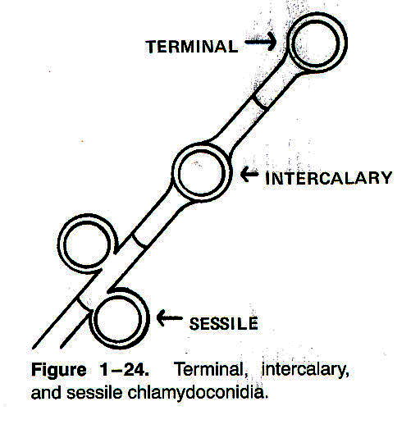
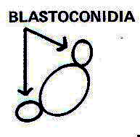
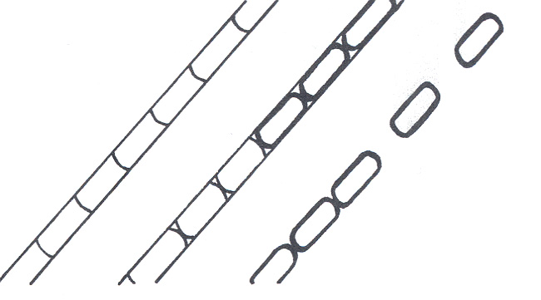
Asexual spore

Slide 20
Sexual reproduction
Is carried out by fusion of compatible nuclei of two parent cells. The process begins by joining of two cells and fusion of their protoplasts (plasmogamy). This enables the two haploid nuclei of the mating cells to fuse together (karyogamy) to form a diploid nucleus. This is followed by meiosis, which again reduces the number of chromosomes to the haploid number.
Sexual spores which are produced by fusion of two nuclei occur less frequently, later, and in smaller numbers than do asexual spores.

Slide 21
The various types of sexual spores include:
Ascospores - single-celled spores produced in a sac called ascus; there are usually 8 ascospores in each ascus.
Basidiospores - single-celled spores borne on a club-shaped structure called basidium.
Zygospores - large, thick-walled spores formed when the tips of sexually compatible hyphae of certain fungi fuse together.
Oospores - spores formed within a special female structure, the oogonium. Fertilization of the eggs or oospheres by the male gametes formed in an antheridium gives rise to oospores.

Slide 22
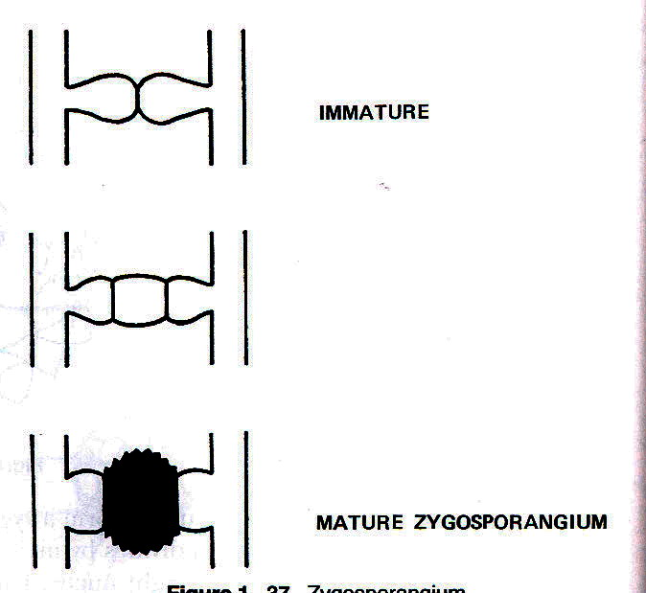
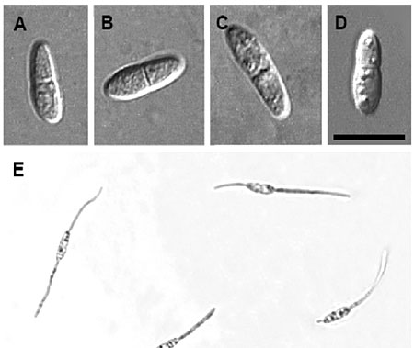
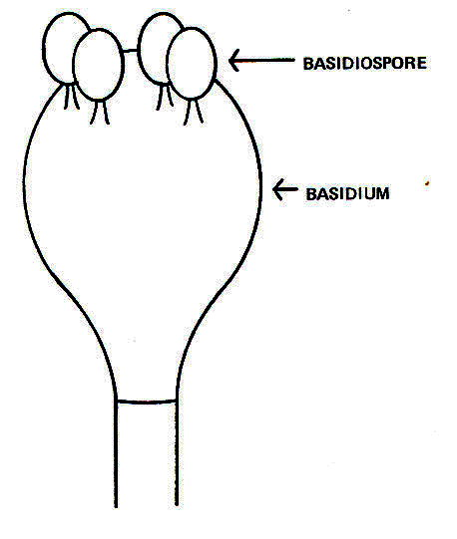
Sexual spore

Slide 23
YEASTS
Predominate unicellular
They are commonly oval, but some are elongated and some spherical.
Yeasts have no flagella or other locomotory organelles seen in bacteria.
Reproduce asexually by budding. Some species produce buds that characteristically fail to detach and become elongated; continuation of the budding process then produces a chain of elongated yeast cells called pseudomycelium or true mycelium/ pseudohyphae.
Yeast colonies are usually soft, opaque, 1–3 mm in size, and cream-colored.
Primarily identified by ability to ferment sugar and assimilation of carbon and nitrogen compounds
Examples include Cryptococcus, Saccharomyces etc.
Candida, Pityrosporum

Slide 24
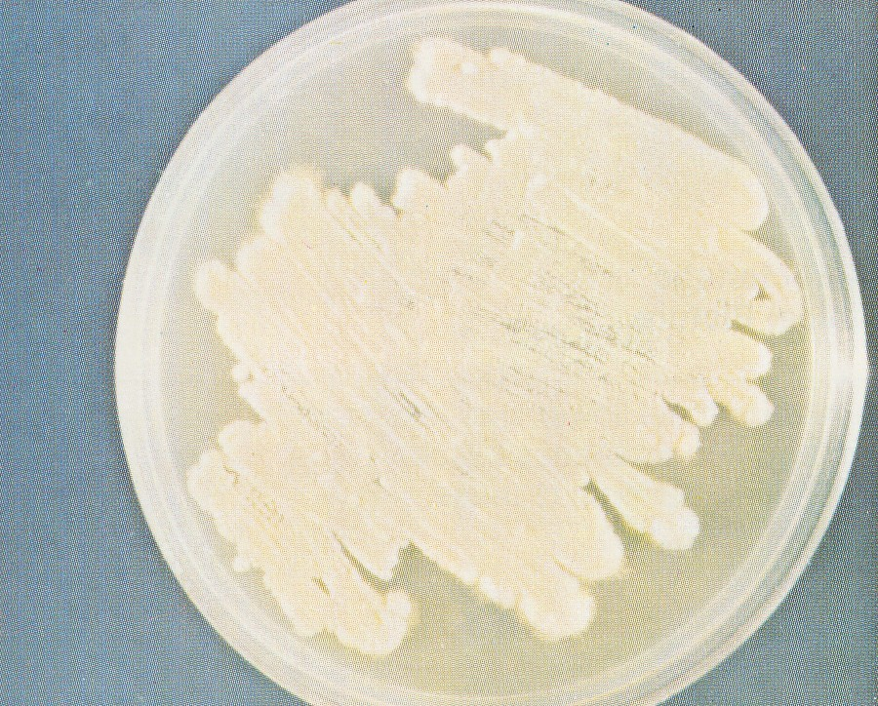
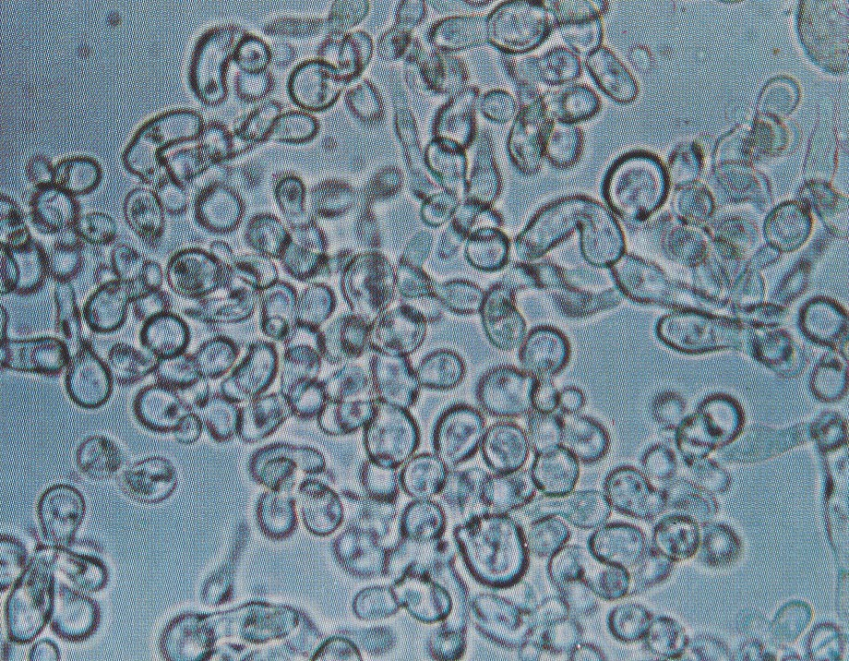
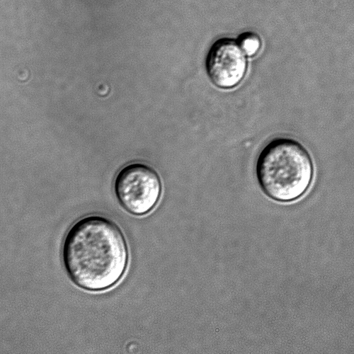
Because the colonies and microscopic morphology of many yeasts are quite similar, yeast species are identified on the basis of physiologic tests and a few key morphologic differences

Slide 25
DIMORPHIC FUNGI
They grow in mycelial form at environmental (room) temperature. They are mold at 27ºC and yeast form at 37ºC. Mould in the cold and yeast in the heat.
Examples (Mneumonic- Body Heat Changes Shape)
Blastomyces, Histoplasma,, Coccodioides, Sporothrix

Slide 26
YEAST-LIKE FUNGI(DIMORPHIC)
These are fungi that are partly yeasts and partly mould (pseudohyphae/pseudomycelia).
An example - Candida albicans does grow as yeast form at room temperature and myciliate form at 37ºC.

Slide 27
IMPORTANT CELL STRUCTURES
Chitin
In the fungal cell wall – polysaccharides
Fungi are insensitive to antibiotics e.g. penicillin that inhibit peptidoglycan
Ergosterol
In the fungal cell membrane
Human cell membrane has cholesterol
Selective action of antifungals based on difference in sterols

Slide 28
Epidemiology & Pathogenesis
Worldwide distribution
Causal Agents are saprophytes restricted in their distribution by soil and climatic conditions
Fungi can cause diseases only if they are provided by their hosts with conditions and nutrients essential for their growth and reproduction.
Factors that affect the incidence of mycoses degree of exposure causative agent e.g. living conditions, occupation, leisure activities
Some yeast are commensals of man and cause endogenous infections when there is an imbalance in the host

Slide 29
Disorders/diseases caused by fungi.
1. Mycotoxicoses
Ingestion of foods contaminated by fungal toxins (rice, maize, groundnuts)e.g.
Aspergillus falvus toxins (aflatoxins)- cause liver damage, carcinoma
Penicillium toxins
Fusarium toxins
Hepatotoxins
Vascular and neurologic toxins- the mould claviceps purpura.

Slide 30
2. Fungal poisoning.
Ingestion of poisonous fungi (Basidiomycetes), e.g. toxic mushrooms;
Amanita phalloides
Amanita muscaria
3. Fungal Allergies
Allergic reactions caused by contact with fungal spores floating in the air e.g. Aspergillus, Mucor, Penicillium, Candida spp.
Asthmatic reaction - rapid bronchconstriction

Slide 31
4. MYCOSES
Superficial mycoses (dermatomycoses and dermatophytoses)
Fungal infection
Those caused by species of Trichophyton, Microsporum, Epidermophyton and Keratomyces (dermatophytes) are called dermatophytoses. Dermatophytoses are commonly called ringworm or tinea (or known as mashilingi locally).
Those caused by non-dermatophyte fungi e.g. Candida spp are called dermatomycoses.

Slide 32
Subcutaneous mycoses:
Mycetoma, Phycomycosis, Chromoblastomycosis, Sporotrichosis, Lobomycosis, Rhinosporidiosis
Systemic mycoses:
Affect internal organs; i.e. All mycoses affecting tissues deeper than the skin (subcutaneous, deep, opportunistic, actinomycosis
Opportunistic mycoses
Diseases due to infection with normally non-pathogenic fungi as a result of weakened immune system

Slide 33
Lab Diagnosis
Useful information including residence, previous travel, animal contact, occupation
Lab investigation involves
Recognition of pathogen in tissue by microscopy
Isolation of pathogen in tissue by microscopy
Isolation of causal fungus in culture
Serological tests
Detection of fungal DNA by PCR

Slide 34
Fungal specimens
Biopsies
Immediately to laboratory in plains simple sterile container (No formalin)
In formal- Saline for histology
30% glycerol for transporting
30%glycerine solution for culture
Superficial fungi e.g Ringworm- skin scales, nail clippings, hair stubs-Simple envelope, matchbox, petri dish
Swabs from mucous membranes
Subcutaneous infection- crusts, aspirated pus, biopsies
Systemic infections- specimen from appropriate site

Slide 35
Direct microscopy
Wet mount with KOH 10%
Calcoflour white- Fluorescent microscopy
Gram films- yeast infections
Giemsa- detect histoplasma capsulatum
Histology- periodic acid-Schiff (PAS) & Grocott- Gomori methamine silver (GMS) in tissue

Slide 36
Culture
Media SDA (Saboraud dextrose agar, 4 % malt extract agar)
Chloramphenicol, to reduce bacterial contamination
Cycloheximide reduce contamination by saprophytic fungi
Incubated at 25-30 and 37ºC
Yeast grows in 1-5 days
Moulds identified by macro and microscopic morphology
Yeasts identified by sugar fermentation, ability to assimilate carbon and nitrogen sources

Slide 37
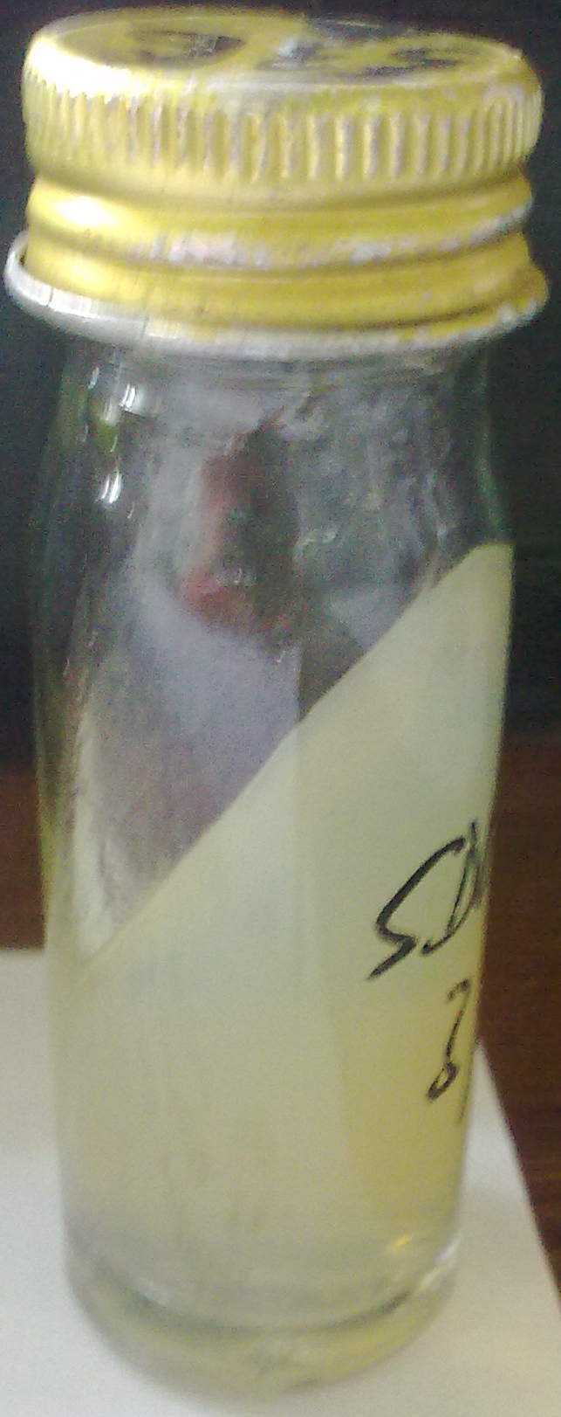

Slide 38
Serology
Immunodiffusion
Counter-current immune electrophoresis
Whole cell agglutination
Complement fixation
ELISA
PCR- detection of DNA in blood, serum, broncheoalveolar lavage, sputum e.t.c

