Slide 1
SUPERFICIAL MYCOSES
KIMAIGA H.O
MBChB (University of Nairobi)

Slide 2
Superficial Mycosis
Dermatotophytoses
Superficial candidiasis
Pityriasis versiclour(tinea versicolor)
White piedra
Black piedra
Otomycosis
Mycotic keratitis

Slide 3
Dermatophytoses
Diseases of superficial keratinized structures- nail, hair, skin
Filamentous/ Monomorphic fungi- Always in mould form
Pathogenic genera:
Trichophyton- Infect skin, hair and nails (Mneumonic Tri)
Microsporum - Infect hair and skin
Epidermophyton - Infect nails and skin
Classified as;
Anthrophillic - restricted to man
Zoophilic- in animals, inflammatory reaction in humans with contact with animals
Geophillic- from the soil, occasionally infects man and animals

Slide 4
Pathogenesis
Infection can be by direct or indirect transfer (fragment of keratin containing the infective particle)
No evidence of natural immunity
Factors that encourage invasion- increased environmental humidity and CO₂ content
Resistance to infection is determined by
Production of inhibitory FAs (fatty acids)
Rate of epithelial cell turnover
T-cell mediated immunity
Unsaturated transferrin
Keratin affected by enzymatic digestion and mechanical pressure
Hyphae grow into newly differentiated keratin as it formed
Branching hyphae & may break up to arthroconnidia particularly in infected hair

Slide 5
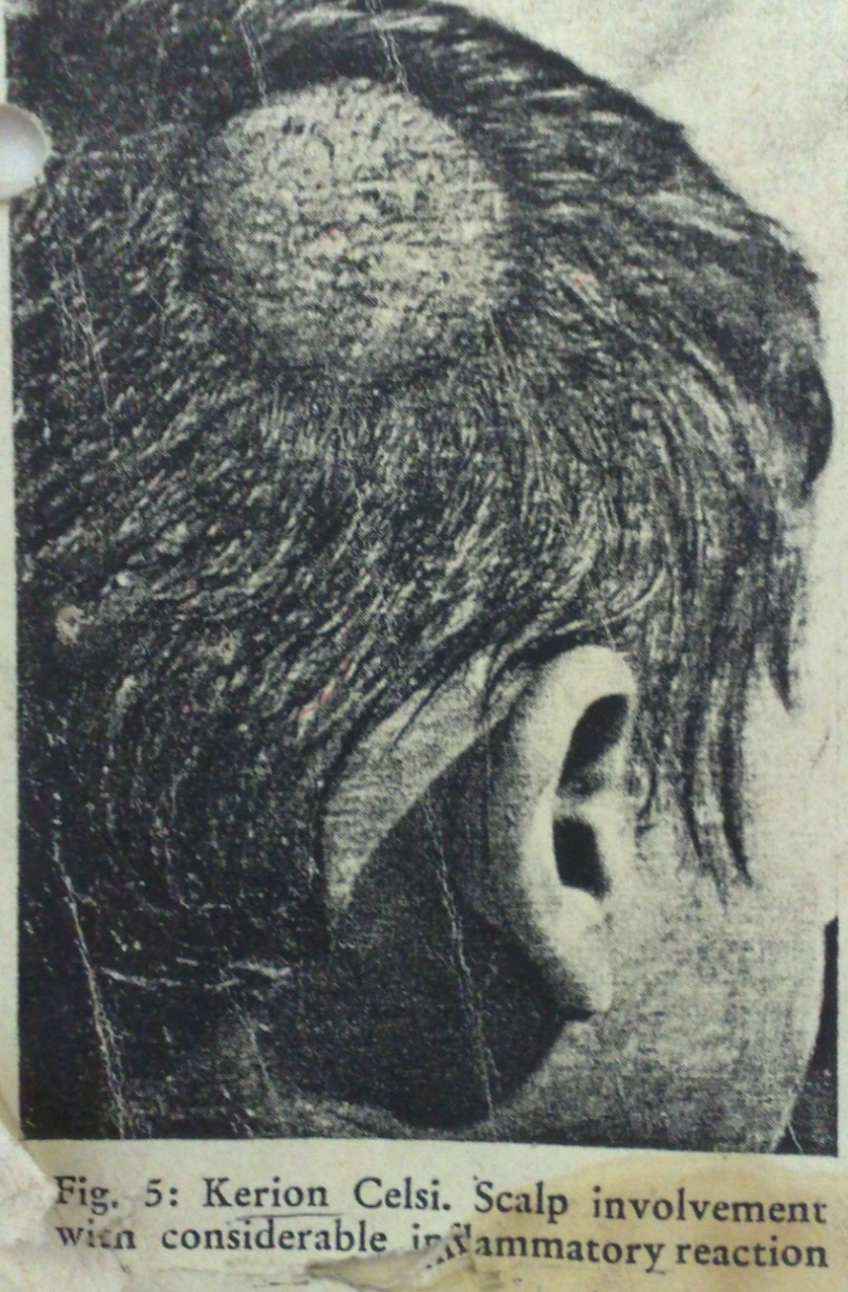
Species of fungi determine type of lesions:
Skin- dry scaling/ hyperkeratosis irritation, erythema, vesicles, pustules, ulceration
Nail- discolouration, thickened, raised
Scalp infection- scaling, hair loss, lesions (kerions)

Slide 6
“Id” reaction
An immunological allergic reaction to circulating fungal antigens
Patients with inflammatory infection develop a secondary rash known as dermatophytid (“id”)
Those with foot ringworm will have vesicular eczema on the hands
Those with scalp ringworm develop follicular rash on the trunk

Slide 7
Epidemiology/ Diseases
Common in tropics
Types:
Tinea corporis (smooth skin)
Tinea cruris (groin/ jock itch)
Tinea capitis (scalp)
Favus is more serious, often from animals and causes permanent hair loss
Tinea pedis (feet/athlete’s foot) - also candida species gram negative bacteria
Tinea unguium(nail plate)
Tinea barbae (beard)
Tinea manuum(palms)
Tinea faciale
NB: these are conditions not genera and species

Slide 8
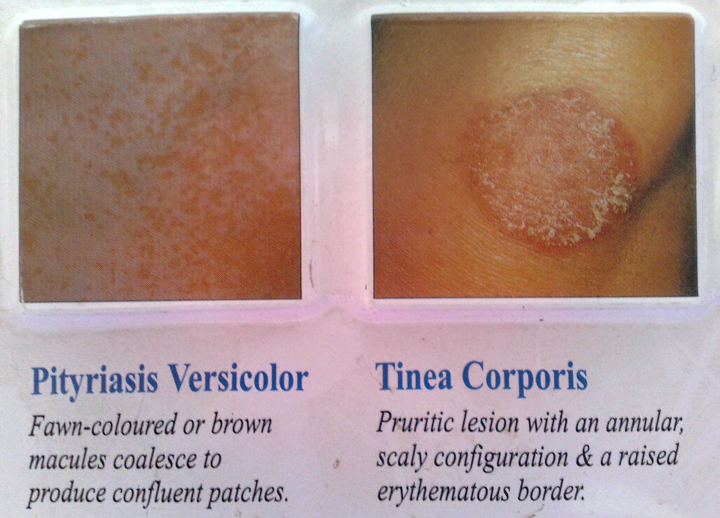
Fungal

Slide 9
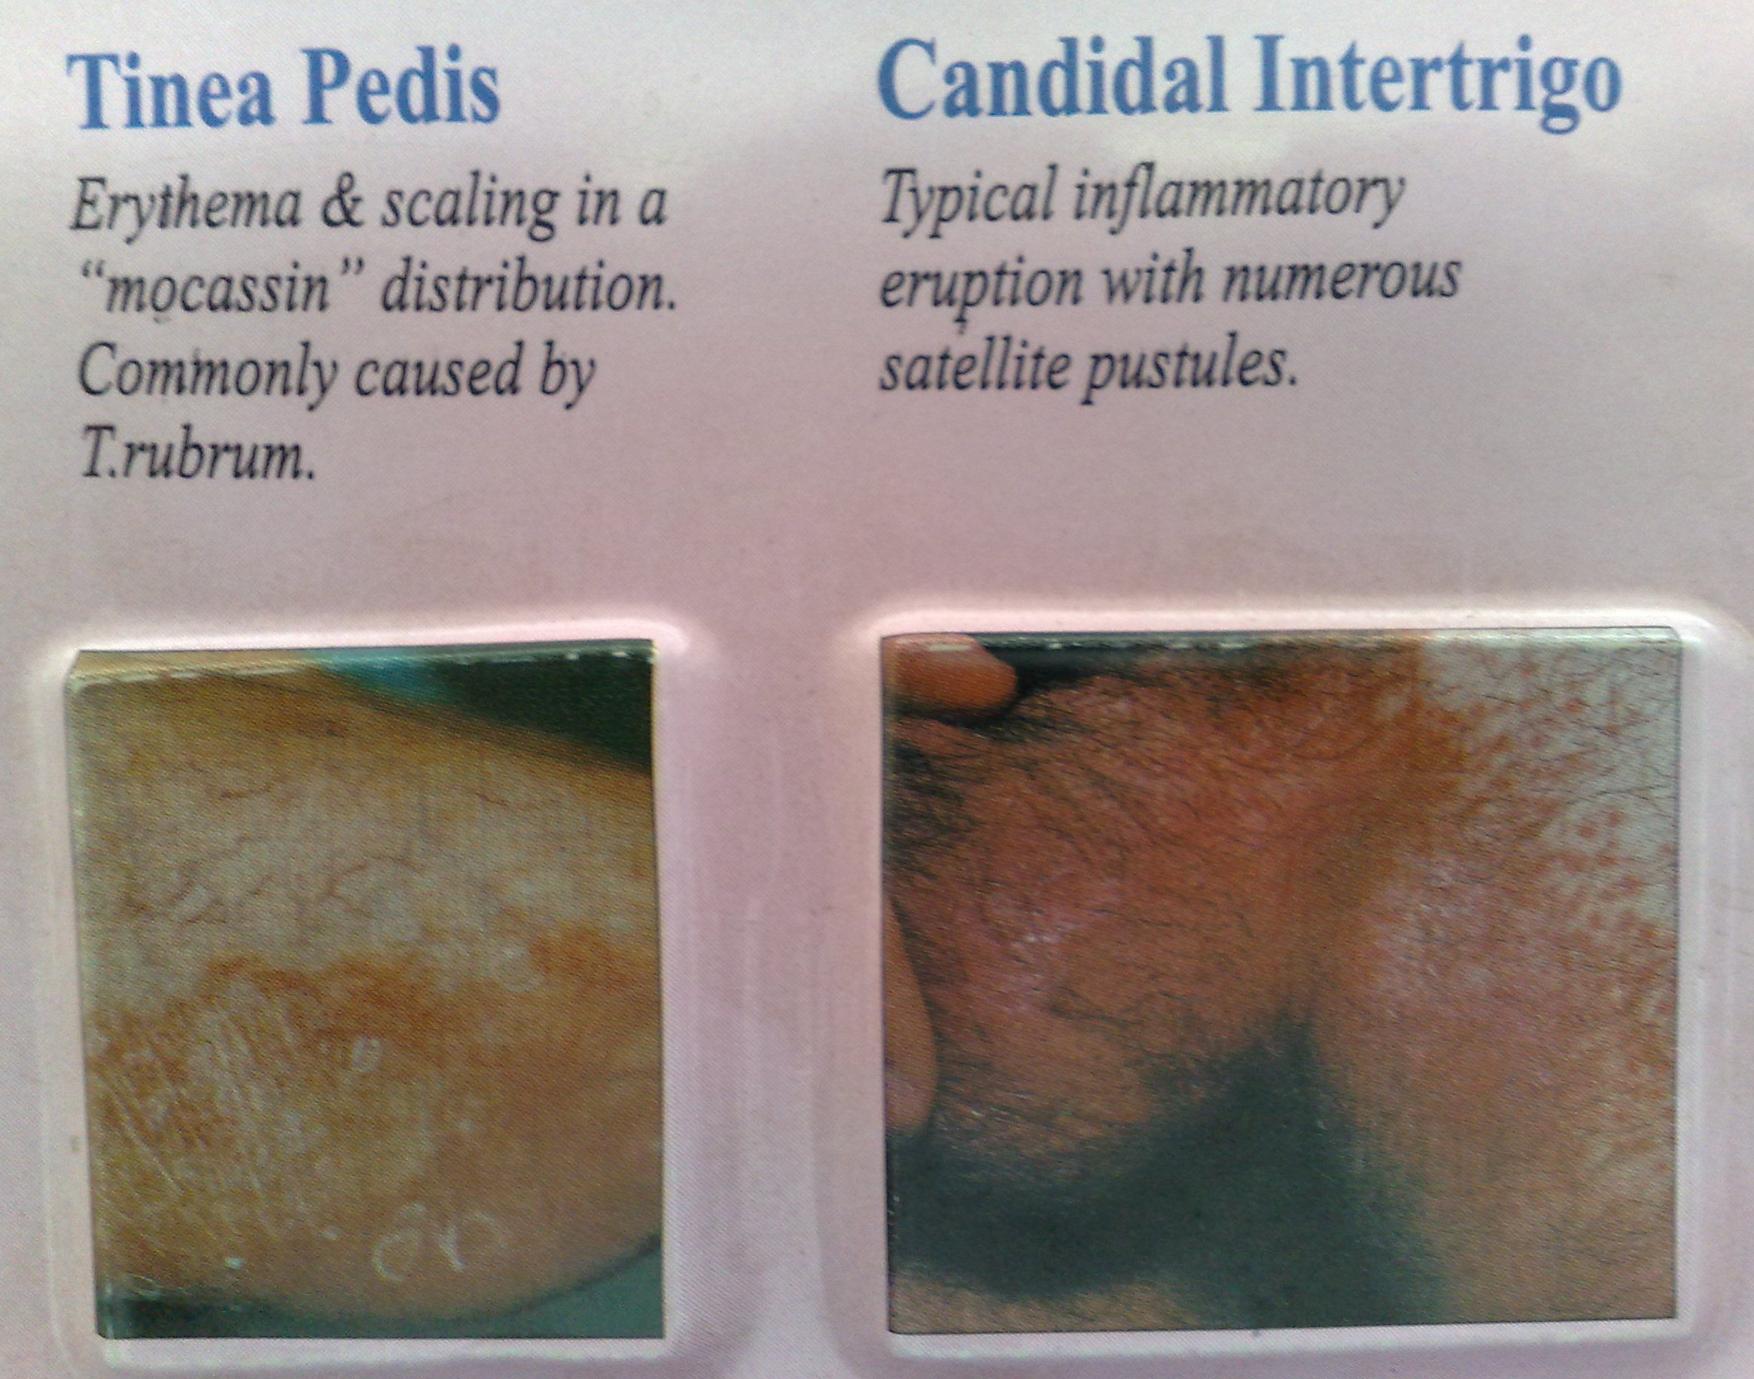

Slide 10
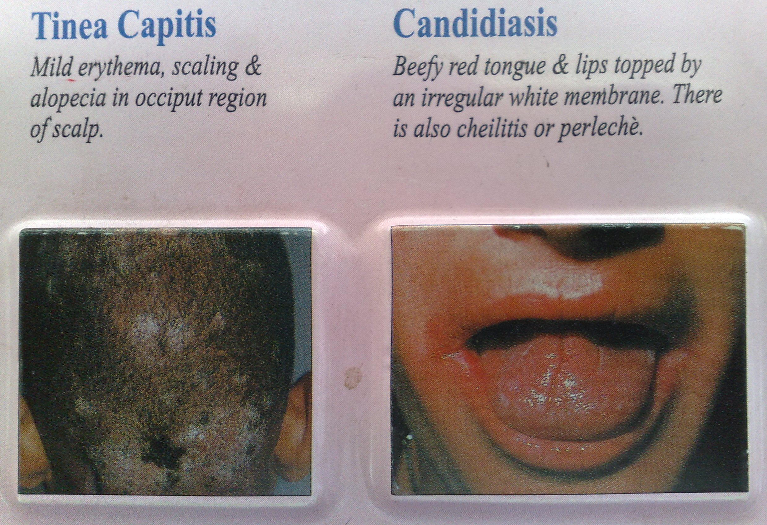

Slide 11
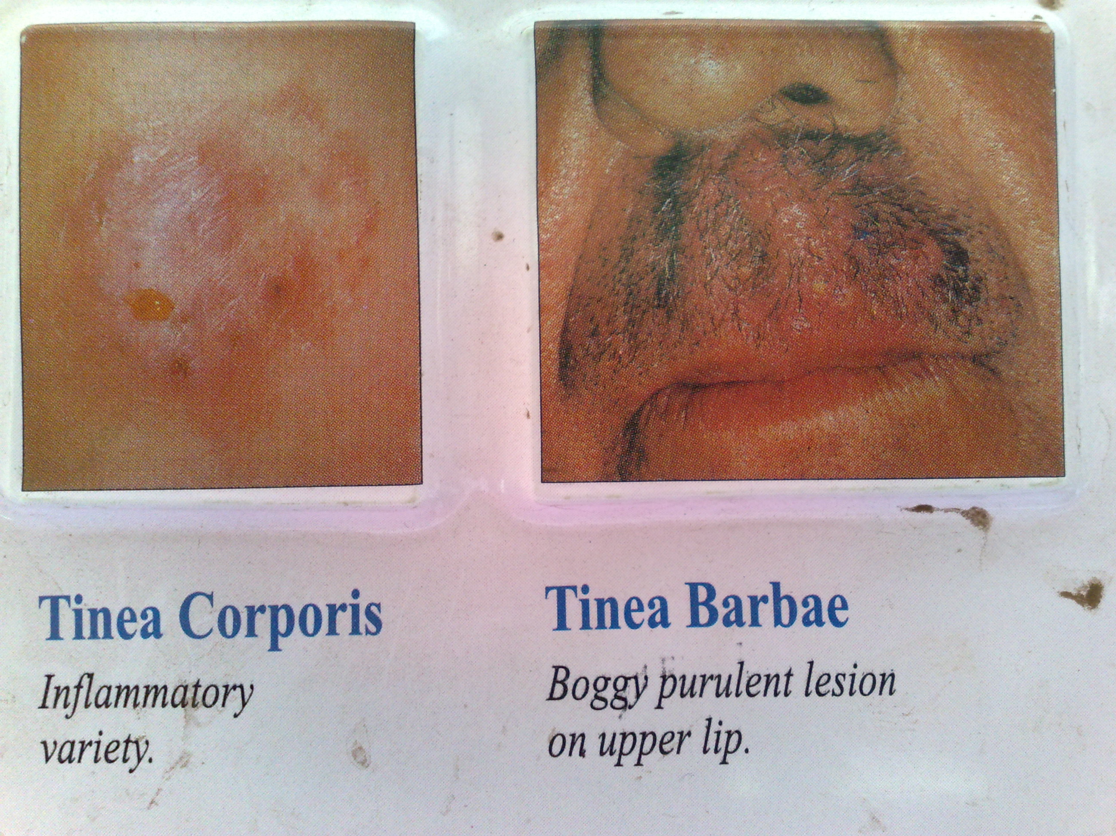
Fungal

Slide 12
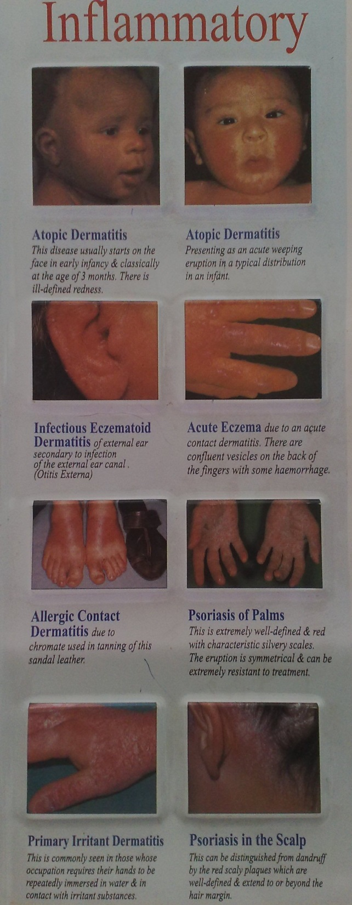
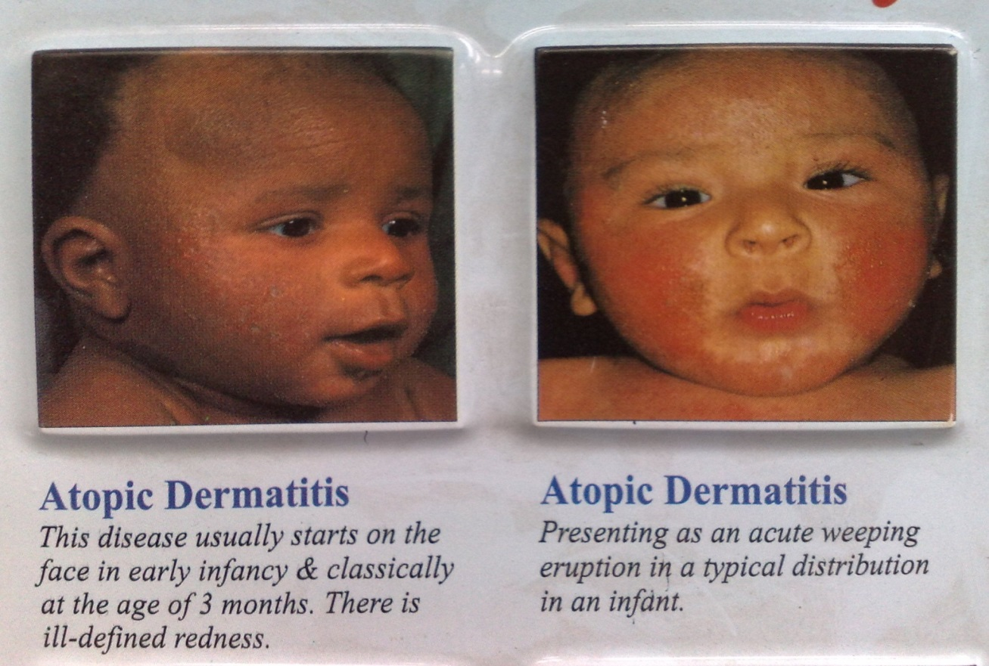
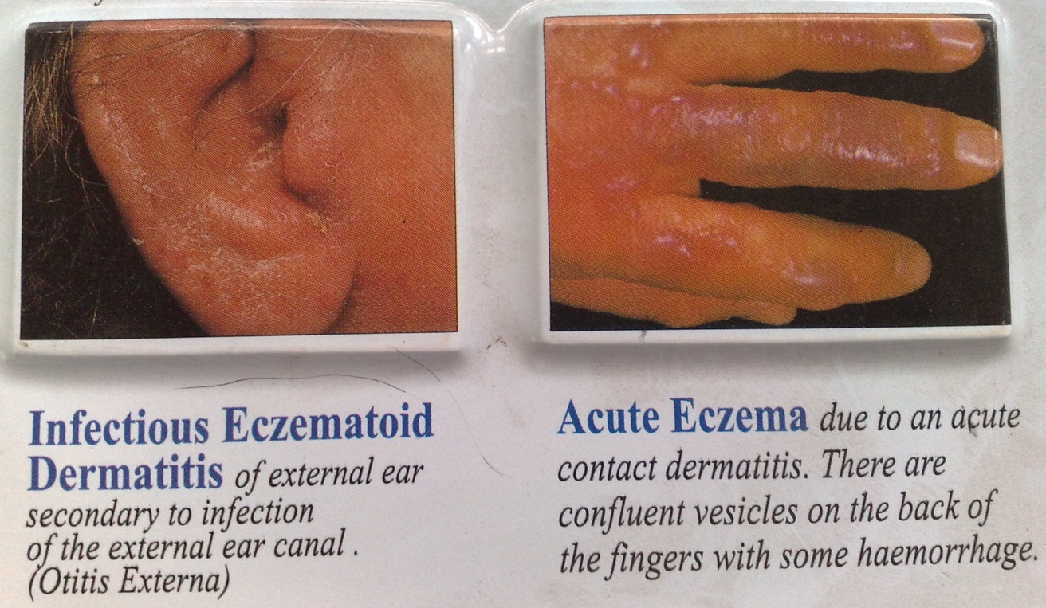

Slide 13
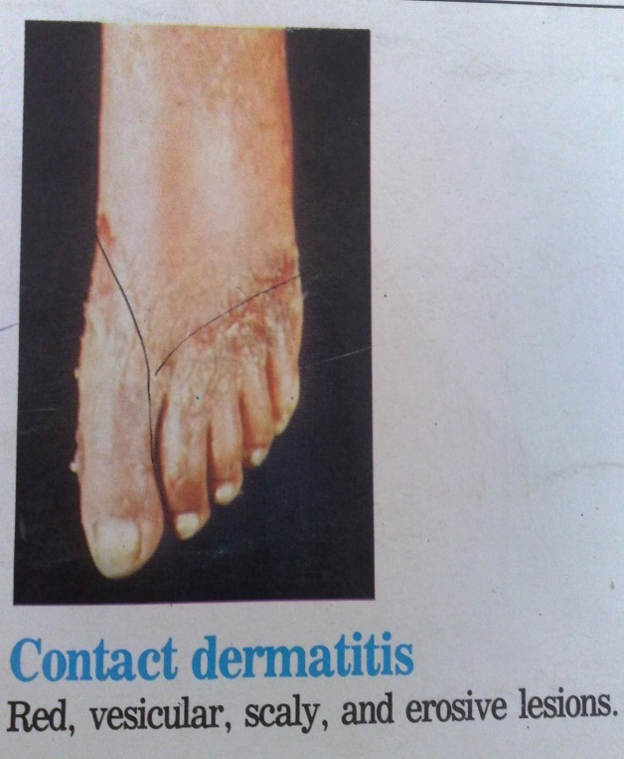
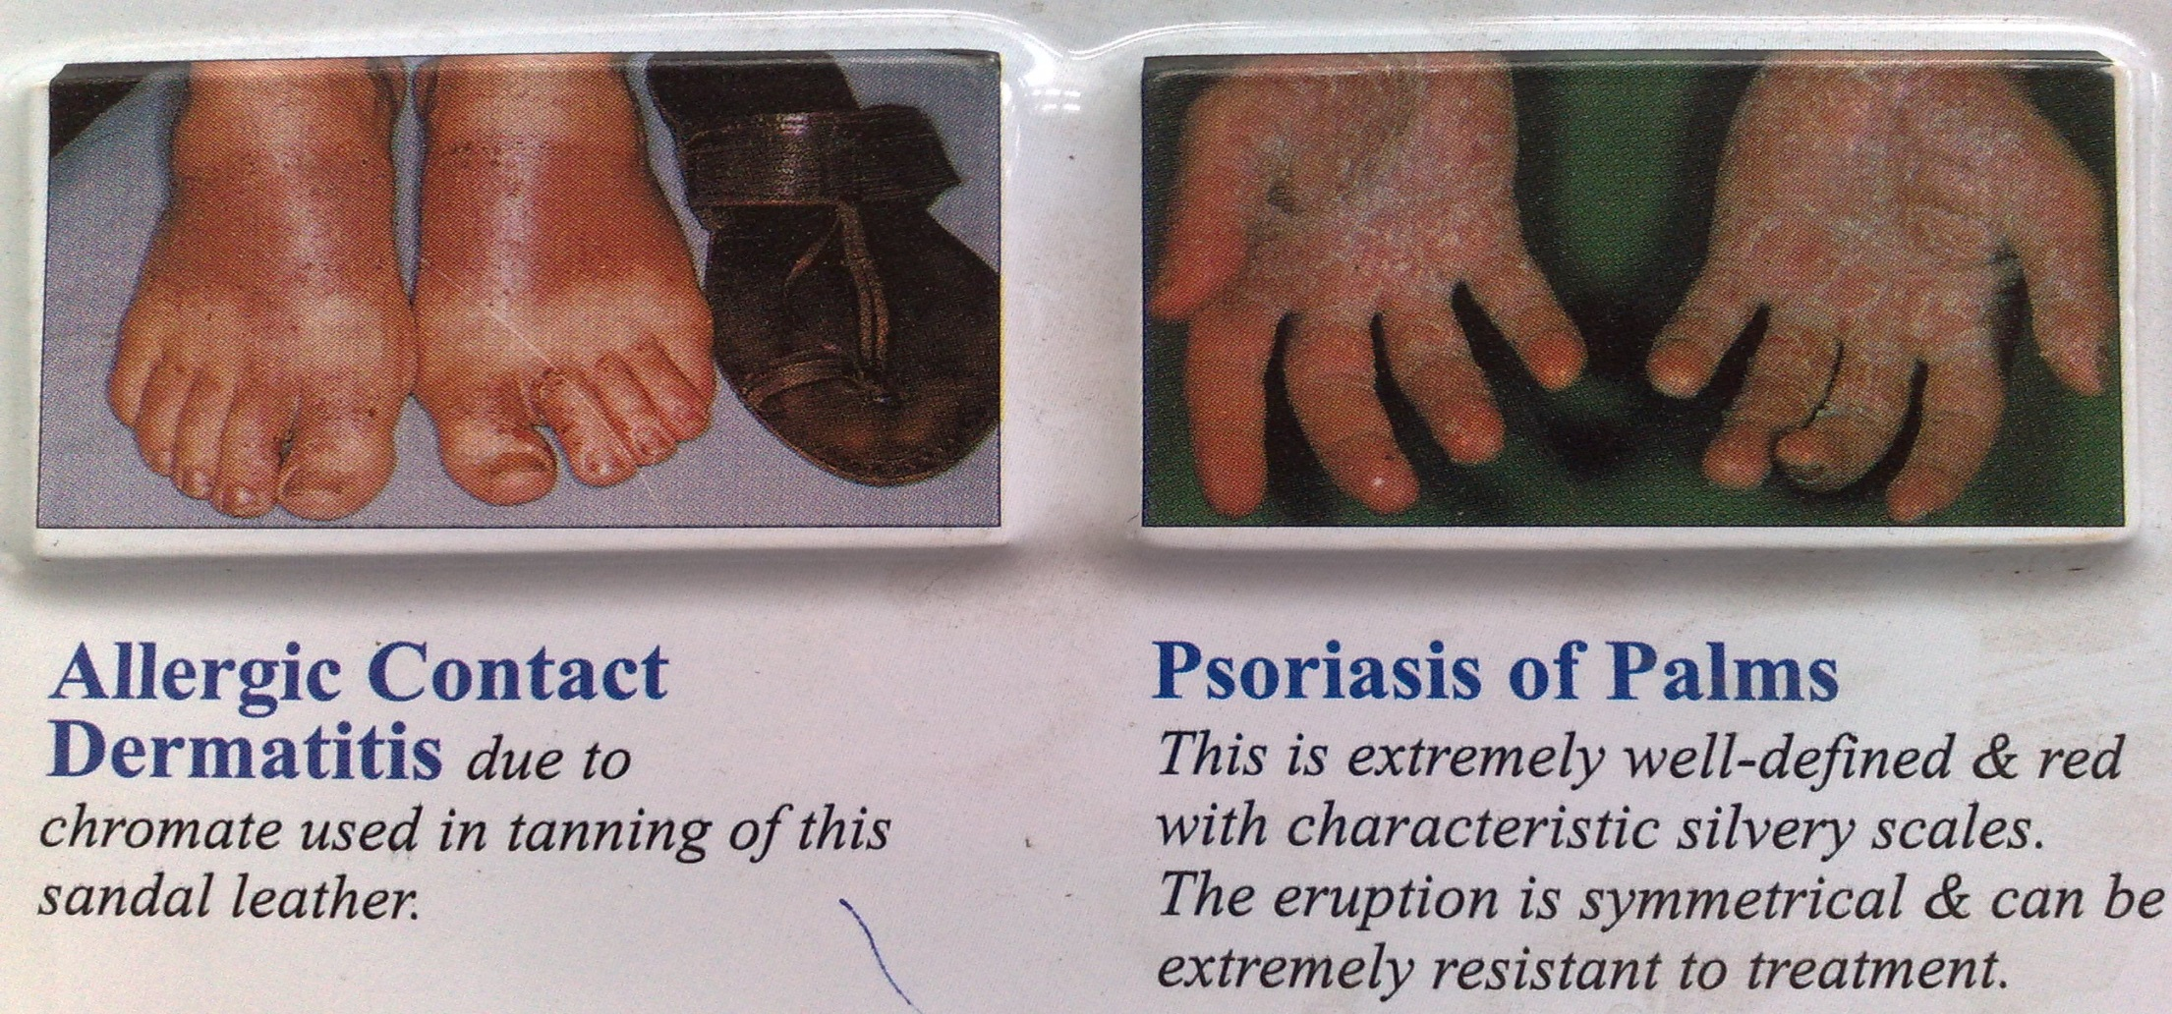

Slide 15
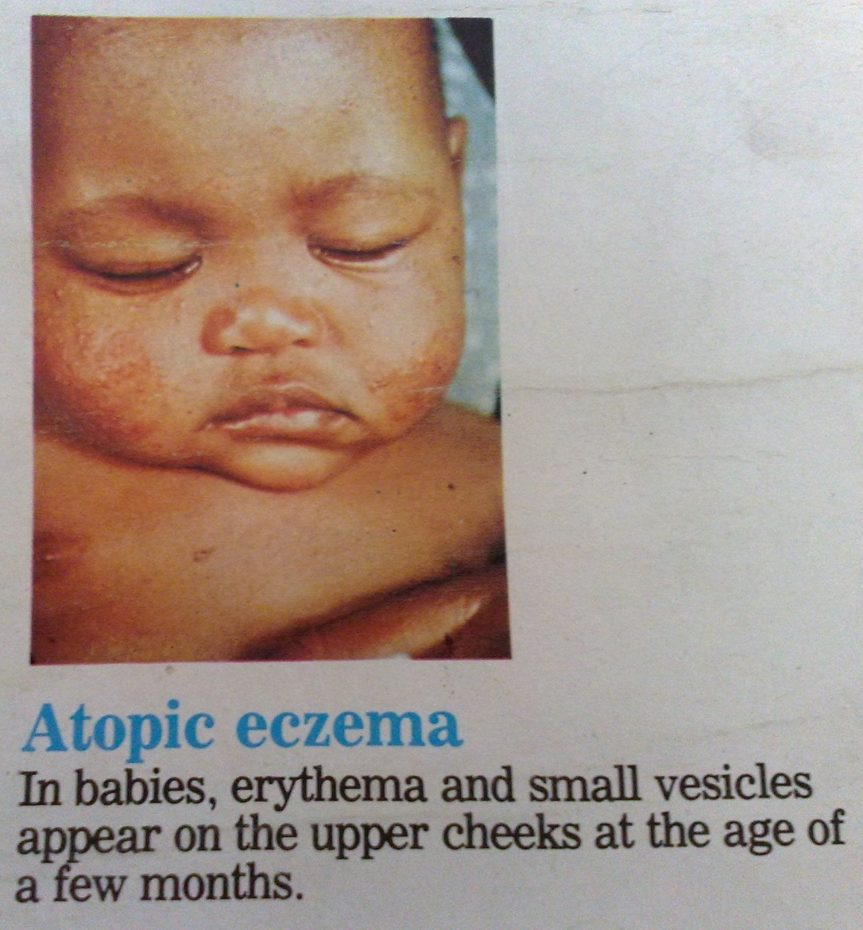
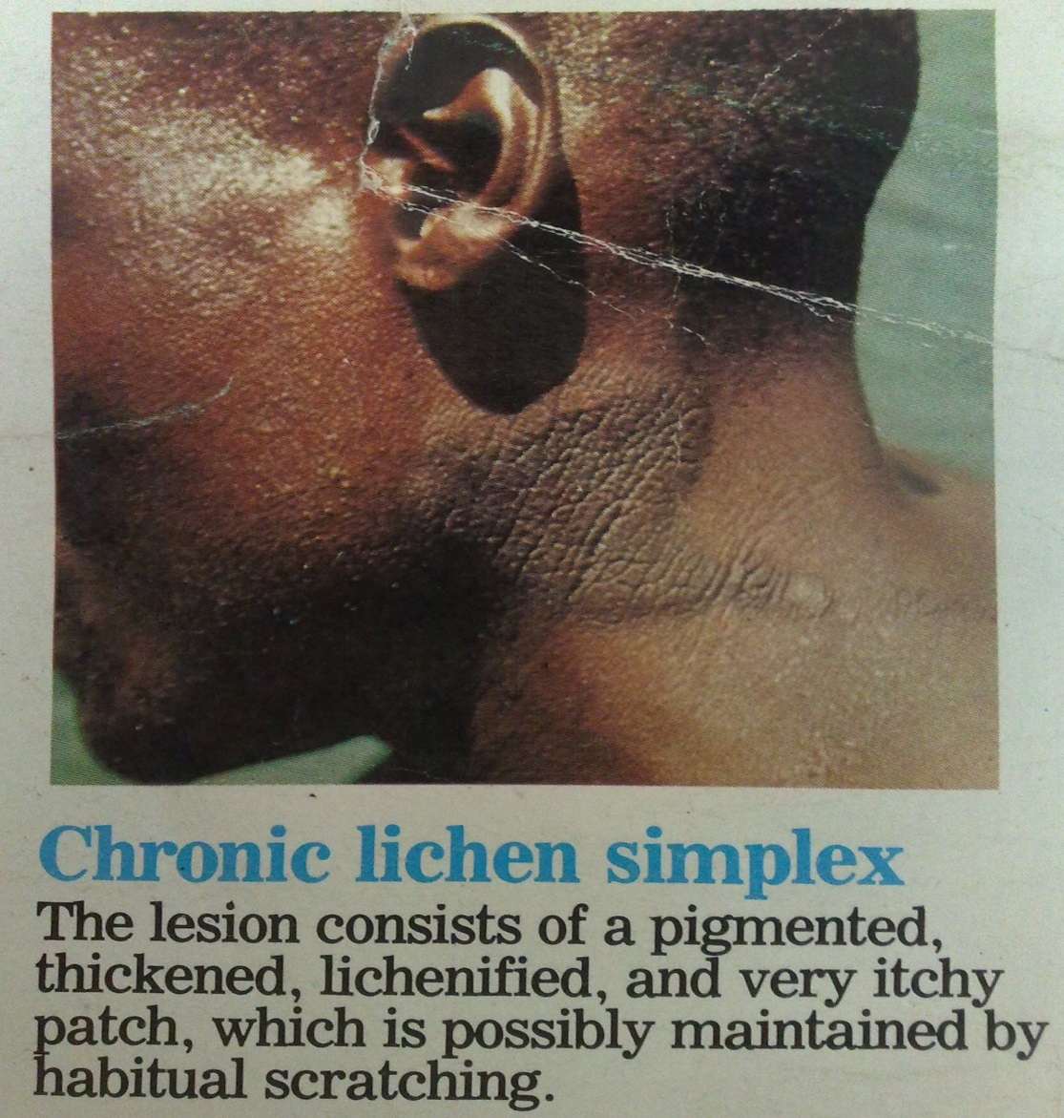

Slide 16
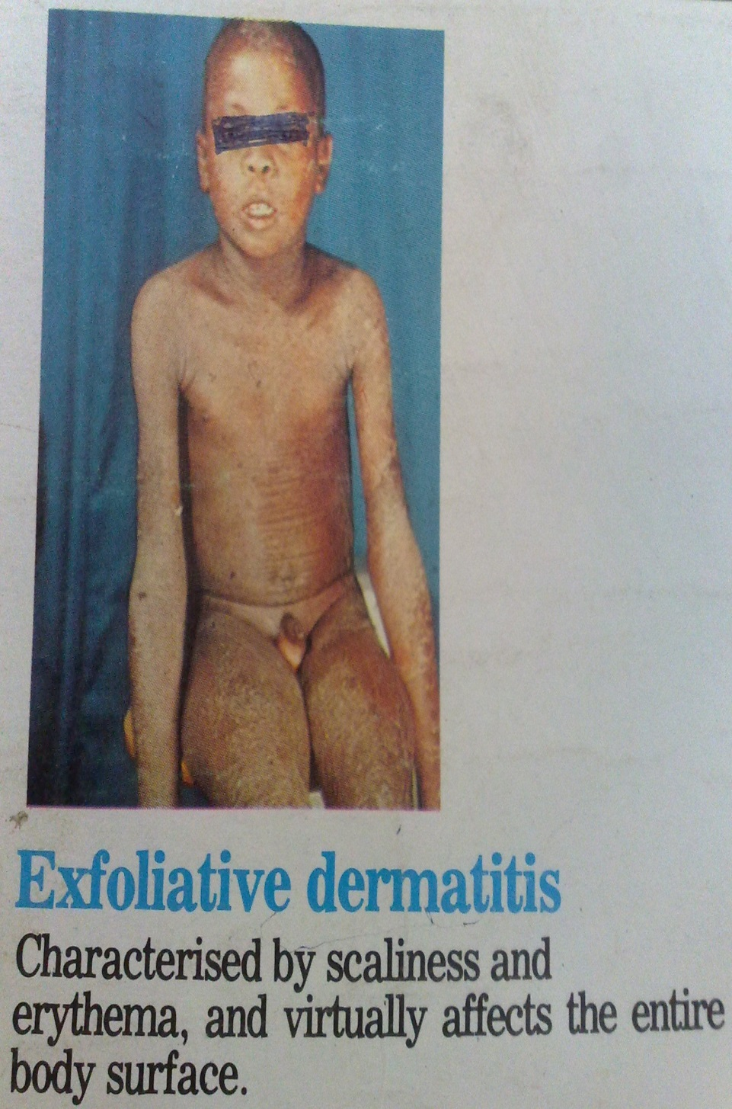
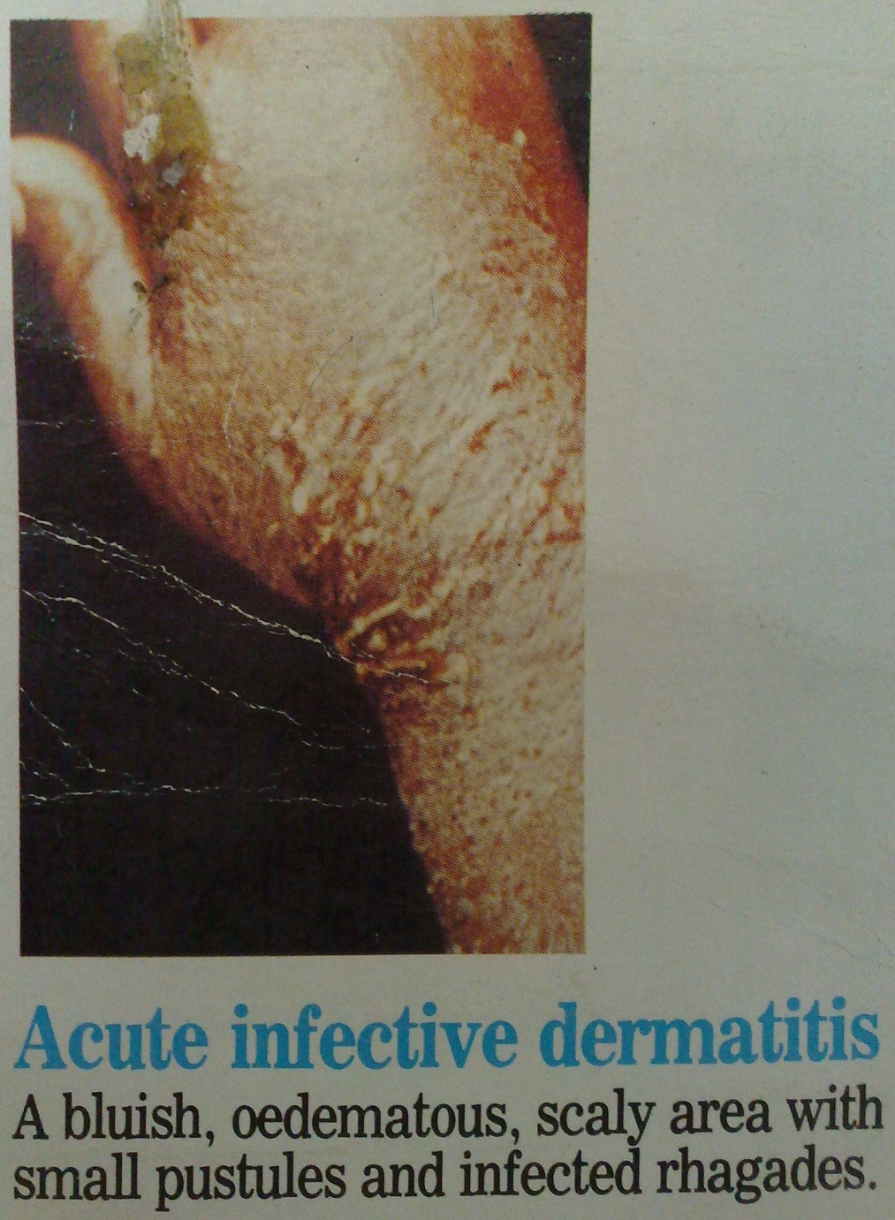

Slide 17
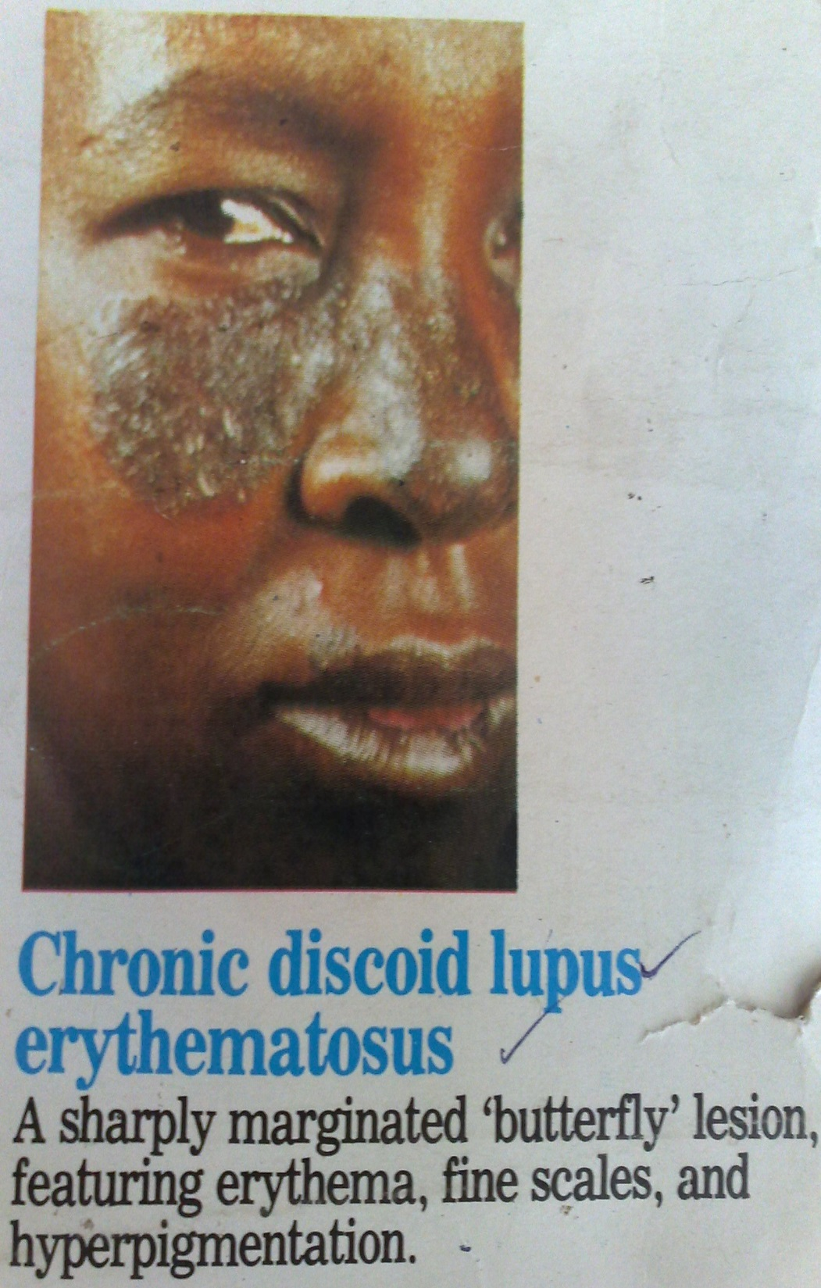
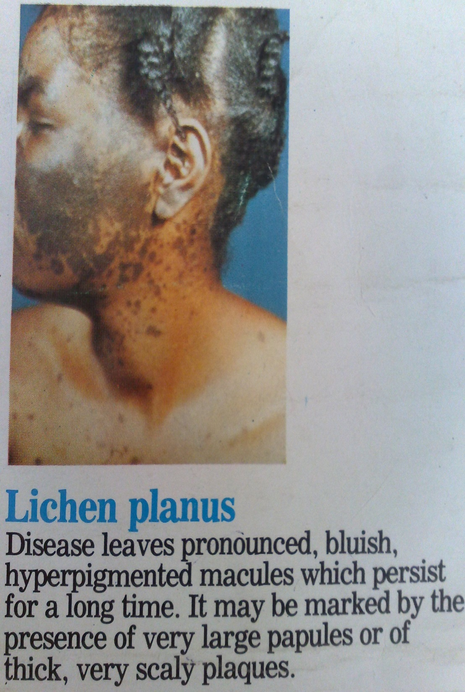

Slide 18
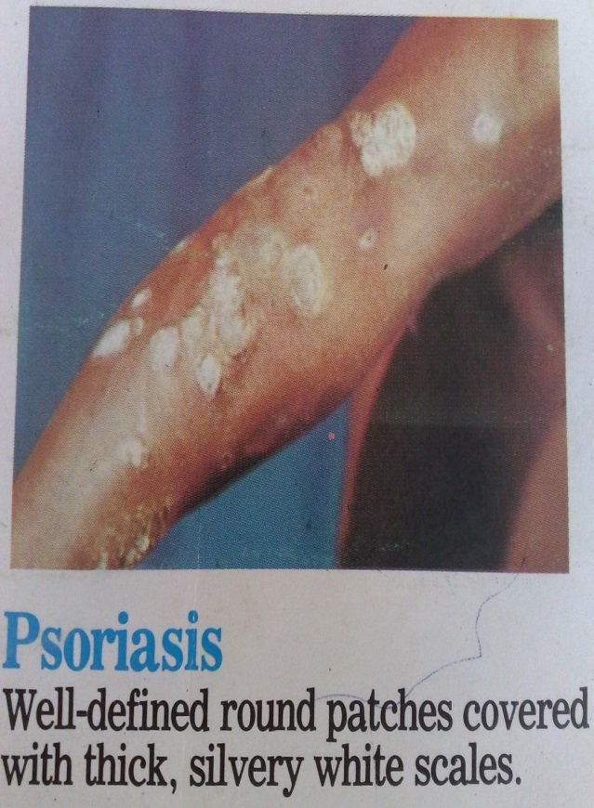
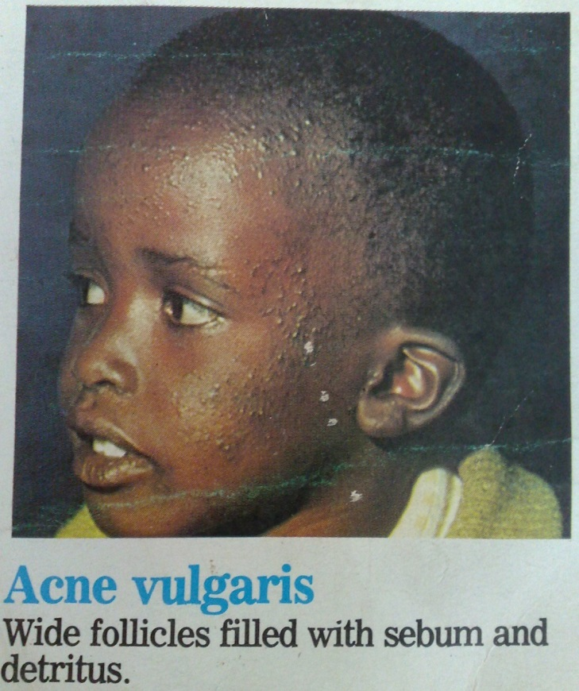
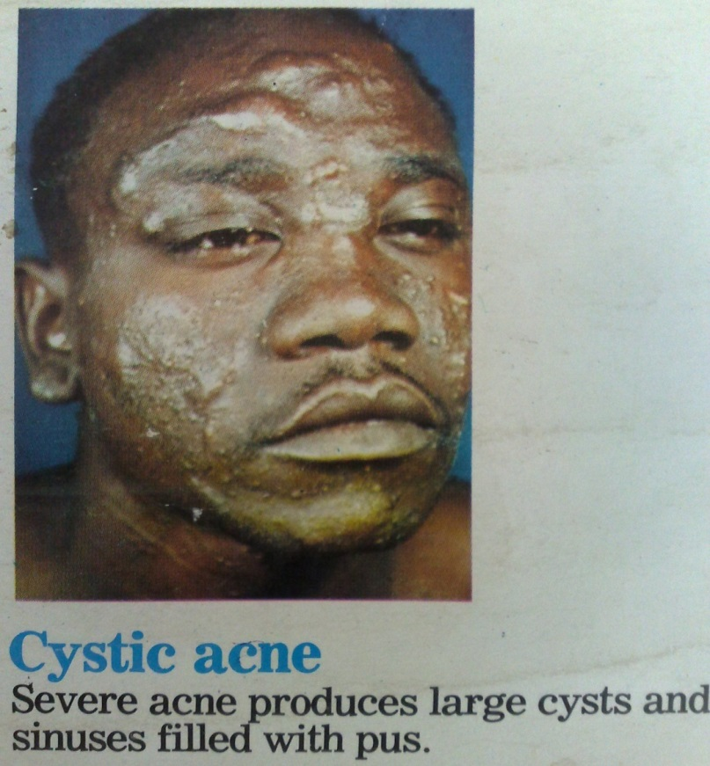

Slide 19
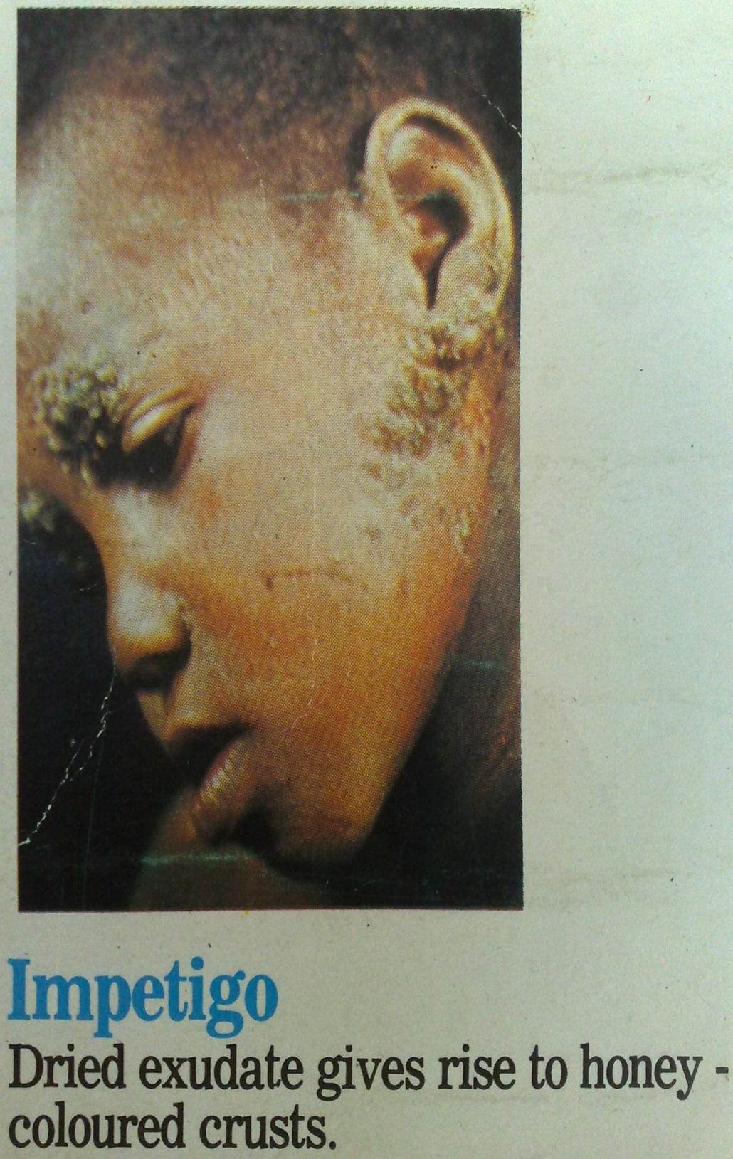
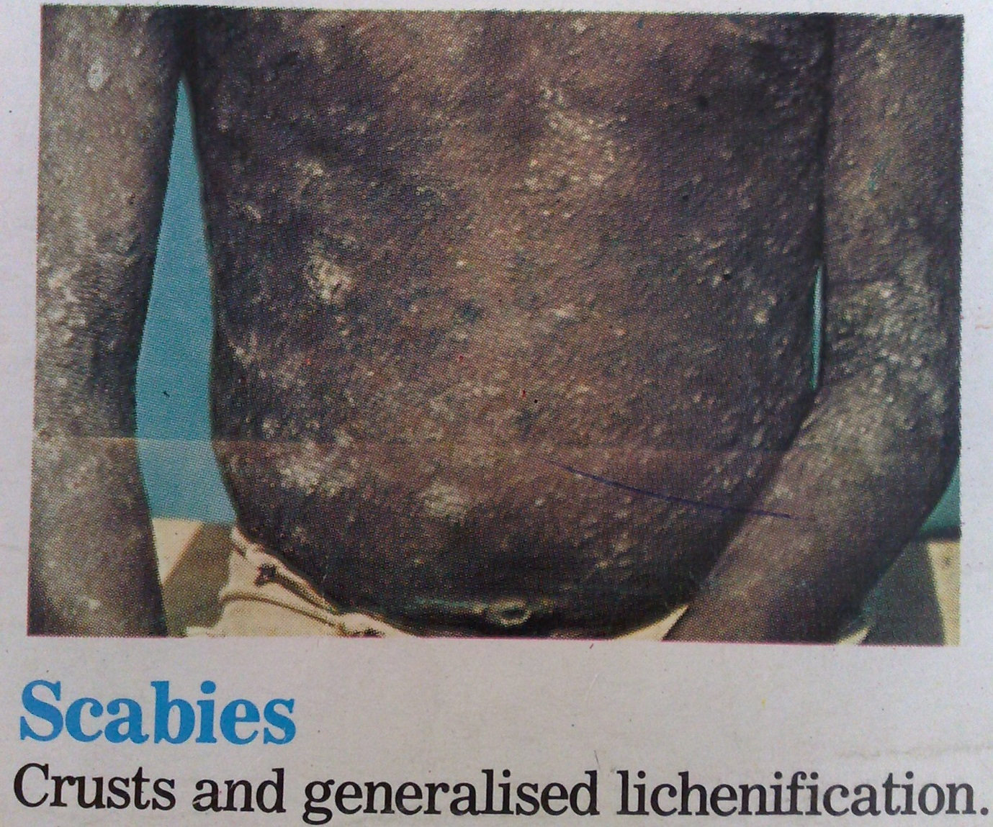

Slide 20
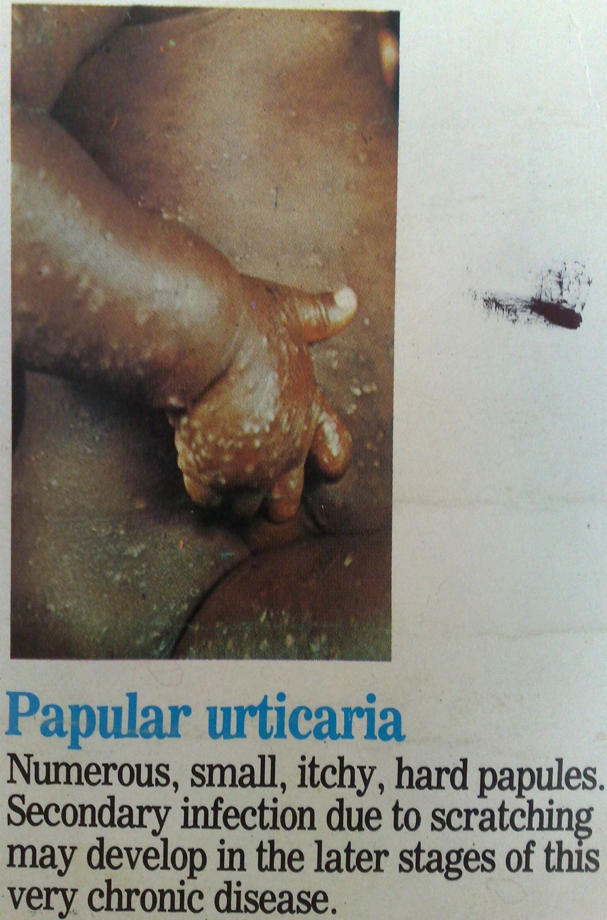
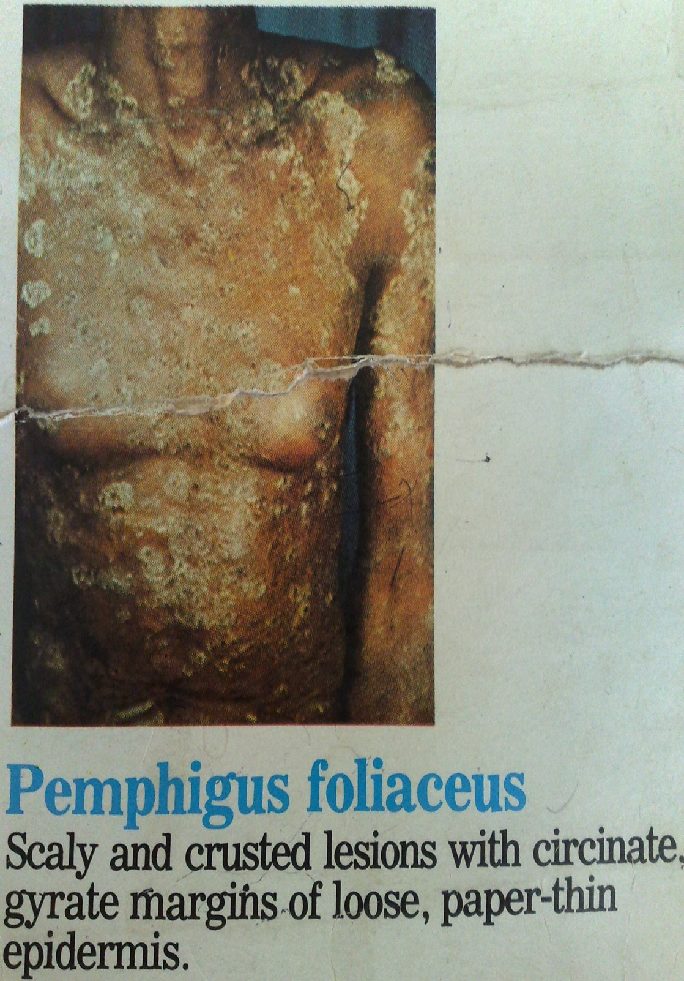

Slide 21
Clinical Manifestations
T. Corporis manifestations
Trichophyton species, microsporum species and epidermophyton floccosum
Frequently from a pet, infection from another body site, person to person
Scaly, itchy rash on trunk legs arm
Itching, dry, circular, scaling lesions
May be very large, affecting the back and chest
In AIDs patients- extensive or follicular forms
Usually zoophilic, occasionally geophillic

Slide 22
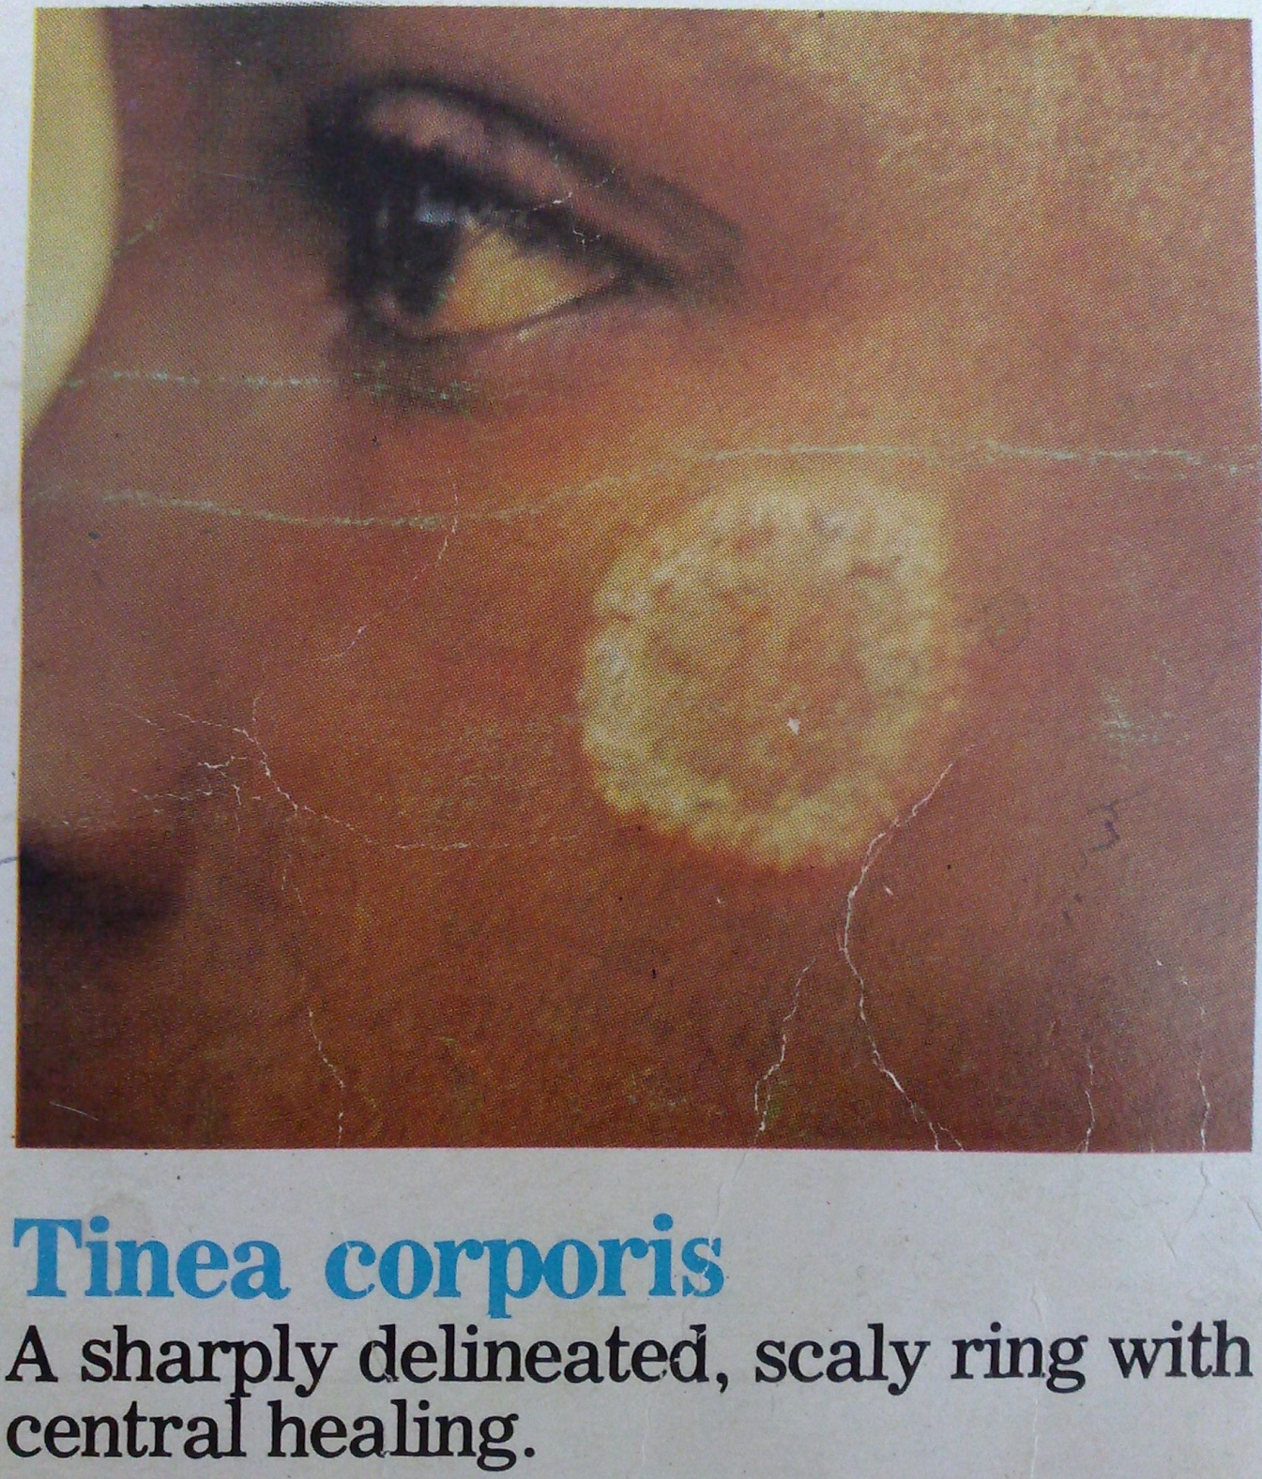

Slide 23
T. Capitis manifestations
Several tricophyton species, and microsporum species
Anthrophillic – easily transmissitted from child to child
Endemic in most African communities
Generally confined to prepubertal children
Diffuse or circumscribed areas of hair loss
Minimal scaling, hair broken at scalp level, leaving black swollen dot at hair follicle
Zoophilic
More inflammation, scaling and hair loss
Itchy inflammatory crusts cover lesion
In AIDs adult T. capitis may be seen

Slide 24
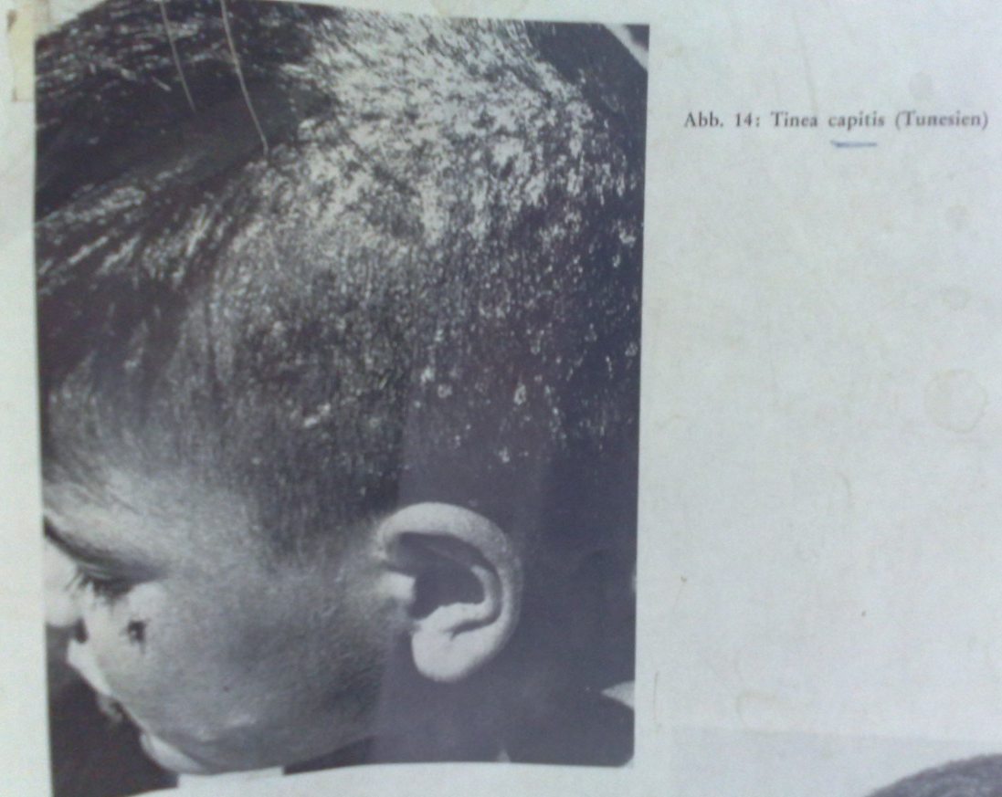
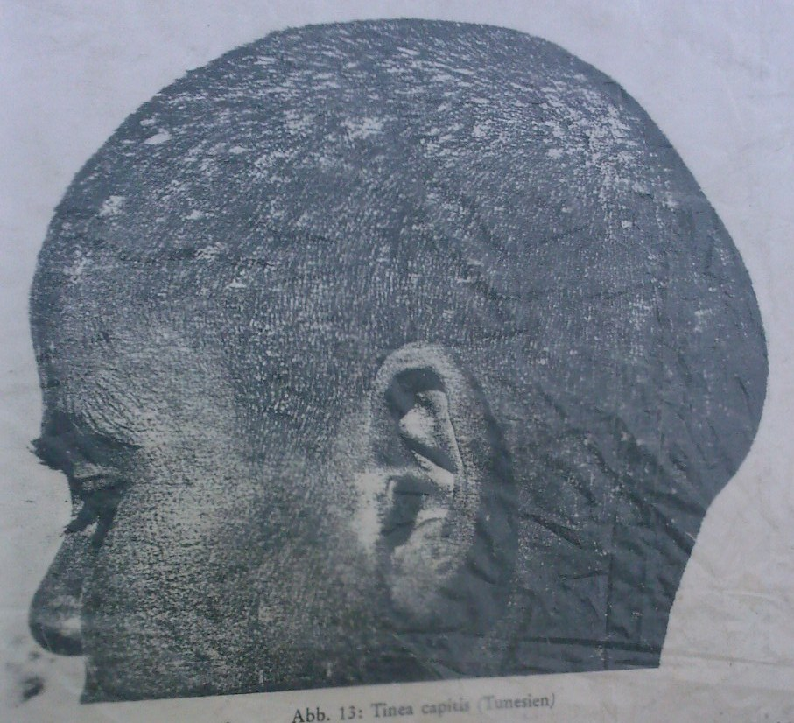
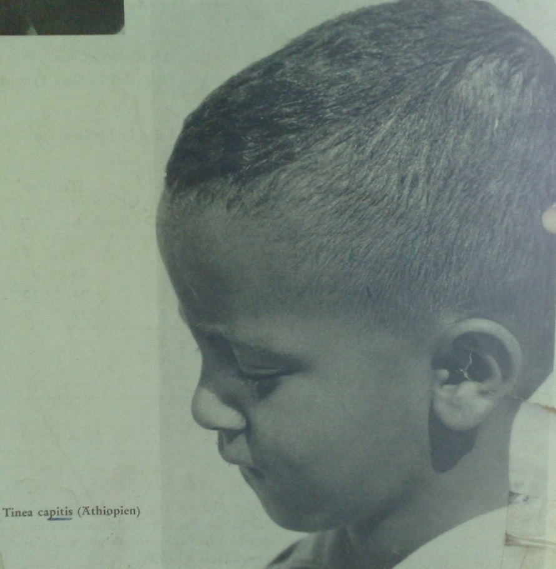
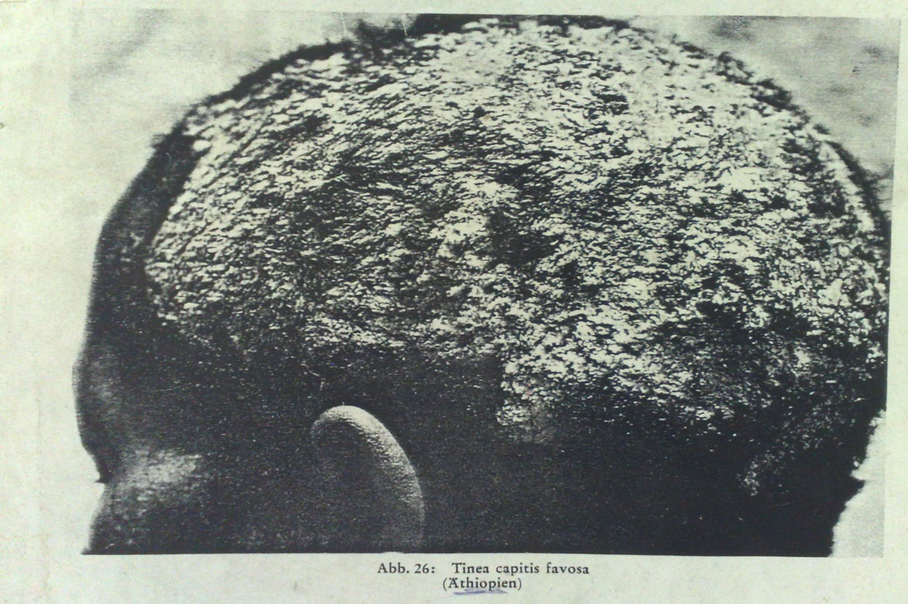

Slide 25
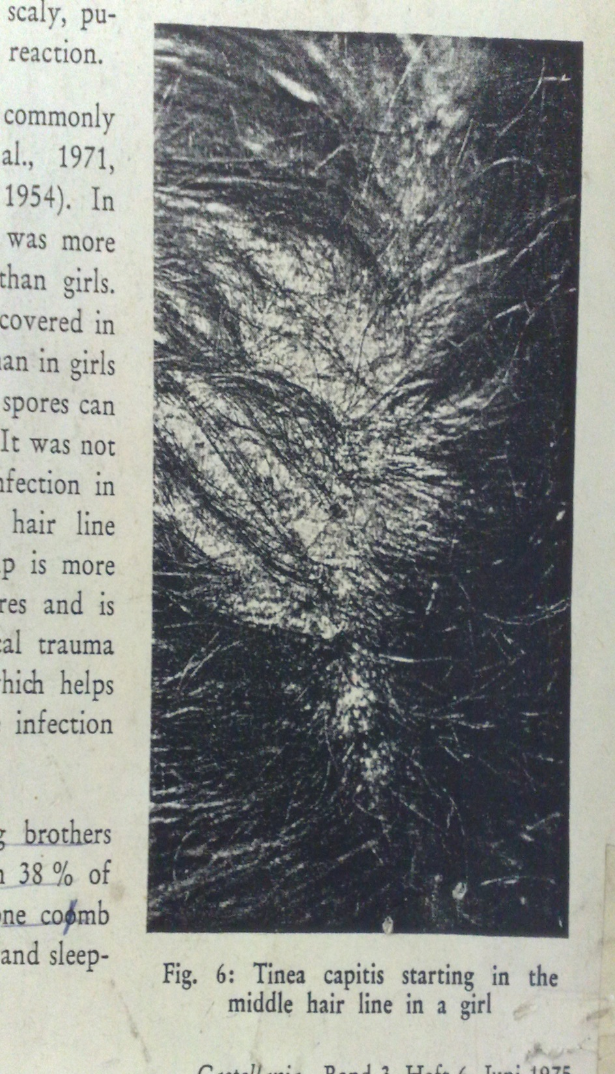
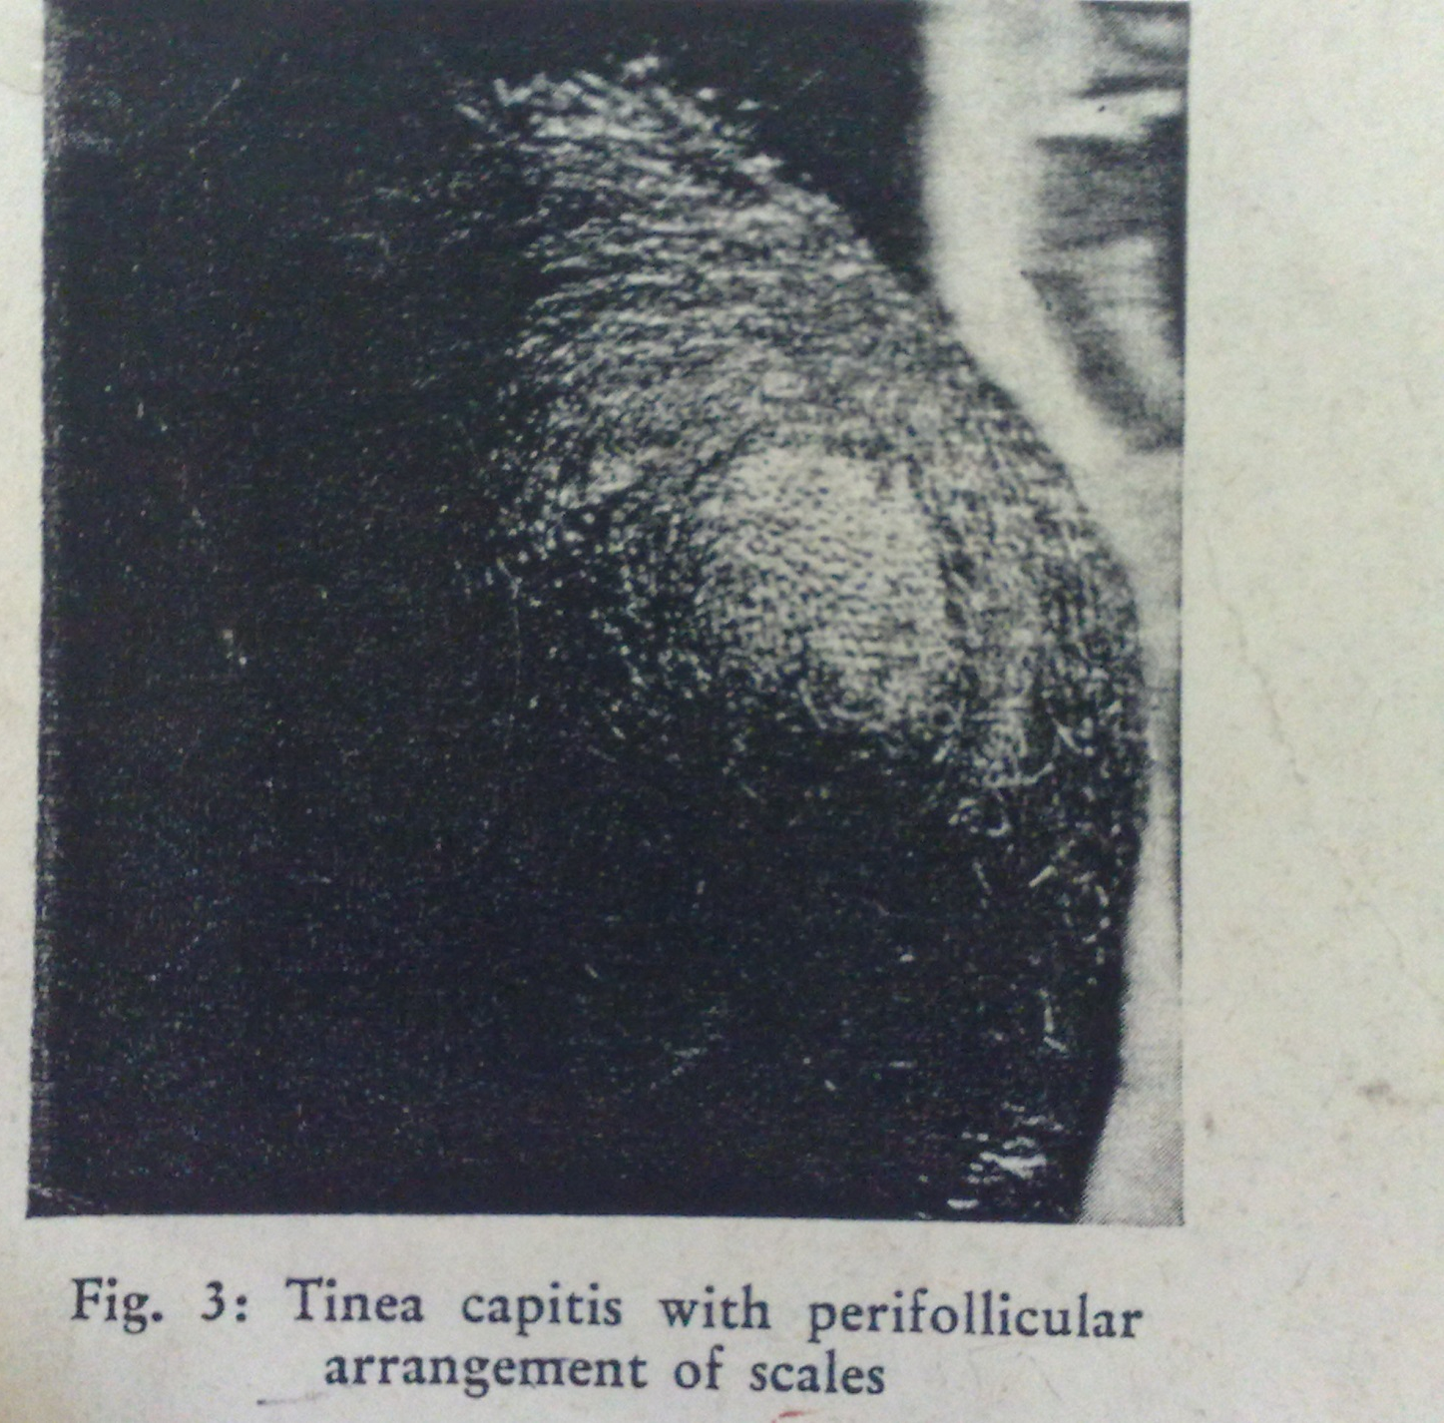

Slide 26
T. Pedis manifestations
Anthrophillic- T. rubrum, E. floccosum
Itchy, +/- pain, +/- erosions of web spaces
Severe erosion with greenish discoloration suggests pseudomonas

Slide 27
Onchomycosis
Toe nails usually
Usually together with sole or web space infection
Anthrophillic
Nail thickened & opaque, distal erosion of nail plate in chronic cases
T rubrum, T interdigtale, Fusorium spp., Acremonium spp.

Slide 28
T. Cruris
Skin of groin and pubic area
Anthrophillic- T rubrum, E floccosum
Usually from another body part
Highly contagious sharing towels e.t.c
One or more rapidly spreading erythematous lesions with central clearing on the inside of thighs, intense pruritus
Lesions with raised erythematous border and brown scaling
Infection may extend locally and spread to other body sites

Slide 29
Lab Diagnosis
Sample
Nail clippings
Skin scrapings (clean skin- 70% alcohol - ↓ bacterial flora)
Plucked hair collected in folded squares of black paper or card fastened with clip
Macroscopic exam (Wood’s lamp)
Detect fluorescence in infected hair, scalp lesions

Slide 30
Direct microscopy
Microscopy of wet mounts of KOH preparations (10-30% KOH digestion 15 mins)
Look for hyphae or arthrospores
Calcofluor white- optical brightener under fluorescence microscope - enhances fungal elements
Microsporum fluoresces a bright yellow green (Wood’s lamp)
Direct microscopic exam of hair roots and skin softened with KOH shows hyphae, arthrospores and distinctive patterns of hair invasion
Arthroconidia retained in hair shaft - endothrix invasion-M. nanum, T. tonsurans
Arthroconidia on a sheath surrounding hair shaft - ectothrix invasion-M.canis, gypseum. T. verrucosum

Slide 31
Shaft of hair with KOH
Skin scrapping with KOH

Slide 32
KOH preparation of hair
KOH preparation of skin

Slide 33
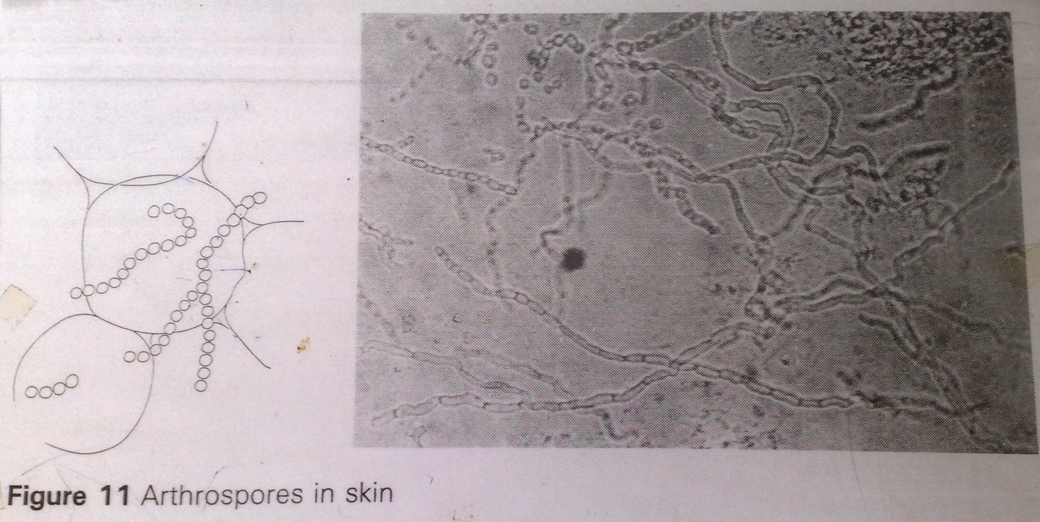
Hyphae in skin:

Slide 34
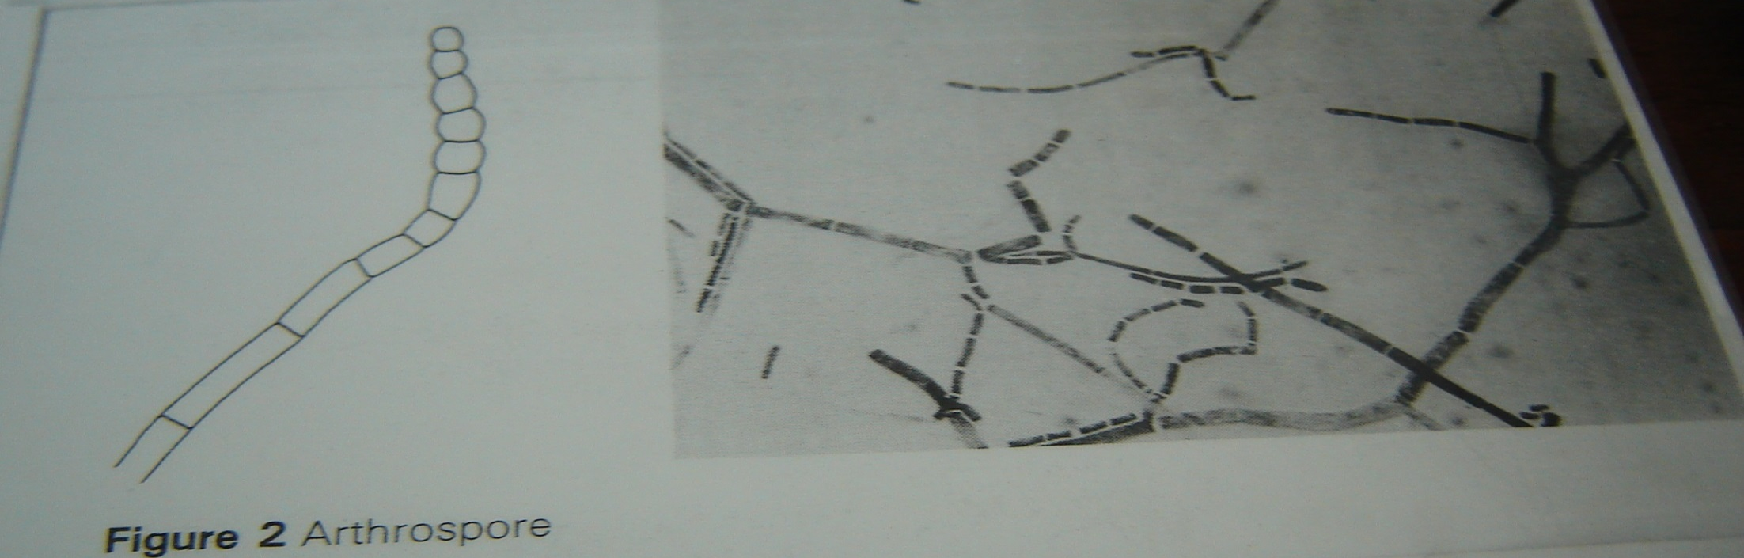
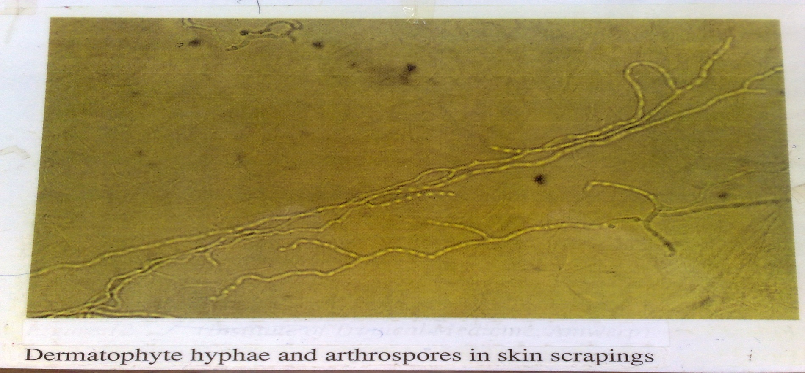

Slide 35
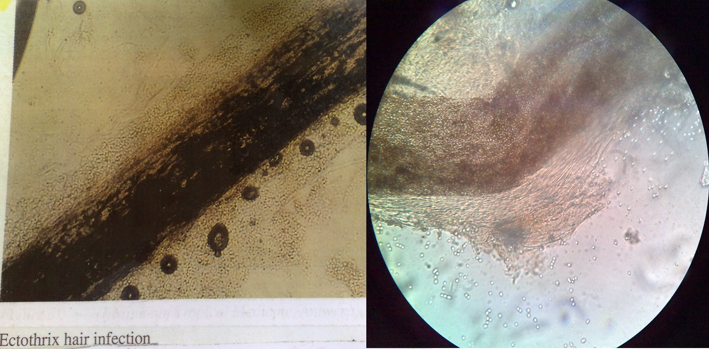

Slide 36
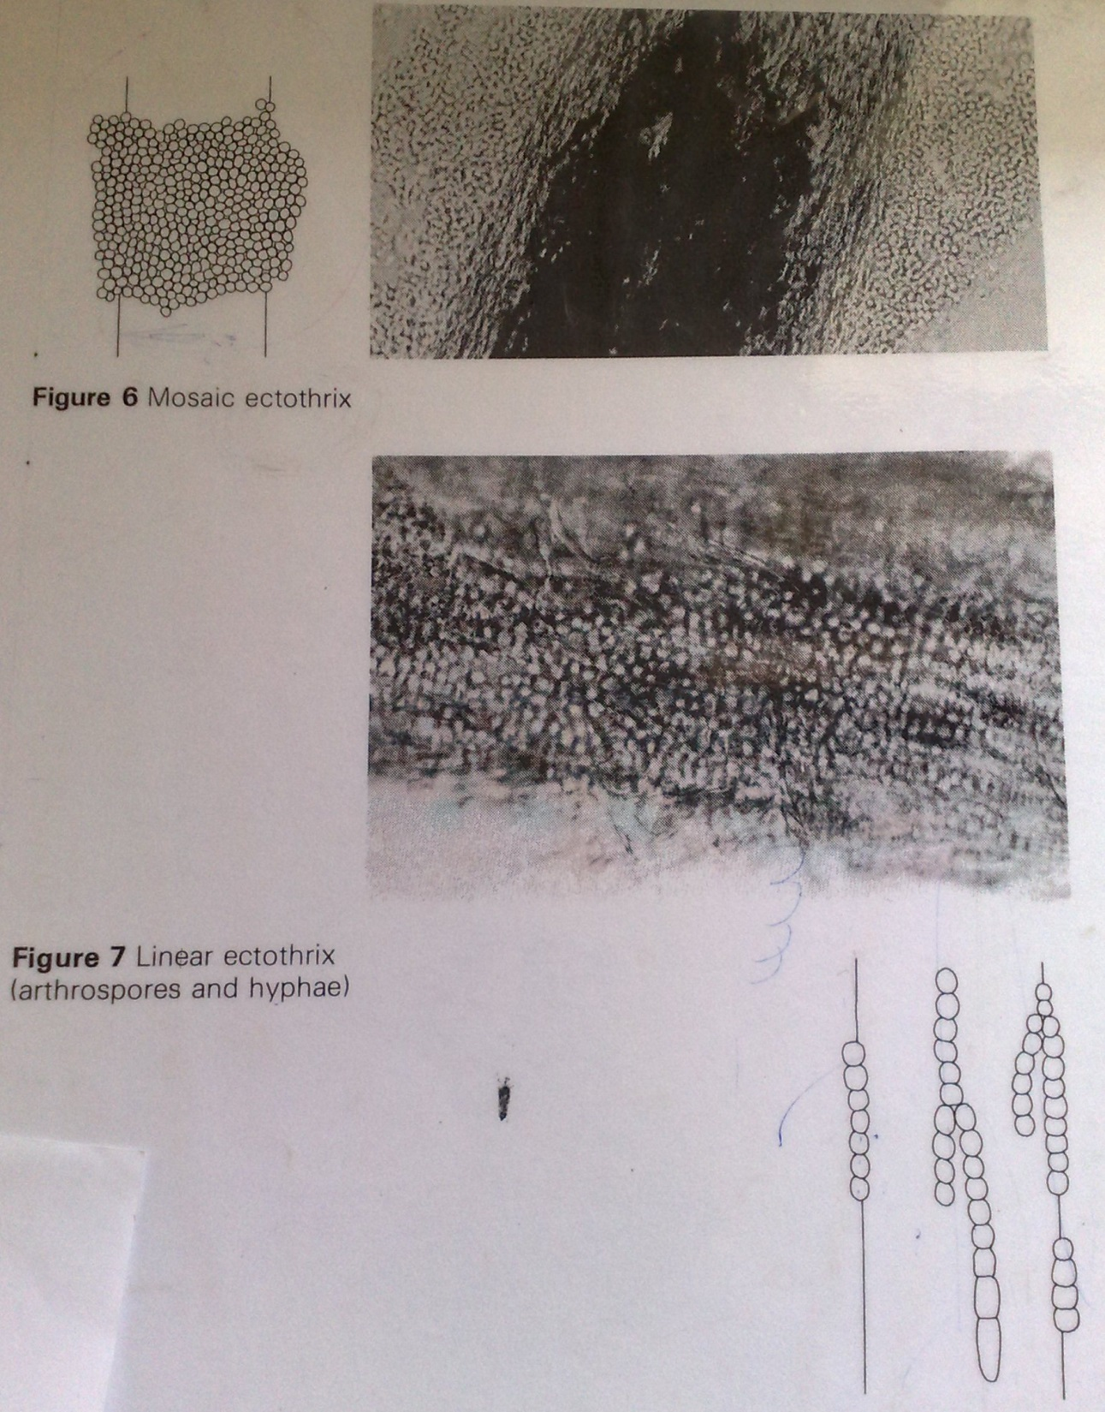

Slide 37
Culture
For isolation and ID of genus and species
On SDA for 10-14 days
Check for colonial morphology
Lactophenol blue staining on a portion of the colony
Look for micronidia and macronidia
Dermatophyte species produce 2 types of asexual spores: macroconidia & microconidia

Slide 38
Treatment
Topical therapy
Nonspecific – Whitfield’s ointment
Specific – Creams, lotions, shampoos
Azole derivatives- Clotrimazole, ketoconazole etc.
Oral antifungals if skin contact hurts– required for nail scalp and severe skin infection includes Griseofulvin, Terbinafine, Itraconazole, Fluconazole
Onchomycosis
Griseofulvin for 12-18 months-high relapse rates
Oral terbinafine or itraconazole

Slide 39
Prevention
Involves minimizing transmission from infected individuals especially through indirect spread from contaminated items

Slide 40
Pityriasis/ tinea versicolor
Caused by Malassezia furfur, normal skin flora
Usually in adults and less common in children
Common in roofing or construction workers in warm climate , exposed to sun, who are constantly wet and sweat hence infection can reoccur even after treatment.
Associated with immonusuppression due to organ transplantation. Not known association with AIDS

Slide 41
Presentation
Superficial infection of keratinized cells
Hypopigmented (in dark skin) or hyperpigmented (in light skin)spots on the chest and back
Coalesce with time to form confluent patches
Fungemia in premature infants on IV lipid supplements

Slide 42
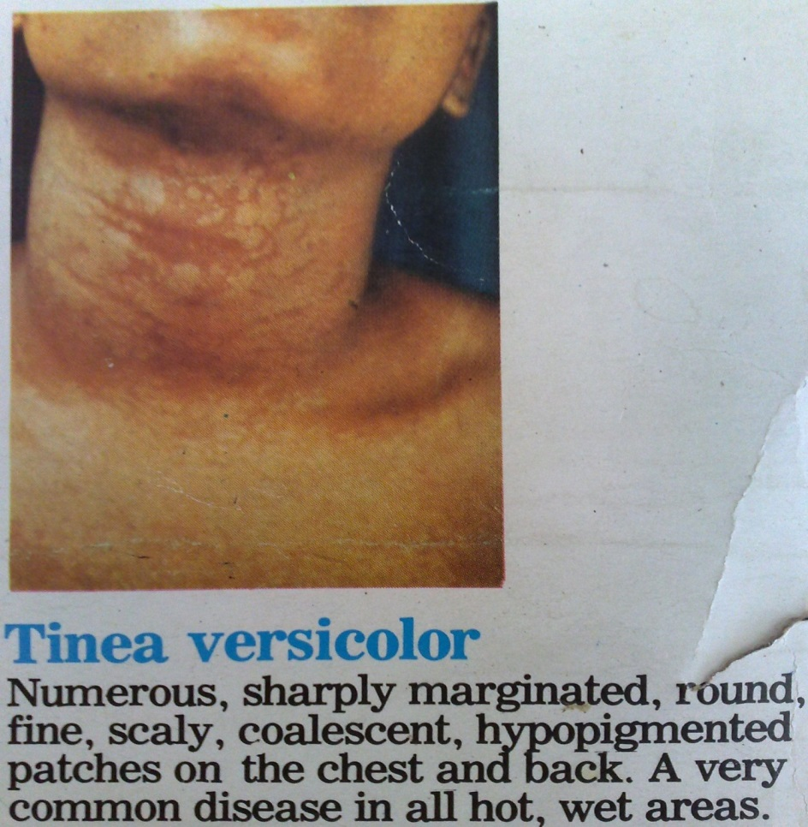
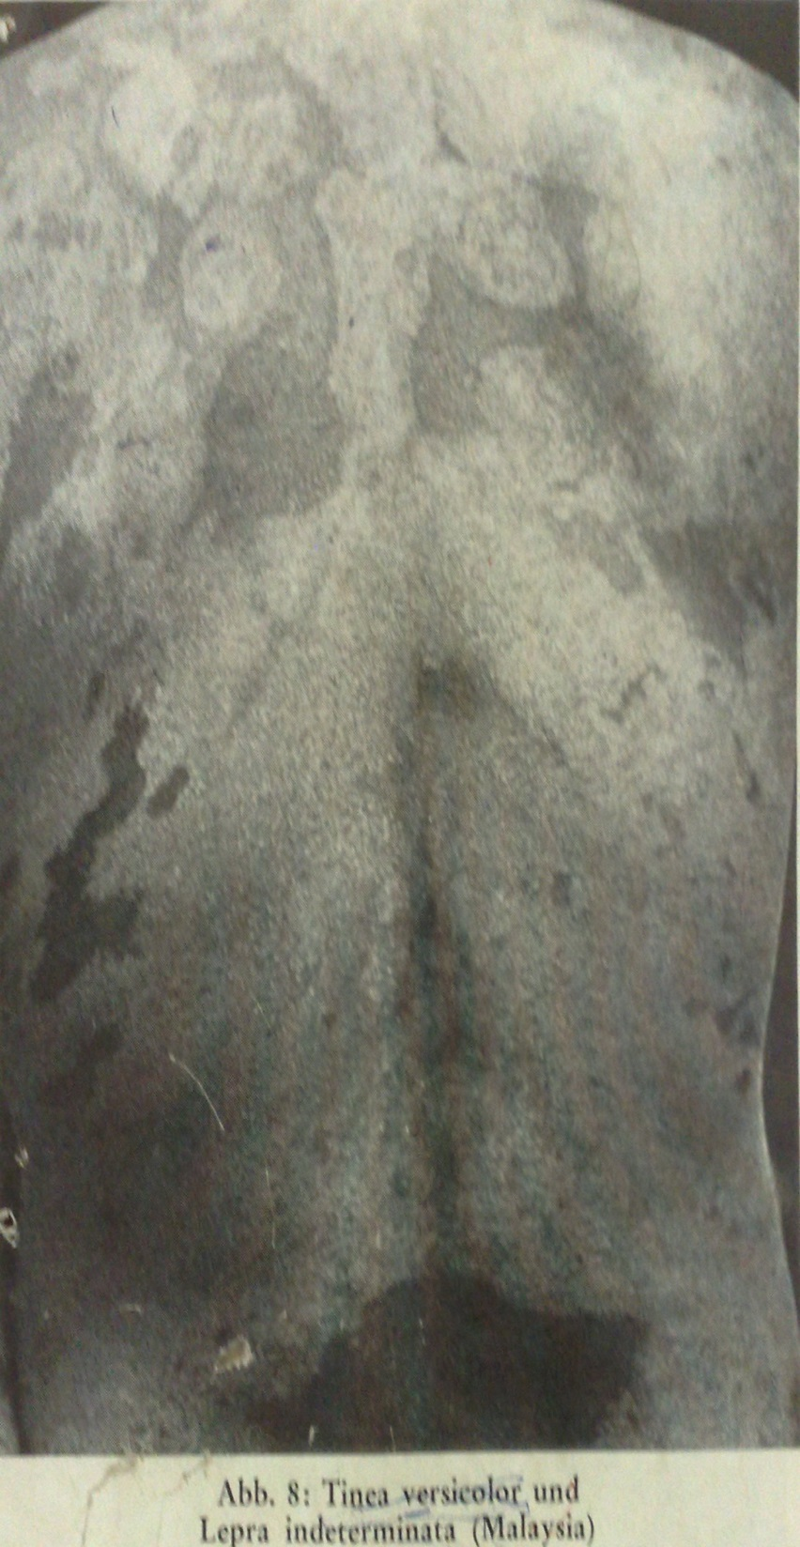
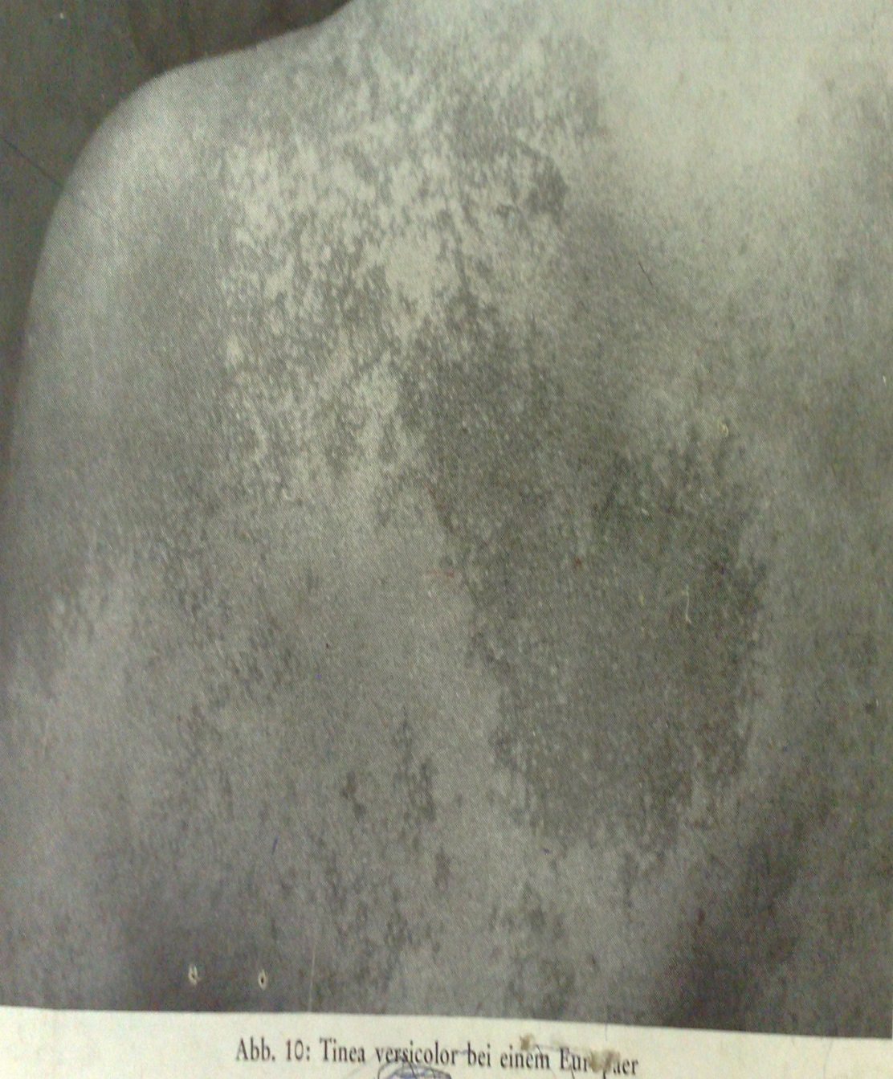
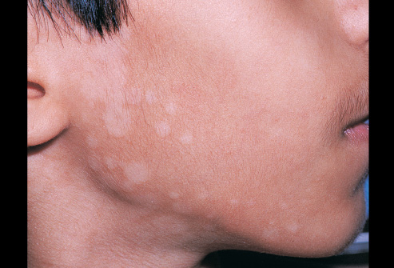

Slide 44
Sebborhoeic dermatitis
Yeast found in large quanties in scales of dermatitis and in dandruff
AIDS patients –Early sign of CD suppresion but also commonly in health persons
Erythema and greasy scale- Eyebrows and eyelashes, scalp, nasolabial folds, behind ears, over sternum.

Slide 45
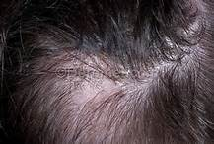
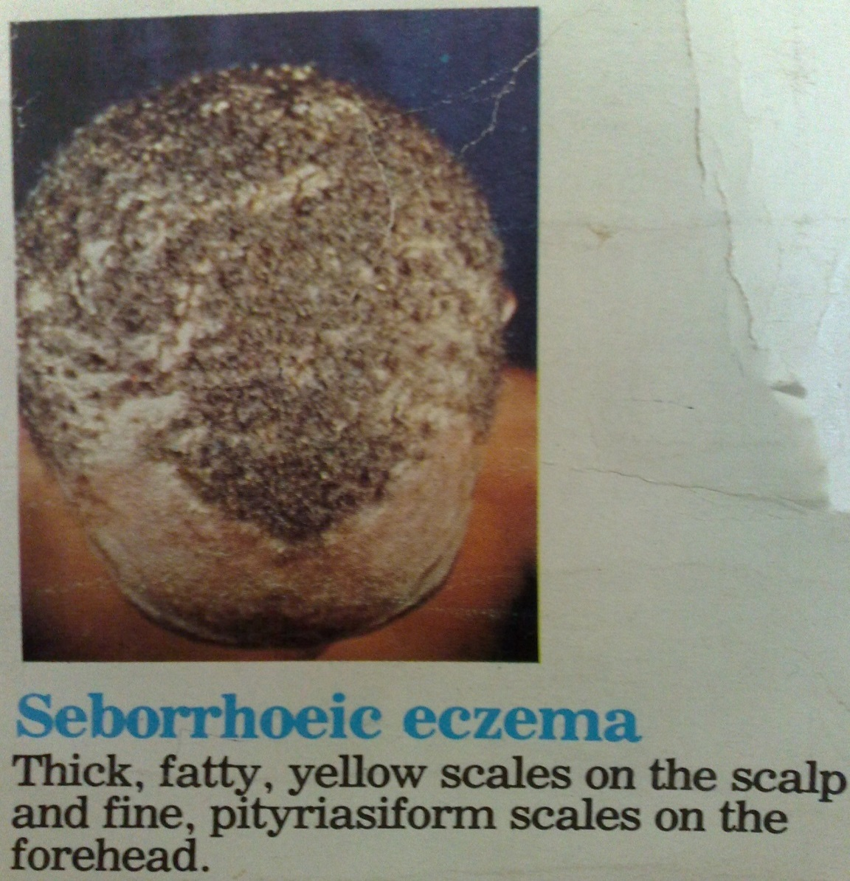

Slide 46
Lab diagnosis
Microscopy
Oval, budding yeast and short filaments
Culture
A lipid supplement is required in medium
Incubated at 32-34⁰C
Small yello-creamed colonies develop within 1 week.
Prevention
General cleanliness
Avoid sharing personal items- combs, towels, clothes

Slide 47
White piedra
Softwhite grayish nodules on hair shafts mainly axillae
Caused by a yeast – Trichosporum beigelii
Shaving off infected hairs is satisfactory treatment

Slide 48
Otomycosis
Chronic otitis externa
Patient has a lot of discomfort, itch on affected site
Aspergillus nigger is the most common species involved
Species isolated on SDA, sporulation after 2 days
Cleaning and topical therapy with azole derivatives

Slide 49
Mycotic keratitis
Fungal infections of the cornea
Can be secondary to injury or bacterial infections, use of steroids
Mainly caused by saprophytic moulds e.g. Aspergillus and Fusarium species

