Slide 1
SUBCUTANEOUS MYCOSES
KIMAIGA H.O
MBChB (University of Nairobi)

Slide 2
Introduction
Subcutaneous mycoses-Disease in which the pathogen, an exosaprophyte, penetrates the dermis or even deeper during or after skin trauma
Lesions gradually spread locally without dissemination to deep organs
Rarely cause deep mycoses in patients with severe underlying abnormalities
Occurs mostly in tropics

Slide 3
Conditions
Mycetoma
Phycomycosis
Chromoblastomycosis
Sporotrichosis
Lobomycosis
Rhinosporidiosis

Slide 4
Mycetoma
Clinical symptom of localized, indolent, deforming, swollen lesions and sinuses, involving cutaneous and subcutaneous tissues, fascia and bone; usually occurring on the foot or hand
Synonyms – maduromycosis or madura foot
Aetiological agents
1. Fungal ( eumycotic mycetoma)
Madurella mycetomi Madurella grisea Pseudallescheria boydii Acremonium spp | Exophiala jaenselmei Leptosphaeria senegalensis Exophiala, Culvularia, Fusarium

Slide 5
2. Bacterial (actimomycotic mycetoma)
Nocardia brasiliensis
Nocardia Asteroides
Nocardia caviae
Streptomyces somaliensis
Actinomaduar madurae
A. pelletieri

Slide 6
Fungal causes differentiated by
Colonial appearance
Growth rate
Pigmentation
Microscopy
Color of granules
Physiological reactions

Slide 7
Pathogenesis
Infection is acquired following trauma to skin by plant materials from trees, shrubs or vegetation debris
Starts out as tumor-like to subcutaneous swelling
Ruptures near the surface; infects deeper tissues including subcutaneous tissues and ligaments
Small particles or grains leak out of lesions – these represents the microcolonies

Slide 8
Clinical features of mycetoma
Tumefaction (tumor-like swelling)
Multiple draining sinuses
Sclerotia (granules/ grains in sinuses)
Dissemination - muscles and bones
Sites commonly affected– feet, lower extremities, hands

Slide 9
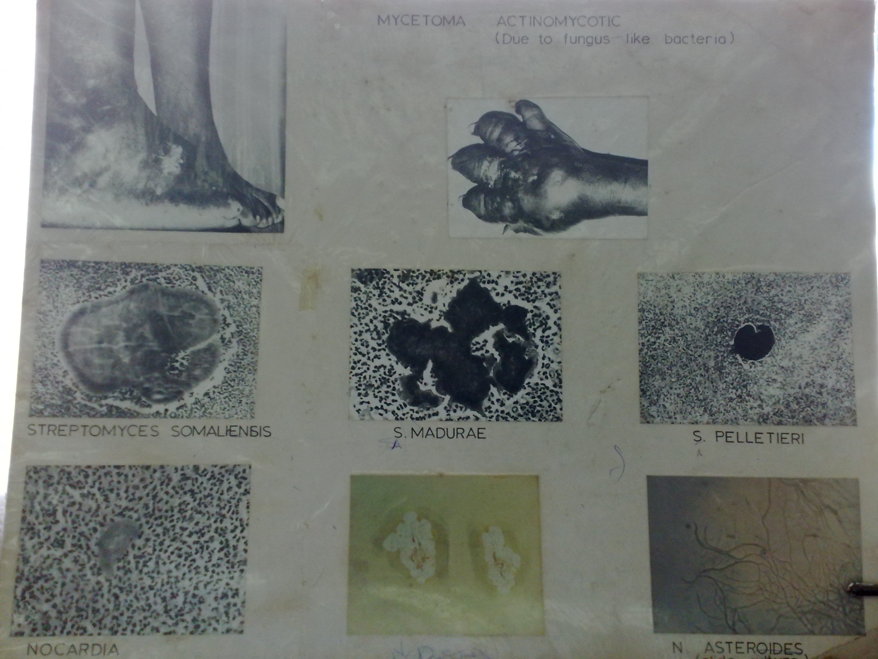

Slide 10
Madura Foot
Fungi-Leptospaerea senegalensis

Slide 11
Fungi-Eumycotic Mycetoma mycetomi

Slide 12
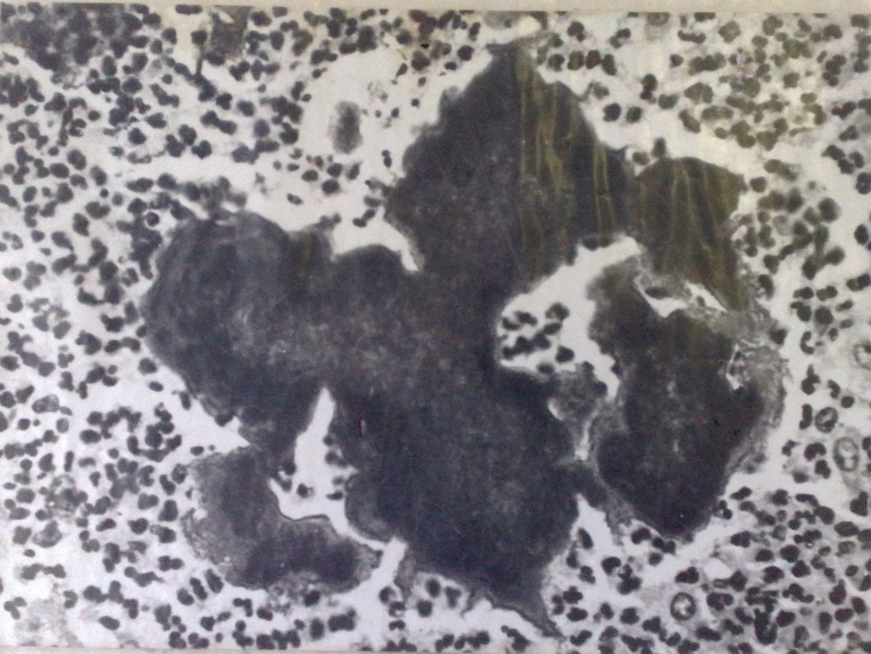
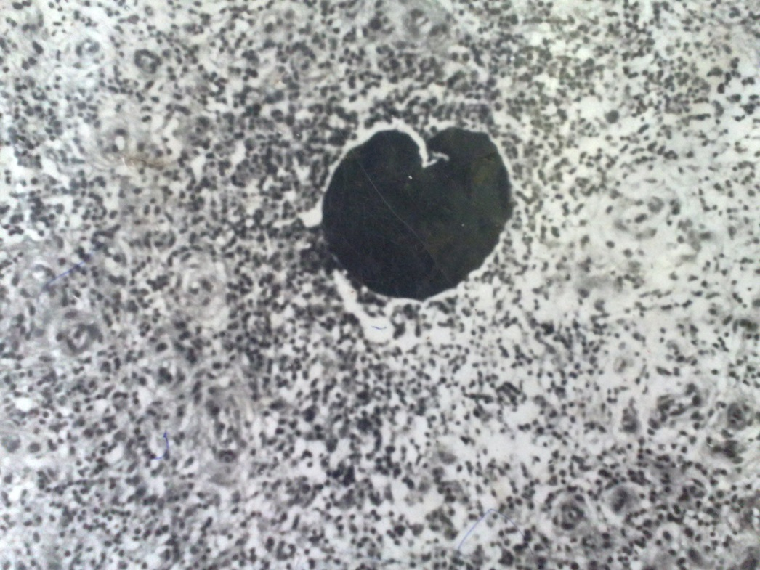
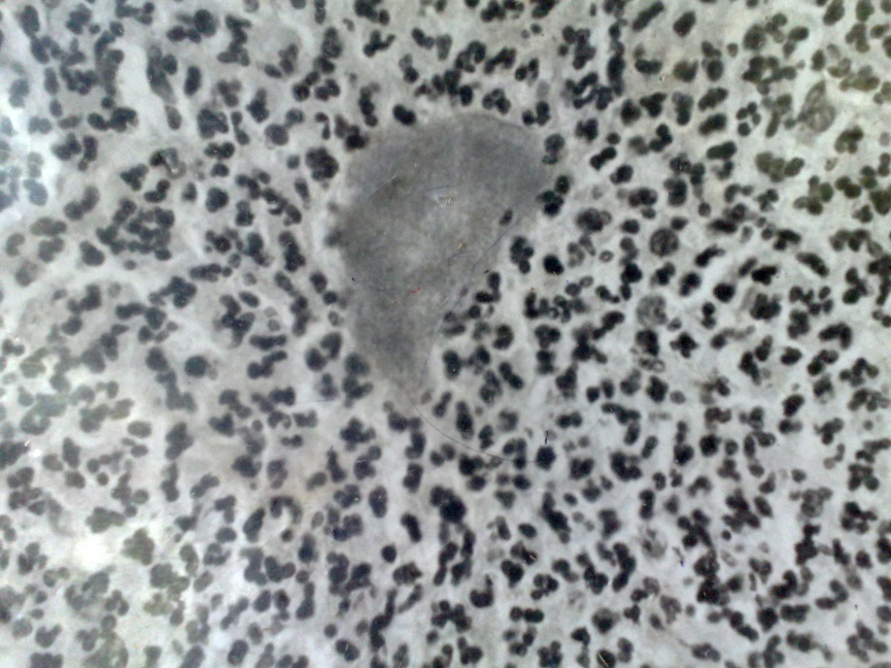
S. pelletieri
S. madurae
Nocardia Asteroides
Nocardia

Slide 13
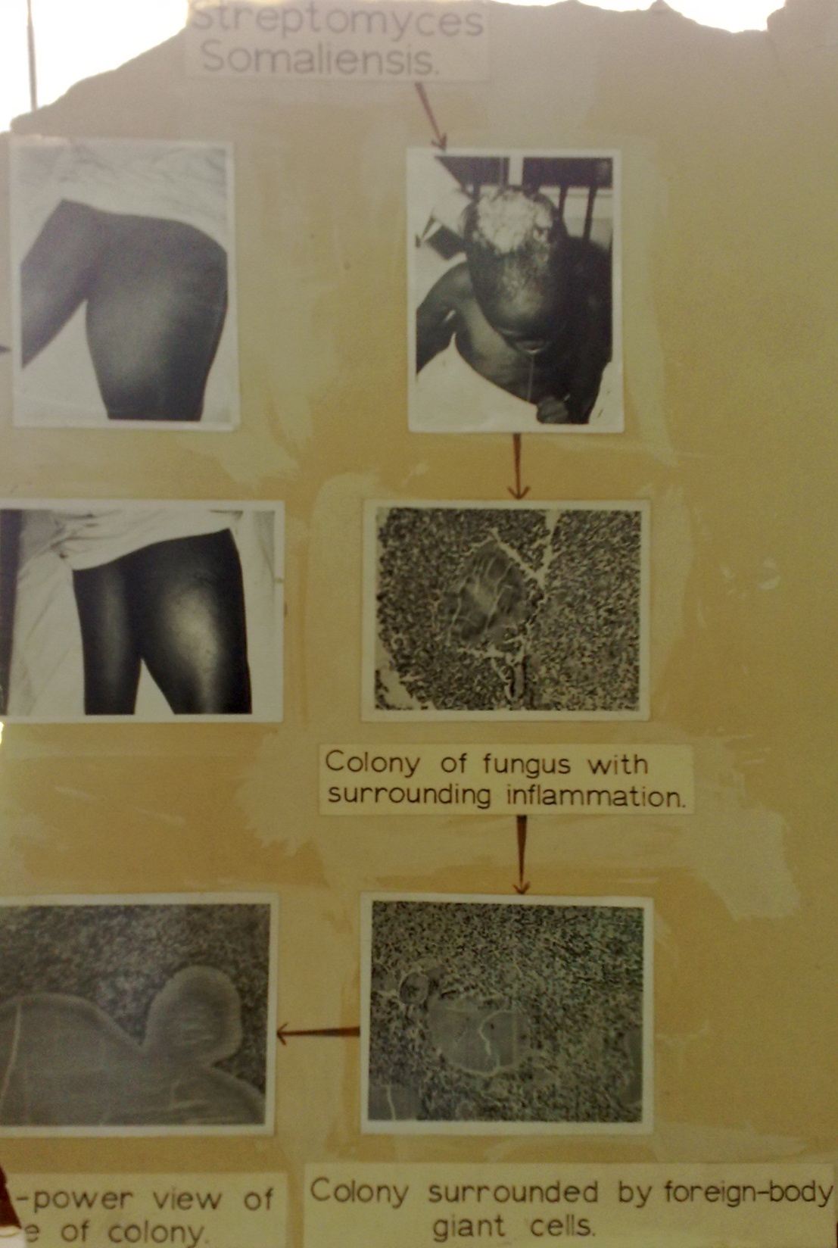
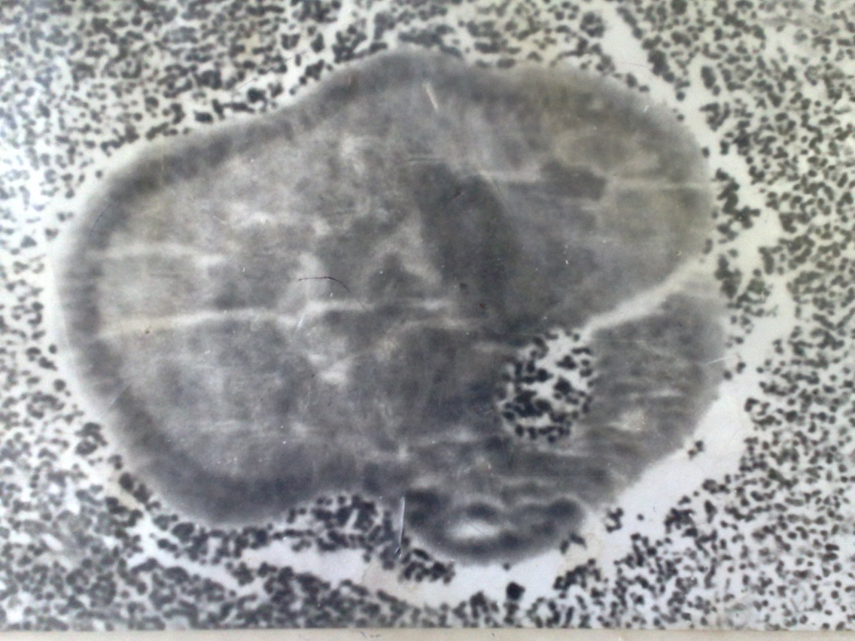
Streptomyces somaliensis

Slide 14
Mycetoma actinomycotic

Slide 15
Fungi-Mycetoma Norcardia Philophora

Slide 16
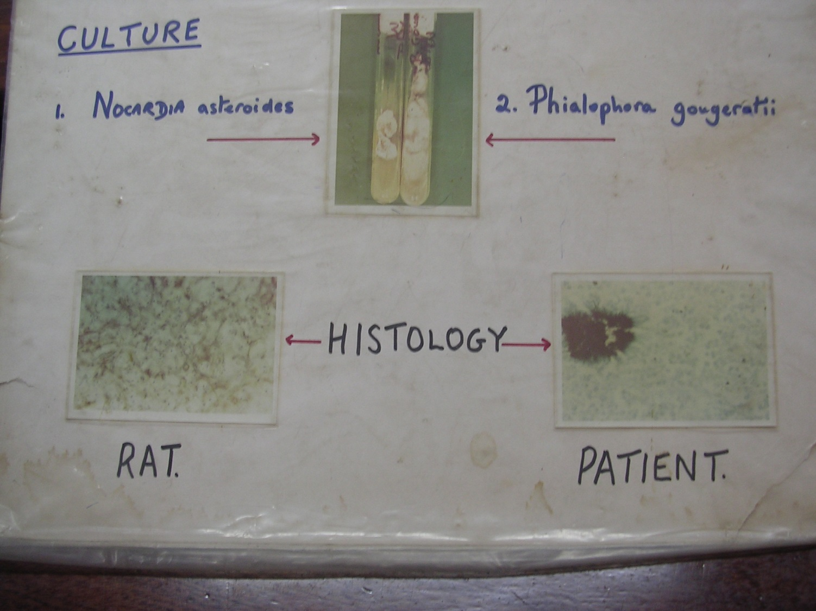

Slide 17
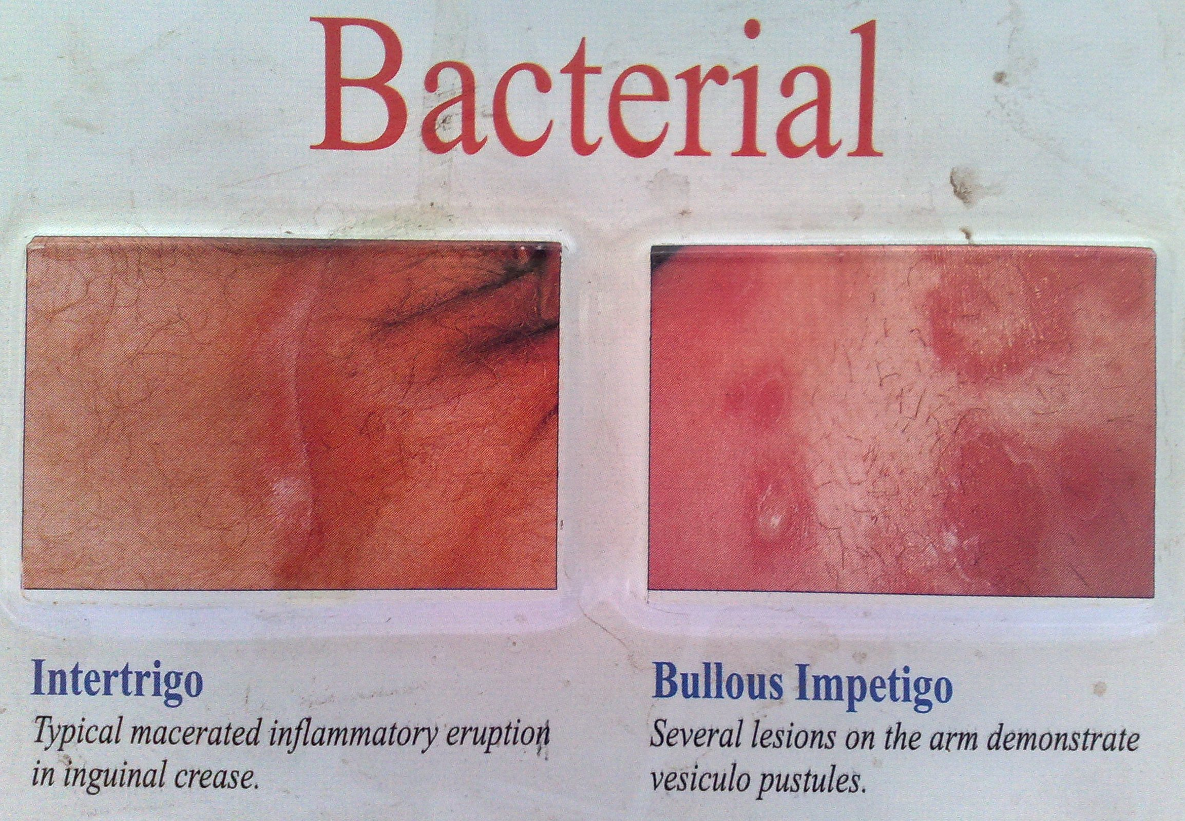

Slide 18
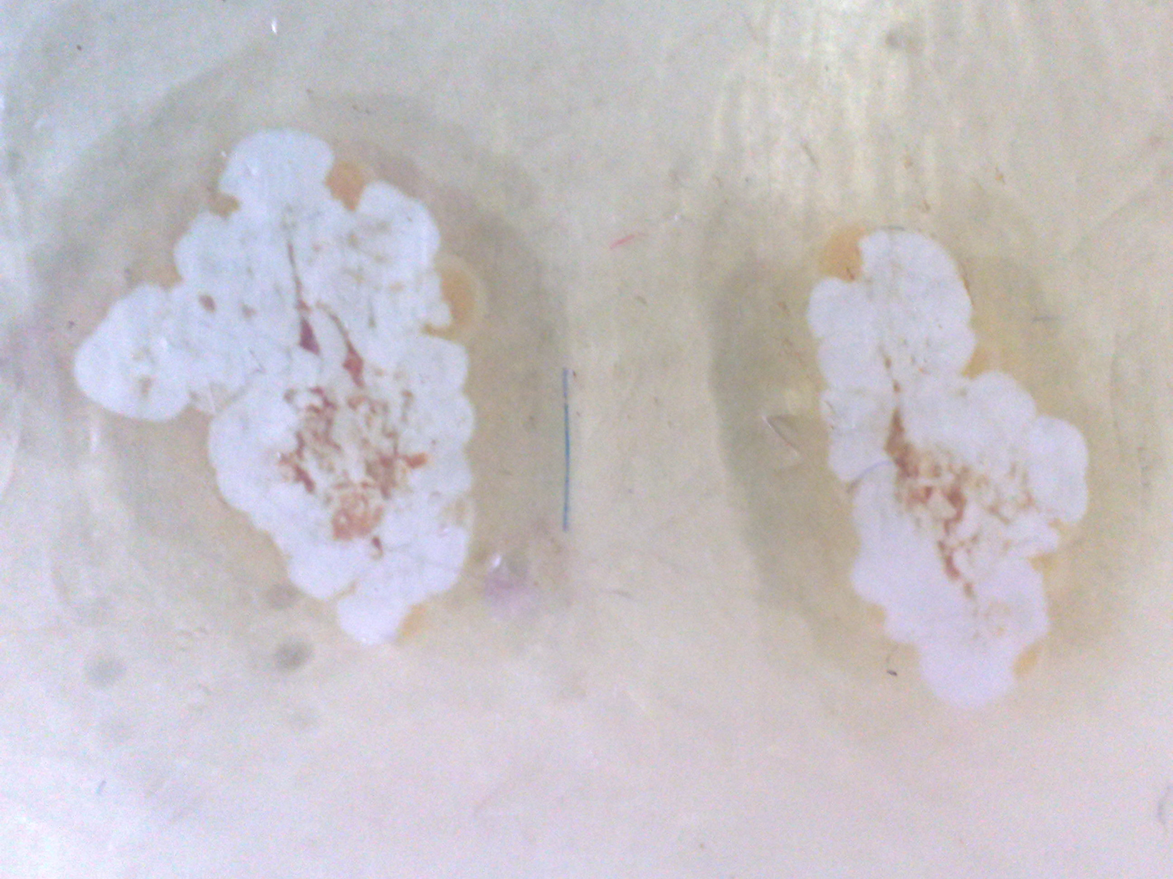

Slide 19
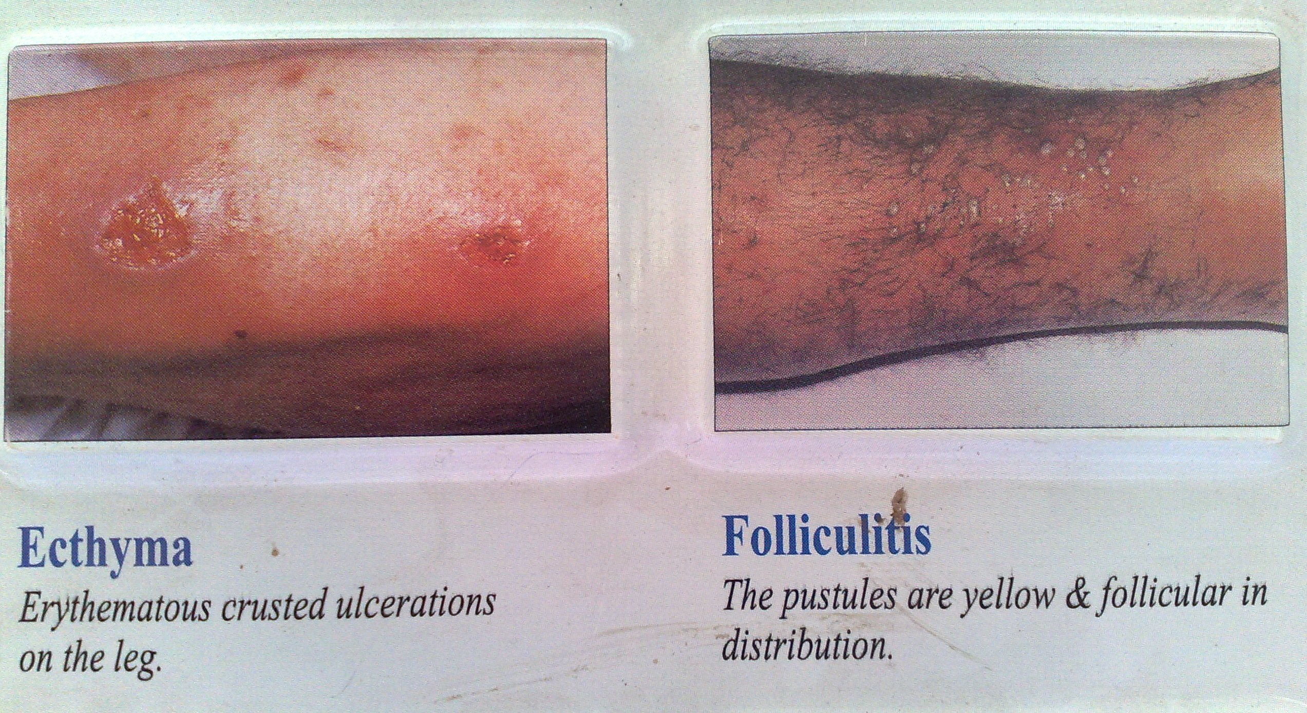

Slide 21
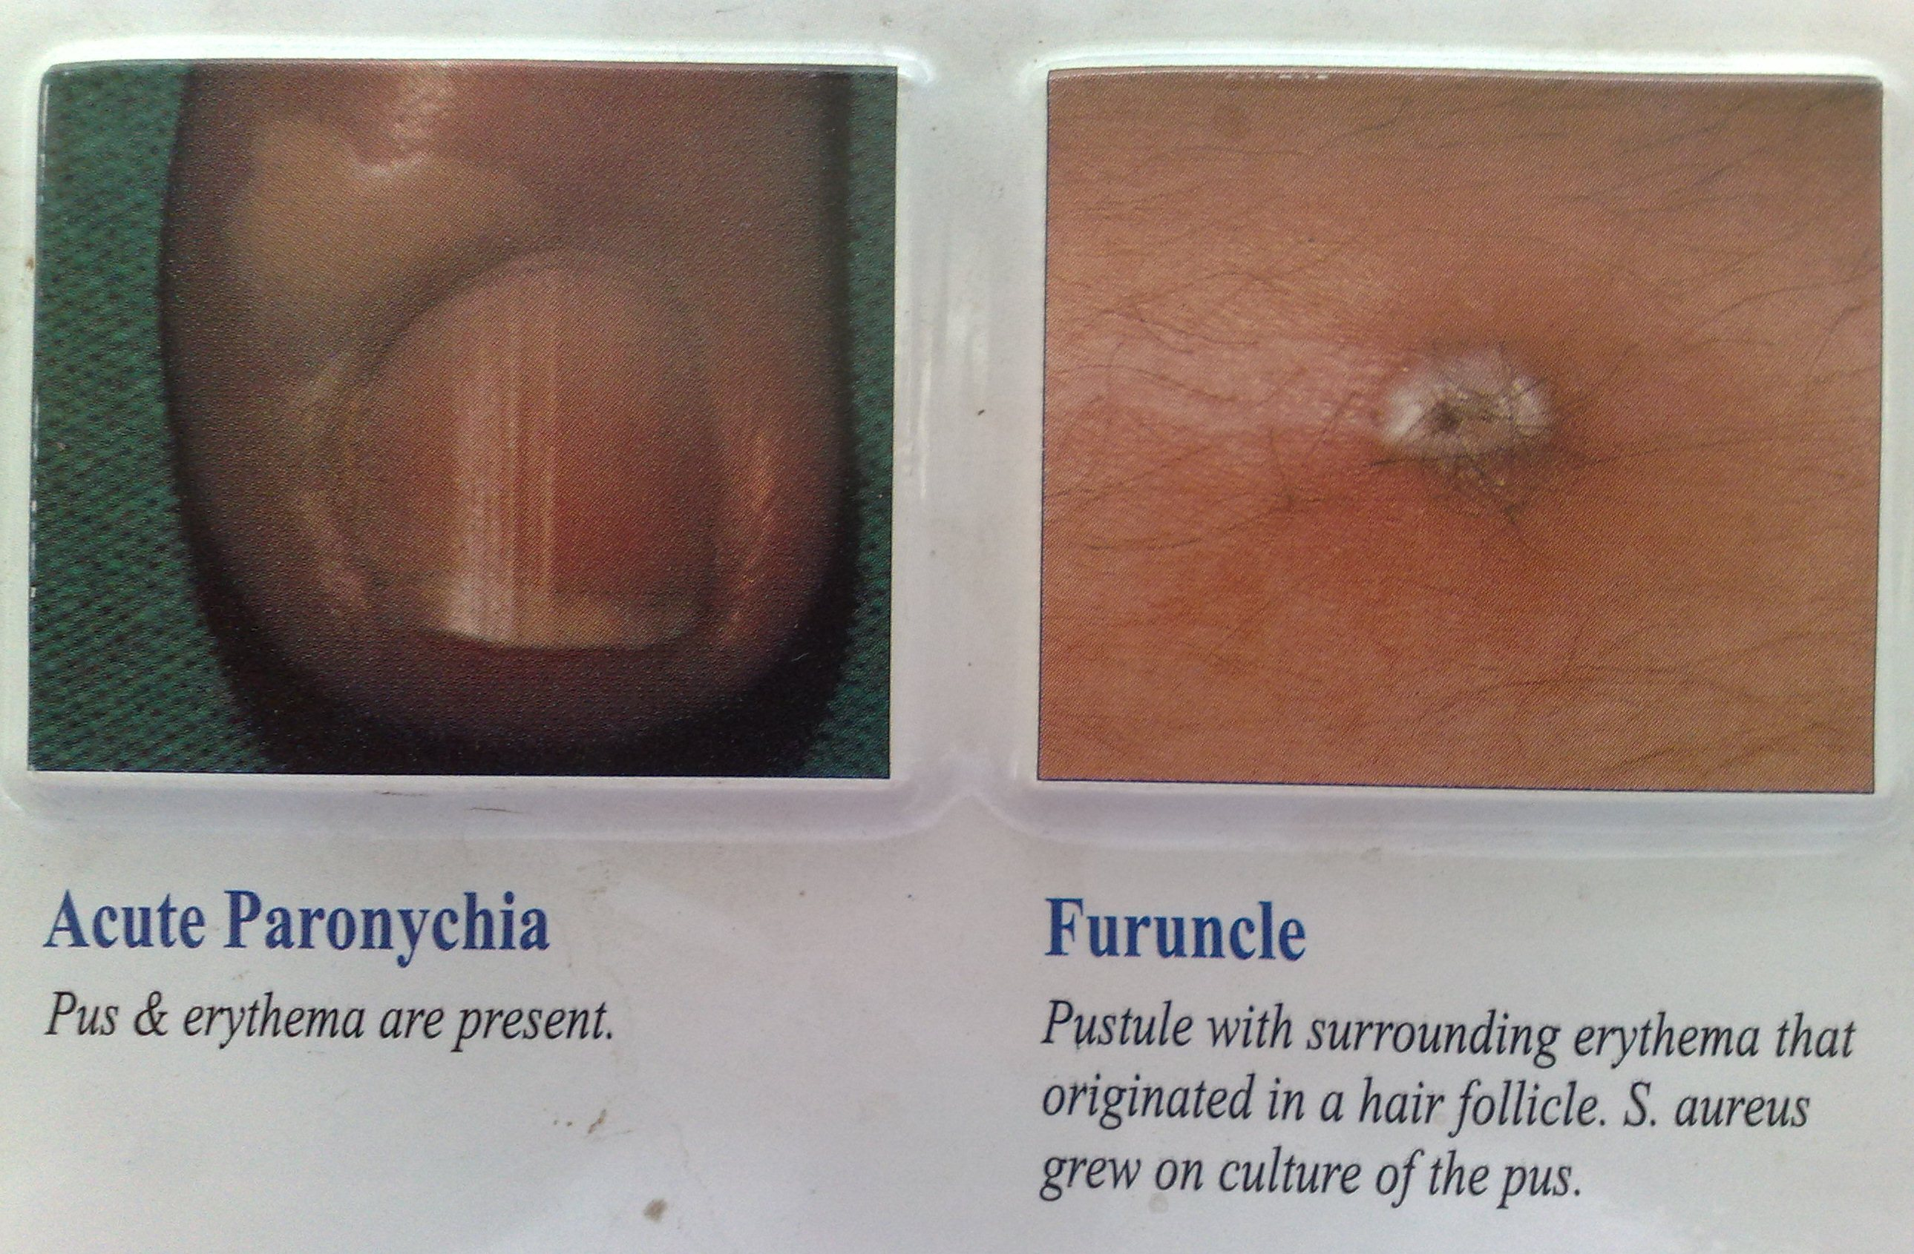

Slide 22
Lab diagnosis of mycetoma
Granules differ in color, shape, dimension and composition
Transport in distilled water or sterile normal saline
Black granules usually fungal
Smalle red granules – Streptomyces
Whitish yellow granules either bacterial or fungal
KOH of granules- presence or absence of hyphae
Histological stains of biopsy from sinus tract

Slide 23
Treatment
Surgical
Eumycetoma- Itraconazole, Ketoconazole
Actinomycetoma- Streptomycin +/- Dapsone, Cotrimoxazole

Slide 24
Phycomycosis
Subcutaneous phycomycosis
Traumatic implantation of saprophytes into subcutaneous tissues
Basidiobolus haptosporus
Usually in children < 10 yrs and adults.
Usually lower ½ of body – gluteal region, thigh > 1 site
Subcutaneous nodules that enlarges with time, painless, stretched skin, smooth, shiny
Swelling has woody consistency
Ulcerated only on trauma

Slide 25
Notes:
Fungi-Phycomycosis(Chromoblastomycosis-Resembles lymphatic filariasis in lymphatic obstruction)

Slide 27
Rhinophycomycosis
Slow progressing infection of subcutaneous tisssues or paranasal sinuses
Causative agent- Conidiobolus coronatus
Saprophyte in soil humus and decomposing plant matter
Inhalation of spore or implantation of spores into nasal cavities by fingernails
Older age group

Slide 28
Affects the nasal mucosa of the turbinates and spreads to the subcutaneous tissues of the face and neck – facial deformities with large nose
Painless, hard swelling
+/- nasal obstruction, +/- epistaxis
Pain on secondary bacterial infections.
Treatment- Itraconazole, Ketoconazole, fluconazole, amphotericin B, Potassium iodide

Slide 29
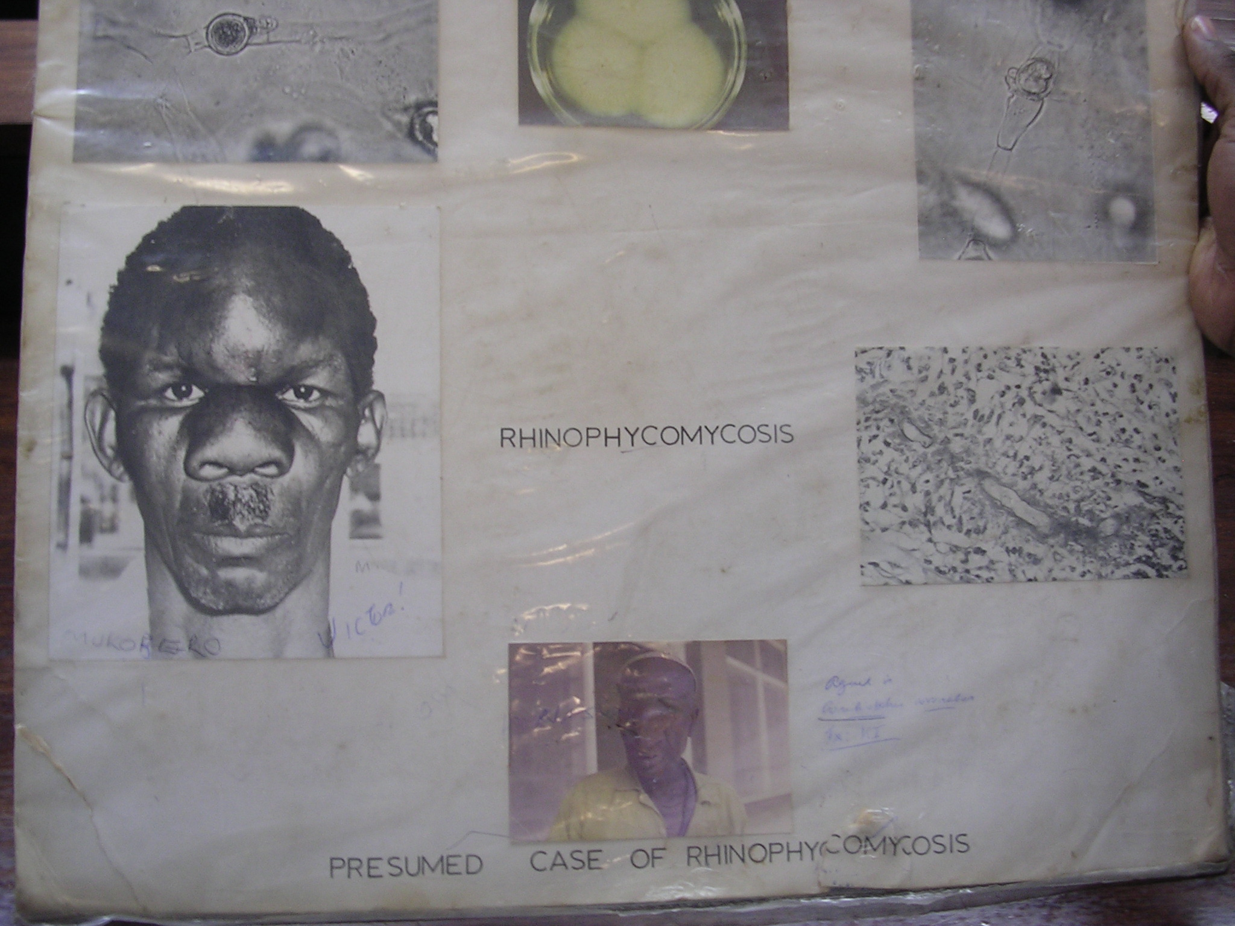

Slide 30
Chromoblastomycosis
Synonyms – chromomycosis or verrucous dermatitis
Cutaneous and subcutaneous tissues
Caused by
Fonsecaea pedrosoi
Fonsecaea compacta
Phialophora verrucosa
Cladophialophora carrionii
Deratiaceous fungi (darkly pigmented)

Slide 31
Soil inhabiting fungi enters hand or feet after trauma
Unilateral swelling on one site of lower limb which can be
One swelling with nodules around it
Scaly lesion
Ulcerated lesion
Thickened skin.
Secondary bacterial infection causes pus production
Recurrent infections results in fibrosis with scar formation causing lymphatic obstruction (resembles elephantiasis)

Slide 32
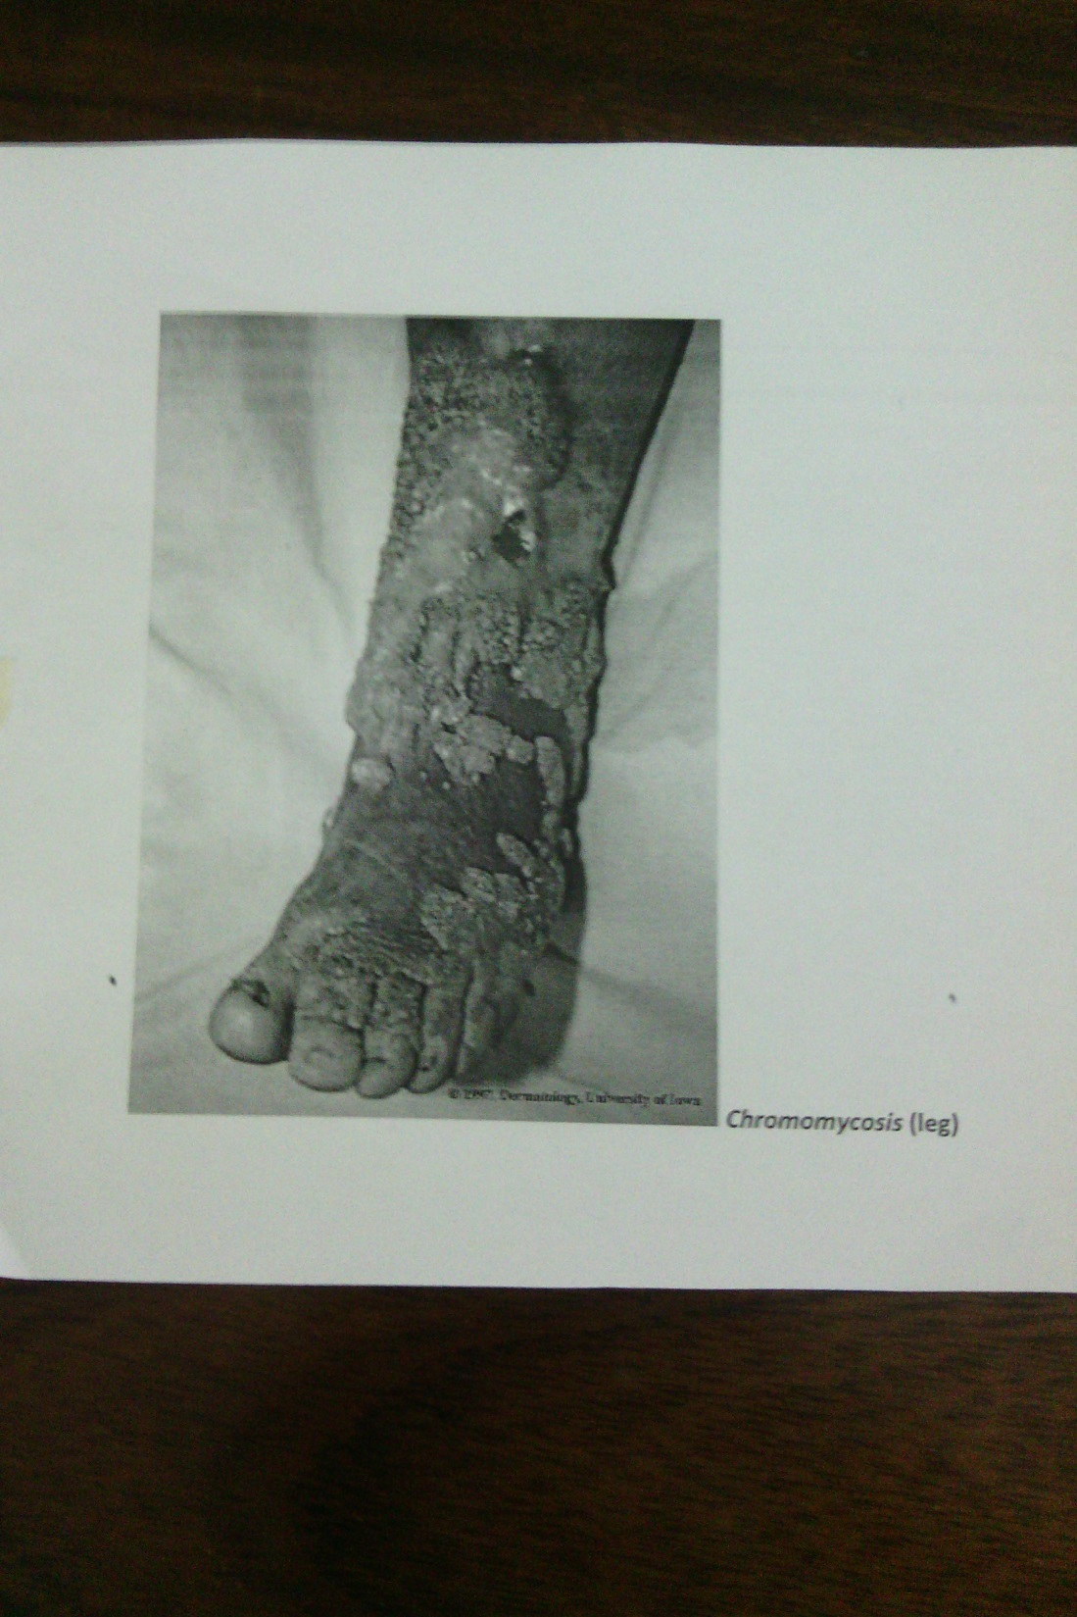

Slide 33
Lab diagnosis
Large spherical clumped cells attached to one another
Cells are dark brown in tissues – sclerotic cells
Attempt to culture the fungus from biopsy tissue must always take place to identify the etiological or causal agent
Colonies of fungi are dark or blackish

Slide 34
Cladosporium

Slide 35
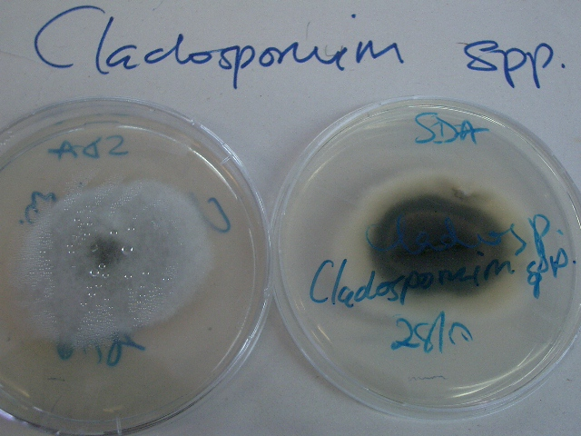

Slide 36
Treatment
Surgery
Heat therapy and/ or crytherapy
Antifungal agents- Usually resistant, Use terbinafine, Itraconazole

Slide 37
SPOROTRICHOSIS
Caused by the thermally dimorphic fungus Sporothrix schenckii
25˚C – mold, 37°C – yeast
Saprophytic fungus – decaying vegetation, soil, thorns
Occupational hazard – florists, agricultural workers
Also known as 'Rose thorn disease'

Slide 38
Acquired through direct inoculation into the skin and rarely via inhalation of conidia
Formation of initial chancre then subcutaneous nodules appear followed by ascending lymphangitis. Nodules ulcerate
Lymphocutaneous lesions on hand and forearm- Skin lesions characteristically follow lymphatic pathways
Can disseminated to face and joints
Rx;
Cutaneous – potassium iodine, terbinafine; disseminated – amphotericin B; intraconizole – cutenous and disseminated

Slide 39
S. schenckii- Mould Form- Hyphae with rosettes and sleeves of conidia
S. schenckii- Yeast Form- Cigar Shaped

Slide 42
Lobomycosis
Caused by Lacazai loboi previously called Loboa loboi
Manifests as keloids, verrucoid to nodular lesions, crusty plaques and tumors
Diagnosis
Skin biopsy
Histological stains
Treatment
Surgery for smal lesions
Cryotherapy

Slide 44
Rhinosporidiosis
Polypoid masses of nasal mucosa, conjunctiva, genitalia and rectum
Causative agent – Rhinosporidium seeberi
Found around lakes and oceans
Painless
Interferes with breathing – nasal.

Slide 45
Lab diagnosis
Specimens – pus, exudates, lesion scrapings, granules
Transport in distilled water or sterile normal saline
Granules – wash then crush to process. Color of grain can suggest possible organism
Direct KOH – presence or absence of hyphae, sclerotic cells
Gram stain – actinomycetes
Histopathology stains
Culture – isolation and identifications
Proper handling to avoid contamination

Slide 46
Treatment
Supportive – secondary infections, pain, e.t.c
Surgery for some lesions e.g for mycetoma, amputation is most effective
Antifungal agents – amphotericin B, intraconazole, flucytosine, other azoles – may have slow or no response
Antibacterials agents in actinomycetoma and in secondary bacterial infections – sulphonamides, rifampicin, streptomycin, amikacin e.t.c.

