Slide 1
SYSTEMIC MYCOSES
KIMAIGA H.O
MBChB (University of Nairobi)

Slide 2
Systemic Mycoses
Fungal infections or diseases which involve the internal organs
Two distinct categories
Infections caused by the true pathogenic fungi
Infections due to opportunistic fungi

Slide 3
TRUE PATHOGENIC FUNGI
Genus | Species | Clinical conditions
Histoplasma | Histoplasma capsulatum | Histoplasmosis
Coccidiodies | Coccidioides immitis | coccidiodimycosis
Blastomyces | Blastomyces dermatitidis | blastomycoses
Paracoccidioides | Paracoccidioides braziliensis | paracoccidiomycosis

Slide 4
Causes infections in immunocompetent and immunocompromised humans
Majority have restricted geographical distribution mostly in parts of N & S america
Organisms exhibit dimorphism
Filamentous in saprophytic state or when grown at temperature of 25°C
Budding yeast in the parasitic state – in tissues or when grown at 37°C
Infections by the majority is acquired by inhalation of spores from the environment into the lungs causing a
Acute pulmonary infection (asymptomatic)
Chronic pulmonary infection
Disseminated infection- immunocompromised people.

Slide 5
Histoplasmosis
Causative agents – histoplasma capsulatum
2 varieties
A. Histoplasma capsulatum capsulatum
A saprophyte which grows in the soil – is found in birds' and bats' droppings
Spelunking (cave exploration)disease or cleaning chicken coops especially chicken farmers
A disease which affects people in all parts of the world – most highly in some parts of America.
Primary infection – remains asymptomatic in the majority or manifests with non specific mild symptoms – flu-like

Slide 6
Minority develop the classical illness with variation in severity and manifestations – as chronic pulmonary disease characterized by progressive cavity formation to disseminated disease
Reactivation of the asymptomatic infections may or may not occur after several years
Opportunistic histoplasmosis occurs rarely
A disseminated disease with multiple organ involvement – enlarged liver, spleen with or without anaemia
The organism is demonstrated in infected parts as an intracellular parasite of RES within phagocytic cells

Slide 7
B. Histoplasma capsulatum duboisii
Causative agent of African histoplasmosis
Encountered in some countries in Central parts of Africa
Clinical manifestation include ulcerative lesions and swellings which involve the:
Skin, subcutaneous tissues and bones
Lungs are not commonly involved
Source and the route of not clearly defined

Slide 8
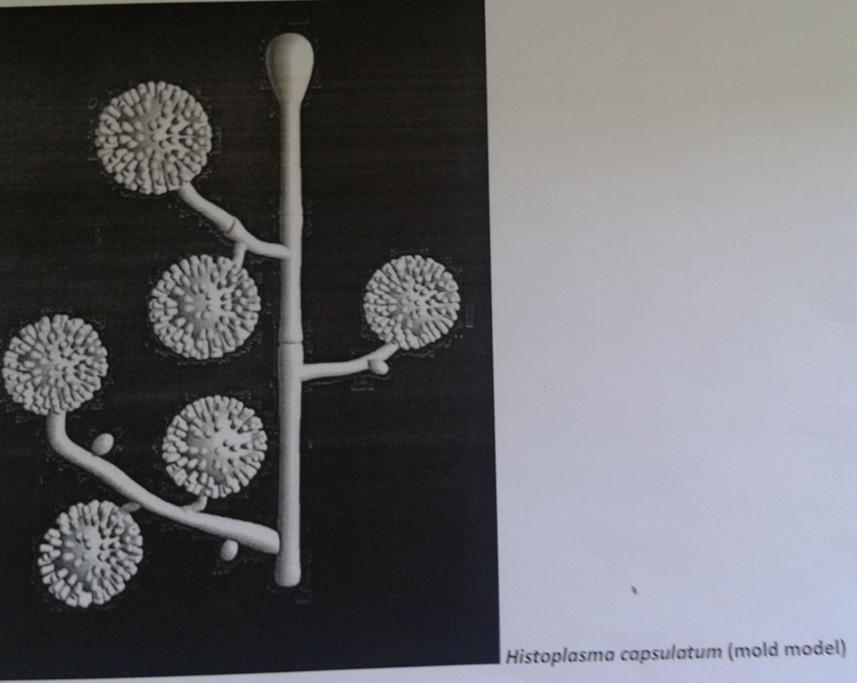
Hyphae with micronidia and tuberculate macronidia

Slide 10
Small intracellular yeasts with narrow neck on bud, no capsule
Can get 30 or more Histoplasma cells in 1 hman cell,cog wheel

Slide 11
Coccidioidomycosis
Coccidioides immitis
Desert valley fever
Arthroconidia breaks from hyphae and is found in desert sand
Spores are inhaled – primary infections in the lungs
Spores develop into large structures in body temperature– spherules – each spherule contains spores
Spherules is the yeast form
Can be asymptomatic or mild illness – mild pneumonia – or severe illness in the minority associated with cavity formation in the lungs
Dissemination occurs rarely - a military disease – Involves skin, meninges, bones, joints, subcutaneous tissue, i.e extra-pulmonary disease

Slide 12
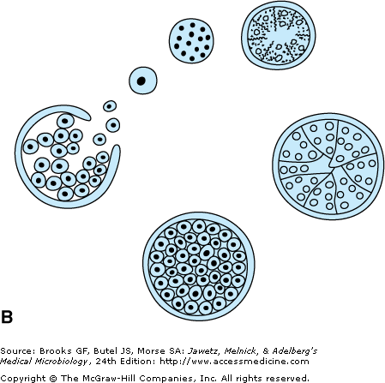
Spherule formation with endospores

Slide 14
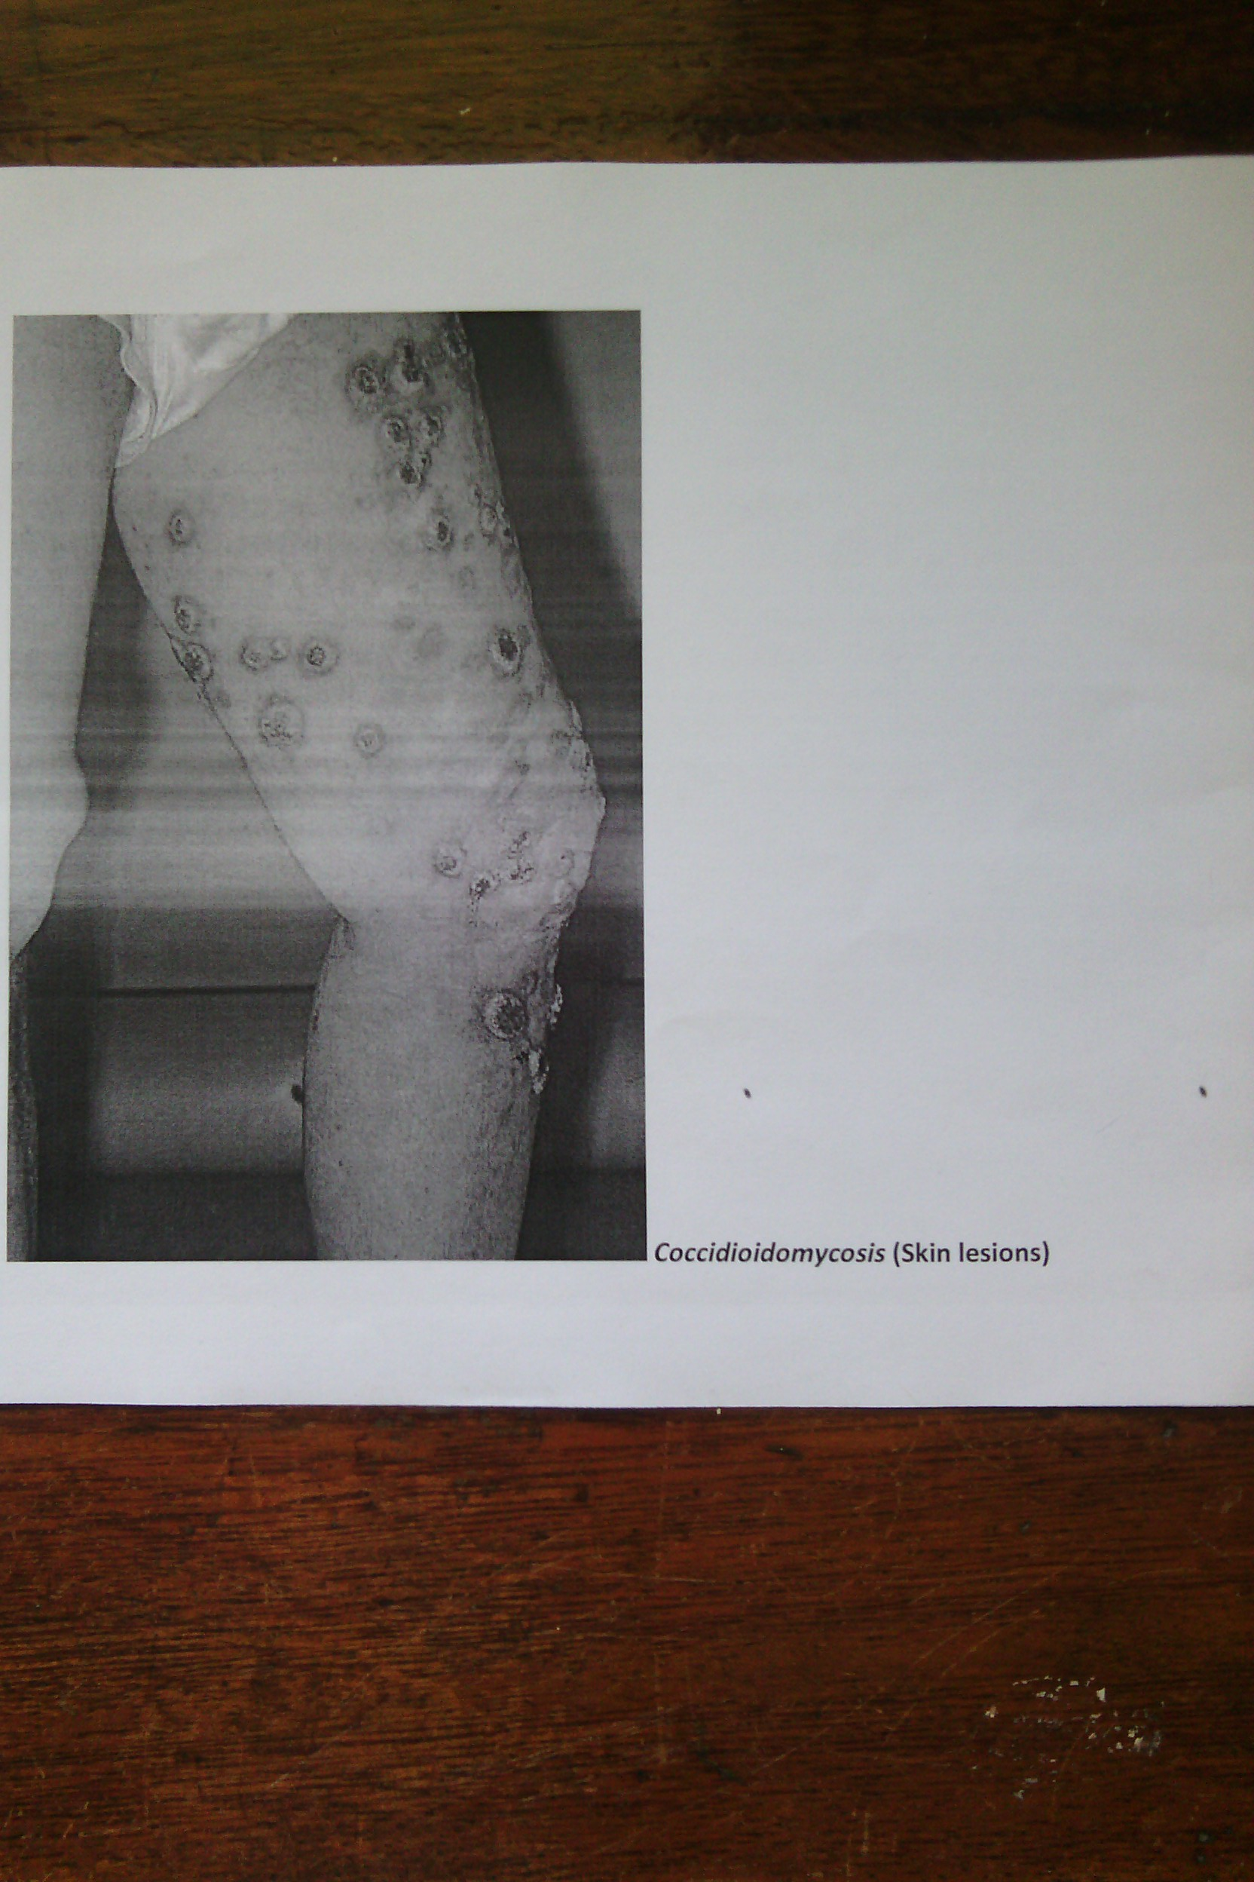

Slide 15
Blastomycosis (South American blastomycosis)
Blastomyces dermatitis
Endemic in parts of North America – also detected in parts of Asia and Africa
Infection can – be asymptomatic
Manifest as primary pulmonary disease
Disseminate to the skin producing chronic swellings or ulceration on exposed parts
Local spread – to bones & possibly internal organs
Fungus observed in infected tissues as yeast cells - each cell produces a single bud

Slide 16
Mneumonic- Blastomyces B’S
Broad based budding yeasts

Slide 18
Paracoccidioidomycosis (South American blastomycosis)
Infection is possibly acquired by inhalation or by direct implantation on the oral or nasal mucous membranes
Spreads via lymphatic and hemotogenous routes
Manifestation include ulceration of the mouth and nose with extension to local lymph nodes
Recognized in infected tissues as large yeast cells with multiple budding

Slide 19
LAB DIAGNOSIS OF PATHOGENIC SYSTEMIC MYCOSES
Higher risk specimens therefore examined in labs with proper equipments and other necessary facilities
Examination of specimens – sputum, discharges, skin scrapings, pus, infected tissue, blood for serology
Demonstration of the yeast form of causative fungus – by direct microscopy or staining and microscopy

Slide 20
Culture – on Sabouraud's medium for isolation and identifications – demonstration of dimorphism
Serological tests in - classical histoplasmosis, coccidioidomycosis and paracoccidioidomycosis
Associated with difficulties in interpretation of results
The significance of antibody levels in differentiation of the illness and past exposure

Slide 21
INFECTIONS DUE TO OPPORTUNISTIC FUNGI
Causative organisms are of low virulence
Disease production depends on diminished host resistance to infections
Genera examples
Candida- Candidiasis
Cryptococcus - Cryptococcosis
Aspergillus- Aspergillosis
Other
Penicillin - Penicilliosis
Pneumocystis jirovecii
Species of penicillium
Mucor, Rhizopus, Absidia (Zygomycophyta)

Slide 22
Candida
Small ovoid cells that reproduce by budding
Thin walled dimorphic fungus
Unicellular yeast- sexual form (harmless)
Filamentous – asexual form (pathogenic)
Can form hyphae in poorly aerated media, body
Cell wall – polysaccharide, mannan, glucan & chitin, alone or complexed with proteins
Fibrillar outer layer (mannan, mannoprotein)

Slide 23
Over 150 spp. 9 commonly pathogenic to humans
C. albicans – most common
C. glabrata, C. tropicalis, C. pseudotropicalis, C. krusei, C. parapsilosis, C. dubliniensis, C. lusitaniae, C. gluilliermondii,

Slide 24
Epidemiology
All of the above yeasts are considered to be normal flora for humans
They usually inhabit oral, intestinal, and urogenital mucous membranes
In healthy individuals, candida infections are usually due to impaired epithelial barrier functions, remain superficial and respond to rx
Systemic candidiasis is usually seen in pts with cell mediated immune deficiency, and those receiving aggressive cancer rx, immunosuppressives, or transplantation therapy.

Slide 25
Predisposing factors
Broad spectrum antibiotics – suppress normal bacterial flora – proliferation
Chemotherapy
IV catheters/ prosthetic implants/ GI tract surgery – provide route of entry
Immunosuppressive conditions – HIV, steroids, pregnancy e.t.c
Diabetes, oral contraceptives and oestrogen therapy

Slide 26
Virulense factors and pathogenesis
Colonization of mucosa e.g female genital tract
Surface molecules for adhesion to the mucosal cells:
Mannoproteins in outer fibrillar layers – adhesins
Fibronectin and other components of extracellular matrix – receptors to mediate binding
Ability to convert to hyphal forms
Associated with adherence and invasion – less virulent spp do not form hyphae
May be involved in the penetration of mucosal barriers and aids spread,

Slide 27
Capacity to form strong attachments to epithelial cells
Hyphal wall protein (Hwp1) – Found on surface of germ tubes and hyphae mediates binding
Mannoproteins mediate binding to components of extracellular matrix(fibronectin, collagen, laminin)
Extracellular enzymes – proteases, elastases, phospholipases (secreted by hyphae)
Digest epithelial cells – facilitate invasiveness
Aspartic proteinases-digest keratin and collagen enabling invasion of deep tissue
Phenotypic switching

Slide 28
Hyphae have surface proteins that resemble complement receptors on phagocytes- confuse ability of phagocytes to recognise C3b bound to candida surface
Up regulation of receptors in conditions such as elevated glucose concentration hence resistance to phagocytes

Slide 29
Colonization is 1st step in development of infections
Kept under control by bacterial normal flora e.g lactobacilli
Broad spectrum antibiotics
Vaginal antiseptics and douching.
Shift of C. albicans from yeast form to hyphal form associated with pathogenecity

Slide 30
Appearance of virulence factors associated with adherence and invasion – less virulent spp do not form hyphae
Hyphae may be involved in the penetration of mucosal barriers and aids spread,
Extracellular enzymes – proteases, elestases digest epithelial cells – facilitate invasiveness
Phenotypic switching

Slide 31
Clinical manifestations
Mucocutaneous infection
Oropharyngeal candidiasis
Infants, elderly, immunocompromised most commonly
Perleche, Oral thrush
A common early presentation in AIDS
5 types
Acute pseudomembranous candidiasis
Acute atrophic oral candidiasis
Chronic erythematous candidiasis
Chronic nodular candidiasis
Chronic plaque like candidiasis/oral leukiplakia-MA LINES
May progress to oral carcinoma

Slide 33
Cutaneous infections
Skin – axilla, groin, vulva, glans penis, inflammatory folds, around umbilicus
Napkin area in infants (diaper rash)
Interdigital clefts, nails, skin folds around nails – hands and feet frequently in water.
Systemic Infections
Neutropenia is a predisposing factor
Endocarditis
Urinary tract infections
Disseminated infections
GIT, pulmonary, carditis, meningitis, ocular, osteoarticular, candidemia, or disseminated candidiasis.

Slide 34
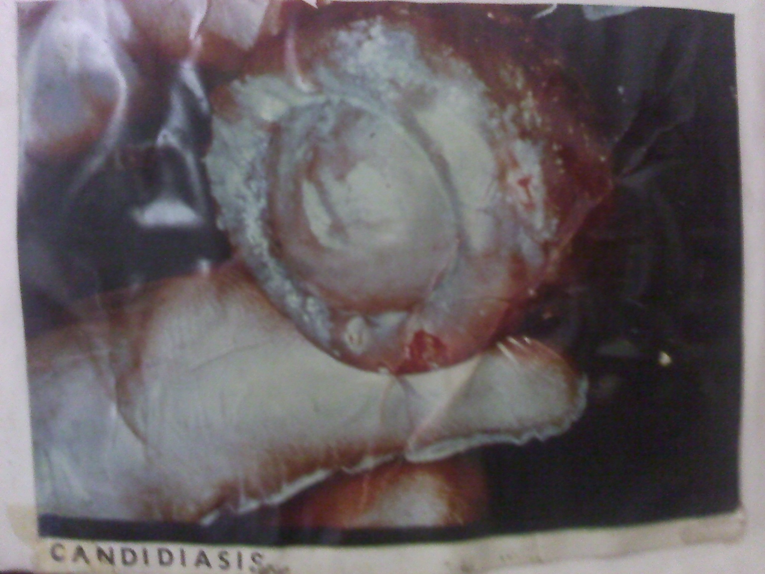

Slide 35
Vaginal candidiasis
Normally C.albicans, also non-albicans species
Usually no underlying abnormality
No ↑ in frequency in severely immunocompromised females, but patients with AIDS have persistent infections
Common - pregnancy, diabetes
Acute (pseudomembranous or erythematous) form more common
Chronic relapsing or persistent form
Secondary vaginal candidiasis - in underlying mucosal disease

Slide 36
Chronic mucocutaneous candidiasis (CMC)
In patients with T-lymphocyte immunodeficiencies – chronic, relapsing
In childhood or infancy - oral, nail & cutaneous candidiasis which recur despite treatment
Oral-chronic pseudomembranous or plaque types
Skin- crusted plaques
Nail plates, folds & periungual skin damaged
Defects unknown

Slide 37
Lab diagnosis of candida
Specimen – exudates or epithelial scrapping, aspirates, biopsy, blood.
Microscopic examination
KOH and/or gram stain of exudates and tissue – budding yeast and pseudohyphae
Culture
On Sabouraud Dextrose Agar
37⁰C , 12-24 hrs
White colonies with a yeast smell.
Germ tube tests (+ve) .Presumptive diagnosis of C. albicans. Form germ tubes at 37⁰C
Multiple samples may be necessary for proper interpretation of results
Freshly collected specimens are more useful especially where quantitative cultures are required for confirmation of the diagnosis

Slide 38
Blood cultures
For detection of candidaemia and endocarditis
Species identification;
Carbohydrate assimilation and fermentation e.g API (analytical profile index) system
Pseudohyphea & chlamydospore production in nutritionally poor media e.g cornmeal agar
Chrom Agar - Media gives different color changes for different fungal species → C.albicans - green, C.tropicalis - blue, C.gatata - pink e.t.c
PCR
Susceptibility testing

Slide 39
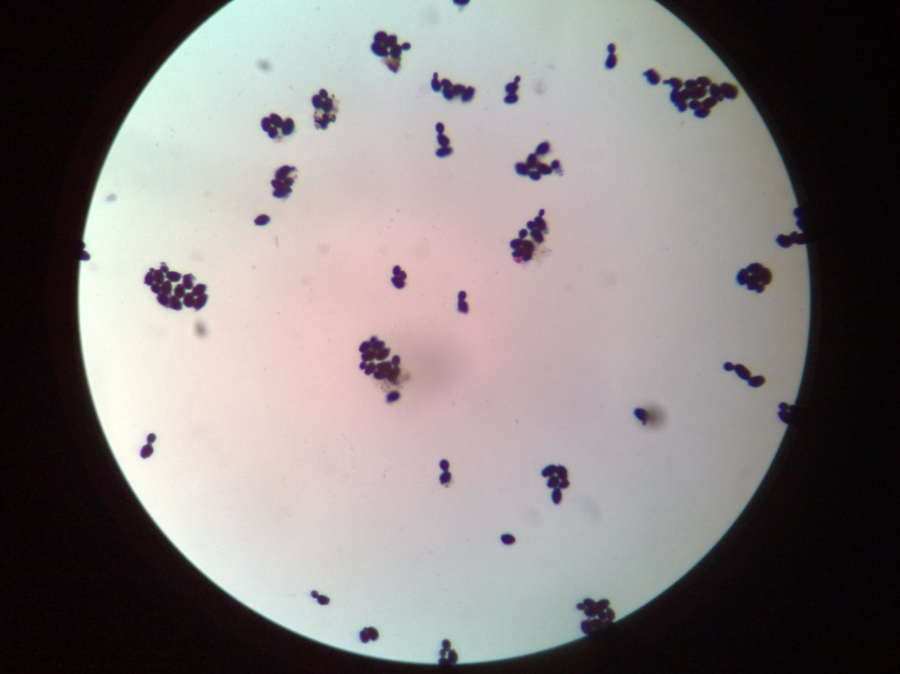
C.albicans G.stain

Slide 40
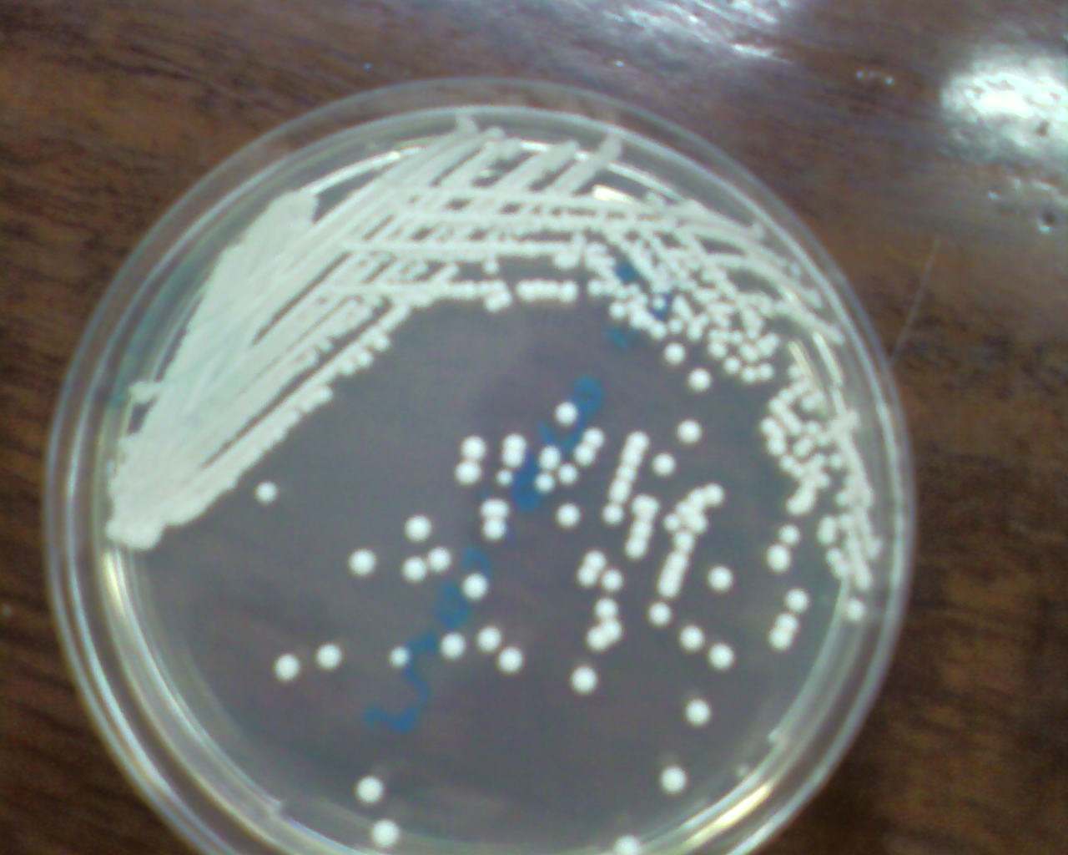
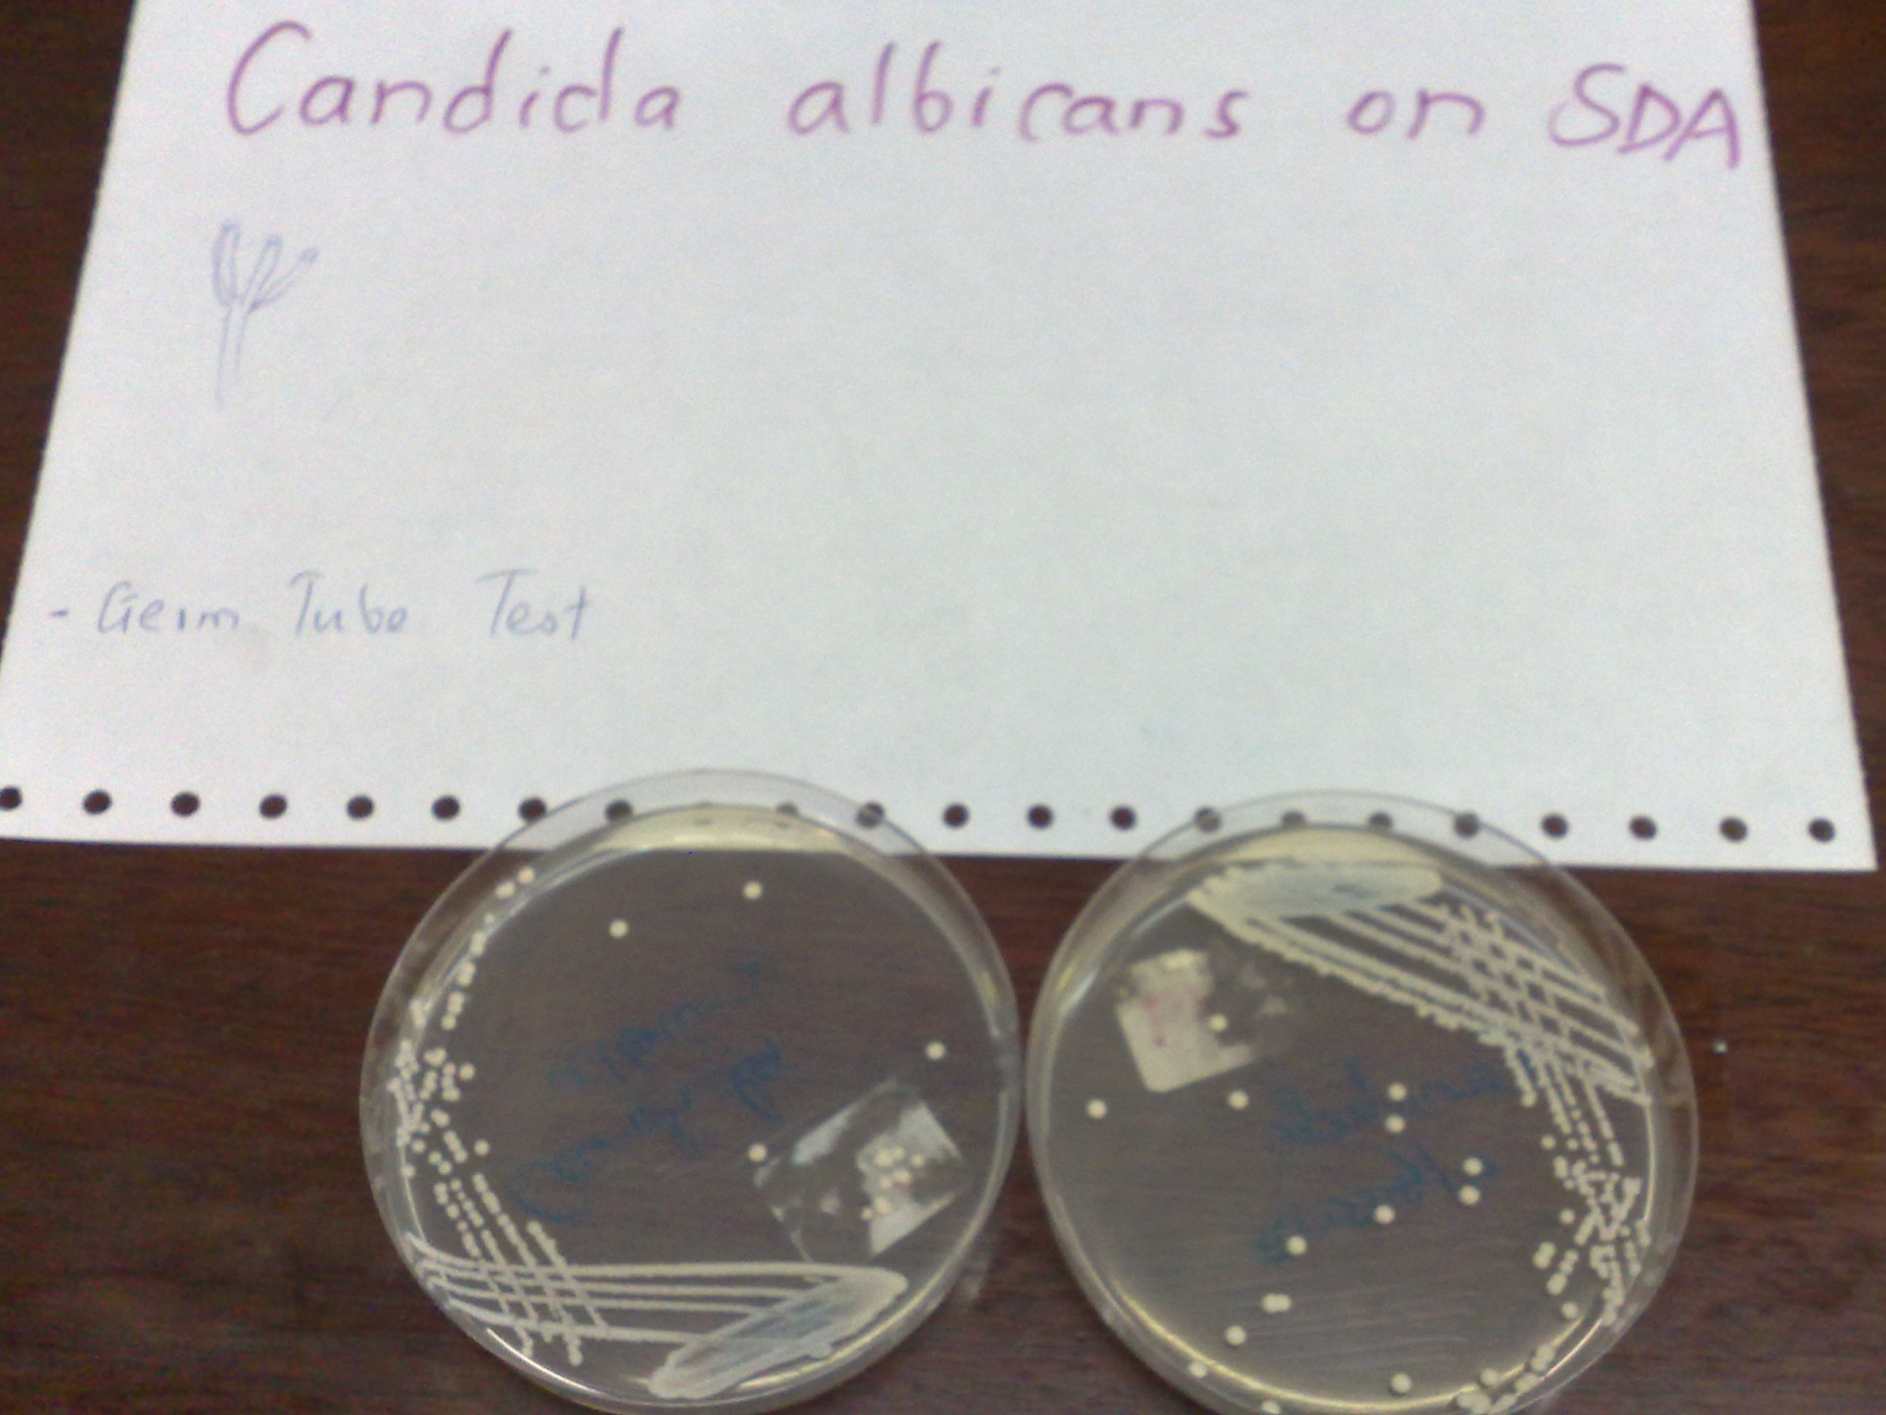
Candida albicans on SDA

Slide 41
Germ tube test (candida albicans)

Slide 42
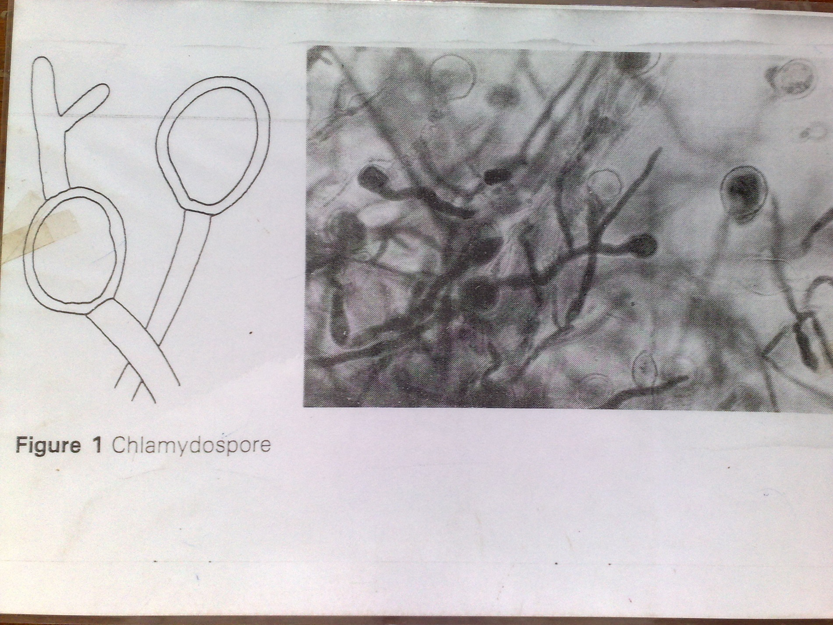

Slide 43
Treatment
Amphotericin B – Drug of choice, IV infusion
More beneficial when used in combination with 5-fluorocytosine (5-FC)
Synergistic effects
lower dose of Amphotericin B – less toxic effects
delay in development of resistance to 5-FC
Other alternatives: fluconazole, itraconazole
Relatively new antifungal agents – voriconazole, caspofungin.
Rx followed by long term suppressive therapy in AIDs pts – fluconazole
No specific preventive measures.

Slide 44
Non albican candida – less susceptible to most antifungal agents, particularly the azoles
C. kreusei – intrinsic resistance to fluconazole
C. lusitaniae – usually resistance to Amphotericin B.
Superficial – reduce moisture and chronic trauma – topical rx – nystatin or azole preparations.
Chronic mucocutaneous infections – fluconazole
Deeper infections – control of predisposing factors may resolve infections

Slide 45
Cryptococcosis
Causative agent – crytococcocus neoformans
Yeast with a polysaccharide capsule
Reproduces by budding
Round/ovoid; 4-6 um diameter
C. neoformans-major pathogenic spp
Subclassified into 4 serotypes and 2 variants
Serotypes based on capsular agglutination rxns –types A, B, C, D
A & D – worldwide; B & C – tropics and subtropics.
A-variety glubii
D-var neoformans
B+C-var gatii

Slide 46
Epidemiology
Environmental – Detected and isolated mainly from pigeon droppings and nesting places, other birds droppings and soil contaminated with the droppings
Also been cultured from eucalyptus trees
Initial infection is acquired through inhalation of dust contaminated with the yeast
Primary infection in most cases occurs in the lungs & remains sub-clinical
Tendency to flare-up after several years as a complication of other conditions particularly those that cause suppression of immunity
Manifestation – meningitis commonest
Uncommon – cutaneous, mucocutaneous, bone infections, disseminated infections

Slide 47
Pathogenesis
Transmission is by inhalation of yeast from an environmental source
Yeast is engulfed by lung macrophages and retained in them
Circulates to other body parts in the macrophages, particular attraction to CNS, where they lodge and multiply
Appear in CSF and blood
Extreme immunosuppression – can cause disease in other organs.

Slide 48
Risk factors
More common in pts with defects in T cell mediated immunity
HIV/AIDS
Post-transplantation
Prolonged corticosteroids therapy,
Hodgkin's disease
Malignancies
Sarcoidosis

Slide 49
Clinical manifestation
Pulmonary cryptococcosis – usually asymptomatic
CNS diseases-meningitis(85%) common in AIDS,meningoencephalitis,cryptococcoma
Cutaneous cryptococcosis
Bone and joint dx
Ocular cryptococcosis
Genital urinary dx-prostate

Slide 50
Lab diagnosis
Specimen – CSF, blood, sputum, biopsy of infected tissues
Procedures
Direct microscopy of CSF, homogenates of tissue mounted in India ink for yeast cells with a capsule
CSF – raised pressure, increased protein, reduced glucose, increase in WCC (increased lymphocytes)
India ink or nigrosin staining of CSF deposits.
Latex agglutination tests (cryptococcal antigen-CRA 6 test) on CSF or serum. Detection of capsular antigen
Rapid test
Detects polysaccharide capsular antigen

Slide 51
Culture of CSF or other specimens on suboraud dextrose agar (SDA) for isolation and identification tests, 37⁰C, in air, may require. 48Hrs – soft, creamy, mucoid, brown colonies
Selective media – Birdseed agar – melanin production (brown colonies)
Gram stain: gram positive yeast cells
Biochemical tests:
Urease test positive
CHO assimilation and fermentations tests e.g API

Slide 52
C. neoformans - Gram positive

Slide 53
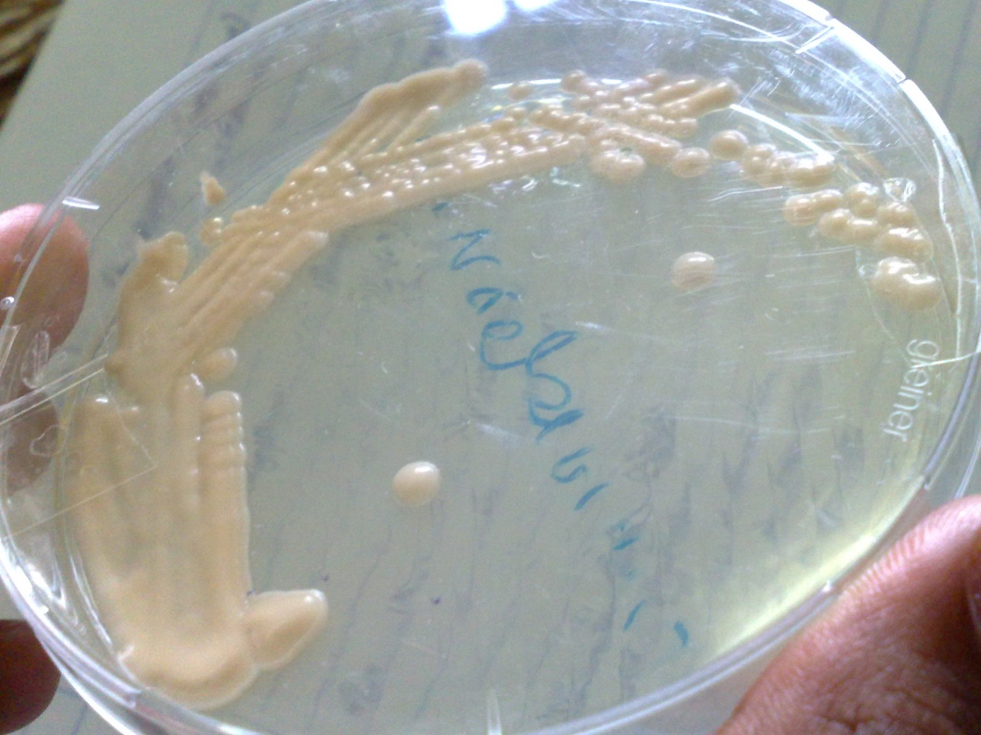
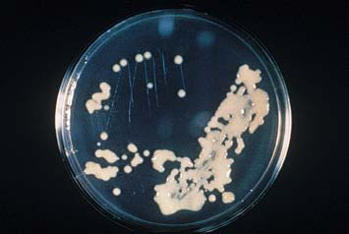
Cryptococcus neoforman on SDA

Slide 54
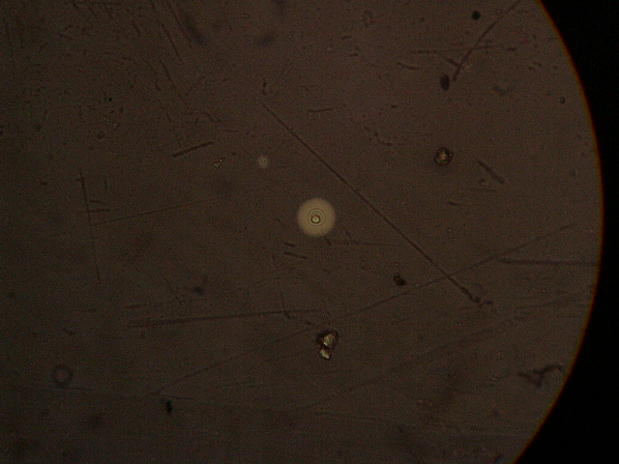
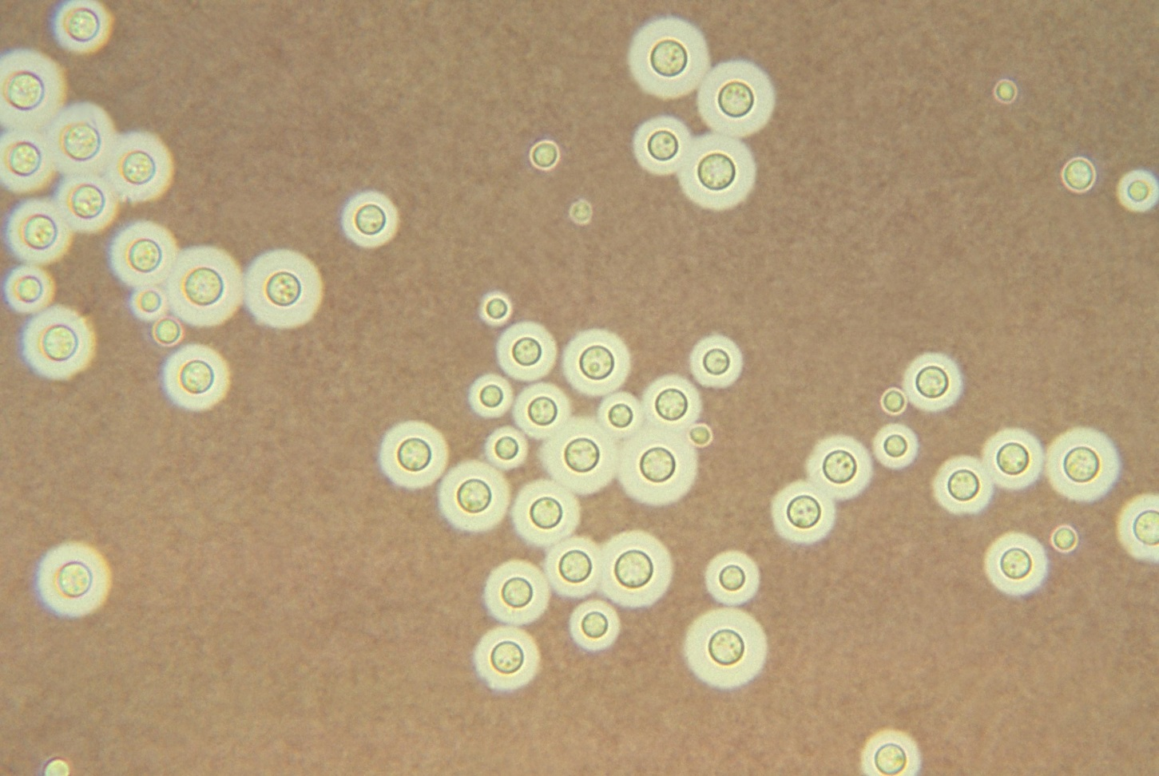
Cryptococcus neoforman- Yeast with capsule
Cryptococcus neoformans using a light India ink staining preparation

Slide 55
Treatment
Amphotericin B – Drug of choice, IV infusion
More beneficial when used in combination with 5-fluorocytosine (5-FC)
Synergistic effects
Lower dose of Amphotericin B – less toxic effects
Delay in development of resistance to 5-FC
After patient is afebrile and culture negative use fluconazole.

Slide 56
Aspergillosis
A group of diseases in which the fungi belonging to the genus aspergillus are involved
May or may not be opportunistic
Genus aspergillus consists of over 800 species – species commonly involved in causation of disease in humans
A. fumigatus – associated with majority
A. flavus
Fungus aspergillus and the spores are found in the environment; soil, decaying vegetation, organic debris, construction and demolition sites
Increased chances of contamination and inhalation of airborne spores

Slide 57
Aspergillosis can manifest as a disease of the respiratory system or other systems
In the respiratory system
Basically three categories of disease
Allergic bronchopulmonary aspergillosis – extrinsic asthma – allergic alveolitis due to hypersensitivity to the spores. Common in farmers that inhale mould in hay
Colonizing aspergillosis – colonization of the pre-existing cavity - post-pulmonary TB in which the fungus grows as a mycelial mass – fungus ball or aspergilloma
Invasive disease – encountered in patients with chronic debilitating illness – characterized by invasion and destruction of lung tissues and blood vessels.-Pneumonia, meningitis, Cellulitis
Majority caused by A. fumigatus

Slide 58
Other forms of aspergillosis
Aspergilloma in the air sinuses – associated with maxillary sinus
Cutaneous aspergillosis – involvement of external ear (otomycosis) – commonly caused by A. niger
Mycetoma – rare – A. nidulans.

Slide 59
Lab confirmation of aspergillosis
Specimen – sputum, infected tissue
Direct microscopy examination
Culture and identifications
Sabouraud's medium and colonial features
Various tests to identify the species
To be differentiated from species not associated with disease causation
Detection of antibodies – in the diagnosis of aspergilloma. Serologic test for circulating cell wall galactomannan antigen in serum.

Slide 60
Aspergillus spp culture
Macroscopic morphology
SDA colony texture
Fast growing
Powdery
Colony color
Front: may vary depending on spp - white, yellow, yellow-brown, brown to black, shades of green
Reverse: uncolored to pale yellow in most isolates; may be purple to olive
Macroscopic morphology
Lactophenol cotton blue stain
Conidopheres:
Terminate in a vesicle covered with either....
Conidia:
One celled, smooth or rough walled
Hyaline or pigmented
Basocatenate, forming long dry chains which may be: divergent(radiate) or in compact columns (columnar)

Slide 63
Aspergillus
Aspergillus fumigatus

Slide 65
Penicillium spp
Macroscopic morphology
SDA colony texture
Fast growing, flat, filamentous
Velvety
Woolly or cottony
Colony color
Front: intially white and becomes
Blue-green, Grey-green, olive-grey, yellow or pinkish
Reverse: usually pale to yellowish
Macroscopic morphology
Hyphae: septate
Conidophores: simple or branched
Metulae: secondary branches on conidophores
Carry the phialides
Conidia: Round, unicellular, visualized as unbranched chains at the tips of the phialides

Slide 66
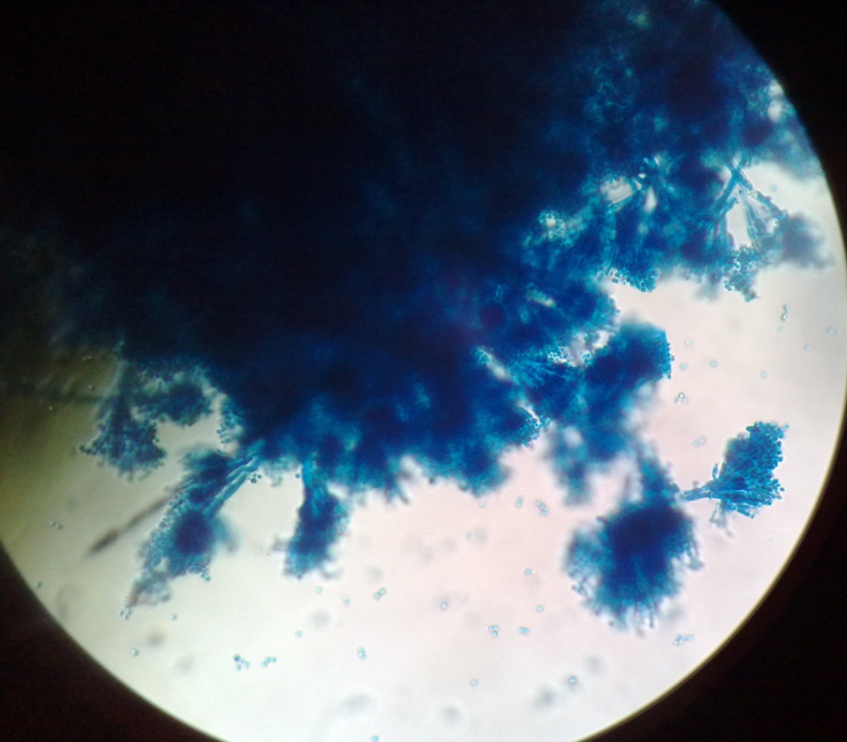
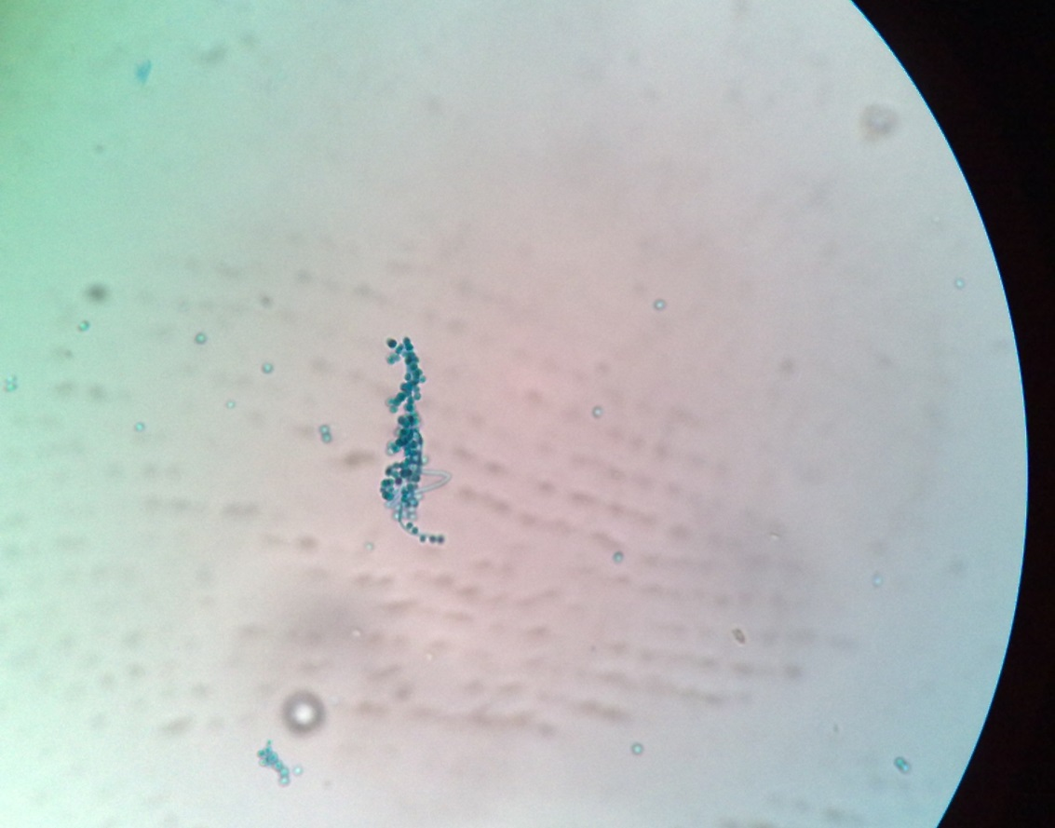

Slide 67
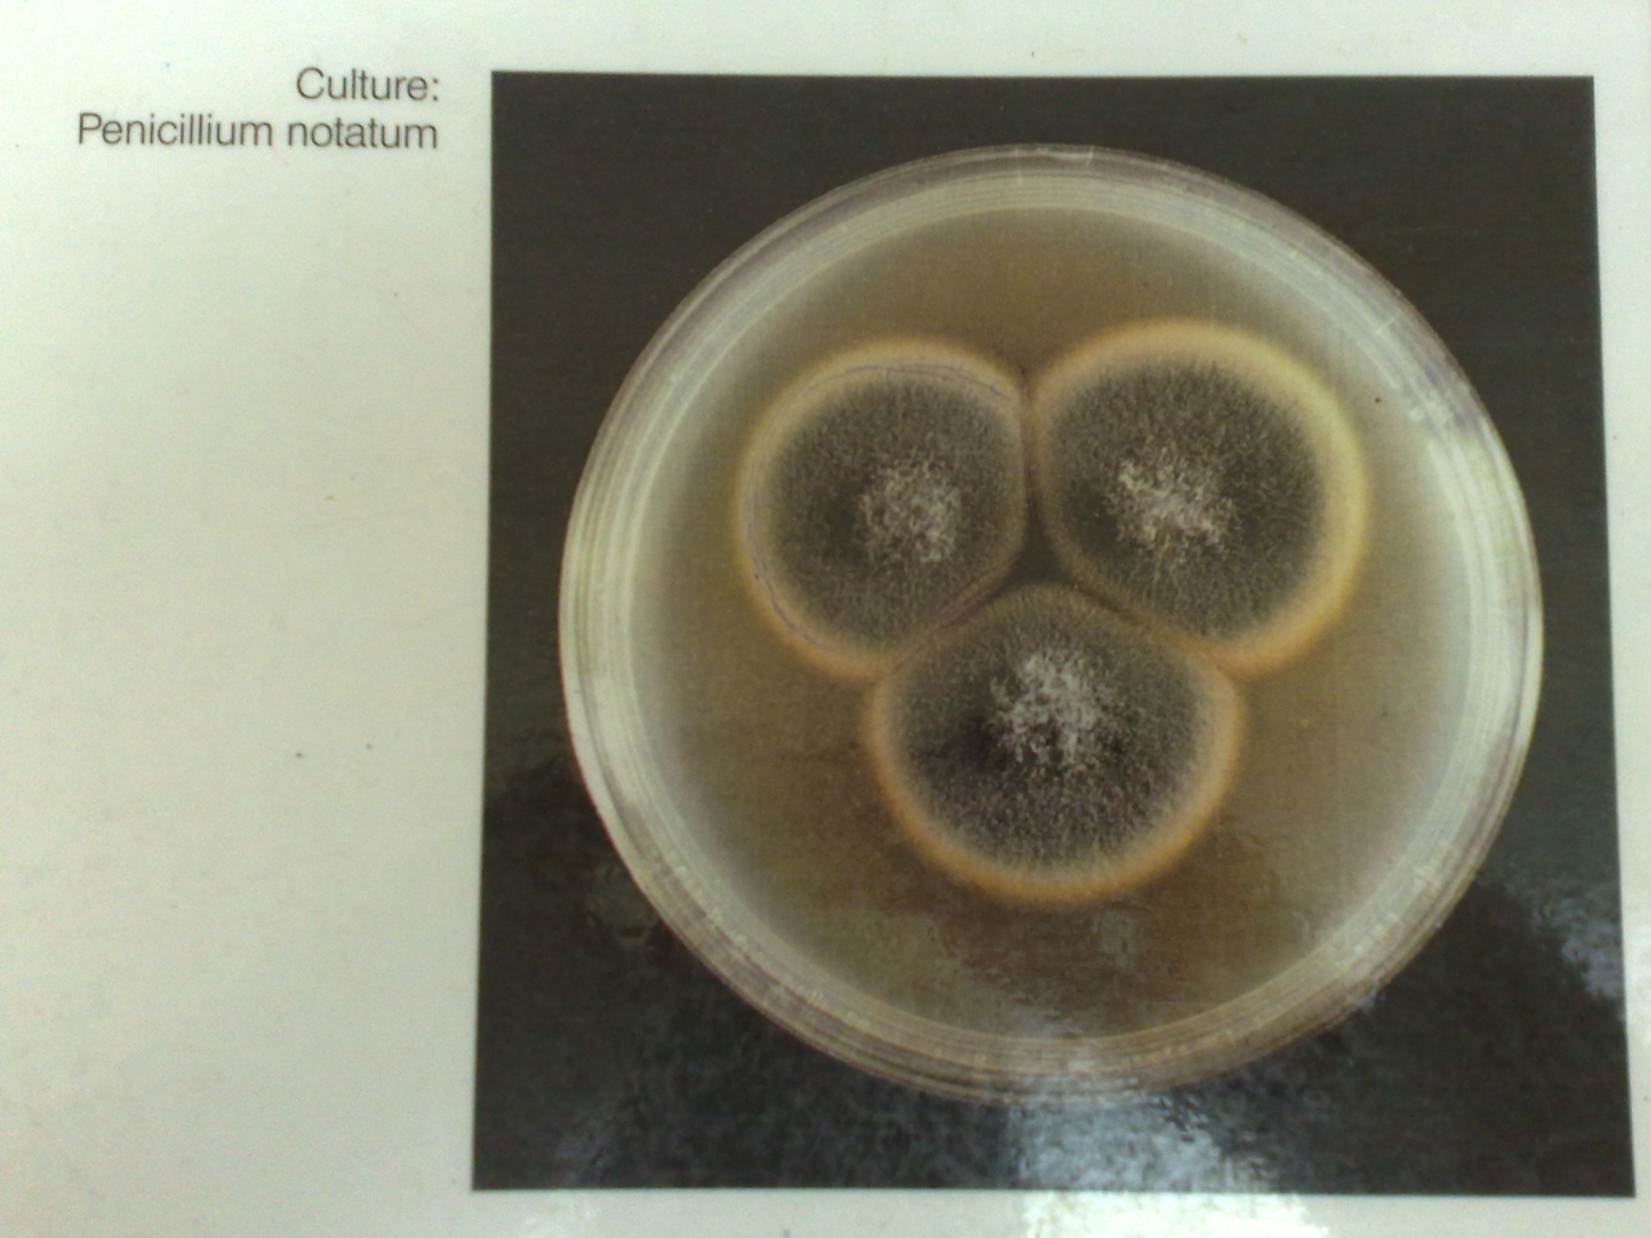
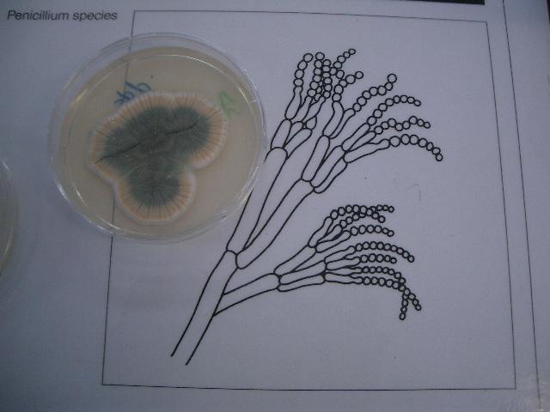

Slide 69
Geotrichum spp
Macroscopic morphology
SDA colony texture
Fast growing
Dry
Finely suede-like
Colony color
Front: white to cream
Reverse: no pigment
Macroscopic morphology
Lactophenol cotton blue (LCB) stain
Hyphae
Hyaline, septate, branched
Break up into chains of
Hyaline, smooth, one celled, subglobose to cylindrical → arthroconidia: release by the separation of a double septum
Balctoconidia production: not found in this genus

Slide 72
Aspects of management of systemic mycoses
Management of predisposing conditions where applicable
Antifungal agents
Amphotericin B
Others – itraconazole, fluconazole, ketoconazole
Other measures - where applicable & surgical procedures

