Slide 1
MYCOLOGY SPOT TEST REVISION
Answered by KIMAIGA H.O
MBChB (University of Nairobi)

Slide 2
1.What condition is this?
Tinea pedis
2. The severe erosion with green discolouration could be due to?
Pseudomonas probably Pseudomona aeruginosa
3. What is the treatment and method of prevention?
Treatment-Topical antifungal e.g. Clotrimazole, Oral antifungals e.g. Fluconazole
Prevention- Minimize transmission from infected individuals and from contaminated items

Slide 3
What condition is this?
Tinea versicolor
What organism causes it?
Malassezia furfur
Pathogenesis?
Constant exposure to sun and sweat inhance superficial infection of keratinized cells hence hypopigmented spots on chest and back
Diagnosis?
KOH mount of skin scales
Orange fluorescence under wood lamp
Culture on SDA

Slide 4
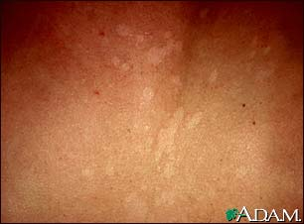
Name the condition shown. What is the causative agent?
Name two other conditions caused by agent above.FOLLICULITIS,DERMATITIS SEBORHEOICQQ11
Name two predisposing factors.

Slide 5
The patient complained of having an itchy scalp
What condition is presented?
Ectothrix hair infection
What is the mechanism of action of the following drugs?
Azole derivatives
Antifungal- Inhibiting the fungal enzyme 14α-demethylase which produces ergosterol .
Polyenes (amphotericin B)
Antifungal- Bind to ergosterol in the fungal cell membrane and promote leakiness of ions and protons which may contribute to fungal cell death.

Slide 6
What genus of dermatophytes is this?
Genus- Microsporum
Species- canis
What features have you identified with?
SDA culture- Colony texture; Wolly to cottony, Flat to sparsely grooved; Colony color- Reverse: deep yellow to yellow-orange
Macroconidia- Spindle shaped, asymmetrical terminal apical knob, 6-15 celled; long, rough & have thick outer cell walls. Rough cell wall. Septal walls are thin
Microconidia –Unicellular, pyriform in shape
What are the possible clinical manifestations?
Tinea Capitis
Tinea Corporis

Slide 7
What genus is this fungi?
Genus- Trichophyton
Species- mentagrophytes
What features have you identified with?
SDA colony- Front: white to cream
Macroconidia - Smooth., Thin-walled. Clavate shaped, Multicelled
Microconidia- Numerous, single celled in clusters, spherical
List 2 possible clinical manifestations?
Ectothrix infection
Tinea capitis

Slide 8
Name three dx ass with the org shown?penicillium notatum.opportunistic infections skin infection, weight loss, abscess, skin lesion, lymphadenopathy.

Slide 9
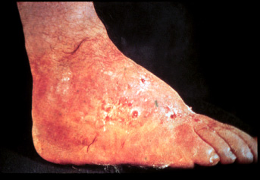
Name the condition.
Madura foot
Name 2 genera associated with the condition
Fungal…madurella mycetomi, madurella grisea, acremonium sp,pseudalescheria boydii, leptospira senegalensis.
Bact(norcadia braziliensis, N.asteroides, N.cavie
What are the clinical features of the above lesions?
(Madura Foot) –Tumefaction, Multiple draining sinuses, Sclerotia/granules in sinuses.
Deforming swollen lesions , Dissemination of fascia, muscles and bones, abscesses formation,
What lab diagnosis will be carried out to distinguish if the causative organism is a fungi or a bacteria?
Color of granules- Black granules; fungal, Small red granules; Streptomyces, Whitish/yellow; Bacterial or fungal
Microscopy- KOH of granules; presence or absence of hyphae
Colonial appearance
Growth rate
Physiological reactions

Slide 10
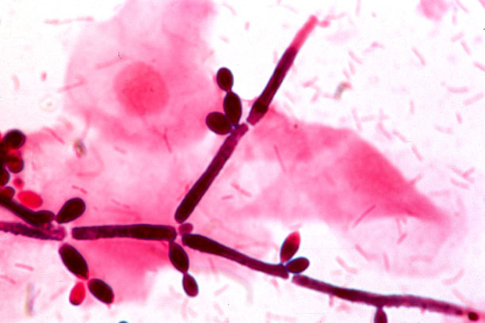
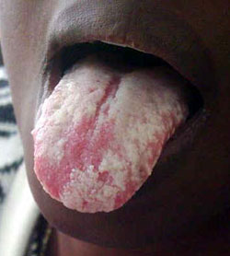
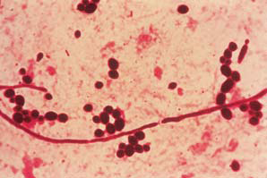
Isolated from an AIDS patient
List 2 features of the causative organism?
Pseudohyphae and chylamydospores. on cornmeal agar
Dimorphic fungi
Germ tubes
Gram positive cells
List 2 lab test to distinguish it from the other species in its genus.
Germ tube tests (+ve)
Carbohydrate assimilation and fermentation
List 2 pre-disposing factors to getting the above infection.
Immunosuppressive conditions – HIV, steroids, pregnancy e.t.c
Broad spectrum antibiotics
Which is the main immunity involved?
Cell mediated immunity

Slide 11
Name the feature shown below and the causative org.?
Chlamydospore,
This type of spore is characteristic of which fungi?
Candida albicans
What is the pathogenisis of the disease caused by the above organism?
Colonization of mucosa e.g UT
Adhesion to mucosal cells using mannoproteins and fibronectin
Penetration of mucosal barriers using hyphae.
Etracellular enzymes like proteases and elastases,phospholipases digest epithelia cells and facilitate invasiveness

Slide 12
Identify the media?
SDA (Saboraud dextrose Agar)
What are the constituents of the media?
Chloramphenicol, to reduce bacterial contamination
Cycloheximide reduce contamination by saprophytic fungi
Dextrose
Peptone
Agar
State the transport media for fungal specimens

Slide 13
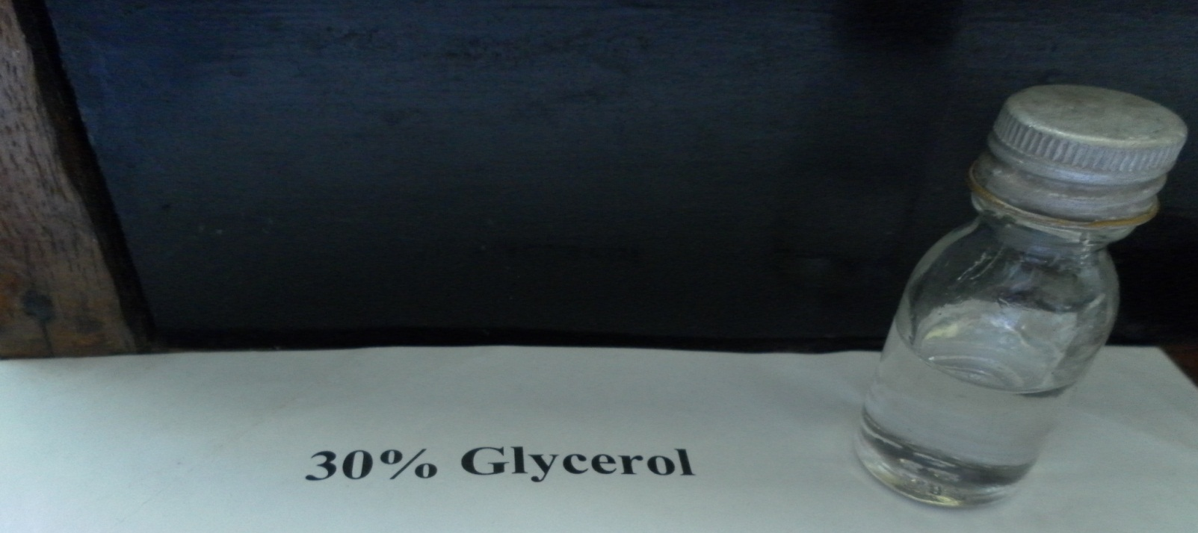
What is the importance of the above in fungal isolation from specimen?
Transport of fungal specimens e.g biopsy

Slide 14
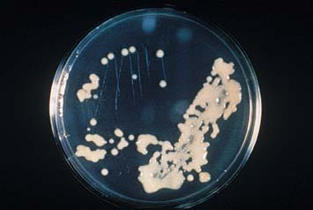
What organism is being tested for?
Cryptococcus neoforman
Pathogenesis?
Enzyme laccase that converts catecholamines to melanine preventing oxidative killing
Transmission is by inhalation of yeast from an environmental source
Yeast is engulfed by lung macrophages and retained in them
Circulates to other body parts in the macrophages, particular attraction to CNS, where they lodge and multiply
Appear in CSF and blood
Extreme immunosuppression – can cause disease in other organs.

Slide 15
What type of staining is demonstarted?
Light India ink staining
What selective medium is used for C. Neoformans and why?
Birdseed agar - Melanin production hence brown colonies

Slide 16
Identify what is shown below ?arthrospores Name two characteristics of the representetative org.?asexual reproduction, branching filaments, mode of trans ofcoccidioides imitis
The spore formation demonstrated below is characteristic of which fungi?
Dermatophyte- Coccidioides immitis

Slide 17
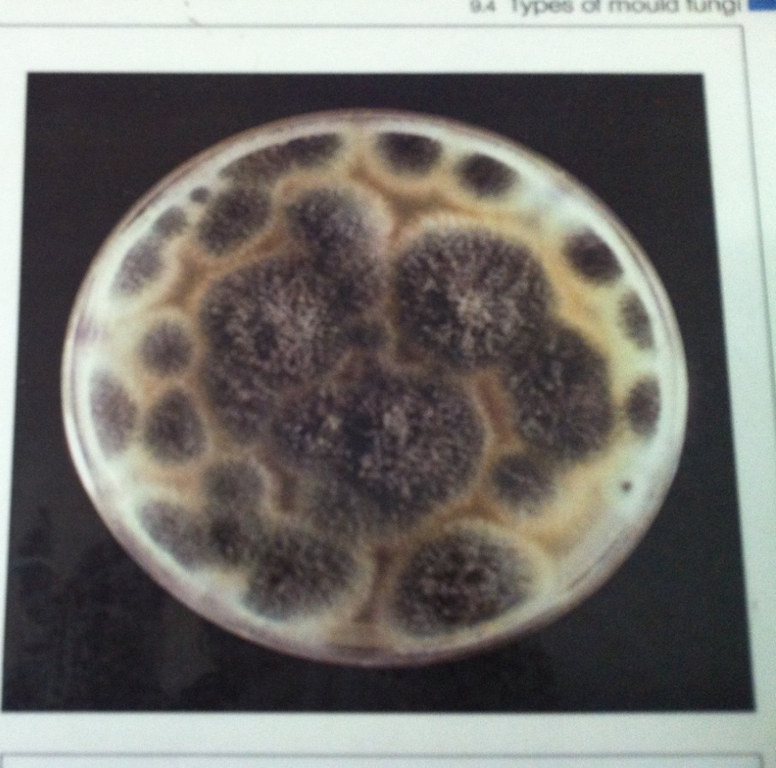
Isolated from sputum of a post pulmonary tuberculosis case
Identify the fungi? Why?
Aspergillus
Conidopheres terminating as vesicle with codia and basocatenate.
SDA colony color; Front: White, yellow, brown to black shades
What is the clinical manifestation ?
Fungus grows as a mycelial mass – fungus ball or aspergilloma due to Colonizing aspergillosis – colonization of the pre-existing cavity - post-pulmonary TB
What serological tests can be carried out to confirm the presence of the organism?
Serologic test for circulating cell wall galactomannan antigen in serum.
IgE specific for aspegillus antigens

Slide 18
This mode of reproduction is characteristic of which organism?
Coccidioides immitis
How is it transmitted?
Inhalation of spores
List 2 complications of the disseminated disease.
Erythrema multiform
Meningitis
Skin lesions

Slide 19
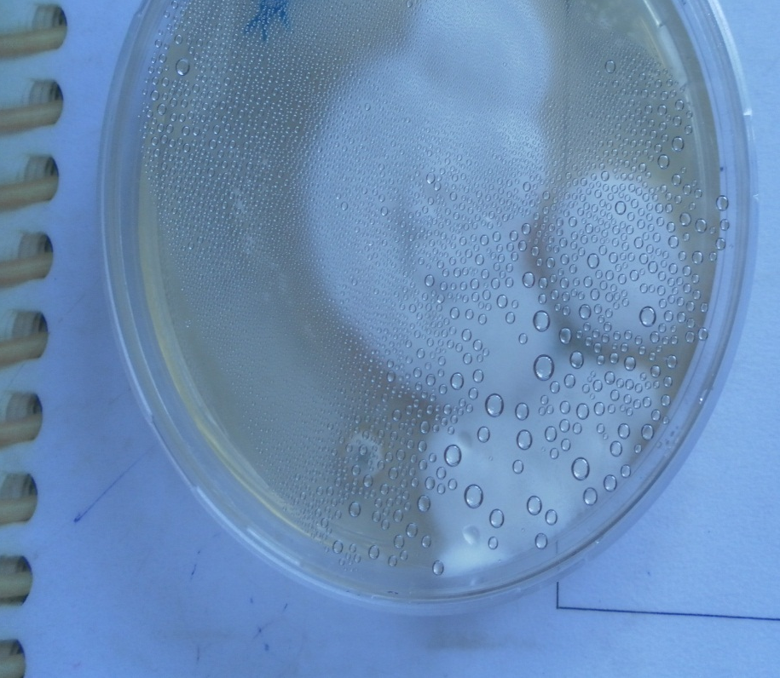
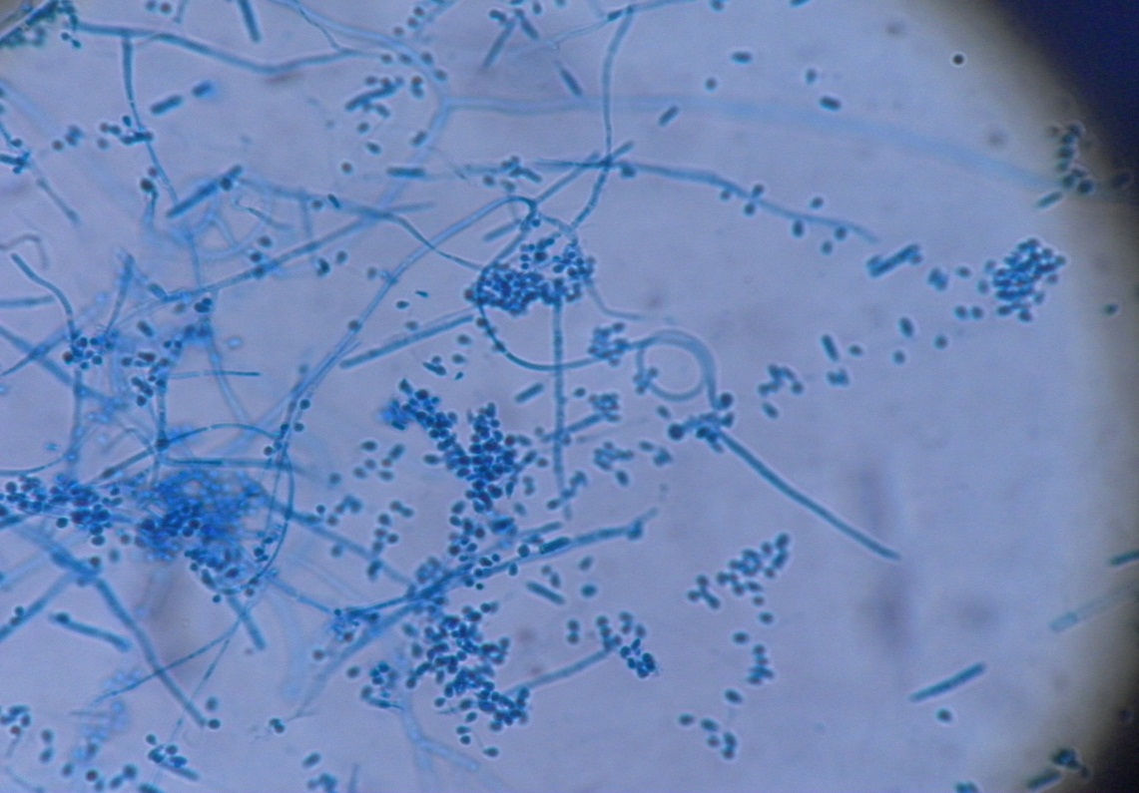
Identify the organism above
Trichophyton mentagrophytes
Give the microscopic and macroscopic features
SDA colony texture- Flat, Some have central folding or develop raised central tufts
Color; Front: white to cream,
Lactophenol cotton blue staining- Spiral hyphae, Smooth multicelled macroconidia , numerous microconidia

Slide 20
Identify the structure giving two examples of fungi with the presentation
Zygospores (Mucor, Rhizopus)

Slide 21
Give the differences between fungi and bacteria in terms of nutrition and cell wall structure
FEATURE | FUNGI | BACTERIA
Cell type/Nucleus | Eukaryotic | Prokaryotic
Cytoplasm | Mitochondria, ER present | Both absent
Cell membrane | sterols | Not there except mycoplasma
Cell wall structure components | Chitin, cellulose, hemicellulose | Peptidoglycan
Spores | For reproduction | For survival
Thermal dimorphism | Yes(some) | No
Oxygen requirement | Strictly aerobic (moulds) Facultative (some yeasts) | Aerobic to anaerobic
Carbon requirement/ Metabolism | Require organic Carbon | Require Inorganic and/ or organic carbon

Slide 22
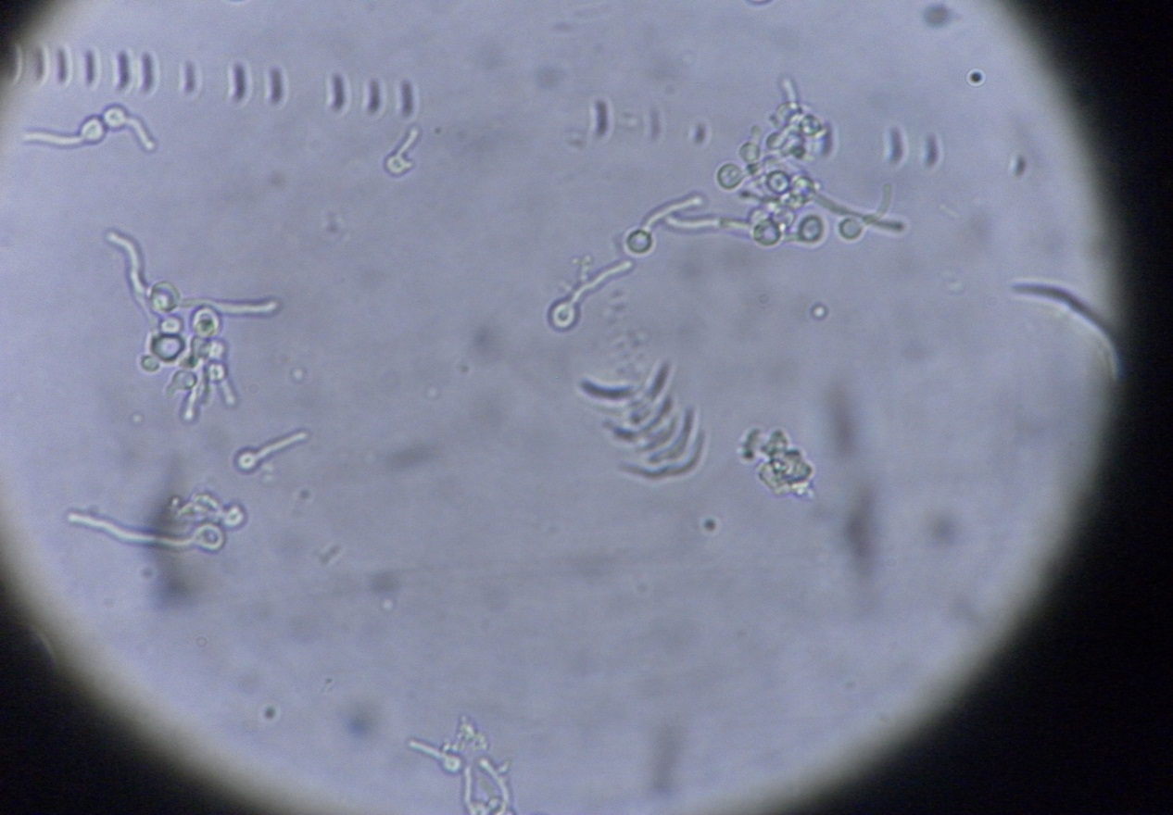
Describe the mechanism behind the test
When placed in serum for 3 hours at 37°C, C albicans forms germ tubes or true hyphae
How does the feature above enhance virulence?
Hyphae enhance adhesion and penetration of mucosal epithelium. Hyphal wall protein on germinal tubes mediate binding. Hyphae also resist phagocytosis

Slide 23
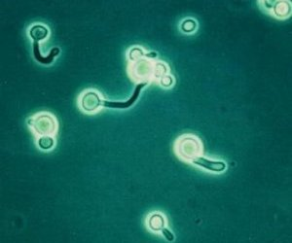
Name the distinctive feature shown and the organism ass. Germ tube
State two dx caused by the organism. Cut, mucocut, systemic

Slide 24
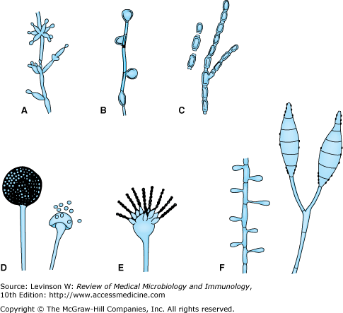
Identify the various structures
Asexual spores.
A: Blastoconidia and pseudohyphae (Candida).
B: Chlamydospores (Candida).
C: Arthrospores (Coccidioides).
D: Sporangia and sporangiospores (Mucor).
E: Microconidia (Aspergillus).
F: Microconidia and macroconidia (Microsporum).

Slide 25
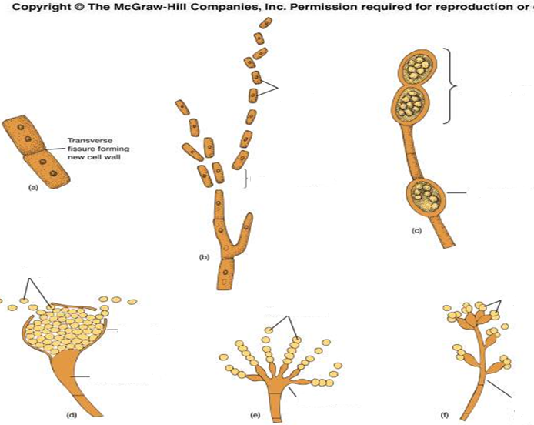

Slide 26
Sexual reproduction in fungi.
Zygospores - large, thick-walled spores formed when the tips of sexually compatible hyphae of certain fungi fuse together.
Oospores - spores formed within a special female structure, the oogonium. Fertilization of the eggs or oospheres by the male gametes formed in an antheridium gives rise to oospores.
Basidiospores - single-celled spores borne on a club-shaped structure called basidium.
Ascospores - single-celled spores produced in a sac called ascus; there are usually 8 ascospores in each ascus

Slide 27
Briefly indicate the laboratory identification of Cryptosporidium sp.
Diagnosis of cryptosporidiosis is made by examination of stool samples.
Most often, stool specimens are examined microscopically using different techniques (e.g., acid-fast staining, direct fluorescent antibody [DFA] , and/or enzyme immunoassays for detection of Cryptosporidium sp. antigens).
Molecular methods (e.g., polymerase chain reaction – PCR)

Slide 28
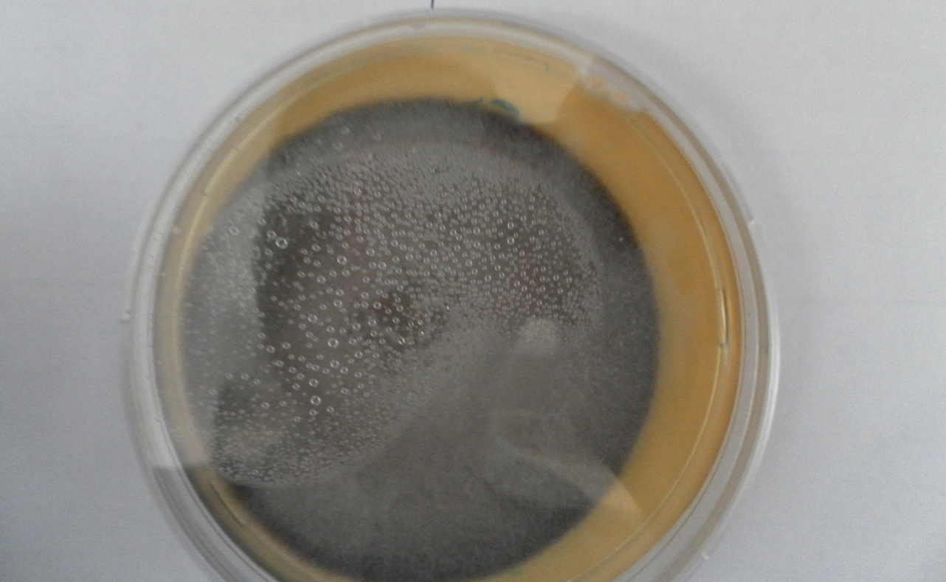
State the clinical manifestations of infection with the above organism
Pseudallescheria boydii
Management of the condition

Slide 29
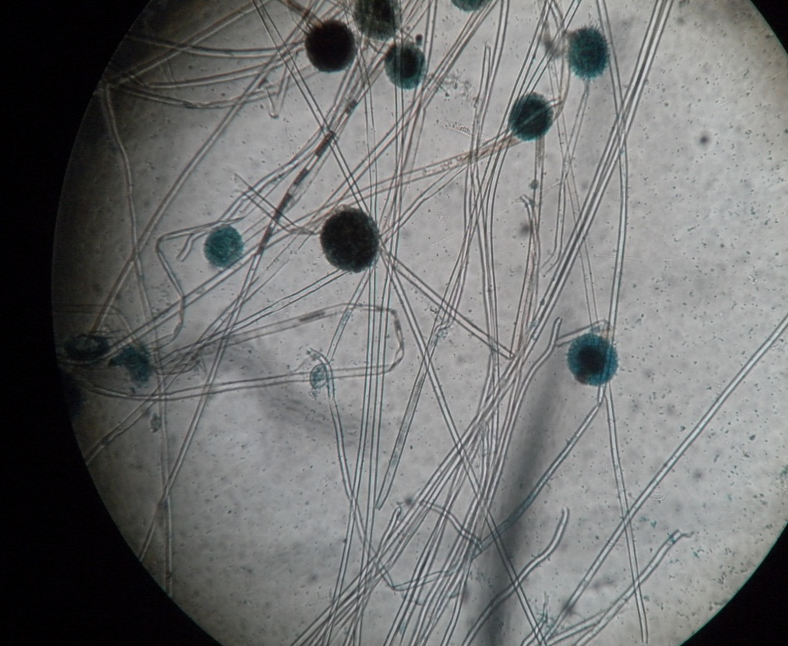
Identify the organism giving a reason
Aspergillus-
Virulence factors of Candida sp.
Surface molecules that permit adhesion to mucosal cells. Mannoprotein in outer fibrillar layer-adhesins. Fibronection and outer components of extracellular matrix- receptors
Ability to convert to hyphal forms enable adhesion , invasion and spread
Exracellular enzymes- proteases, elastases, for invasion
Hyphae have surface proteins that enable evasion of phagocytosis

Slide 30
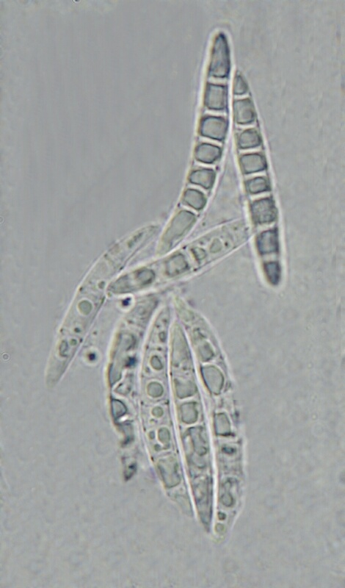
Identify organisms with this structure
Fusarium species

Slide 31
Explain immune response to the above infection
Hypersensitivity causes dermatophytid ("id") reactions due to circulating fungal antigens
Scaly, itchy rash on trunk legs arm
Cell-mediated immune responses to dermatophyte antigen.
How would one identify the organism macroscopically?
Detect fluorescence in infected skin lesions using Wood’s lamp

Slide 32
Name three superficial fungi associated with the condition shown?
Identify the source of the specimen… microsporum, epidermophyton and
Trichophyton.

Slide 33
Name the condition and likely causative agent and mode of transmission.

Slide 34
Identify kingdom and genus of photo microscope.
What is the mode of transmission
State two clinical conditions it causes.

