Slide 1
PARASITOLOGY SPOT TEST REVISION
Answered by KIMAIGA H.O
MBChB (University of Nairobi)

Slide 2
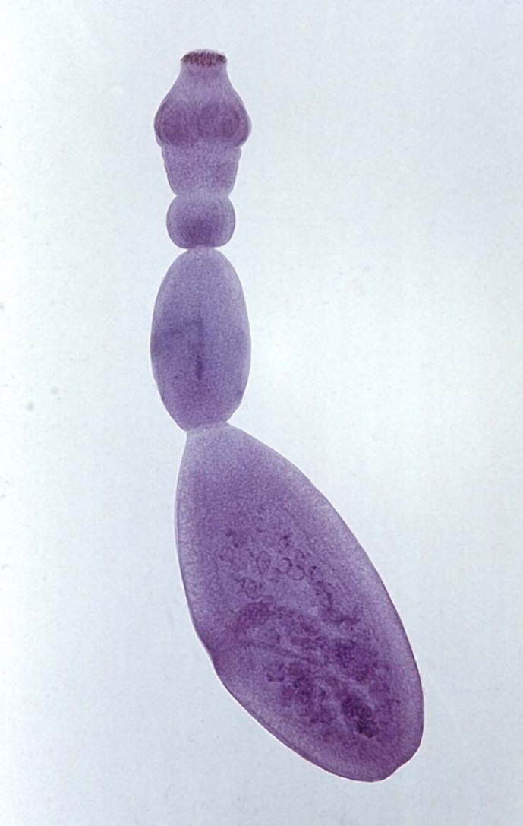
Name the larva form of the parasite shown
  Hydatid cysts
State two methods of treatment for this helminthes
  Surgery to remove the parasite mass
  Use of drugs like albendazole,praziquantel

Slide 3
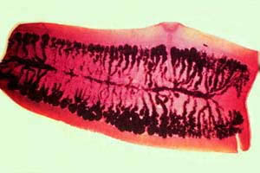
State the natural reservoir for this metazoa shown above
  Cow.
Name two complications associated with the above named parasite
  Weight loss
  Edema due to kwashiokor
  PEM
  Appendicitis or cholangitis from migrating proglottids.

Slide 4

State the drug used to treat the trematode transmitted by this snail
  Praziquantel
  metrifonate
Two methods of control and prevention for the above trematode
  At resevoir level-drain infested water,treating the water with mulluscicides,using biological organism tht fees on the snails
  At host-resevoir level-building bridges,putting signs indicating tht the water is infected
  At man level-health education,proper sanitation,tx with appropriate drugs.

Slide 5
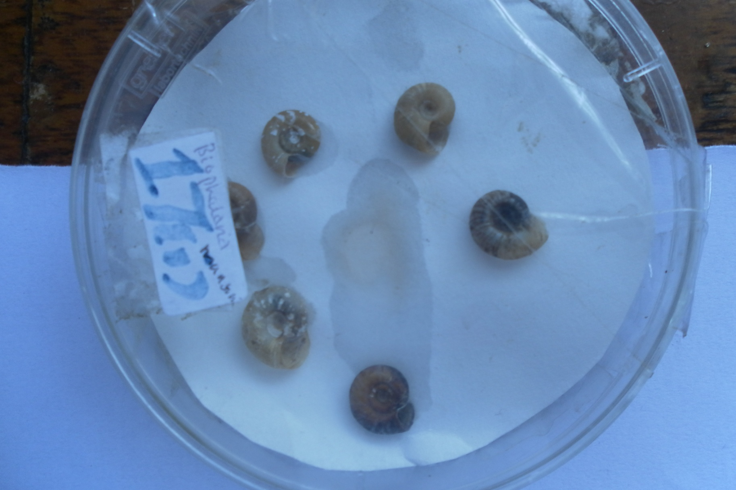
Identify the organism shown and the ass parasite for which it’s a vector?
-biomphalaria species of snails,
-schistosoma mansoni

Slide 6
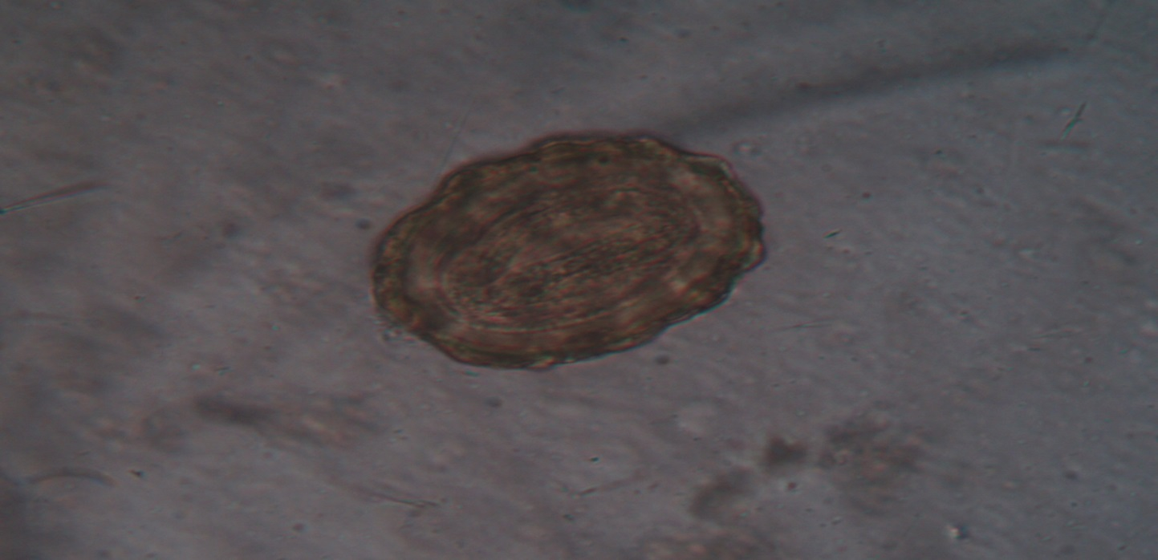
State four complications associated with the adult form of the nematode
  Hepatobilliary obstruction
  Anemia,
  Intestinal obstruction
  Ascites

Slide 7
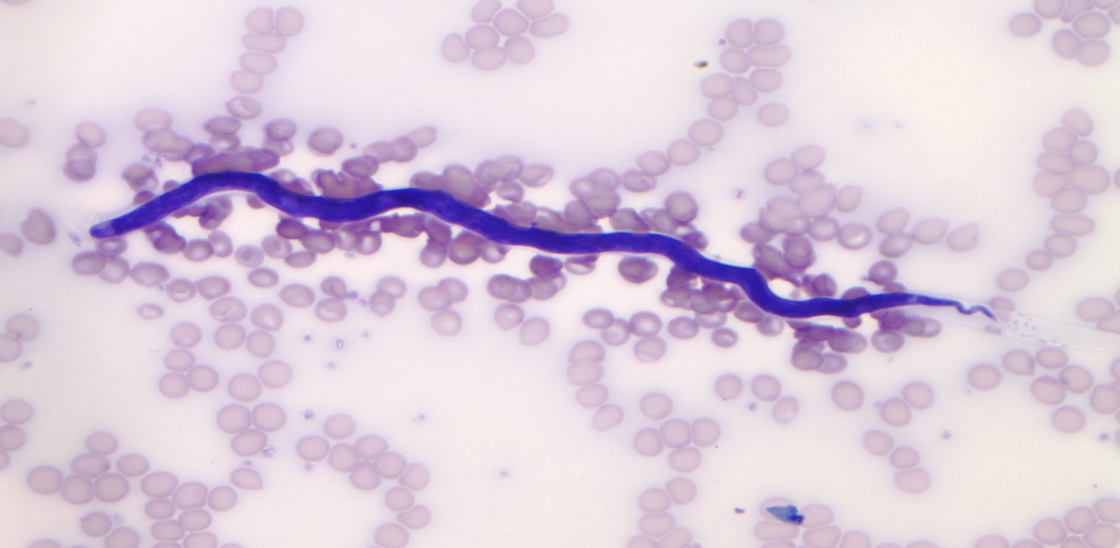
The following shows an unsheathed microfilaria state one possible method of treatment and control
  Treatment with Ivermectin
  Vector control: Larvicides, aerial insecticides spray
  Personal prophylaxis: yearly ivermectin
  Nodulectomy
  Migration of communities from endemic areas

Slide 8
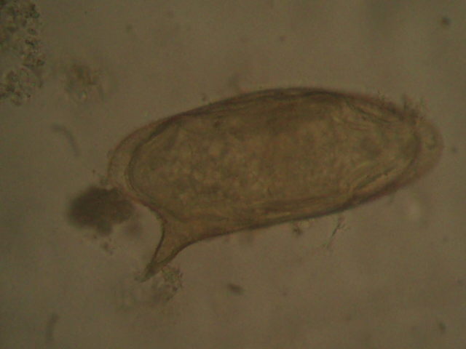
Name the vector of the above parasite
  Biomphalaria snail
Name 2 complications of the above metazoa
  Hepatosplenomegaly
  Intestinal obstruction, esophagial varices, hemmorhoids, cor-pulmonale,

Slide 9
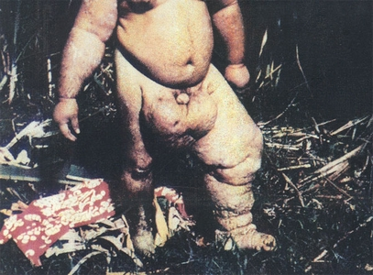
State two possible organisms that can cause the conditions seen above
  Wuchereria bancrofti, Brugia malayi, Brugia timori.
State two methods of management for this condition
  Clearing the resevoir sites,use of mosquito nets,use of pesticides,tratment of patients,

Slide 10
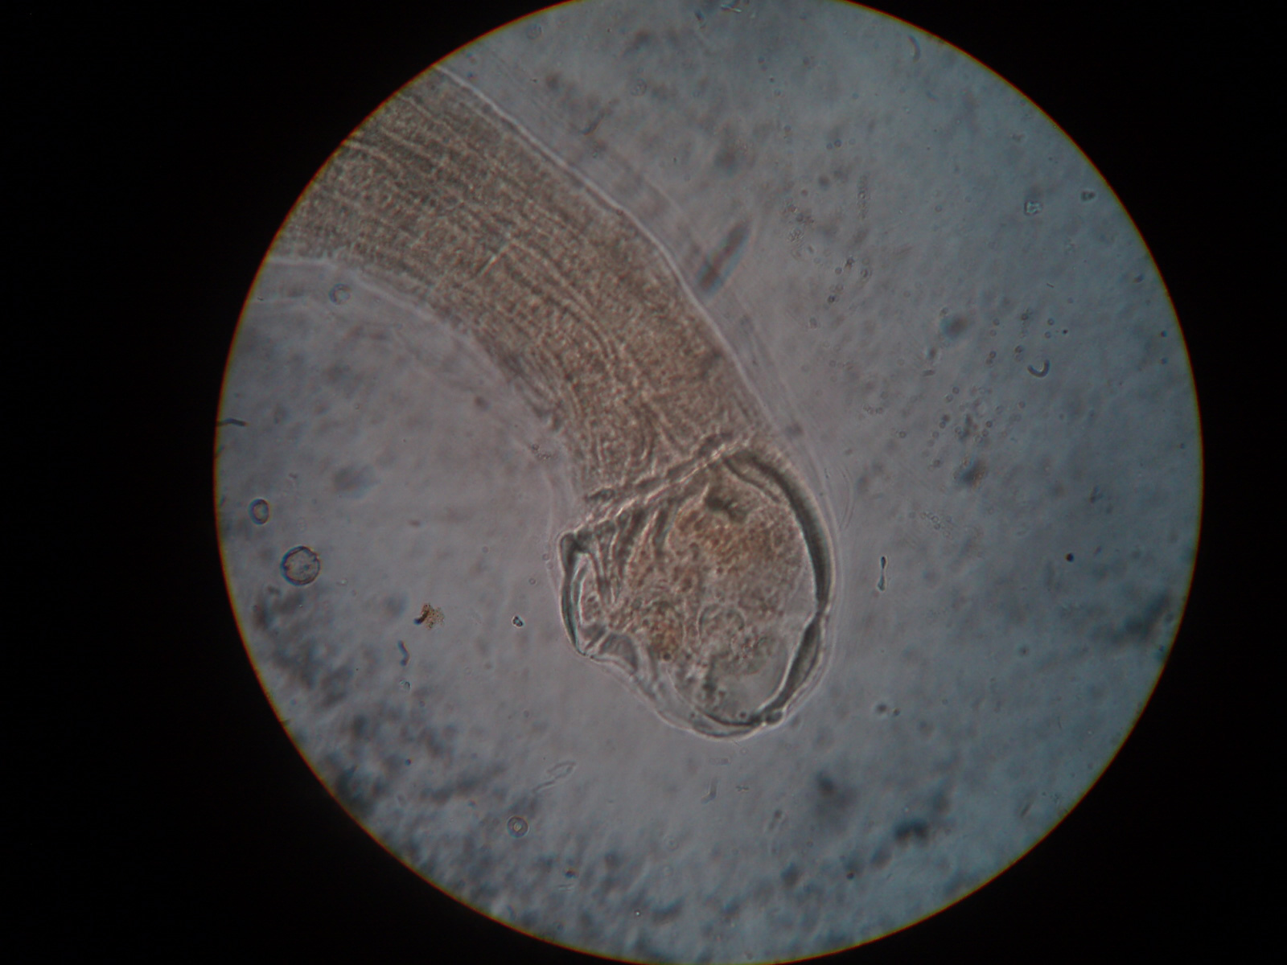
Identify stage, genus and species of this parasite
Name 2 drugs useful for treatment of infection
Name the organism shown above and state the anemia associated with it
  Necator americanus
  Hypochromic microcytic anaemia-Loss of iron
  Macrocytic anaemia- Loss of Vitamin B₁₂ and folic acid

Slide 11
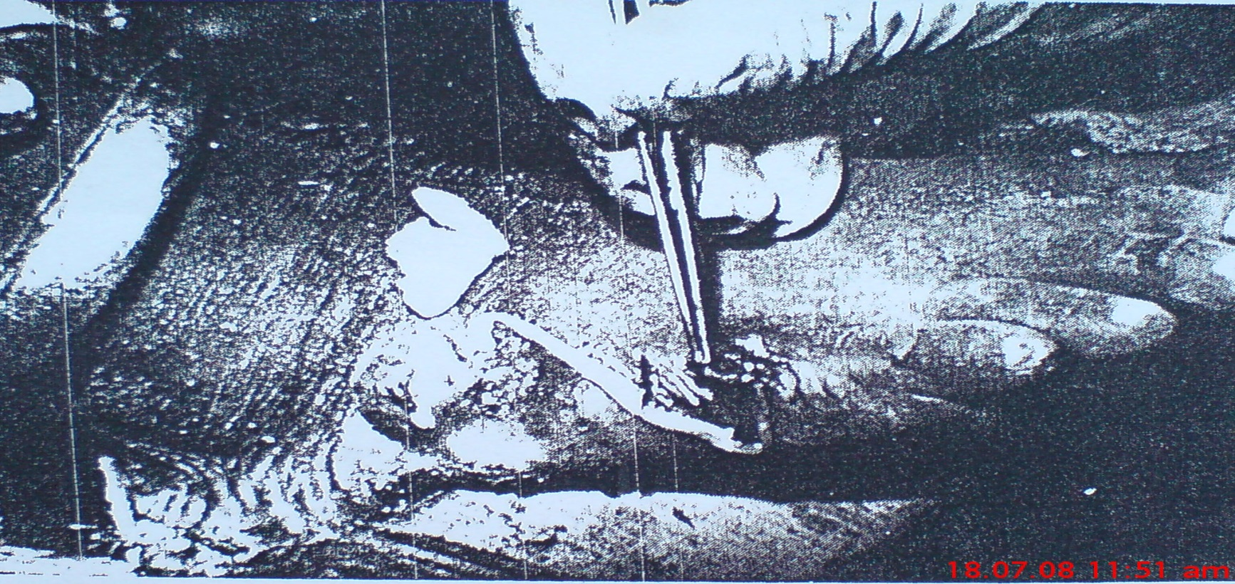
Name the possible causative agent of the above clinical condition
  Dracunculus medinensis
Sate the mechanism of transmission of the above named organism
  Ingestion of water containing copepod that have ingested the larvae

Slide 12
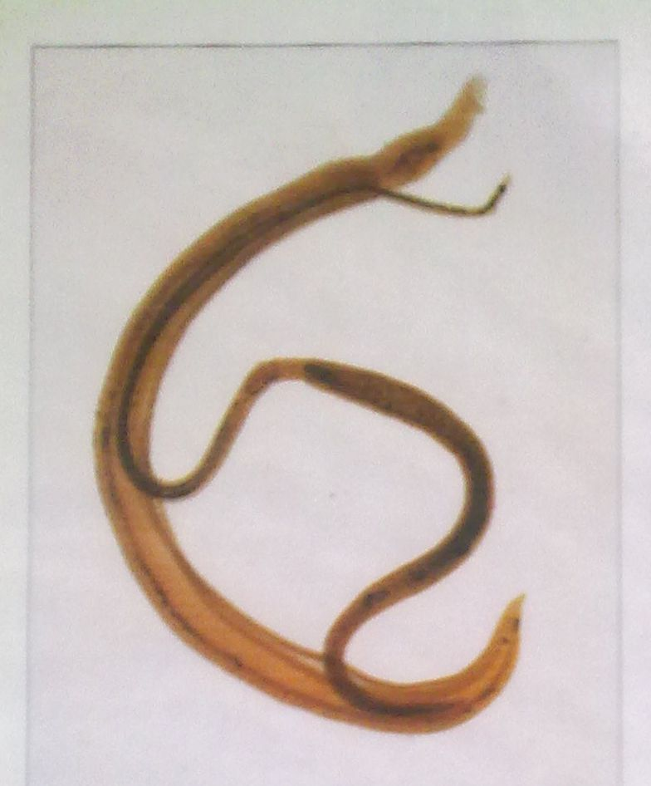
Name the org shown below?
  Schistosome
Give two reasons for your identification?
  Gynecophoric
  canal. Females are long and slender, held in gynecophoric canal.
State four ways of management and control of the reservoir of this parasite
  Use of molluscicides eg niclosamide
  Use of biological org tht feed on the snailseg other snails or predator fish
  Clearing the infected water and bushes
  Cementing of canal walls

Slide 13
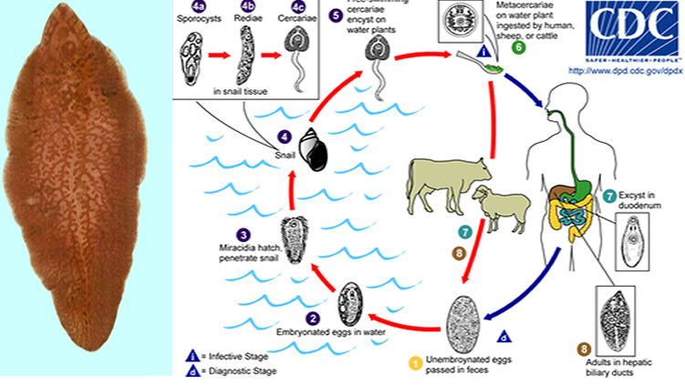
The above is a life cycle of a particular organism. State the organ/ organ system it is likely to be found and treatment
  Liver- Hepatic system, bile ducts
  Treatment -Triclabendazole

Slide 14
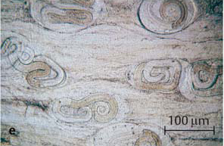
The organism shown is intracellular, state the particular tissue it has tropism for
  Particualar tissue-muscle

Slide 15
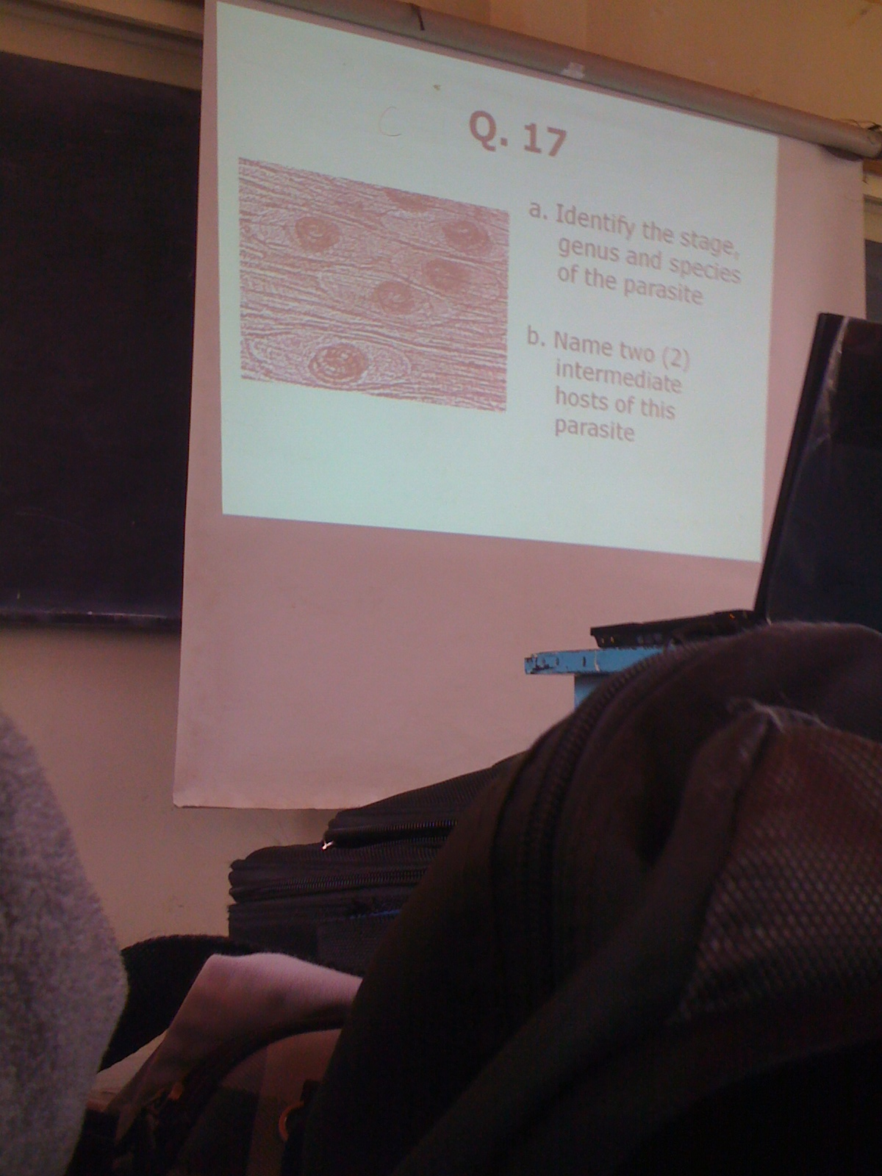

Slide 16
State the causative agent for visceral larva migrans and mode of treatment
  Toxocara canii and toxocara cati.
  Treated with antiparasitic drugs, usually in combination with antiinflammatory medications.
  Diethylcarbamazine, Thiabendazole, Albendazole, Mebendazole

Slide 17
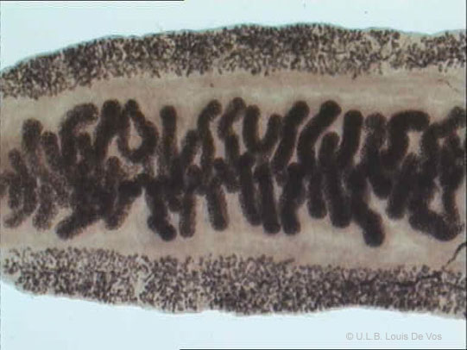
The following organism is a hermaphroditic parasite state the organ it is likely to infect
  liver
State the type of immune response one has to parasitic infestation
  Adaptive immunity-production of th2 cells

Slide 18
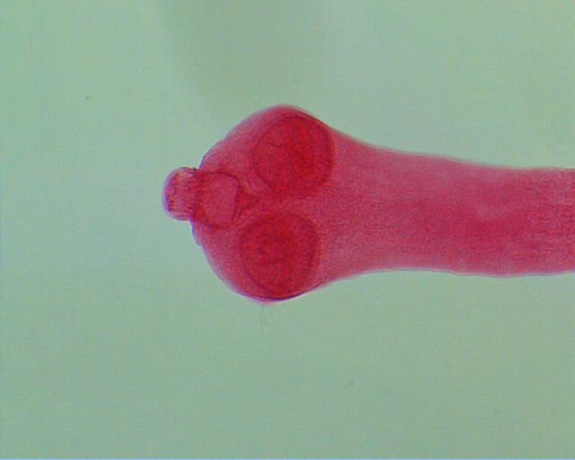
Name the intermediate host(s) associated with the parasite shown
  Cow
Give one difference between cyclophyllidae and pseudophyllidae families in cestodes
  Cyclophyllidae-No uterine pore, Only the lateral genital pore, may or may not have hooklets
  Pseudophilidae-Has a uterine pore, has both lateral and midial genital pore,has no hooklets

Slide 19
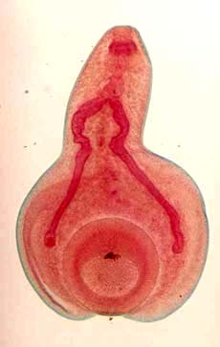
Name the genus of the above parasite
  Gastrodiscoides
Two medical importance of mites
  Cause scabies
  Allergic conditions
  Dermatosis

Slide 20
Identify 2 parasites likely to cause the above lesion
  Onchocerca volvus
  Loa Loa
Name the serological test and 2 drugs to be used in one parasite you have named above.
  Serological test- ElISA
  Diethyl carbamazine (DEC) and Ivermectin

Slide 21
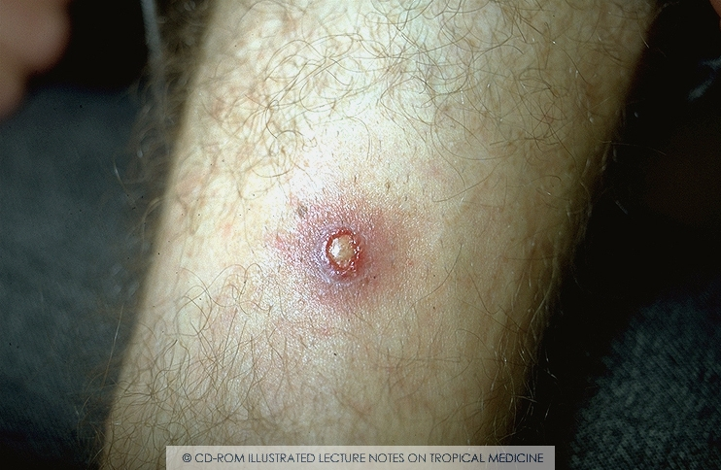
Give 2 organisms that are likely to cause this.
  Auchmeronmyia luteola
  Dematobia hominis
Classify myiasis causers into families and in each family give 2 genera.
  Calliphoridae- Chrysomya, cochliomyia
  Sacrophagidae- Sarcophaga, wohlfahrtia
  Oestridae - Dermatobia, Auchmeronmyia

Slide 22
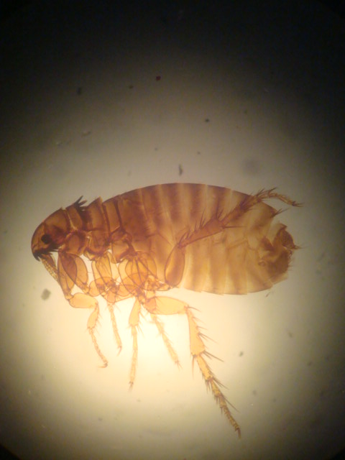
Identify the likely species of flea and give a reason.
  Xenopsylla cheopis
Give 2 medical importance of fleas.
  Plague
  Murine Typhus

Slide 23
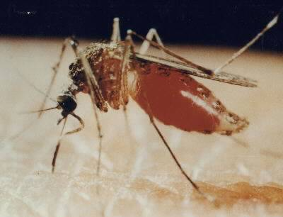
Name the fly shown giving a reason.
  Culex Mosquito
List 2 useful compounds suitable for its destruction.
  DDT
  Permethrin

Slide 24
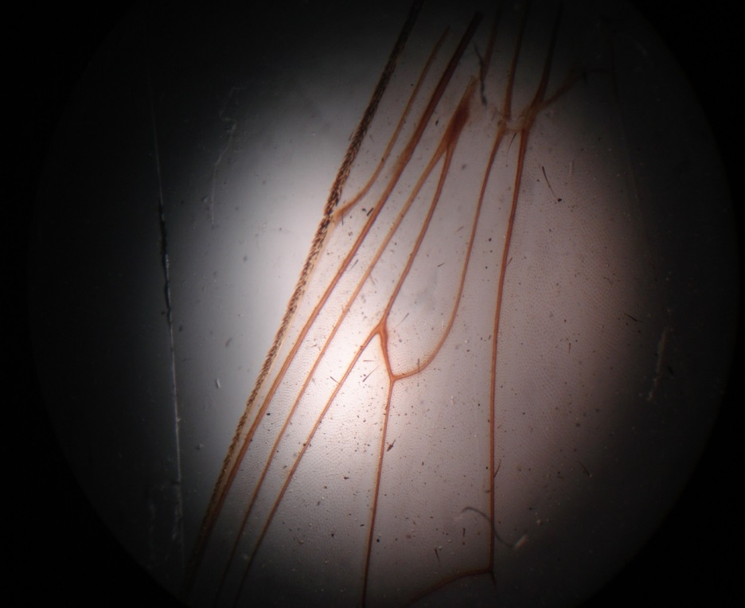
Name the structure shown and the organism itself?
  Hatchet cell - Glossina species
Name the dx tx by the org. trypanosomiasis
(african)
State 2 mechanisms of immune evasion of the parasite associated with this organism.
  Due to the surface coat of the parasite
  Continuously changing the surface to escape host immune response
  Perivascular cuffing (lining around the brain), choroid plexus attack in CNS (CSF production interrupted), meningoencephalitis (direct attack to meninges)

Slide 25
The above are thin smears from a patient. Identify 2 parasites likely to be identified.
  Plasmodium falciparum and plasmodium malariae
Which of the two is most likely to be identified. Give 2 reasons for your answer.

Slide 26
Give 2 clinical manifestations of A.
List the types of malaria.

Slide 27
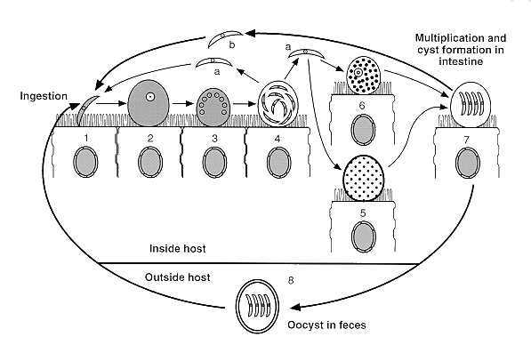
Identify the parasite with the above life cycle.
Mount treatment for the patient.

Slide 28
Identify the parasite above.
What is its natural habitat?
Give 2 differences between Naegleria and Acanthamoeba species

Slide 29
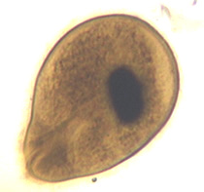
A
B
C
D
E
Label the parts.
Give 1 complication associated with the above parasite.

Slide 30
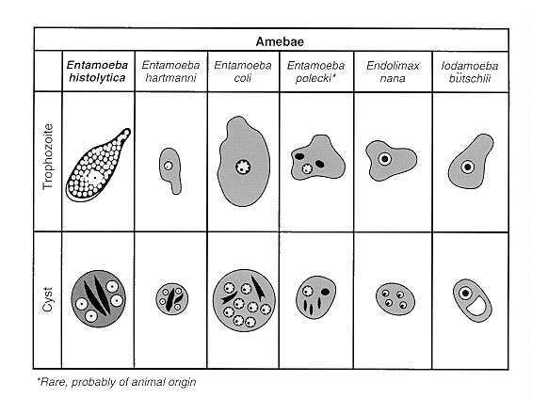
A
B
C
D
Name the above species of amoebae.
Describe briefly the pathogenesis of amoebiasis.

Slide 31
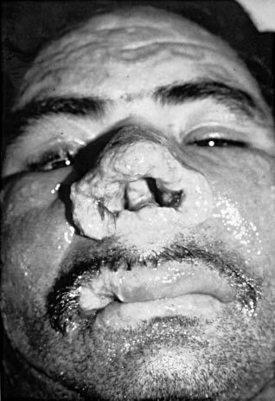
Name the species of parasite likely to cause the above lesion
Name its media of growth.
Name 2 zoonotic protozoan diseases.

Slide 32
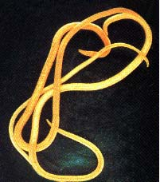
Identify the stage genus and species of the parasite
Name two complications associated with the infection of this parasite
  Asphyxia, obstructive jaundice, pancreatitis.
State the method for control of the infection.
  Mass deworming projects, health education, proper fecal oral disposal.

Slide 33
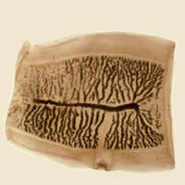
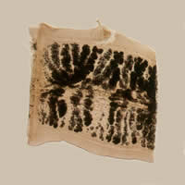
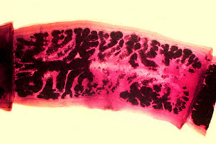
Gravid proglottids
T saginata lateral branches of uterus 15-20
T. saginata
T solium lateral branches of uterus 7-13
T. solium

Slide 34
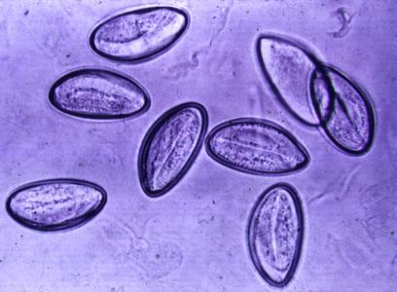
Identify genus and species
  Enterobius vermicularis
Give reasons
  Eggs are in planoconvex in shape (like capital D)
  Usually are embryonated (larvae inside visible)

Slide 35
Identify genus and species
  Trichomonas vaginalis,
Name specimens you would collect to identify parasite
  Sedimented urine
  Vaginal & prostatic secretions & scrapings
Mount preventive and control measures for the parasite spread.

Slide 36
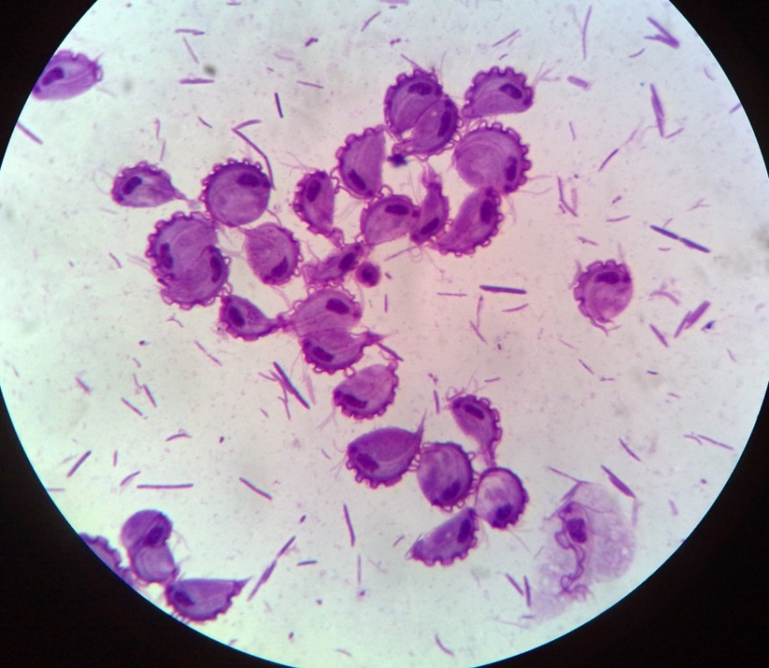
Identify slide
  Trophozoites T.vaginalis
Diagnosis
  Trophozoites on a wet mount of sedimented urine, vaginal & prostatic secretions & scrapings by microscopy
  Fluorescent microscopy
  Fixed smears can be stained with Papanicolau, Giemsa, Leishman & PAS
  Culture on Trussel & Johnsons’ medium/simplified trypticase serum medium used to maintain bacteria free cultures of the flagellate
  Nucleic acid hybridization & PCR

Slide 37
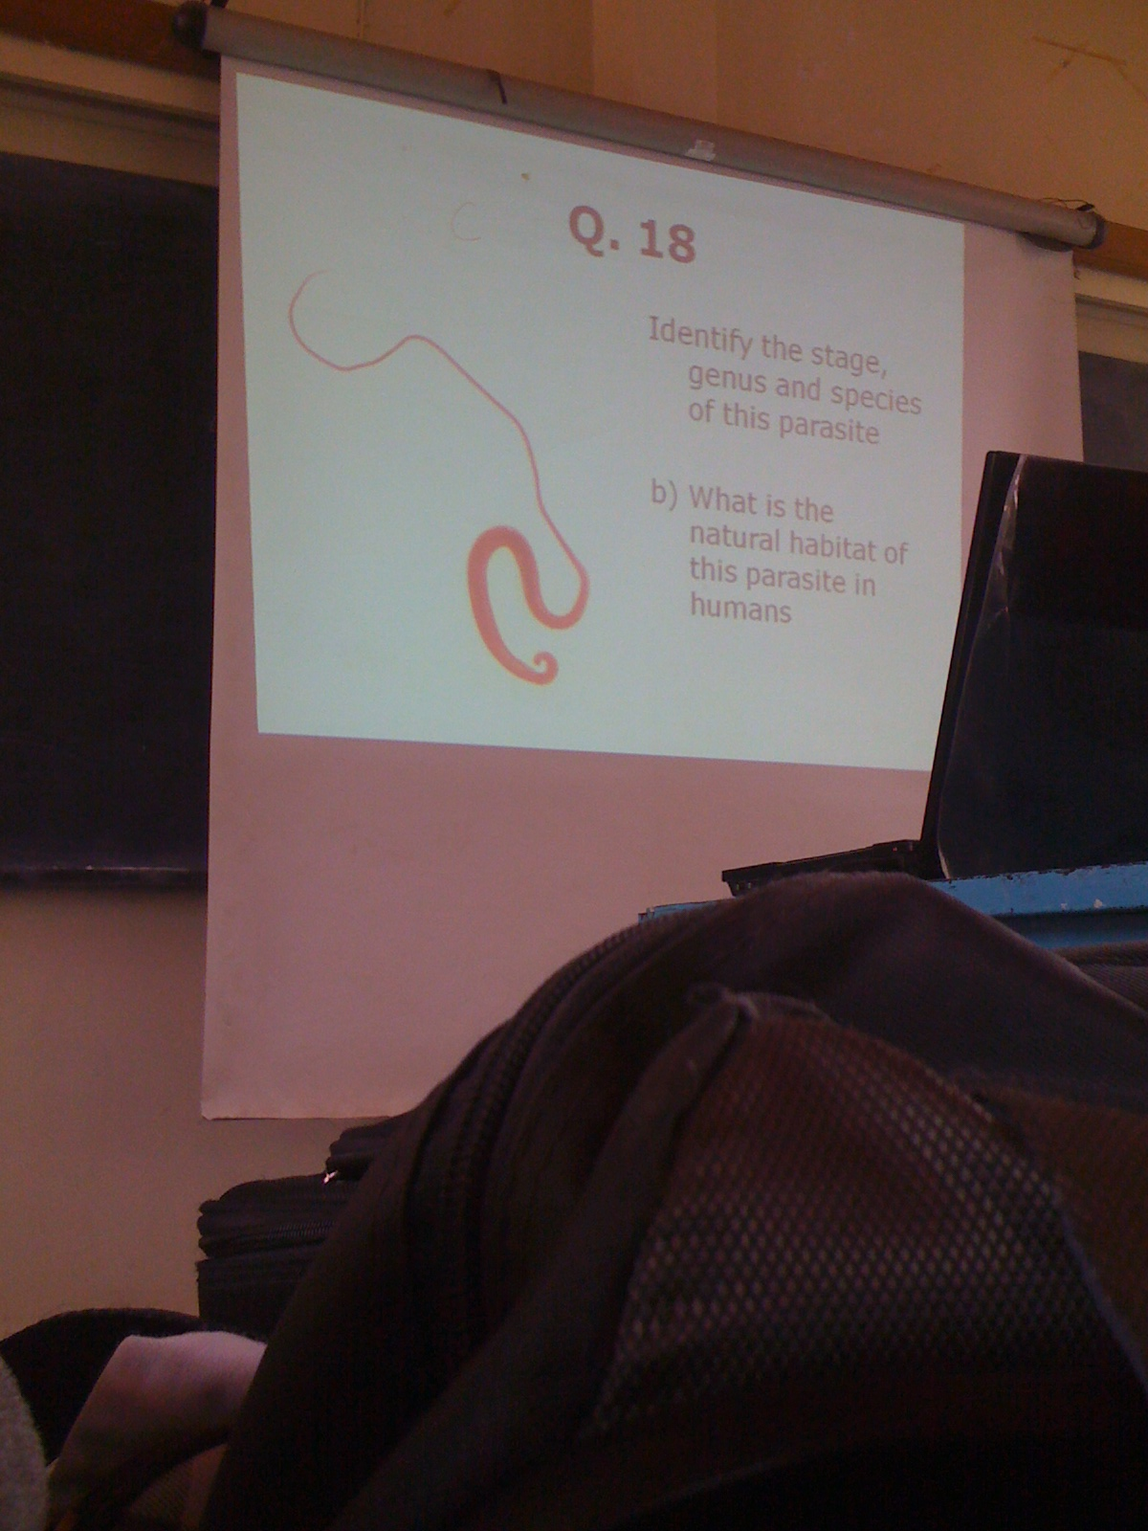

Slide 38
Identify this arthropods
Name two infections transmitted by this arthropods

Slide 39
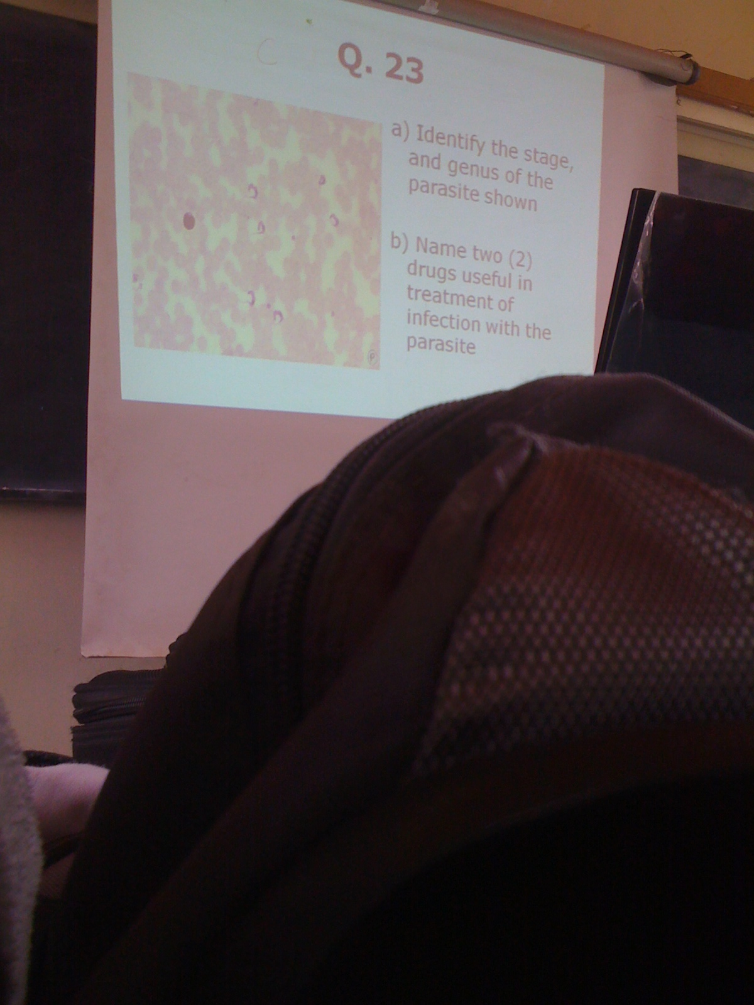

Slide 40
