Slide 1
PARASITOLOGY SPOT TEST REVISION
KIMAIGA H.O
MBChB (University of Nairobi)

Slide 2
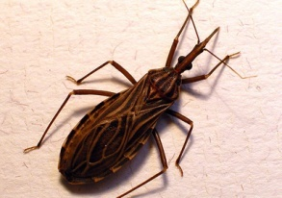
Name the organism shown?
  Reduviid bug
Mention the clinical presentation of the organism transmitted by the organism?
  (TRIATOMA)Chagoma,romanas sign, myocarditis, megacolon, xenodiagnosis

Slide 3
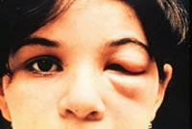
Name the above clinical presentation.
  Romanas sign
State the pathology behind the presentation.
Give 2 confirmatory lab procedures in the identification of the parasite.
State its geographical distribution.
  Brazil, mexico, south america

Slide 4
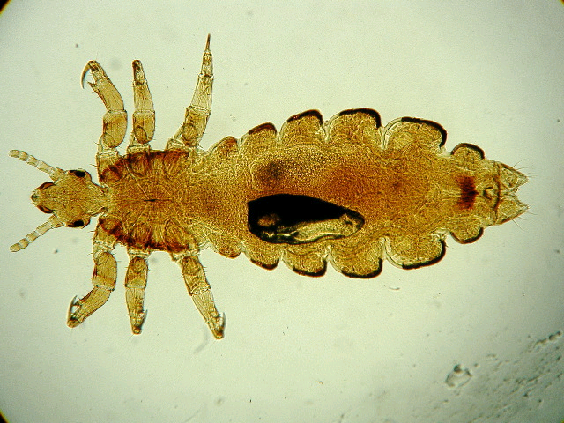
Identify arthropod
State four diseases associated or transmitted by the above ectoparasite
  Rickettsia prowazeki (Epidemic or louse-borne typhus)
  Rachalimae quntana (Trench Fever)
  Borrelia recurrentis (Relapsing fever - endemic relapsing fever)
  Allergic reactions
    Pediculosis
    Maculae caeruleae- Small characteristic bluish spots

Slide 5
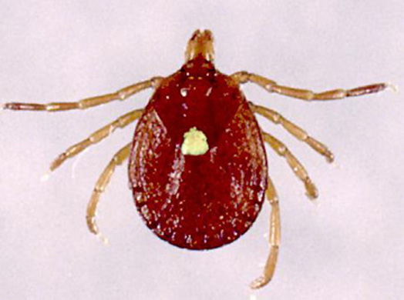
State the type of tick shown above and two possible clinical features associated with it
  Hard tick
  Rocky Mountain Spotted Fever
  Tularemia
  Q fever
  Lyme deases
  Tich-borne relapsing fever

Slide 6
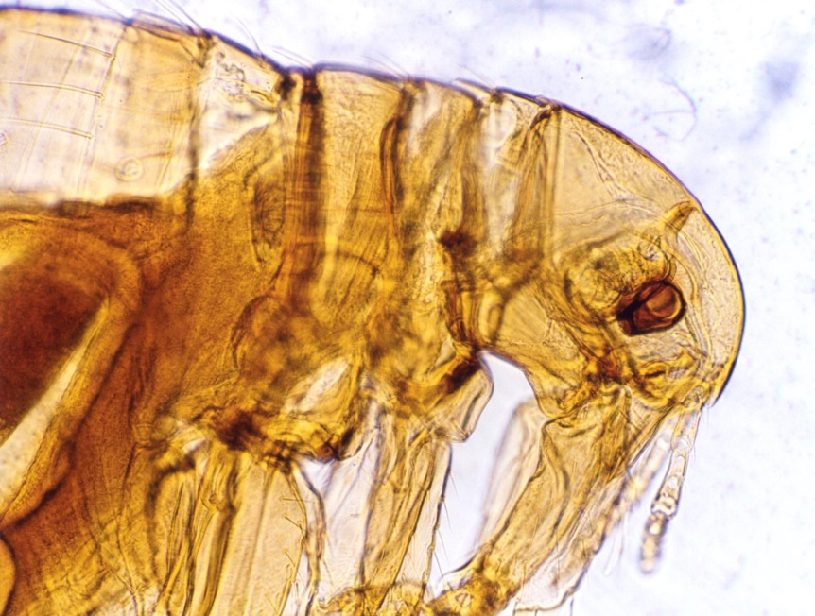
The following is involved in the transmission of several parasites list three
  Hymenolepis diminuta
  Dipilidum caninum
  Hymenolepis nana
Name a type of hypersensitivity associated with the above parasite
  Type 1 hypersensitivity

Slide 7
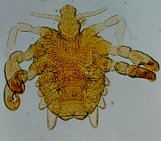
Identify the genus of this organism
  Pthirus
Name the natural habitat of this particular organism
  Pubic region mainly but may be found in armpits or beard, eyebrows, or eyelashes.

Slide 8
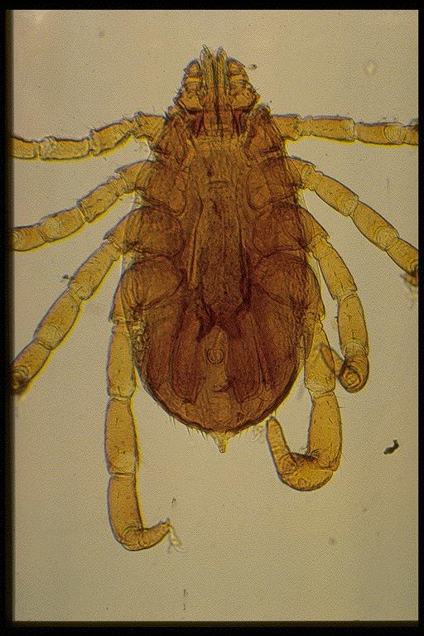
Name three dx associated with the vector shown?

Slide 9
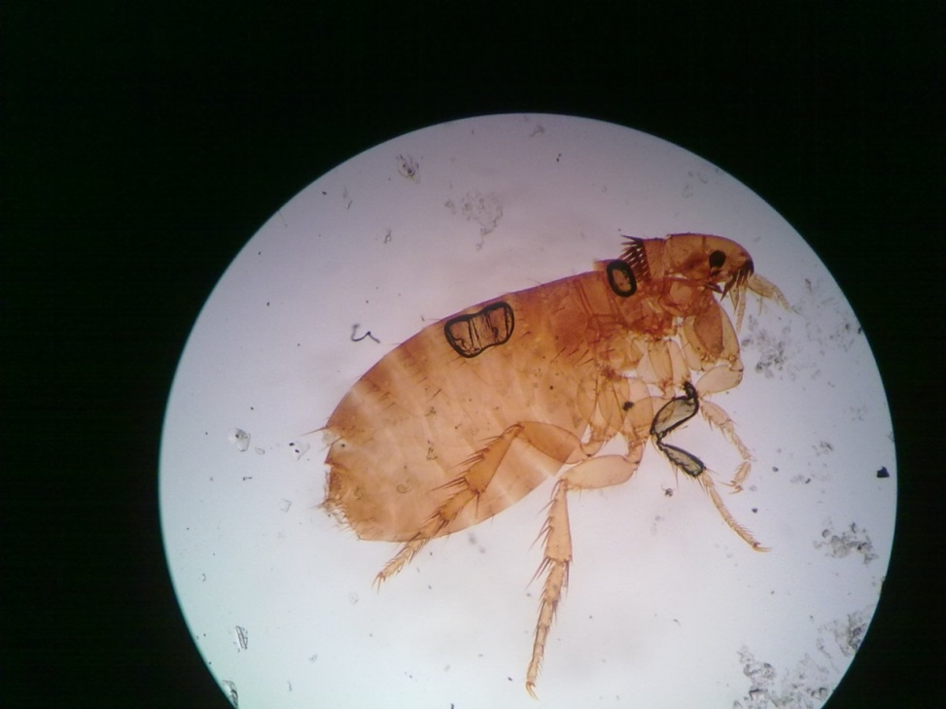
Identify the org shown?dog flea

Slide 10
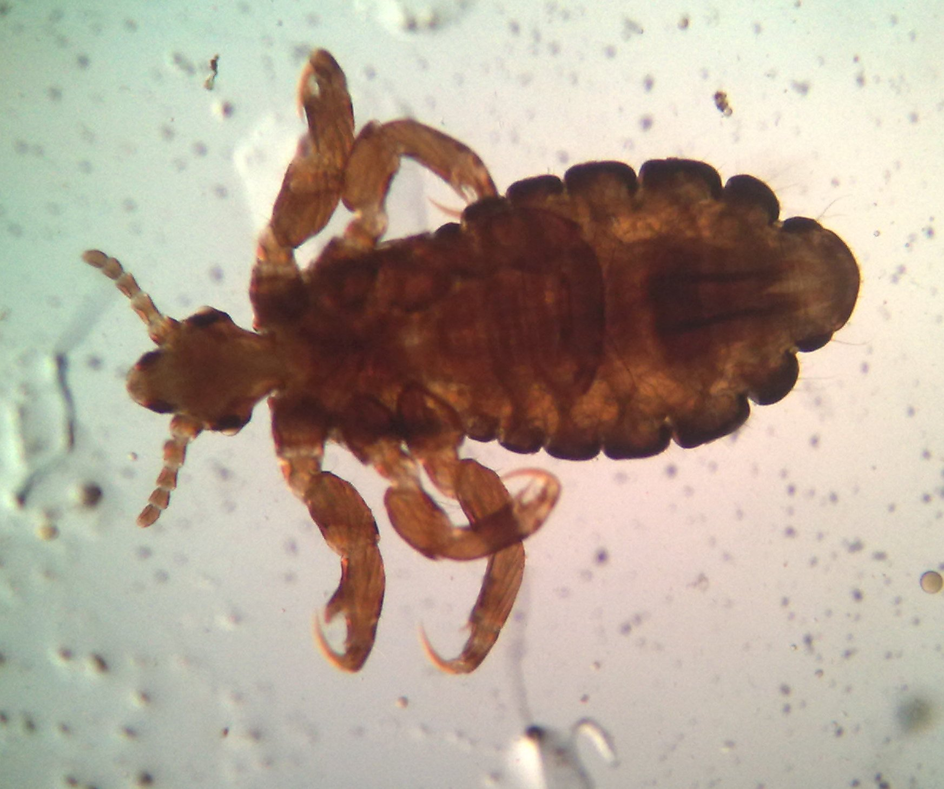
Name the parasite and ass dx?
-Human louse
louse borne epidemic typhus.(rickettsia.prowazekii)
louseborne epidemic relapsing fever.
Borrelia recurrentis trench fever.bartonella
quintana

Slide 11
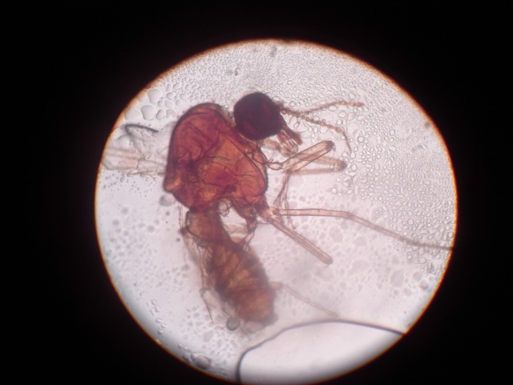
Name the dx for which the insect shown is a vector? Culicoides vector for Mansonella Perstans.peritonitis, pleuritis, pericarditis

Slide 12
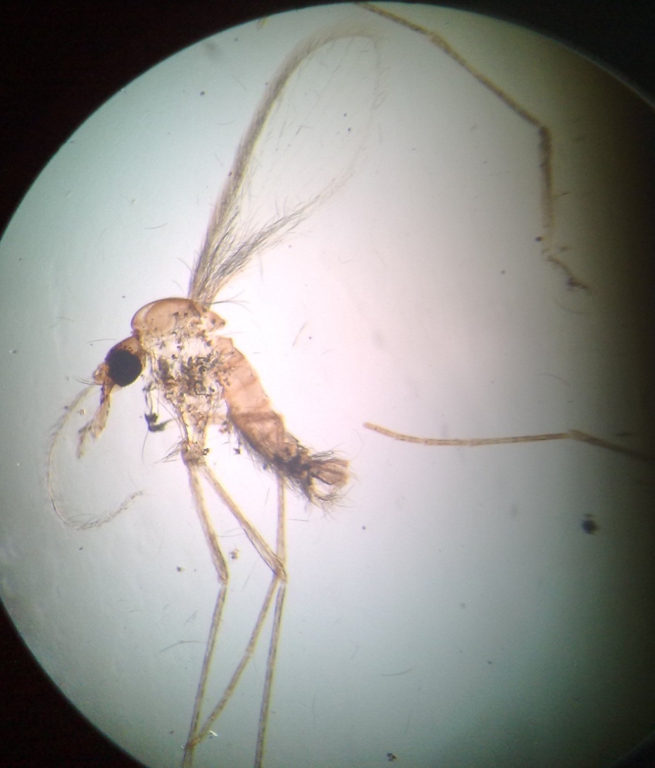
Identify anthropod which parasite uses it as an intermediate host and what disease is it cause

Slide 13
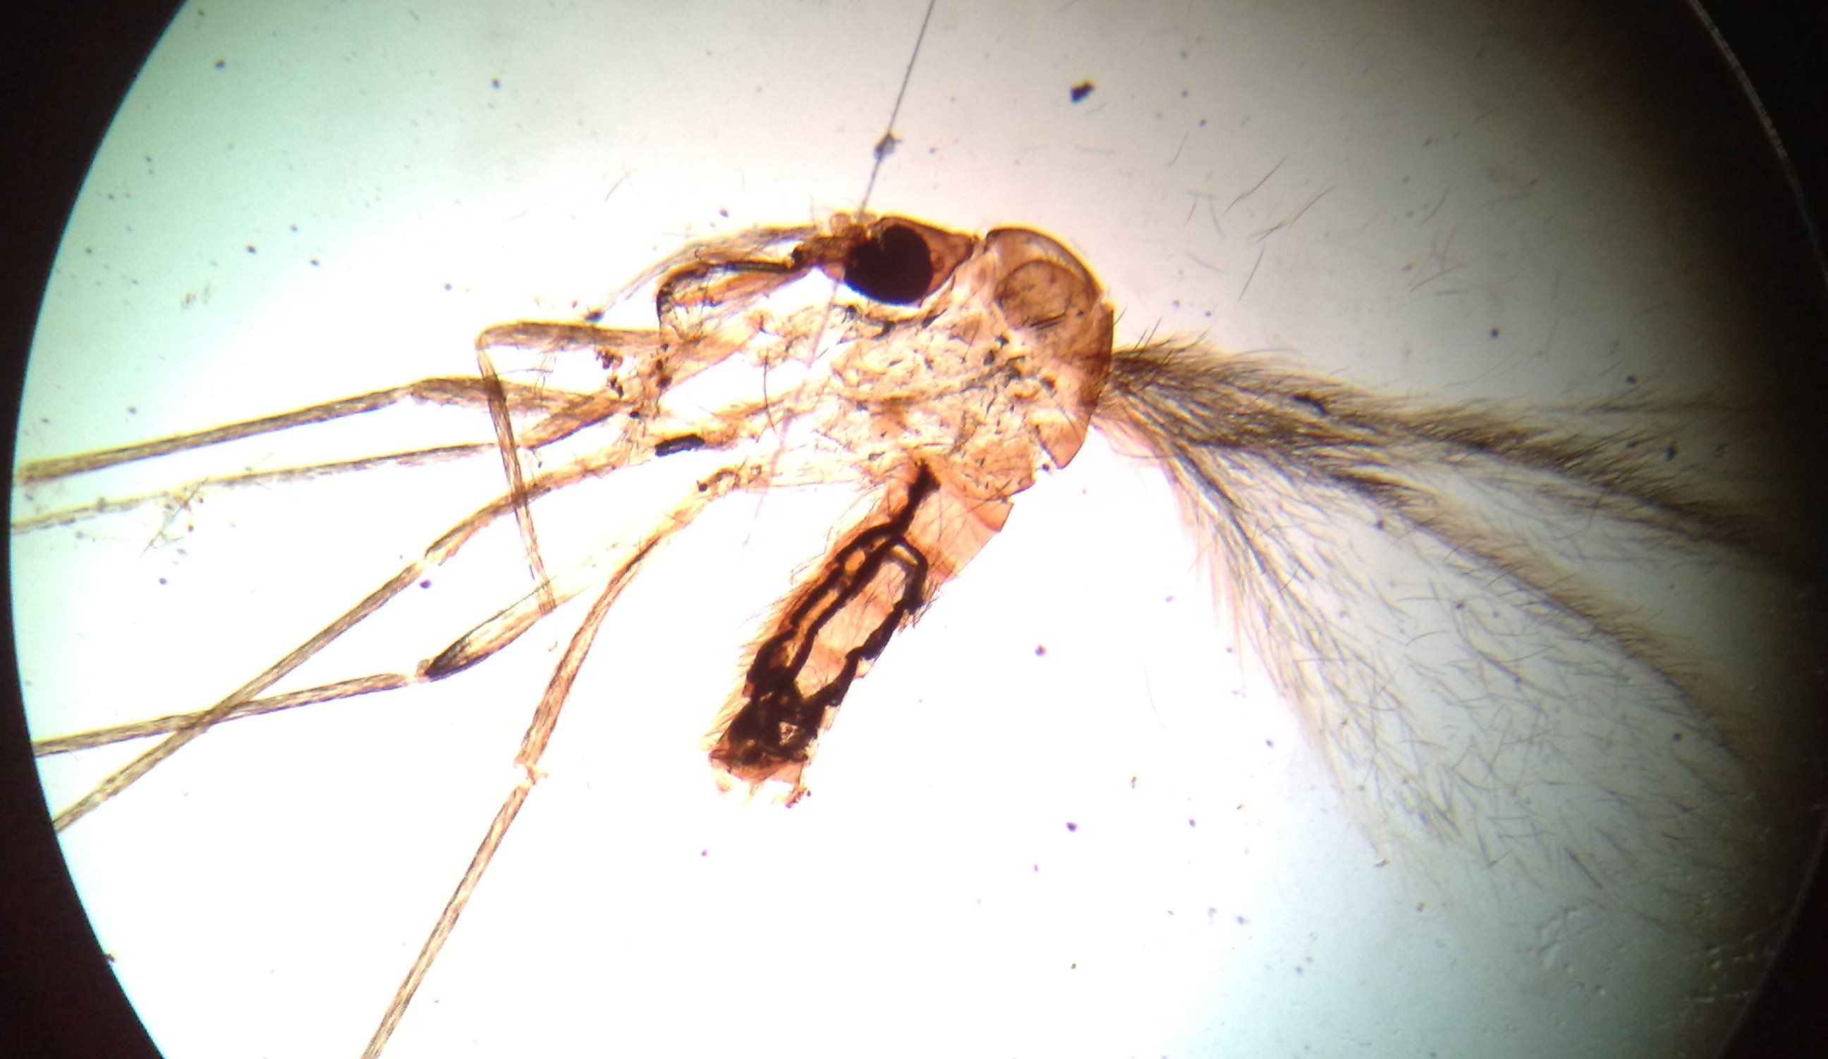
name the vector and disease it transmits what is the drug og choice for treating disease caused?

Slide 14
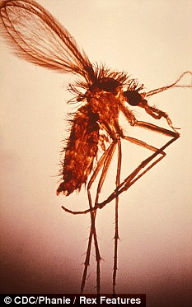
Name the vector shown and the parasite it transmits.phlebotomus, sandfly… leishmania
State its clinical presentation. kalazar, peripheral oedema, diarrhea, leishmanioma, palour

Slide 15
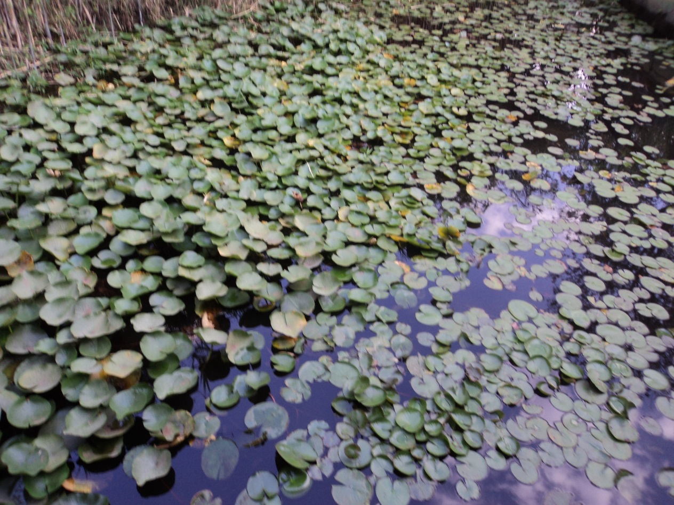
Name the organism that is associated with the plant shown?
  Fasciolopsis buski, F. hepatica
Name the infective stage and its vector?
  Metacercariae, Snail and water plants

Slide 16
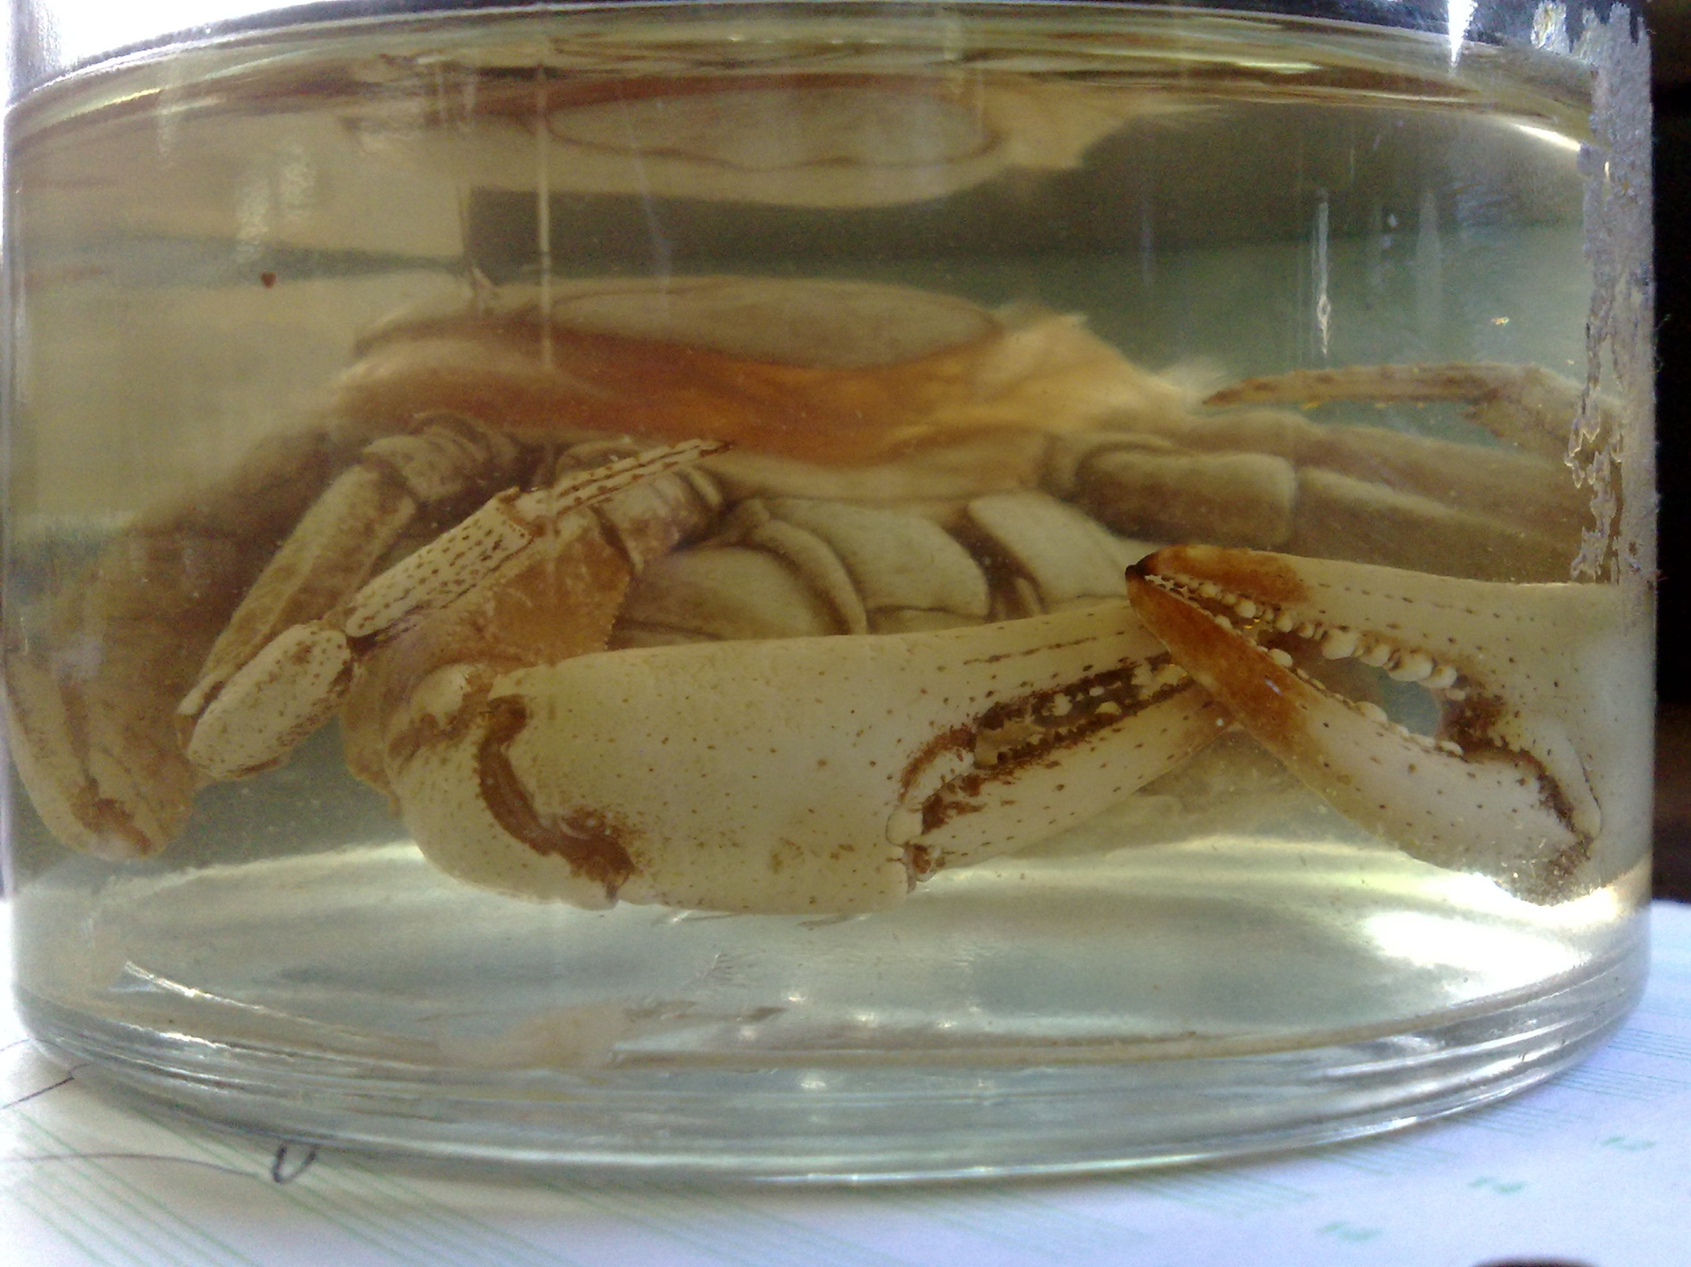
The following crab has a phoretic relationship with a fly, name the possible parasite transmitted by the fly
  Onchocerca volvus
What bacteria genus is associated with the above named parasite
  Wolbachia

Slide 17
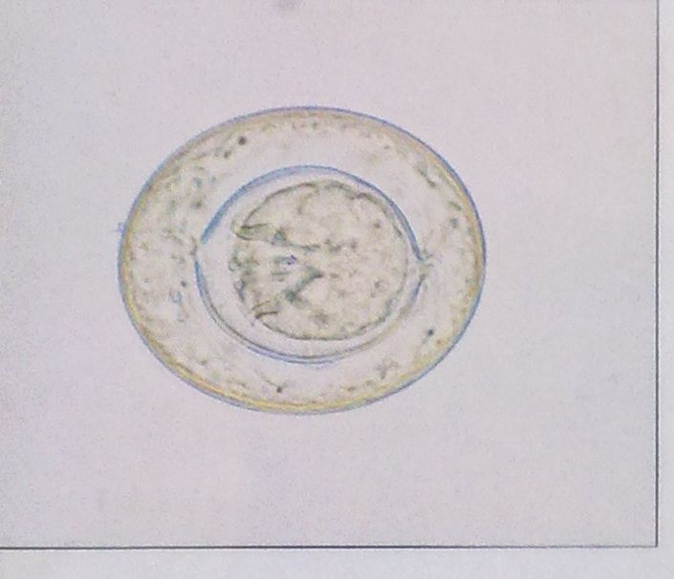
Identify the stage ,genus and species of the organism shown. Hymenolepsis nana, egg

Slide 18
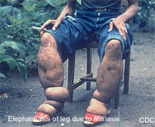
Identify the condition shown
W.bancrofti, elephantiasis
Name two other condition that may be caused by the infection with the parasite. Chyluria, lymphoedema, chyluria, TPE,

Slide 19
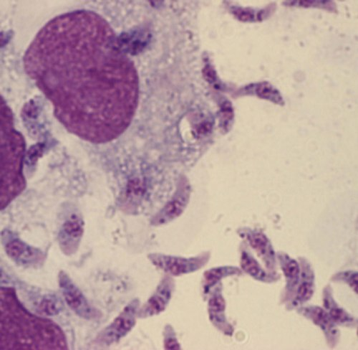
Name the parasite shown in the microscope. Tachyzoites of T. gondii
State the mode of transmission and tx choice.trimethoprim+sulphamethoxazole, pyrimethamine+sulphadiazine, spiramycin in PG, pyrimethamine+clindamycin,
Pyrimethamine+atovaqoune

Slide 20
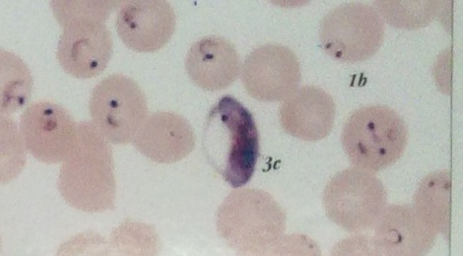
Name the stage of the parasite shown 3c. P. falciparum gametocyte
State the drug for treatment of dx caused by the parasite.
mefloquine, artemisinine and lumefantrine. coartem

Slide 21
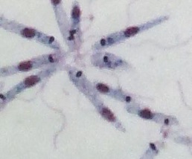
Name the stage and the representative parasite. Leishmania promastigotes
State the specimen source…
Bone marrow, spleen, lymph node

Slide 22
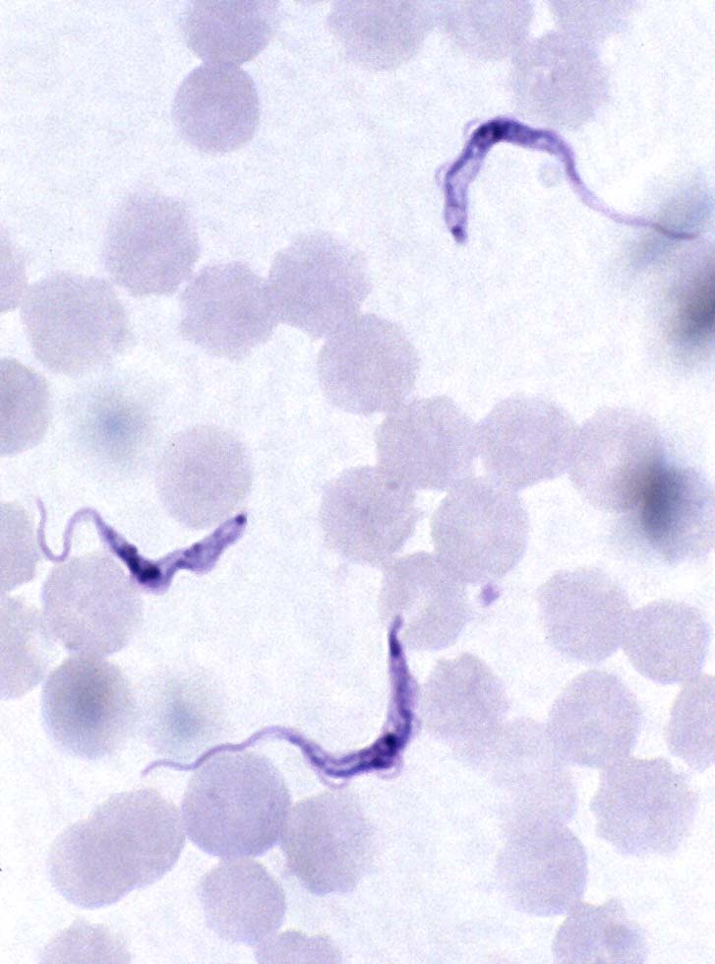
Name the stage of the parasite shown.
Trypomastigotes.
State the drug used for treatment.
B4 cns. Suramin, pentamidine, benzinidazole.
After CNS. Melarsoprol, DFMO,
nitrofurazone

Slide 23
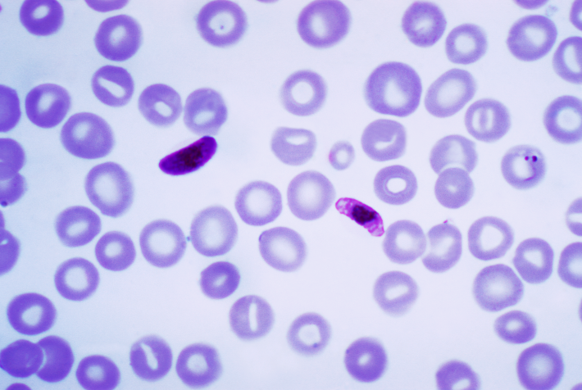
Name the stage of the parasite shown.
Plasmodium falciparum (gametocytes)
State two ass complication.
Hyperpyrexia, convulsions, hypoglycaemia, DIC,severe anaemia
Hypereactive malaria splenomegally

Slide 24
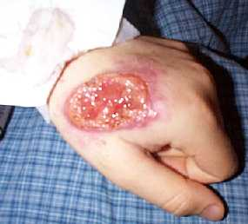
Name the causative organism?
Visceral leish. L. donovani or L. infantum, kalazar,PKDL, amastigotes
In bone marrow, xenodiagnosis, promastigotes in NNN.
Old world cut leish: L. Aethopica- Hyrax vector. L.(tropica)major-
Simple dry lesion on the cheek.Great Gerbil. L(tropica)minor- dogs and wild carnivores
L.major. Wet lesion of mouth. Montenegro test(skin test)
New World cut Leishmaniasis:L.B. panamensis, L. mexicana amazonensis
Mucocutaneous Leishmaniasis: early lesions of espundia,pharyngeal involvement. Destructive
espundiaL.braziliensis- causes espundia… skin biopsy technique.xenodiag with hamster.
Diffuse Cutaneous L eishmaniasis(DCL)- due 2 failure of CMI- L.Mexicana. Amazonensis. DCL
Never infects the mucosa and is readily distinguished from espundia causing Leishmania.
Two other conditions associated with organism?wet lesion on lips, dry lesion on the cheek.

Slide 25
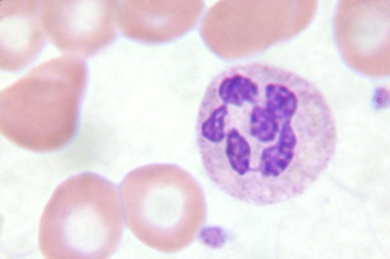
Name the organism which may cause the feature shown?
plasmo
Name the mode of transmission? Mosquito bite

Slide 26
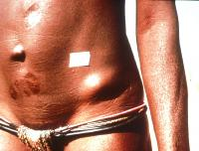
Identify the condition shown and the causative organism?onchocercoma, onchocerca volvulus

Slide 27
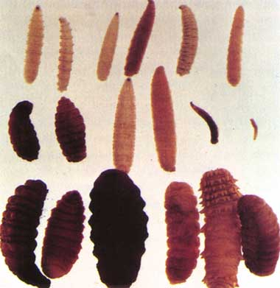
Name the dx ass with the org shown?myiasis

Slide 28
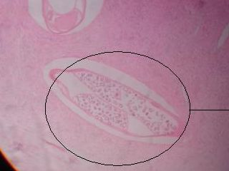
Organism shown?
1 of the filarial worms(w.banc,b.malayi)

Slide 29
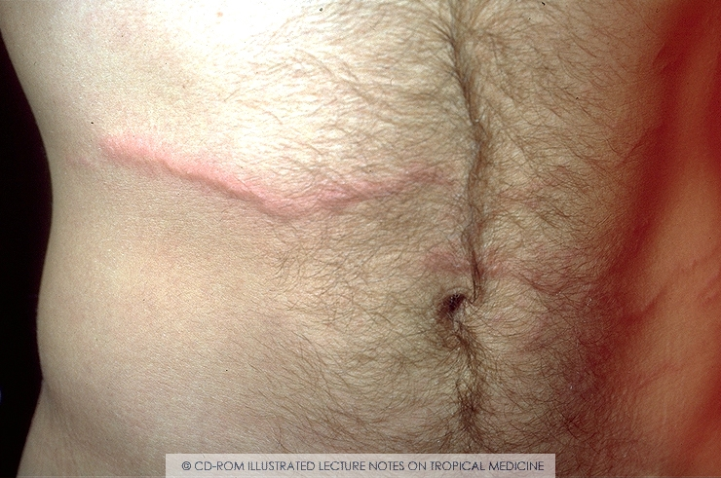
Name the organism ass with the dx shown?strongyloides,ancylostoma caninum, ancylostoma braziliensis,
necator americanus

Slide 30
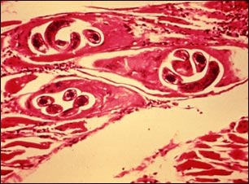
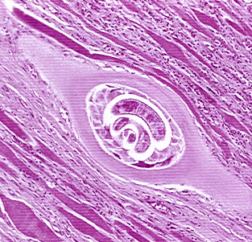
Identify the genus of the larval form of the parasite. Whatis it’s natural habitat
Clinical presentation and the causative organism?trichinella spiralis… myositis, trich spiralis myalgia, diff in breathn, meningitis

Slide 31
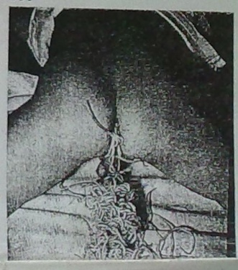
Name the worm ass with the condition shown?ascaris lumbricoides
Give the drug used for treatment?
-Pyrantel pamoate,
-levamisole,
-albendazole,
-mebendazole,
-thiabandazole

Slide 32
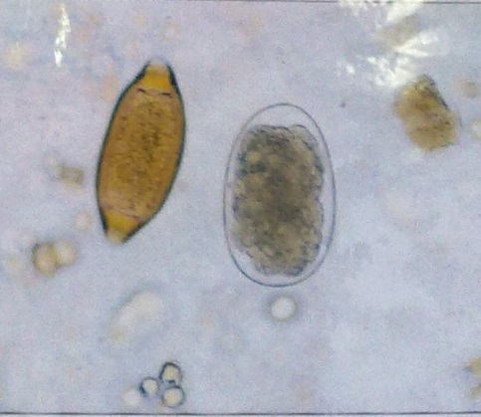
Name the two org with these xstic egg?
-trichuris trichiura,
-ancylostoma duodenale or necator americanus

Slide 33
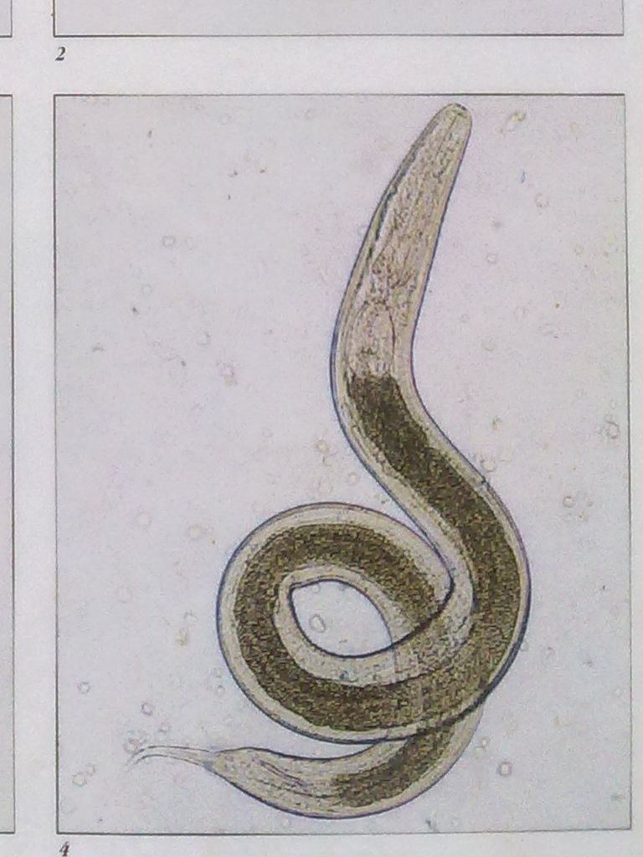
Name the org shown and its clinical presentation?
-enterobius vermicularis(Pinworm).
-Pruritus ani,loss of appetite, weight loss,
peritonitis, nightmares

Slide 34
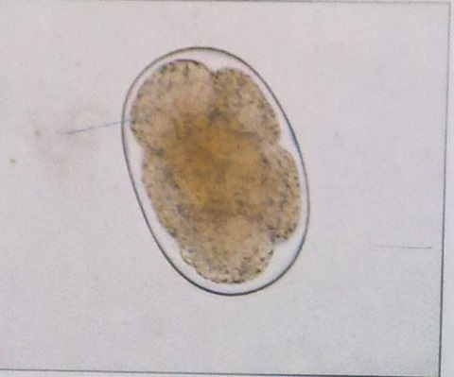
Give two org with this xstic egg?
-Ancylostoma duodenale, necator americanus
-strongyloides stercoralis

Slide 35
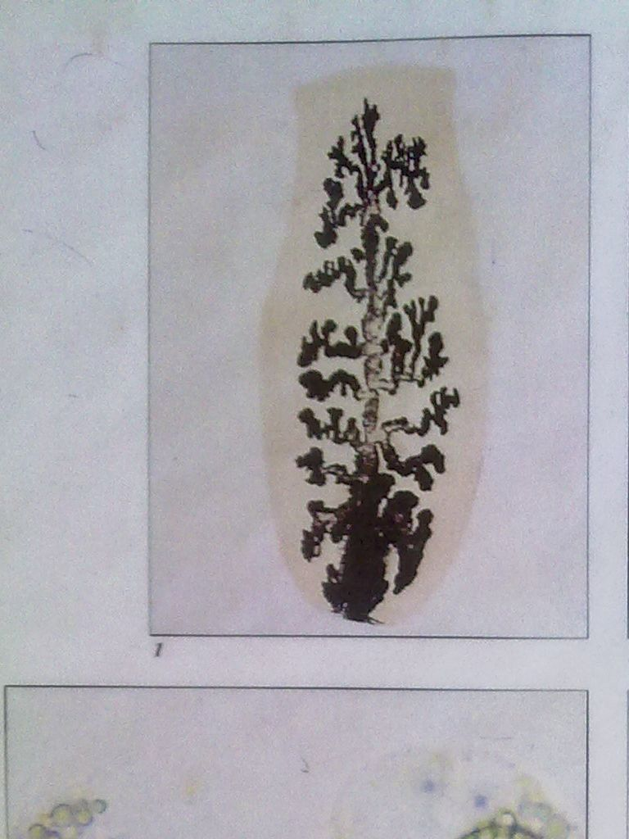
Identify the org and ass its intermediate host?
-Taenia solium
-pig.

Slide 36
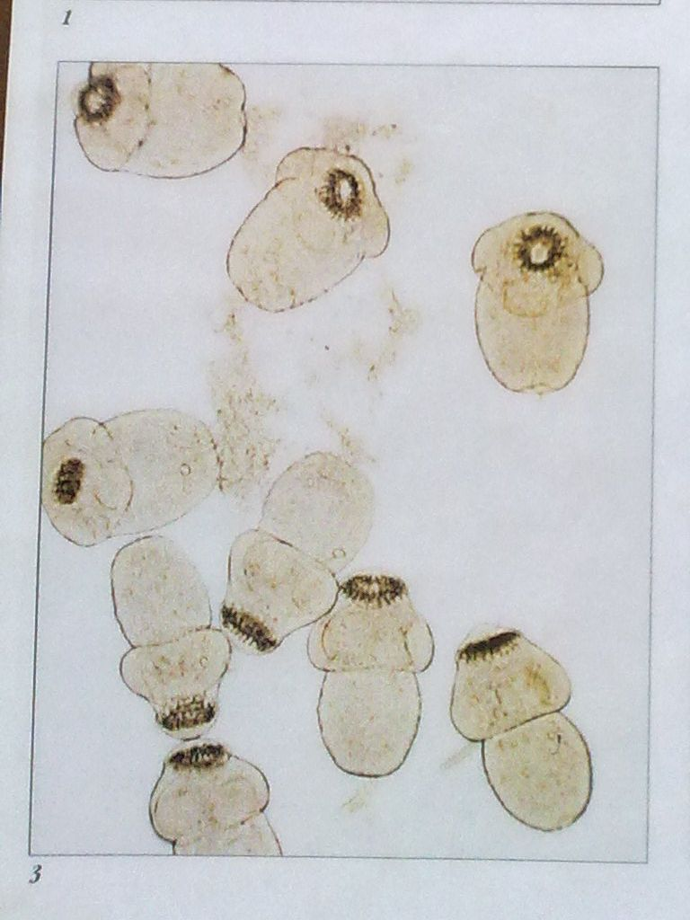
Identify what is shown below?
Mention the clinical presentation of the org ass?
-E. granulosus protoscolex
-hydatidosis(space occupying lesion)
-anaphylaxis(allergic rxn) coz of hydatid sand.

Slide 37
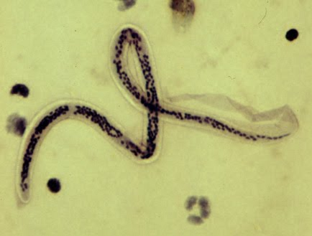
Name the parasite shown. W.bancrofti
State two reasons for your identification.
Nuclei don’t extend to tail
Sheathed
Nuclei clearly separated

Slide 38
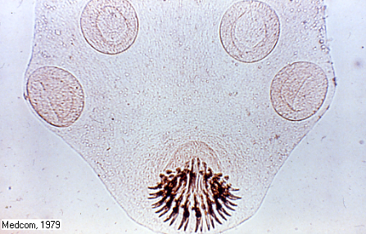
Identify the parasite shown and the dx it causes. Taenia solium
Name the drug used for treament.
Praziquantel
Niclosamide(plus
Laxatives)

Slide 39
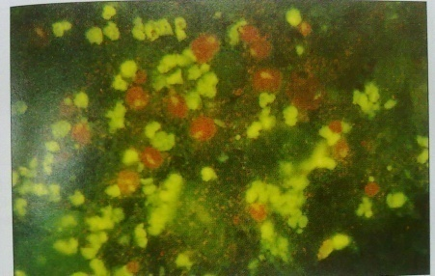
Identify the org in the specimen?
Naegleria fowleri
Give the drug used for treatment?
Amphotericin B, sulphur dimidine

Slide 40
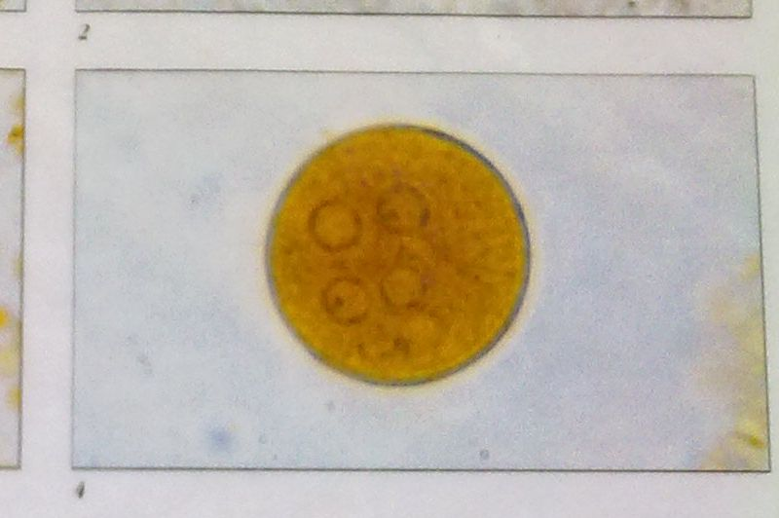
Identify the organism shown ? Entamoeba coli
Give two reasons for your identification?
-More than 4 nuclei
-its iodine stained

Slide 41
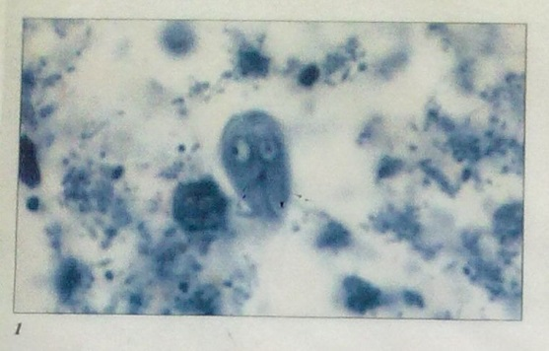
Who is that peeping and what does he do for a living? Giardia lamblia.
Causes steartorhea

Slide 42
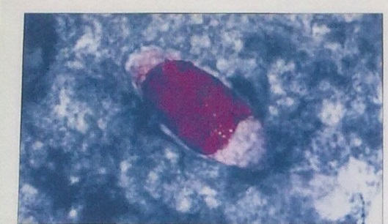
Name the org and two reasons for your identification? Isospora belli.
Ellipsoid shape and 1 sporoblast

Slide 43
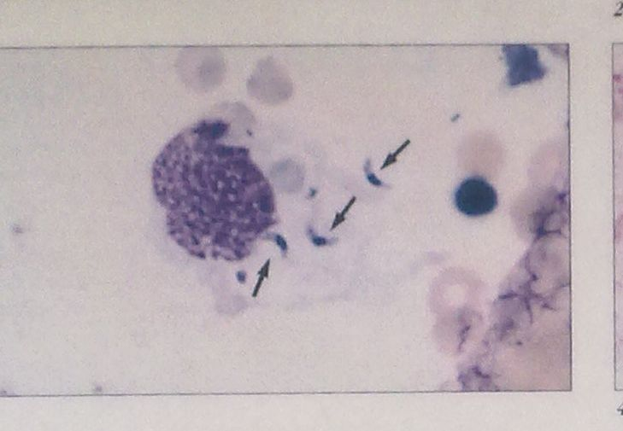
Name the org shown and ass dx?
Crescent shaped tachyzoites of toxoplasma gondii.
Fever, muscle ache, lymphadenopathy, myocarditis, retinitis, encephalitis,
hydrocephalus

Slide 44
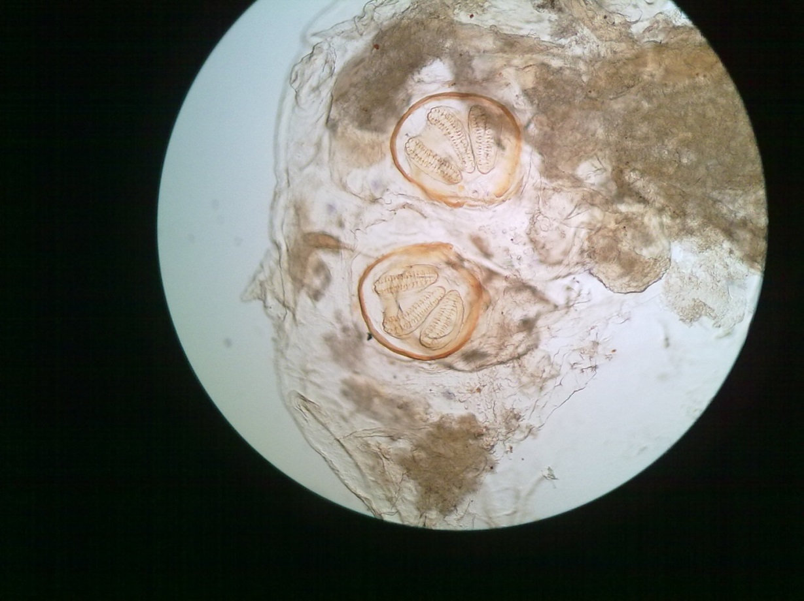
Name the specimen shown and dx ass with the same?
Caliphoria vomitoria spiracles.
myiasis

Slide 45
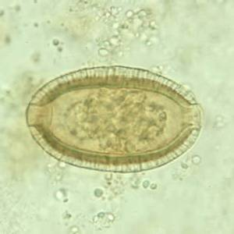
Identify the stage genus and species of the parasite under the microscope.
Capillaria
philipinensis
Name the clinical site where the parasite is normally found. Ileum(C.P)
      Liver(C.H)

Slide 46
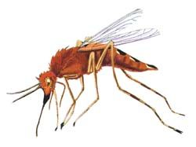
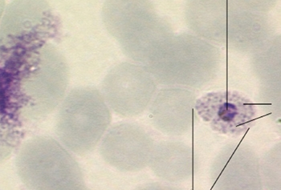
Name the vector and the feature in B, anopheles
Give one reason for your identification in B

Slide 47
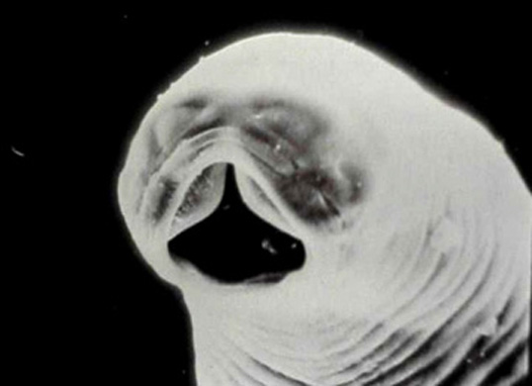
Identify the parasite shown. N americanus.
State the drug used for treatment
Bephenium hydroxynophthoate
Pyrantel pamoate
mebendazole

Slide 48
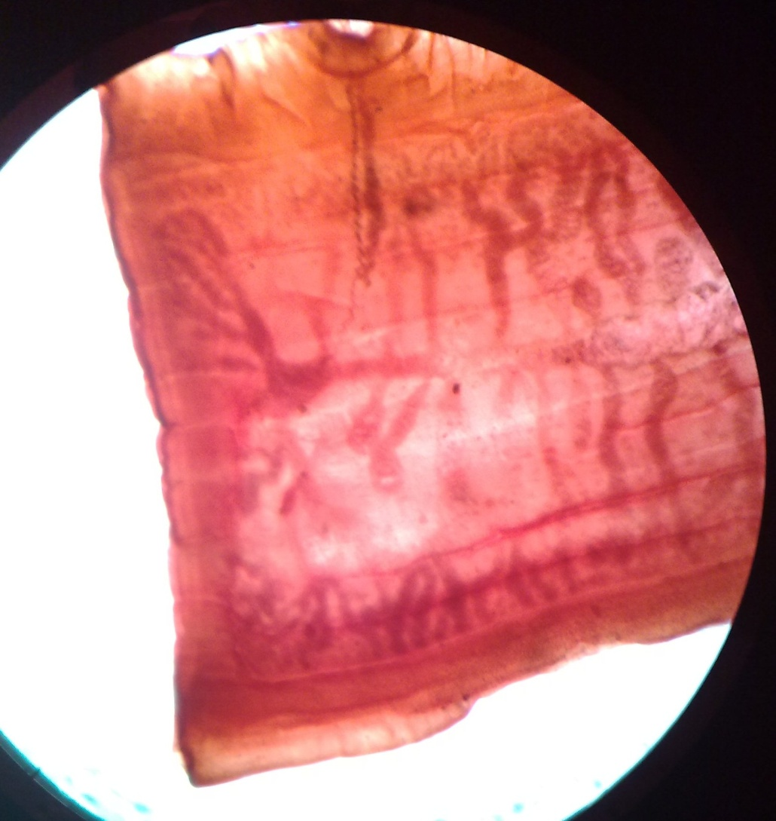
name the stage, genus and species of parasite what is the major complication it causes

Slide 49
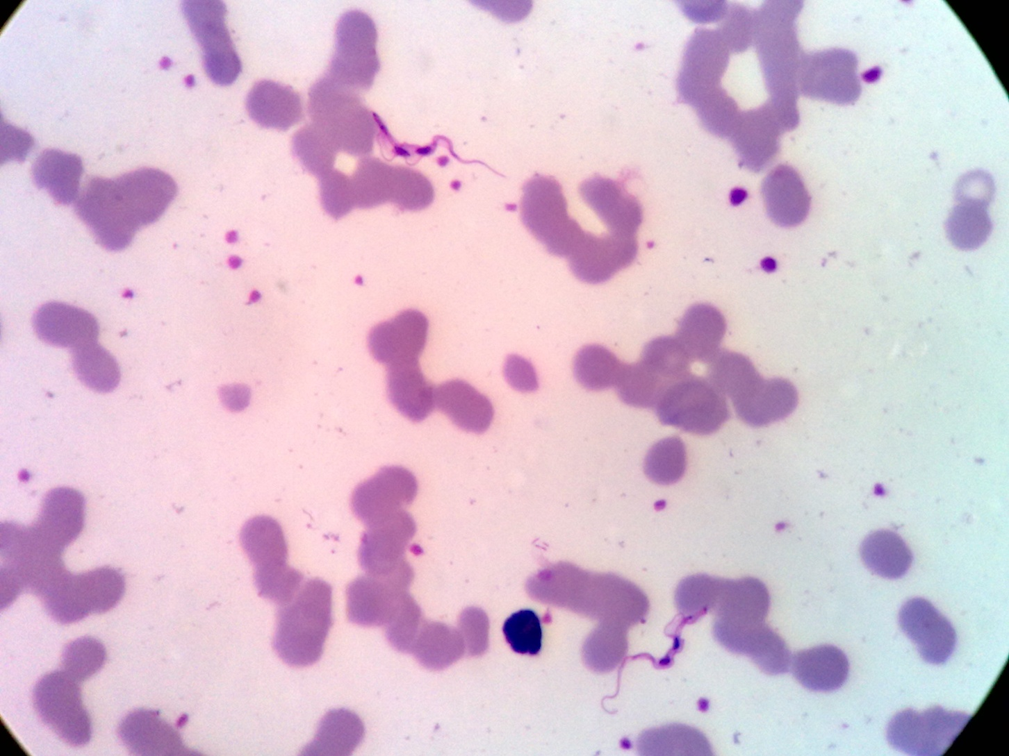
Identify the stage of the genus and spps of the parasite name the insect vector responsible for it’s transmission

Slide 50

Name the stage and spps of protozoa name the it’s mechanical vector

Slide 51

Name the stage, genus and species of parasite shown name two complications it cause

Slide 52


Identify parasite, stage, genus, species and vector involved in it’s transmission

Slide 53

Identify, genus,and species of parasite how does man get infection?

Slide 54


Identify stage, genus, species of organism. What condition is mailny associated with it?

Slide 55

Identify class,genus,species, intermediate host and treatment.HETEROPHYES

Slide 56


Identify helminth and of transmission and treatment.

Slide 57

Identify helminth mode of transmission and treatment

Slide 58

Identify stage of parasite, class, genus,species and two complications.

Slide 59

Identify kingdom, order, species and treatment

Slide 60

Identify the stage of parasite and three complications it causes.

Slide 61

Identify stage, kingdom, genus, species, treatment of condition.

Slide 62

Identify parasite intermediate host and treatment.

Slide 63

fasiolapsisbuski
Identify the class of parasite genus and species.
List two complications parasite causes.

Slide 64

Identify condition shown and it’s causes
MYIASIS\
Least two preventive measures for this condition.

Slide 65

Identify condition and two causative agents.
LOIASIS,LOALOA;
What is the treatment?

