Slide 1
VIROLOGY SPOT TEST REVISION
KIMAIGA H.O
MBChB (University of Nairobi)

Slide 2
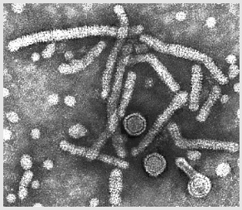
1.List 2 properties of the virus shown
Belongs to hepadnaviridae family,it’s a DNA virus,it has an enveloped nucleocapsid,its icosahedral nucleocapsid,replication takes place in the nucleus
2.Give methods of prevention of the virus shown
Vaccination-live attenueated vaccines,blood and body fluid screening for the virus,protected sex

Slide 3
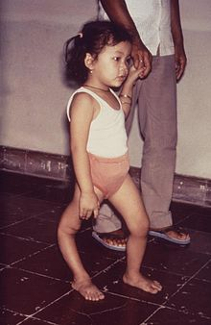
1.Name two other viruses in the family of the virus that causes the condition above
Echovirus, cocksackie A andB, hepatitis A.
2.Gve two disadvantages of the live vaccine(sabin) against the causative agent of the above condition.
-cannnot be used in immune compromised pple
-since its given orally,its limited by interference.
3.Give the immune response aganist the virus that causes the above condition.
Production of IgG,and IgM and IgA in circulation.

Slide 4
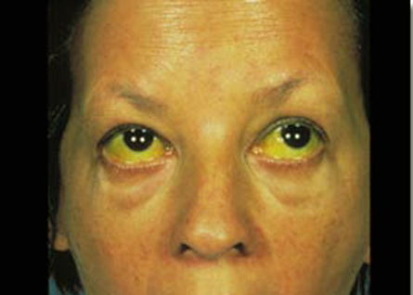
1.Give viral agents that could cause the condition shown above.
Hepatitis viruses,A,B,C,D,E,yellow fever virus.

Slide 5
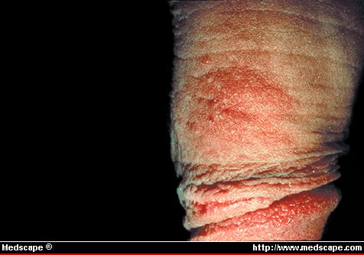
1.List two other conditions caused by the virus that causes the above condition
Virus-human herpes virus-2.-conditions-ulcerative vesicular lesions in the vagina, urethra.
2.Give methods of prevention and treatment of the condition above.
Prevention- newborns and persons with eczema should be protected form infected people, vaccines are being developed against the virus.
Tx- acyclovir, valacyclovir, gancyclovir-all of which are replication inhibitors.

Slide 6
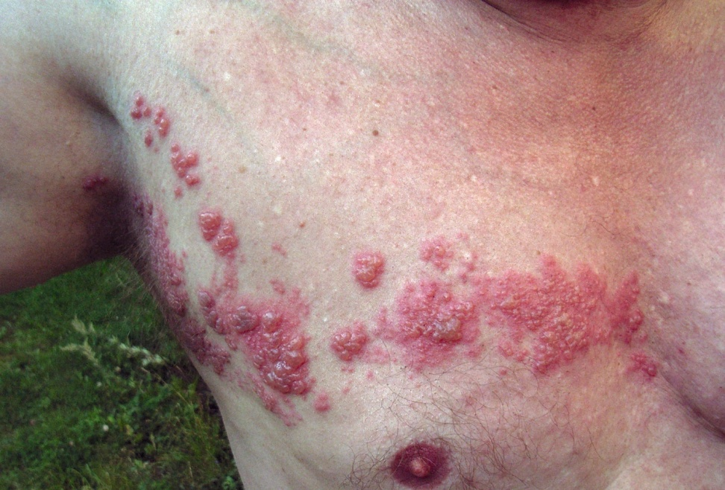
1.Identify the condition above.
-shingles(zoster)
2.Give its method of transmission.
Respiratory droplets-respiratory mucosa-blood(viremia)-skin-ganglia-skin through specific dermatomes
3.What type of vaccine is used in prevention of the above condition.
Live attenuated vaccine

Slide 7
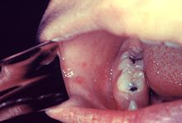
1.What type of vaccine is used to prevent the condition associated with the above presentation?
2.Give the 2 types of envelope spikes associated with this virus.

Slide 8
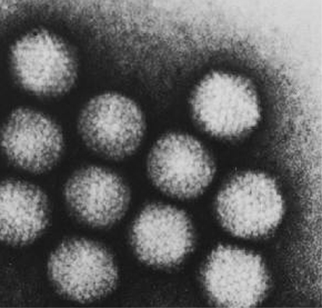
1.Describe the morphology of the virus displayed.
Doughnut appearance
2.Give the name of the family of the above virus.
herpesviridae

Slide 9
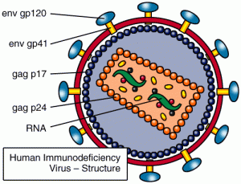
1.Name the parts labelled S and M ☺
S-gp 120
M-nuclear envelope
2.State Two methods you can use to diagnose HIV one.
ELISA-to detect viral antigen eg p24and Abs against them.
PCR-for detecting viral RNA
Development of constitutional illness can also be used
Fall in CD4+ lymphocytes below 200.

Slide 10
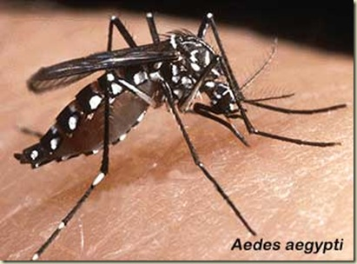
1.Give viruses transmitted by the vector above
flaviviridae-Yellow fever virus,dengue virus
Togaviridae-WEE,EEE,VEE
Bunyaviridae-rift valley fever,cremea congo hemorragic fever virus
2.Give methods of control of the above vector.
Draining of stagnant water,clearing of bushes around home areas,use of mosquito nets,use of insecticides .

Slide 11
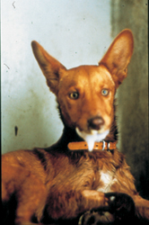
Through what receptor does the virus enter the preferred cell.
  Acetylcholine receptors
Give two methods used to diagnose the condition represented above.
  IFA-to identify the rabies antigen,
  Serology
  Animal observation-signs of encephalitis,seizures,hypdrophobia,dysphagia,confusion and lethargy.
Does the virus cause a localized or a systemic infection?

Slide 12
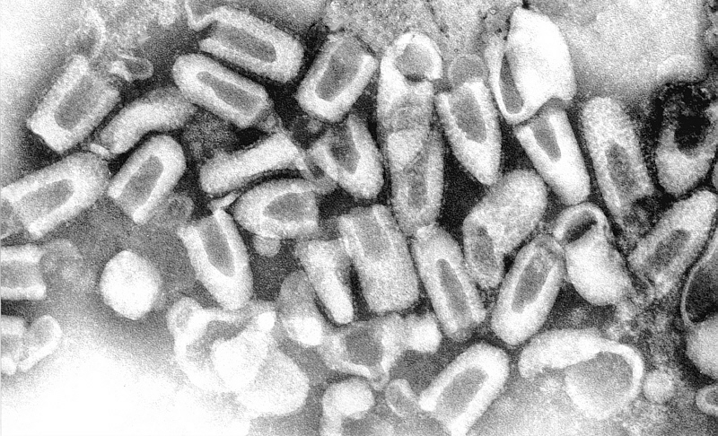
Identify the virus,
Name the virus shown. Rabies
Rhabdoviridae
State the mode of tx and the ass dx
Bite by rabied dog
Rabies
disease caused and it’s mode of transmission
Name the family of the virus whose cycle is shown above
Give 2 characteristic clinical manifestations of this virus

Slide 13
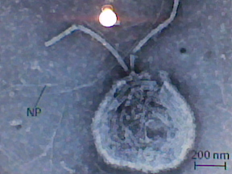
1.Give three viruses that display the morphology shown above.
2.What is the mode of transmission of the above virus?

Slide 14
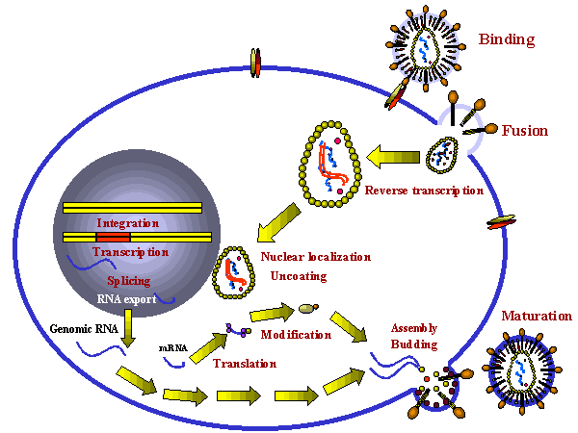
Above is the replication cycle of HIV
1.Name the receptors used by HIV for entry of the virus into host cells
CD4 receptors
2.Name the key enzyme in the replication of HIV-1
Reverse transcriptase enzyme
3.Name some of the drugs that target this enzyme.

Slide 15
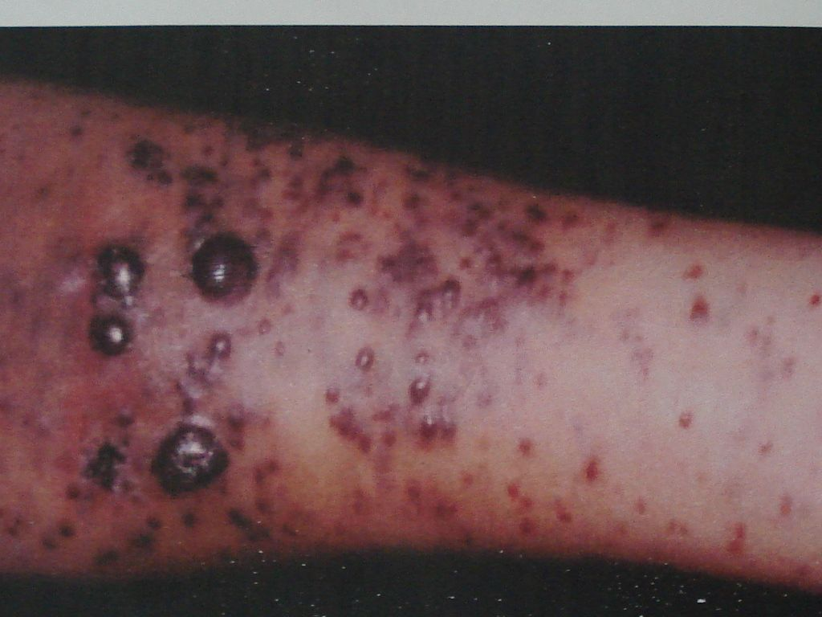
Identify the lesion in spot
  Karposi Sarcoma Lesion
Name the virus that causes the above presentation.
  Human herpes virus-8
What is the site of genome replication for the virus associated with the lesion?
List other diseases caused by the virus.

Slide 16
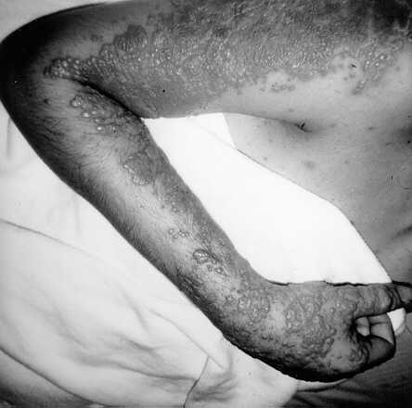
Name the site of primary infection of the virus linked to this lesion
List 2 antiviral agents against this virus

Slide 17
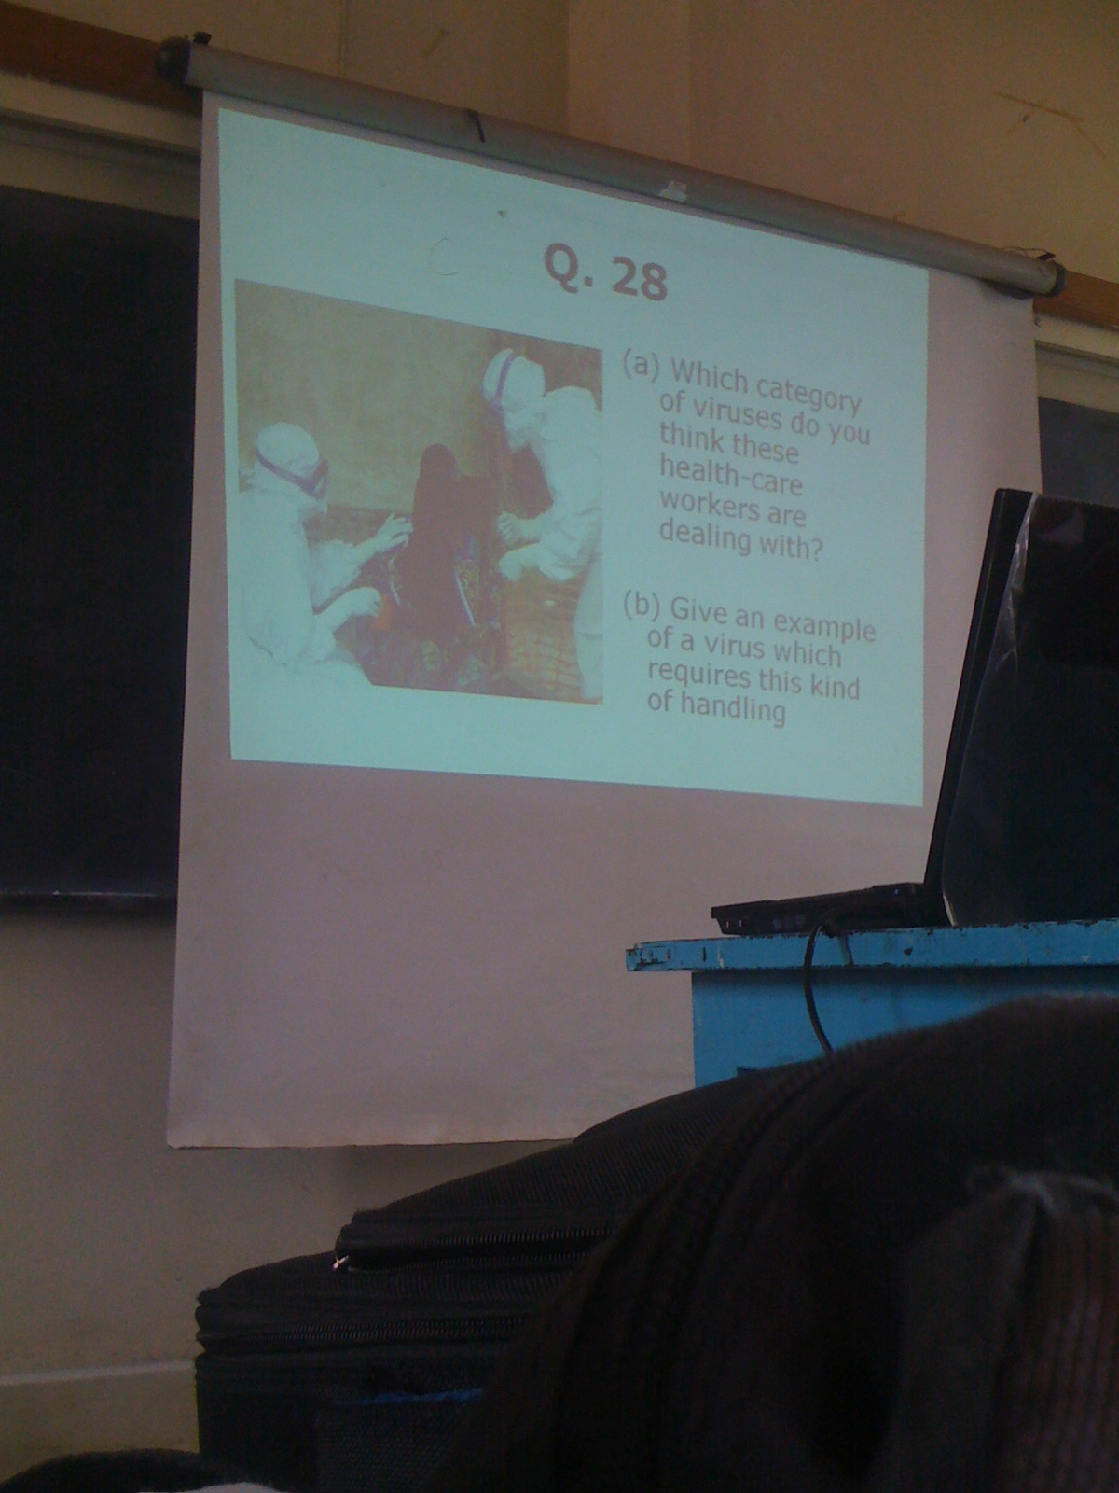

Slide 18
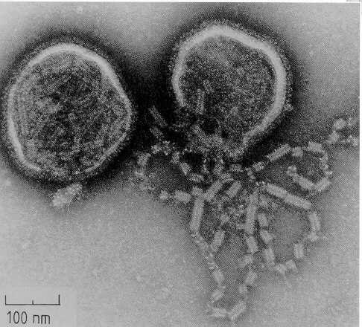
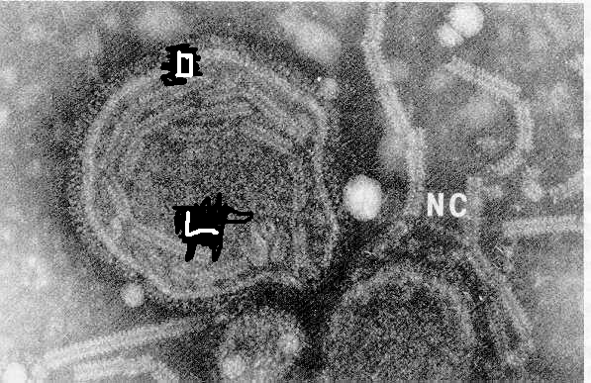
Label the parts L and O above
Name 3 oncogenic viruses and their associated cancers
Describe the above morphology
List three viruses with this morphology

Slide 19
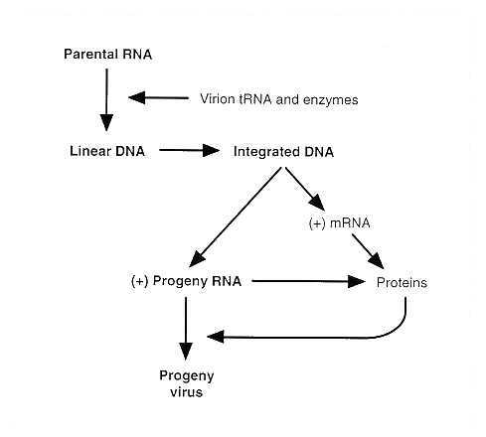
List 2 viruses that follow this replication cycle
State 2 predisposing factors of HIV infection

Slide 20
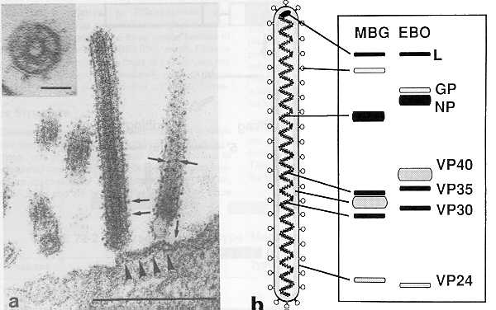
Describe the genome of the virus displayed
Mount 2 control strategies against diseases caused by VHF viruses

Slide 21
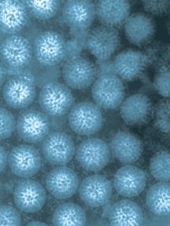
The diagram shows a photomicrograph of a virus commonly associated with infantile
Diarrhoea
Name the virus. rotavirus
Name the family of the virus.
reoviridae

Slide 22
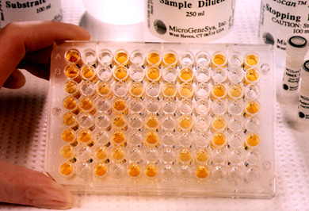
Identify the serological technique shown
State the two components
Antibody
Enzymatic amplification
Solid phase or sorbent,

Slide 23
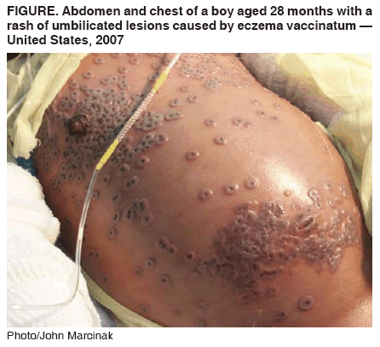
Identify the clinical condiion shown and the causative organism. Umbilicated lesions caused by eczema vaccinatum.

Slide 24
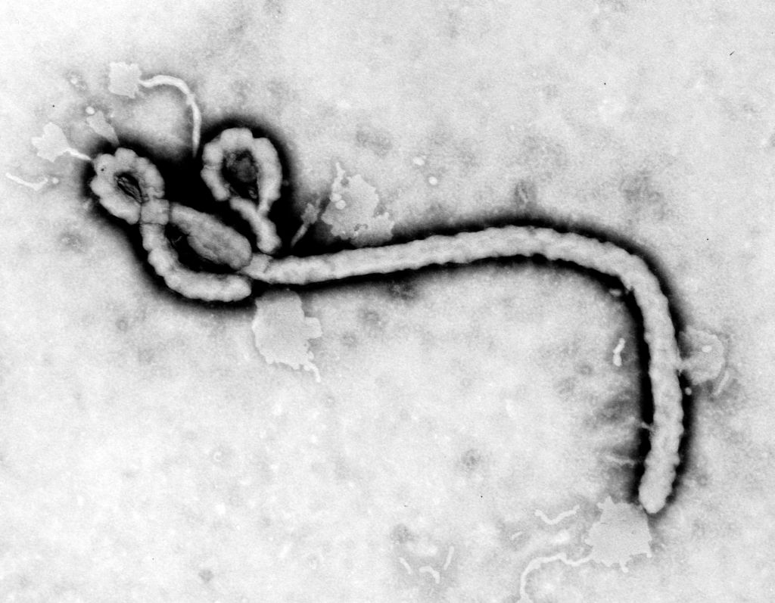
Identify the virus shown in the diagram. Ebola.
State the family the virus and one xstic
Filoviridae, ss RNA, enveloped, linear

Slide 25
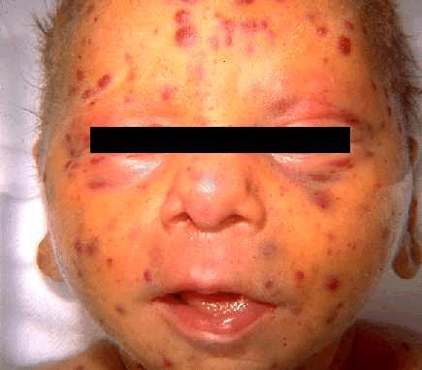
Name the virus ass with the condition shown. Measles
State the family of the virus and one xstic. Paramyxoviridae
Ss negative polarity, linear, enveloped, non segmented

Slide 26
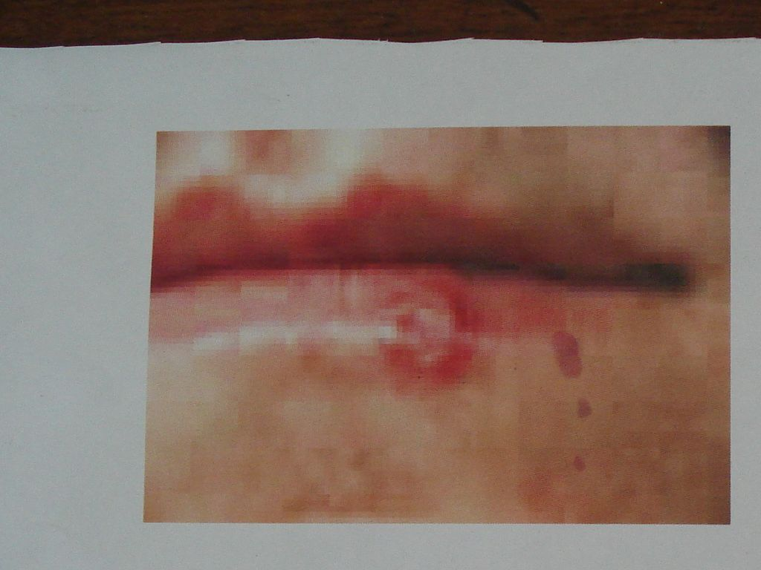
Name the condition and the ass virus? Herpes labialis by HSV1
Drug recommended?

Slide 27
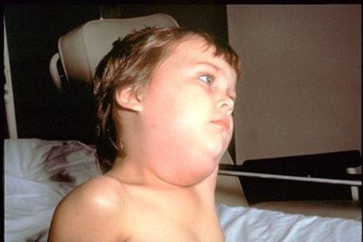
Name the condition and two org in the same family with the causative org?
  Mumps
  Paramyxo- Measle, rsv, Parainfluenza
List the properties of the virus that causes the above condition.
  Belongs to paramyxoviridae family,its an RNA virus,it is single standed with a negative sense,enveloped and has a helical bucleocapsid
2.State two complications associated with infection with the above virus
  Orchitis-if bilateral can lead to sterility
  Menengitis-this is benign,self limited and aseptic.
  Sterility

Slide 28
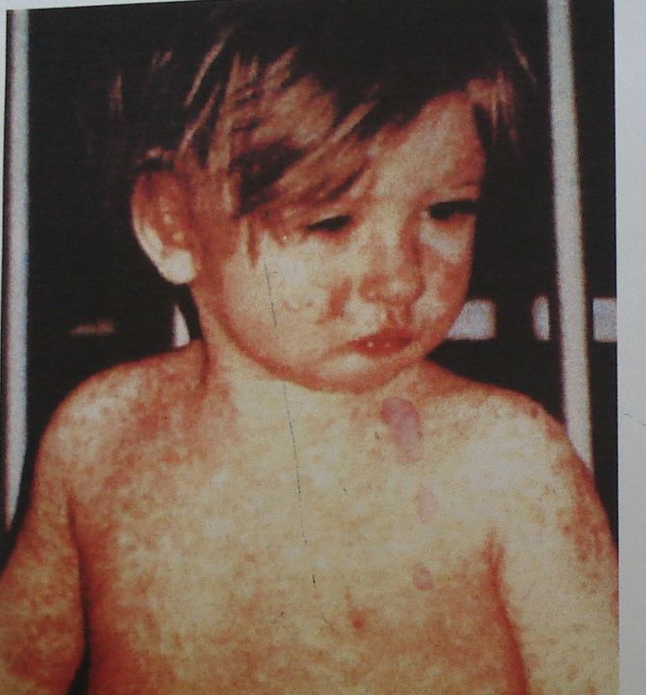
Name the condition ,causative org and means of prevention?chicken pox, varicella zoster.
Acyclovir is usefull in preventing
varicella.
Plus vaccine

Slide 29
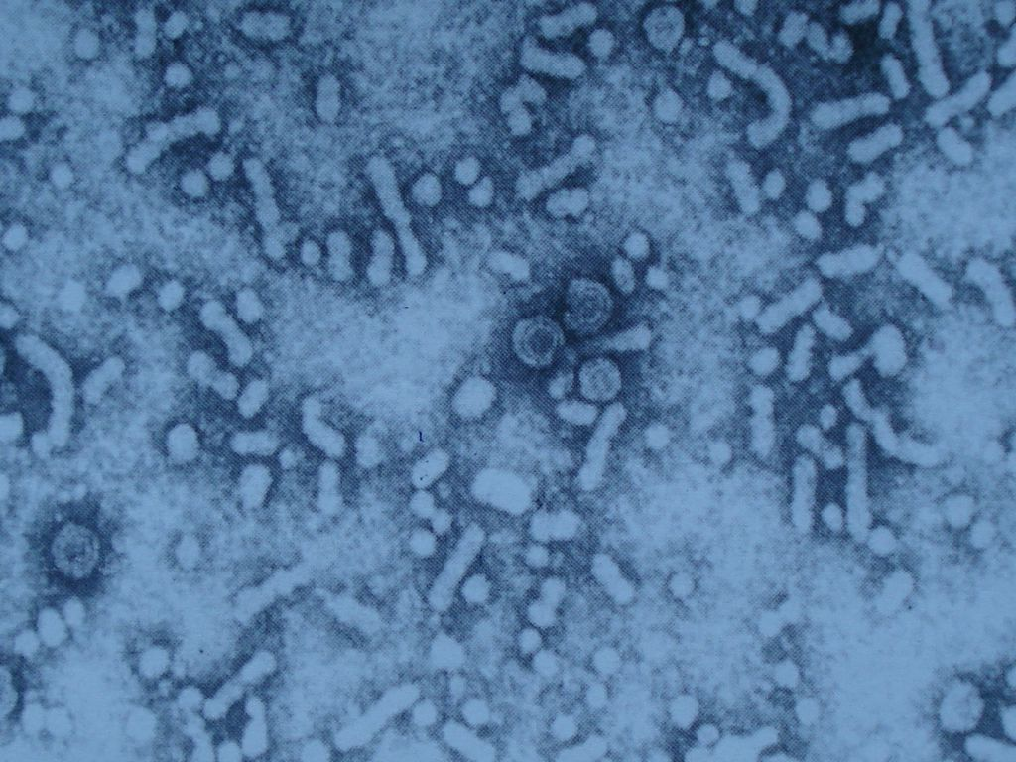
Name the virus shown below,its clinical presentation and complication.
Dark urine, pale faeces, elevated transaminase levels, jaundice
hepatocellular carcinoma

Slide 30
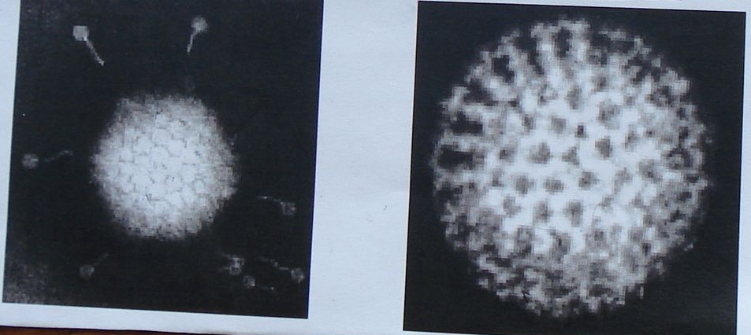
Name the two viruses in the photomicrograph below and name the dx caused by each? L.adenovirus, pneumonia, conjuctivitis, acute respiratory disease, pharyngitis, also gastroenteritis
R. influenza. Sinusitis,
fever, myalgia, h/ache
sorethroat, cough
What is the main mode of transmission of virus

Slide 31
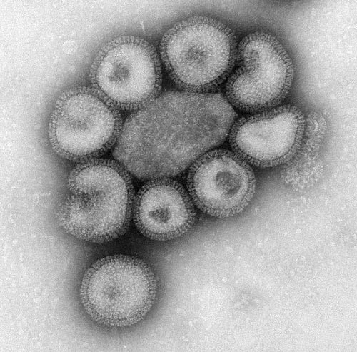
Name the virus shown. influenza
State its mode of transmission.
Respiratory droplets

Slide 32
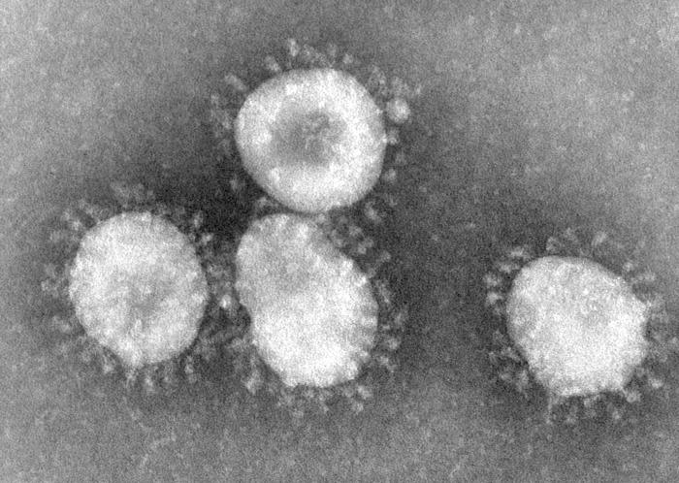
Identify class,order and species of virus shown and mode of transmission
corona virus

Slide 33
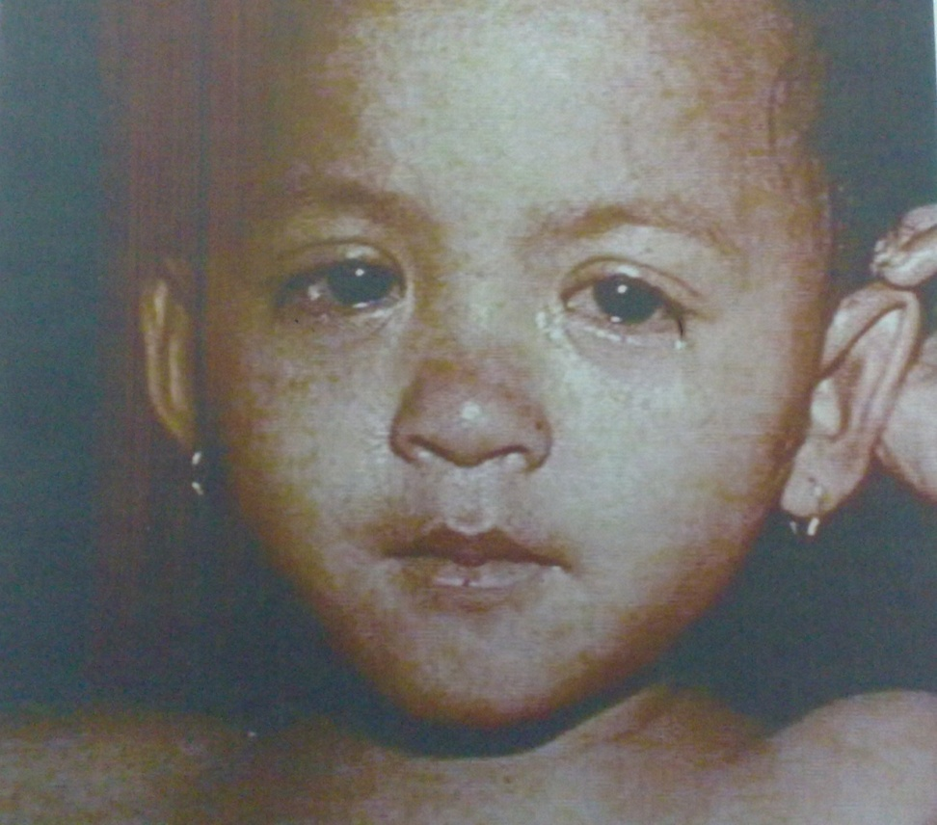
Name the condition shown and two complications it causes.

Slide 34
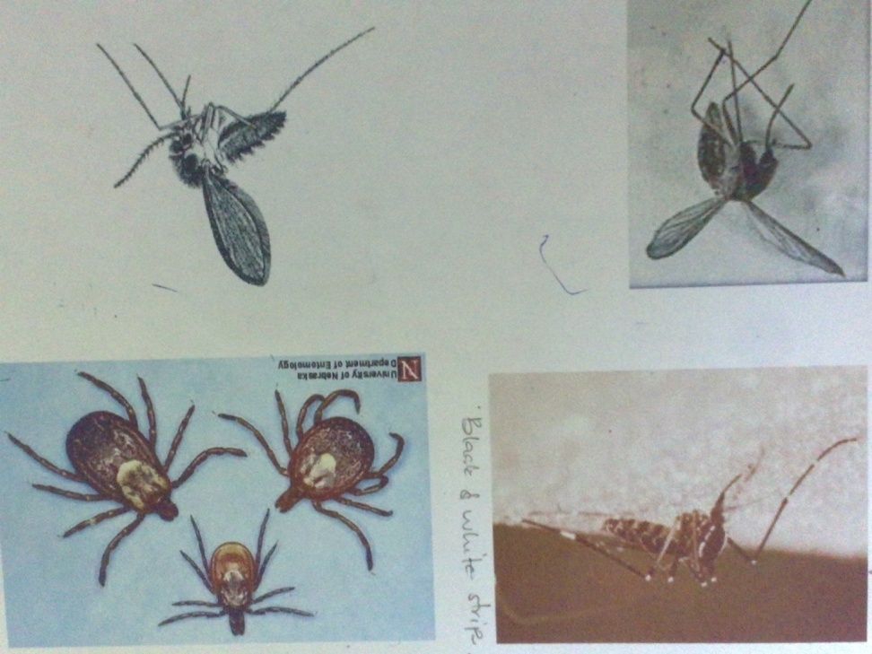
Name four viral diseases transmitted by these vectors

Slide 35
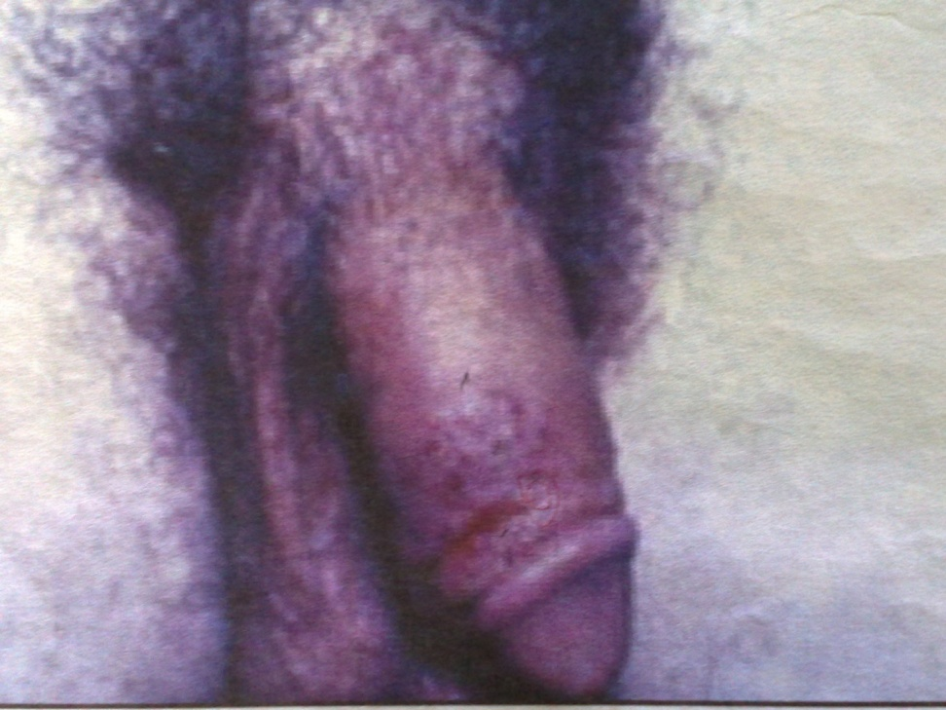
Identify the family and class of the virus and name the condition shown

Slide 36
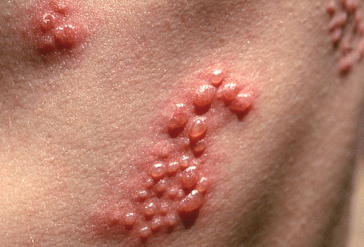
Name the condition and causative viral agent.

Slide 37
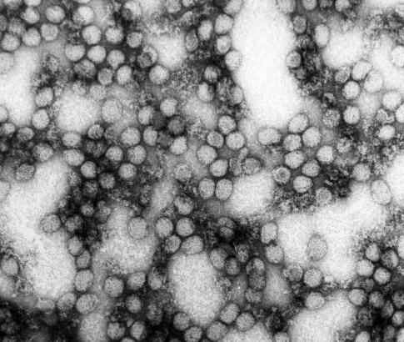
Identify virus, mode of transmission and it’s prevention
ENTEROVIRUS

Slide 38
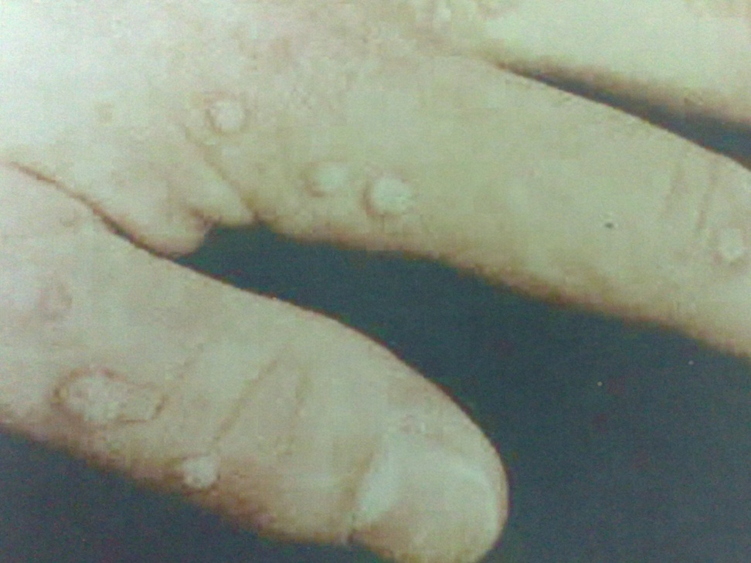
Identify the virus, type of nucleic material contained state whether it’s enveloped or no

Slide 39
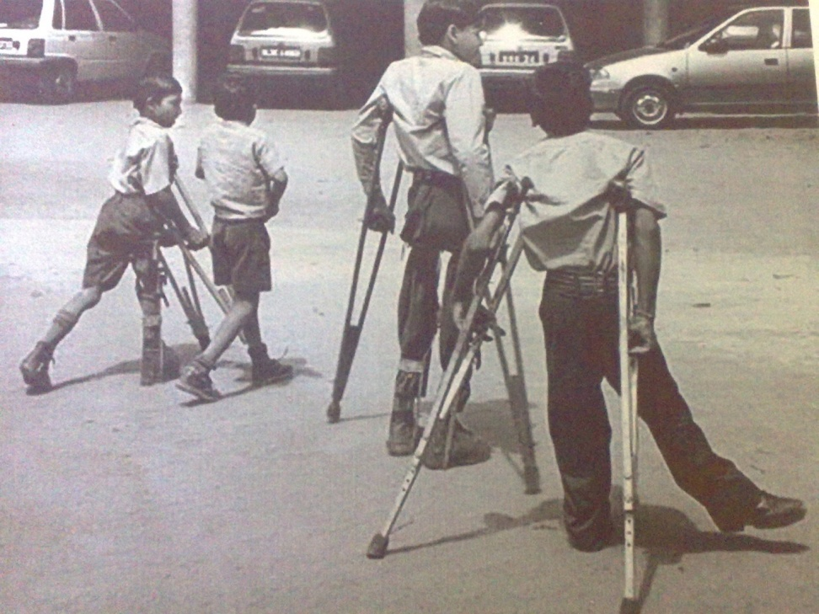
What virus caused this condition what kind of genome does it have and it’s route of transmission

Slide 40
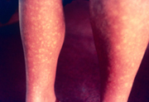
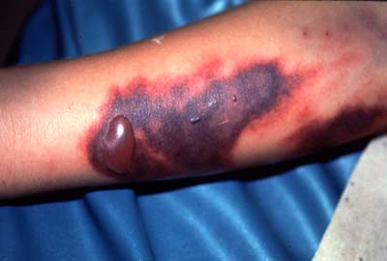
Identify the virus that causes these conditions to what family does it belong?
DENGUE VIRUS

Slide 41
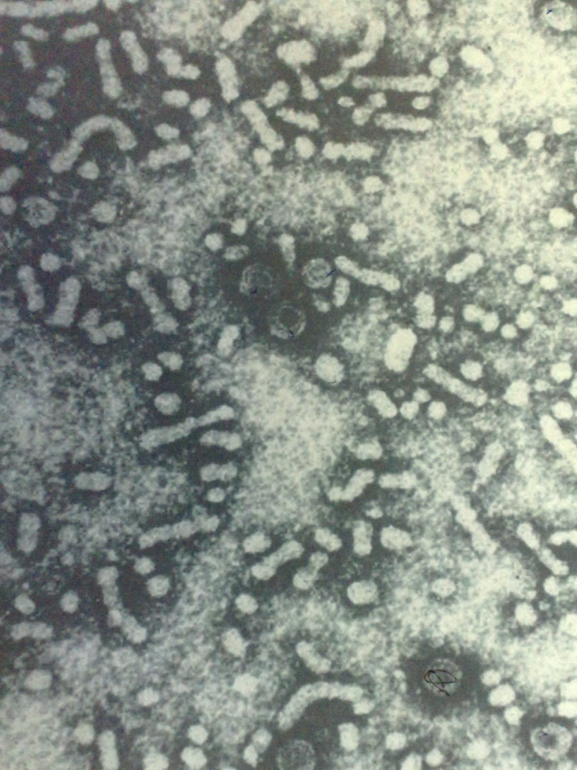
Identify virus and it’s family describe it’s genome

