Slide 1
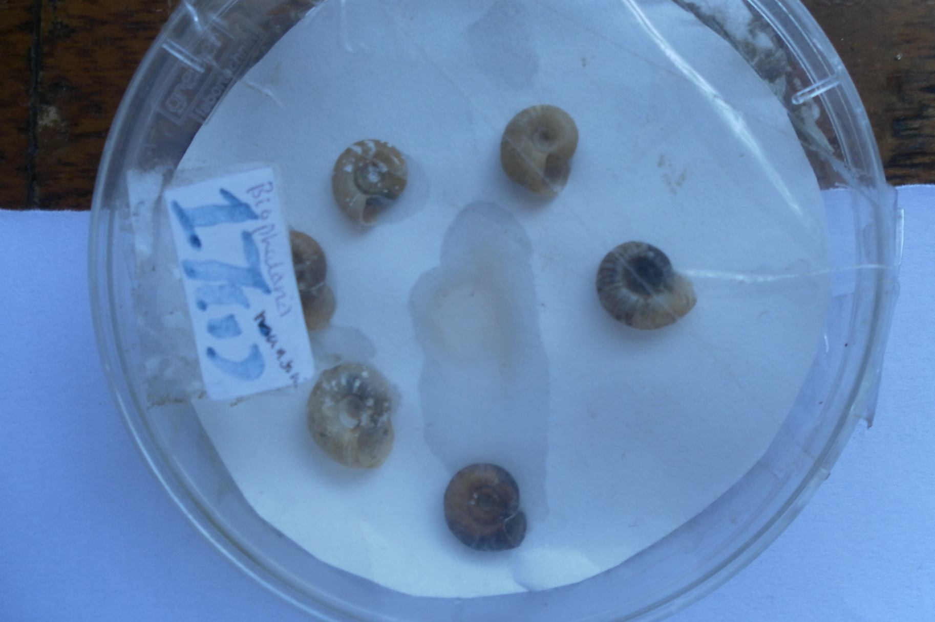
Name the intermediate host. Name the parasite and mode of transmission it causes

Slide 2
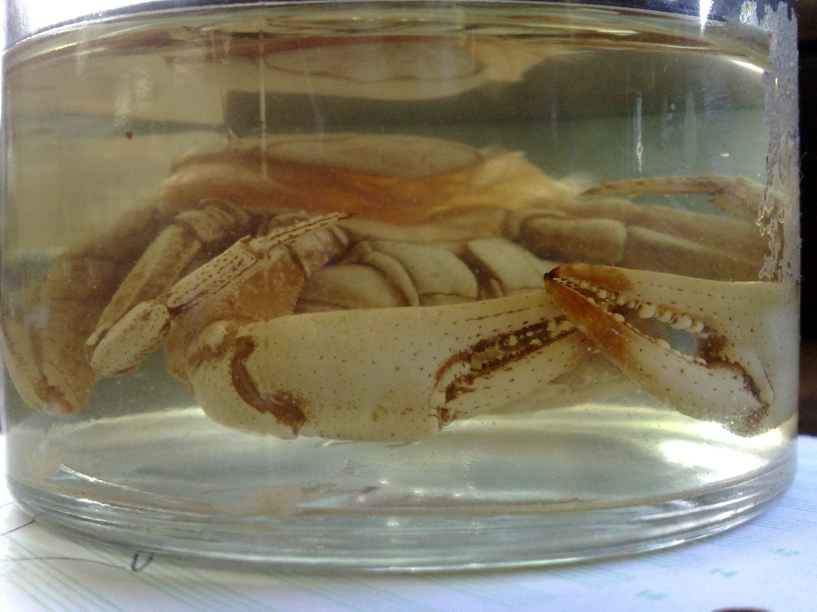
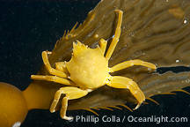
Identify the crustacean shown name the parasite related to it

Slide 3
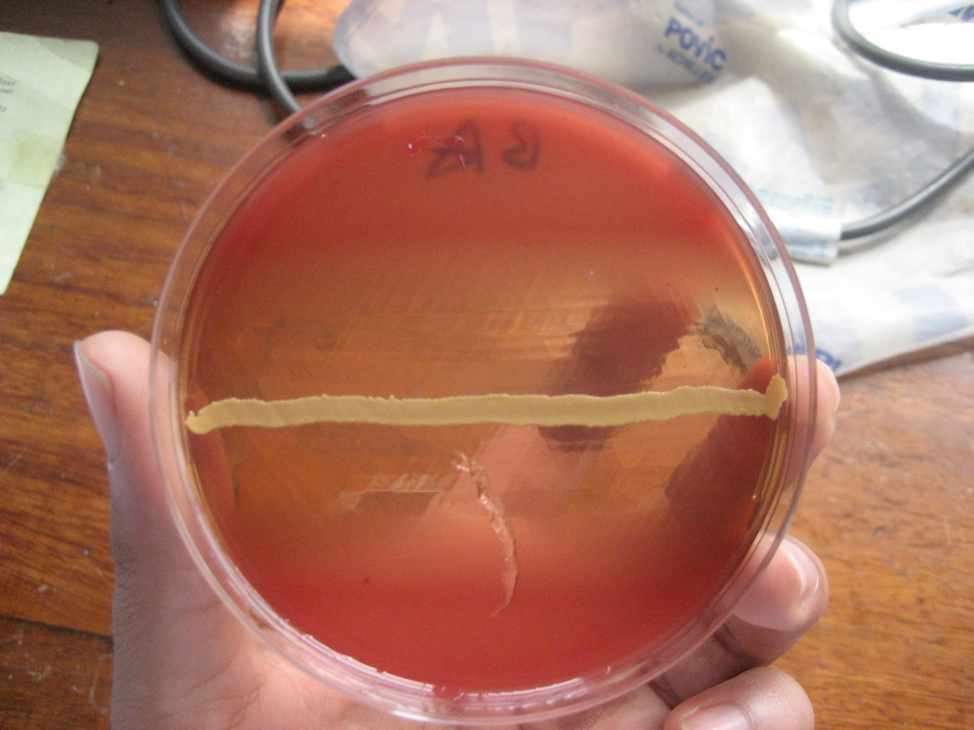
Name the phenomena what is the basis of this phenomenon

Slide 4
Name parasite and condition causedby this parasite. Name any other condition caused by this parasite.

Slide 5
name the stage, genus and species of parasite what is the major complication it causes

Slide 6
Identify the stage of the genus and spps of the parasite name the insect vector responsible for it’s transmission

Slide 7
Name the stage and spps of protozoa name the it’s mechanical vector

Slide 8
name the vector and disease it transmits what is the drug og choice for treating disease caused?

Slide 9
Name the stage, genus and species of parasite shown name two complications it cause

Slide 10
Name the vector and disease associated with it

Slide 11
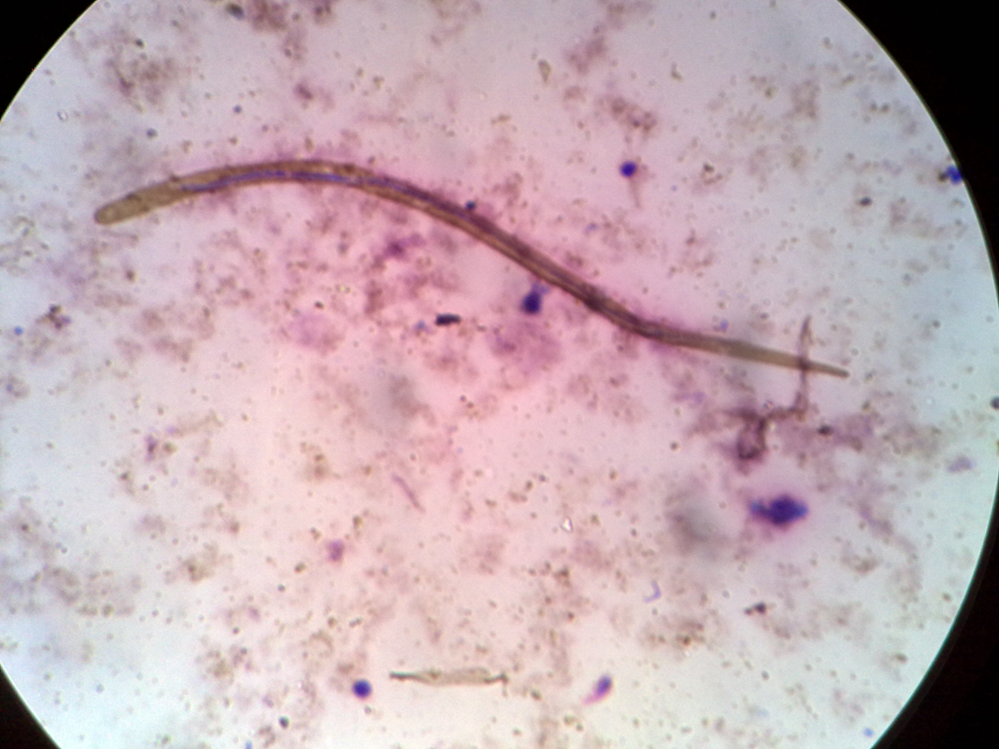
Identify parasite, stage, genus, species and vector involved in it’s transmission

Slide 12
Identify anthropod which parasite uses it as an intermediate host and what disease is it cause

Slide 13
Identify, genus,and species of parasite how does man get infection?

Slide 14
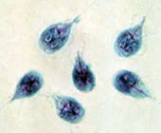
Identify stage, genus, species of organism. What condition is mailny associated with it?

Slide 15
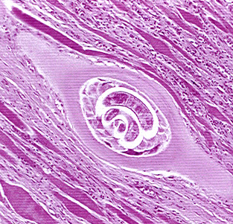
Identify the genus of the larval form of the parasite. Whatis it’s natural habitat

Slide 16
Identify class,genus,species, intermediate host and treatment.

Slide 17
Identify vector and name two diseases associated with the vector.

Slide 18
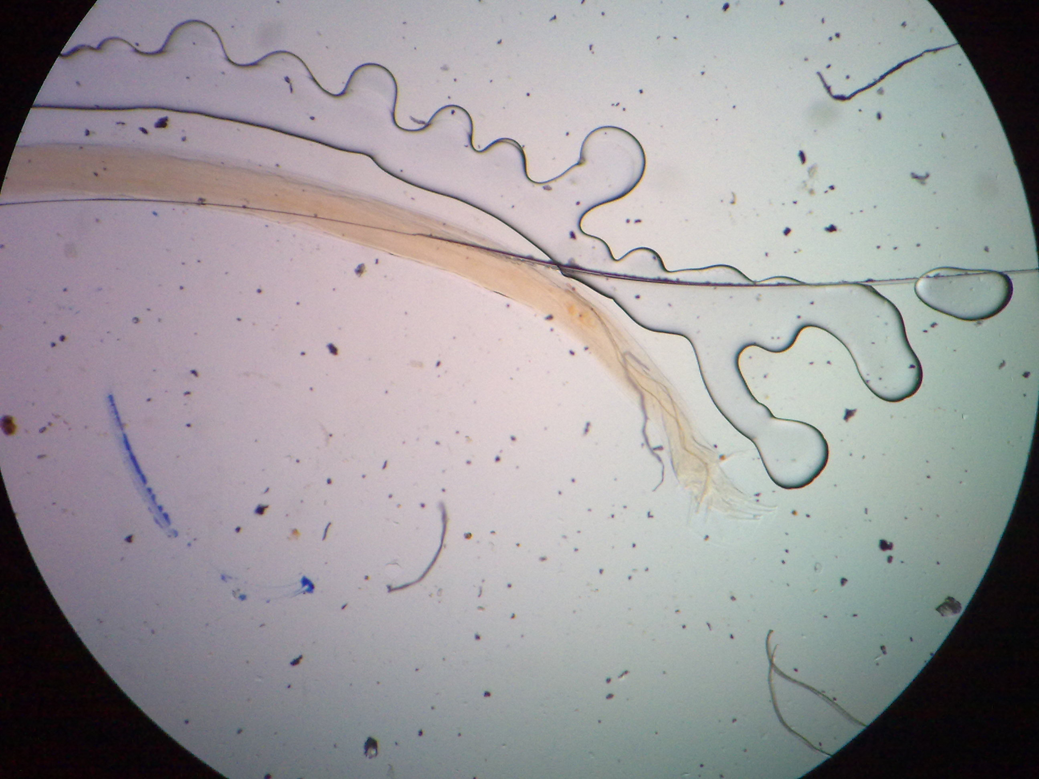
Identify helminth and of transmission and treatment.

Slide 19
Identify helminth mode of transmission and treatment

Slide 20
Identify stage of parasite, class, genus,species and two complications.

Slide 21
Identify kingdom, order, species and treatment

Slide 22
Identify the stage of parasite and three complications it causes.

Slide 23
Identify stage, kingdom, genus, species, treatment of condition.

Slide 24
Name the condition and likely causative agent and mode of transmission.

Slide 25
Identify class,order and species of virus shown and mode of transmission

Slide 26
Name the condition shown and two complications it causes.

Slide 27
Name four viral diseases transmitted by these vectors

Slide 28
Identify the family and class of the virus and name the condition shown

Slide 29
Name the condition show own and two complications it causes.

Slide 30
Name the condition and causative viral agent.

Slide 31
Identify the virus, disease caused and it’s mode of transmission

Slide 32
Identify virus, mode of transmission and it’s prevention

Slide 33
Identify the virus, type of nucleic material contained state whether it’s enveloped or no

Slide 34
What virus caused this condition what kind of genome does it have and it’s route of transmission

Slide 35
Identify virus and it’s family describe it’s genome

Slide 36
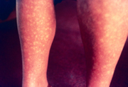
Identify the virus that causes these conditions to what family does it belong?

Slide 37
Identify parasite intermediate host and treatment.

Slide 38
Identify the virus, family and name the condition it causes.

Slide 39
Identify the class of parasite genus and species.
List two complications parasite causes.

Slide 40
Identify condition shown and it’s causes
Least two preventive measures for this condition.

Slide 41
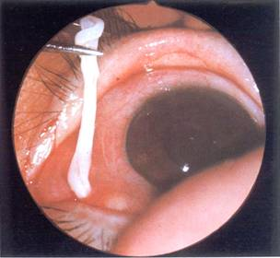
Identify condition and two causative agents.
What is the treatment?

Slide 42
Test shown is bacitracin
what is it’s indication?

Slide 43
Name the method of testing for antibiotic susceptability shown.
Name two other methods of testing for antibiotic susceptability.

Slide 44
Name two likely organisms to cause such areaction on the TSI media.
List at least two ways of differentiating the two organisms.

Slide 45
State the indication of the test shown.
What is the basis of the colour change in this test?

Slide 46
What is the indication of this test

Slide 47
List two pigments produced by the microbe cultured.
List two diseases caused by organism.

Slide 48
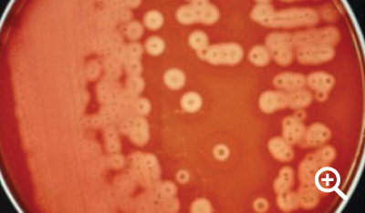
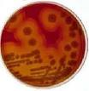
Culture from high vaginal swab from a female with pueperal sepsis and gram stained. Identify organism.
What is the selective media for this organism

Slide 49
Identify kingdom and genus of photo microscope.
What is the mode of transmission
State two clinical conditions it causes.

Slide 50
Identify genus of the photogragh shown
What is the staining techinique used?
What pathological conditions does it cause?

Slide 51
List three conditions caused by organism depicted on microscopy.
What is the mod of transmission.

Slide 52
Specimen is sputum
List three virulence factors of the bacteria shown.
List three pathogenic conditions it causes.

Slide 53
Identify species
Classify disease conditions caused.

Slide 54
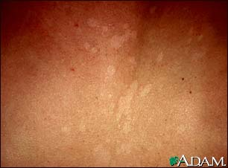
Name the condition shown. What is the causative agent?
Name two other conditions caused by agent above.
Name two predisposing factors.

