Slide 1
Pathology of HIV infection
Dr Timothy Onyuma

Slide 2
Epidemiology
The epidemiology and the outcomes of HIV infection have changed with time.
It is estimated that approximately 37 million people are living with HIV, approximately 21 million are on antiretroviral treatment and 1.8 million new infections occur annually (www.Unaids.com).

Slide 3
HIV transmission
Maternal to child (MTC)- In utero, Perinatally, Breastmilk
Heterosexual
Anorectal in men who have sex with men (MSM)
Intravenous drug users (IVDU)
Transfusion of infected blood products
Accidental inoculation in healthcare workers
Organ transplantation

Slide 4
Majority of all infections are HIV type 1 infections which has several clades. A rare smaller proportion is by HIV type 2 which is also less virulent.

Slide 5
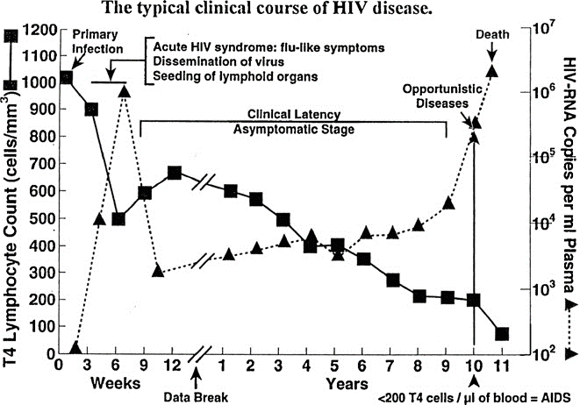
Pathogenesis

Slide 6
Primary infection of cells;
CD4+ T cells
Monocytes and Macrophages in lymph nodes, spleen, liver, brain, lung, bone marrow
Dendritic cells in lymphoid germinal centers and at lymphoepithelial surfaces

Slide 7
HIV causes human disease by;
Progressive destruction of CD4 T cells and impaired cell mediated immunity and immune surveillance
Direct tissue damage by HIV through mononuclear cell activation
Systemic indirect tissue damage through immune activation

Slide 8
Spectrum of Diseases
VIRUSES
Adenovirus B19 parvovirus Cytomegalovirus Epstein–Barr virus Hepatitis A, E B (±hepatitis D) Hepatitis C Herpes simplex Human herpes virus 8 (Kaposi sarcoma virus) Herpes zoster Global Human papillomavirus, high-risk Global, causing squamous carcinomas Human papillomavirus, low-risk Global, genital and skin: diffuse warts in children J-C virus Molluscum contagiosum

Slide 9
BACTERIA
Bartonella spp. Campylobacter and Shigella enteritis Chlamydia trachomatis, epidemic in MSM in HICs Intestinal spirochaetosis Listeria Mycoplasma spp. Neisseria gonorrhoea Nocardia spp. Non-typhoidSalmonellaspp. Sepsis Pneumococcal infections Rhodococcus equi Staphylococcus aureus and E. coli sepsis Syphilis

Slide 10
MYCOBACTERIA
M. Tuberculosis M. avium-intracelluare Other non-TB mycobacteria, Leprosy BCG infection

Slide 11
FUNGI
Aspergillus spp. Blastomyces dermatitidis Candidaspp. Coccidioides immitis Cryptococcus neoformans Dermatophyte spp. Histoplasma capsulatum H. duboisii Paracoccidioides brasiliensis Penicillium marneffei Pneumocystis jiroveci Sporotrichum schenkii Trichosporonosis

Slide 12
PARASITES
Acanthamoeba and Balamuthia spp. Cryptosporidiumspp. Entamoeba dispar common in MSM Falciparum malaria in pregnant women Isospora belli, Leishmania spp. Microsporidia Scabies Demodex mites Schistosoma spp Spirometra spp. Strongyloides stercoralis Toxoplasma gondii, Trichomonas

Slide 13
MALIGNANCIES
Kaposi sarcoma B cell lymphomas Hodgkin’s disease T cell lymphoma Invasive cervical carcinoma Anal carcinoma

Slide 14
DIRECT HIV-INDUCED LESIONS
Acute seroconversion illness Bone marrow dyshaemopoiesis Cardiomyopathy adults and children Cerebral vasculitis Growth failure in children mostly from Africa HIV encephalitis (HIVE) CD8 encephalitis in those of black African descent on long-term ART Vacuolar myelopathy of spinal cord HIV-associated neurocognitive disorder (HAND) Inflammatory demyelinating polyneuropathy HIV-associated myopathy

Slide 15
DIRECT HIV-INDUCED LESIONS
Lymphoepithelial cystic lesion of the parotid gland Lymphoid hyperplasia in gut and enteropathy HIV enteritis HIV-associated nephropathy (HIVAN) mostly restricted to those of black African descent Lymphoid interstitial pneumonia (LIP) mainly in children Metabolic dysfunction Persistent generalized lymphadenopathy (PGL) Papular pruritic dermatitis Wasting syndrome much also due to tuberculosis

Slide 16
Lymphoma | Subtype | Associated Infections
Lymphomas also occurring in immunocompetent patients | Burkitt’s and Burkitt’s-likelymphomas Diffuse large B celllymphoma (DLBC) Centroblastic Immunoblastic Extranodal MALT lymphoma Peripheral T cell lymphoma Hodgkin lymphoma | EBV EBV EBV EBV H Pylori EBV EBV

Slide 17
Lymphoma | Subtype | Associated Infections
Lymphomas occurring more specifically in HIV-infected persons | Primary effusion lymphoma Plasmablastic lymphoma of the oral cavity Plasmablastic lymphoma developing from multicentric castlemans disease | HHV 8 and EBV EBV HHV8

Slide 18
Other tumors associated with HIV
Type of Cancer | Associated infections
Kaposi's sarcoma | HHV8
Conjunctival squamous cell carcinoma | ? HPV 16 and 18
Cervical squamous cell carcinoma | HPV 16 and 18
Anal squamous cell carcinoma | HPV 16 and 18
Liver adenocarcinoma | Hepatitis B and C
Smooth muscle tumor | EBV
Lung adenocarcinoma | ?

Slide 19
Common organ diseases
GIT
Commonly infections that are associated with HIV cause wasting ‘Slim disease’.
Mostly caused by cryptosporidium, severe CMV enteritis, non-typhoid salmonellosis and systemic tuberculosis

Slide 20
In MSM Chlamydia trachomatis serovar L2, causing lympho-granuloma venereum (LGV) proctitis; syphilis; Shigella flexneri and Vero cytotoxin-producing Escherichia coli – these with colitis and systemic sepsis

Slide 21
“HIV enteropathy” directly causes diarrhea and wasting. Its case definition however requires exclusion of all other opportunistic infections.
Its histological features include hyperplastic mucosal lym-phoid follicles with HIV antigen on immunostaining, cryptitis, and excess crypt apoptosis

Slide 22
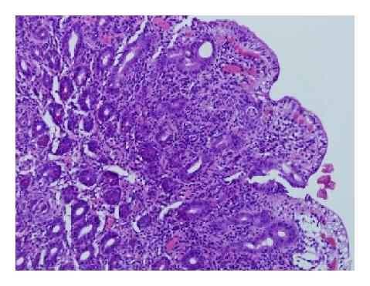

Slide 23
Cardiac disease
Mostly seen in chronically infected persons
The diseases include;
Ischaemic heart disease from coronary arteryatherosclerosis
HIV-associated myocarditis, leading to dilatedcardiomyopathy (DCM) as a late stage with heartfailure (and poor prognosis)

Slide 24
Opportunistic infections [toxoplasmosis, aspergillosis, candidiasis, staphylococcal septic emboli, tuberculosis] and tumours (Kaposi’s sarcoma, B cell lymphoma)
Wasting of myocardial mass in association with loss of body weight. Some of this may be due to apoptosis of myocytes associated with local TNFα production

Slide 25
Brain disease in HIV
The entry by HIV into the CNS occurs during early infection and mostly in the microglial cells. The giant cell encephalitis is now rarely seen with ARV treatment.
A whole range of opportunistic infections may occur - toxoplasmosis, tuberculosis, cryptococcosis, JC virus encephalitis and pneumococcal meningitis

Slide 26
Cerebrovascular disease, with stroke, is increasingly reported, related to arterial arteriosclerosis and vasculitis
CD8 encephalitis in patients using ARVs
HIV-associated neurocognitive disorders (HAND) in chronic infection with immune activation

Slide 27
Immune activation
In untreated HIV infection, patients are in states of enhanced immunological activation – both innate and adaptive systems with raised inflammatory markers in body fluids

Slide 28
Endothelial cell dysfunction
An association of HIV infection with P selectin and venous thromboembolism, tissue-plasminogen activator and mortality, and D-dimer with venous thromboembolism (VTE) and cardiovascular disease.

Slide 29
Drug toxicities
Group | Toxicities
Nucleoside reverse transcriptase inhibitors (NRTI) | Generic: mitochondrial toxicity. Muscle and nerve damage Lactic acidosis, liver steatosis, hepatitis Hypersensitivity reaction (ABV)
Non-nucleoside reverse transcriptase inhibitors (NNRTI) | Liver necrosis Stevens–Johnson syndrome; toxic epidermal necrolysis
Protease inhibitors (PI) | Generic: dyslipidaemias Lipodystrophy Liver damage

Slide 30
Immune reconstitution inflammatory syndrome(IRIS)
The resurgence in cell-mediated immunity, albeit incomplete, pro-motes inflammation in many tissues against infectious organisms and their antigens, including viruses within tumour cells
The resulting tissue swelling, oedema and breakdown characterizes IRIS

Slide 31
The inflammation may be acute or granulomatous, and considerable organ damage can occur, eg from enlarging CNS lesions, massive lymphadenopathy, erupting suppurative lymph nodes and acute lung injury

Slide 32
IRIS presents either as a reactivation of known organ disease, or unmasking of previously occult infection, presenting de novo as tuberculoid disease
Host HLA variations play a role in IRIS, but overall about one-quarter of treated patients may expect a severe IRIS reaction

Slide 33
Conclusion
There have been many advances in understanding HIV over years. The opportunistic infections and drug toxicities more so with increased survival dominate clinical presentation.
Understanding the range of pathologies is invaluable in the management of patients.

Slide 34
Ref
J Pathol 2015; 235: 229–241

