Slide 1
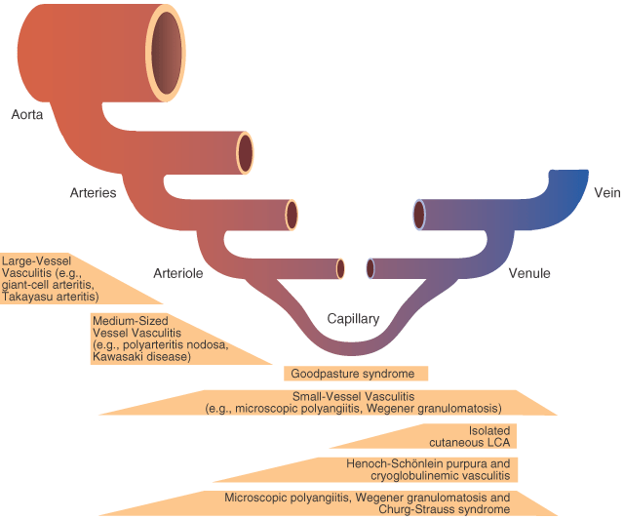
Diseases of Blood Vessels
Dr E. Walong, Anatomic Pathology Unit, Department of Human Pathology. Email: edwin.walong@uonbi.ac.ke,

Slide 2
Introduction
Blood vessel diseases show multiorgan manifestations
Main affected organs: brain, eyes, kidneys, gastrointestinal tract, endocrine system
Aetiology: congenital, environmental (mechanical trauma, toxins, radiation)
Infections, inflammatory, metabolic and neoplastic

Slide 5
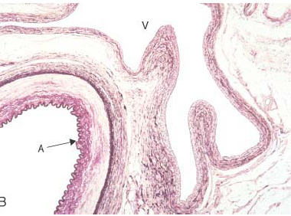

Slide 6
Objectives
To classify blood vessel diseases
To outline the pathogenesis and pathology of blood vessel diseases including clinical manifestations
To describe the diagnostic approach to blood vessel diseases

Slide 7
Congenital
Arteriovenous malformations
Fibromascular dysplasia
Vascular hamartomas (will be discussed under benign neoplasms)

Slide 8
Classification

Slide 9
Classification, High Flow

Slide 10
Classification, Low Flow

Slide 11
International Society for Study of Vascular Anomalies (ISSVA)

Slide 12
Port Wine Stain (naevus flameous)

Slide 13
Telengiectasia

Slide 14
Telengiectasia

Slide 15
Hereditary Hemorrhagic Telangiectasia

Slide 20
Nonne Milroy Syndrome

Slide 32
Fibromuscular dysplasia
Dysplasia in this context means abnormal development
Anatomically, the smooth muscle cells are oriented in a disorganised manner within the media

Slide 33
Fibromascular dysplasia

Slide 34
Medial Degeneration in Marfan’s syndrome
Lysosomal storage disease
Smooth muscles, undergo degeneration resulting in aneurisms

Slide 35
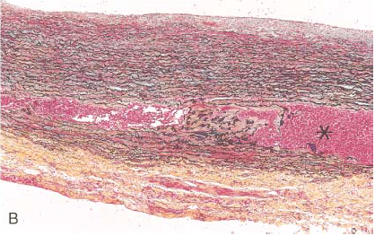
Medial degeneration in Marfan syndrome

Slide 36
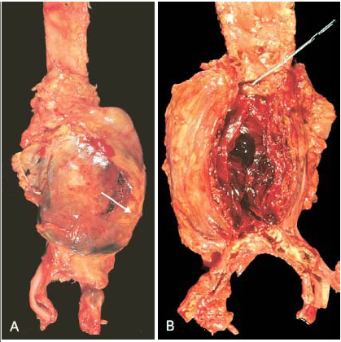
Aortic Aneurism due to Marfan’s

Slide 37
Aneurisms
Localised dilatation of arteries
These usually occur at the point of weakness
aetiology: any disease process that results in localised blood vessel wall weakening
Congenital, fibromuscular dysplasia,in some, unknown
Degenerative: Marfan’s syndrome, atherosclerosis, hypertension, etc.
Aneurisms within the internal capsule in hypertension: Charcot Bouchard
Risk – Rapture.

Slide 38
Berry Aneurisms, Brain

Slide 39
Vascular Trauma

Slide 40
Carotid Artery

Slide 41
Vascular Trauma

Slide 42
Classification of Vascular Trauma, Blunt Force

Slide 43
Sharp force Trauma
Partial or complete transection
Blunt traumatic patterns may be observed (sharp-blunt trauma)

Slide 44
Infectious - Bacterial
Direct infection of endothelium
Mycoplasma hominis
Treponema pallidum
Leptospira spp
Bartonella spp
Rickettsia spp

Slide 45
Pulmonary haemorrhage

Slide 46
Bartonella quintana
Bacillary angiomatosis (skin) bacillary peilosis (visceral organs such as liver)
Immunosuppressed individuals
Nodular pink-purple lesions
Histology: lobulated proliferation of capillaries

Slide 47
Warthin Starry stain for Bartonella

Slide 48
Treponema pallidum
Stages: primary, secondary, tertiary
Primary: mucosal microvascular injury with ulcers
Secondary: small arteries and capillaries
Tertiary: CNS-general paresis, tabes dorsalis, syphilitic aortitis

Slide 49
Lymphocytic inflammation, vasa vasora

Slide 50
Bacterial Toxins
Bacterial toxins that are associated with vascular injury (arterioles, capillaries)
Include Escherichia coli (O157:H7) , Shigella dysenteriae, S. sonei, C. jejuni
Streptocuccus pneumoniae
Drugs: Cyclosporin nephropathy

Slide 51
Haemolytic Uremic Syndrome
Injury to arterioles and capilaries resulting in endothelial activation
Microvascular thrombosis
Intravascular haemolysis
Renal: azotemia.

Slide 52
Viruses associated with hemorrhagic fever syndromes
Notes:
The combination of fever and hemorrhage can be caused by different viruses, rickettsiae, bacteria, protozoa, and fungi. However, the term “viral hemorrhagic fever” (VHF) is usually reserved for systemic infections characterized by fever and hemorrhage caused by a special group of viruses transmitted to humans by arthropods and rodents. VHFs are febrile illnesses characterized by abnormal vascular regulation and vascular damage and are caused by small, lipid-enveloped RNA viruses. This syndrome can be caused by viruses belonging to four different families that differ in their genomic structure, replication strategy, and morphologic features (Table 11-4). Arenaviruses, bunyaviruses, and filoviruses are negative-stranded, whereas flaviviruses are positive-stranded RNA viruses. Hemorrhagic fever viruses are distributed worldwide, and the diseases they cause are traditionally named according to the location where they were first described. The oldest and best known is yellow fever virus; others include Lassa fever, lymphocytic choriomeningitis, Ebola, and Dengue viruses.

Slide 53
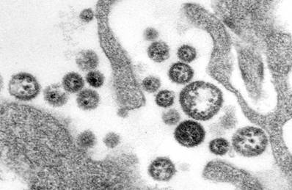
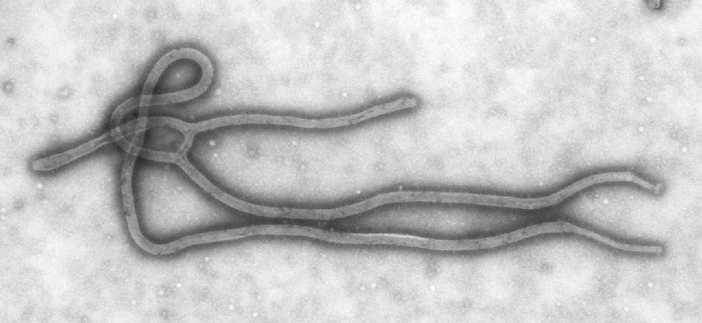
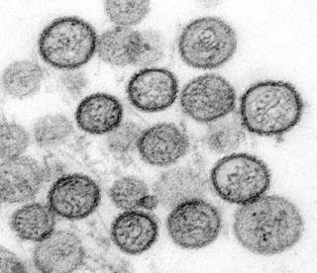
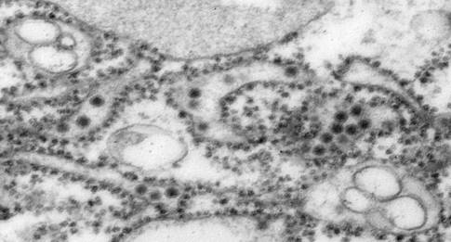
A
C
B
D
EM Morphologic features of viruses from the four familiar causing viral hemorrhagic fever:
A. Arenavirus B. Bunyavirus C. Filovirus D. Flavivirus

Slide 54
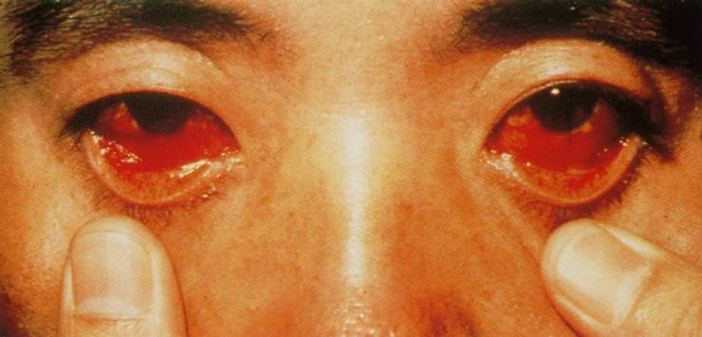
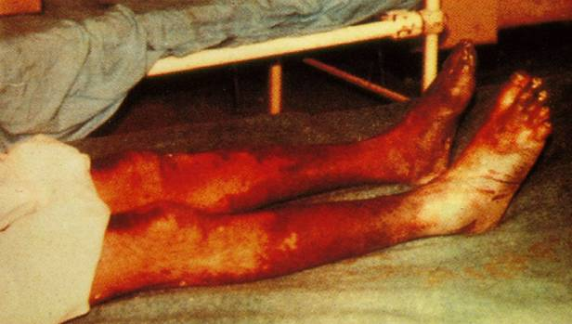
Subconjunctival
Hemorrhage
in
Hemorrhagic Fever
With
Renal Syndrome
(HFRS)
Ecchymoses in
Crimean-Congo
Hemorrhagic Fever
(CCHF)
Notes:
Prodrome
myalgia, prostration, dizziness, flushing, conjunctival injection
Increased vascular permeability
proteinuria, periorbital edema, retroperitoneal edema
Manifestations of vascular damage
petechiae, ecchymosis, frank hemorrhage
Hypotension and shock
Multisystem involvement
pulmonary, GI, hepatic, renal, neurologic

Slide 55
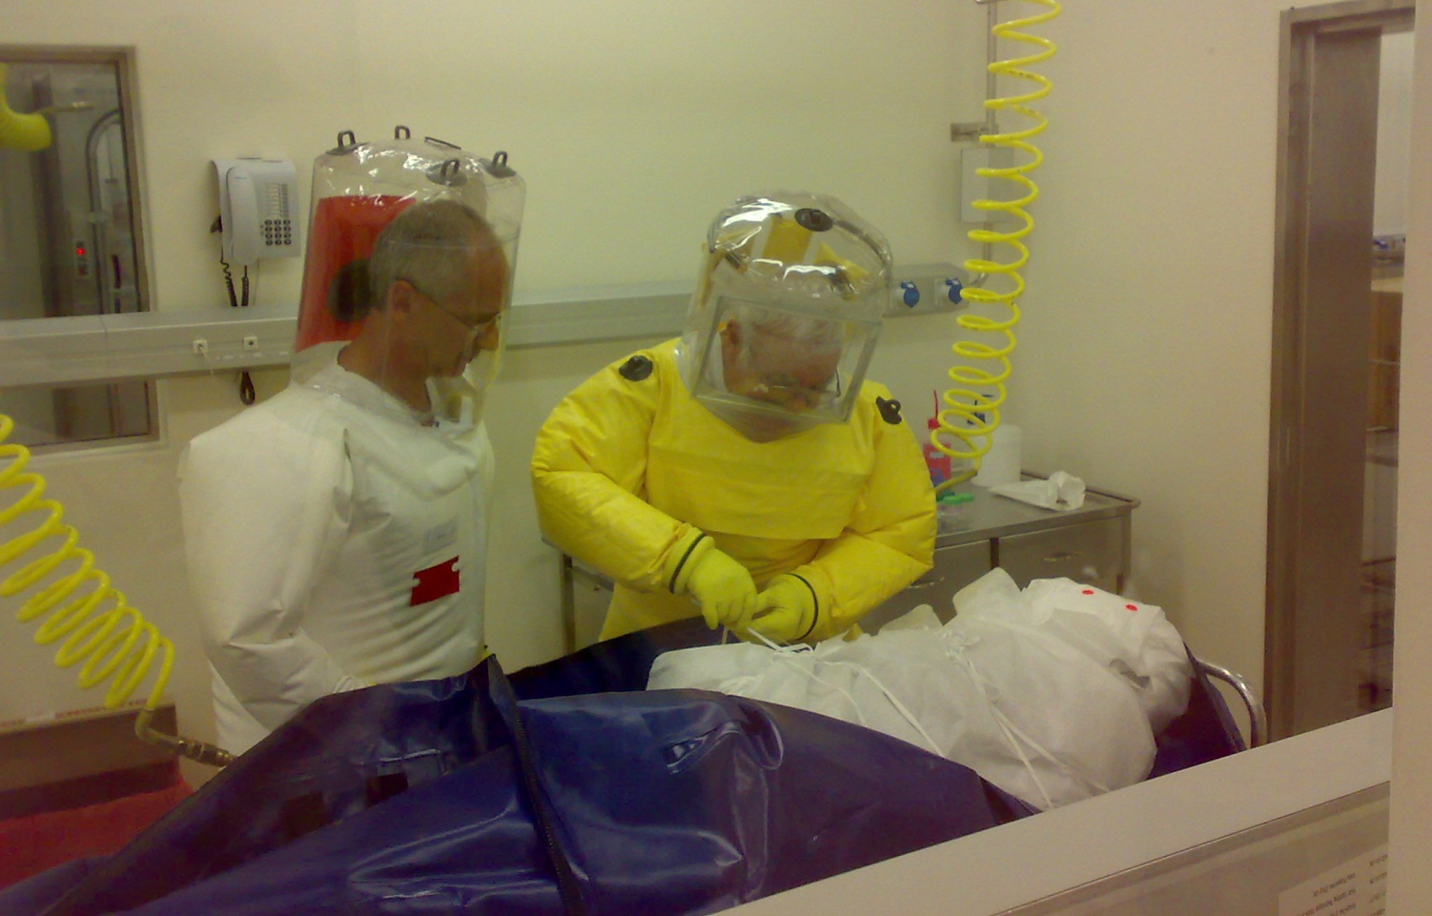
Tour guide from SA fallen ill in Zambia, died Sept 13, 2008
Two further deaths on Sept. 30, and October 4: paramedic and a nurse who treated tour guide

Slide 56
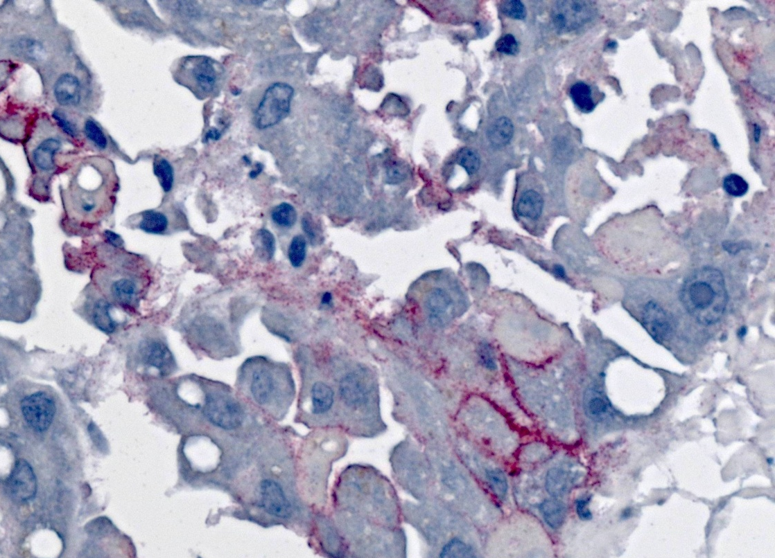
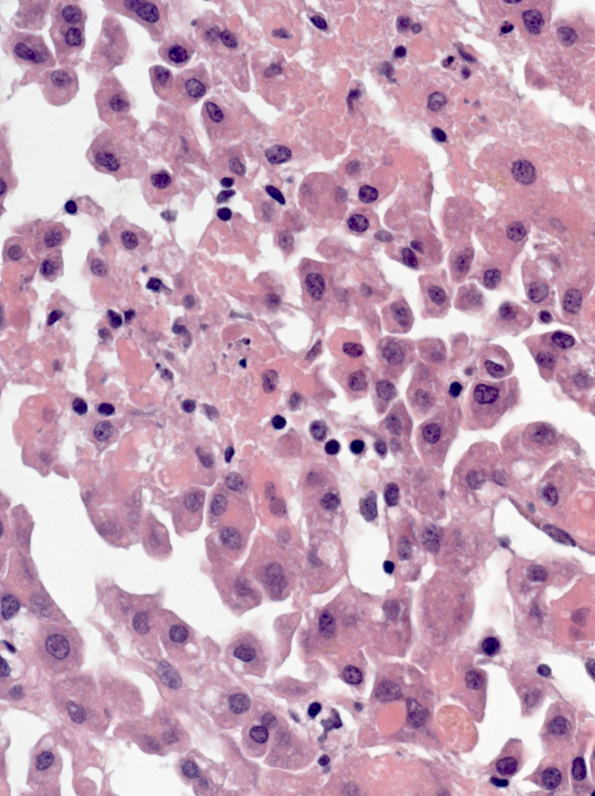

Slide 57
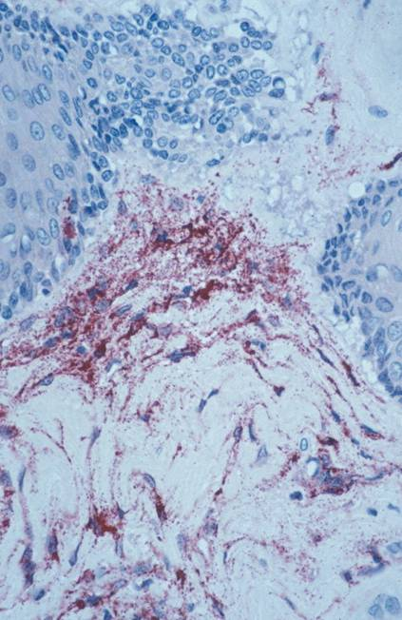

Slide 58
Fungal – Aspergillus

Slide 60
Protozoal Infections
Plasmodium falciparum
Infected erythrocytes express adhesive PfEMP 1 and 2 proteins
These adhere to endothelial cells (sequestration)
Resulting in vascular congestion, ischemia and injury

Slide 61
What is vascular sequestration?

Slide 62
Vascular Sequestration
Parasitized red blood cells adhere to the endothelium
The endothelium, activated resulting in recruitment of inflammatory cells, inflammation and thrombosis
Results in ischemic injury

Slide 64
Brain, vascular sequestration

Slide 65
Other diseases associated with vascular sequestration
Sickle cell disease
Polycythemia
Chronic myeloid leukemia and acute myeloid leukemia, where white cell counts are greatly elevated

Slide 66
Sickle cell disease

Slide 67
leukemia

Slide 68
leukemia

Slide 69
Polycythemia

Slide 70
Degenerative vascular diseases, atherosclerosis
Various injury to the blood vessels target the endothelium
Results in endothelial activation

Slide 72
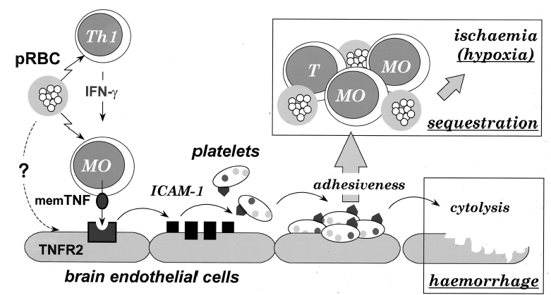

Slide 73
Environmental Exposures - Radiation
Capillary, arterioles and venules affected
Results in endothelial injury with plump endothelial cells
Endarteritis obliterans
Stromal proliferation and occlusion of vascular channels

Slide 74
Environmental – Chemical Exposures

Slide 77
Metabolic – Vascular injury due to hyperglycemia, hyperlipidemia, hypertension
Chronic injury
Advanced glycosylation end products
Affects predominantly medium sized arteries
Predisposes to atherosclerosis

Slide 78
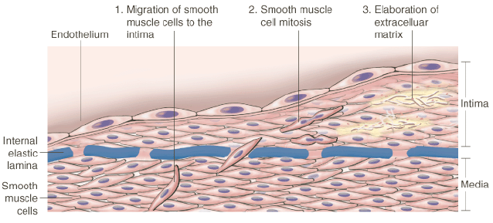
Atherosclerosis

Slide 79
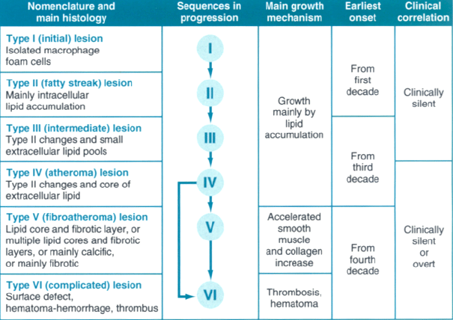

Slide 80
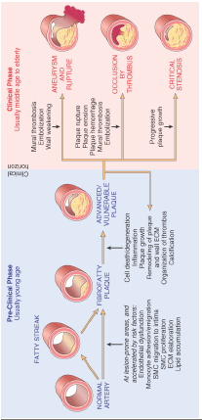
Atherosclerosis

Slide 81
Atherosclerosis-morphology

Slide 82
Vascular Pathology due to hypertension
Elevated blood pressure, frequently long duration
Media: hyperplasia and fibrosis occurs – onion skin arterolosclerosis
Fibrinoid necrosis may ensue

Slide 83
Fibrinoid Necrosis

Slide 84
Inflammatory Aetiology
Autoimmune
Associated with collagen vascular disorders eg Rheumatoid arthritis, systemic lupus erythematosus
Others associated with immune complex deposition
Immune mediated vascular injury in eclampsia/pre eclampsia (maternal-foetal intolerance)

Slide 85
Pre Eclampsia

Slide 86
Pre eclampsia, eclampsia
Etiology: insufficient placentation due to insufficient immune tolerance to the fetal allograft
Placenta: VEGF and VEGF subunits, mainly soluble FMS like Tyrosine Kinases (s-FLT)
Systemic vascular pathology characterised by endotheliosis, hypertension

Slide 87
Renal Pathology in PE

Slide 88
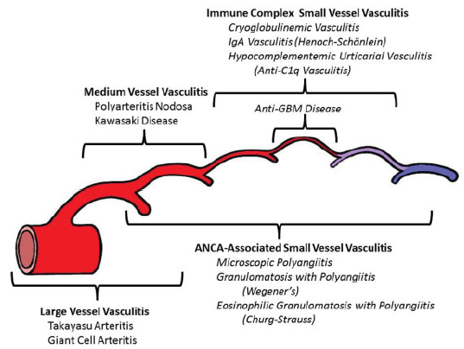
Chapel-Hill Classification

Slide 89
Large vessel Vasculitis
Takayasu – granulomatous, preferentially affects females, 50 y and below, inflammation is granulomatous
Giant cell, aka temporal arteritis, frequently non giant cell, aka pulseless

Slide 90
Medium Vessel Disease
Polyarteritis Nodosa – affects medium sized arteries, as well as capillaries,veins. Not associated with glomerulonephritis or ANCA
Kawasaki Disease – frequently mucocutaneous, lymph nodes. Affects coronary circulation, children involved

Slide 91
Small Vessel Disease
Includes ANCA associated disease (MPO-ANCA, PR3-ANCA)
Microscopic polyangitis, granulomatous (Wegeners), eosinophilic (Churg-Strauss), IgA deposits (HSP), immune complex, etc

Slide 92
Variable Vessel Disease
Behçets disease – can affect arteries, capillaries, veins, associated with oral and genital ulcers
Cogan syndrome – ocular inflammatory lesions with associated vestibular involvement

Slide 96
Henosch Schonlein Purpura, Pulmonary Haemorrhage

Slide 97
Henoch Schonlein Purpura

Slide 98
Leucocytoclastic vasculitis

Slide 99
Organ Specific Vasculitis
Primary central nervous system vasculitis
Underdiagnosed, frequently requires biopsy
Some are classifiable by the Chapel Hill classification
Majority are unclassified, simply referred to as the primary CNS vasculitis

Slide 104
Drugs of abuse
drugs of abuse such as Cocaine, heroin
Intravenous abuse of oral medications
Injury to medium sized arteries, arterioles
Lung, skin, kidney, central nervous system
NB: Cannabis use-acute subarachnoid haematoma

Slide 105
Effects of cocaine

Slide 106
Injury to the vasular allograft
Use of allografts: bypass surgery, repair of injured blood vessels, etc
Grafts: rejection may occur
Synthetic materials – teflon, resistant

Slide 107
Malignant Neoplasms of Blood Vessels
Angiosarcoma, Kaposi Sarcoma
Invariably fatal if untreated
Angiosarcoma – poor 5 year survival rates

Slide 108
Clinical Approach
History
Skin changes, mass lesions, bleeding, trauma, etc
Physical Examination
Peripheral pulses, auscultation, etc
Radiology – Angiography
Laboratory – Haematology (full blood count, bleeding time, coagulation studies)
Anatomic Pathology: Histopathology (routine, special stains, Immunohistochemistry, immunofluorescence)

Slide 110
Lungs, PTE

Slide 112
Deep veins of the leg, Thrombi

Slide 113
Deep Vein Thrombosis and PTE
Approximately 30% of surgical mortalities
Medical mortalities, unclear
Sudden death, 3 cases in 2015
No evidence of preventive therapy in these cases

Slide 114
Case 2
Child, 3 years
Admitted due to respiratory symptoms
In the course of therapy, develops gangrene of right arm, forearm, hand
Query, Tourniquet?

Slide 115
Gangrene, right upper limb

Slide 116
Gangrene, digits

Slide 117
Histopathology: Organising thrombi

Slide 118
Underlying Diagnosis: acute myeloid leukemia

Slide 119
PRESS Study
Pediatric Respiratory Surveillance Study
2014-2016
Objective: etiology of pediatric SARI
65 autopsies (~200 mortalities, ~1000 cases meeting the clinical definition)

Slide 121
Crescents

Slide 124
Emerging issues
Manifestation of renal vasculitis
These also had pulmonary hemorrhage
Their etiology in SARI is unclear
Further insight required – clinical implications in pediatrics, etiology.

Slide 125
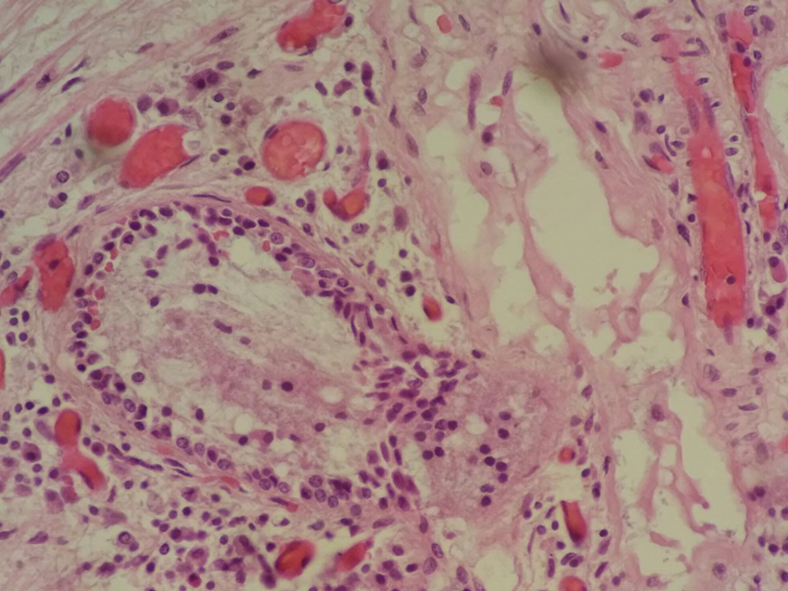
Thrombotic Microangiopathy

Slide 129
Press series
Microvascular thrombi suggestive of thrombotic microangiopathy seen in 12% of cases
Main sites: renal, thymus, lung
Contribution to SARI pediatric mortality is unclear
Etiology: unknown

Slide 130
Biopsy Series
Medium sized hospital pathology practice, 200 biopsies per year
In 2018, increase in cases of ischemic bowel disease, 8 cases in January
Vascular pathology seen in all cases
Arterial disease: 2 cases (thromboembolus – atherosclerosis- 1, TMA-3 cases. Vasculitis 1 case. No obvious vascular pathology: 3 cases.
Appendix (1/15 with vascular disease)

Slide 131
Case 1:
Male, 54 years
Presents with abdominal pain, vomiting.
Exploratory laparotomy: segmental ischemic necrosis of the jejunum
Masses seen: serosal surface of the lesser curvature (celiac)

Slide 132
Gastric Mass

Slide 133
Segmental jejunal ischemic necrosis and serosal nodules

Slide 134
Serosal Gastric mass

Slide 135
Segmental jejunal infarction

Slide 136
Serosal mass, segmental infarction

Slide 137
Artery, vasculitis

Slide 138
Artery, necrotizing vasculitis

Slide 139
Outcome
Diagnosis: polyarteritis nodosa
Client deteriorated, died while undergoing care
Autopsy not performed

Slide 140
Case 2: Female, 28 years, appendix.

Slide 141
Small vessel (arteriole) vasculitis.

Slide 142
Arteriole, vasculitis

Slide 143
Arteriolar vasculitis with thrombosis

Slide 144
Outcome
Small vessel vasculitis
Client traced and referred to rheumatology for diagnostic workup, management

Slide 145
Summary, Vasculitis
Intestinal resections:
Appendicectomies:
Other gastrointestinal resections:

Slide 148
Conclusion
Blood vessels frequently involved in the pathogenesis of many lesions
Specific blood vessel disease has manifestations in multiple organs depending upon the involved vascular channels
Diagnosis relies upon clinical-pathologic correlation

