Slide 1
INTRODUCTION TO PATHOLOGY
CHAIR DEAPMENT OF H. PATHOLOGY
HEADS OF THE THEMATIC UNITS
AP, HBT,CC,IM

Slide 2
OBJECTIVES
Understand and define pathology
terminologies and concepts involved in the study of pathology
Define the sub branches
Understand concept of pathology

Slide 3
Dept of Human pathology
Chairman of department
4 unit heads
Anatomic pathology
2nd year LME
3rd year, study of general principles of pathology
4th year Systemic pathology building up upon what learnt in 3rd year and applied as you rotate in junior clerkship
6th year we follow up with Forensic medicine

Slide 4
pathology
A bridge between pre-clinical years and clinical years
Basis of understanding diseases and the principles of treatment
Involves all laboratories i.e. microbiology, histo/cyto, heam and BT, clinical chemistry, immuno lab and investigations performed in discerning the varies diseases

Slide 5
definition
Scientific study of diseases , its cause and effect of disease on the human body (Pathos= suffering)
Study of structural and functional changes in cell, tissues and organs that underlie disease
Explains the WHY and WHEREFORES of signs and symptoms manifested by patients thus providing sound foundation for rational clinical care and therapy

Slide 6
Techniques Used
Molecular
Microbiological
serological
Immunological
Morphological
Gross
Histology
cytology

Slide 7
Pathology of diseases
Definition
Aetiology/causes i.e. genetic or acquired
Pathogenesis and pathology mechanisms of its development, sequences of events and state of expression of disease
Morphology – gross and microscopic structural alteration in cells and organs
Laboratory investigations
Clinic effects and complications functional consequences
Treatment and outcome

Slide 8
Cytology and Cytopathology
Autopsy/PM
Cytology
Definition: Study of cell morphology
Cytopathology
Study of cellular alteration

Slide 9
TOPICS
Normal cell cycle
Cell injury
nutritional/occupation diseases
Inflammation
Cellular adaptations
Genetic basis of disease
Healing and repair
Neoplasia

Slide 10
Pathology of AIDS
Rheumatic fever and infective endocarditis
Congestion/edema/shock
Diseases of blood vessels
Thrombosis/embolism/ischaemia/infarcts
Hypertension

Slide 11
Cytopathology
The study of cellular alteration in terms of patterns of disease
The changes affects the cytoplasmic and nuclear morphology of individual cells and groups of cells
May be exfoliative or Fine Needle Aspiration cytology
Imprint smears from biopsy specimen and squash smears applicable in brain cytotopathology
Started early but best defined in the era of George Papanicolaou 1930-1940

Slide 12
Exfoliative cytology
Cells shed naturally into the body cavities e.g. Effusions. Pleural, peritoneal, pericardial, joint spaces and CSF
Brush cytology e.g. papsmears , bronchial brash, gastric, anal etc
Lavages and washes over the aerodigeative tract.
Cell are preserved using 95% ethanol as opposed to tissues for histology which are fixed in 10% formosaline and buffered formaline.

Slide 13
FNA cytology
Lumps aspirated from various body parts e.g. breast, abdominal masses, chest cavity masses, scalp masses
Deep seated masses aspirated under imaging guidance
Skin lesion unless large masses have poor yields and requires biopsy for histological assessment

Slide 14
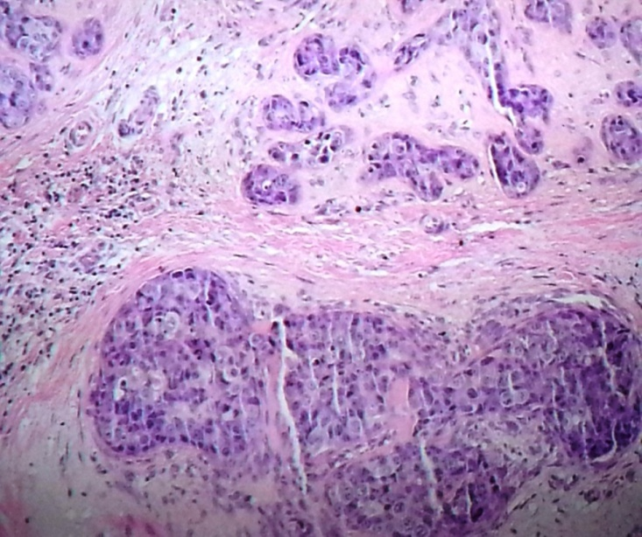
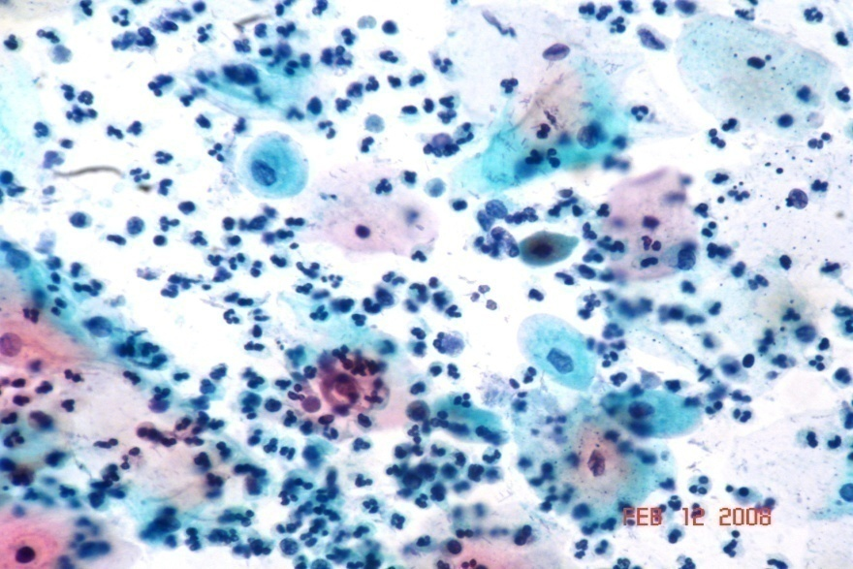

Slide 15
Papanicolaou stain/H/E
PAP
CYTO
H/E
HISTO
meningioma

Slide 16
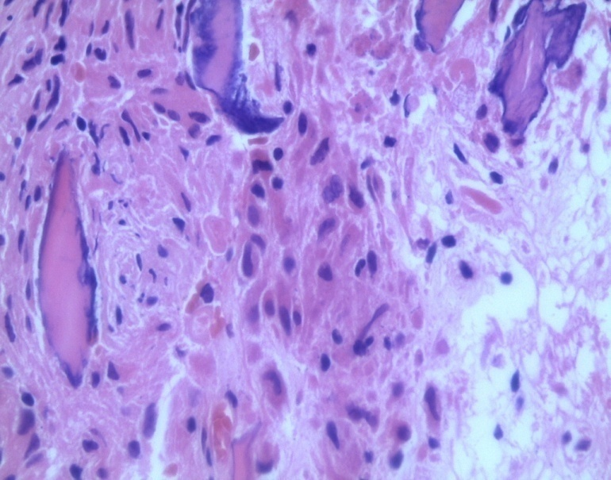
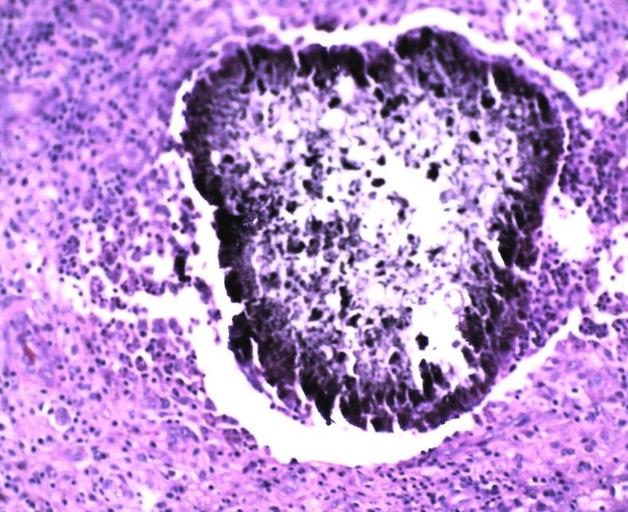
IMMUNO
H/E
PAS

Slide 17
Examinations
Combined from all the discipline of Dept of pathology
Written – Essays and MCQ
Oral exam

Slide 18
Text books
Robbins : Pathologic basis of disease 9th Edition
Robbins: Basic Pathology 10th Edition
Internet-Pathology outlines
Pathology notes

Slide 19
THANK YOU

