Slide 1
DISORDERS OF CELL GROWTH
Dr Edwin Walong. MBChB, MMed (Path), FC Path ECSA
Lecturer, Anatomic Pathology Unit, Department of Human Pathology, CHS, UoN.
MBChB III/BDS III General Pathology Series. 1400h, 21/01/2019

Slide 2
Scope
Excessive growth
  Hypertrophy
  Hyperplasia
Diminished growth
  Atrophy/hypoplasia
Abnormalities of cellular differentiation
  Metaplasia
  Dysplasia

Slide 3
Scope
Dystrophies, dyscrasia
Neoplasia – abnormal new growth, not within the scope of this presentation

Slide 4
Objectives
Describe the pathologic basis of disorders of cell growth
Describe disorders of cell growth with appropriate clinical-pathological correlates

Slide 5
Pathologic Basis–Growth Potential of cells
Labile cells – continuous replication
stem cells within a replicative compartment (with a high mitotic rate) undergo frequent asymmetric cell division.
Examples: lymphoid cells (germinal centers) bone marrow, epithelia (basal layers, crypts-lower two thirds)
Hyperplasia, hypoplasia/atrophy, dysplasia

Slide 6
Pathologic Basis–Growth Potential of cells
Stable cells – discontinuous replicators
Mitotic activity of neighboring cells; which are activated having been in the Go phase
Few mitotic figures
Secretory epithelial structures (kidney, liver, pancreas, endocrine glands.
Connective tissues – endothelial cells, fibroblasts, lymphoid tissue (non – blastic)
Hyperplasia, hypoplasia/atrophy, metaplasia

Slide 7
Pathologic Basis–Growth Potential of cells
Permanent cells – have limited capacity to replicate
DNA replication and regeneration may occur
Striated muscle (skeletal, cardiac, smooth) and neurons

Slide 8
Disordered Cell Growth
Excessive growth
  Hypertrophy
  Hyperplasia
Diminished growth
  Atrophy/hypoplasia
Abnormalities of cellular differentiation
  Metaplasia
  Dysplasia

Slide 9
Hyperplasia
Increase in size of an organ due to an increase in number of specialized cells
Responds to stimuli
Changes are reversible
May result in increased function

Slide 10
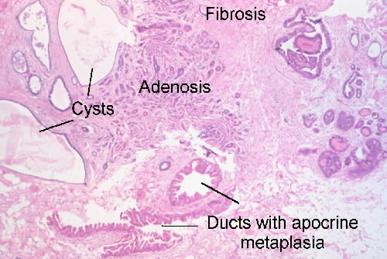
Breast – epitheliosis, adenosis

Slide 11
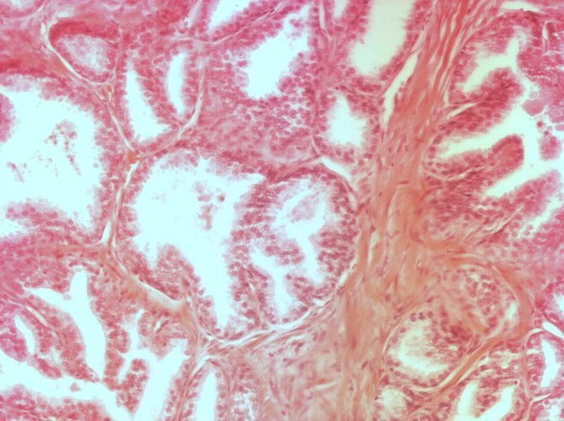
prostate

Slide 12
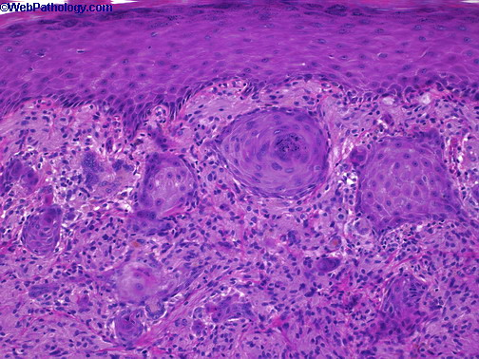
Pseudoepitheliomatous Hyperplasia (keratoacanthoma)

Slide 13
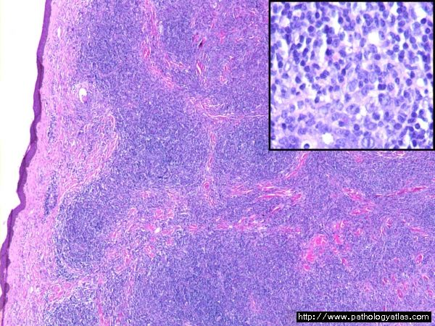
Pseudolymphoma

Slide 14
Disordered Cell Growth
Excessive growth
  Hypertrophy
  Hyperpalasia
Diminished growth
  Atrophy/hypoplasia
Abnormalities of cellular differentiation
  Metaplasia
  Dysplasia

Slide 15
Hypertrophy
Increase in the size of an organ or tissue due to increase in size of its constituent specialized cells
Pure hypertrophy without hyperplasia is seen in striated muscle.
Exception: intimal proliferation (hyperplasia)

Slide 16
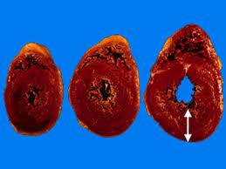
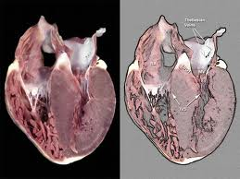
Cardiac hypertrophy

Slide 17
Disordered Cell Growth
Excessive growth
  Hypertrophy
  Hyperplasia
Diminished growth
  Atrophy/hypoplasia
Abnormalities of cellular differentiation
  Metaplasia
  Dysplasia

Slide 18
Atrophy/Hypoplasia
Reduction in organ size due to loss of constituent cells
Secondary lysosomes (autophagy) and residual bodies – lipofuschin pigment
Apoptosis is observed
Physiology – ‘involution’
Examples of atrophy

Slide 19
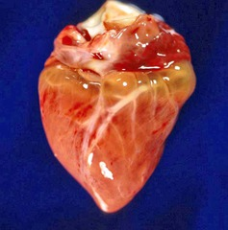
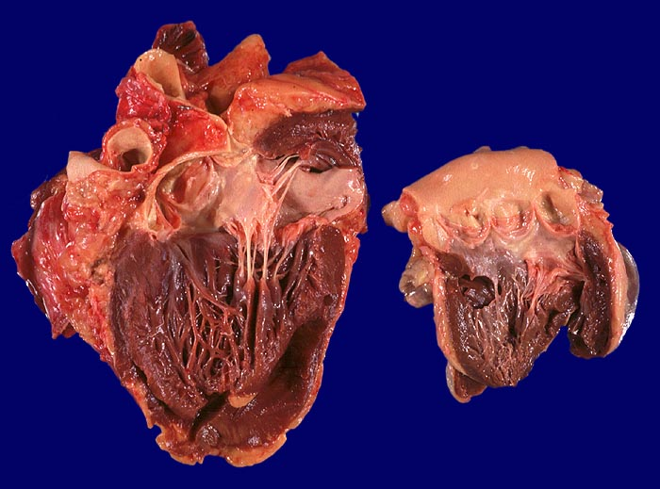
Starvation atrophy

Slide 20
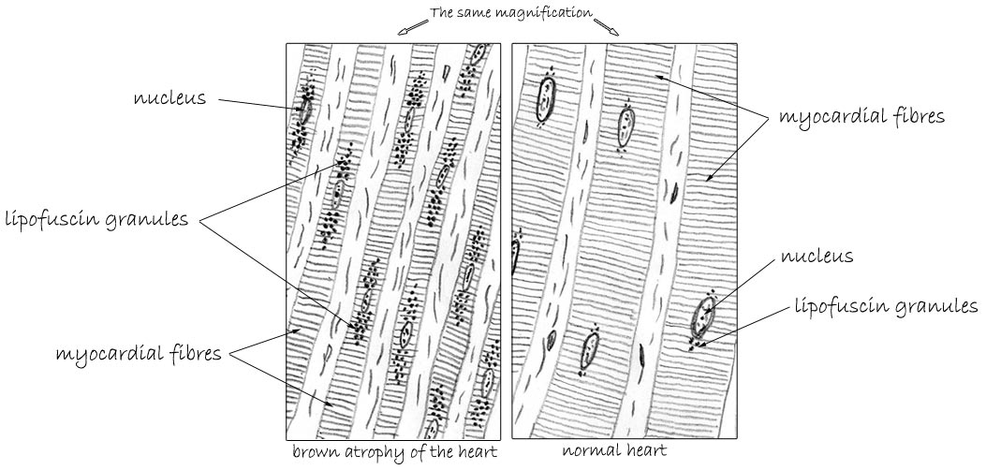

Slide 21
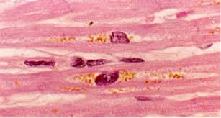
Starvation atrophy

Slide 22
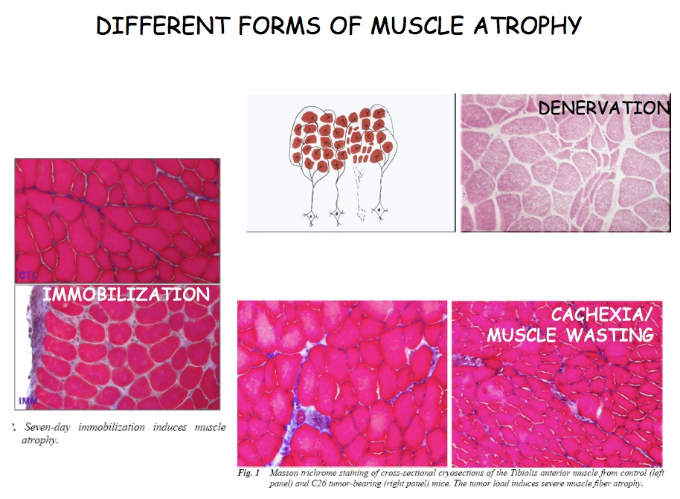
Skeletal muscle atrophy

Slide 23
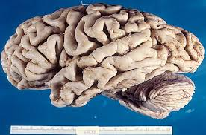
Senile atrophy

Slide 24
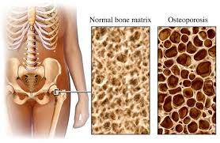
Osteoporosis

Slide 25
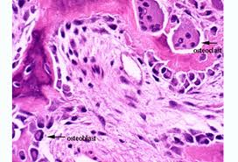
Osteoporosis

Slide 26
Disordered Cell Growth
Excessive growth
  Hypertrophy
  Hyperplasia
Diminished growth
  Atrophy/hypoplasia
Abnormalities of cellular differentiation
  Metaplasia
  Dysplasia

Slide 27
Metaplasia
Change of one type of differentiated tissue to another type of differentiated tissue

Slide 28
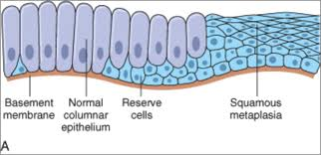
Squamus metaplasia

Slide 29
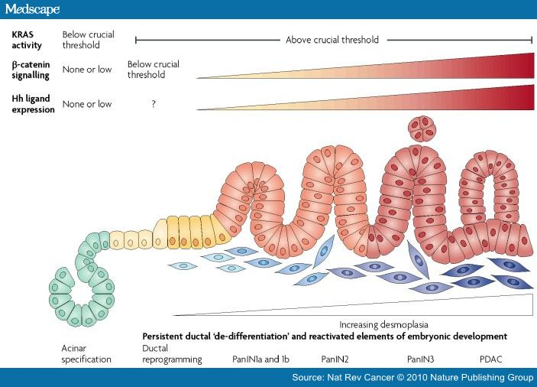
Acinar to ductal metaplasia, pancreas

Slide 30
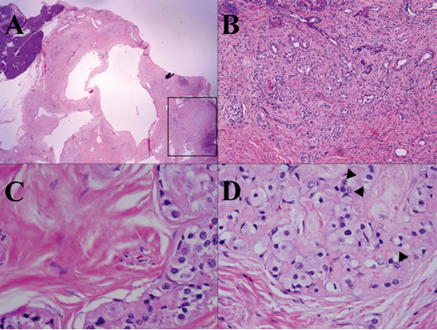
Acinar to ductal metaplasia

Slide 31
Disordered Cell Growth
Excessive growth
  Hypertrophy
  Hyperplasia
Diminished growth
  Atrophy/hypoplasia
Abnormalities of cellular differentiation
  Metaplasia
Dysplasia , dystrophy

Slide 32
Dysplasia
‘Abnormal growth’, there is defective maturation, non functional tissue
Premalignant change
Early events in multistep carcinogenesis

Slide 33
Dystrophies, dyscrasia, dysplasia
Dys – bad or difficult
Trophe – nourishment, crasia – abnormal, plasia-growth
Disorders of structure or function of tissues as a result of abnormal or inadequate nutrition
They include agenesis, atrophy, hypertrophy, hyperplasia, metaplasia

Slide 34
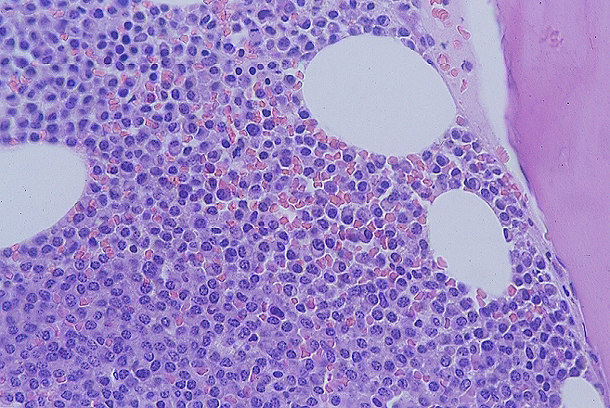
Megaloblastic anaemia

Slide 35
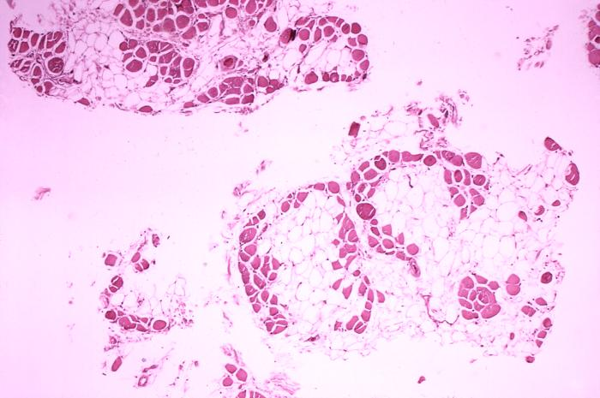
Muscular dystrophies

Slide 36
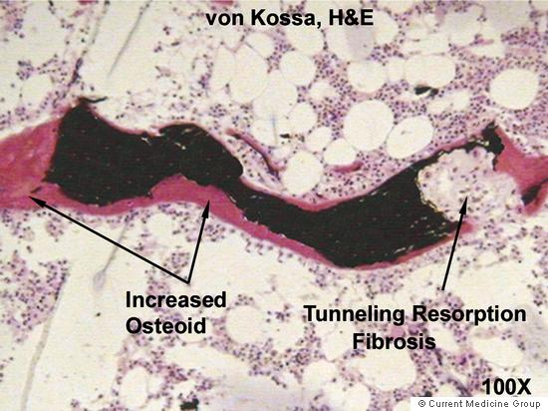
Renal Osteodystrophy

Slide 37
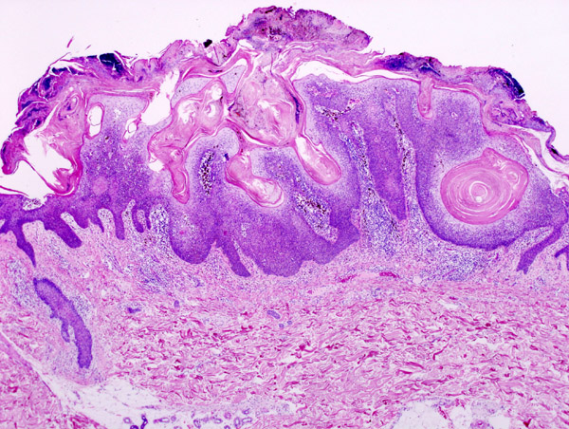
Cutaneous Dystrophies, seborrheic keratosis, actinic keratosis

Slide 38
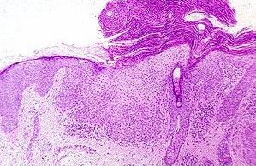
Cutaneous Dystrophies – actinic keratosis

Slide 39
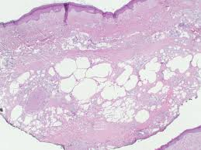
Lipodystrophy

Slide 40
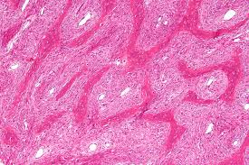
Fibrous ‘dysplasia’and other descriptions of dystrophy
Notes:
Remember to add dyscrasia

Slide 41
Conclusion
Disorders of cell growth occur in many pathologic processes
Their identification is important for diagnosis of a variety of lesions

