Slide 1
Cell cycle
Dr Zuriel
2019

Slide 2
The Cell cycle
Notes:
The cell cycle, or cell-division cycle, is the series of events that take place in a cell leading to its division and duplication (replication).

Slide 3
Notes:
The cell cycle, or cell-division cycle, is the series of events that take place in a cell leading to its division and duplication (replication).

Slide 4
At the molecular level, growth is stimulated initially by the receptor mediated actions of growth factors – e.g. VEGF, EGF, PDGF, IGF-I & 2 – on the cells in the quiescent G₀ phase of the cell cycle via intracellular second messengers.
Stimuli are transmitted to the nucleus of the cell where nuclear transcription factors - e.g. MYC*, MYB, JUN, FOS, and REL oncoproteins - are activated, leading to the initiation of DNA synthesis followed by cell division.

Slide 5
MYC protein can either activate or repress the transcription of other genes.
Those activated by MYC include several growth-promoting genes, including cyclin-dependent kinases (CDKs), whose products drive cells into the cell cycle. Genes repressed by MYC include the CDK inhibitors (CDKIs).
Thus, MYC promotes tumorigenesis by increasing expression of genes that promote progression through the cell cycle and repressing genes that slow or prevent progression through the cell cycle.

Slide 6
Signal transduction
Notes:
At the molecular level, growth is stimulated initially by the receptor mediated actions of growth factors – e.g. VEGF, EGF, PDGF, IGF-I & 2 – on the cells in the quiescent G₀ phase of the cell cycle via intracellular second messengers. Stimuli are transmitted to the nucleus of the cell where nuclear transcription factors - e.g. MYC*, MYB, JUN, FOS, and REL oncoproteins - are activated, leading to the initiation of DNA synthesis followed by cell division.
MYC protein can either activate or repress the transcription of other genes. Those activated by MYC include several growth-promoting genes, including cyclin-dependent kinases (CDKs), whose products drive cells into the cell cycle. Genes repressed by MYC include the CDK inhibitors (CDKIs). Thus, MYC promotes tumorigenesis by increasing expression of genes that promote progression through the cell cycle and repressing genes that slow or prevent progression through the cell cycle.

Slide 7
Cyclins, CDKs and CDKIs
Notes:
Orderly progression of cells through the various phases of the cell cycle is orchestrated by cyclin dependent kinases (CDKs), which are activated by binding to cyclins. The CDK-cyclin complexes phosphorylate crucial target proteins that drive the cell through the cell cycle. On completion of this task, cyclin levels decline rapidly. More than 15 cyclins have been identified; cyclins D, E, A, and B appear sequentially during the cell cycle and bind to one or more CDK.
CDK Inhibitors (CDKIs) silence the CDKs and exert negative control over the cell cycle. One family of CDKIs ( i.e. p21 [CDKN1A], p27 [CDKN1B], and p57 [CDKN1C]) inhibits the CDKs broadly, whereas the other family of CDKIs (i.e. p15 [CDKN2B], p16 [CDKN2A], p18 [CDKN2C], and p19 [CDKN2D]; sometimes called INK4 (A-D) proteins) has selective effects on cyclin D/CDK4 and cyclin D/CDK6. Expression of these inhibitors is down-regulated by mitogenic signaling pathways, thus promoting the progression of the cell cycle.

Slide 8
Orderly progression of cells through the various phases of the cell cycle is orchestrated by cyclin dependent kinases (CDKs), which are activated by binding to cyclins.
The CDK-cyclin complexes phosphorylate crucial target proteins that drive the cell through the cell cycle. On completion of this task, cyclin levels decline rapidly.
More than 15 cyclins have been identified; cyclins D, E, A, and B appear sequentially during the cell cycle and bind to one or more CDK.

Slide 9
CDK Inhibitors (CDKIs) silence the CDKs and exert negative control over the cell cycle. One family of CDKIs ( i.e. p21 [CDKN1A], p27 [CDKN1B], and p57 [CDKN1C]) inhibits the CDKs broadly, whereas the other family of CDKIs (i.e. p15 [CDKN2B], p16 [CDKN2A], p18 [CDKN2C], and p19 [CDKN2D]; sometimes called INK4 (A-D) proteins) has selective effects on cyclin D/CDK4 and cyclin D/CDK6. Expression of these inhibitors is down-regulated by mitogenic signaling pathways, thus promoting the progression of the cell cycle.

Slide 10
Growth-inhibitory signals
Retinoblastoma (RB) gene
P53 gene
Transforming Growth Factor-β Pathway
Adenomatous Polyposis Coli-β-Catenin Pathway

Slide 11
The RB gene
Notes:
The RB protein is a DNA-binding protein expressed in every cell & exists in a hypophosphorylated (active) and a hyperphosphorylated (inactive) state. The RB protein regulates the G₁ phase* - an extremely important checkpoint in the cell cycle clock.
RB protein also:-
stimulate transcription factors that regulate cell differentiation - e.g. myocyte-, adipocyte-, melanocyte-, and macrophage-specific transcription factors
induces senescence
*In G₁, cells can exit the cell cycle, either temporarily (quiescence) or permanently (senescence). Once they cross the G₁ checkpoint, cells are obligated to complete mitosis. Therefore, in G₁ diverse signals are integrated to determine whether the cell should enter the cell cycle, exit the cell cycle and differentiate, or die. RB is a key node in this decision making process.
Mechanism
The initiation of DNA replication requires the activity of cyclin E/CDK2 complexes, and expression of cyclin E is dependent on the E2F family of transcription factors. Early in G₁, RB is in its hypophosphorylated active form, and it binds to and inhibits the E2F family of transcription factors, preventing transcription of cyclin E. Hypophosphorylated RB blocks E2F-mediated transcription in at least two ways:-
- it sequesters E2F, preventing it from interacting with other transcriptional activators.
-RB recruits chromatin remodeling proteins (histone deacetylases and histone methyltransferases) which bind to the promoters of E2F-responsive genes such as cyclin E, thus making their DNA insensitive to transcription factors.
However, upon mitogenic signaling, GF signaling leads to cyclin D expression and activation of cyclin D-CDK4/6 complexes which in turn phosphorylate RB→ RB protein inactivation, release of E2F & hence, induction of target genes such as cyclin E. Expression of cyclin E then stimulates DNA replication and progression through the cell cycle. When the cells enter S phase, they are committed to divide without additional growth factor stimulation. During the ensuing M phase, the phosphate groups are removed from RB by cellular phosphatases, regenerating the hypophosphorylated (active) form of RB.

Slide 12
P53 gene
Notes:
In non-stressed, healthy cells, p53 has a short half-life (20 minutes) because of its association with MDM2, a protein that targets it for destruction. When the cell is stressed ( e.g. by DNA damage), p53 undergoes post-transcriptional modifications that release it from MDM2 and increase its half-life. During the release, p53 also becomes activated as a transcription factor.
p53 protein triggers transcription of many genes, broadly categorised into two groups; those that cause cell cycle arrest and those that cause apoptosis. If DNA damage is repaired during cell cycle arrest, the cell reverts to a normal state; if the repair fails, p53 induces apoptosis or senescence.
Mechanism
DNA-damage triggers/activates two related protein kinases: ataxia-telangiectasia mutated (ATM) and ataxia-telangiectasia mutated related (ATR). Once triggered, both ATM and ATR phosphorylate a variety of targets, including p53 and DNA repair proteins→ cell cycle arrest and stimulation of DNA repair pathways respectively. p53-mediated cell cycle arrest occurs late in the G₁ phase and is caused by p53-dependent transcription of the CDKI p21. p53 also helps the repair process by both transcription-dependent ( (i.e. by inducing certain proteins, such as GADD45 -growth arrest and DNA damage- that help in DNA repair) & transcription-independent mechanisms .
If DNA damage is repaired successfully, p53 up-regulates transcription of MDM2, leading to destruction of p53 and relief of the cell cycle block. If the damage cannot be repaired, the cell may enter p53-induced senescence or undergo p53-directed apoptosis. Pro-apoptotic actions of p53 are mediated in part by transcriptional activation of BAX, but there are other connections as well between p53 and the apoptotic machinery.

Slide 13
Transforming Growth Factor-β (TGF- β) Pathway
Notes:
Mechanism
Ligand binding →
transcriptional activation of CDKIs with growth-suppressing activity; & repression of growth-promoting genes such as c-MYC, CDK2, CDK4, and cyclins A and E.

Slide 14
Adenomatous Polyposis Coli-β-Catenin Pathway / WNT signaling pathway
Notes:
The APC gene exerts antiproliferative effects through the APC protein, a cytoplasmic protein whose dominant function is to regulate the intracellular levels of β-catenin*. β-catenin is an important component of the WNT signaling pathway that regulates cell proliferation. WNT protein is a soluble factor that induces cellular proliferation by binding to its receptor and transmitting signals that prevent the degradation of β-catenin, allowing it to translocate to the nucleus, where it acts as a transcriptional activator in conjunction with the TcF molecule.
In quiescent cells, which are not exposed to WNT, cytoplasmic β-catenin is degraded by a destruction complex, of which APC protein is an integral part. With loss of APC (in malignant cells), β-catenin degradation is prevented, and the WNT signaling response is inappropriately activated → transcription of growth-promoting genes, such as cyclin D1 and MYC . *β-catenin binds to the cytoplasmic portion of E-cadherin, a cell surface protein that mediates intercellular interactions, &; it can translocate to the nucleus and activate cell proliferation, among other functions.

Slide 15
Apoptosis
Notes:
Apoptosis … “programmed cell death” is a pathway of cell death that is induced by a tightly regulated suicide program in which cells destined to die activate enzymes capable of degrading the cells' own nuclear DNA and nuclear and cytoplasmic proteins. The fundamental event in apoptosis is the activation of enzymes called caspases. Activated caspases cleave numerous targets, culminating in activation of nucleases (that degrade DNA), as well as other enzymes that destroy nucleoproteins and cytokeletal proteins. Caspase activation is achieved through two distinct pathways; the mitochondrial pathway and the death receptor pathway.
The extrinsic ( death receptor) pathway
Cells express surface molecules, called death receptors, that trigger apoptosis- e.g. type I TNF receptor and Fas (CD95). The extrinsic pathway is initiated when CD95 molecule is bound to its ligand, CD95L, leading to trimerization of the receptor and thus its cytoplasmic death domains, which attract the intracellular adaptor protein FADD. This protein recruits pro-caspase 8 to form the death-inducing signaling complex. Pro-caspase 8 is activated by cleavage into smaller subunits, generating caspase 8*. Caspase 8 then activates down-stream caspases such as caspase 3, (an executioner caspase) that cleaves DNA and other substrates to cause cell death. Cellular proteins, notably a caspase antagonist called FLIP**, block activation of caspases downstream of death receptors.
*caspase-8 may cleave and activate a pro-apoptotic member of the Bcl-2 family called Bid, thus activating the mitochondrial pathway. The combined activation of both pathways delivers a lethal blow to the cell.
**some viruses produce homologues of FLIP, thus keeping the infected cells alive.
The intrinsic pathway
The intrinsic pathway of apoptosis is triggered by a variety of stimuli, including withdrawal of survival factors, stress, and injury. Activation of this pathway leads to permeabilization of mitochondrial outer membrane, with resultant release of molecules, such as cytochrome c, that initiate apoptosis.
The integrity of the mitochondrial outer membrane is regulated by pro-apoptotic (e.g. BAX and BAK) and anti-apoptotic (e.g. BCL2 and BCL-XL) members of the BCL2 family of proteins. The pro-apoptotic proteins promote mitochondrial permeabilization & their action is inhibited by the anti-apoptotic proteins.
BH3-only proteins – e.g. BAD, BID, and PUMA- regulate the balance between the pro- and anti-apoptotic proteins. They promote apoptosis by neutralizing the actions of anti-apoptotic proteins. When the sum total of all BH3 proteins expressed "overwhelms" the anti-apoptotic BCL2/BCLXL protein barrier, BAX and BAK are activated and form pores in the mitochondrial membrane. Cytochrome c leaks into the cytosol, where it binds to APAF-1, activating caspase 9 which (like caspase 8 of the extrinsic pathway) cleave and activate the executioner caspases.

Slide 16
Apoptosis; Extrinsic p/w & p53 response

Slide 17
EPITHELIAL PRECANCEROUS SKIN LESIONS

Slide 18
DEFINITION
precancerous skin lesions are one that has strong potential to transform into malignancy- characterized -
clinically- by having potential to becomes invasive carcinomas
histopathologically - shows cellular atypia confined to epidermis

Slide 19
DIFFERENTIATION & ANAPLASIA
pleomorphism
abnormal nuclear morphology
mitosis
loss of polarity
loss of uniformity of the individual cells as well as loss of architectural orientation

Slide 20
PRECANCEROUS SKIN LESION
actinic keratosis
arsenical keratosis
chronic radiation keratosis
bowen’s disease
erythroplasia of queyrat
erythroplakia
leukoplakia

Slide 21
ACTINIC KERATOSIS
age >60 - 80% chances of development
m>f
phenotype of fair skin which burn & freckles easily and rarely tan
blue or light coloured eyes & blond hair
immunosuppression
genetic syndromes – like xeroderma pigmentosum & albinism

Slide 22
PATHOGENESIS
sunlight exposure
uv-induced mutation in
tumor-suppressor gene p53

Slide 23
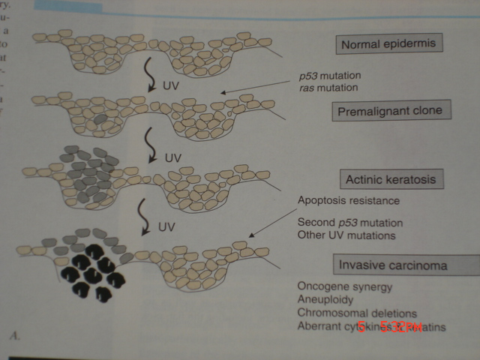
PATHOGENISIS

Slide 24
CLINICAL PICTURE
in elderly patient
80% of lesions found on chronically sun exposed sites – head, neck, forearms & dorsa of hand
erythematous, flat, scaly,yellow coloured papules and patches
hypertrophic - cutaneous horn
actinic cheilites

Slide 25
ACTINIC KERATOSIS

Slide 26
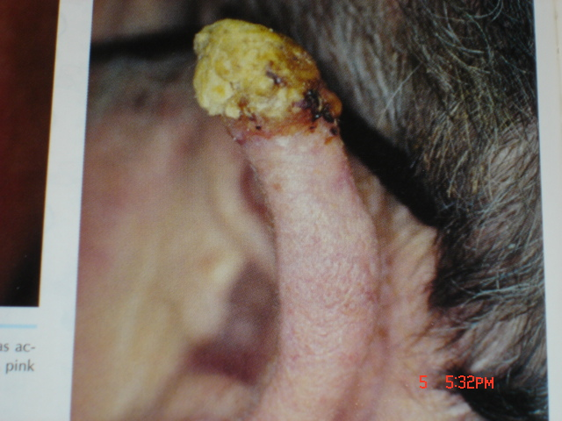
ACINIC KERATOSIS

Slide 27
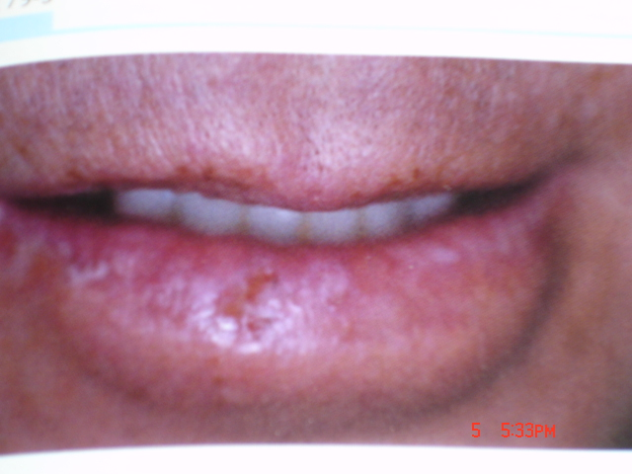
ACTINIC CHEILITIS

Slide 28
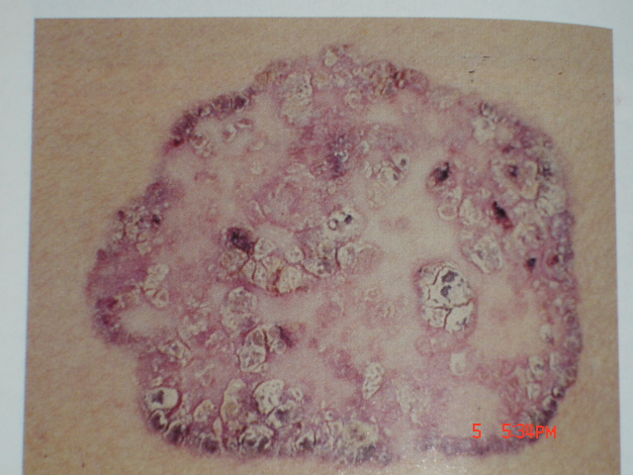
ARENICAL KERATOSIS

Slide 29
CHRONIC RADIATION KERATOSIS
occurs after chronic exposure to radiation
x’ray therepy
medical personnel
dentists
nuclear accidents
Papules, plaques at palms, fingers & mucosa
scc & bcc may develops with other malignancy

Slide 30
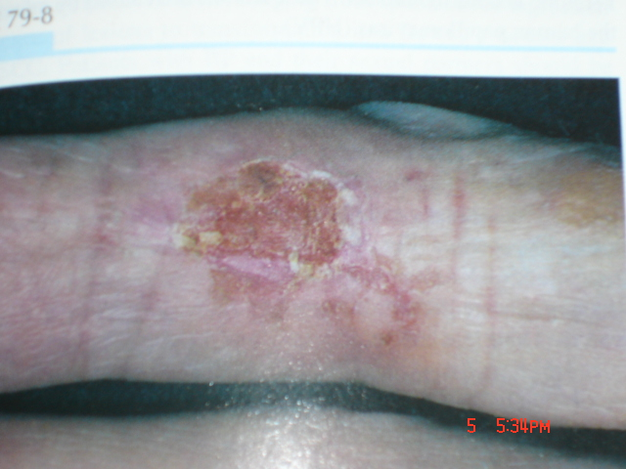
RADIATION KERATOSIS

Slide 31
BOWEN’S DISEASE
squamous cell carcinoma in situ
affects both skin & mucous membranes -having potential to progress into invasive carcinoma
age >60 rarely before 30 years of age
can occur at any body parts – sun or non sun exposed areas of body
sun exposure, arsenic exposure, ionizing radiation, immunosuppression, infection with hpv-16 specially anogenital bowen’s disease

Slide 32
CLINICAL PICTURE
discrete
slowly enlarging
pink to erythematous
thin plaque with well demarcated, irregular borders
over lining scales or crust
hyperkeratotic verrucous lesions
5% of bd progress to invasive scc

Slide 33
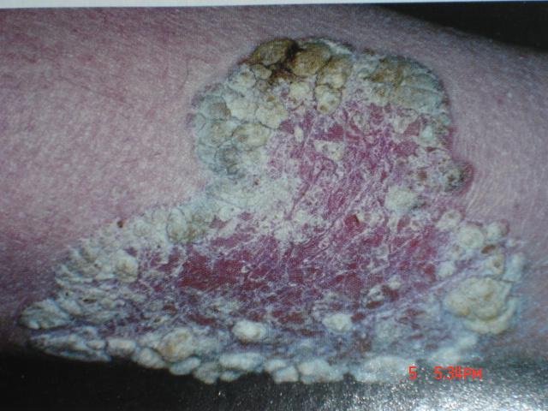
BOWNE’S DISEASE

Slide 34
PATHOLOGY
full thickness cellular atypia
basement membrane remains intact
hyperkeratosis
parakeratosis
acanthosis
complete disorganization of epidermal architecture
wind blown appearance
loss of maturation & polarity

Slide 35
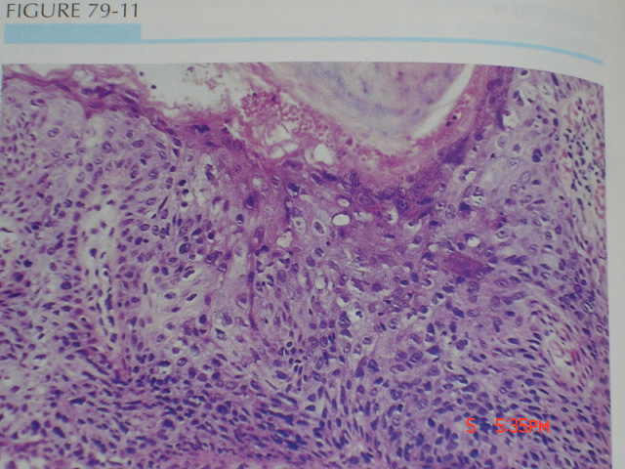
HISTOPATHOLOGY

Slide 36
ERYTHROPLASIA OF QUEYRAT
equivalent- is carcinoma in situ affecting the mucosal surfaces of penis in uncircumcised males
age 20 to 80 years
uncircumcised
poor hygiene
smegma
hpv-16 & 18 infection

Slide 37
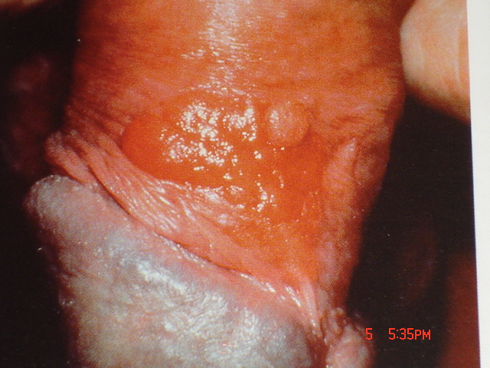

Slide 38
LEUKOPLAKIA
it is fixed predominantly white lesion of mucosa
oral & ano genital mucosal surfaces
alcohol & tobacco use
age >50 to 70 years
5 to 25% risk of becoming invasive
clinically -
Asymptomatic, asymmetric, white plaque at floor of mouth
lateral & ventral tongue, soft plate

Slide 39
ATYPICAL MELANOCYTIC NEVUS

Slide 40
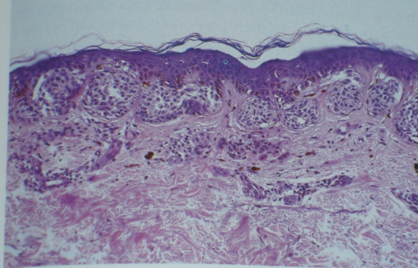
HISTOPATHOLOGY

Slide 41
Transitional epithelium of the cervix

Slide 42
Premalignant disease of the cervix
HPV infection
CIN I
CIN II
CIN III
Cervical
cancer
Normal cervix

Slide 43
HPV infection
DNA virus.
Over 100 different types and subtypes of this virus.
Common infection effecting epithelial surface.
Low risk type (HPV 6,11) cause genital warts.
High risk types (HPV 16, 18, 31, 33, 45, 56).
HPV is a common infection while cervical cancer is a rare disease.

Slide 44
Factors that increase risk of transmission:
Smoking.
Increasing parity.
Early age of intercourse.
Oral contraceptive pills.
Immunosuppression.

Slide 45
Cervical intraepithelial neoplasia
Dysplasia:
abnormal epithelial cells that fail to mature. (hyperchromasia, larger, variable size, mitosis).
it may be mild, moderate or severe

Slide 46
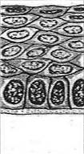
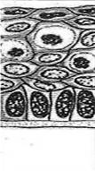
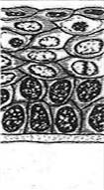
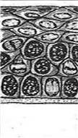
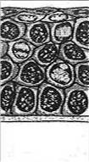
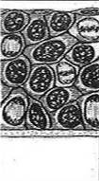
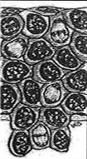
Classification of CIN
CIN¹ | Normal | CIN 1 (condyloma) | CIN 1 (mild dysplasia) | CIN 2 (moderate dysplasia) | CIN 3 (severe dysplasia/CIS) |  | Invasive cancer
Histology of squamous cervical epithelium¹

Slide 47
Bethesda system
Low grade squamous intraepithelial lesion (LSIL); HPV infection, CIN I.
High grade squamous intraepithelial lesion (HSIL); CIN II, CIN III.

Slide 48
Outcome of CIN
Spontaneous regression.
Progression to invasive cancer.
Progression from one stage to another takes years.
Detection and treatment of CIN prevents cancer cervix.

Slide 49
premalignant lesions of the vagina.
Vaginal neoplasia is more common in patients who have previously been treated for cervical or vulvar neoplasia.
The vaginal apex, in the fornices or about the vestibule and lower vagina .
Low grade to high grade spectrum.

Slide 50
Endometrial hyperplasias
Simple hyperplasia - Increased number of glands but regular glandular architecture
Complex hyperplasia - Crowded irregular glands
Simple hyperplasia with atypia - Simple hyperplasia with presence of cytologic atypia (prominent nucleoli and nuclear pleomorphism)
Complex hyperplasia with atypia - Complex hyperplasia with cytologic atypia

Slide 51
CGH and Adenomatous Hyperplasia.

Slide 52
Most common premalignant disorders
vulva, vagina, and cervix.
The cervix is obviously the most common due to the fact that it is reflected in abnormal Pap smears.
There are also ovarian neoplasms that are premalignant

Slide 53
SIL-HG & Carcinoma.

Slide 54
Breast Proliferative changes
ductal and lobular hyperplasia
atypical ductal and lobular hyperplasia
higher risk for the cancer than "normal" population
associated w. microcalcifications (!mammography!)
incidental histological finding
atypical hyperplasia = precancerous lesion

Slide 55
Gastric carcinogenesis
Multistep gastric carcinogenesis
Normal mucosa – non-atrophic gastritis
atrophic gastritis – intestinal metaplasia
dysplasia - carcinoma

