Slide 1
1. Radiation Injury 2. Iatrogenic Desease
Dr Edwin Walong
Anatomic Pathology Unit
Department of Human Pathology
School of Medicine, University of Nairobi
February 11, 2019

Slide 3
Clinical applications of Radiation
Diagnostic radiology
Radiotherapy: Malignant neoplasms
Radiation therapy for other diseases: Radioactive Iodine, radiation for keloids/hypertrophic scars

Slide 4
Scope
The nature and effects of ‘ionizing radiation’ and ‘non ionizing radiation’ in cells, tissue and the individual

Slide 5
Objectives – Radiation Injury
To understand the physical nature of radiation
To understand the cellular changes induced by radiation
To discuss tissue and organ changes due to ionizing radiation in humans
To discuss the sequelae of total body irradiation

Slide 6
Objectives, Iatrogenic Disease
Description
Iatrogenic disease due to pharmacological agents
Iatrogenic disease due to invasive diagnostic or therapeutic procedures
Diagnosis of iatrogenic disease

Slide 7
Radiation
Energy bearing particles or waves travel through a vacuum
Includes travel through matter containing media
This media is not required for their propagation.

Slide 9
Radiation- Ionizing or Non Ionizing
Ionizing
Non ionizing

Slide 10
Ionizing radiation

Slide 13
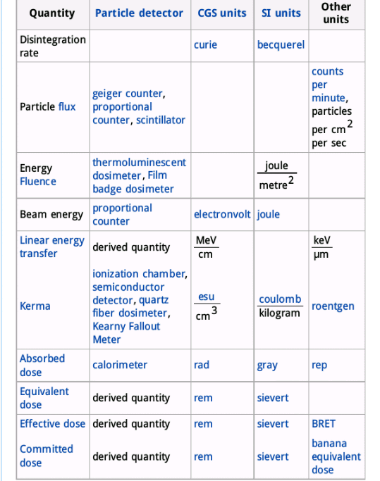

Slide 14
Units of Dose
Gray (Gy) – The Unit of ionizing energy absorbed (absorbed dose). I Gy = 1 J/Kg
Sievert (Sv) – The Unit of absorbed dose taking account of Linear Energy Transfer (LET).
For α particles- 1Sv = Gy x20, β particles: 1Sv = Gy x1, γ

Slide 16
Effects of Ionizing Radiation
Target Theory – injury results to ionization of specific cellular components.
Targets include nucleic acids, enzymes and proteins that bear the SH group
Poison Theory – injury results from ionization and production of free radicals. This results in membrane injury

Slide 17
Effects upon DNA

Slide 19
Cell Cycle Checkpoints

Slide 20
DNA Repair

Slide 23
Effect on Cells: Chromosomal Changes
Deletions
Translocations
Fragmentation
Adhesion breaks between chromosomes
Polyploidy and aneuploidy
The number of these mutations is related to the dose of radiation

Slide 24
Consequences
Inhibition of cell division
Germ-line mutations
Carcinogenesis

Slide 25
Effect Upon Cell Membranes

Slide 26
Effects Upon Proteins

Slide 27
* Law of Bergonie and Tribondeau

Slide 28
Effect of Radiation on Tissues
Acute
Occur hours to days following radiation exposure
Due to depletion of stem cells in an organ or tissue
Apparent when cell number reduction > cell regeneration
Further radiation exposure leads to tissue death, irreversible tissue damage
Bone marrow, skin, GIT

Slide 29
Effect of Radiation on small blood vessels
Late
Occur months to years following radiation exposure
Related to endothelial damage → intimal thickening, occlusion → ischaemic fibrosis, necrosis

Slide 30
Effects, large blood bessels
Due to injury involving vasa vasora
Transmural necrosis
Aneurisms

Slide 31
Heart
Pericardium – Fibrosis
Myocardium -Radiation induced cardiomyopathy – minimal inflammatory infiltrate
Worse when cardiotoxic drugs are used
Endocardium – valvular thickening, fibrosis, calcification
Coronary – intimal foam cell accumulation

Slide 32
Nervous System
Brain, spinal cord, peripheral nerve
Neurons – resistant
Injury to glial and oligodendrocytes
Glial and vascular injury – vasogenic oedema due to Blood Brain Barrier Dysruption
Endothelial vasculopathy
Spinal cord – transient myelitis (2-4 months)
Delayed myelitis (20-30 months)

Slide 33
Peripheral Nerves
Fairly resistant
Peripheral neuropathy
Perineural inflammation and ganglionitis

Slide 34
Bone Marrow
Highly sensitive
Stem cell injury leading to pancytopenia
Myelodysplasia may predominate

Slide 35
Other tissues
Ovaries/Testes, highly susceptible – germ cell necrosis, supporting cells are retained
Eye – optic neuropathy, lens opacity, retinal injury
Lymphoid cells – disorders in homing and recirculation
Endocrine – hyperplasia - hypoplasia

Slide 36
Conclusion – Radiation Injury
Ionizing induced injury affects the DNA/Proteins/lipid membranes
Microvascular injury is associated with acute injury
Repair with fibrosis is an intermediate manifestation
Long term - neoplasia

Slide 37
IATROGENIC DISEASE

Slide 38
Objectives, Iatrogenic Disease
Description
Iatrogenic disease due to pharmacological agents
Iatrogenic disease due to invasive diagnostic or therapeutic procedures
Diagnosis of iatrogenic disease

Slide 39
definition
Iatrogenic (of a disease or symptoms) induced in a patient by the treatment or comments of a physician.
Chambers English Dictionary

Slide 40
Iatrogenic Disease
One of the basic principles in treatment stated by Hippocrates is “First do no harm”.
An iatrogenic disorder occurs when the deleterious effects of the therapeutic or diagnostic regimen causes pathology independent of the condition for which the regimen is advised.
A landmark study in 1991 identified that the majority were due to substandard medical care (PDF attached)

Slide 41
US Series, Iatrogenic Disease

Slide 42
Etiology
Diagnostic procedures (mechanical and radiological)
therapeutic regimen (drugs, surgery, other invasive procedures)
hospitalization
the medical practitioner and their assistants

Slide 43
Mechanical procedures
Diagnostic aspiration of fluids may lead to haemorrhage, secondary infection, etc.
Rapid pleural or peritoneal fluid aspiration and needle biopsies may lead to shock and even death.
Endoscopic procedure may cause perforation of hollow viscus.

Slide 44
Diagnostic Radiology
Reactions to contrast media
Intravascular contrast media may be nephrotoxic reaction
Cerebral angiography may cause transient or permanent neurological deficits.
Radiation injury (radioactive isotopes) – fetus,

Slide 45
Adverse Drug Reactions
defined by WHO as any response for a drug which is noxious, unintended and which occurs at doses normally used for prophylaxis, diagnosis and therapy of disease].
ADR can be classified as predictable (side effects, toxicity, super infection, drug interactions) and unpredictable (intolerance, idiosyncrasy, allergy or pseudo allergy)

Slide 46
ADR
When fewer than 6 different drugs are given in hospitalized patients, the probability of an adverse reaction is about 5%, but if more than 15 drugs are given, the probability is more than 20%.
General hospital, 2 to 5% are due to ADR and fatality in patients with ADR varies from 2-12%. ADR occurs in the elderly more frequently [5].

Slide 47
ADR
To overcome the inadequacies in the WHO definition, new definition for adverse drug reaction is “an appreciably harmful or unpleasant reaction, resulting from an interaction related to the use of a medicinal product

Slide 48
ADR
which predicts hazard from future administration and warrants prevention or specific treatment or alteration of the dosage regimen or withdrawal of the product”.
six types
doserelated (Augmented),
non-dose-related (Bizarre),
doserelated and time-related (Chronic),
time-related (Delayed),
withdrawal (End of use),
failure of therapy (Failure).

Slide 49
Physician as a cause of Disease
imprudent use of medicine or procedure
unjustified remarks and misinterpretation of investigational data
The physician should be aware of the properties of drugs that he prescribes and their potential dangers.
Ignorance of the possibility of a reaction is a clear evidence of negligence.
The physician should warn the patient of the likely side effects

Slide 55
Suggested Reading
Radiation Injury: Walter and Israel, General Pathology (text) and a small section in Robbin’s Pathology
Iatrogenic Disease:
http://www.aegris.org/blog/Harvard_I.pdf
http://www.yourmedicaldetective.com/public/335.cfm

