Slide 1
MBChB General Pathology Series:
1. NUTRITIONAL DISEASES
2. ENVIRONMENTAL DISEASE
3. OCCUPATIONAL DISEASE
Dr Edwin Walong. MBChB, Mmed (Pathology), FCPATH ECSA
11 February 2019

Slide 2
Intended Learning Outcomes
Identify risk factors and describe the pathology nutritional, occupational and environmental disease
Establish the role of the physician in prevention and management of nutritional, occupational and environmental disease

Slide 3
Outline
Nutritional Disease
  - Macronutrient deficiency
  - Micronutrient deficiency
  - Obesity
Environmental Disease
  - Particles
  - Chemicals
  - Radiation
  - trauma
Occupational Disease
  - physical agents, occupational disease in health care ergonomics

Slide 4
Nutritional Disorders
caused by an insufficient intake of food or of certain nutrients
inability of the body to absorb and use nutrients
overconsumption of certain foods
Nutrition disorders can be particularly serious in children, since they interfere with growth and development, and may predispose to many health problems, such as infection and chronic disease.

Slide 5
Classification of nutritional disorders
Deficiency
  -macronutrient
  -micronutrient
Excessive nutrient consumption
  Macronutrient
  Micronutrient

Slide 6
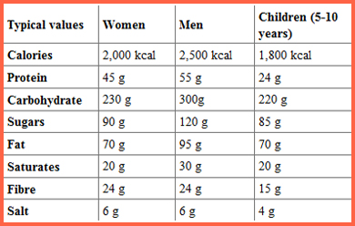
RDA

Slide 7
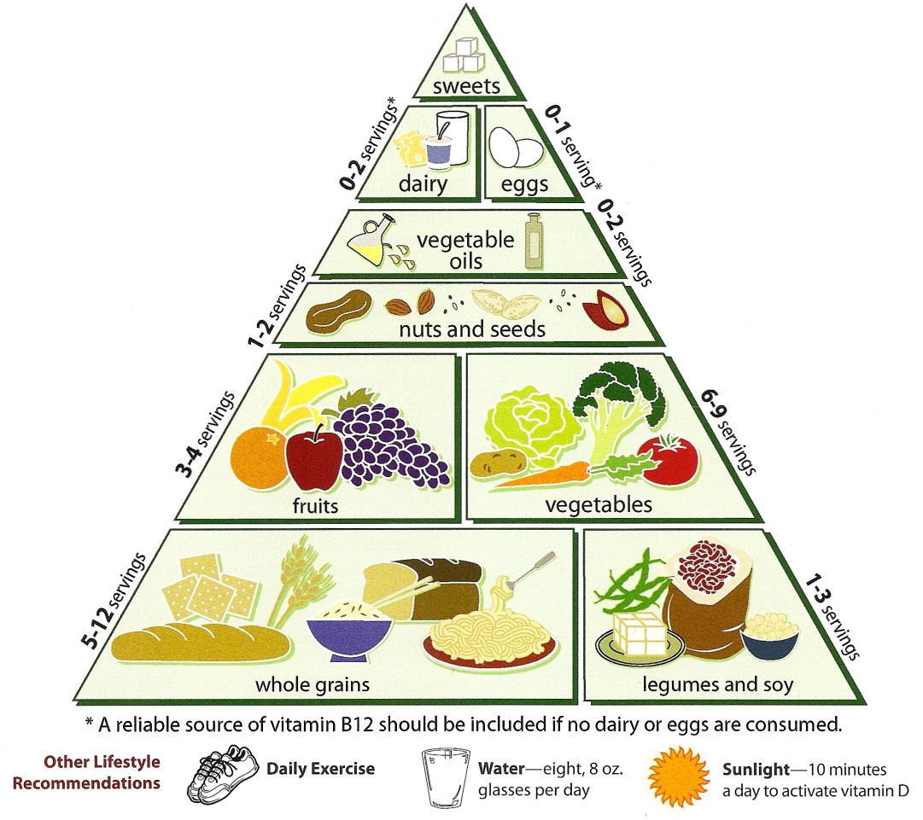

Slide 8
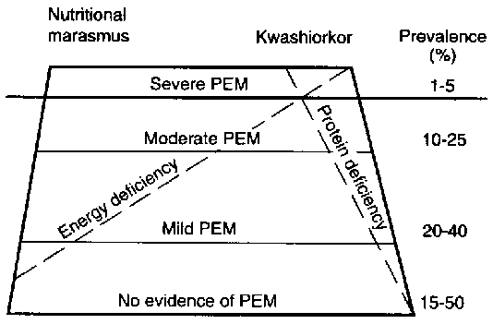
Nutritional Disorders, Macronutrients

Slide 9
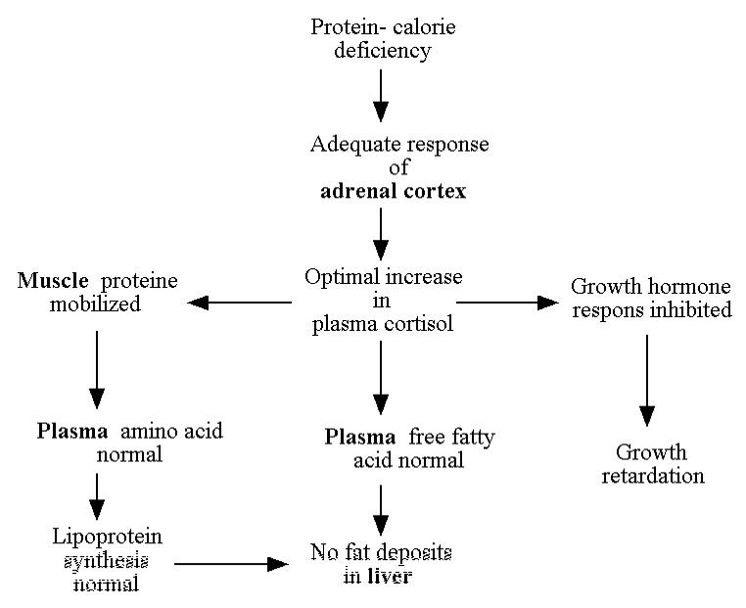

Slide 10
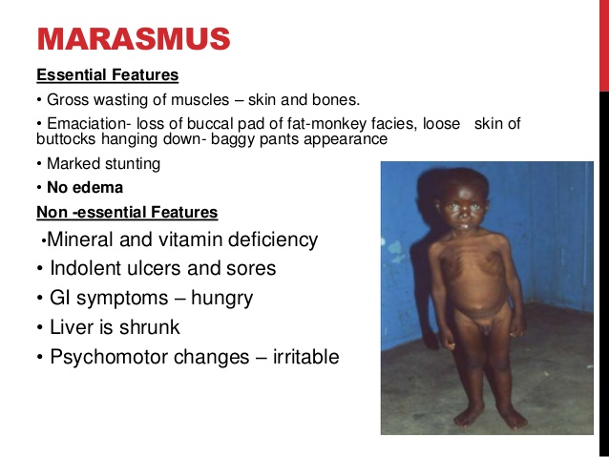
Marasmus

Slide 11
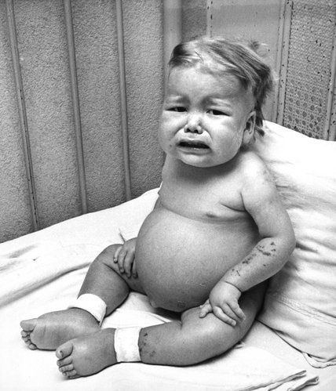
kwashiakor
Ga (Coastal Ghana) ‘when the second child comes’
Predominantly protein malnutrition

Slide 12
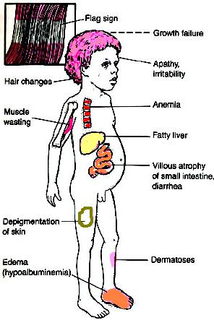

Slide 13
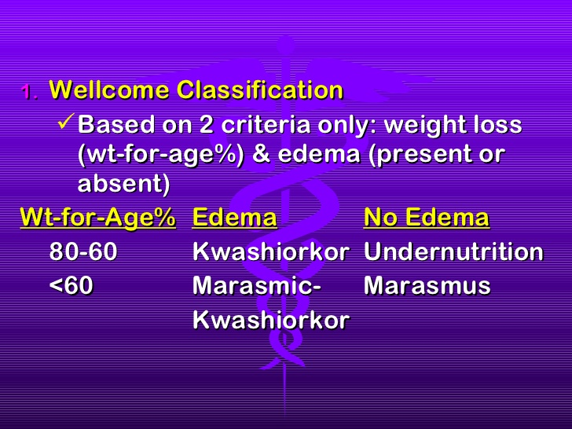

Slide 14
Micronutrient Deficiency
Deficiency of micronutrients vitamins (A, B1-12, C, D, E, folate) Minerals (Iron, Zinc, Iodine, Copper)

Slide 15
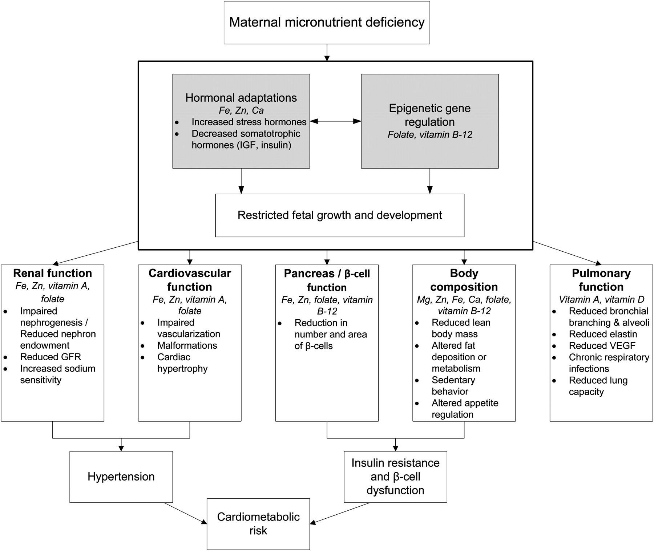

Slide 16
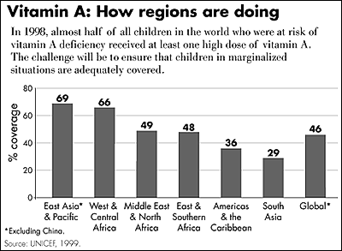

Slide 17
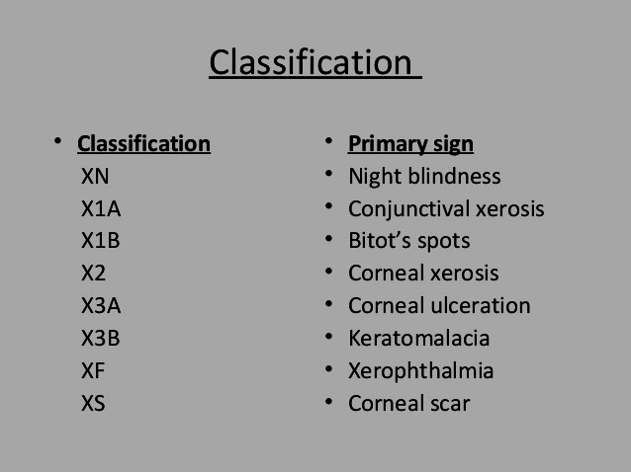

Slide 18
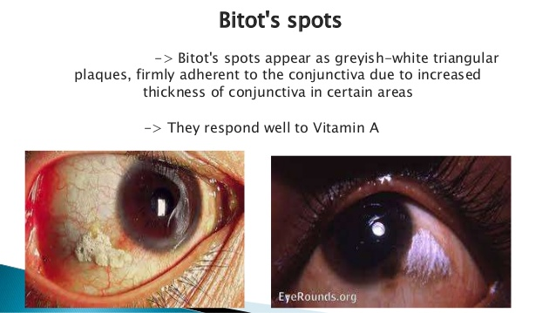

Slide 19
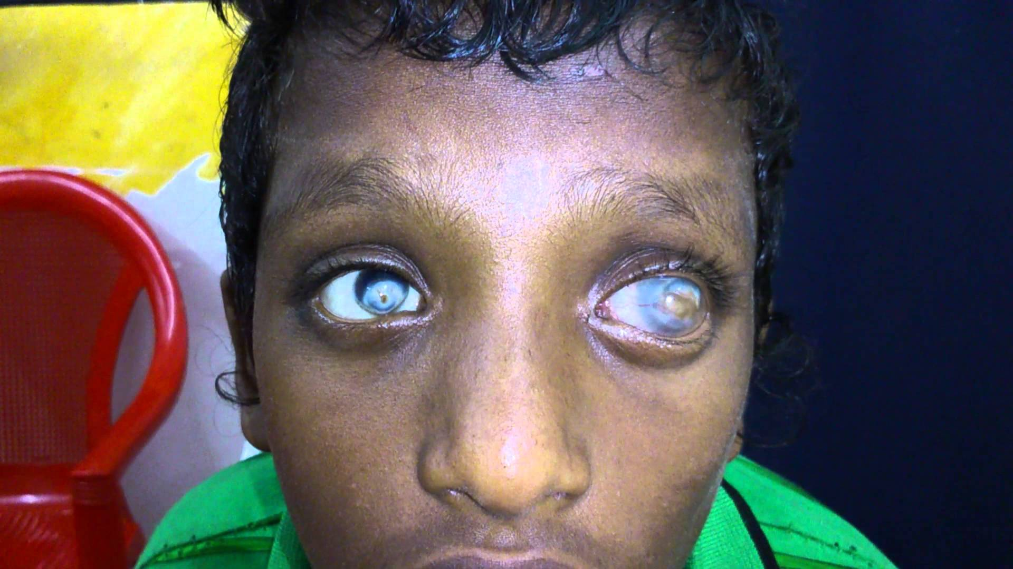
Right – corneal scar, left xerophthalmia

Slide 20
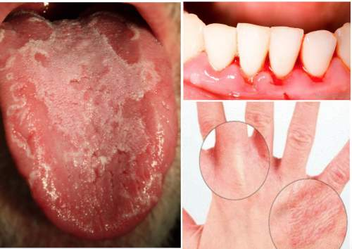
Vitamin C

Slide 21
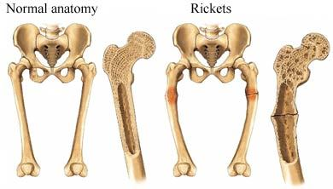
Vitamin D - Rickets

Slide 22
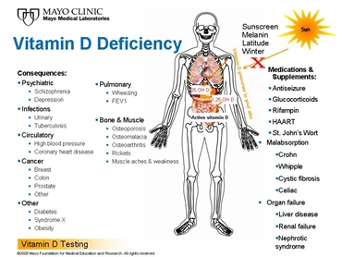
;;;;;;;;
444
44
.

Slide 23
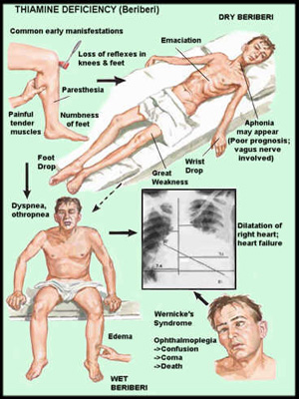
Beriberi

Slide 24
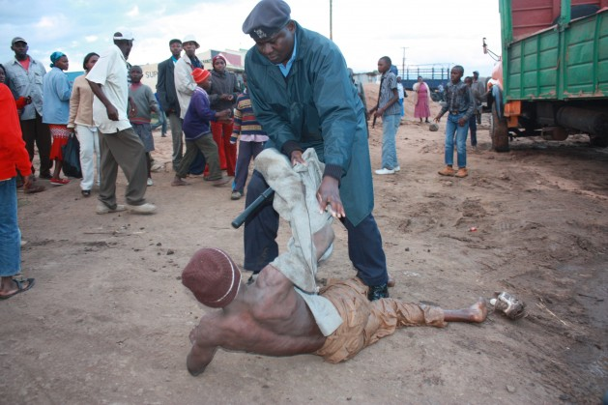

Slide 25
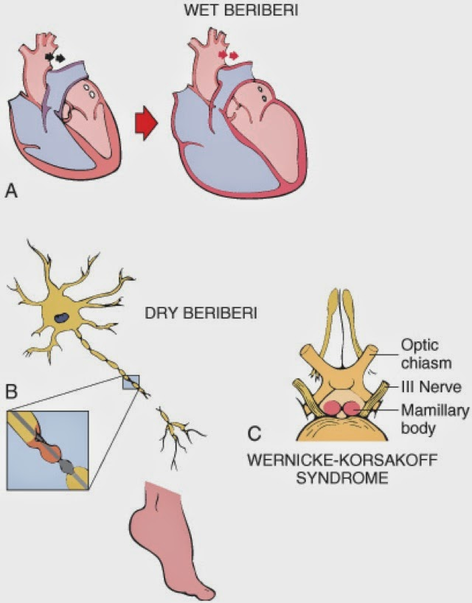

Slide 26
Other B vitamin deficiencies
B2 – riboflavin – arabiflavinosis
B3 – Niacin – Pellagra
Folic acid/B12 – Megaloblastic Anaemia

Slide 27
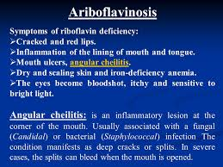

Slide 28
Nutritional disorders due to increase in nutrients
Hypervitaminosis A
Hypervitaminosis C (acidification of urine)
Hypervitaminosis D
Iron Overload
Copper overload

Slide 29
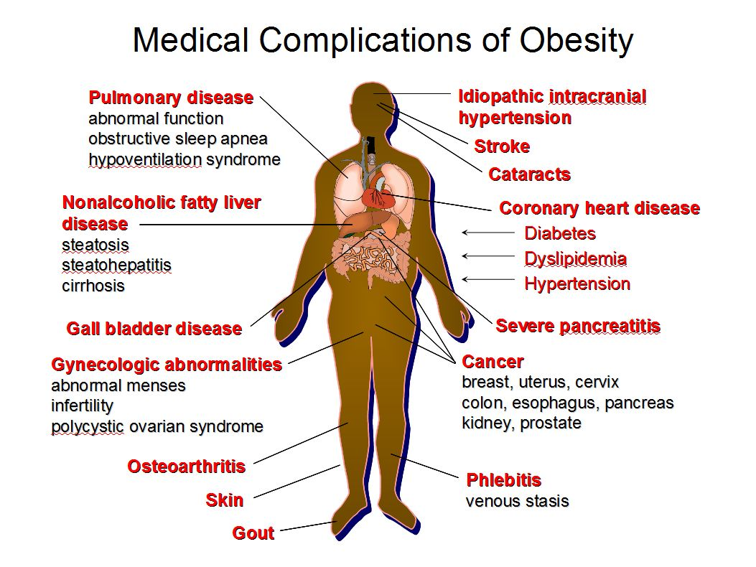

Slide 30
Outline
Nutritional Disease
  - Macronutrient deficiency
  - Micronutrient deficiency
  - Obesity
Environmental Disease
  - Particles
  - Chemicals
  - Radiation
  - trauma
Occupational Disease
  - physical agents, occupational disease in health care ergonomics

Slide 31
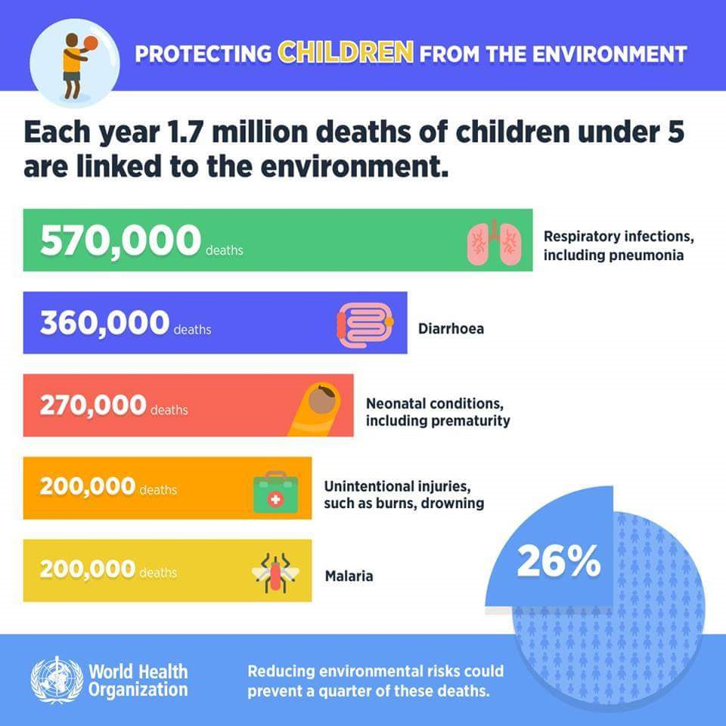

Slide 32
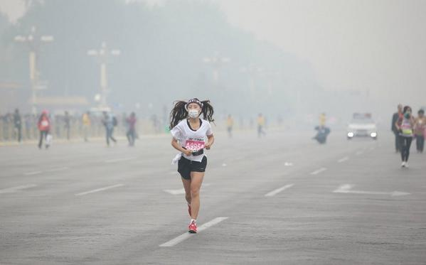

Slide 33


Slide 34
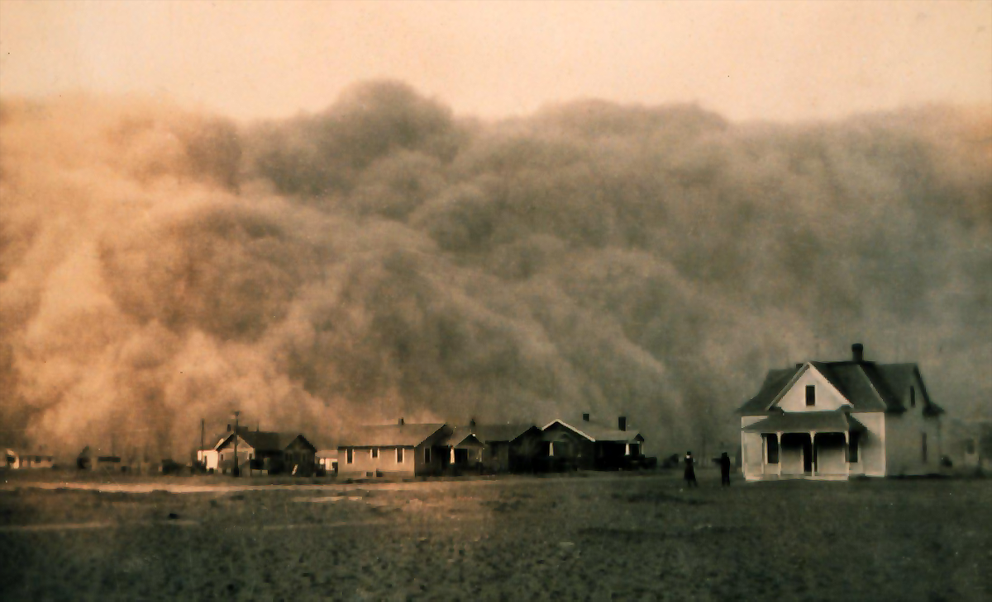

Slide 35
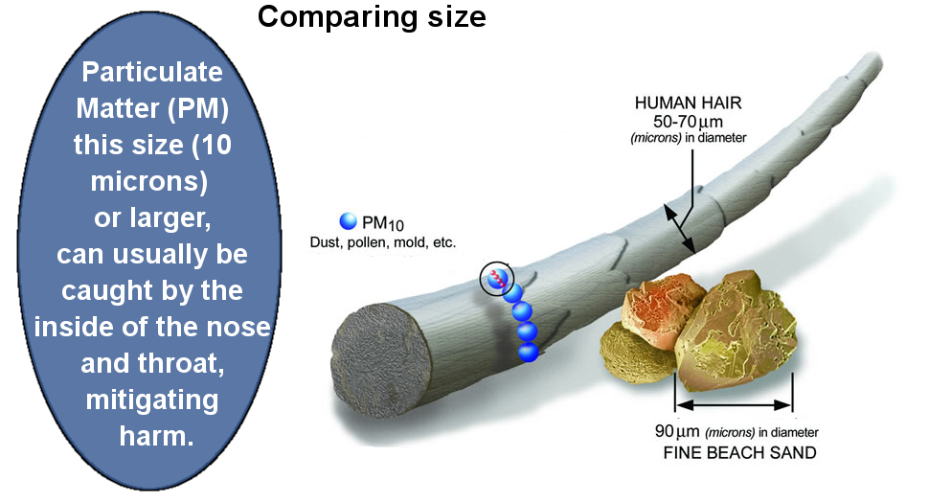

Slide 36
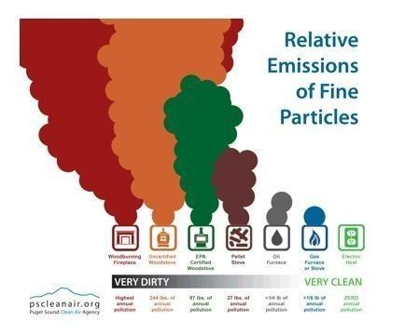

Slide 37
Others: Trauma
Injuries resulting from accidents, homicides, suicides
Accidents: diseases/injuries due to the external environment
Accidents: includes natural disasters, agents
Accidents don’t just happen
These result from a chain of critical events that lead to disaster

Slide 38
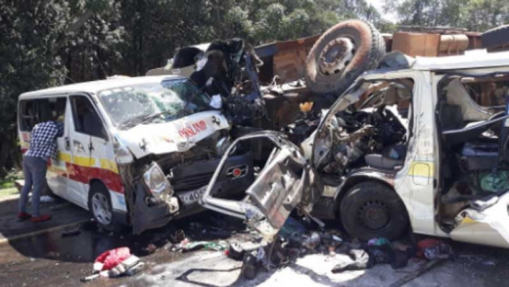

Slide 39
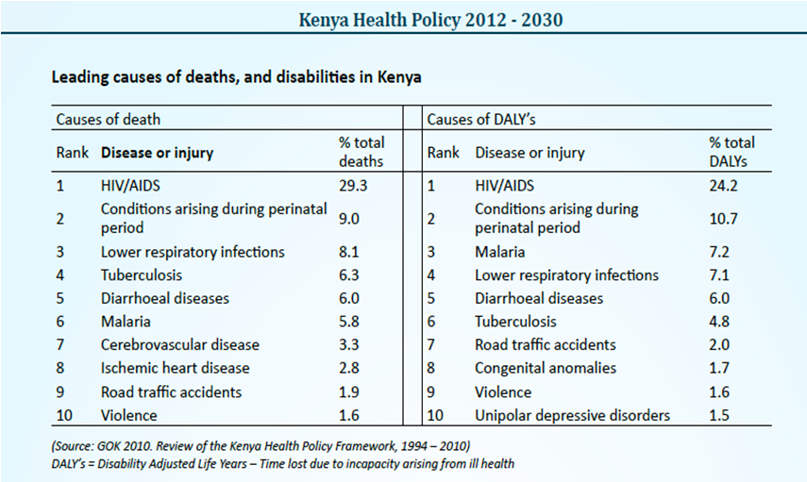

Slide 40
Manner of Death (or Injury)
Natural
Unnatural
  Homicide
  Accidental
  Suicide

Slide 41
Manner of Death (or Injury)
Natural
Unnatural
  Homicide
  Accidental (due to the external environment)
  Suicide

Slide 42

Occupational Health

Slide 43
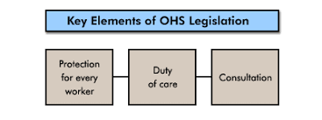

Slide 44
Conclusion
Significant causes of morbidity and mortality
Result from behavioural factors
The built environment contributes to these
Their identification is essential for public safety

Slide 45
The University of Nairobi
Vision:
  A world-class university committed to scholarly excellence

