Slide 1
GENETIC BASIS OF DISEASE AND DISORDERS
DR M.P. OKEMWA

Slide 2
GENETIC DISORDERS
Illness caused by one or more abnormalities in the genome.
Some are heritable and passed down from parents genes.
Others are caused by new mutations or defects in DNA. In such they will be heritable if affecting germ cells.
Hence same disease like cancer may be caused by an inherited condition in some, by new mutations in others and non genetic causes in still others.

Slide 3
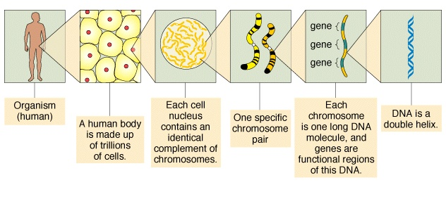

Slide 4
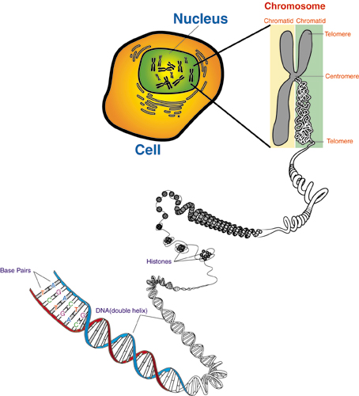
Image source: www.biotec.or.th/Genome/whatGenome.html

Slide 5
Chromosomes
DNA is packaged into individual chromosomes (along with proteins)
DNA + associated chromosomal proteins = chromatin
prokaryotes (single-celled organisms lacking nuclei) have a single circular chromosome
eukaryotes (organisms with nuclei) have a species-specific number of linear chromosomes

Slide 6
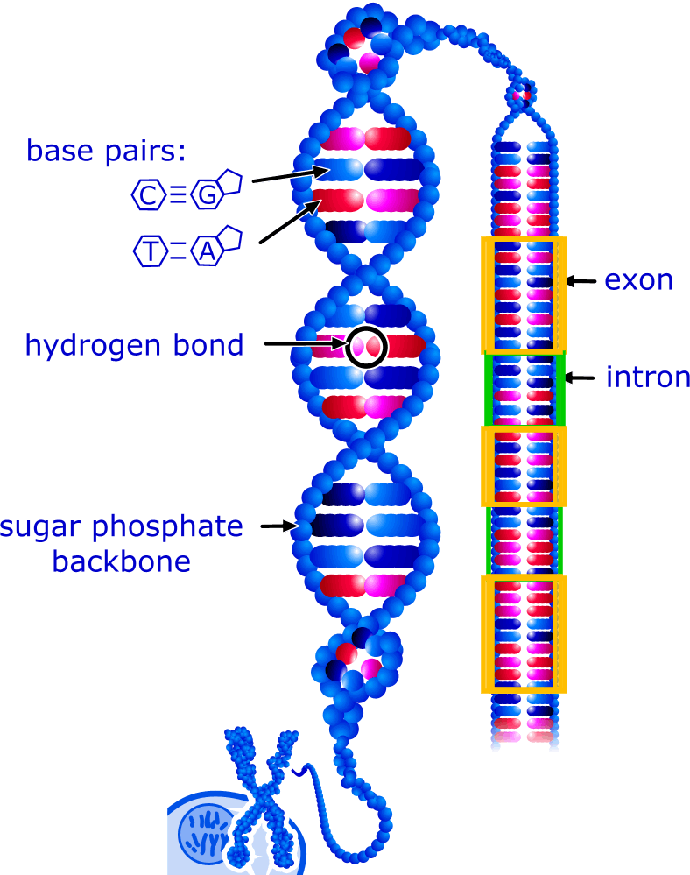
DNA
~3.2 billion base pairs in every cell build the human genome
genes form only 1,5% of the human genome
a gene is a segment of the DNA, that encodes the constructon plan for a protein

Slide 7
DNA
can be thought of as the “blueprint” for an organism
composed of small molecules called nucleotides
four different nucleotides distinguished by the four bases: adenine (A), cytosine (C), guanine (G) and thymine (T)
is a polymer: large molecule consisting of similar units (nucleotides in this case)
DNA is digital information
a single strand of DNA can be thought of as a string composed of the four letters: A, C, G, T
ctgctggaccgggtgctaggaccctgactgcc
cggggccgggggtgcggggcccgctgag…

Slide 8
GENES
A gene is a unit of DNA that codes for a specific protein.
Genes consist of exons and introns. The exons contain the DNA code for the protein, while intervening introns, which make up most of the size of a gene, have an unknown function.
The introns must be cut out and the exons spliced together in the mRNA before it leaves the nucleus.
The location of a gene on the chromosome is called the locus.

Slide 9
GENOTYPE, PHENOTYPE
The alleles that are present represent the genotype of a person.
The expression of the genotype leads to the phenotype, or what is clinically apparent in the person.
Genetic heterogeneity refers to the appearance of a common phenotype for several genotypes.
Mutations refers to alteration from normal.

Slide 10
PROTOONCOGENES
A proto-oncogene is a normal gene that can become an oncogene due to mutations.
Proto-oncogenes code for proteins that help to regulate cell growth and differentiation.
Proto-oncogenes are often involved in signal transduction and execution of mitogenic signals, usually through their protein products.
Upon activation, a proto-oncogene (or its product) becomes a tumor-inducing agent, an oncogene. Examples of proto-oncogenes include RAS, WNT, MYC, ERK, and TRK.

Slide 11
PROTOONCOGENES
There are two mechanisms by which proto-oncogenes can be converted to cellular oncogenes:
Quantitative: Tumor formation is induced by an increase in the absolute number of proto-oncogene products or by its production in inappropriate cell types.
Qualitative: Conversion from proto-oncogene to transforming gene (c-onc) with changes in the nucleotide sequence which are responsible for the acquisition of the new properties

Slide 12
MUTATIONS
Genetic mutations can involve autosomes or the sex chromosomes.
The effect depends on the function of the region affected.
A mutation involving a gene coding for an enzyme appears as a recessive trait because, in the heterozygote, one gene copy is present and enough enzyme is made to provide for sufficient metabolic function.
A mutation involving a gene coding for a structural protein appears as a dominant trait, because one copy of the abnormal gene leads to formation of an abnormal protein that interferes with formation of tissues

Slide 13
SINGLE GENE MUTATIONS
Mutations can occur in many forms:
Missense: Change in a single amino acid
Nonsense: Change in a stop codon
Deletion: Loss of a single base pair, with frameshift
Insertion: Gain of a single base pair, with frameshift
Duplication: An extra gene with more protein production
Splice site: Abnormalities at the intron-exon boundary
Triple repeats: Increased tandem repeats

Slide 14
Chromosomal disorders
DNA is packaged into individual chromosomes (along with proteins)
Humans have 23 pairs- 22 autosomes and a pair of sex chromosomes (X,Y)
Haploid(N) –describes a cell that contains a single set of chromosomes usually gametes in human beings.
Normal eukaryotic organism is composed of diploid cells, one set of chromosomes from each parent hence 46 chromosomes in humans= 23N

Slide 15
Chromosomal disorders
Numerical
-euploid= multiple of haploid number (N)
-aneuploid= trisomy or monosomy meaning one extra or one less number of chromosomes caused by a non disjunction during meiosis
Structural
- translocation; movement of a segment of a chrom
- deletion; removes a chromosome segment
-inversion; reverse of a segment within a chromosome
- duplication; repeat of a chromosome segment

Slide 16
Chromosomal disorders
50% of first trimester miscarriages
5% of still births
0.5% of live borns
-Down’s syndrome- trisomy 21
- Fragile X syndrome
Somatic cell abnormalities in cancers

Slide 17
Down syndrome (trisomy 21)
The result of an extra copy of chromosome 21.
47, 21+
characteristic facial features, short stature; heart defects, usually some degree of mental retardation.
often sexually underdeveloped and sterile.
susceptibility to respiratory disease, shorter lifespan
is correlated with age of mother but can also be the result of nondisjunction of the father's chromosome 21.

Slide 18
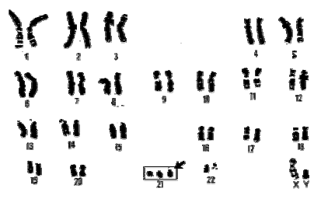
Human Chromosomes karyotype(map)

Slide 19
….
Pataus syndrome- Trisomy 13
Edwards syndrome- trisomy 18
Turners-XO
Cri du chat- deletion of part of Chr 5
Klinefelters-47 XXY
Prader –Willi syndrome (del 15)q11-13
-hyperphagia(compulsive overeating)
-mild to moderate MR
-short stature, small external genitalia, hypotonia

Slide 20
PATTERNS OF INHERITANCE
This are often seen in mendelian disorders where whole chromosmes are affected.
Autosomal recessive
Autosomal dominant
X-linked recessive
X-linked dominant

Slide 21
AUTOSOMAL RECESSIVE
This pattern is typically seen with a mutation in a gene encoding for an enzyme, resulting in loss of function.
Heterozygotes generally have enough gene product to get by. Homozygotes generally have too little, but the amount of product and severity of disease may vary. The standard recurrence risk is 25%.

Slide 22
SICKLE CELL ANEMIA
An example of a common autosomal recessive condition is sickle cell anemia. Normal adult hemoglobin is comprised of four globin chains that bind iron. Two of the chains are alpha and two are beta. A point mutation in the beta globin chain gene leads to an abnormal globin that causes red blood cells to change shape (sickle) under low oxygen concentrations. The mutation causes a substitution of valine for glutamic acid at position 6 of the beta globin chain, leading to abnormal conformation of this protein.

Slide 23
AUTOSOMAL DOMINANT
This pattern typically occurs when a mutation involves a gene encoding for a structural protein.
There can be a "dominant negative" effect in which the product interferes with formation of complex protein structures or a "gain of function" in which the product leads to appearance of abnormal features .

Slide 24
MARFAN SYNDROME
Marfan syndrome is another example of an autosomal dominant condition involving a structural gene, in this case the fibrillin gene,
It encodes for a protein that is a component of microfibrils that form connective tissues, particularly in the aorta, eye, and skeletal system.
Affected persons are tall, with long fingers (arachnodactyly), loose joints, ocular problems, and a propensity for the aorta to rupture.

Slide 25
X-LINKED RECESSIVE
In this pattern, females are typically carriers.
Because of X-inactivation that leaves some functional genes available to produce product, they do not display the phenotype.
Depending upon how much product is needed to be healthy, some females may be mildly affected

Slide 26
HEMOPHILIA A
An example of an X-linked recessive condition is the blood clotting disorder known as hemophilia A.
In this condition, there is a mutation in the gene coding for the production of blood clotting factor VIII.
This disease illustrates the fact that the amount of product made can vary somewhat, and factor VIII activity determines the severity of the disease, so the phenotype varies from mild to severe, a phenomenon called variable expression.

Slide 27
X-LINKED DOMINANT
Theoretically, both males and females will be affected, but a "double dose" of the abnormal gene product may be lethal in utero, so that virtually no males are seen with the disease.

Slide 28
PENETRANCE
The pattern of transmission can be confounded by reduced penetrance and by variable expression.
Reduced penetrance means that the gene is present and can be transmitted to offspring but does not produce the phenotype in the parent, leading to a "skipped" generation in a pedigree.
Variable expression-where the disease is present (complete penetrance) but the severity of gene expression varies from mild to severe.

Slide 29
MULTIFACTORIAL INHERITANCE
No one specific gene is involved.
Instead, multiple genes and environmental factors interact to produce a phenotype.
The recurrence risk is above the average 3%, but the amount is difficult to state precisely.
An example is non-insulin dependent diabetes mellitus where family history, dietary influence, smoking and obesity amongst others influence development of disease.

Slide 30
Major events in the history of Molecular Biology 1952 - 1960
1952-1953 James D. Watson and Francis H. C. Crick deduced the double helical structure of DNA
1956 George Emil Palade showed the site of enzymes manufacturing in the cytoplasm is made on RNA organelles called ribosomes.
James Watson and Francis Crick
George Emil Palade
Notes:
Outline format

Slide 31
Major events in the history of Molecular Biology 1970
1970 Howard Temin and David Baltimore independently isolate the first restriction enzyme
DNA can be cut into reproducible pieces with site-specific endonuclease called restriction enzymes;
the pieces can be linked to bacterial vectors and introduced into bacterial hosts. (gene cloning or recombinant DNA technology)
Notes:
Outline format

Slide 32
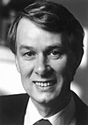
Major events in the history of Molecular Biology 1970- 1977
1977 Phillip Sharp and Richard Roberts demonstrated that pre-mRNA is processed by the excision of introns and exons are spliced together.
Joan Steitz determined that the 5’ end of snRNA is partially complementary to the consensus sequence of 5’ splice junctions.
Phillip Sharp
Richard Roberts
Joan Steitz
Notes:
Outline format

Slide 33
Major events in the history of Molecular Biology 1986 - 1995
1986 Leroy Hood: Developed automated sequencing mechanism
1986 Human Genome Initiative announced
1990 The 15 year Human Genome project is launched by congress
1995 Moderate-resolution maps of chromosomes 3, 11, 12, and 22 maps published (These maps provide the locations of “markers” on each chromosome to make locating genes easier)
Leroy Hood

Slide 34
Major events in the history of Molecular Biology 2000-2001
2000 Complete sequence of the euchromatic portion of the Drosophila melanogaster genome
2001 International Human Genome Sequencing:first draft of the sequence of the human genome published

Slide 35
Major events in the history of Molecular Biology 2003- Present
April 2003 Human Genome Project Completed. Mouse genome is sequenced.
April 2004 Rat genome sequenced.

Slide 36
Clinical applications
Identifying diseases like TB- NA probes can be used to detect genetic information of a pathogen in a sample.
Neoplastic conditions as leukemia- the surface markers may not be expressed in some cases or may be too small, hence the use of NA hybridization assays.
Identity testing-Include paternal disputes, organ transplant, determine whether a particular body fluid came from a particular individual
Genetic diseases-Include Philadelphia chromosome in CML.The abnormality is t(9;22). Specific probes can be used to detect the c- abl- bcr gene rearrangement

Slide 37
Clinical applications
A probe is a short relatively well characterized nucleic acid segment used to search an unknown sample for the presence of complementary sequences through the hybridization process is called nucleic acid probe.
IHC, FISH, CISH, PCR,Genetic mapping, DNA typing and many others are all in the pathologist’s realm.
Human Genome project is now being followed by Human Embryology Project.
Use of embryonic tisssues as spare parts in treatment of certain ailments.
Those ‘with good’ genes survive longer- evolution

Slide 38
Gene therapy solutions
Cloning
- reproductive cloning;constructing an egg using genetic material from another source
- dna cloning; dna is extracted from a host and replicated using plasmids
- therapeutic cloning; stem cells are extracted from embryo and used to treat host
Genetic silencing; technique with which geneticists can deactivate an existing gene
Gene splicing- dna from an organism is cut and some gene inserted. Useful in recombinant technology for production of insulin, vaccines etc

Slide 39
forensics
Paternity dna testing- easy DNA, genemetrics
Crime scene trace evidence – blood , hair, secretions in sexual assault etc
Mass accidents- matching body parts or identifying the bodies that cant be identified visually
Decomposed or remains of tissues found during investigations to be matched to unknown or lost persons
Following lineages/ tribes- Jews for example have preserved portions that they use for mapping out

Slide 40
