Slide 1
Haemolysis: Acquired red cell defects
MBChB 3 lecture series
Dr. Jamilla Rajab

Slide 2
Lecture outline
Introduction:
Categories of acquired HA
Mechanisms
Immune haemolytic anaemia
Mechanisms
Non immune HA
Causes
Hypersplenism

Slide 3
Learning objectives
At the end of this lecture you should be able to:
Discuss the acquired red cell defects causing haemolysis
Outline the investigations for an acquired haemolytic condition

Slide 4
Acquired causes of haemolysis
Acquired haemolytic conditions are due to extracorpuscular* causes of haemolysis,
Due to abnormal environmental factors acting on normal RBC
Main categories:
Immune haemolytic anaemias
Non-immune acquired HA
* Notable exception - PNH

Slide 5
Environment and red cell damage
Vasculature
Fragmentation haemolysis
Antibodies
Immune mediated destruction
RBC
Toxins, chemicals, drugs etc
Direct destruction of RBC
Spleen
Red cell sequestration and destruction
Infectious agents
Direct damage to RBC

Slide 6
IMMUNE HAEMOLYTIC ANAEMIA
Due to antibodies produced against red cell antigens
Auto-immune HA
Allo-immune HA
Drug-induced HA

Slide 7
Mechanisms of RBC destruction:
Cell-mediated immune (CMI) destruction leading to extravascular destruction
Complement mediated destruction – may lead to intravascular haemolysis

Slide 8
CMI
RBC sensitized by IgG is destroyed by cells of the RES
Tissue macrophages express receptors binding Fc portion of IgG molecule

Slide 9
Immune mediated destruction of IgM-sensitized cells depends on C^{I} activation:
RBC destruction is mediated through 2 mechanisms:
Direct C^{I} -induced cytolysis which occurs when there is massive activation of C^{I}
C^{I} activation followed by recognition of C3 degradation products on RBC by specific receptors on RES mainly by liver macrophages (Kupffer cells)

Slide 10
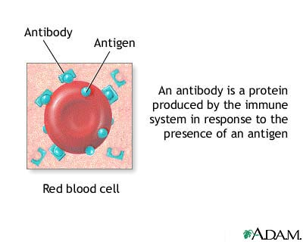
Antibody against a specific red cell antigen latches onto the antigen
The antibody may be IgG or IgM.
IgG coated red cells usually removed extracellularly.
IgM antibodies can cause compliment activation and red cell lysis

Slide 11
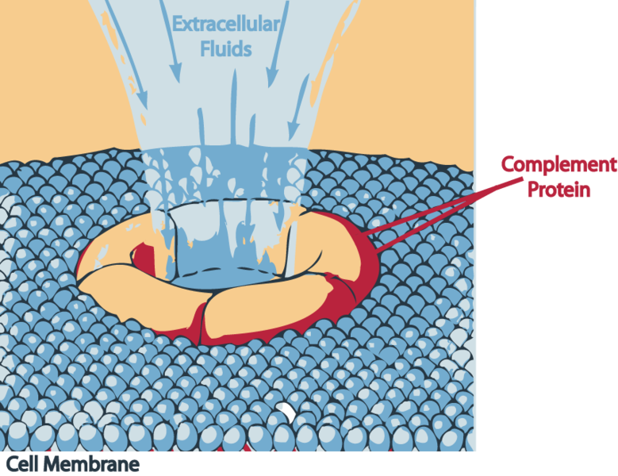

Slide 12
AIHA:
Causes:
Ideopathic
Complication of other diseases:
Immmune diseases (e.g. SLE)
Malignant lymphoproliferative diseases (e.g. CLL, Lymphomas)
Reaction to certain infections
Some viral infections, mycoplasma

Slide 13
Autoimmune haemolysis
Warm antibody type – IgG mediated:
RBC destruction predominantly extravascular in the spleen
Cold cold anitbody type – IgM mediated:
Haemolysis is predominantly intravascular

Slide 14
Alloimmune HA
Antibodies against red cell antigens are from different individuals:
Haemolytic transfusion reaction,
Haemolytic disease of the newborn
Transplantation-associated haemolytic disease

Slide 15
Drug induced immune anaemia
Cephalosporins
Levodopa
Methyldopa
Penicillin and its derivatives
Quinidine
Some nonsteroidal anti-inflammatory drugs (NSAIDs)

Slide 16
Drug may induce true autoantibodies against red cell antigens (methyldopa)
OR
Drug may induce specific antibodies against it (drug) and red cell damaged as a result of drug-antibody complex - red cell interaction (e.g. penicillin, cephalosporins etc)

Slide 17
Non immune mechanisms
Red cell fragmentation syndromes
Microangiopathic haemolytic anaemia (MAHA)
Abnormal vasculature associated with red cell fragmentation and haemolysis eg:
Hypertensive disease
Fibrin clots in vasculature (DIC)
March haemoglobinuria/long distance runners
Synthetic cardiac valves
Pregnancy related

Slide 18
Infectious agents:
Malaria, Barbesia
Invade the red cell
Bartonellosis
Intracellular bacteria
Clostridial sepsis and other bacterial infections
Cause direct injury to the red cell and subsequent destruction

Slide 19
Chemical agents, drugs, venoms:
Cause oxidant damage to the red cell – eg oxidant drugs (E.g. in G6PD deficiency; dapsone, sulfasalazine etc) and Chemicals - oxygen
Non oxidant damage – arsine, lead, copper, water
Venoms – spider bites, snake venoms, bee stings etc
Physical agents:
Thermal injury
Ionizing radiation

Slide 20
Spleen
Hypersplenism
Spleen sequesters red cells and destroys abnormal cells and aged cells
Hypersplenism associated with increased sequestration and destruction
Hypersplenism associated with splenomegaly

Slide 21
Paroxysmal Nocturnal Haemoglobinuria
Uncommon acquired disorder due to an acquired somatic mutation
Acquired membrane defect of RBC rendering cell sensitive to C^{I} mediated lysis
deficiency of glycophosphatidylinositol leading to absence of protective proteins on the membrane

Slide 22
Laboratory Workup
Is the anaemia haemolytic?
What is the site of haemolysis?
What is the aetiology/cause?
Initial Investigations:
FBC
Hb, Hct, Rbc MCH, MCHC
WBC, Platelets
Reticulocyte count
Raised indicating increased erythropoietc activity

Slide 23
Blood film
Important morphologic changes e.g.
Spherocytes (Immune haemolytic anaemias, toxins, burns)
Red cell fragments (fragmentation anaemias)
Polychromasia
Nucleated red cells
Parasites etc

Slide 24
Biochemical tests for haemolysis
Bilirubinemia (increased indirect bilirubin)
LDH increased
Haptoglobulin, hemopexin decreased
Urinalysis
Haemosiderin
Haemoglobinuria
Urobilinogen

Slide 25
Specific studies:
Directed by history and PE and preliminary tests:
Direct antiglobulin test (Immune mediated haemolysis)
Antibody identification
Tests for drug mediated haemolysis
Hams-Dacie/Hams test (serum acidified lysis test) – PNH (sugar or sucrose lysis test)
Flow cytometry
Red blood cell survival [⁵¹ Cr] survival) -rarely used, can demonstrate shortened RBC (hemolysis).

Slide 26
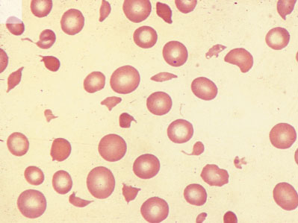
FRAGMENTS/SCHISTOCYTES

Slide 27
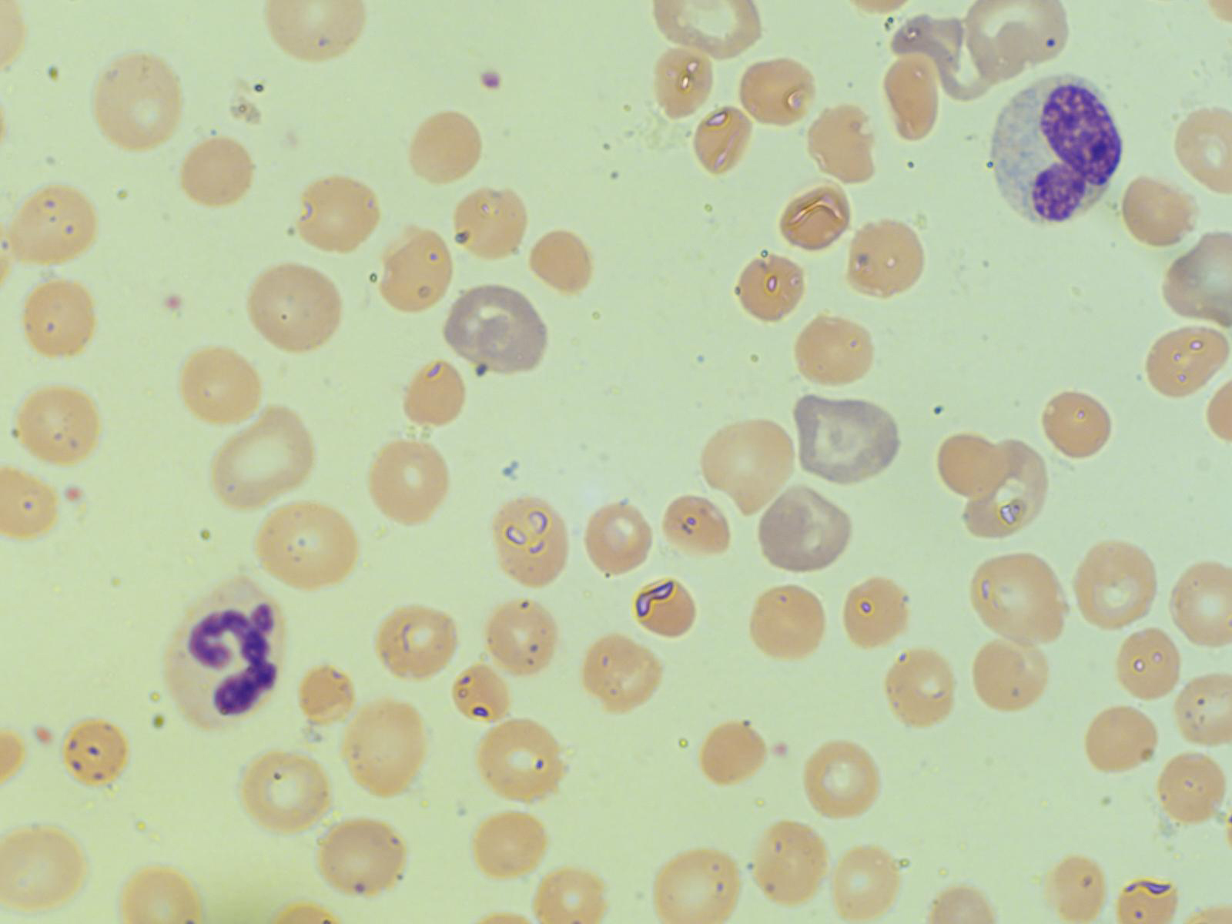
Polychromasia

Slide 28
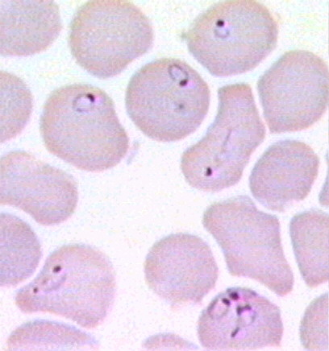
Malaria parasites

Slide 29
Thank you for participating! Any last questions?

