Slide 1
HAEMOPOETIC SYSTEM AND PARASITE EFFECTS

Slide 2
PROTOZOAN
Malaria
Babesiae
Leishmania donovani
Trypanosomiasis
Amoebasis
Giardiasis
Toxoplasmosis

Slide 3
METAZOAN
Schistosomaisis
Filariasis
Hookworm infestation
Trichuriasis \(trichuris trichura

Slide 4
MALARIA
Endemic in many parts of the world particularly South East Asia and Africa
Coast , Eastern, western and Nyanza
Plasmodium falciparum
Plasmodium vivax
Plasmodium ovale
Plasmodium malariae

Slide 5
MALARIA
Effect of parasites on the red cell causing haemolysis
Effects of enlarged spleen causing dilutional effect (hypersplenism) with reduced red cell survival
Effects of cytokines (inflammatory)on the bone marrow
Folate deficiency in chronic malaria
Effects of drugs (primaquine )

Slide 6
LABORATORY EVALUATION
Diagnosis
Tests to demonstrate haemopoetic and other effects

Slide 7
MALARIA
Total blood count
Progressive normocytic normochromic anaemia appears after 48hrs then rapid fall over next 4-5 days
Polychromasia/nucleated red cells/fragments
Parasites on film: density
Macrocytic picture in chronic malaria with folate deficiency

Slide 8
WBC: count usually normal
Monocytosis +/- pigment in monocytes
Platelets: reduced in acute malaria
Hypersplenism
Immune destruction
Low grade DIC
Raised PT and APTT

Slide 9
BIOCHEMISTRY
Raised total bilrubin (indirect)
Renal function tests
Blood sugar hypoglycaemia in severe malaria
Raised lactate level (metabolic acidosis)

Slide 10
DIAGNOSIS
Thick film
Thin film
Parasite density and identification
QBC method: acridine orange flouresence of parasites
Antigen detection test: chromatographic detection of histidine rich proteins (parasight F)
Molecular methods (PCR)

Slide 11
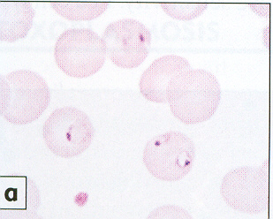

Slide 12
Leishmaniasis
L. donovani causative agent for visceral leishmaniasis
Hyperplasia of macrophages and lymphocytes
Massive production of immunogllobins
Progressive hepatosplenomegally
Anemia is due to hypersplenism
Ineffective erythropoesis
Megaloblastosis due to folate deficiency

Slide 13
LEISHMANIASIS
TOTAL BLOOD COUNT
Anaemia: normocytic normochromic
Leucopenia (neutropenia)
Thrombocytopenia
Raised ESR
Raised C-reactive protein

Slide 14
Diagnosis:
Bone marrow aspirate
Splenic aspiriation (most sensitive)
Buffy coat preparation of PBF.
I
immunological
Detect antibodies: ELISA (enzyme linked immunoabsorbtionassay)
FAT (florsecent antibody test)
IHA(indirect haemagglutination test)
Varying degrees of sensitivity and specificity
Cell mediated immunity test: leishman skin test with intradermal injection of killed promastigotes)

Slide 15
Biochemistry
Reduced albumin
Raised gamma globulins

Slide 16
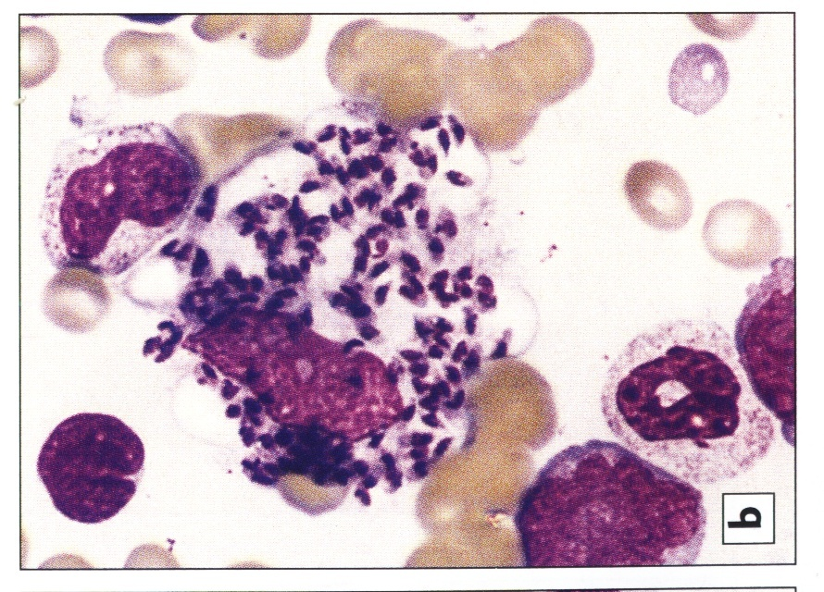

Slide 17
Bone marrow is hyperactive and megaloblastic
Increased macrophages with leishmania donovani bodies

Slide 18
BABESIA
Haemolytic anaemia
Reduced haemoglobin
Increased total bilrubin (indirect)
Renal function tests
DIAGNOSIS
Peripheral blood film
PCR

Slide 19
babesiae

Slide 20
TRYPANOSOMIASIS
Haemolysis due to phagocytosis of antibody coated RBCs
Also by haemolysins produced by parasite
Moderate leucocytosis
Deranged coagulation (late stage)
Thrombocytopenia
Increased fibrinolysis

Slide 21
DIAGNOSIS
Examination of blood
Lymph node aspirate
Cerebrospinal fluid

Slide 22
Blood film: thick and thin
Buffy coat preparation
QBC

Slide 24
AMOEBIASIS
microcytic hypochromic anaemia seen in chronic disease due to blood loss or due to anaemia of chronic disease
GIARDIASIS
Malabsorbtion of folate in acute giardial diarrhoea
Chronic giardia causes B12 deficiency due to damage of ileal receptors, utilization of B12 by parasite and bacterial overgrowth in the bowels

Slide 25
METAZOAN PARASITES
BILHARZIA
Effects of portal hypertension bleeding from varices
splenomegally
Granulomas cause various degrees of bleeding
GIT
Haematuria
Hypersplenism: normocytic normochromic anaemia
Leucopenia
Thrombocytopenia
Deranged liver function tests
Renal dysfunction due to hydronephrosis

Slide 26
DIAGNOSIS
Direct visualization of the parasite
In urine (S haematobium)
In stool (S mansoni)
Rectal sni
New diagnostic methods detect schistosoma antigen in serum and urine (expensive)
Indirect tests
Chemical reagent strips for detection of red cells and proteins useful in endemic areas as surrogate markers

Slide 27
Immunological tests
ELISA (enzyme linked immunoabsorbent
assay)
IHA (Indirect haemagglutination test)
IFAT (indirect flourscent antibody test)
RIA (radio-immunoassays)

Slide 29
HOOK WORM
0,03ml/day/worm for N americanus
0,15ml/day/worm for A duodenale
PBF: microcytic hypochromic
Eosinophilia
Reduced proteins: odema
Demonstrate Ova

Slide 31
TRICHURIASIS
Heavy infection involves the caecum upto rectum blood loss
Direct demonstration of eggs and egg count
TBC and PBF
Thick and thin film
Bone marrow examination
Aspirate of spleen and lymphnode
Urine and stool examination

Slide 33
SUMMARY OF LABORATORY INVESTIGATION
TBC and PBF
Thick and thin film
Bone marrow examination
Aspirate of spleen and lymphnode
Urine and stool examination
Immunological tests
Biochemical tests

