Slide 1
Aspects of Haemostasis Haemostasis II and III
Dr PM Maturi
Senior Lecturer
Hematology and Blood transfusion
MBChB III clerkship

Slide 2
Objectives
Describe key aspects of the normal haemostatic mechanism
- Explain the interaction between the various components and how the equilibrium is maintained
- Describe the abnormalities that may lead to bleeding disorders and thrombotic disorders
Link to approach to diagnosis, laboratory investigation of a patient suspected to have a bleeding or thrombotic disorder

Slide 3
Objectives
Be able to self appraise the level of knowledge
and understanding of the haemostasis system
and its disorders at the undergraduate level
and
Be able to apply this knowledge in the investigation and management of a patient with a haemostatic abnormality

Slide 4
Haemostasis
Definition
Maintain blood fluid, flowing and within the
vessels channels
What are the mechanisms involved to achieve this?
The Vessel – role and function

Slide 5
Laminar flow, synthesis of various substances
The platelets
Interaction with the vessel wall
Role and function - Adhesion
- Release
- Aggregation

Slide 6
The coagulation pathway
Extrinsic and Intrinsic pathways
- Major factors and cofactors
The common Pathway
The Fibrinolytic System
- components, role and function
The Natural Inhibitors of Coagulation
- Antithrombin III, Protein C and S, Heparin Cofactor , Thrombomodulin
-Level of inhibition

Slide 7
The Disorders of Haemostasis
Abnormalities of the haemostatic system result in spontaneous or prolonged bleeding
or thrombotic episodes or increased risk of thrombosis and thromboembolism

Slide 8
Disorders
Vessel disorders
The clinical presentation
Purpura and petechiae haemorrhages
Prolonged bleeding from puncture sites
Mucosal bleeds
Rarely deep bleeds

Slide 9
Introduction to Vascular disorders
Macrovascular Disorders
Trauma
Atherosclerosis
Disorders of connective tissue(Ehlers- Danlos) Osteogenesis imperfecta, Marfan syndrome)
Inflammatory vasculitis (syphylis, TB, Mycotic, RA, SLE, PAN, Kawasaki dx)
A-V Malformations ( Haemangiomas, HHT)

Slide 10
Vascular disorders..
Microvascular disorders
Purpura (mechanical, factitious, simplex)
Cutaneous vasculitis
Microbial endothelial damage(rickettsial, leptospiral,parvovirus B19,Viral h’rrhagic fevers
Scurvy,steroid,senile,amyloidosis,hereditary conn.tissue dx, HHT,
DIC,warfarin skin necrosis,fat embolism,TTP,HIT,
Assoc. with endothelial malignancy

Slide 11
Platelet Disorders
Symptom & signs of platelet disorders
Skin, mucous membrane
Petechiae, purpura, echymosis, haematomas
Epistaxis, mennorrhagia, oral cavity, upper & lower GIT hrrhage, haematuria, conjuctival
Haemorrhages, intra cerebral bleeds (< 10,000)

Slide 12
Introduction to disorders
Qualitative or Quantitative
Hereditary or Acquired
Hereditary:
vW dx, Glanzmanns Thromboasthenia, Bernard Soulier syndrome, Platelet Storage Pool dx, Wiskott Aldrich syndrome
Acquired dx states:
ITP,DIC HUS, TTP, Systemic amyloidosis, Hypersplenism, AA, Uraemia, Mechanical damage (cardiac bypass…) Iatrogenic: Posttransfusion purpura, Drug induced immune thrombocytopenia, Drug induced plt dysfunction(aspirin)

Slide 13
Platelet changes-Drugs
Myelosuppresive drugs
Cytotoxics,Chloramphenical,chlorthiazide,
Alcohol,Tolbutamide
Selective Thrombocytopaenia
Quinidine,Sulphonamides,Heparins(HIT type I &II),phenylbutazone,penicillamine,
PASA, rifampicin
Radiotherapy

Slide 14
Platelet changes-Immune destruction
Neonatal-Maternal ITP,SLE,Alloimmune
Platelet auto ab-ITP,BM transplant
Others
SLE, Malaria,AIDS related, IM, other viral infections,LPDs, drugs

Slide 15
Platelets - Clinical significance
Clinical significant thrombocytopaenia – <100,000/ul
50-100,000ul/l – no spontaneous bleeding, surgical bleeding risk is low
20 – 50,000 ul/l -Spontaneus bleeding rarely occurs, risk of surgical bleeding increased
<20,000ul/l- risk of spontaneous bleed high
risk of surgical bleed greatly increased

Slide 16
Disorders of the Coagulation Pathway
Von Willebrands Disease.
The Haemophilias:
Haemophilia A
Haemophilia B
Acquired Disorders:
Liver disease
DIC
Vitamin K deficiency

Slide 17
Thrombosis
Inappropriate activation of normal haemostatic processes(formation of blood clot(thrombus) in injured vasculature or thrombotic occlusion of a vessel.
3 influences predispose to thrombus formation –Virchows triad
Endothelial injury.
Stasis or turbulence of blood flow
Blood hypercoagulability.

Slide 18
Thrombosis
Can develop anywhere in CVS (Cardiac chambers, valve cusps, arteries, veins or capillaries).
Composed of tangled mesh of layers of platelets admixed with layers of RBCs and degenerating leucocytes).
Fate of thrombus –
Propagation
Embolisation
Dissolution
Organization

Slide 19
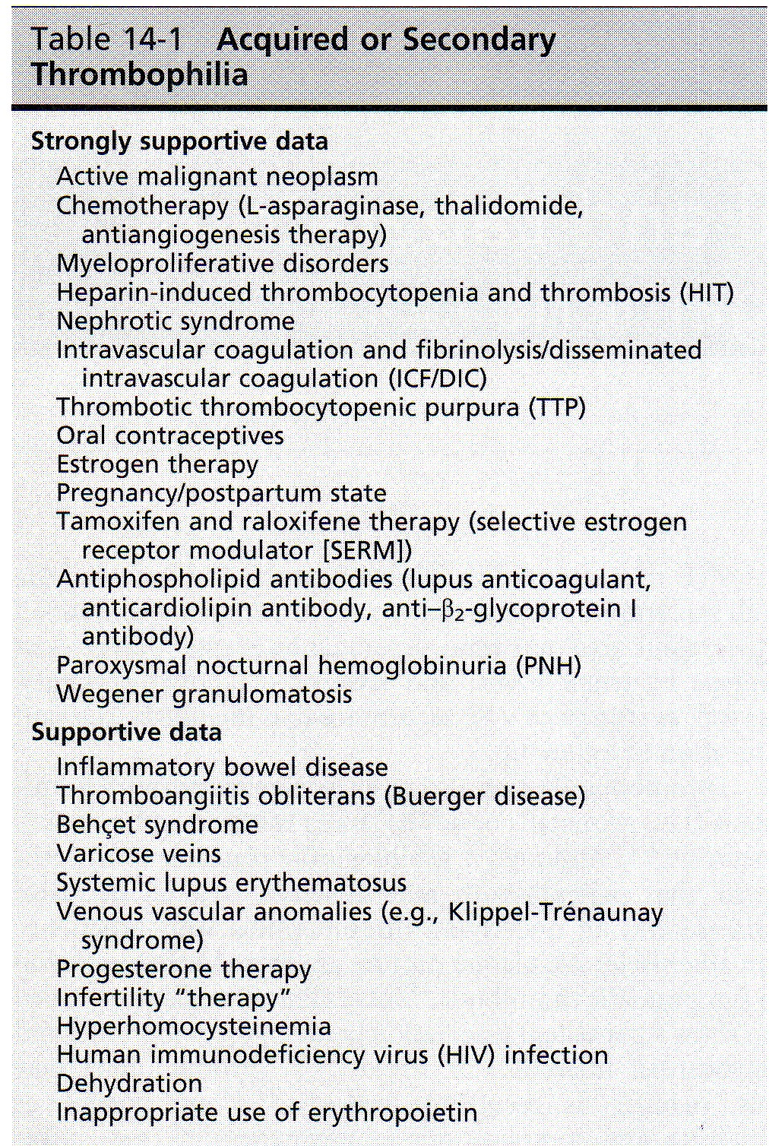
Thrombophilia- acquired or secondary

Slide 20
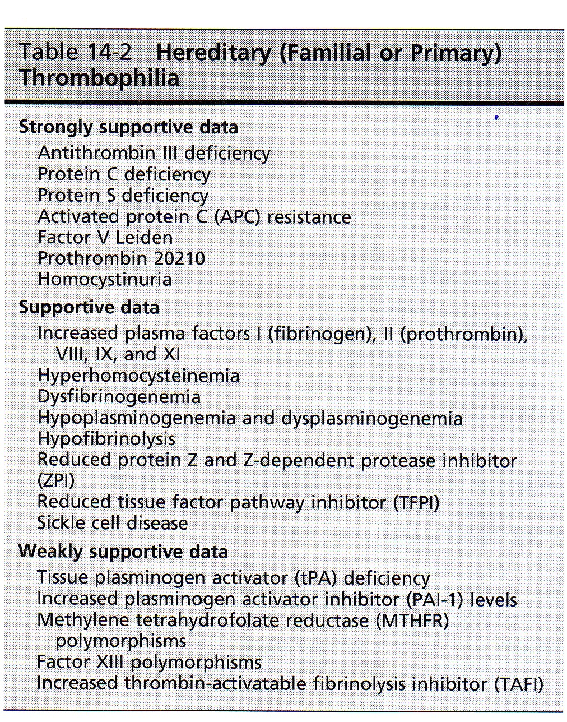
Thrombophilia-Hereditary (Familial or Primary)

Slide 21
Thrombophilia- clinical manifestation

Slide 22
Approach to management. Acute Therapy
.
AIM- to prevent extension or embolism of an acute thrombus
( Lysed or organised & activated acute inflammatory system is back to baseline)
IV,(SC) unfractionated heparin- doses sufficient to prolong aPTT to lab specific therapeutic range.
LMWH
(Enoxaparin,tinzaparin,Dalteparin)
Monitoring of LMWH- aPTT, Ideally use anti-Xa activity.
Then oral anti-coagulation- To achieve INR to a target of 2.5 (Range 2-3).
Heparin and oral anti-cuagulation therapy overlap by at least 5 days.

Slide 23
Approach to management Acute therapy
Thrombolysis-in young otherwise healthy patients
(Thrombolytic agents eg.Alteplase)
Total duration of anticoagulation- 3months.
Patients with persistent risk factors may require up to 6 months
Embolectomy
Secondary Prophylaxis
Aim- to prevent reccurrent thrombosis beyond 6 months
(VTE regarded as a chronic disease)

