Slide 1
Blood Groups and Blood Group Serology
MBChB III
Dr P.M Maturi

Slide 2
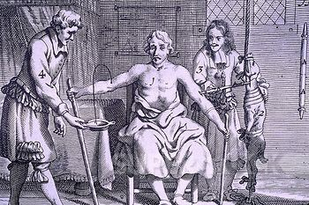

Slide 3
Objectives
At the end of this session you should be able to:
Define blood groups and state significance
Discuss the ABO and Rh blood groups
State other blood groups causing transfusion reactions
Compatibility testing

Slide 4
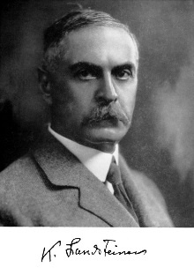
Karl Landsteiner (1868-1943)

Slide 5
History and discovery of blood groups
1900 – ABO by Landsteiner
Named A, B and O
1914 – 1917 – Methods developed to store and transfuse blood
World War 1 – First large scale transfusions based on serologic ABO detection
1940 – Rh by Landsteiner and Weiner
Levine and Stetson in 1939 described a case
Notes:
O developed from ‘Ohne’ – German for without (ie without A or B)
1939 – Woman delivered still birth and got severe HTR after transfusion of husbands blood. Her serum agglutinate husbands and 80 of 100 donors blood.

Slide 6
Blood Groups (BG)
Blood groups are inherited structures located on the outer surface of the red blood cell
May be found on other cells or in soluble form in plasma
BG are either carbohydrates or proteins structures
Inheritance of these BG is determined by genes found at specific sites (loci) on a chromosome
Eg ABO genes located on chromosome 9
Notes:
Antigens of the ABO blood group are sugars; Rh blood group are proteins

Slide 7
Blood Groups Terminology
ISBT has categorized the BG antigens into various systems with assigned numbers, gene designation, antigens, etc
Eg. ABO (ISBT No 001); Rh (ISBT no 004) etc
29 blood group systems described
Each system has 1 – over 30 antigens
Frequency of various BG varies between different populations
Notes:
ISBT – International Society for Blood Transfusion;
Classes (>29) gives name, iSBT system, number, chr location, gene name, assoc antigens, component name and functionc

Slide 8
Major;
ABO and Rhesus
Others;
MNS, P, Lutheran, Kell, Lewis, Duffy, Kidd
Minor ;
Diego, Yt, Xg, Shanna, Dombrock, Cotton, Landsteiner/Wiener, H, Kx, Gerbich, Cromer, Knops, Kidian, Ok, RAPH, JMH, I, Globoside, GIL

Slide 9
BLOOD GROUP INHERITANCE.
Most BG are co-dominant
BG genes passed from parents → offspring
One gene/allelic pair derived from each parent.
BG antigen in child must be present in at least one parent.
Notes:
Co-dominant : both characteristics are equally expressed

Slide 10
Blood Group Inheritance
Man
Woman
AO
BO
AB
AO
BO
OO

Slide 11
ABO Blood groups
Blood Group (Phenotype) | Genotype
A | AA or AO
B | BB or BO
AB | AB
O | O
Notes:
Subgroups of A: A_{1,} A₂ give rise to A₁B, A₂B etc

Slide 12
ABO Blood group systems
ABO is most important in transfusion medicine
Inheritance is in Mendelian manner
ABO locus encodes specific enzymes that synthesize A and B antigens on RBCs from a precursor substance (H)
Detectable at 5 – 6 weeks of life
Maximum levels 3 – 4 years
Notes:
Enzymes are glycosyltransferases)

Slide 13
Synthesis of A and B antigens
Precursor substance
A Gene
B Gene
Enzyme
A Antigen
B Antigen
Blood group O lacks A and B antigens but has H antigen

Slide 14
Rh blood group system
Second to ABO in importance in transfusion medicine
Rh gene on chromosome 1
Most complex system > 50 antigenic specificities
RhD antigen most important clinically
The RHD gene is dominant
RhD positive whenever this gene is present

Slide 15
Rh antigens
Majority of individuals Rh D +
Kenya approx. 2.5 – 4 RhD negative
Significant role in haemolytic disease of the newborn (HDN)

Slide 16
Blood Group Antibodies
Antibodies formed in the sera of an individual who lacks the corresponding antigen
Naturally occurring antibodies
Become detectable at 4 months age
IgM subtype

Slide 17
Antibodies
Blood Group | Antibody in plasma
A | Anti-B
B | Anti- A
O | Anti- A, Anti-B
AB | Lack ABO antibodies

Slide 18
Blood Group Antibodies cont..
Immune antibodies
Arise through:
Transfusion or injection of incompatible blood
Pregnancy
Injection of A or B substances found in some vaccines
IgG subtype

Slide 19
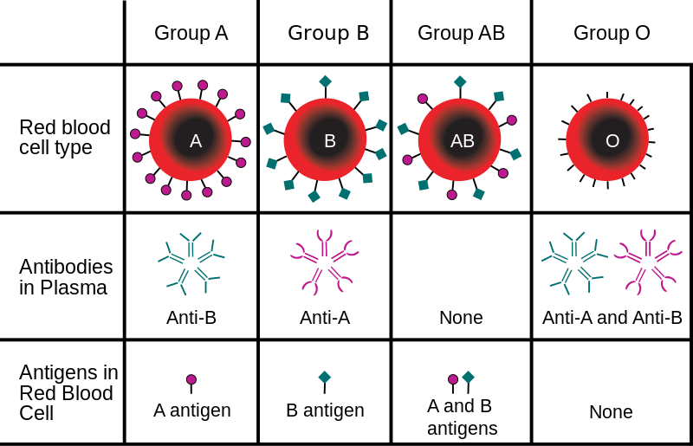
Blood Groups & antibodies

Slide 20
Clinical significance of BG
Significance in blood transfusion
ABO, Rh most important
Must transfuse with ABO Rh compatible blood
Hemolytic Disease of the Newborn
Rh, ABO, others
Paternity testing
Forensic studies
Transplantation medicine
BG are also found on tissues

Slide 21
Compatibility testing

Slide 22
Compatibility testing:
Done to ensure that the recipient’s immune system does not attack the donor red cells
Includes:
ABO and Rh D typing of the patient
Antibody screening
Crossmatching

Slide 23
Antibody screening:
Performed on patients blood
For detection of unexpected potentially significant antibody to RBC antigens
Antibodies associated with haemolysis (HTR), decreased RBC survival or haemolytic disease of the newborn (HDN)
Any antibodies detected are identified to assist in selection of suitable blood

Slide 24
Crossmatching:
Crossmatching is serological testing between patient serum (or plasma) and donor red cells to detect incompatibility
Recommended for all transfusions
Detects ABO incompatibility and clinically significant antibody

Slide 25
Crossmatching
Cross matching is done by mixing sample of patient serum/plasma with a sample of the donor red cells
Use of anti-human globulin reagent (Coomb’s reagent) assists in detection of incompatibilty

Slide 26
Conclusion
Knowledge of blood groups is important in transfusion and transplantation medicine
Blood group antigens are substances found on the red cell’s outer surface
The ABO and Rh systems are the most important clinically
Compatibility testing aids in ensuring that the recipient’s immune system does not attack the donor red cells

Slide 27
The End!
Questions?

