Slide 1
Iron metabolism
MBChB 3 Lecture series
Prof J. N. Githang’a

Slide 2
Lecture Outline
Iron metabolism
Body iron compartments
Requirements, sources and absorption
Internal iron cycle, plasma iron transport
Iron storage
Methods of investigation for deranged iron metabolism

Slide 3
Iron metabolism
Iron vital for living organisms, essential for many cellular functions:
Oxygen transport (haempoglobin)
Cell division
Electron transport
In tissues usually in-cooperated into various proteins: heme, iron flavoproteins, heterogonous groups
Nearly ½ of enzymes & co-factors of krebs cycle contain iron or need its presence

Slide 4
Body Iron compartments
Total body iron approx 4g (3.5 – 4.5) in adult male, less in female
Hb 67% (2.5 – 3g)
Stores – 30% (0.8 – 1g)
Myoglobin - 3% (0.1g)
Tissue iron - 6 - 8mg
.

Slide 5
Requirements
1-2 mg/day
Higher requirements in
Growth periods
Pregnancy
Lactation
Females of reproductive ages

Slide 6
Sources of iron
Heme iron:
Meats, poultry, fish
10 – 15% of Fe in diet
Non haem iron:
Cereals, vegetables, fruits, roots
70% of dietary Fe
Mostly ferric form

Slide 7
Dietary iron:
Variable, 10-30mg in “well balanced”
5 – 10 % absorbed (0.6 – 1 mg)
Heme iron better absorbed and it enhances absorption of non-haem iron
Reducing agents in HCL in gastric juice enhance non-haem iron absorption
Dietary substances that enhance or inhibit dietary non-haem iron absorption

Slide 8
Loss:
I mg/day
Desquamation epithelial cells (GIT, GU, skin, etc)
Iron balance:
Intake = loss
Balance achieved via control of absorption
Iron content in mucosal cells affects absorption
Absorption increased in iron deficient states; reduced in overload states

Slide 9
Iron Absorption
Absorption takes place in the duodenum and upper jejenum
Iron uptake in the proximal bowel is through the pathways:
Haem pathway
Non-haem iron [ferrous (2+) and ferric (3+)]

Slide 10
Iron Absorption cont.
Haem Pathway:
Haem absorbed into enterocyte by independent pathway as intact metalloprotein through specific receptor
Receptor
HAEM
Enterocyte
Haem oxygenase
HAEM
IRON
Ferritin

Slide 11
Iron Absorption cont.
Non Haem Pathways
Ferric iron (3+) is converted to Ferrous by ferrireductase
Ferrous iron (2+) uses the divalent metal transporter-1 (DMT-1) to enter the enterocyte
HCL in gastric juice facilitates the conversion of ferric iron to ferrous iron

Slide 12
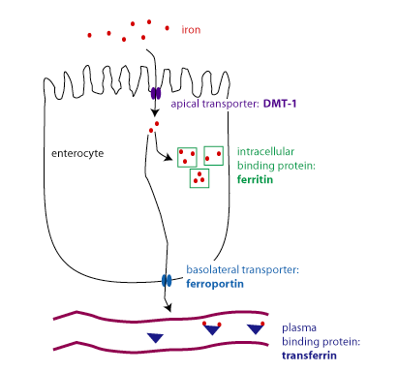
Iron absorption
DMT-1 = Divalent metal transporter-1
Fe²⁺

Slide 13
Factors affecting *Fe absorption
Enhancers:
Ascorbic acid
Heme
Organic acids
Amino acids
Simple sugars
Cysteine
Inhibitors:
Phytates
Phosphates
Polyphenols
Tanin
Calcium
Zinc
Soil clay
Cadmium
* Non haem iron

Slide 14
Importance of iron regulation
Although essential, iron in excess can promote the formation of highly toxic reactive oxygen species (ROS), which can damage DNA, protein, and lipid membrane, leading to organ dysfunction
Organisms have developed regulatory systems to optimize the absorption and organ distribution of iron

Slide 15
Hepcidin
Key factor in iron regulation
A hormone (25 aa), produced by liver cells (also acute phase protein)
Major hormonal regulator of iron homeoHepcidin inhibits the activity of iron exporter, ferroportin-1 (FPN-1),
Inhibits iron release from macrophages, intestinal cells

Slide 16
Hepcidin cont.
Feedback circuitry between hepcidin and iron levels in the body ensures systemic iron homeostasis.
Decreased production:
iron deficiency, hypoxia, ineffective erythropoiesis
Increased production:
Inflammation, infection when iron stores are full
causes reduced intestinal iron absorption and increased iron retention in macrophages
Protects organism from infection with siderophilic and gram-negative bacteria

Slide 17
Internal Iron cycle
Circulating
Erythrocytes
Hb Synthesis
RBC senescence
Marrow
Erythroblasts
Macrophages:
Storage pool
Iron transport
Plasma
T-Fe
Hb degradation
Absorption

Slide 18
Plasma iron transport
Transferrin:
MWt 80,000 Daltons
Glycoprotein, synthesized in liver
Many genetic variants
When not compounded to iron – apotransferrin
Normally 33% saturated with iron
Concentration varies in physiologic and pathologic conditions

Slide 19
Iron storage
Ferritin & haemosiderin
Ferritin:
Water soluable
Compound of ferric hydroxide and apoferritin
Found in all body cells and tissue fuids
Plasma content closely correlates with body stores

Slide 20
Haemosiderin:
Mainly in macrophage system (marrow, kupffer cells in liver, spleen)
Water insoluble
May pathologically accumulate in tissue
Formed from aggregates of ferritin
Perl’s stain (Prussian blue reaction) used to show iron stores

Slide 21
LABORATORY TESTS
1. Full blood counts:
- Hb Low
- HCT/PCV low
- MCV (<76 fl in deficiency state)
- MCH (<26 pgin deficiency state)
- MCHC (reduced in deficiency state)
WBC
PLTs
2. Peripheral blood film

Slide 22
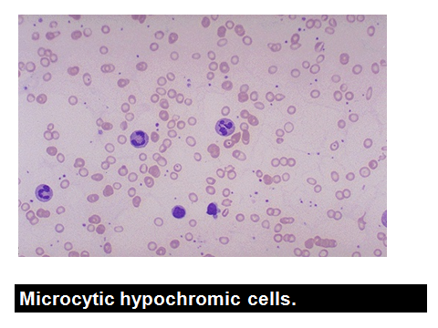
2. Peripheral blood film examination
Microcytic hypochromic cells in deficiency state

Slide 23
3. Biochemical Features
Serum Fe (reduced in deficiency state)
Serum ferritin (reduced in deficiency state)
Transferrin saturation reduced N= 33%
(reduced in deficiency state)
TIBC (increased in deficiency state)

Slide 24
Contd.
Red cell porphyrin (increased in deficiency state)
Serum transferrin receptors (increased in deficiency state)
4. B.M.A (not necessary in uncomplicated IDA)
Absent iron stores in deficiency state

Slide 25
Perl’s stain showing increase bone marrow iron stores

Slide 26
Thank you!
Questions?

Slide 27
Absorption:
Intestinal lumen
Plasma
Haem
Mucosal cell
Erythropoietic pool
Fe⁺⁺⁺
Ferritin
iron
ferrireductase
T-Fe
Fe++
DMT-1
Ferroportin
Storage pool

