Slide 1
MACROYTIC and Normocytic red cell

Slide 2
Full blood count and examination of the peripheral blood film
FBC Haemoglobin level
Red cell indices
White cell count and differential
Platelets

Slide 3
Red cell values & Indices
Normal ref. ranges known for age & sex, physiological status
VALUES
Red cell count(RBC) Male 4.5-6.5, Female 3.8-5.8
x10¹²
Haemoglobin concentration g/dl (eg neonate 18- 22g/dl, adult female 11.5 – 14. 5g/dl)
Packed Cell Volume or haematocrit (PCV, Hct)
Reticulocyte count 0.2-2% (10-100x 10⁹) Infants-2-6% (100 -150 x10⁹)

Slide 4
INDICES
Packed cell volume(PCV) or Haematocrit (Hct)
Mean Cell Volume(MCV)fl
Mean Corpuscular Haemoglobin (MCH) pg
Mean Cell Haemoglobin Concentration (MCHC)g/dl

Slide 5
MEAN CELL VOLUME
MCV is measured directly by automated analysers
Can be calculated : PCV divided RBC count
MCV is equal to PCV/RBC count fl
Refers to the average size (volume) of the red cells
Normal range is 76fl to 96fl
Based on the formula PCV = MCV x RBC

Slide 6
RED BLOOD CELLS
Red cell has a diameter of 7.5 – 8 μm
Appear circular in outline
Disciform in shape
Central area of pallor
Pink areas represent haemoglobisation
Flexible and able to pass through the microcirculation (d= 3.5 μm)
Delivers O₂ to tissues and takes away CO₂
Life span 120 days

Slide 7
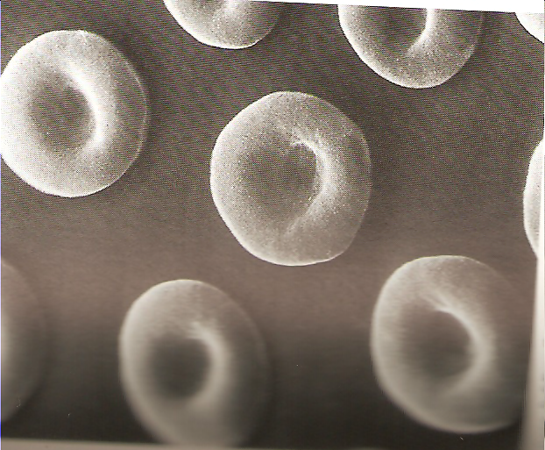

Slide 9
MACROCYTIC ANAEMIAS (MCV>100fl) | MICROCYTIC ANAEMIAS (MCV <80fl) | NORMOCYTIC ANAEMIAS (MCV 80-100fl
MEGALOBLASTIC ANAEMIA NON MEGALOBLASTIC ANAEMIA Liver disease Haemolytic anaemia Alcoholism Myelodysplastic syndromes Hypothyroidism Aplastic anaemia | Iron deficiency Thalassemia Sideroblastic anaemia Anaemia of chronic disease | RETICULOCYTE PRODUCTION NORMAL Recent blood loss Haemolytic anaemia RETICULOCYTE PRODUCTION DEFICIENT Aplastic anaemia Myelophthisic anaemia Chronic renal failure Anaemia of chronic disease hypothyrodism

Slide 11
Megaloblastic anaemia is an important and common cause
B12 and folate deficiency or combined
Coenzymes for and thymidylate and purine synthesis
Build up of in cytoplasm and slower division resulting in larger cell

Slide 12
Causes of B12 deficiency
Dietary lack: vegans
Malabsorbtion: Gastric: PA
: gastrectomy
: Intestinal: stagnant loop syndrome
: tropical sprue
: ileal resection
: congenital specific malabsorption
with proteinuria (Imershund-Grasbeck syndrome)
: fish tapeworm
: drugs (metformin)
Abnormalities of B12 metabolism: TC deficiency
: nitrous oxide anaesthesia

Slide 13
CAUSES OF FOLATE DEFICIENCY
Inadequate intake: poverty
: institutions
: goats milk
: special diets
Excess loss: Dialysis
: CCF
: exfoliative dermatitis
Drugs: anticonvulsants
phenobarbitone
Mixed: alcohol
: liver disease
Malabsorbtion: Gluten induced enteropathy
:tropical sprue
Increased utilization: pregnancy
: prematurity
: excess marrow turnover: haemolytic anaemia,MF
: malignancy: myeloma carcinomas)
:inflammatory diseases
Folate metabolism: Inborn errors
: drugs Methotrexate, pyrimethamine

Slide 14
Laboratory Feature of megaloblastic anaemia
Macrocytosis , anaemia, leucopenia, thrombocytopenia, pancytopenia
Hypersegmented neutrophils
Megaloblastic erythropoesis on bone marrow examination
Distinguished by estimation of serum folate and B12 levels

Slide 15
Clinical features
Pallor
Mild icterus
Angular stomatitis
Glossitis
Cardiac failure in severe cases
Neurological symptoms (B12 deficiency) subacute combined degeneration of the spinal cord
Neural tube defects (folate deficiency in pregnancy)

Slide 16
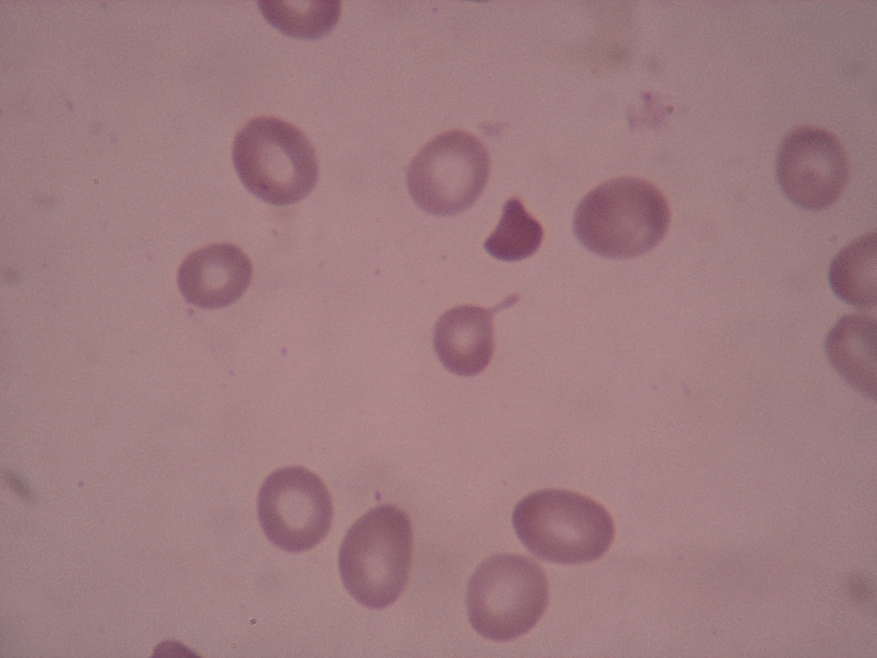
Peripheral blood film

Slide 17
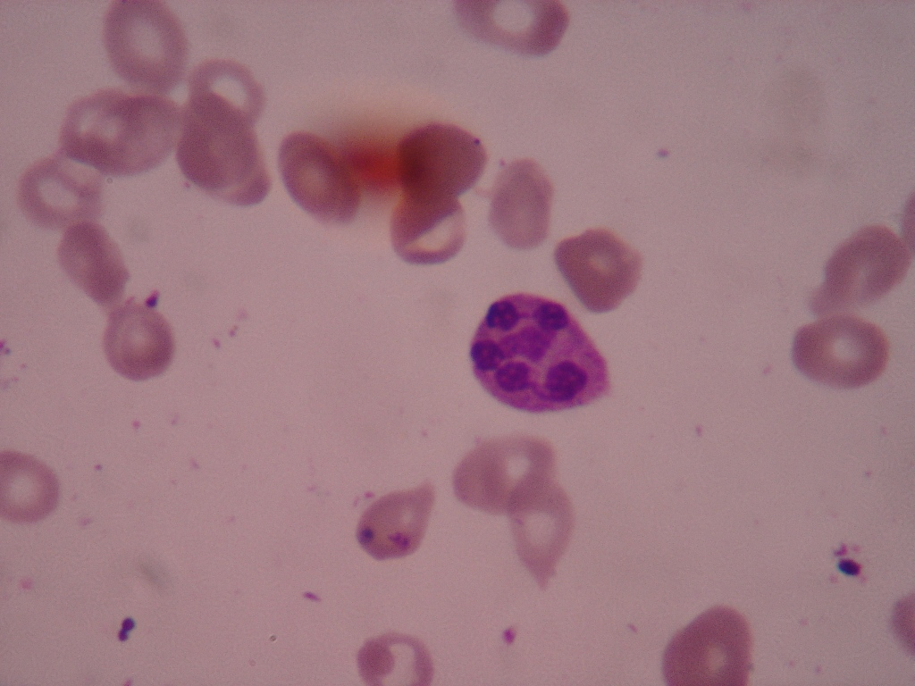
Peripheral blood film

Slide 18
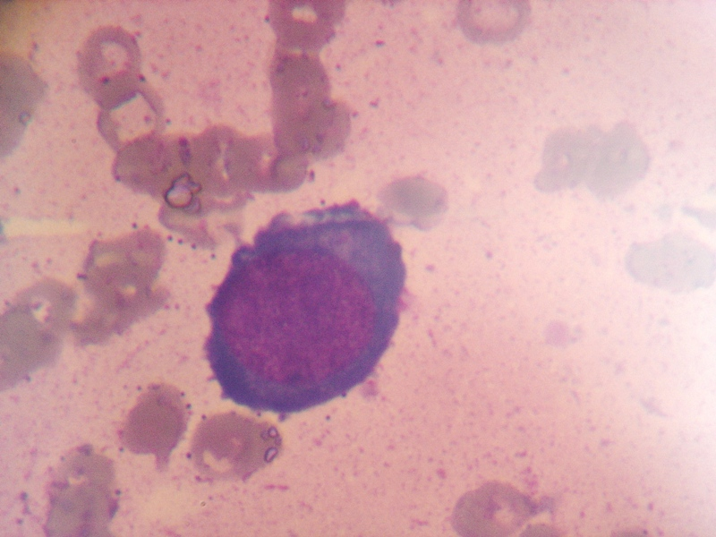
Bone Marrow examination

Slide 21
Other causes of macrocytic anaemia
Reticulocytosis especially in haemolytic anaemia
Icterus
Unconjugated hyperbilrubinaemia
+/- splenomegally
Polychromasia, nucleated rbcs
Haemoglobinuria

Slide 22
Other causes
Liver disease
round macrocytes +/- target cells
deranged LFTs and features of liver disease
Myelodysplastic syndromes
Alcoholics
Drugs
Aplastic anaemia
Pregnancy
New borns

Slide 23
Drug-induced macrocytosis
Folate antagonists (eg, methotrexate)
Purine antagonists (eg, 6-mercaptopurine [6-MP])
Pyrimidine antagonists (eg, cytosine arabinoside [ara-C])
Alkylating agents (eg, cyclophosphamide)
Zidovudine (AZT)
Trimethoprim
phenytoin

Slide 24
Physical examination
The following physical findings may be noted:
Pallor +/- icterus
Glossitis
Tachycardia +/- flow murmurs in patients with severe anemia
Splenomegaly may be quite remarkable when the macrocytosis is due to hemolysis, infiltrative disorders, or neoplasms
Jaundice suggests liver disease or hemolysis, both of which may lead to an increased MCV
Neurologic disorders, such as ataxia, loss of posterior column sensations, loss of deep tendon reflexes (particularly ankle reflex),

Slide 25
INVESTIGATIONS
LABORATORY
CBC and examination of the PBF
RETICULOCYTE COUNT
Tests to establish haemolysis and its cause
Serum folate and B12 assays
Schilling test
IF and Parietal cell antibodies
LFTs , thyroid function tests
Bone marrow examination

