Slide 1
ANTIHELMINTHICS
KIMAIGA H.O
MBChB (University of Nairobi)

Slide 2
Helminths are parasitic worms
Helminthiasis = infection with parasitic worms
Pathogenic worms are metazoa, classified into:
Round worms (Nematodes)
2 flat worms:
Flukes (Trematodes)
Tapeworms (Cestodes)

Slide 3
2 clinically important helminthic infections:
Those with worms in the GIT
Tapeworms
Intestinal round worms e.g Ascaris lumbricoides, Trichuris Trichuria
Those with worms in other tissues of the host’s body
Trematodes e.g S.mansoni, S.haematobium
Tissue round worms e.g Trichinella spiralis, filarial worms
Hydatid tapeworms (Echinococcus species) e.g E. granulosus

Slide 4
General MoA of anithelminthics
Drug must penetrate the cuticle of the worm to gain access to its GIT
3 mechanisms of action:
Cause paralysis of the worm
Damage the cuticle of the worm, leading to partial digestion or rejection by host immune mechanisms
Interfering with metabolism of the worm

Slide 5
Anti helminthic drugs may either act:
Locally to expel worm for the GIT or
Systemically to eradicate adult helminths or developmental forms that invade organs and tissues

Slide 6
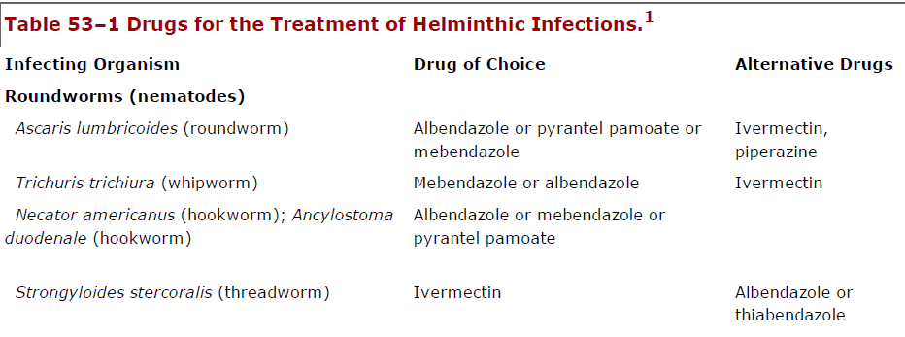
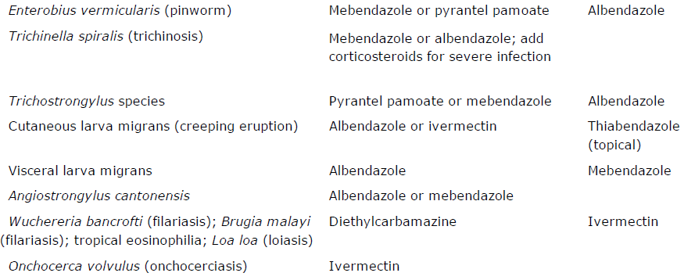

Slide 7
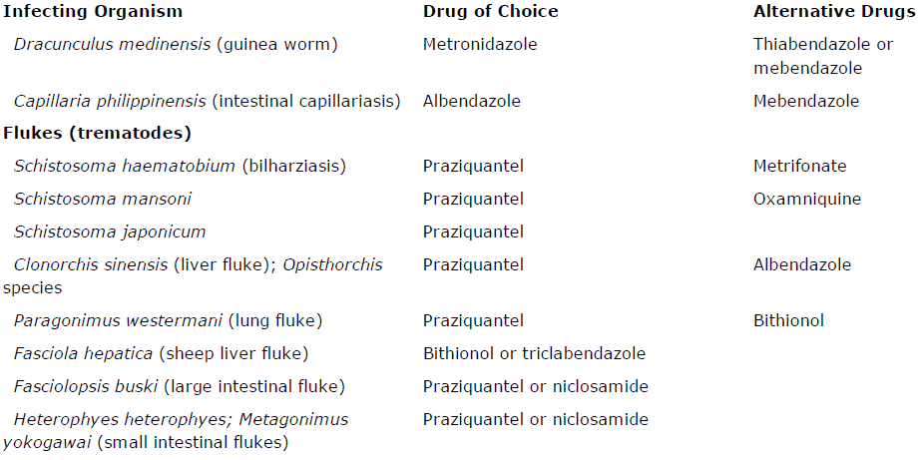

Slide 9
TREMATODES
Schistoma species-(Blood flukes)
S.haematobium, S.mansoni. S.japonicum → main spp causing human schistosomiasis
Less common spp are S.intercalatum & S.mekongi
Spp in Africa: S.mansoni & S.haematobium
Schistosomal disease primarily involves the liver,spleen & GIT (S.mansoni & S.japonicum) or the GUT (S.haematobium)
Clonorchis sinensis- Liver flukes
Paragonium stemani- Lung fluke

Slide 10
CESTODES
Medically important
Taenia saginata = beef tape worm
Taenia solium = pork tapeworm. Can also cause cysticerci (encysted larvae) in muscles, viscera, brain, eyes
Diphyllobothrium latum = fish tapeworm
Hymenolepsis nana = dwarf tapeworm
Humans are definitive hosts for all the above
Others include E. granulosus (dog tapeworm) and can cause hydatid cysts in the liver, lung and brain

Slide 11
DRUGS
PRAZIQUANTEL
Chemistry
Synthetic isoquinoline - pyrazine derivative

Slide 14
Pharmacokinetics
Rapidly absorbed after oral administration
80% bioavailbility
Peak plasma conc in 1-3 hrs
CSF conc is 14-20% plasma conc
≈80% bound to plasma proteins
Extensive 1st pass metabolism
Most of the drug metabolized to inactive hydroxylated and conjugated products
Plasma t1/2 = 0.8-2 hours compared to 4-6 hours for metabolites

Slide 15
T1/2 prolonged in patients with severe liver disease including those with severe hepatosplenic schistosomiasis
Excreted mainly via the kidneys (60-80%) and bile (15-35%)
Plasma conc of praziquantel increased when taken with high CHO meal or cimetidine (Hepatic CYP P450 inhibitor)
Bioavailability markedly decreased with some antiepileptics e.g phanytoin & carbamazepine(Hepatic CYP P45O inducer) with corticosteroid

Slide 16
MoA
Increases cell membrane permeability of helminths, resulting in loss of intracellular calcium, massive contractions, and paralysis of their musculature.
Phagocytes are thus able to attach to worms, causing their death.
It is effective against adult schistosomes and immature forms
Also has prophylactic effect against cercarial infection

Slide 17
Clinical Uses
Praziquantel tablets taken with liquid after meal
Should be swallowed without chewing because the bitter taste may induce retching and vomiting
1. Schistosomiasis
Praziquantel is the drug of choice for all forms of schistosomiasis and flukes (trematodes) except fasciola hepatica (sheep liver fluke)
Single oral dose of 40mg/kg or 2-3 doses of 20mg/kg each 4-6 hours apart → achieves high cure rates of 75-95%

Slide 18
Marked decrease in egg counts (>85%) in those not cured
Drug effective in adults and children
Generally well tolerated by patients in hepatosplenic stage of advanced disease
Not clear whether it can be used safely or effectively during acute stage of disease (Katayama fever) because of release of dying immature worms may worsen symptoms
Rare cases of resistant S.mansoni and S.japonicum reported
Effectiveness for chemoprophylaxis has not been established

Slide 19
2. Clonorchiasis, opisthorchiasis, paragonimiasis, fasciolopsiasis, mentagonimiasis, heterophyiasis
3 doses of 25mg/kg taken 4-8 hours apart on the same day2/7 result in 100% cure rates for clonorchiasis and opisthorchiasis
A 2/7 course provides 90-100% cure rates for pulmonary paragonimiasis
A 1-2 day course effective against fasciolopsiasis, metagonimiasis and other forms of heteropiasis
Note praziquantel not effective against fascioliasis (F.hepatica)

Slide 20
3. Taeniasis & Diphyllobothriasis
Single dose or praziquantel 5-10mg/kg results in nearly 100% cure rates for T.saginata, T.solium and D.latum
Praziquantel does not kill eggs, ∴ theoretically possible for larvae of T.solium released from eggs in the large bowel could penetrate the intestinal wall and give rise to cysticercosis

Slide 21
4. Neurocysticercosis
Albendazole preferred
However when albendazole not available or appropriate, praziquantel has similar efficacy at dose of 50mg/kg/day in 3 divided doses × 14/7
Praziquantel (not albendazole) has ↓ bioavailability when taken concurrently with corticosteroides

Slide 22
5. H.nana
Praziquntel is the DOC
Single dose of 25mg/kg is taken and repeated in 1/52
6. Hyadatid disease
Praziquantel kills protoscoleces but does not affect the germinal membrane

Slide 23
ADVERSE REACTIONS
Direct adverse effects
Mild and transient AEs are common
Begin within several hours of ingestion & persist for hours up to 1/7 & are dose related
Most frequently: headache, dizziness, drowsiness, lasstiude
Other AEs: nausea, vomiting, abdominal pain, loose stools, pruritis, urticaria, arthralgia, myalgia & low grade fever
Mild and transient elevation of liver enzymes has been repoted

Slide 24
Indirect Adverse effects
0ccur several days after starting praziquantel & include; low grade fever, pruritis, skin rashes, arthralgia, myalgia, and worsened eosinophilia
These indirect SEs probably due to release of foreign proteins from dying worm rather than direct toxicity
In rx of neurocysticercosis with praziquantel inflammation reactions around dying parasites produces headache, meningismus, seizures, nausea, vomiting, mental changes & CSF pleocytosis

Slide 25
Latter SEs:
Occur in up to 90% of patients who do not receive corticosteroids
Occur during or shortly after rx and last for 2-3 days
Respond to appropriate symptomatic therapy and analgesics and anticonvulsants
More serious SEs e.g arachnoiditis, hyperthermia, and ↑ intracranial pressure may occur
NB: corticosteroids e.g dexamethosone commonly given concurrently wiht praziquantel to ↓ inflammation reactions during rx of neurocysticercosis. However this is controversial as corticosteroids ↓ plasma levels of praziquantel by up to 50%

Slide 26
Contraindications and cautions
Praziquantel is contraindicated in ocular cysticercosis, because parasite destruction and host response may cause irreversible damage in the eye .
Avoid driving, operating machinery and other tasks that require mental alertness → drug causes dizziness and drowsiness
Preferably avoided in pregnancy because high doses of praziquntel increase abortion rates in rats

Slide 27
Some workers also caution against use of the drug in spinal neurocysticercosis.
Patients should be cautioned against chewing bitter tablets → regurgitation of segments could be hazardous → cause cysticercosis

Slide 28
METRIFONATE
Safe alternative drug for rx of S.haematobium infection
Not active against S.mansoni & S.japonicum

Slide 29
Chemistry and pharmacokinetics
An organophosphate cholinesterase inhibitor,(anticholinesterase) originally used as an insecticide
Rapidly absorbed after oral admin
Peak plasma conc within 1-2 hours
T1/2 = 1-5 hours
Prodrug which undergoes spontaneous non-enzymatic transformation to dichlorvos (2,2 dichlorovinyl dimethyl phosphate - DDVP), which is the active metabolite
Dichlorvos is responsible for inhibition of acetylcholinesterase
Dichlorvos and metrifonate well distributed to tissues and completely eliminated in 1-2 days

Slide 30
Antihelminthic action and pharmacologic effect
MoA of dichlorvos against both mature and immature stages of S.haematobium by inhibition of cholinesterase in helminth
Inhibition temporarily paralyzes adult worms → shift from bladder venous plexus to small arterioles in the lungs → trapped and encased by immune system and die
Has no effect against S.haematobium ova
Live eggs ∴ continue to pass in urine for several months after adult worms have been killed

Slide 31
Clinical use
Used as alternative drug to praziquantel, only in tx of S.haematobium
Dose 7.5-10mg/kg given orally 3 times at intervals of 2/52
Cure rates are 44-93%
Effective for prophylaxis when given monthly to children in endemic areas
Has been used in mass treatment programs

Slide 32
Adverse reactions
Mild and transient cholinergic symptoms include: nausea, vomiting, abdominal pain, bronchospasm, headache, sweating, fatigue, dizziness, vertigo.
Symptoms are dose related, may begin 30 min and persist for up to 12 hours

Slide 33
Contraindications and caution
Should not be used after recent exposure to insecticides or drugs that might potentiate cholinesterase inhibition
Use of depolarizing muscle relaxants avoided for at least 48 hours
CI in pregnancy

Slide 34
OXAMNIQUINE
Chemistry
Semisynthetic tetrahydroquinoline

Slide 35
Pharmacokinetics
Readily absorbed after oral admin
Bioavailability ≈ 50-70%
Food retards absorption
Not given IM as it causes intense and prolonged local pain
Peak plasma conc 2.5 hours after oral admin
T1/2 = 2.5 hours
Extensively metabolized in gut wall and liver to inactive metabolites which are excreted in urine, up to 75% of these in the 1st 24 hours

Slide 36
Antihelminthic action and pharmacologic effects
Active against both mature and immature stages of S.mansoni, but not cercarie
MoA thought to be by alkylation of essential macromolecules including DNA in the parasite
Adult male S.mansoni worms are more vulnerable to its action than female worms
Male preferentially concentrates drug resulting in contraction and paralysis of worms and they detach from terminal mesenteric venules & transit to liver where they die
Surviving females return to mesenteric vessels and but fail to lay eggs
Effective in some instances of praziquantel resistance

Slide 37
Clinical use
Safe and effective in all stages of S.mansoni disease including advanced hepatosplenomegaly
Generally less effective in children who require higher doses than adults
Better tolerated with food
Cure rates 70-95%, marked decrease in egg excretion in those not cured

Slide 38
Adverse effects
More than 1/3 of patients get mild symptoms which start ≈ 3 hours after dose, last several hours
CNS symptoms most common & include dizziness, headache & drowsiness
Other SEs include nausea, vomiting, diarrhea, colic, pruritus and urticaria
Infrequent AEs include: low grade fever, orange-red discoloration of urine, proteinuria, microscopic haematuria, a transient decrease in leukocytes, insomnia, amnesia, behavioral changes and hallucinations

Slide 39
Seizures are rare and generally occur within hrs of ingestion, most often in people with a history of seizure disorders
Some AEs occur several days to 1 month after tx and are likely to be due to host reaction to dead & dying worms
Include liver enzyme elevation, eosinophilia, transient pulmonary infiltrates ± cough & ronchi, urticaria and fever

Slide 40
Contraindications and cautions
Patients should be observed for 3hrs after ingestion for signs of CNS disturbances
Pts with history of epilepsy should be hospitalized for tx or an alternative drug used
Use with caution in pts whose work or activity requires mental alertness → drug makes many people dizzy or drowsy
Oxamniquine contraindicated in pregnancy

Slide 41
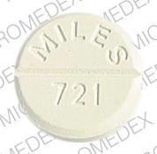
NICLOSAMIDE
Chemistry
Halogenated salicylamide derivative
Pharmacokinetics
Appears to be minimally absorbed from GIT → neither drug nor metabolite recovered from blood or urine
500 MG

Slide 42
Antihelminthic action & pharmacologic effects
Inhibit oxidative phosphorylation of ADP by mitochondria of parasite
Hence rapid killing and digestion of scolesces & segments of cestodes (not ova or larvae) and they may become unrecognizable in stool
May also stimulate ATPase activity

Slide 43
Clinical use
Given in the morning on an empty stomach or after a light meal
Tablets must be chewed thoroughly and then swallowed with water
1. Tx of T.saginata, T.solium & D.latum
Single dose of 2g
2hrs after rx of T.solium infection give an effective purgative (e.g 15-30g of magnesium sulfate) to eliminate all mature segments before ova can be released → avoid cysticercosis

Slide 44
2. Rx of H.nana, H.diminuta & Dipylidium caninum
Infection with H.nana usually multiple, ∴ rx with 2g OD × 7/7 leads to cure rates of 75%
NB: niclosamide not effective against cysticercosis or hyadatid cysts
3. Rx of intestinal flukes
Can be used an alternative drug for tx of F.buski, heterophyes heterophyes & metagonimus yokogawai infections
Rx with 2g every other day × 3 doses

Slide 45
Adverse effects
Usually infrequent mild and transient
Include nausea, vomiting, diarrhea and abdominal pain which occur in <4% of patients
Rare AEs: headache, skin rash, urticaria, pruritis ani & vertigo
Contraindications and caution
Avoid alcohol consumption on day of tx and 1 day after
Safety of drug not established in pregnancy and children <2yrs of age

Slide 46
BITHIONOL
DOC for tx of fascioliasis
Also an alternative drug in tx of pulmonary paragonimiasis

Slide 47
Parmacokinetics
Peak blood levels in 4-8hrs after ingestion
Excretion appears to be mainly via the kidneys

Slide 48
Clinical use
Rx of paragonimiasis and fascioliasis
Dosage 30-50mg/kg in 2-3 divided doses, orally after meals on alternate days until 10-15 doses given
For pulmonary paragonimiasis cure rates over 90%
Cerebral paragonimiasis → repeat courses of tx may be necessary

Slide 49
Adverse effects, contraindications and cautions
AEs in upto 40% of patients and are generally mild and transient
Occasionally severity may requide interruption of tx
They include diarrhea, vomiting, nausea, abdominal cramps, anorexia, dizziness and headache

Slide 50
Skin rashes may occur after a week or more of tx → suggests a reaction to antigen released from dying worms
Caution
In children <8yrs, limited experience with age group

