Slide 1
Introduction to hepatobiliary system
J.W.Githaiga
Thematic head General Surgery-UON

Slide 2
Hepatobiliary/pancreatic system

Slide 3
Objectives
Review relevant surgical anatomy.
Review physiology of the hepaticobiliary/pancreatic systems.
Outline the pathology of the hepaticobiliary/pancreatic systems.
Understand the presentation of diseases of the hepaticobiliary/pancreatic systems.
Overview of investigations.
Mangement

Slide 5
Surgical anatomy of the Liver

Slide 9
Presentation
Abdominal pain.
Jaundice.
Weight loss
Body itchness.
Dark urine.
Pale stools.

Slide 17
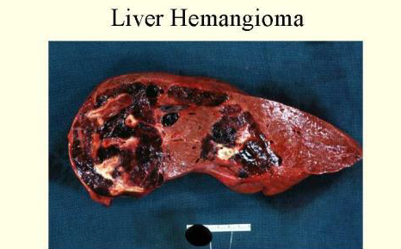

Slide 21
Investigations
FBC.
LFT
Tumour markers;alpha fetOprotein,CA19-9, CEA.

Slide 23
Liver Function Tests

Slide 29
Imaging
Plain Abdominal X-Ray.
Abdominal US.
CT Scan.
MRI/MRCP.
ERCP.
HIDA Scan.

Slide 34
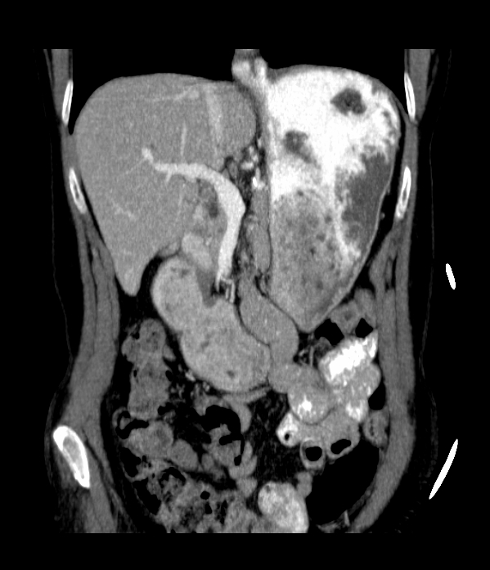
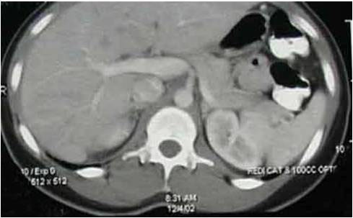
PORTAL VEIN
Coronal and Axial images
CT
US

Slide 37
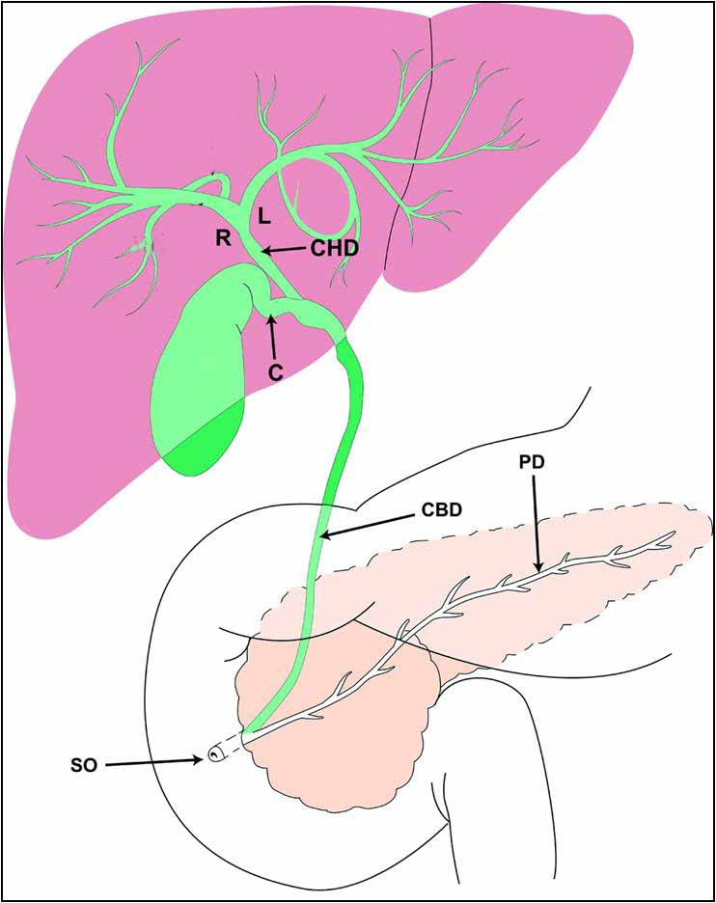
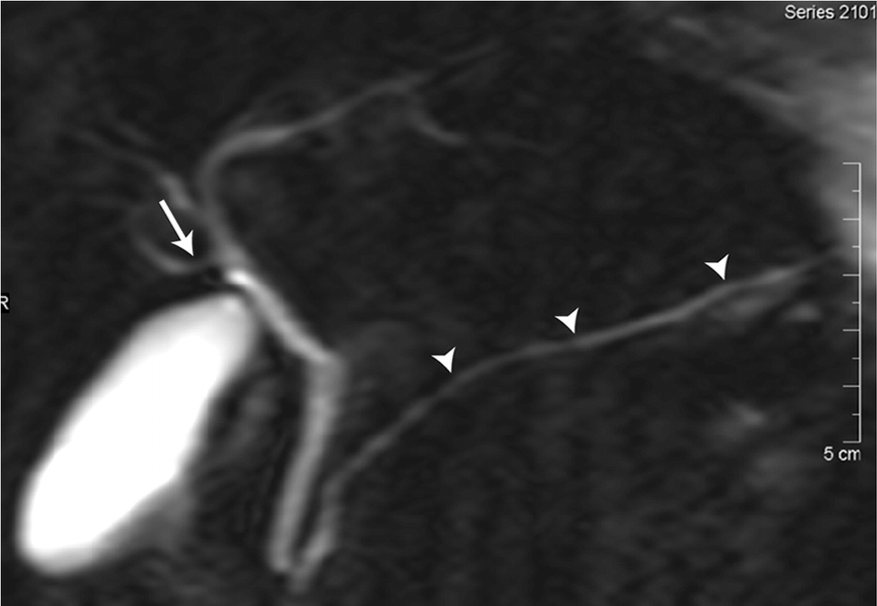
NORMAL BILIARY ANATOMY
MR CHOLANGIOGRAM (MRCP)
Silva, A. C. et al. Radiographics 2004;24:677-687

Slide 38
HEPATIC ARTERIAL FLOW LATERAL AORTOGRAM SHOWS ORIGIN OF CELIAC ARTERY AND THE SUPERIOR MESENTERIC ARTERY
CELIAC
The Celiac Artery splits into
3 branches: Supplies
Diaphragmatic organs
1- Common Hepatic Artery.
2- Splenic Artery.
3- Lt. Gastric Artery.
SMA
Notes:
Arterial blood flow to the liver is via the Celiac Artery which extends from the anterior surface of the aorta and splits into 3 branches.

Slide 39
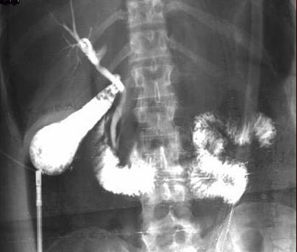
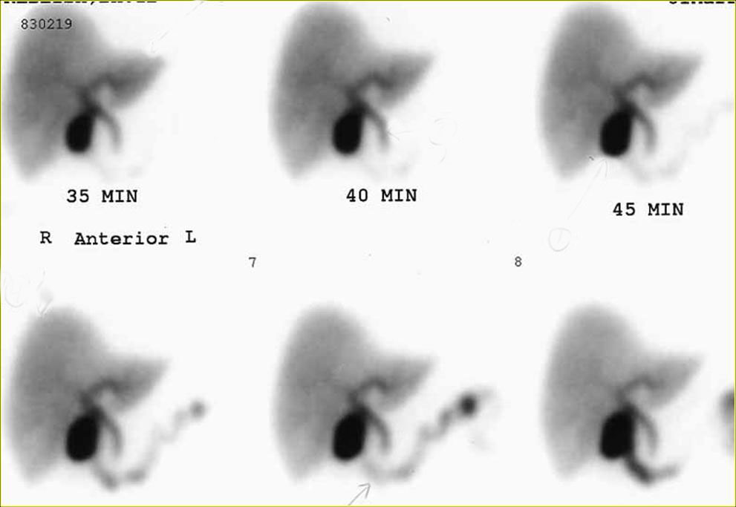
OPERATIVE CHOLANGIOGRAM
HEPATO-BILIARY SCAN - HIDA

Slide 40
Pancreatic Diseases
Benign – pancreatitis, pancreatic cysts,pancreatic pseudocysts,adenomas,Neuroendocrine tumours.
Malignant; cystadenocarcinoma,adenocarcinoma,periampullary tumours,Neuroendocrine tumours,lymphomas.

Slide 41
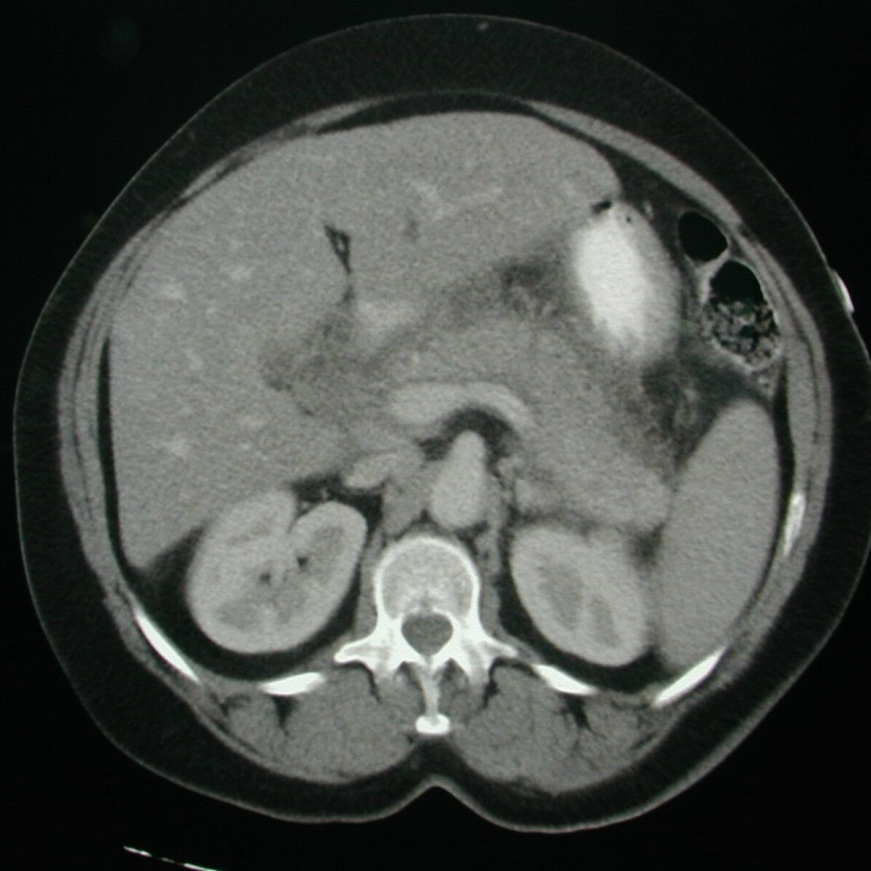
PANCREATITIS elevated AMYLASE & LIPASE
Biliary calculi-obstruction
Alcohol- chemical toxicity

Slide 42
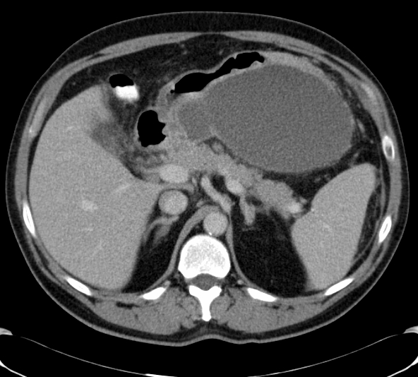
COMPLICATIONS OF PANCREATITIS
Pseudocyst
Pain
Infection
Hemorrhage- pseudoaneurysm
Pancreatic insufficiency
Large retrogastric fluid collection is a pseudocyst related to pancreatic enzyme break down of tissue.

Slide 43
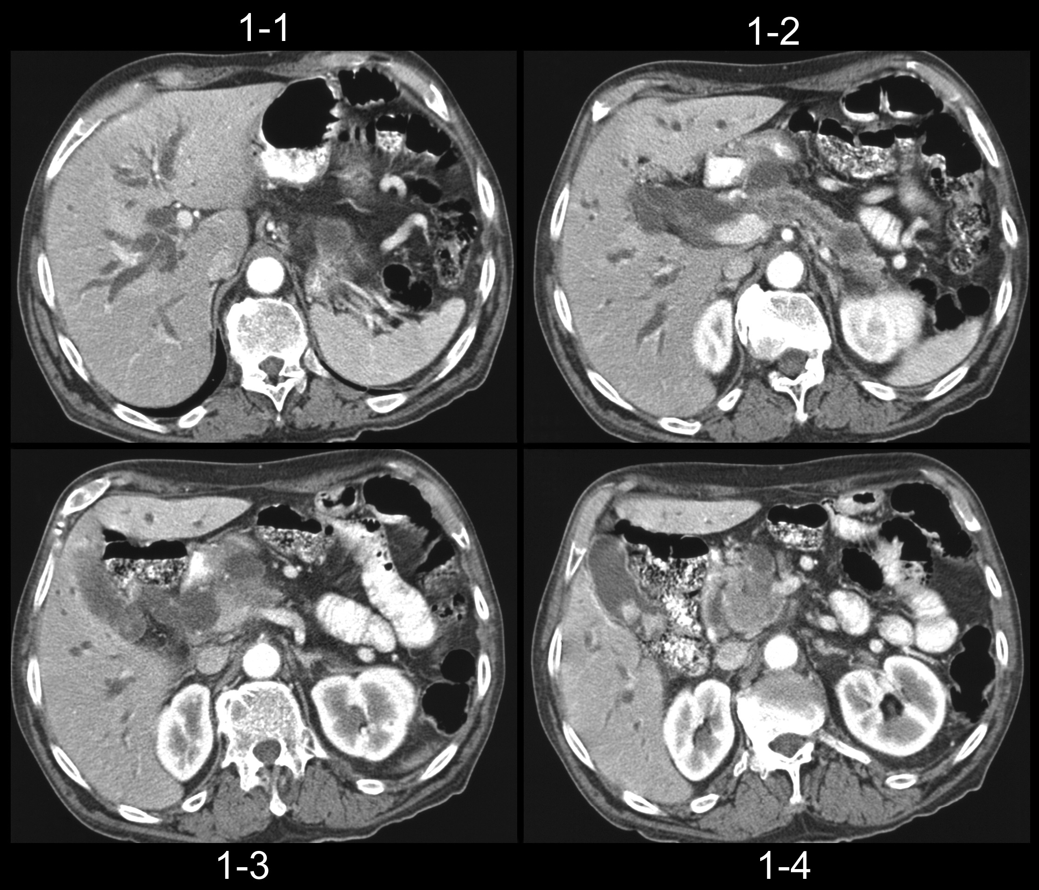
PANCREATIC CANCER OBSTRUCTIVE JAUNDICE

Slide 44
Management.
Gallstones (Cholelithiasis)- symptomatic- cholecystectomy= open/laparoscopic.
Choledocholithiasis- ERCP,CBD Exploration.Cholecystectomy.
Malignant obstructive jaundice; Ca head of pancrease,Cholangiocarcinoma,HCC,Porta hepatis nodes( metastases ). Whipples procedure, segemental resection,Lobectomy,Transplantation. Palliation- bypass.

