Slide 1
Abdominal Trauma
Dr Ojuka

Slide 2
Objective
Mechanism of injury
Review of anatomy
Review of physiology
Evaluation
Management

Slide 3
Introduction
Common cause of death if unrecognized :
Cause of preventable death
Exam can be compromised by:
Alcohol, illicit drugs
Injury to brain, spinal cord
Injury to ribs, spine, pelvis

Slide 4
Mechanism of Injury
Can be blunt or penetrating
Assault , Fall, Road accident
Blunt
Compression
Shearing in acceleration –deceleration
Crushing
Penetrating
Laceration

Slide 5
Anatomy : External
Anterior
Flanks
Back

Slide 6
Anatomy : Internal
Peritoneal cavity
Retroperitoneal
Pelvis

Slide 7
Physiology
Aim id to
Identify and quantify the injurious agent.
Maintain Critical Organ function
Restore Homeostasis
Mobilize Energy reserves
Provide substrate for tissue repair
Repair of dysfunctional tissue
Eradicate sepsis

Slide 8
Response to Injury
Energy
Temperature
O2 Consumption
Ebb Phase
Flow Phase
Anabolism
Catabolism
Death
Injury
Minutes
Hours
Days…………………Weeks

Slide 9
Factors influencing the Extent and Duration of the Metabolic Response
Pain and Fear
Surgical Factors:
Type of surgery
Region
Duration
Preoperative support
Extent of the trauma and degree of resuscitation
Post traumatic complications:
Hemorrhage
Hypoxia
Sepsis and Fever
Starvation Ileus
Re-operation
Pre-existing nutritional status
Age and sex

Slide 12
Other Endogenous Substances
Glucagon | Catabolic role Glycogenlysis, Lipolysis and ketogenesis Levels increase with in 24 hours
Renin-Angiotensin | Promotes volume homeostasis Potent vasoconstriction, inotropic Effects glucose metabolism
TRH / TSH | Decrease thyroid hormone activities (euthyroid sick syndrome) Reduce levels of T4 in severely injured are predictive of mortality
Endogenous Opioids | B-endorphins attenuate pain receptors Immune & GI modulators

Slide 13
Water Balance
Under the influence of ADH
Results in WATER RETENTION.
Inappropriate ADH Secretion
Low Plasma Osmolarity
High Urine Osmolarity

Slide 14
Sodium Balance
Early Retention
Plasma levels: normal/ raised

Slide 15
Metabolic Response to Trauma- Fourth year Lecture- 1423-1424 Potassium Balance
Initial Decrease
Intracellular K is released by injured tissue
 | K Loss, Duration/ days | Amount/day
Mild Trauma | 1 | 20 mmol
Gastrectomy | 2-3 | 50 mmol
Major Trauma | 7-8 | 70- 100 mmol

Slide 16
Protein Balance
Protein loss depends on
the severity of the injury
The body tissue affected
Gender, age and state of health of the patient
The nutritional status of the patient
Degree of Protein break-Down may be limited by glucose infusion.

Slide 17
Nitrogen Balance
1g N2 = 6.25g Protein = 30g wet muscle
Daily intake= 120g prot = 20g N2
Daily Loss= 2-3 g N2

Slide 18
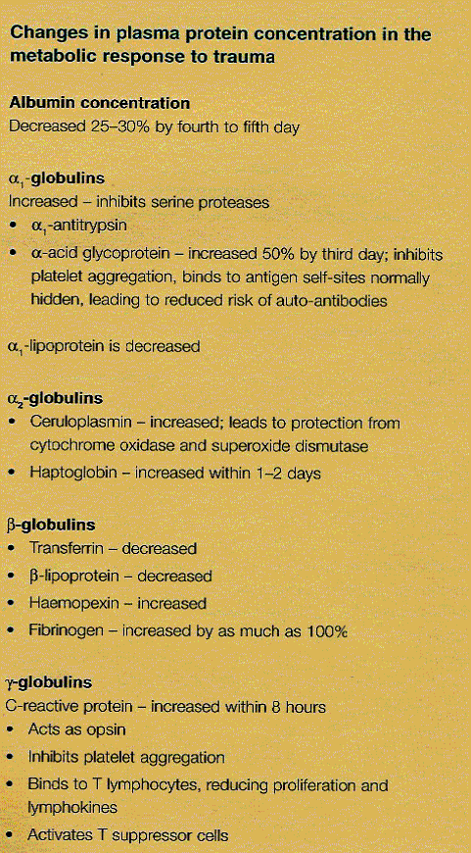

Slide 19
A Schematic Diagram Showing Nitrogen and Sodium Balance

Slide 20
Glucose Balance
Immediate increase in glucose level
This continues in to the early catabolic Phase

Slide 21
Change in Metabolic Rate

Slide 23
Change in Immune response
Cytokine mediated response:
Cell to cell mediation
Immune cell production, proliferation and survival
Regulation between proinflammatory & antinflammatory
Chemotaxis to the site of the injury and promotes wound healing
Hemodynamic instability with tackycardia vasodialation ( Septic shock)
Fever & leukocytosis ( Systemic inflammatory response syndrome)
Cachexia
Indothelial cell mediators
Intracellular mediators

Slide 24
Methods to Minimize the Metabolic Response
Replace blood and fluid losses
Maintain Oxygenation
Give adequate nutrition
Provide Analgesia
Avoid Hypothermia

Slide 25
Abdominal Injury Patterns
Blunt
Penetrating
Unstable
Stable
In Association CHEST/PELVIS

Slide 26
Abdominal Trauma
Unrecognized injury:
Cause of preventable death
Exam compromised by:
Alcohol, illicit drugs
Injury to brain, spinal cord
Injury to ribs, spine, pelvis

Slide 27
Evaluation
Variables Influencing Diagnostic Test Choice:
mechanism of injury
hemodynamic stability
test safety
test cost
test availability
examiner experience
-Elliot/Militello

Slide 28
Evaluation
Physical Exam
Diagnostic Peritoneal Lavage (DPL)
Computed Tomography (CT)
Ultra-sonography (US)

Slide 29
Assessment: Physical Exam
Inspection
Percussion
Palpation
Auscultation
Young male with stab wound in the LUQ abdomen.

Slide 30
Physical Examination
More reliable in penetrating than blunt trauma
Abdominal tenderness usually a reliable sign.
false positive 18%
false negative 23%
Entry and exit wound must be determined
Detailed secondary survey
Always think of trajectory

Slide 31
Clinical Examination
Limitations:
Unconscious
Intoxicated / drugged
Uncooperative
Pregnant
Spinal injury
Friction abrasion injury/injury to abdominal wall

Slide 32
Adjuncts: Intubation
Gastric Tube
Relieves dilatation
Decompresses stomach before DPL
Aids GI contrast administration if CT to be done
May induce vomiting/aspiration
Basilar skull fractures

Slide 33
Adjuncts: Intubation
Urinary Catheter
Monitors urinary output
Decompresses bladder before DPL
Diagnostic
Urethral injury

Slide 34
Choice of Investigation
Patient’s stability
Availability of investigation
Ability to Predict underlying organ injury

Slide 35
A. Diagnostic Peritoneal Lavage (DPL)
Advantages: ideal for suspected hemoperitoneum, small bowel injury.
Disadvantages
Oversensitive
Non-specific
Invasive
Doesn’t evaluate the retroperitoneum
Relative contraindications: pregnancy, children, pelvic frxs, previous abd. surgery

Slide 36
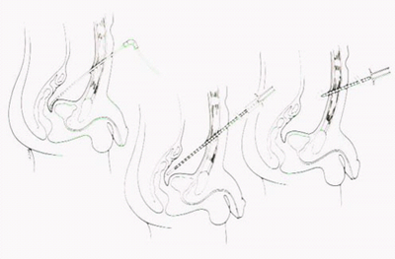
Diagnostic Peritoneal Lavage
Positive Criteria
>10 cc blood initially
RBC 100,000/mm³
WBC 500/mm³
presence of:
^{bile}
^{bacteria}
^{food fibers}
inability to read newsprint through tubing
fluid from CT or Foley

Slide 37
B. CT Scanning:
Advantages
Provides organ specific information
Can evaluate the retroperitoneum
Useful for severity grading
Disadvantages:
Time consuming
Costly
NOT for unstable patients
Requires accurate interpretation
Ct scan or TUNNEL OF DEATH

Slide 38
C. Focused Abdominal Sonography for Trauma (FAST):
Advantages :
Simple
Rapid average 2–4 min
Non invasive
Can be performed at the end of the primary survey (IN CASUALTY)
Detects fluid in pericardial sac, right or left upper quadrant and pelvis

Slide 39
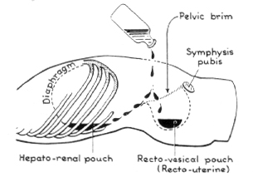
Objective of FAST is to Find Free Fluid in Peritoneal Cavity

Slide 40
Special Studies in Blunt Trauma

Slide 41
Timing of Investigations:
FAST
should be undertaken as part of the end of the primary survey IN CASUALTY, usually 5-10 minutes post arrival of patient

Slide 42
Timing of Investigations:
DPL early (< 30 minutes post arrival) BP 80-90mmHg, not responding to fluid challenge of 2L
CT scanning NO role in the unstable patient
Diagnostic Laparotomy may be life saving if/when resources are limited.

Slide 43
BLUNT TRAUMA: Principals of Management
STABLE
FAST/CT scan
Observe
UNSTABLE
Check airway, breathing, circulation
Determine – Is there intra-peritoneal blood?
DPL
FAST
Exploratory Laparotomy

Slide 44
Penetrating Trauma: Principals of Management
Unstable
Urgent surgery (within 10 minutes of arrival)
Stable
Determine peritoneal penetration
25% not associated with peritoneal penetration.
Ways to determine peritoneal penetration.
Local wound exploration (not really applicable to gunshot wounds)
Laparoscopy
Laparotomy

Slide 45
Exploratory Laparotomy
“Gold Standard?” - missed injuries do occur
Negative laparotomy
Complications = 25.6% per Lowe, et al
Mortality = 1.6%

Slide 46
Indications for Celiotomy:
Blunt
+DPL or ultrasound
Hypotension, suspected visceral injury
Peritonitis
Penetrating
+DPL or ultrasound
Peritoneal/retroperitoneal injury
Peritonitis
Hypotension
Evisceration

Slide 47
Indications for Celiotomy Plain X-ray
Free Air
Retroperitoneal air
Ruptured diaphragm

Slide 48
Indications for Celiotomy Special Studies
CT scan: Free air, visceral injury?, fluid?
Cystogram: Bladder rupture, intraperitoneal injury
Upper GI: Duodenal rupture

